Slide 1
NGO Aid Operations Management System (NGO-AOMSYS) Documentation

Slide 2
INTRODUCTION
Non-Governmental Organizations (NGOs) often face challenges in managing the allocation of aid provisions to dispersed households in need. This necessitates efficient management of aid allocation and distribution, whether in-kind or in cash. To address these challenges, NGO-AOMSYS (NGO Aid Operations Management System) is being developed. This software aims to streamline the process of aid management and distribution within national limits.

Slide 3
Problem Definition
NGOs struggle with effectively managing aid allocation and distribution to geographically dispersed households in need.

Slide 4
Purpose
The purpose of NGO-AOMSYS is to facilitate the efficient allocation and distribution of aid, whether in cash or in-kind, to households in need, while also providing transparency and accountability to donors, volunteers, and aid recipients.

Slide 5
Scope
NGO-AOMSYS will encompass features such as donor registration, volunteer management, aid recipient registration, aid operation coordination, and system administration.

Slide 6
Overview
NGO-AOMSYS will allow donors to register and contribute funds or materials, volunteers to register and offer their services, and aid recipients to apply for assistance. Operation coordinators will manage aid requests, schedule operations, and ensure efficient distribution. The system will employ algorithms to optimize aid operations based on available resources.

Slide 7
Definitions, Acronyms, and Abbreviations
NGO: Non-Governmental Organization
NGO-AOMSYS: NGO Aid Operations Management System

Slide 8
SYSTEM OVERVIEW
NGO-AOMSYS will consist of modules for donor registration, volunteer registration, aid recipient registration, operation coordination, and system administration. It will employ algorithms to optimize aid operations based on available resources.

Slide 9
DESIGN CONSIDERATIONS
a.Usability:
User-friendly Interfaces: Ensure that all user interfaces are intuitive and easy to navigate.
Accessibility: Design interfaces that are accessible to users with disabilities, following accessibility guidelines.
Multilingual Support: Provide support for multiple languages to accommodate users from diverse backgrounds.
Feedback Mechanisms: Implement feedback mechanisms to allow users to report issues or suggest improvements.

Slide 10
b.Scalability:
Modular Design: Design the system with modular components to facilitate scalability and extensibility.
Load Balancing: Implement load balancing techniques to distribute incoming requests evenly across multiple servers.
Database Optimization: Optimize database performance to handle increasing data volume efficiently.
Horizontal Scaling: Plan for horizontal scaling by adding more servers to the system to handle increased load.

Slide 11
c.Security:
Data Encryption: Implement encryption mechanisms to protect sensitive data both at rest and in transit.
Access Control: Enforce strict access control policies to ensure that users only have access to the data and functionalities relevant to their roles.
Audit Trails: Maintain audit trails to track user actions and detect any unauthorized access or suspicious activities.
Regular Security Audits: Conduct regular security audits to identify and address potential vulnerabilities in the system.

Slide 12
d.Efficiency:
Algorithm Optimization: Optimize algorithms for aid allocation, distribution, and resource optimization to improve overall system efficiency.
Caching Mechanisms: Implement caching mechanisms to reduce database load and improve response times for frequently accessed data.
Asynchronous Processing: Utilize asynchronous processing techniques to handle long-running tasks without blocking the main application thread.
Resource Monitoring: Monitor system resources and performance metrics to identify bottlenecks and optimize system performance accordingly.

Slide 13
e.Maintainability:
Code Documentation: Maintain comprehensive documentation for the codebase to facilitate easier maintenance and troubleshooting.
Version Control: Utilize version control systems to track changes to the codebase and facilitate collaboration among developers.
Automated Testing: Implement automated testing practices to ensure code reliability and detect regressions early in the development process.
Error Logging: Implement robust error logging mechanisms to capture and log errors for analysis and troubleshooting.

Slide 14
DATA DESIGN
a.User Data:
DonorProfile:
Variables:donorName,donationHistory,shippingPreferences
Volunteer Profile:
Variables:volunteerName,profession,availability
Aid Recipient Profile:
Variables:recipientName,householdComposition,supportNeeded
Administrator Profile:
Variables:adminName,adminPrivileges

Slide 15
b.Operational Data:
Donation Data:
Variables:donationType,donationAmount,donationTimestamp
Aid Request Data:
Variables:requestType,householdDetails,priorityLevel
Aid Operation Data:
Variables:operationType,operationSchedule
System Statistics:
Variables:donationAmounts,aidDistribution,volunteerActivity

Slide 16
SYSTEM ARCHITECTURE
a.User Interface:
Methods:displayLoginForm(),showDonationScreen(),viewAidRequests()
Variables:donorInterface,volunteerInterface,adminInterface

Slide 17
b.Backend Application:
Methods:processDonation(),approveVolunteer(),scheduleAidOperation()
Variables:dataProcessor,businessLogic,sessionManager

Slide 18
c.Database Management System (DBMS):
Methods:queryDonorProfile(),updateAidRequests(),retrieveSystemStatistics()
Variables:userDatabase,donationDatabase,aidRequestDatabase

Slide 19
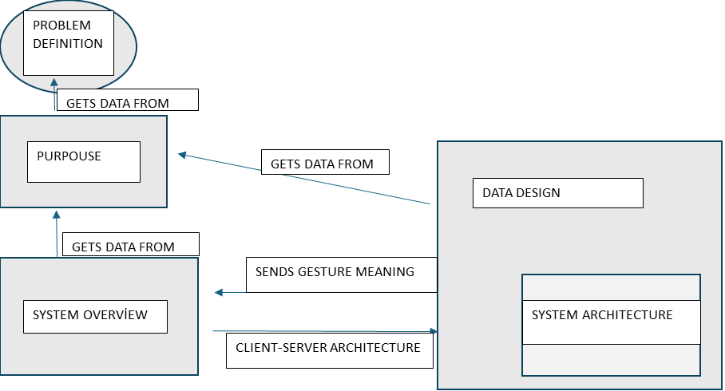

Slide 20
