Slide 1
claude · ~/taskflow · zsh
$ claude
CLAUDE CODE
FOR BUILDERS
Your pair-programmer that lives in the terminal.
DATA SENSE
Launchpad community · The one-hour hands-on class

Slide 2
agenda.md
THE NEXT HOUR
What we'll cover
1
2
Set up & get oriented
The core loop
install, log in, where things live
ask, edit, commit
3
4
Drive it
Real work
slash commands, context, permissions
fix a bug, ship a feature
5
6
Make it yours & track it
Wrap & practice
CLAUDE.md, extensions, usage
cheat sheet and homework
claude-code-for-builders
01

Slide 3
what-is-claude-code.md
THE BIG PICTURE
What is Claude Code?
An AI coding agent that lives in your terminal. It reads your project, runs commands, and writes code, all by talking to it in plain English.
Understand
Build
any codebase in minutes
features from a description
Debug
Ship
and fix what's broken
tests, docs, and commits
claude-code-for-builders
02

Slide 4
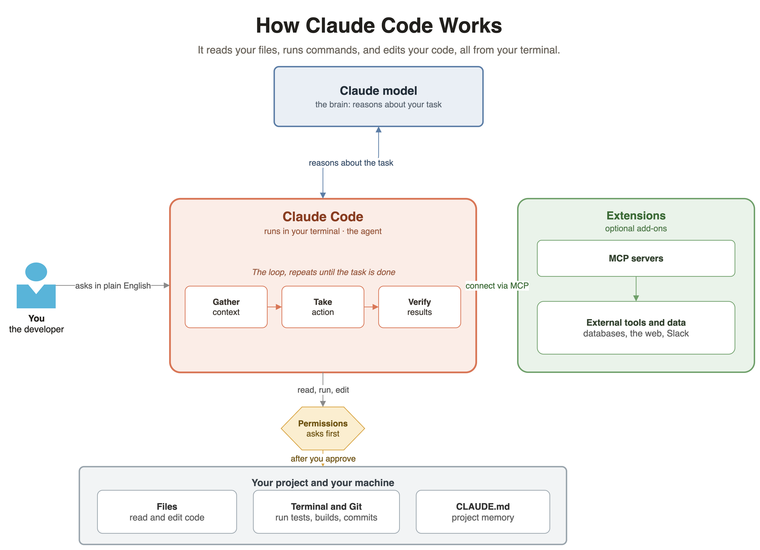
how-claude-code-works.drawio
claude-code-for-builders
03

Slide 5
PART 1
Set up & get oriented
Install, log in, and learn to read the screen and find your files.
claude-code-for-builders
04

Slide 6
install.sh
INSTALL
One line and you're in
macOS · Linux · WSL
Windows PowerShell
> curl -fsSL https://claude.ai/install.sh | bash
> irm https://claude.ai/install.ps1 | iex
Native install auto-updates
Available everywhere
It quietly stays on the latest version in the background. Homebrew and WinGet you upgrade by hand.
Not just the terminal: also VS Code, JetBrains, the desktop app, web, Slack, and CI/CD.
claude-code-for-builders
05

Slide 7
login.sh
LOG IN & LAUNCH
Start a session
first run
Log in with Claude Pro, Max, Team, or a Console account.
Credentials are stored, so you log in once.
/help lists commands, /resume reopens a past chat.
/status shows version, model, and account anytime.
> cd my-project
> claude
» opens browser to log in
> /login
» switch / re-auth anytime
claude-code-for-builders
06

Slide 8
the-interface.md
GET ORIENTED
How to read the screen
what you see when it starts
THE HEADER TELLS YOU
Claude Code v2.x
model: claude-opus-4-8
cwd: ~/taskflow
>
accept edits on · shift+tab to change
Model
which Claude you're talking to
cwd
the folder it can read and edit
The > prompt
where you type, in plain English
Mode line
current permission mode
claude-code-for-builders
07

Slide 9
where-things-live.md
FIND YOUR FILES
Where everything lives
your personal Claude Code folder
THREE SCOPES
> ls ~/.claude
settings.json your settings
CLAUDE.md your rules
commands/ /commands
agents/ subagents
skills/ skills
projects/ auto memory
User
~/.claude/ · all your projects
Project
./.claude/ · commit it, team shares it
Local
settings.local.json · just you, gitignored
Also in Cloud settings: your account, usage, and team controls (more on that later).
claude-code-for-builders
08

Slide 10
PART 2
The core loop
Ask, edit, commit. The rhythm you'll use every single day.
claude-code-for-builders
09

Slide 11
how-it-works.md
THE BIG IDEA
It's not ChatGPT in a terminal
THE LOOP
Reads your files
It opens the code itself. You don't paste anything in.
1 You describe
↓
Runs commands
2 Claude explores
Tests, git, your build: it can actually run them.
↓
3 It proposes
Edits code
↓
It writes changes straight into your files.
4 You approve
Asks permission
↓
5 It acts
Nothing changes until you approve it.
claude-code-for-builders
10

Slide 12
ask.md
ASK
Understand before you touch anything
try these on the repo you just cloned
> what does this project do?
> what technologies does it use?
> where is the main entry point?
> explain the folder structure
> how do I create custom skills?
No manual context
Claude reads the files it needs on its own. You never attach anything.
Pro tip
Always let Claude explore first. Understanding beats editing blind.
claude-code-for-builders
11

Slide 13
first-change.md
EDIT
Your first code change
the prompt
> add a hello world function to the main file
You're always in control
Claude never changes a file without asking. Approve one edit at a time, or press Shift+Tab to cycle into accept-edits for a session when you trust the flow.
1
Finds the right file
2
Shows you the proposed diff
3
Asks for your approval
4
Makes the edit
claude-code-for-builders
12

Slide 14
git.md
COMMIT
Version control, in plain English
session prompts
> what files have I changed?
> commit my changes with a
descriptive message
> create a branch feature/quickstart
> show me the last 5 commits
> help me resolve merge conflicts
No commands to memorize
It's the same Git underneath. You describe the outcome and Claude writes the commands and a clean commit message for you.
claude-code-for-builders
13

Slide 15
PART 3
Drive it
Slash commands, context, and permissions. This is what makes you fast.
claude-code-for-builders
14

Slide 16
slash-commands.md
TYPE A SLASH
The commands you'll use most
SESSION
DOING WORK
/help
list every command
/init
write a starter CLAUDE.md
/clear
start fresh, clear context
/model
switch the model
/compact
summarize to free context
/plan
explore before editing
/resume
reopen a past chat
/permissions
control what it can do
/status
version, model, account
/usage
check cost and limits
Tip: just type / to see everything your version supports, then start typing to filter.
claude-code-for-builders
15

Slide 17
context.md
CONTEXT IS EVERYTHING
Keep Claude focused
Claude only knows what's in its context window. Manage it and your results get sharper.
/clear
/compact
new task? wipe the slate clean
keep going but free up room
/context
/init
see how full the window is
generate a CLAUDE.md to load every time
@app.py
# use pytest
pull a specific file into the prompt
tell Claude to remember a rule
claude-code-for-builders
16

Slide 18
permissions.md
PERMISSIONS
Press Shift+Tab to change the mode
default
Stop the prompts
Asks before the first use of each tool. The safe starting point.
Add allow rules in .claude/settings.json so trusted commands never ask again.
accept edits
Auto-accepts file edits in this folder. Fast once you trust it.
Plan mode is gold
plan
Use plan mode for anything big. Review the plan, then let it build.
Reads and explores only, no edits. Proposes a plan first.
claude-code-for-builders
17

Slide 19
input-tricks.md
SPEED
Input & navigation tricks
/
the command and skill menu
PROMPT SYMBOLS
@
mention a file: @app.py
Tab
autocomplete a command
!
run a shell command inline
Up
scroll through history
Esc
stop, or press twice to rewind
#
save a rule to memory
Ctrl+D
exit the session
Be specific. Break big asks into steps.
claude-code-for-builders
18

Slide 20
PART 4
Real work
Fix a real bug, ship a feature, and see the full range of what it can do.
claude-code-for-builders
19

Slide 21
debug.md
BUILD
Fix a bug, ship a feature
describe the problem, not the solution
WHAT CLAUDE DOES
> there's a bug where users can
submit empty forms, fix it
> add input validation to the
registration form
Locates the relevant code
Understands the context
Implements a solution
Runs tests if they exist
claude-code-for-builders
20

Slide 22
workflows.md
MORE MOVES
Four everyday workflows
Refactor
Write tests
> refactor auth to use async/await instead of callbacks
> write unit tests for the calculator functions
Update docs
Code review
> update the README with installation instructions
> review my changes and suggest improvements
claude-code-for-builders
21

Slide 23
more-examples.md
BEYOND THE BASICS
More things you can ask
Explore
Build
Data
> trace how a login request flows through the app
> build a dashboard of our top-returned UK products
> analyze data/tasks.csv and summarize the trends
Automate
Explain
Improve
> write a script to rename these 200 files
> explain this error and tell me how to fix it
> find and fix the slowest part of this endpoint
claude-code-for-builders
22

Slide 24
PART 5
Make it yours & track it
Give Claude memory, extend it, and keep an eye on your usage.
claude-code-for-builders
23

Slide 25
CLAUDE.md
PROJECT MEMORY
Teach Claude your project once
CLAUDE.md in your repo root
Claude reads it at the start of every session.
Run /init to generate a starter, then trim it.
Keep it under ~200 lines so it stays sharp.
Type # remember X to append a rule live.
Commit it so your whole team shares the context.
# TaskFlow
## Commands
- run: python app.py
- test: pytest
## Conventions
- 4-space indent, type hints
- validate all form input
claude-code-for-builders
24

Slide 26
extend.md
MAKE IT YOURS
Six ways to extend Claude Code
Skills / commands
Subagents
Hooks
reusable workflows behind /name
a helper with its own context
run a script on an event
MCP
Plugins
CLAUDE.md
connect outside tools and data
bundle and share the above
always-on project rules
These are your Part 5 topics for a future deep dive. Today: just know they exist.
claude-code-for-builders
25

Slide 27
usage.md
CLOUD SETTINGS
Track your usage and cost
run it inside a session
> /usage
(alias: /cost) see limits & spend
Console / API account
Shows session cost and token breakdown. Authoritative billing and spend limits at console.anthropic.com/usage.
Pro / Max subscription
Shows plan limits and how much you've used (24h / 7d). Not a bill. Full view at claude.ai/settings under Account and Usage.
Good habits
Check /usage now and then. Set a spend limit if you're on API. /status shows your account anytime.
claude-code-for-builders
26

Slide 28
PART 6
Wrap & practice
The cheat sheet, the demo repo, and what to do next.
claude-code-for-builders
27

Slide 29
cheatsheet.md
KEEP THIS HANDY
Command cheat sheet
SHELL · from your terminal
SHORTCUTS
command | what it does
claude | start a session
claude -c | continue last chat
claude -p "q" | one-off, then exit
/
command menu
Shift+Tab
permission mode
@ file
mention a file
SESSION · inside Claude Code
# rule
save to memory
command | what it does
/init | make a CLAUDE.md
/clear · /compact | manage context
/usage | cost and limits
Esc Esc
rewind
claude-code-for-builders
28

Slide 30
taskflow/
THE DEMO REPO
Meet TaskFlow, what we hacked on
the repo you'll clone
EACH FILE FEEDS A DEMO
> git clone <your-repo>
taskflow/
├─ app.py entry point
├─ taskflow/
│ ├─ calculator.py stats
│ ├─ auth.py auth
│ └─ registration.py bug
├─ data/tasks.csv demo data
└─ README.md thin docs
registration.py
empty-form bug, add validation
calculator.py
pure funcs, write unit tests
auth.py
callbacks, refactor to async
data/tasks.csv
analyze and summarize
claude-code-for-builders
29

Slide 31
recap.md
LOCK IT IN
Recap & practice
You can now…
TRY IT YOURSELF
• Install, log in, find your files
• Ask a codebase about itself
• Edit through the approval flow
• Drive with slash commands
• Manage context & permissions
• Fix a bug, add a feature, ship it
On your own project:
1 run /init to make a CLAUDE.md
2 ask it what the project does
3 fix one thing and commit it
4 check /usage
The reps are how it sticks.
claude-code-for-builders
30

Slide 32
go-further.md
GO FURTHER
Make Claude Code yours
CLAUDE.md
Skills
project memory
reusable workflows
Hooks
MCP
automate on events
connect tools & data
$ claude # now go build something.
Docs: code.claude.com/docs · In-session help: /help · Community: anthropic.com/discord
DATA SENSE
Launchpad community · Keep building.
claude-code-for-builders
31

