Slide 1
WORKSHOP | OCTOBER 2026
Jev
The first System One model
Typed questions in, calibrated decisions out: an AI primitive for software, not chat.
What it is, how it works, its properties, and how to build with it.
Every number and code sample in this deck was verified live against api.typesafe.ai while preparing this workshop.
Notes:
Welcome. Today is about a genuinely different kind of model. Not a better chatbot: a model that returns decisions instead of text. Everything shown today ran live against the real API; the notebooks in the repo reproduce every number.

Slide 2
AGENDA
Five segments, five notebooks
 | Segment | Hands-on companion
01 | Why another kind of model, and what Jev is | 01_hello_jev.ipynb
02 | The four primitives: Choice, Score, Noul, Box | 02_primitives.ipynb
03 | Probability vs confidence, routing on uncertainty | 03_confidence.ipynb
04 | Architectural patterns, and the economics, measured | 04_patterns.ipynb
05 | Real builds, sharp edges, properties reference | 05_real_world.ipynb
Format: each segment is slides for the ideas, then a notebook to run the ideas against the live API.
Jev workshop | TypeSafe AI's System One model | October 2026
2
Notes:
Two hours total. The deck carries concepts; notebooks carry proof. Attendees need Python 3.10+ and a TypeSafe API key from console.typesafe.ai.

Slide 3
THE STORY WE WILL FOLLOW
9:04 am. A ticket arrives.
support@yourcompany | ticket #18,402
A good support lead reads this and, in about two seconds, knows three things:
“Our API integration started returning 500 errors on every request about 20 minutes ago, and we can't process any customer orders until this is fixed.”
Which team?
technical, obviously
How urgent?
very: revenue is stopped
How angry?
tense, still civil
No deliberation happened. Nobody multiplied anything or wrote a paragraph. That instant, effortless read is what psychologists call System 1 thinking, and it is exactly the reflex your software lacks. Today's question: how do we give code that reflex, with an honest measure of how sure it is?
Ask the room: what did your own brain do in the two seconds after reading the ticket? That introspection IS the API we are about to learn.
Jev workshop | TypeSafe AI's System One model | October 2026
3
Notes:
Open with the story, not the technology. Read the ticket out loud, pause, and ask what their brain just did. Collect two or three answers; they will name routing, urgency, and tone without prompting. Then land the thesis: the workshop is about turning that two-second human read into a programmable, measurable primitive. This ticket returns on later slides, so the room keeps one running example.

Slide 4
PART 1 | WHY
LLMs produce text for people. Your code needs decisions.
– The mismatch. LLMs are trained to write prose a person likes reading. Software needs a value it can branch on: a category, a score, a boolean.
– The workaround we all ship. Prompt a text generator to "respond ONLY with JSON", then parse, validate, retry, and hope the schema holds under load.
– The tax. Seconds of latency and dollars per thousand calls, for what is often a one-word judgment.
– The risk. Confident-sounding text is not a measure of certainty. There is no principled number to threshold on.
the parse-and-hope pattern
prompt = """Classify this ticket.
Respond ONLY with valid JSON:
{"team": ..., "urgent": ...}"""
reply = llm(prompt + ticket) # 2-8 s
data = json.loads(reply) # pray
team = data.get("team") # maybe?
# retries, regex repair, schema drift...
“Models have been superhuman at chat for years, so where is all the automation?”
Diogo Almeida, TypeSafe AI founder (launch post, Sept 2026)
Jev workshop | TypeSafe AI's System One model | October 2026
4
Notes:
Frame the pain before the product. Everyone in the room has written the code on the right. The quote sets up TypeSafe's bet: automation is blocked not by model intelligence but by the interface: text.

Slide 5
PART 1 | WHAT
Jev: typed questions in, calibrated decisions out
state
your data: a string or any
JSON structure (ticket,
record, transcript, policy)
typed answers
Jev
one per question ID:
choice + probability per option
score on your rubric + confidence
noul: probability a statement is true
box: where something is in an image
evaluates every question
against the state,
in parallel, independently
questions
typed: Choice, Score,
Noul, Box. You define
the answer space.
your code branches, sorts, thresholds, routes. No parsing, by construction: answers are constrained to the options you supplied.
Why “System One”: Kahneman's fast, intuitive judgment, as opposed to slow System 2 reasoning. Ask what a knowledgeable person could answer in a second with the right context in front of them.
Jev workshop | TypeSafe AI's System One model | October 2026
5
Notes:
The whole model on one slide. Emphasize: questions are independent and parallel, answers come back under your IDs, and the model cannot return a value outside your schema. Impossible-to-parse output is impossible by design.

Slide 6
PART 1 | THE IDEA BEHIND THE NAME
System 1 and System 2: two kinds of thinking, two kinds of model
In psychology (Kahneman, Thinking, Fast and Slow)
In AI, the analogy maps cleanly
– System 1: fast, automatic, intuitive, near-zero effort. Reading the tone of an email, spotting the odd item on a shelf.
– System 2: slow, deliberate, effortful. Multiplying 17 x 24, planning an itinerary, writing a document.
– System 2 models: chat LLMs and reasoning models. Chains of thought, seconds of latency, dollars per Mtok. Built to deliberate and generate.
– System One models (Jev): snap judgments over the context in front of them. Typed answers, calibrated probabilities, ~100 ms. Built to decide, never to generate.
 | System One model (Jev) | System 2 models (chat and reasoning LLMs)
Latency | ~0.1 to 0.5 s | seconds to minutes
Output | typed decision + calibrated probabilities | free-form text, code, chains of thought
Cost | $0.042 / Mtok in, output free | dollars per Mtok, output billed
Best at | atomic judgments: classify, score, verify, detect | generation, multi-step reasoning, dialogue
Fails when | the question needs deliberation or arithmetic | you need speed, calibration, or structured output
Rule of thumb: if a knowledgeable person answers it in a second, it is a Jev question. If they reach for a whiteboard, decompose it into Jev questions composed in code, or hand it to a System 2 model.
Jev workshop | TypeSafe AI's System One model | October 2026
6
Notes:
This slide is the vocabulary lesson for the whole class. Kahneman's System 1 is fast pattern recognition, System 2 is slow deliberation. TypeSafe named the category after the former: Jev makes the gut-check judgments, and your code or a reasoning model does the deliberating. The two kinds of model are complements, not competitors: most production systems will use both.

Slide 7
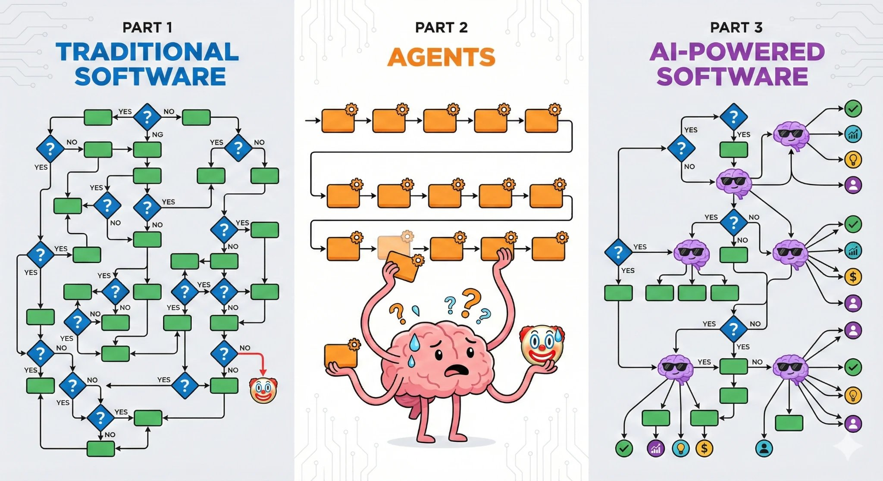
PART 1 | WHERE IT SITS
Three software architectures (TypeSafe's framing)
– Traditional software: reliable primitives composed into decision trees. Deterministic, but blind to unstructured data.
– LLM agents: the model chooses its next step in a loop. Powerful with a human watching; every loop is another chance to go off the rails.
– AI-powered software: code owns control flow; the model appears only where the system needs programmable common sense. Each AI task atomic and constrained. This is the slot Jev is built for.
Diagram: docs.typesafe.ai, How to build with TypeSafe
Jev workshop | TypeSafe AI's System One model | October 2026
7
Notes:
The official diagram contrasts the three shapes. The pitch is not anti-agent; it is that unattended, high-volume automation needs the third shape: a normal software workflow that inserts System One only where a judgment is required.

Slide 8
PART 1 | WHO
TypeSafe AI, the lab behind Jev
– Founded 2024, San Francisco. CEO Diogo Almeida (ex-OpenAI, Google Brain; a co-inventor of RLHF), COO Sasha Sheng, CTO Erik Gafni.
– The thesis: “Machine Native Intelligence”. Large-scale automation will be ~99% machine-to-machine. Build AI with software properties: structure, reliability, testability, speed, low cost. “Building prod, not God.”
– The product. Hosted API only (closed weights, waitlist). One endpoint: POST /v1/systemone. One pricing axis: input tokens.
– No per-customer fine-tuning. Same weights for every account; you adapt it through state, instructions, and criteria.
Timeline
Sep 15, 2026
Jev launches (jev-1.13.0), “first System One model”
Sep 16, 2026
Out of stealth: $40M seed led by DCVC
Oct 9, 2026
Reported: $870M Series A at $7.5B valuation led by a16z (Bloomberg)
Oct 14, 2026
Jev 1.14 ships as jev-preview: images, Box, 262k long context
~Oct 21, 2026
jev-latest alias scheduled to move to 1.14
Jev workshop | TypeSafe AI's System One model | October 2026
8
Notes:
Why the buzz is recent: the company is weeks out of stealth and the 1.14 release landed three days before this workshop. Series A numbers are press-reported, not company-confirmed; flagged as such. The RLHF-co-inventor pedigree matters: the founder helped create the training method he is now arguing against for automation.

Slide 9
PART 1 | THE BUZZ, BOTH SIDES
Traction is real. So are the caveats.
Signal
Noise control
– Adoption: ~13% of Vercel paid teams tried it within 24h of launch, about 2x GPT-5.6-family uptake (InfoQ, Oct 2026).
– Measured by users: median 7x speedup and 30x cost savings; 76 ms median latency across 12.7k analyzed posts (OpenChamber via InfoQ).
– The demo everyone shared: Jev playing Doom from structured game state; 0.114 s vs 8.566 s for GPT-5.6 Terra on the same decision (The Register).
– “No hallucinations” needs an asterisk. It can still emit a confidently wrong valid value; it “delegates the hallucination problem to the user” (Armin Ronacher). Calibration is the mitigation, not magic.
– Adversarial input is a live concern. HiddenLayer (Oct 16, 2026) reports Jev is more steerable by prompt injection than LLMs; TypeSafe's own jaggedness page agrees it does not treat state as hostile.
– Closed and new. Hosted only, no open weights, versioning started at 1.13 three weeks ago. Pin versions, test on your data.
Jev workshop | TypeSafe AI's System One model | October 2026
9
Notes:
This slide is the credibility slide: show you know both columns. The left column is why we are in this room; the right column is what responsible adoption looks like. The security finding directly motivates the guardrails design in notebook 05: never let Jev alone gate adversarial traffic; combine thresholds, review bands, and testing on real attacks.

Slide 10
FOUNDATIONS | ZERO ASSUMED KNOWLEDGE
First, the basics: what is a model, actually?
– A model is a function with knobs. Billions of adjustable numbers called parameters (or weights). Text goes in as tokens (word pieces), numbers flow through the knobs, an output comes out.
– Training = turning the knobs. Show the model an example, measure how wrong its output is, nudge every knob a tiny step in the direction that makes it less wrong. Repeat, trillions of times. That is gradient descent; nobody sets any knob by hand.
– Pretraining is that loop on a huge slice of the internet with one task: predict the next token. The result, a base model, is a brilliant text-continuer with no goal: not helpful, not safe, not decisive.
– Post-training decides what it becomes. The same base model can be turned into a chatbot, a reasoning engine, or a decision model, purely by what you reward next. That choice is the next three slides.
1. example in
2. model
“The capital of
France is …”
billions of knobs
produce an output
4. nudge knobs
3. compare
every parameter
moves a tiny step
output vs truth:
how wrong was it?
repeat ~trillions of times
The whole secret of 'training'
is choosing WHAT counts as 'wrong' in step 3. Change the definition of wrong, and the same loop produces a completely different animal.
Jev workshop | TypeSafe AI's System One model | October 2026
10
Notes:
This slide assumes nothing. Vocabulary established: parameters/weights/knobs, tokens, gradient descent as 'nudge all knobs to be less wrong', pretraining as next-token prediction, base model as raw material. The dark box is the bridge to the next three slides: RLHF, RLVR, and RLCD are the SAME loop with three different definitions of wrong.

Slide 11
FOUNDATIONS | RECIPE 1 OF 3
How RLHF actually works (the chatbot recipe)
1
collect human preferences
2
train a taste model
3
optimize against taste
Give the model one prompt, sample two answers, A and B. A human picks the one they like better. Do this tens of thousands of times.
Train a second model, the reward model, to predict which answer the human would prefer. It becomes a cheap, automatic judge of 'what people like'.
The chatbot generates, the reward model scores, and every knob is nudged toward higher-scoring answers (the RL part, usually PPO). Loop until the model reliably produces what people prefer.
prompt -> answer A vs answer B -> 'B is better'
answer -> reward model -> score 0.87
generate -> score -> nudge knobs -> repeat
The catch: the model is optimized to PLEASE the judge, not to be right. Pleasing rewards confident-sounding answers (hallucination), agreeing with the user (sycophancy), and collapsing onto one crowd-pleasing style (mode dropping). Perfect for chat. Poisonous for a number your code must trust.
Jev workshop | TypeSafe AI's System One model | October 2026
11
Notes:
Walk the three cards slowly; this is the full RLHF mechanism: preference data, reward model, PPO loop. Fun fact for the room: TypeSafe's founder co-invented this recipe (InstructGPT/ChatGPT lineage), which is why his critique of it carries weight. End on the catch: step 3 optimizes for human approval, and approval is not accuracy.

Slide 12
FOUNDATIONS | RECIPE 2 OF 3
RLVR: reward what can be checked
1
Pick checkable problems
2
Let the model think out loud
3
Reward only verified wins
Math with known answers, code with unit tests, puzzles with verifiable solutions. No human taste needed.
It writes a long chain of thought, then an answer. Those 'thinking tokens' are generated text: slow, and billed.
Did the code pass the tests? Did the answer match? Nudge knobs toward chains of thought that END correct.
What it produces: reasoning models (the 'thinking' models you have used). Genuinely strong on hard, multi-step problems. The cost: seconds to minutes of latency and output-token bills, because deliberation IS generated text. This is the System 2 machine: brilliant on a whiteboard, wrong tool for a two-second judgment call.
Where you have met these: chat assistants are RLHF; 'extended thinking' and o-style models are RLVR. Jev is neither.
Jev workshop | TypeSafe AI's System One model | October 2026
12
Notes:
Keep this one brisk: the audience has used reasoning models. The point to land is the cost structure: RLVR quality rides on generated thinking tokens, so you pay in both seconds and dollars. That sets up the question RLCD answers: what if the judgment does not need any text at all?

Slide 13
FOUNDATIONS | RECIPE 3 OF 3, JEV'S RECIPE
RLCD: reward honest probabilities
1
Ask a closed question
2
Model answers in probabilities
3
Score against reality
4
Nudge toward calibration
A question with a fixed answer space and a known real outcome: 'which team did this ticket actually go to?'
No text. It puts probability on each option: billing 0.12, technical 0.88, sales 0.00.
A proper scoring rule pays out for honesty: claiming 0.99 and being wrong costs far more than admitting 0.60. Hedging everything at 0.33 earns nothing.
Knobs move so that stated probability tracks real frequency: things it calls 0.8 should come true about 80% of the time.
Notice what is missing from this loop: text.
There is no generation step to hallucinate in, no judge of style to flatter. The ONLY way to score well is to know the answer when it is knowable, and to say 'not sure' honestly when it is not. That property, calibration, is what your code will threshold on all afternoon.
Jev workshop | TypeSafe AI's System One model | October 2026
13
Notes:
Mirror the RLHF slide deliberately: same loop, different definition of wrong. RLHF's judge is human taste; RLVR's judge is a verifier; RLCD's judge is reality plus a proper scoring rule. If someone asks what 'proper scoring rule' means: a payout scheme where your expected reward is maximized by reporting your true belief, like the Brier score; overconfidence is punished quadratically. Then the dark box: no text anywhere in the loop, which is why Jev cannot be a chatbot and does not hallucinate prose; it can still be wrong, but it is honestly wrong, with the uncertainty attached.

Slide 14
PART 1 | HOW IT IS TRAINED, RECAP
RLHF makes chatbots. RLCD makes decisions.
 | RLHF | RLVR | RLCD (Jev)
Optimizes for | responses people prefer | verifiable task rewards | calibrated decisions
Produces | chatbots and assistants | reasoning models | System One models
Output | fluent text | chains of thought + answer | typed values + probabilities
Failure style | sycophancy, confident hallucination, mode dropping | slow, expensive | wrong value, but with honest uncertainty attached
Mode dropping: preference training narrows the output distribution toward a favored style. Great for pleasant chat, bad for honest probabilities. RLCD's contract is the opposite: no text, just decisions whose probabilities are optimized against outcomes.
Jev workshop | TypeSafe AI's System One model | October 2026
14
Notes:
RLHF was co-invented by the founder, used for InstructGPT and ChatGPT. RLVR gave us reasoning models. RLCD is the third branch: reinforcement learning for calibrated decisions. The point is not that RLHF is bad; it is that human preference and machine trustworthiness are different optimization targets.

Slide 15
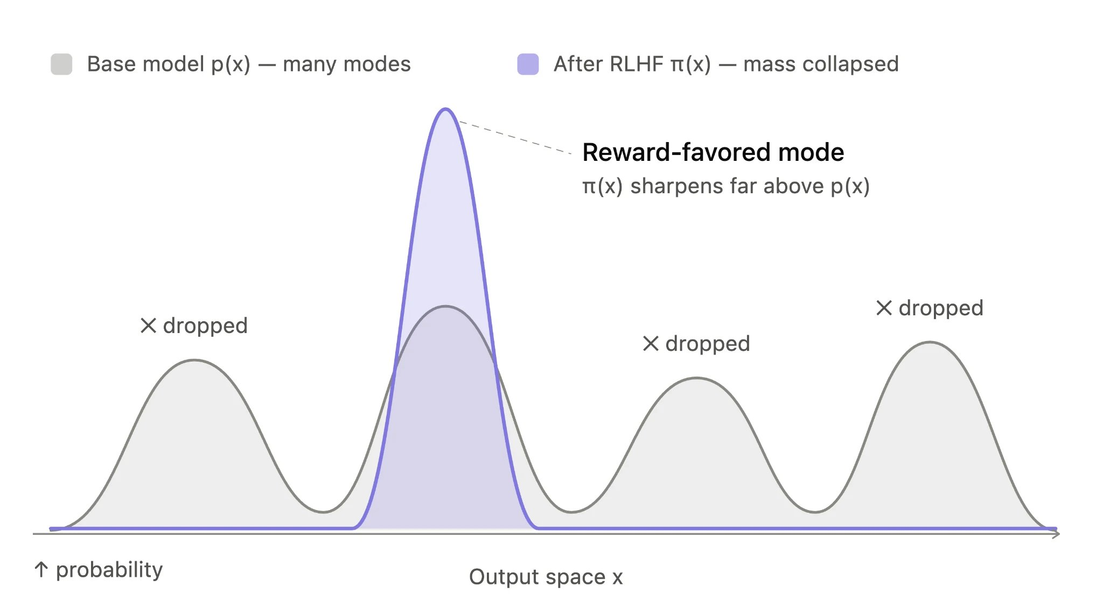
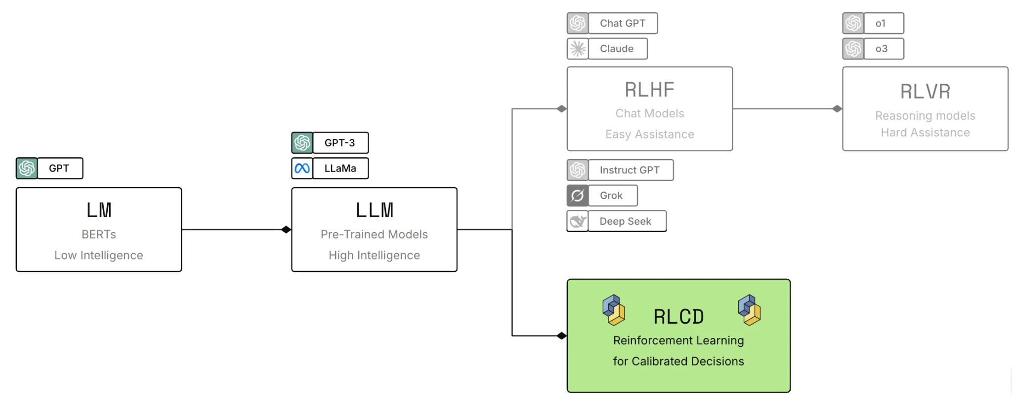
PART 1 | HOW IT IS TRAINED, IN PICTURES
The official diagrams: three branches, and why not RLHF
Pretrained language models branch three ways: RLHF to chatbots, RLVR to reasoning models, RLCD to decision models. Jev takes the highlighted path.
Mode dropping: preference training narrows a base model's distribution toward a favored style. Pleasant text, distorted probabilities.
Why it matters for you: a model optimized to please cannot also be trusted to report honest uncertainty. RLCD's contract (no text, calibrated probabilities) is what makes the thresholds in Part 3 meaningful.
Diagrams: docs.typesafe.ai, AI primer
Jev workshop | TypeSafe AI's System One model | October 2026
15
Notes:
Both figures come straight from TypeSafe's AI primer. Left: the three post-training branches. Right: mode dropping, the milder cousin of GAN mode collapse; RLHF rewards a style, which suppresses honest spread. If attendees want depth, the primer is a 10-minute read: docs.typesafe.ai/introduction/machine-learning-primer.

Slide 16
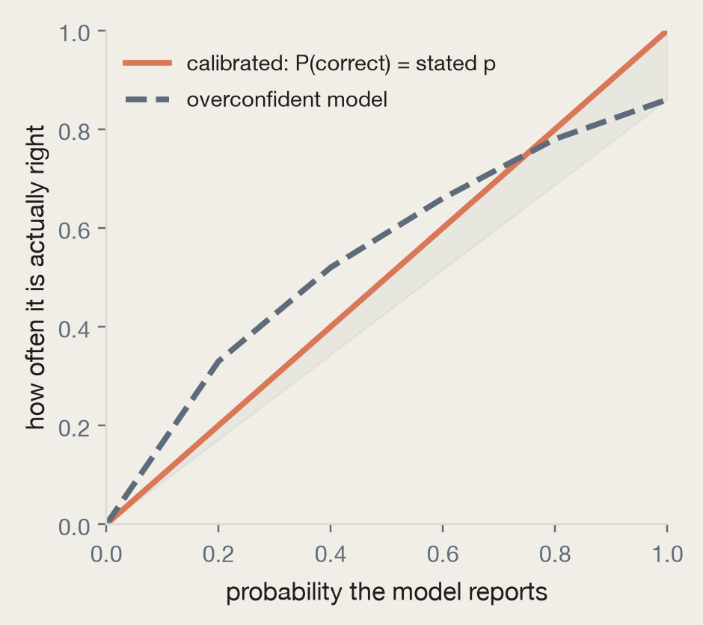
PART 1 | THE PROPERTY THAT MAKES IT USABLE
Calibration: probabilities you can price risk with
– The definition. Across many predictions, outcomes given 0.2 happen about 20% of the time; outcomes given 0.8 happen about 80%.
– Groups, not guarantees. Calibration says nothing about one specific answer. It makes thresholds and expected-cost math meaningful.
– The contrast. An overconfident model's 0.9 means “probably”. A calibrated model's 0.9 is a number you can put in a formula next to the cost of being wrong.
– The payoff. “I don't know” becomes a usable signal: mid-range values route to review instead of silently guessing.
Jev workshop | TypeSafe AI's System One model | October 2026
16
Notes:
This is the slide to slow down on. Calibration is WHY thresholds in the rest of the workshop mean anything. Exercise 3 in notebook 03 shows how to test calibration on your own labeled data.

Slide 17
PART 2 | THE API
One endpoint. Three fields in, three out.
POST https://api.typesafe.ai/v1/systemone
response (authorization: Bearer $TYPESAFE_API_KEY)
{
"model": "jev-latest",
"state": "Help! Payouts failing for 3 days.",
"questions": {
"is_urgent": {
"type": "noul",
"instructions": "Does this convey urgency?"
},
"department": {
"type": "choice",
"instructions": "Which team handles this?",
"criteria": {
"billing": "Payments, refunds",
"technical": "Bugs, outages",
"sales": "Pricing, accounts"
}
}
}
}
{
"model": "jev-1.13.0",
"answers": {
"is_urgent": {
"type": "noul",
"noul": 0.95
},
"department": {
"type": "choice",
"choice": "billing",
"probabilities": {
"billing": 0.88,
"technical": 0.12,
"sales": 0.0
},
"confidence": 0.81
}
},
"usage": {"input_tokens": 318, "output_tokens": 34}
}
Jev workshop | TypeSafe AI's System One model | October 2026
17
Notes:
Point out: question IDs are chosen by you and never sent to the model, so instructions must contain the full question. The response model field is the versioned ID that actually answered: log it. Python SDK: pip install typesafe-sdk, then client.system_one(state=..., questions=...) with typed Choice/Score/Noul objects.

Slide 18
PART 2 | THE PRIMITIVES
Four question types, four shapes of answer
Type | Answers | Returns | Maps onto
Choice | which of these options? | choice + probability per option + confidence | a switch over code paths
Score | which level on my rubric? | score (can land between levels) + probabilities + confidence | a threshold or a ranking
Noul | is this true? | one number: probability of yes (0 to 1) | an if statement
Box (preview) | where is it in this image? | four fractional edges + confidence | a crop or an overlay
Choosing: prefer the type whose answer your code can act on directly. And the rule that pays for the workshop: ask every question you might need in ONE request. Questions are evaluated in parallel; an extra question barely moves latency and costs only its own tokens.
Jev workshop | TypeSafe AI's System One model | October 2026
18
Notes:
Up to 255 options per Choice, 2 to 10 levels per Score, Noul criteria optional, Box needs jev-preview plus the images header. No limit on question count per request; the bound is context size.

Slide 19
SCENARIO 1 | TEXT
Our 9:04 ticket, as one Jev call
state (the ticket, verbatim)
Choice
Which team should handle this?
technical
“Our API integration started returning 500 errors on every request about 20 minutes ago, and we can't process any customer orders until this is fixed.”
confidence 1.00
Score
How frustrated does the customer appear?
0.67 of 2
leaning 'frustrated but civil'
Noul
The message conveys urgency
0.99
about as yes as it gets
One request. 428 input tokens. $0.000018. The support lead's two-second read is now a programmable reflex that runs on every ticket, every time, with its uncertainty attached. (Answers above are the documented quickstart output for this exact ticket.)
Walk the mapping out loud: the ticket is the state, each thing the human 'just knew' became one typed question, and each answer is a value code can branch on.
Jev workshop | TypeSafe AI's System One model | October 2026
19
Notes:
This is the payoff of the opening story: same ticket, same three judgments, now as an API call. Point at the chips left to right: a Choice for routing, a Score for tone, a Noul for urgency. Then the economics line: at $0.000018 per ticket, nobody will ever ration this. Notebook 01 runs this exact call.

Slide 20
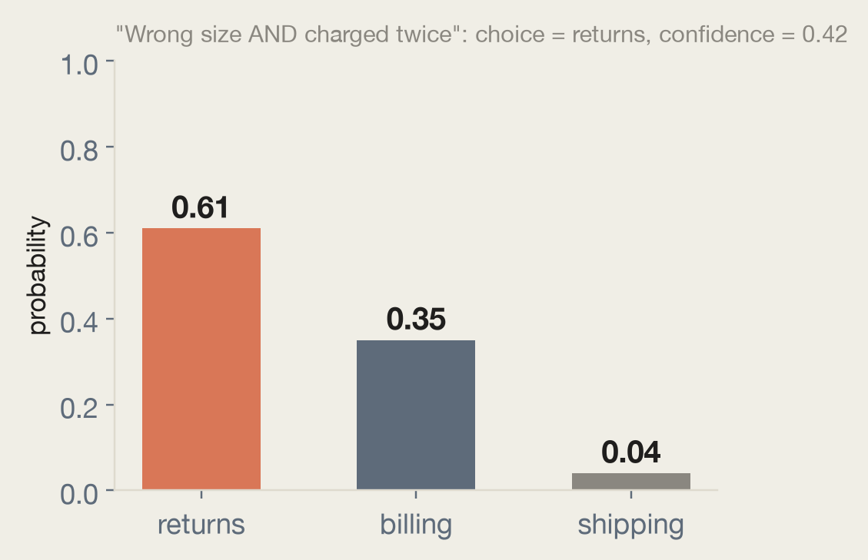
PART 2 | PRIMITIVE 1 OF 4
Choice: one option from a defined set
– criteria is a map of option name to description. Both are sent to the model; write descriptions that separate neighbors. Use None when the name is enough.
– Always add an escape hatch. An “other / none of the above” option gives honest probability somewhere to go.
– The distribution is the feature. An ambiguous ticket splits probability; code can CC the runner-up team when its share is over 0.25.
– Structured descriptions (what / not_for / examples) sharpen confusable options.
Choice(
instructions="Which team should handle this?",
criteria={
"returns": "Exchanges, wrong or damaged items",
"shipping": "Delivery status, delays, lost packages",
"billing": "Charges, invoices, payment problems",
},
)
Jev workshop | TypeSafe AI's System One model | October 2026
20
Notes:
The chart is a real documented response: wrong size AND double charge belongs to two teams, and the split says so. Confidence 0.42 is the model being honest, not failing. Notebook 02 reproduces this live.

Slide 21
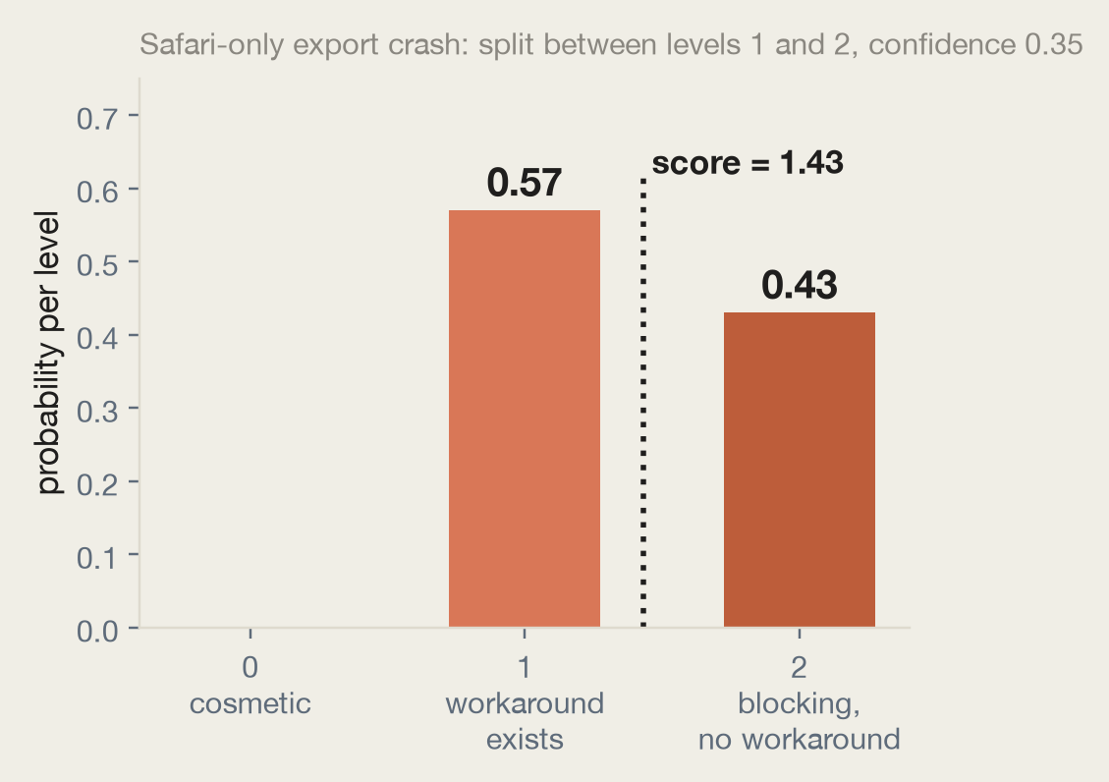
PART 2 | PRIMITIVE 2 OF 4
Score: a position on a rubric you define
– criteria is an ordered list, low to high: 2 to 10 levels. A level's number is its array position.
– score is the probability-weighted mean of level numbers, so it can land between levels: 1*0.57 + 2*0.43 = 1.43.
– Describe situations, not degrees. “Broken, but a workaround exists” beats “moderately severe”. Levels that are bare numbers return noise (live anti-example in notebook 02).
– One dimension per question. “Punctual and smart” is two questions; split and weight in code.
– Normalize before combining: divide by len(criteria) - 1.
Same score can hide different distributions: 1.0 may be “all on level 1” or “half on 0, half on 2”. Read probabilities and confidence alongside score.
Jev workshop | TypeSafe AI's System One model | October 2026
21
Notes:
The Safari bug is the teaching example: a workaround exists for most users but not all, so the model splits 0.57/0.43 and the fractional score ranks it between levels. Python SDK keys score probabilities and legend by int.

Slide 22
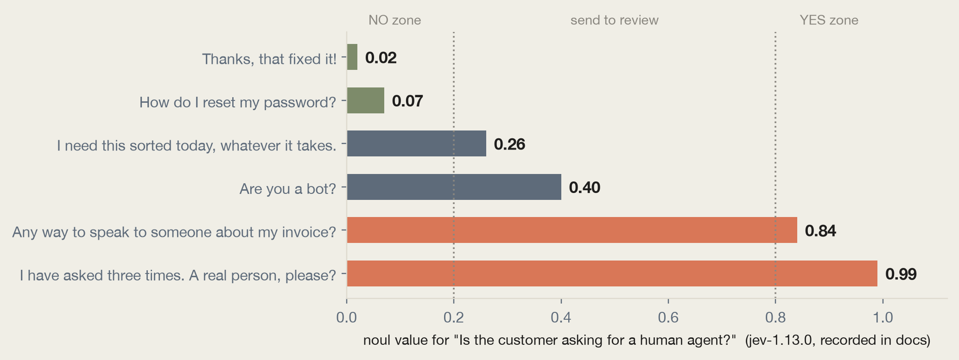
PART 2 | PRIMITIVE 3 OF 4
Noul: the probability that a statement is true
– One number. Near 1: strong yes. Near 0: strong no. Near 0.5: the model is telling you it cannot tell. No separate confidence; with two outcomes the value says it all.
– Phrase high = yes. “Is the message free of personal data?” inverts your thresholds.
– One proposition per Noul. “Angry AND wants a refund” is two questions.
– It is not a dial. The value is probability of yes, never a measure of degree. Measuring degree is a Score's job.
– Optional criteria pin down a subtle yes/no boundary with explicit true and false descriptions.
Jev workshop | TypeSafe AI's System One model | October 2026
22
Notes:
The ladder is recorded jev-1.13.0 output from the docs, reproduced live in notebook 02. The middle band is the design feature: 'Are you a bot?' hints without asking and lands at 0.40; production code sends that band to a person. Threshold placement follows cost of error: raise it when false yes is expensive.

Slide 23
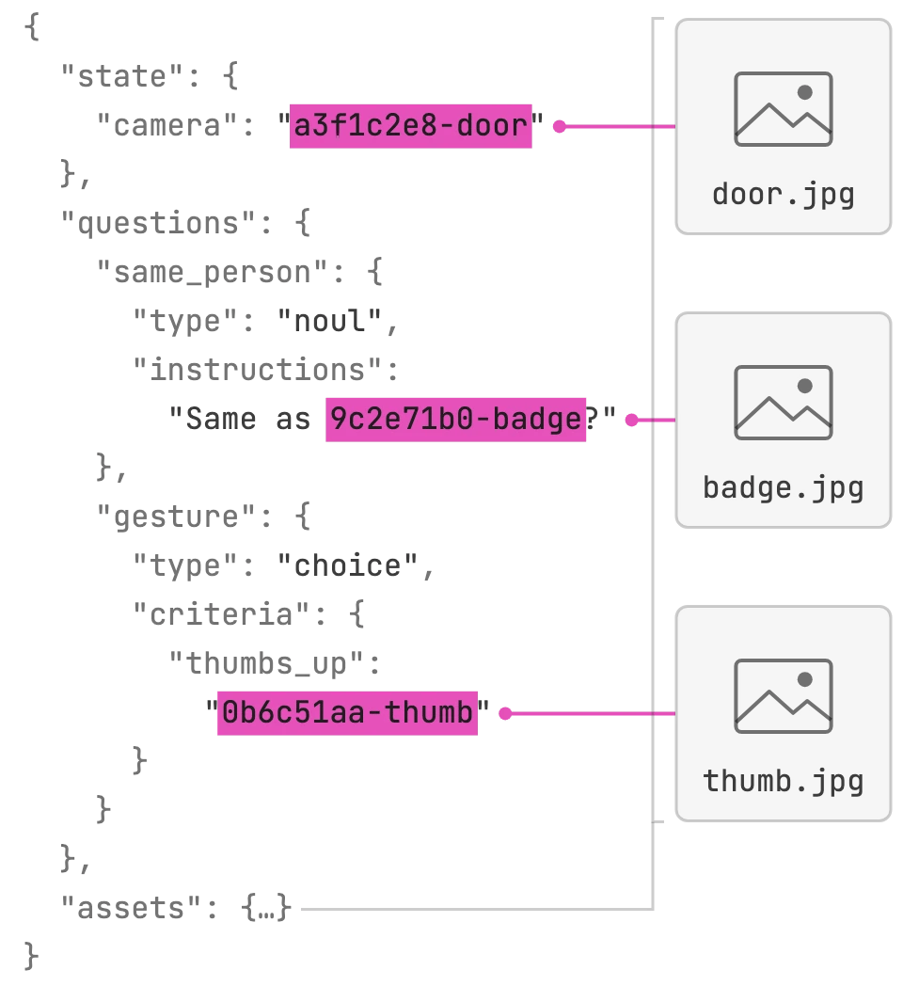
PART 2 | PREVIEW CAPABILITY
Images: pictures go anywhere text goes
– Placement: an image can sit in the state, inside a question's instructions, or as the criteria themselves: define Choice options by example pictures.
– Mechanics: list each image once in the request's assets map under a reference string; write the reference wherever the image belongs. The SDKs do this for you: Image(Path("door.jpg")).
– Opt-in and experimental: every image request needs the header TypeSafe-Danger-Zone-Images: true. “Dreamer-ready”: prototypes yes, production not yet.
– Limits: PNG/JPEG only, 16 MiB per file, sides 280 to 1568 px, 32 MiB per request. Billed as ordinary input tokens.
– Field report from building this deck: image calls run seconds, not milliseconds; raise the SDK timeout or the default 10 s cap plus retries will stack into minutes.
Official diagram: one request, three image placements (state, instructions, criteria), all declared in assets.
Jev workshop | TypeSafe AI's System One model | October 2026
23
Notes:
The anatomy diagram is from docs.typesafe.ai/images: door.jpg is the state, badge.jpg lives inside a Noul's instructions, thumb.jpg defines a Choice option. References are plain strings matched anywhere in request text, so use UUIDs in production. Jev 1.13 and 1.14 both accept images; Box questions need 1.14.

Slide 24
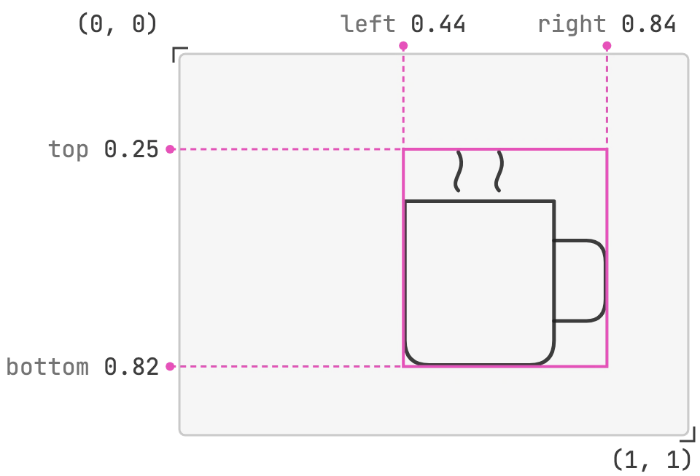
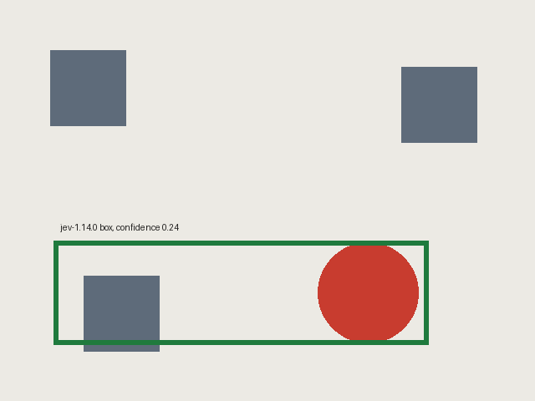
PART 2 | PRIMITIVE 4 OF 4, PREVIEW
Box: where is it in the image?
– What it returns: the smallest rectangle around the target: four edges (top, bottom, left, right) as fractions of image size, plus confidence. Resolution-independent by construction.
– Needs Jev 1.14: send model="jev-preview" plus the images header. Box takes no criteria; instructions need not be a question: “the coffee mug in `photo`” is enough.
– There is no “not found”. A Box always returns edges, even for an absent target. Pair it with a Noul (“Is there a mug in `photo`?”) and ignore the box when the Noul is low.
– Low confidence has remedies: re-ask on a crop, pad the box before cropping, or verify each edge with a Noul (“does the mug continue past the left edge?”).
Official diagram: edges as fractions from the top-left corner.
Our live test (notebook 02): Jev 1.14 boxed the red circle; vertical edges accurate, horizontal loose, confidence honestly reported at 0.24.
Jev workshop | TypeSafe AI's System One model | October 2026
24
Notes:
Demo moment: notebook 02 generates the scene with PIL, calls jev-preview, and draws the returned box. The loose horizontal edges plus 0.24 confidence are the honest-preview story: the model knows when it is unsure, and the docs give three concrete remedies. Edge-check benchmark from the docs: on 36 test crops, per-edge Nouls caught 30 of 36 cut-offs.

Slide 25

SCENARIO 2 | IMAGE
The doorbell camera: four questions about one photo
Noul
Is there a person in `porch`?
0.05
nobody there: do not ping the phone
Noul
Is there a delivered package in `porch`?
0.97
notify: 'package delivered'
Choice
Is the door open or closed?
closed 0.99
no alert needed
Box
the parcel on the mat in `porch`
see photo
confidence 0.85: crop it for the thumbnail
The green box is Jev's answer, drawn by our code: left 0.50, top 0.67, right 0.70, bottom 0.87.
We ran this exact call while building this deck (jev-1.14.0, one request, 1,229 input tokens, about $0.00005). Four judgments about one frame, and the fourth answer is a location the code can crop to. Every doorbell, every frame, for less than a cent a day.
Jev workshop | TypeSafe AI's System One model | October 2026
25
Notes:
The image twin of the ticket scenario. Walk the rows as the product behavior they become: no person, so no 3am ping; package at 0.97, so send the delivery notification; door closed, so nothing to flag; Box at 0.85 confidence, so crop the thumbnail. Ask the room: what threshold would YOU demand on 'person at door' before waking someone at 3am? There is no right answer; there is only the cost of a false ping vs a missed visitor. That is next section's topic. Reminder: images need the danger-zone header and jev-preview for Box; notebook 02 has the runnable version.

Slide 26
QUICK CHECK | YOU CALL IT
Which primitive would you reach for?
A
“Does this outbound email contain a password, API key, or other secret?”
B
“Which of our 40 product categories does this new listing belong to?”
C
“How complete is this bug report, from 'just says broken' to 'steps plus environment'?”
D
“Where is the signature on this scanned contract, and is it even signed?”
Answers A: Noul (threshold it; phrase so high = yes). B: Choice with a none_of_the_above escape option. C: Score with described situations as levels. D: a Box paired with a Noul, because a Box always returns edges, even on an unsigned page.
Jev workshop | TypeSafe AI's System One model | October 2026
26
Notes:
Run it as a show of hands per card before revealing the answer line. A and B go fast. C is the one people get wrong (many say Noul: 'is it complete?'); use it to re-land 'Noul is probability of yes, not a dial'. D tests whether the Box-has-no-not-found gotcha stuck. Two minutes, big retention payoff.

Slide 27
PART 3 | THE TWO NUMBERS
Probability tells you what. Confidence tells you whether to act.
probabilities
confidence
The answer's full distribution over YOUR options or levels. Sums to 1. What the model believes.
One 0-to-1 statistic computed from that distribution's shape: 1 when probability piles on one outcome, 0 when spread evenly.
Never a value outside the schema you supplied.
A sensible default, not magic: the formulas are published.
The published formulas (verified against the API in notebook 03):
Type | Formula | Intuition
Choice | (p_max - 1/n) / (1 - 1/n) | how far the winner sits above an even split
Score | 1 - (prob-weighted distance from top level) / (even-spread distance) | nearby probability hurts less than far-away probability
Noul | none returned; use |2p - 1| if you need one | distance from a coin flip
Jev workshop | TypeSafe AI's System One model | October 2026
27
Notes:
Key distinction for Scores: probability split across ADJACENT levels keeps more confidence than the same split across opposite ends; a Choice treats all options as unordered. Alternatives worth trying: top probability, and top-to-second ratio. Anti-pattern from TypeSafe's own guide: if you only ever take the best option, you do not need a confidence threshold at all.

Slide 28
PART 3 | USING IT
Three paths, and thresholds that scale with risk
Confidence | Behavior | Example
high | act automatically | route the ticket, show the balance
medium | proceed with caution | ask the user to confirm, flag for review
low | do not act | human agent, clarifying question, fallback system
a = r.choices["intent"]
if a.confidence < 0.5:
route_to_human() # genuinely unsure
elif a.choice == "check_balance":
show_balance() # low stakes: 0.5 ok
elif a.choice == "approve_transfer":
if a.confidence > 0.85: # high stakes:
confirm_then_execute() # high bar
else:
ask_user_to_confirm()
One system, different gates per action. Reading a balance at 0.6 risks a wrong screen; approving a transfer at 0.6 risks money. The risk tolerance lives in code, in named constants, reviewable in a pull request. Start conservative, test against your data, adjust.
Jev workshop | TypeSafe AI's System One model | October 2026
28
Notes:
This is the single most transferable pattern of the workshop. Notebook 03 runs this router over live utterances including 'approve it I guess? actually wait' which lands in the confirm band exactly as designed.

Slide 29
QUICK CHECK | SAME NUMBER, DIFFERENT ANSWER
The model says: approve_transfer, confidence 0.55. Now what?
1
Approve it
2
Ask the user to confirm
3
Route to a person
the model did pick approve_transfer, after all
act, but put a human click in the loop
0.55 is barely better than a shrug
Trick question: the number alone cannot tell you. The same 0.55 means 'go ahead' for showing a balance (worst case: a wrong screen) and 'absolutely not' for moving money (worst case: an irreversible transfer). Thresholds are priced by the cost of being wrong, per action. For a transfer, 0.55 clears no sane bar: option 2 or 3, never 1.
Second round, same number: choice = check_balance, confidence 0.55. Hands up for 'just show it'. (Correct: yes. Worst case is a re-ask.)
Jev workshop | TypeSafe AI's System One model | October 2026
29
Notes:
Poll the room on the three cards first; you will get a spread, which is the point. The reveal is that stakes, not confidence, choose the behavior; confidence only says how sure the model is, never whether that is sure ENOUGH. The second round (check_balance at the same 0.55) cements it: same number, opposite decision, because the downside is trivial.

Slide 30
SCENARIO 3 | SCALE
9:00 am, Monday: 500 tickets in the queue
technical
187 tickets
Jev
5 questions each,
one call per ticket
billing
154 tickets
sales
121 tickets
human review
38 tickets
500 tickets
(24 drawn)
illustrative split; the review lane is every low-confidence answer, surfaced instead of guessed
– The bill: 500 calls x ~500 tokens = 250k tokens = about one cent. The entire Monday-morning queue, triaged with uncertainty attached, for $0.01.
– The time: at ~0.3 s per call, under 3 minutes sequentially; seconds with a small concurrent pool (the Twitch cookbook runs 8-wide).
– The alternative you were pricing: an LLM pass over 500 tickets costs dollars and minutes, so you ration it. At Jev prices, rationing stops being a design constraint.
Jev workshop | TypeSafe AI's System One model | October 2026
30
Notes:
This is the economics slide told as a morning. The grid-to-lanes picture is the whole architecture: a loop in code, one call per item, lanes decided by thresholds, and the honest 38 that go to a person. Numbers are illustrative but the arithmetic is real and runs in notebook 04. Segue: so what do speed and price actually look like against LLMs? Next slide, the chart.

Slide 31
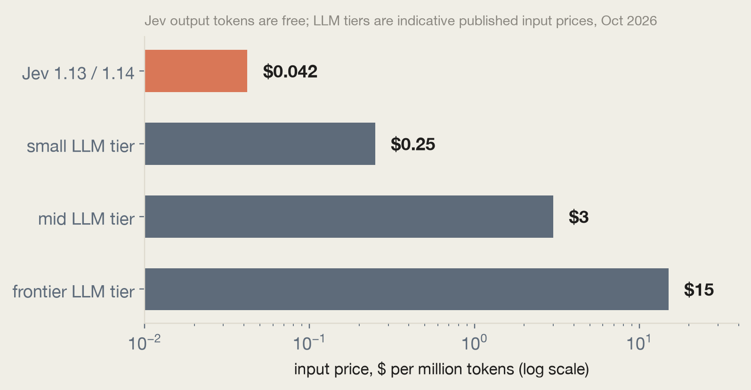
PART 4 | PROPERTIES THAT CHANGE ARCHITECTURE
Fast enough for request paths, cheap enough for everywhere
– Latency: company claims 70 to 500 ms; our measurements from this workshop: ~280 ms per text call including network. Fast enough to sit in front of every LLM call.
– Price: $0.042 per million input tokens, output free. A 5-question triage request is ~500 tokens: about $21 per million tickets.
– What this unlocks: screen every message both directions, score every passage in RAG, classify entire agent traces, ask speculative questions by default.
Indicative LLM tier prices for scale; check current vendor pricing. The point is orders of magnitude, not decimals.
Jev workshop | TypeSafe AI's System One model | October 2026
31
Notes:
The economics ARE the product. At these prices the question flips from 'can we afford an AI check here' to 'why would we not check'. That reframing drives every pattern in part 4.

Slide 32
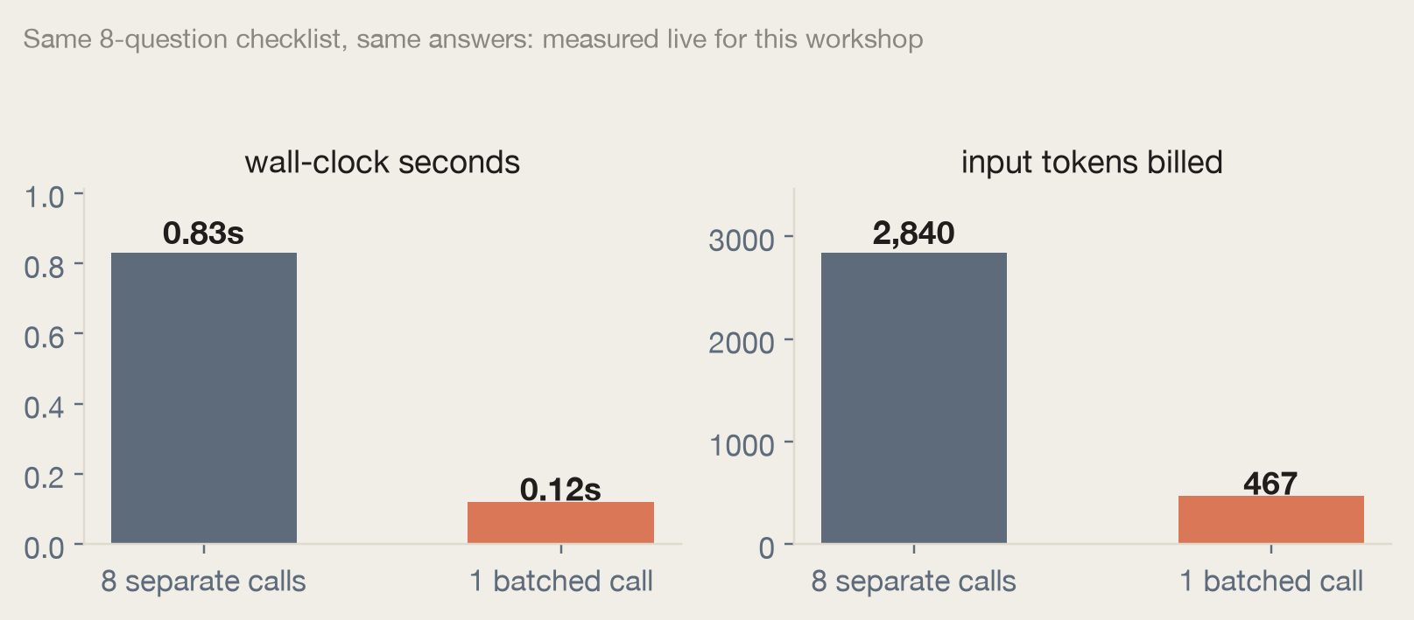
PART 4 | WE MEASURED IT
Batching questions: our live experiment
– The setup: an 8-question compliance checklist over one policy paragraph; 8 separate calls vs 1 call with 8 questions.
– Result: 6.8x faster, 6.1x fewer input tokens, answers numerically identical (within 0.01).
– Why: every call pays to resend the state and a round trip; a batch pays once.
– Docs' version at 13 questions: 11.5x cheaper, 9.6x faster. The ratio grows with question count and state size.
Run it yourself: notebook 04, cell 6. No limit on questions per request; the bound is context (64k per request, 32k state plus any one question).
Jev workshop | TypeSafe AI's System One model | October 2026
32
Notes:
This chart was generated from a real run during preparation. Invite the room to re-run notebook 04 and watch their own numbers land in the same ballpark. If questions do not all fit in context, reuse the same state across a few requests.

Slide 33
PART 4 | PATTERN 1 OF 4
Speculative fan-out: ask everything, let code choose
– The idea. Send every question your code MIGHT need, including ones that only matter for some inputs. Code ignores the irrelevant answers.
– Why it is nearly free. Questions evaluate in parallel; an extra question adds a few tokens, not a round trip.
– The example. Triage asks category, bug severity, repro steps, refund requested, frustration, all at once. A feature request simply never reads the severity answer.
– Independence guarantee. One question's answer is never hidden context for another; adding a question cannot change the others' results.
r = client.system_one(state=ticket, questions={
"category": Choice(...), # always used
"bug_severity": Score(...), # only if bug
"has_repro": Noul(...), # only if bug
"refund_asked": Noul(...), # only if billing
"frustration": Score(...), # always used
})
if r.choices["category"].choice == "bug_report":
if (r.scores["bug_severity"].score > 1.5
and r.nouls["has_repro"].noul > 0.6):
escalate_to_engineering()
Jev workshop | TypeSafe AI's System One model | October 2026
33
Notes:
Coding agents fall into one-question-per-call more than people do; TypeSafe ships an agent skill that teaches them to batch. The full decision tree resolves from one call.

Slide 34
PART 4 | PATTERN 2 OF 4
Composite scoring: the model judges, your weights decide
– Resist the one-big-question urge. “Rate this candidate 1-10” hides several judgments behind one number you cannot tune.
– Instead: one Score per dimension (Python depth, leadership, system design), normalized by each scale's top level, combined with weights in code.
– The payoff. Senior-IC weights and manager weights produce different rankings from the SAME model judgments. Priorities change in a constants file, under code review, not in a prompt.
– Judgment vs policy. The model owns the former, your code owns the latter. Keep them separable and both become testable.
norm = lambda qid: (r.scores[qid].score
/ (len(DIMENSIONS[qid].criteria) - 1))
ic_fit = (0.45 * norm("python_depth")
+ 0.10 * norm("team_leadership")
+ 0.45 * norm("system_design"))
em_fit = (0.15 * norm("python_depth")
+ 0.55 * norm("team_leadership")
+ 0.30 * norm("system_design"))
Also feeds classical ML: use the probabilities as features for a downstream model when you have labeled outcomes.
Jev workshop | TypeSafe AI's System One model | October 2026
34
Notes:
Notebook 04 ranks three resumes under both weight profiles live. When the ranking disagrees with your team's intuition, you adjust a coefficient and rerun: fast, auditable iteration.

Slide 35
PART 4 | PATTERNS 3 AND 4 OF 4
Confidence-gated routing + intent routing
Confidence-gated routing
Intent routing
– Confidence is a second decision axis: the answer says what, confidence says whether to act on it.
– A floor (for example 0.5) catches genuine uncertainty for everything; each action then sets its own bar by stakes.
– Checking a balance clears at 0.6; approving a transfer wants 0.85 plus a confirmation.
– Jev sits in front as the fast, cheap classifier; expensive handlers are invoked only when needed.
– order_status: deterministic code, no LLM at all. product_question: a specialist LLM with the right context loaded.
– complaint: a complexity Score decides between an LLM and a person.
– The routing call costs fractions of a cent per thousand messages and saves an LLM invocation on most of them.
Jev workshop | TypeSafe AI's System One model | October 2026
35
Notes:
Both run live in notebooks 03 and 04. The combined shape, classify cheaply, gate on confidence, spend money only where deterministic code cannot go, is the canonical production architecture for Jev.

Slide 36
PART 4 | WHERE IT FITS
Five use-case families (TypeSafe's own map)
AI automation software
Real-time applications
AI map-reduce over big data
Code owns control flow; Jev handles semantic decisions. Run it a million times in the background, no human co-pilot.
Frontier intelligence at ~150 ms: decisions faster than human perception, inside UIs and game loops.
100x cheaper means you can afford giant corpora: search, classify traces, extract features at dataset scale.
Universal verification
Harness engineering
Industry examples
support triage, insurance claims, financial crime, legal and compliance, e-commerce catalogs, trust and safety, recruiting, demand forecasting
Check prompts, extractions, citations, reasoning traces, and tool calls of OTHER AIs at a fraction of the LLM's cost.
Make your agent harness smarter: model routing, semantic retrieval, error detection, guardrails.
Jev workshop | TypeSafe AI's System One model | October 2026
36
Notes:
The use-case map at docs.typesafe.ai/concepts/use-case-map has a worked accordion per industry. For this audience: universal verification and harness engineering are the ones adjacent to our agent-platform work, guardrails on every tool call become affordable.

Slide 37
PART 4 | RECEIPTS
The cookbooks publish measured results
Cookbook | What it builds | Published result
Parallel questions | 13-question regulatory briefing, batched | 12.2x cheaper, 10.0x faster, same answers
Re-ranking (CLERC legal) | BM25 shortlist, then one Noul per query-candidate pair | top-1 accuracy 5% to 18%; top-10 38% to 62%
Skill suggestion | pick at most 1 of 182 agent skills, two-stage | rank 182 in one request, re-check top 3
SDE cascade | extract with mini model, verify with Jev, escalate the rest | most of a reasoning model's quality at a fraction of cost
Hierarchical classification | beam search over Choice probabilities | deep patent/retail/biomedical trees, parallel beams
Guardrails for LLMs | screen every message, hazard Nouls + severity | pass / review / block from one request per message
Entity alignment | 450 candidate pairs, one Score + 3 companion Nouls | duplicate detection across two product catalogs
All 20+ at docs.typesafe.ai/cookbooks, each with runnable code. Notebook 05 builds two of them in miniature.
Jev workshop | TypeSafe AI's System One model | October 2026
37
Notes:
These are TypeSafe's published numbers, not ours; we reproduced the batching claim ourselves (previous slide) and got the same shape. The re-ranking rows are the strongest third-party-verifiable claims: public dataset, published methodology.

Slide 38
PART 5 | THE HONEST SLIDE
Nine documented failure modes (Jev 1.13 jaggedness)
Failure mode | Do this instead
Literal reading: answers what you wrote, not what you meant | write the exact condition; boundary cases into criteria
Math, numbers, counting | keep arithmetic in code; one Noul per item, sum yourself
Date and time comparison | extract parts as Choices; compare in code (notebook 05, live)
Indirection, double negatives | reduce hops; point at state by backticked path
Large state full of irrelevant detail (context rot) | filter in code first; send only what the question needs
Adversarial content can steer answers | precise criteria; test on real attacks; never Jev alone as the gate
Contradictory instructions vs criteria | align them; never map true to no
Choice option order can bias the answer | reorder options; check consistency
Generation: it cannot produce text | a generative model, or a Choice over pre-parsed candidates
Jev workshop | TypeSafe AI's System One model | October 2026
38
Notes:
TypeSafe publishes this list themselves and dates the review (last reviewed Oct 2, 2026). Teach the smell test: if code can compute it exactly, the model has nothing to add. Notebook 05 demos counting and the ambiguous-date trap live, including the confidence gate catching 11/05/2026 splitting between May and November.

Slide 39
PART 5 | SCOPE
What Jev is not
– Not a chat model. It cannot write replies, summaries, or explanations. Pair it with an LLM when you need words.
– Not a coding-agent brain. There is no model=“jev-latest” setting that powers Claude Code or Cursor. Jev goes inside the software your agent writes.
– Not a calculator or a clock. Arithmetic, counting, date math: code's job, always.
– Not a reasoning engine. Multi-hop System 2 tasks get decomposed into atomic questions composed in code, or handed to a reasoning model.
– Not fine-tunable. Same weights for everyone; your domain lives in state, instructions, criteria.
The mental model
Code owns the workflow.
Jev answers the judgment calls.
LLMs write the words,
when words are needed.
Jev workshop | TypeSafe AI's System One model | October 2026
39
Notes:
The 'coding agents' page exists because people kept asking. Worth repeating the division of labor out loud: deterministic rules in code, judgment in Jev, generation in LLMs. Most production systems will use all three.

Slide 40
PART 5 | REFERENCE CARD
Properties your team will ask about
 | Jev 1.13 (jev-latest) | Jev 1.14 (jev-preview)
Released | Sep 15, 2026 | Oct 14, 2026
Price | $0.042 / Mtok input, output free | same
Context | 64k per request / 32k per question | same; 262k with long-context header
Input | text (string, object, array) | text + images (preview header)
Box questions | no | yes
– Rate limits: tokens/sec and requests/sec per organization; SDKs retry 429/529 with backoff and honor retry-after.
– Errors: 400 bad request, 401 auth, 413 too large, 422 validation (names the field), 429 rate limit, 529 overloaded.
– Versioning: aliases move on release (latest moves to 1.14 ~Oct 21); responses report the versioned model. Pin versions once thresholds are tuned.
– Data: not trained on customer requests; ZDR available for enterprise.
– Language: English primary; others accepted with lower accuracy, so watch confidence.
Full distilled documentation: reference/JEV-REFERENCE.md in the workshop folder.
Jev workshop | TypeSafe AI's System One model | October 2026
40
Notes:
This slide is the one to hand to the platform team. The danger-zone headers (images, long context) are per-request opt-ins, which is a nice API design detail: experimental surface is impossible to enable by accident.

Slide 41
PART 5 | GO BUILD
Getting started, four ways
1. Playground
console.typesafe.ai/playground: paste a state, add questions, read answers. No code. Best first five minutes.
Your lab, after this deck
01 hello jev: first calls, cost math
02 primitives: all four, with anti-examples
03 confidence: formulas verified live
04 patterns: the 6.8x batching experiment
05 real world: guardrails, search,
the sharp edges, reference
2. Python SDK
pip install typesafe-sdk
export TYPESAFE_API_KEY=...
client.system_one(state=..., questions=...)
3. HTTP
POST api.typesafe.ai/v1/systemone with Bearer auth. Any language, no SDK required.
4. Agent skill
claude plugin marketplace add typesafe-ai/skills, then claude plugin install typesafe@typesafe-ai: your coding agent learns the API, the primitives, and to batch questions.
A full run of all five notebooks costs under one cent.
Jev workshop | TypeSafe AI's System One model | October 2026
41
Notes:
Send attendees to the Playground during the break; it is the fastest way to internalize the state-plus-questions model. The agent skill matters for teams: it is how their coding agents stop writing one-question-per-call integrations.

Slide 42
The one-sentence takeaway
Code owns the workflow.
Jev answers the judgment calls.
docs.typesafe.ai console.typesafe.ai/playground docs.typesafe.ai/cookbooks
Workshop materials: jev-workshop/ (five executed notebooks, this deck, and JEV-REFERENCE.md)
Notes:
Close with the division of labor, then open Q&A. Common first questions: pricing at scale (slide 17), security posture (slide 6 and 24), and when NOT to use it (slide 25).

