Slide 1
datasense workshop
Real-Time
Communication Patterns
Polling · Webhooks · SSE · WebSockets
Pick the right pattern. Build apps that feel live without overengineering.
datasense · Real-Time Patterns Workshop
1

Slide 2
What we'll cover
Four patterns, three projects, one running scenario.
• The four real-time patterns and what each is for
• When to pick which (the decision tree)
• HTTP basics + JWT auth, refreshed
• Hands-on: 7 runnable example folders (server + client per pattern)
• Three full projects, including the LiveOrder capstone that composes all four
• Where these show up in AI apps (LLM streaming, MCP, voice agents)
datasense · Real-Time Patterns Workshop
2

Slide 3
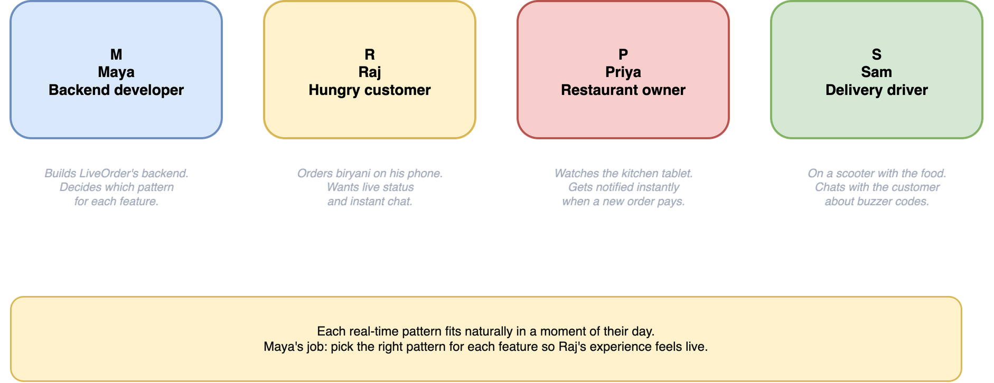
Meet the cast
Every example below is told through these four. Same people, different patterns.
Maya builds it · Raj uses it · Priya cooks it · Sam delivers it
datasense · Real-Time Patterns Workshop
3

Slide 4
LiveOrder: one app, all four patterns
Same backend Maya runs. Each feature picks the pattern that fits.
FEATURE
DATA FLOW
PATTERN
Stripe says Raj paid
External event
WEBHOOK
Priya's tablet shows new orders
Server -> restaurant
SSE
Raj's order status timeline
Server -> customer
SSE
Raj chats with Sam about buzzer
Two-way live
WEBSOCKET
Raj sees Sam's scooter on map
Frequent updates
SSE / fast polling
Maya checks nightly pricing job
Rare batch check
POLLING
Same backend. Four patterns. Each one chosen because it fits that feature's shape.
datasense · Real-Time Patterns Workshop
4

Slide 5
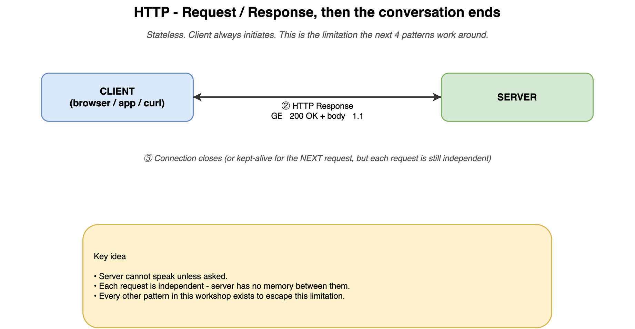
The problem with plain HTTP
The client always speaks first. The server can never push.
Every real-time pattern in this workshop exists to work around this one limit.
datasense · Real-Time Patterns Workshop
4

Slide 6
HTTP on the wire - it's just text
Request and response are both plain text with a tiny structure. That's the entire protocol.
REQUEST (what your browser sends)
RESPONSE (what the server replies)
GET /api/users HTTP/1.1
Host: api.example.com
Accept: application/json
Authorization: Bearer eyJhbGciOiJ...
User-Agent: Mozilla/5.0 ...
HTTP/1.1 200 OK
Content-Type: application/json
Content-Length: 348
Cache-Control: no-store
{"users":[
{"id":1,"name":"Maya"},
{"id":2,"name":"Raj"}
]}
Method + path + headers + blank line + optional body. Status line + headers + blank line + body.
datasense · Real-Time Patterns Workshop
6

Slide 7
Stateless - the single property that makes real-time hard
The server has no memory between requests. The client carries everything.
Two requests one second apart = two strangers walking up to a counter.
The server doesn't remember 'Maya is logged in' - it re-derives it from the token Maya's browser
sends with every single request.
This is GREAT for scale (any server can serve any request) but TERRIBLE for real-time:
When a new message arrives on the server for Raj, the server cannot say 'let me notify Raj' -
there is no open line to Raj. There is no phone number. There is no email address baked in.
The four real-time patterns are all answers to the question:
'how do we work around HTTP being request/response, stateless, and client-initiated?'
Polling
SSE / WS
Webhook
client keeps asking
client opens a long-lived line; server pushes
an external system already had a line to your server
datasense · Real-Time Patterns Workshop
7

Slide 8
HTTP status codes that matter for real-time
Memorise these. You'll handle them in every pattern below.
CODE
MEANING
WHEN YOU'LL SEE IT
200
OK
successful poll; successful webhook receipt
201
Created
after a POST that creates something
202
Accepted
'Got it, processing async' - webhook receivers
204
No Content
long-poll timeout; nothing to send
304
Not Modified
ETag/If-None-Match - smart polling savings
401
Unauthorized
missing/expired token; bad webhook signature
404
Not Found
wrong URL or missing record
408
Request Timeout
long-poll fell past server limit
429
Too Many Requests
polling too fast or rate-limited
500
Internal Server Error
bug; crashed dependency
502
Bad Gateway
proxy got nothing useful from backend
503
Service Unavailable
maintenance, overload; webhook senders retry
datasense · Real-Time Patterns Workshop
8

Slide 9
Stateless vs stateful, per pattern
HTTP itself is stateless. Some patterns add stateful connections on top.
PATTERN
CONNECTION MODEL
STATEFUL?
Polling (short)
new HTTP request per poll
Stateless
Polling (long)
one held HTTP request
Stateless on server, in-flight on client
Webhook receiver
separate HTTP request per event
Stateless
SSE
one long-lived HTTP connection
Stateful at the transport level
WebSocket
one persistent connection, both directions
Stateful
Stateful = costs memory per client. 100K SSE/WS connections = ~10 GB. Plan accordingly.
datasense · Real-Time Patterns Workshop
9

Slide 10
HTTP versions in 90 seconds
All four real-time patterns are identical across versions. Only scaling limits differ.
HTTP/1.0
one TCP connection per request
why care: mostly historical
HTTP/1.1
keep-alive (re-use connections), chunked transfer
why care: what most 'long-lived' patterns assume; SSE works here but is limited to 6 connections per host in browsers
HTTP/2
one TCP connection multiplexes many parallel requests
why care: SSE works much better here; modern default everywhere
HTTP/3
same idea as HTTP/2 but runs on UDP (QUIC)
why care: better on flaky mobile; connection survives IP changes
datasense · Real-Time Patterns Workshop
10

Slide 11
The four patterns at a glance
Mental model first. Wire format and code in the next sections.
POLLING
WEBHOOKS
SSE
WEBSOCKETS
Are we there yet?
Don't call us,
we'll call you
Tune in.
Server broadcasts.
Open a phone line
Client repeatedly asks the server on a timer. Crude. Sometimes the right answer.
External server POSTs to your URL when something happens. Server-to-server.
Server holds one HTTP connection and pushes events. Browser-native. One-way.
Persistent, bidirectional, low-overhead. Use only when you really need two-way.
datasense · Real-Time Patterns Workshop
5

Slide 12
SECTION
Polling
datasense · Real-Time Patterns Workshop
12

Slide 13
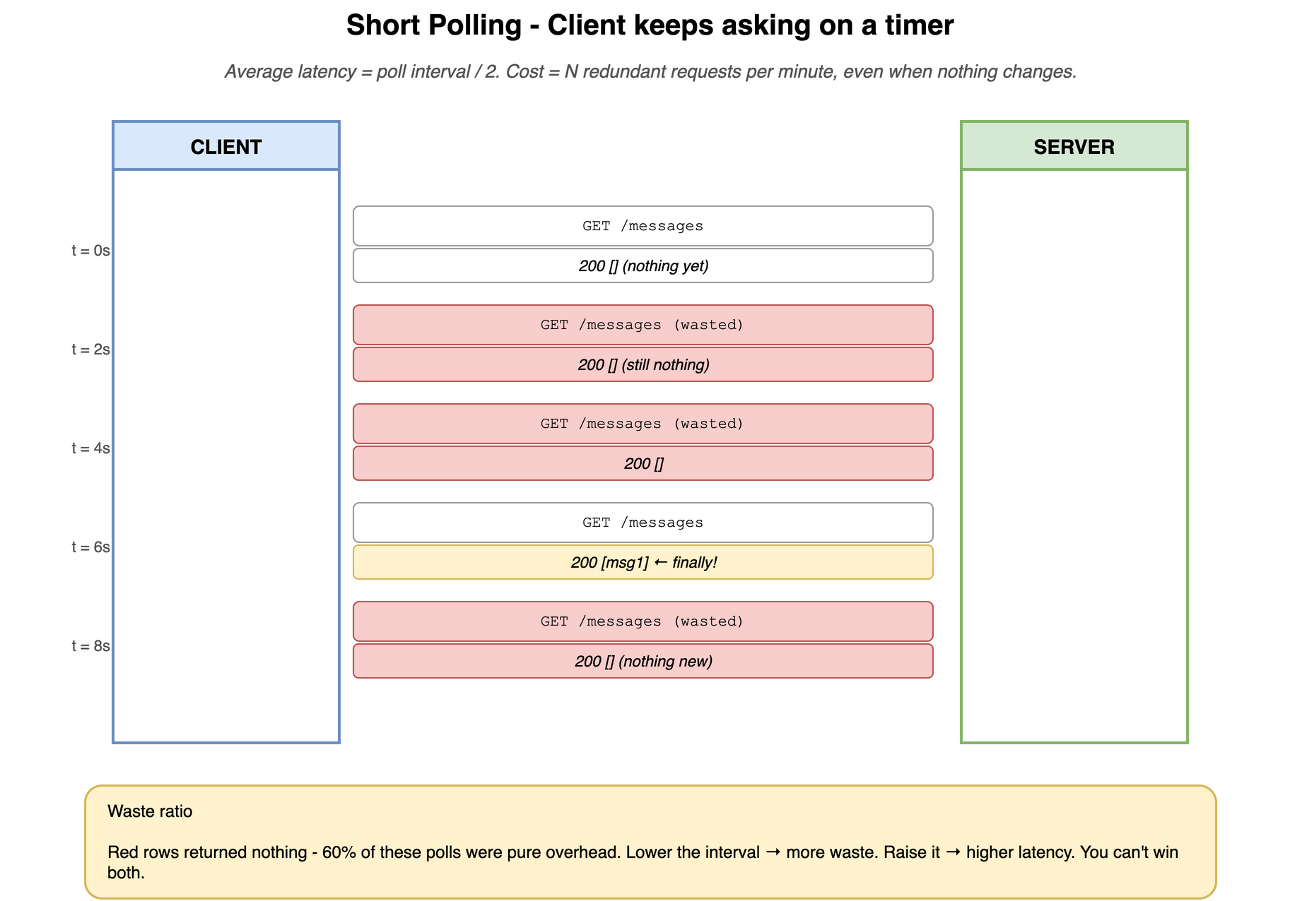
POLLING
CONCEPT
Short polling - the protocol
Client asks on a timer. Server immediately returns whatever it has.
datasense · Real-Time Patterns Workshop
13

Slide 14
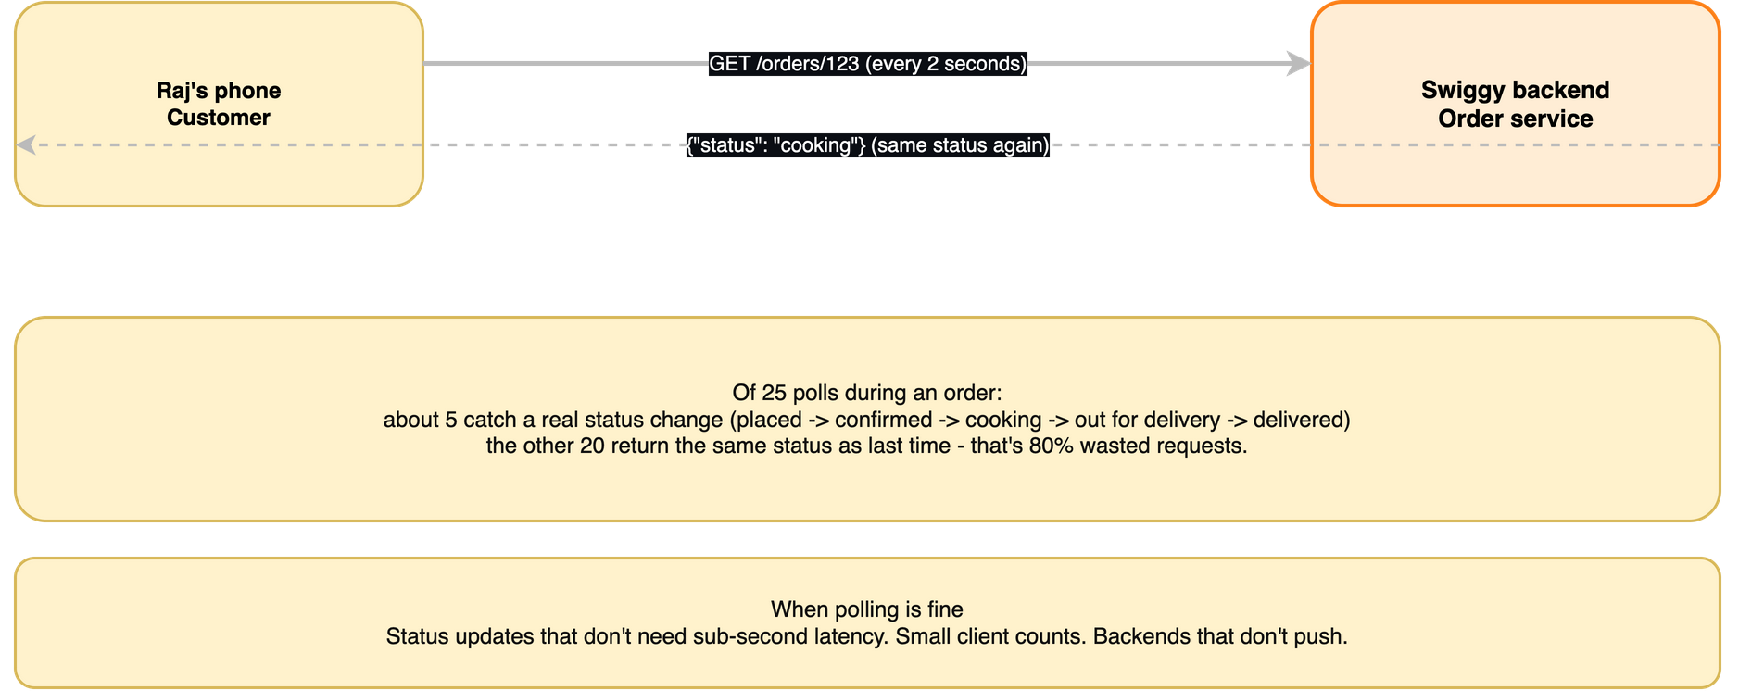
POLLING
EXAMPLE
Raj refreshing his Swiggy order
The kid in the back seat. 'Are we there yet?' Most refreshes return the same status.
datasense · Real-Time Patterns Workshop
14

Slide 15
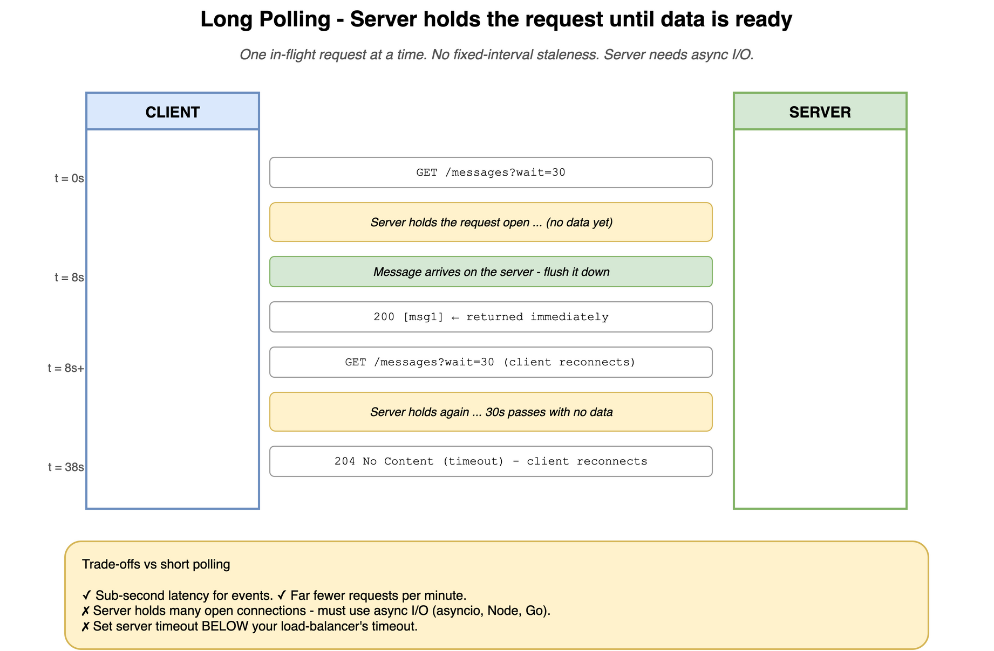
POLLING
CONCEPT
Long polling - the protocol
Server holds the request open until data is ready (or timeout). One held connection per client.
datasense · Real-Time Patterns Workshop
15

Slide 16
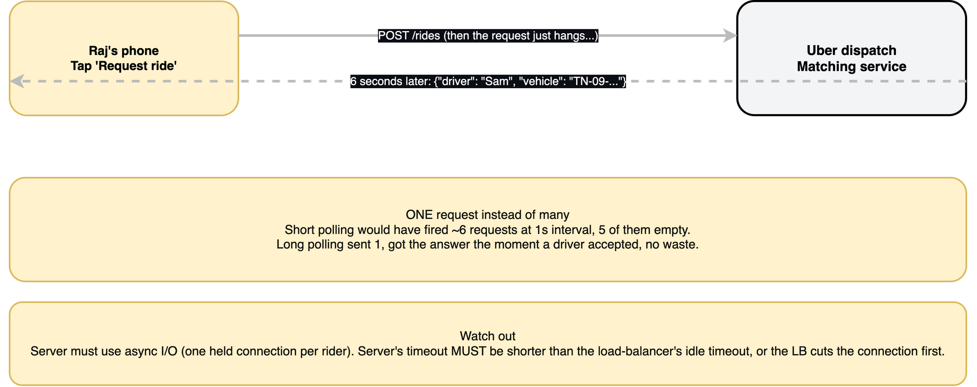
POLLING
EXAMPLE
Raj waits for an Uber driver
One held request. The server replies the moment a driver accepts. No wasted polls.
datasense · Real-Time Patterns Workshop
16

Slide 17
POLLING
Short polling in 18 lines
The whole pattern - client setInterval, server returns current state.
client.js (8 lines)
server.py (4 lines)
let last = null;
const id = setInterval(async () => {
const r = await fetch(`/orders/${o}/status`);
const { status } = await r.json();
if (status !== last) {
updateUI(status);
last = status;
}
if (status === "delivered") clearInterval(id);
}, 3000); // poll every 3 seconds
@app.get("/orders/{order_id}/status")
def get_status(order_id: int):
order = db.get_order(order_id)
return {"status": order.status}
datasense · Real-Time Patterns Workshop
17

Slide 18
POLLING
The hidden cost of short polling
Raj's order: 25 minutes, status changes 5 times, polled every 3 seconds.
500
5
99%
polls fired
actually meaningful
wasted
Now multiply by 10,000 concurrent customers:
5,000,000 HTTP requests per hour just to track order statuses.
99% of them returned nothing useful.
Lower interval -> smoother UX, higher cost. Raise interval -> cheaper, laggy. You cannot win both.
datasense · Real-Time Patterns Workshop
18

Slide 19
POLLING
Making polling cheaper without changing patterns
Six tricks that cut waste 10x. Use them ALL before you reach for SSE.
1. Cursor / since= parameter
Send the last-seen id so the server returns only deltas.
2. ETag + If-None-Match
Server returns 304 with empty body when nothing changed. Bandwidth -> ~zero.
3. Exponential backoff
If five polls in a row return empty, slow down. Reset on activity.
4. Jitter
Add +-10% random offset so 10K clients don't sync up and DDoS you.
5. Pause when invisible
Page Visibility API. No point polling for a tab no one's looking at.
6. Conditional auth caching
Don't hit your auth DB on every poll. JWT verify in-process is fine.
datasense · Real-Time Patterns Workshop
19

Slide 20
POLLING
Polling bugs you'll hit, and the fix
Every team rediscovers these. Save yourself the outage.
'Data never updates' even though server has new data
Browser or CDN cached your GET. Add Cache-Control: no-store, or ?t=<ts> cache-buster.
Long-poll times out at 30s even though you set 60s
A proxy or LB has a shorter idle timeout. Set server < LB always.
Worked in dev, exploded in prod
Dev had 1 user; prod has 10K. Add per-endpoint req/sec and DB query metrics; you'll see the N+1.
Polling continues after tab closes
Forgot to clearInterval on unmount/visibilitychange. Always pair start with stop.
UI shows duplicate notifications on every poll
Missing cursor; you're re-fetching the whole list. Add ?since=<last_id>.
datasense · Real-Time Patterns Workshop
20

Slide 21
POLLING
When polling IS the right call
It is fashionable to roll eyes at polling. Resist. Big companies use it for the right things.
Talking to an external API you don't control
OpenAI Batch / Fine-tuning, S3 Glacier, AWS Lambda async invokes - all polled because they don't push to you.
The thing you're checking changes rarely
A nightly batch job. Polling every minute is 60 reqs; SSE would be overkill.
Cost of being a few seconds stale is zero
A dashboard of yesterday's sales numbers. Nobody's watching it tick.
You have very few clients
Internal admin tool used by 5 people. 500 polls/hour is rounding-noise.
Platform / network kills long-lived connections
Corporate proxies, iOS background fetch, aggressive serverless idle timeouts.
You're shipping in three days, alone
Polling is the only pattern you can build, test, deploy, and debug in an afternoon.
datasense · Real-Time Patterns Workshop
21

Slide 22
POLLING
When polling is the right call (and when it isn't)
It's not always wrong. Just usually mis-used.
Use polling when
Don't poll when
Updates are rare and a few seconds stale is fine
You're calling someone else's API that only supports REST
Total clients < 100; engineering cost matters more than waste
You need to ship in an afternoon
Status checks for slow background jobs (batch reports, fine-tunes)
The UI must feel live (chat, typing, multiplayer, game)
You have 10k+ mostly-idle clients (millions of empty requests)
You'd be polling at 10+ Hz - just use SSE
You're hitting someone else's rate-limited API quota
The source already supports webhooks; just use those
datasense · Real-Time Patterns Workshop
22

Slide 23
SECTION
Webhooks
datasense · Real-Time Patterns Workshop
23

Slide 24
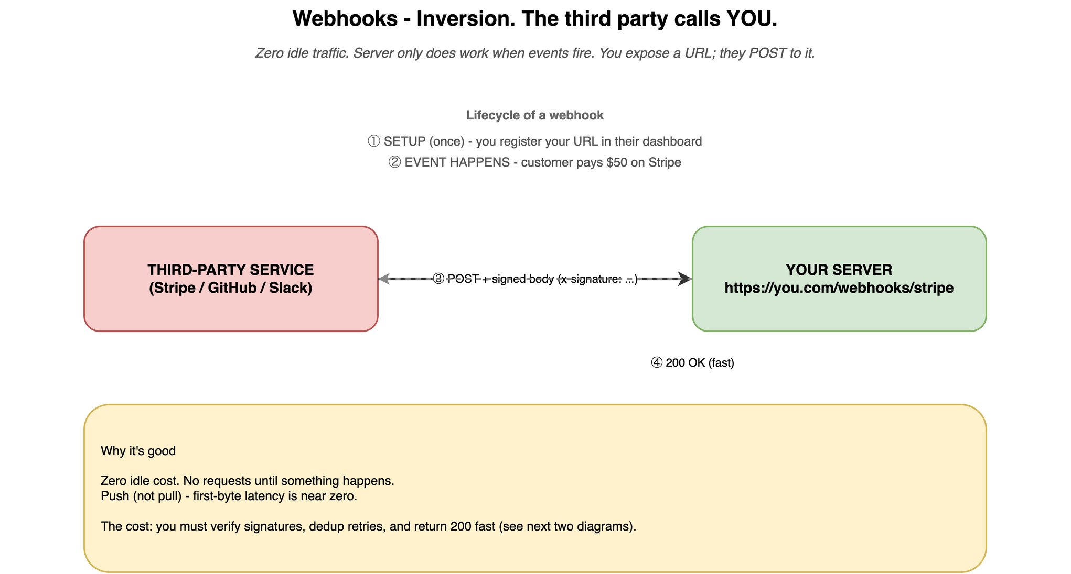
WEBHOOK
CONCEPT
Webhook - the protocol
Third-party server POSTs to YOUR URL when something happens. Zero idle traffic.
datasense · Real-Time Patterns Workshop
24

Slide 25
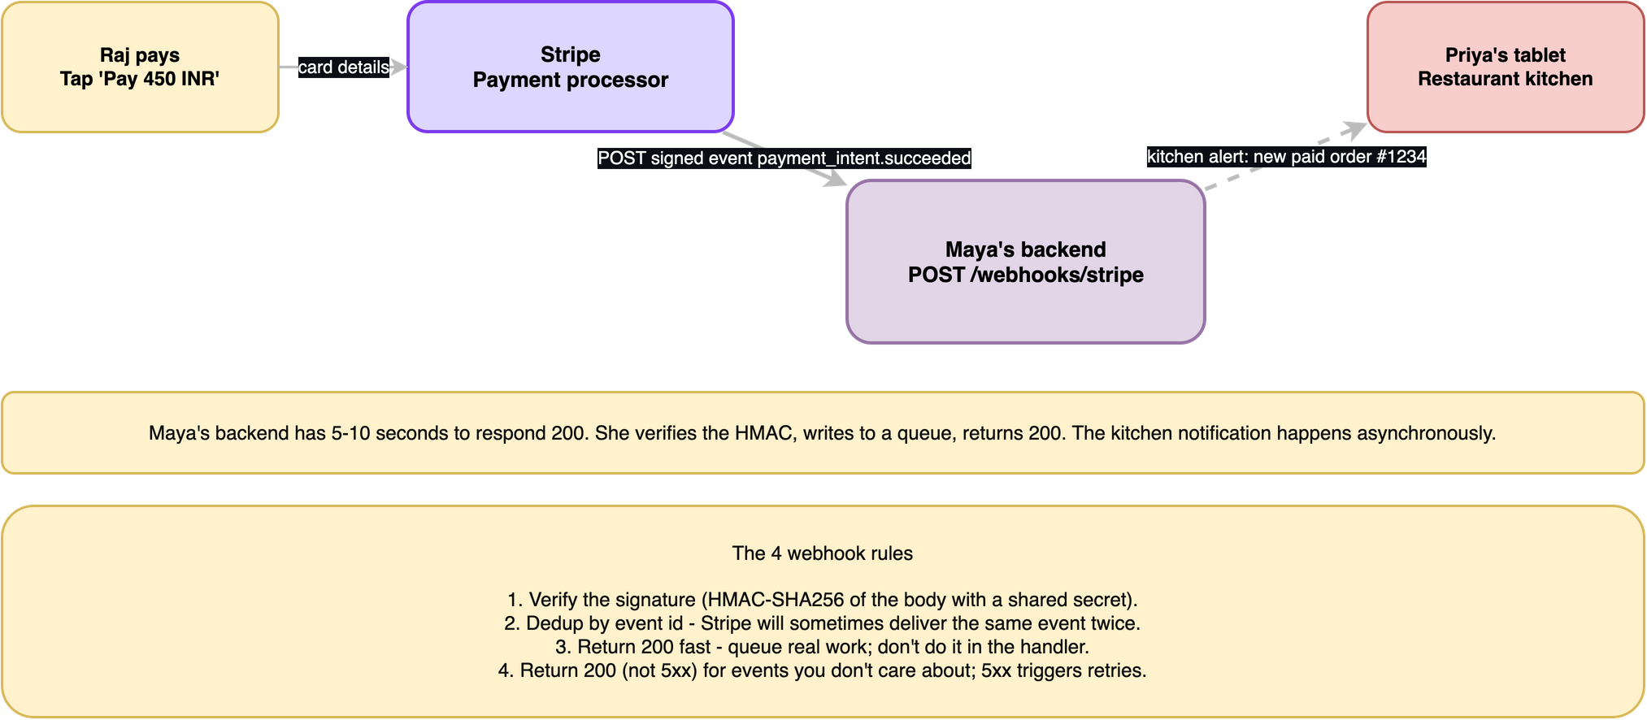
WEBHOOK
EXAMPLE
Stripe pays for Raj's biryani
Stripe is the source of truth. They tell Maya's backend when the card cleared.
datasense · Real-Time Patterns Workshop
25

Slide 26
WEBHOOK
The role flip - webhooks are just inverted polling
Same HTTP. Same servers. Just swap who is the client and who is the server.
POLLING
WEBHOOK
YOU are the client.
THEY are the server.
You ASK them.
GET /payments/recent
GET /payments/recent
GET /payments/recent
GET /payments/recent
GET ...
THEY are the client.
YOU are the server.
They POST you (when it happens).
POST /webhooks/stripe
{ type: payment.succeeded, ... }
(silence ... silence ...)
POST /webhooks/stripe
That role flip is the entire idea behind webhooks.
datasense · Real-Time Patterns Workshop
26

Slide 27
WEBHOOK
Webhook payload anatomy
Stripe shape, but every provider follows the same outline.
{
"id": "evt_1NXY2bAB4tH...", # unique event id - USE THIS FOR DEDUP
"type": "payment_intent.succeeded", # what happened - your switch statement
"created": 1700000000, # timestamp - useful for ordering
"data": {
"object": { # the resource at event-fire moment
"id": "pi_3NXY...",
"amount": 5000,
"currency": "usd",
"customer": "cus_abc123",
"metadata": { "order_id": "order_789" }
}
},
"livemode": true,
"api_version": "2023-10-16" # sender's API version
}
Don't assume metadata fields you didn't set are present. Defensive parsing pays off.
datasense · Real-Time Patterns Workshop
27

Slide 28
WEBHOOK
The four rules of webhook receivers
Skip any one and you'll have very interesting outages.
1. Return 2xx fast
Don't do work in the handler. Verify, queue, return 200. Stripe times out at 5-10 seconds.
2. Verify the signature
HMAC-SHA256 of the body, constant-time compare. Without this, anyone can fake events.
3. Dedup by event id
Senders sometimes deliver twice. Without dedup, you'll double-charge cards.
4. Return 200 (not 5xx) for events you don't care about
5xx triggers retries forever. Log + 200 is the right answer for noise.
datasense · Real-Time Patterns Workshop
28

Slide 29
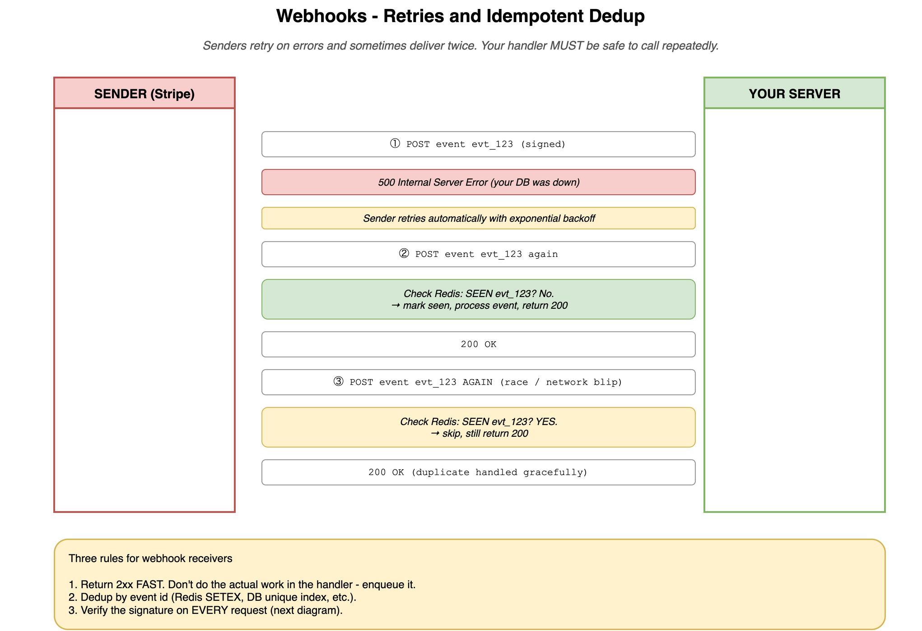
WEBHOOK
Retries and idempotent dedup
Same event id arriving twice is normal. Be ready.
datasense · Real-Time Patterns Workshop
29

Slide 30
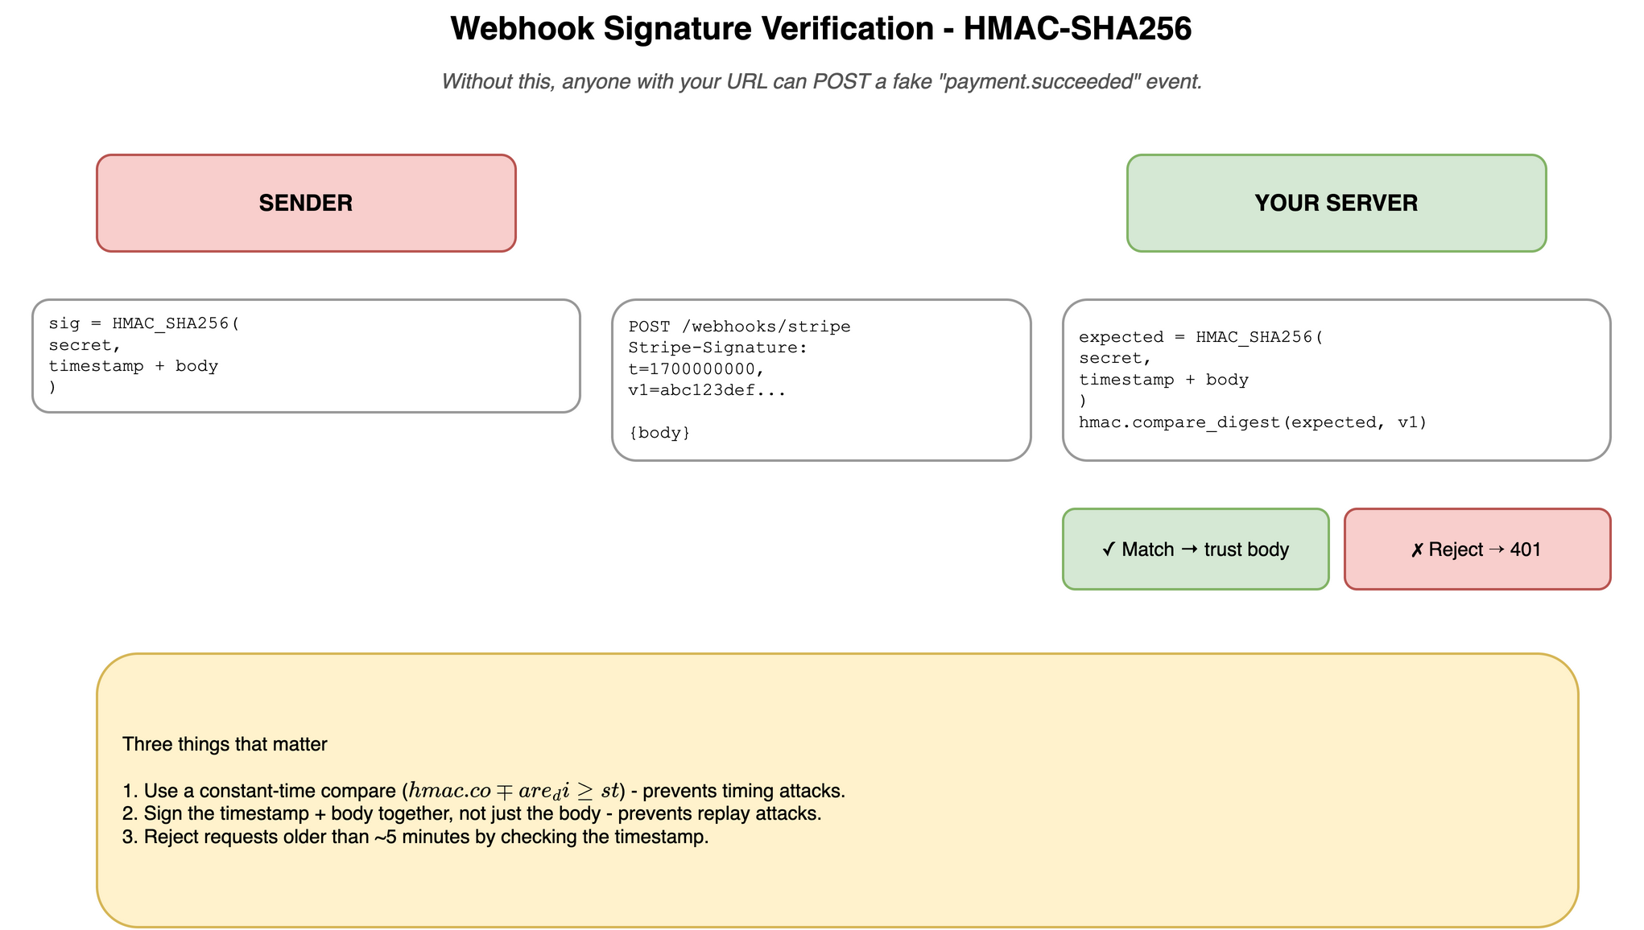
WEBHOOK
Signature verification - HMAC-SHA256
The one thing standing between your webhook URL and fake events.
datasense · Real-Time Patterns Workshop
30

Slide 31
WEBHOOK
A production-shape Stripe receiver (FastAPI, 22 lines)
Verify, dedup, enqueue, return 200. Everything else happens in a worker.
import hmac, hashlib, json, os
from fastapi import FastAPI, Request, HTTPException
app = FastAPI()
SECRET = os.environ["STRIPE_WEBHOOK_SECRET"]
seen = set() # in prod: Redis SET with TTL
def verify(body: bytes, header: str) -> bool:
parts = dict(p.split("=", 1) for p in header.split(","))
signed = f"{parts['t']}.{body.decode()}".encode()
expect = hmac.new(SECRET.encode(), signed, hashlib.sha256).hexdigest()
return hmac.compare_digest(expect, parts["v1"]) # constant-time!
@app.post("/webhooks/stripe")
async def stripe_webhook(req: Request):
body = await req.body() # RAW bytes, not parsed JSON
if not verify(body, req.headers.get("stripe-signature", "")):
raise HTTPException(401, "bad signature")
event = json.loads(body)
if event["id"] in seen: # dedup BEFORE enqueue
return {"received": True, "duplicate": True}
seen.add(event["id"])
await queue.put(event) # the real work happens elsewhere
return {"received": True}
datasense · Real-Time Patterns Workshop
31

Slide 32
WEBHOOK
Testing webhooks locally
Stripe can't reach localhost:8000. Here's how to bridge.
webhook.site
look only
Visit https://webhook.site, get a unique URL, paste into Stripe. Sees every request in a dashboard. Can't run YOUR code against it but great for inspecting payloads.
ngrok / Cloudflare Tunnel / Tailscale Funnel
tunnel
ngrok http 8000 -> public URL forwarding to localhost. Combined with the ngrok web inspector (localhost:4040) you can see + replay every request.
Stripe CLI (or provider equivalent)
real events, no tunnel
stripe listen --forward-to localhost:8000/webhooks/stripe. Forwards real test webhook events from your Stripe account straight to localhost. Handles signature setup.
datasense · Real-Time Patterns Workshop
32

Slide 33
WEBHOOK
If you're the SENDER (offering webhooks to customers)
The other side of the table. Same rules, mirrored.
• Make registration first-class. UI + API to register URLs, multiple URLs per account, filter by event type.
• Sign every payload. Per-customer signing secret. Document the algorithm and rotation flow.
• Include a timestamp in the signed payload (defeats replay attacks).
• Retry with backoff. Standard schedule: 1m, 5m, 15m, 1h, 6h, 12h. Give up after ~24h, mark endpoint disabled.
• Provide a 'Send test event' button in the dashboard - your customers will use it constantly.
• Maintain a delivery log: last 100 deliveries, status codes, response times, response bodies. Invaluable for support.
• Build internal rate limits. A bug that fires 1M duplicate webhooks tonight = 1M customer outages.
datasense · Real-Time Patterns Workshop
33

Slide 34
WEBHOOK
Webhooks in the wild
Once you know to look, you see them everywhere.
Stripe
payments, refunds, disputes, subscriptions
GitHub
pull requests, pushes, issues, deployments - powers every CI system
Slack Events API
messages, channel events, reactions - how every chat bot works
Twilio
incoming SMS / call events / delivery status
Calendly / Cal.com
meeting booked, cancelled, rescheduled
Shopify
orders, inventory updates, abandoned carts
Auth0 / Clerk / Supabase Auth
user signed up, password changed, MFA enabled
OpenAI Batch API
when a batch job finishes (newer services do this)
Your own service
any time customers ask 'can you POST when X happens?'
datasense · Real-Time Patterns Workshop
34

Slide 35
SECTION
Server-Sent Events
datasense · Real-Time Patterns Workshop
35

Slide 36
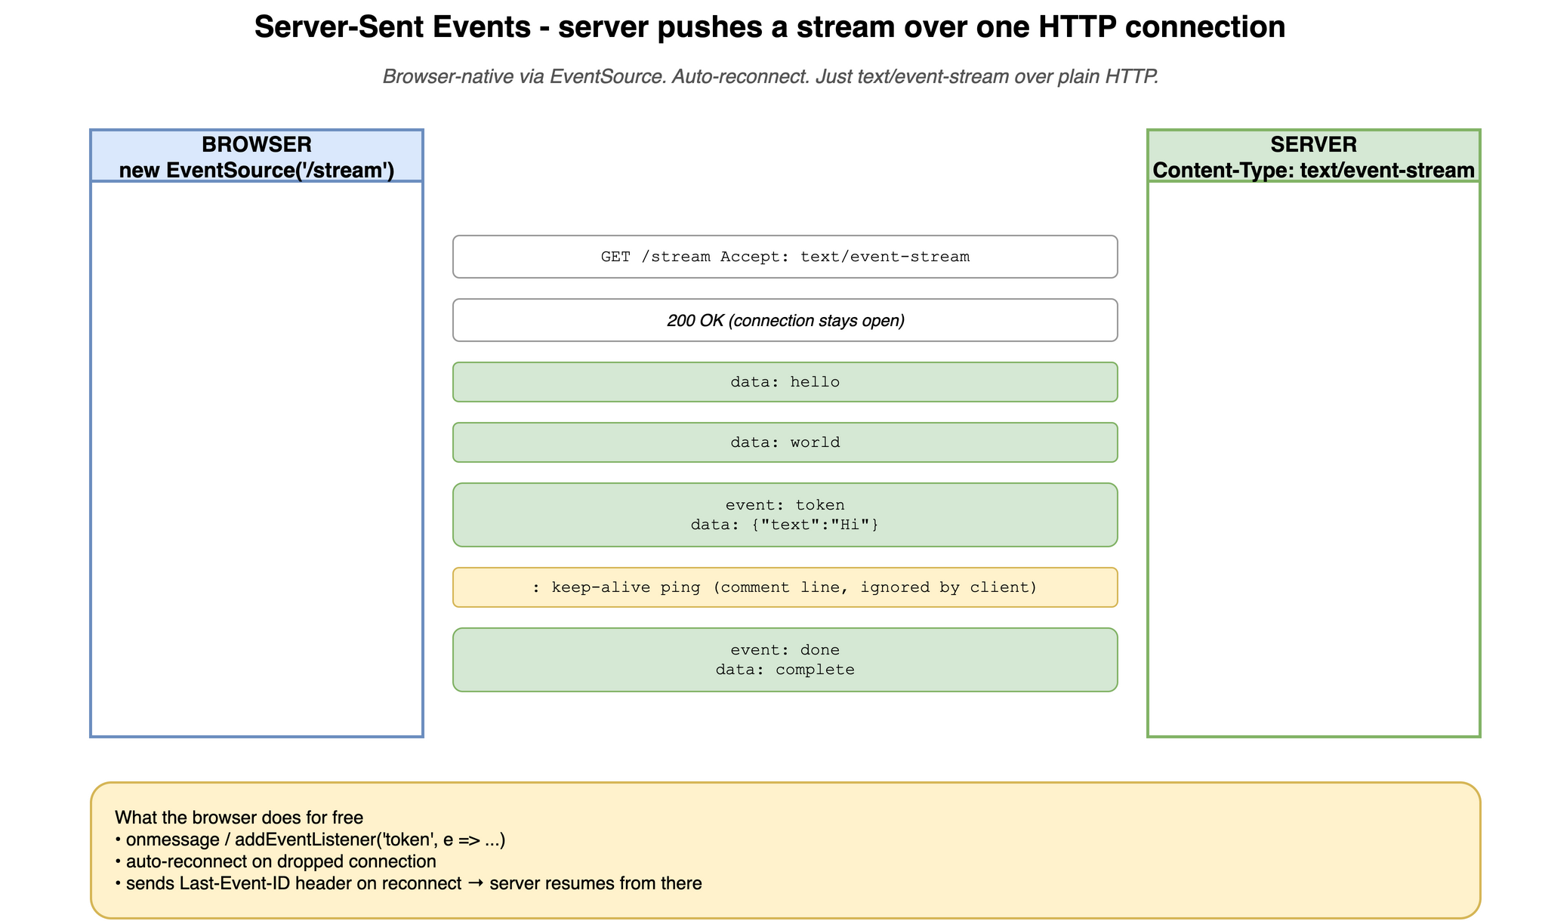
SSE
CONCEPT
SSE - the wire format
One HTTP connection. Server streams labelled events; client reads as they arrive.
datasense · Real-Time Patterns Workshop
36

Slide 37
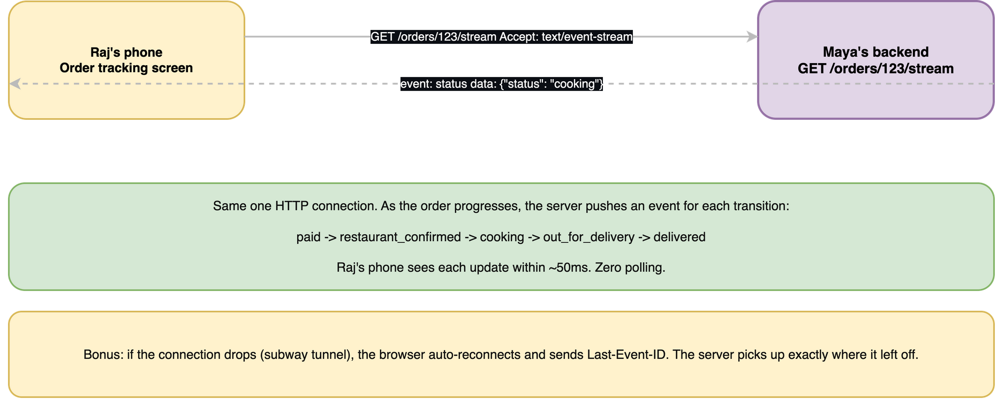
SSE
EXAMPLE
Raj watching his order status live
Server pushes 'paid -> cooking -> out for delivery -> delivered' as events. Zero polling.
datasense · Real-Time Patterns Workshop
37

Slide 38
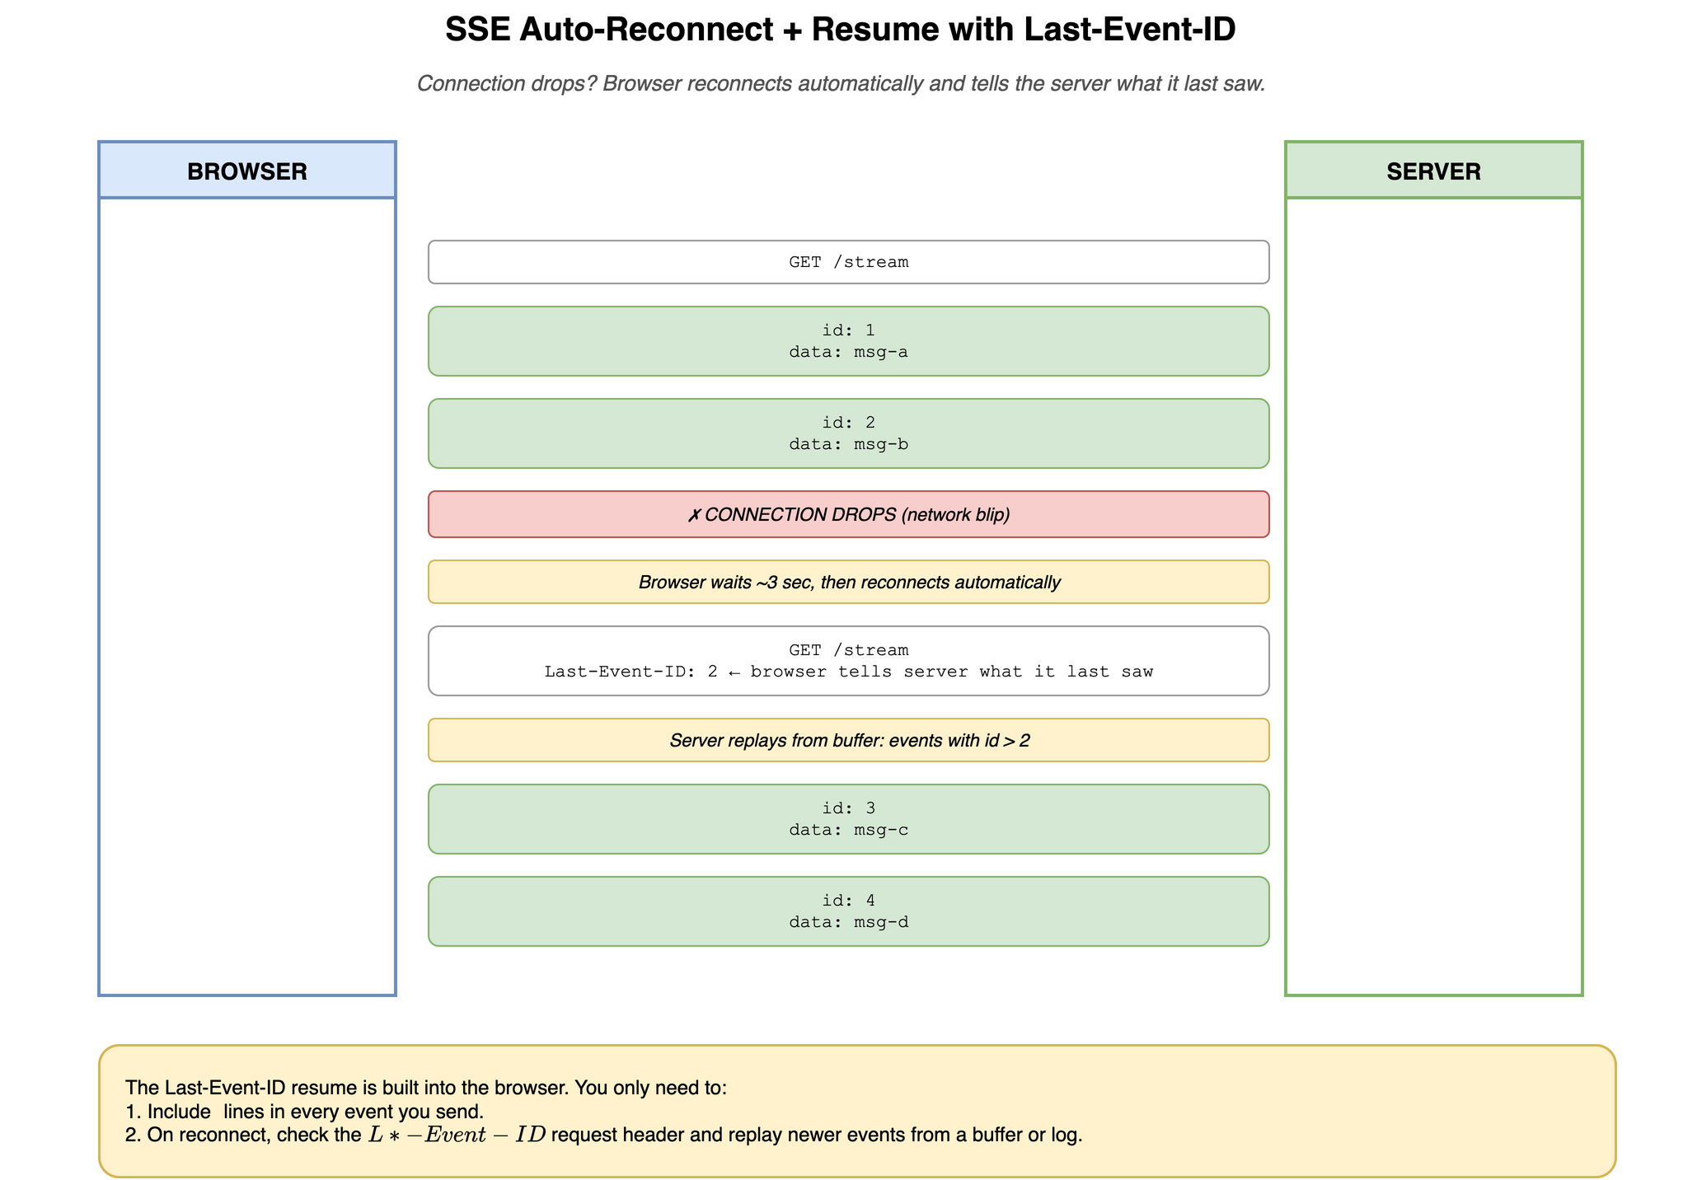
SSE
CONCEPT
Auto-reconnect with Last-Event-ID
Connection drops? Browser reconnects and tells the server what it last saw. Server resumes.
datasense · Real-Time Patterns Workshop
38

Slide 39
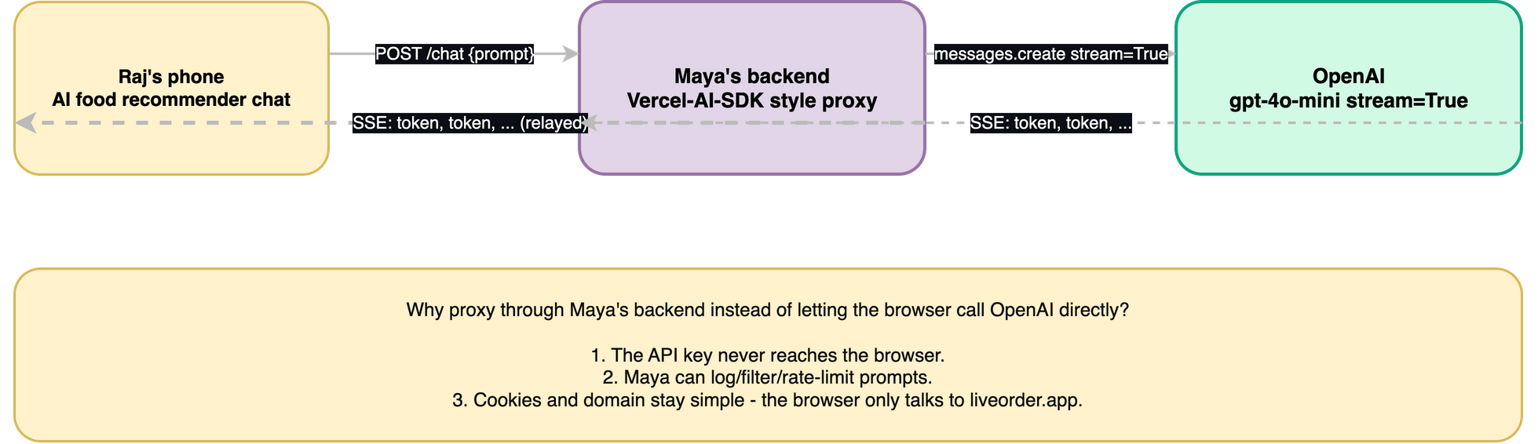
SSE
EXAMPLE
Streaming an LLM response (the ChatGPT pattern)
Backend proxies OpenAI's SSE stream as SSE to the browser. Same wire format both sides.
datasense · Real-Time Patterns Workshop
39

Slide 40
SSE
The SSE grammar - all of it
Five fields plus a blank line. That's the protocol in full.
event: <event-type> optional, default 'message'. JS addEventListener key.
id: <event-id> optional. Browser remembers; sends as Last-Event-ID on reconnect.
retry: <ms> optional. Tells browser the reconnect delay.
data: <line of payload> can repeat; multiple data: lines join with '\n'.
:<comment> ignored by client. Use to send keep-alive pings.
<- BLANK LINE ends this event
Examples
--------
data: hello # simplest possible event
event: token # named event with JSON payload
data: {"text": "Vada"}
id: 42 # with id - enables Last-Event-ID resume
event: chunk
data: {"text": " Pav"}
: keep-alive ping # comment - keeps proxies from closing
datasense · Real-Time Patterns Workshop
40

Slide 41
SSE
EventSource - the browser's SSE client
Three handlers, one close. The browser does parsing, reconnecting, Last-Event-ID.
const es = new EventSource('/api/stream');
es.onmessage = (e) => console.log('default event:', e.data);
es.addEventListener('token', (e) => { // NAMED event
const { text } = JSON.parse(e.data);
appendToken(text);
});
es.onopen = () => console.log('connected');
es.onerror = () => console.log('error or reconnecting');
es.close(); // otherwise it auto-reconnects forever
FREE from EventSource
NOT included
· Auto-reconnect on dropped connection
· Custom headers (no Authorization: Bearer ...)
· Last-Event-ID sent on reconnect
· Binary frames (text only)
· Built into every modern browser
· Way to send data back (use fetch POST)
datasense · Real-Time Patterns Workshop
41

Slide 42
SSE
Minimal SSE endpoint (FastAPI)
A generator yields events. StreamingResponse pipes them out.
from fastapi import FastAPI
from fastapi.responses import StreamingResponse
import asyncio
app = FastAPI()
@app.get("/stream")
async def stream():
async def gen():
for i in range(10):
yield f"data: chunk {i}\n\n" # double-\n ends each event
await asyncio.sleep(1)
yield "event: done\ndata: complete\n\n"
return StreamingResponse(gen(), media_type="text/event-stream", headers={
"Cache-Control": "no-cache, no-transform",
"X-Accel-Buffering": "no", # disable nginx buffering
})
datasense · Real-Time Patterns Workshop
42

Slide 43
SSE
Three MUSTs and three SHOULDs for an SSE server
Get these right and your SSE endpoint behaves the same in dev and prod.
MUST
SHOULD
Set Content-Type: text/event-stream
Send keep-alives
How the browser knows to keep the connection open and parse the body as events.
Every 15-30s send ': ping\n\n'. Stops proxies/LB from dropping the idle line.
End every event with \n\n
Cache-Control: no-cache, no-transform
Blank line tells the client 'this event is complete'. Forget it and the client waits forever.
Stops any layer from caching the response.
Disable proxy buffering
Don't gzip the stream
X-Accel-Buffering: no for nginx; check LB docs for others. Without this, your stream batches at the proxy.
Compression buffers bytes to compress efficiently. Defeats streaming.
datasense · Real-Time Patterns Workshop
43

Slide 44
SSE
Maya picks SSE: who pays what
Same 'track my order' feature. Numbers at 10K concurrent customers.
METRIC
POLLING (every 3s)
SSE
Latency
0-3 seconds (poll gap)
near zero (push)
Idle requests
10K every 3s = 3,300/sec
0 - heartbeat ping every 20s
Server CPU
high - lots of work to say nothing
low
Memory
tiny - stateless
~1 GB at 10K (50-100 KB / open conn)
User experience
feels laggy on status changes
instant
10K open connections is the SSE sweet spot. Past 100K, plan for a pub-sub backbone.
datasense · Real-Time Patterns Workshop
44

Slide 45
SSE
SSE gotchas every team hits
All recoverable. Knowing them up front saves the all-nighter.
All events arrive at once at the end
A proxy or middleware is buffering. nginx: 'proxy_buffering off' or header 'X-Accel-Buffering: no'. Disable gzip on event-stream endpoints.
Connection dies after 60s of silence
Idle-killer somewhere (LB, proxy, mobile network). Send ': ping\n\n' every 15-20 seconds.
Browser shows 'reconnecting' forever
Server is returning a non-200 status. EventSource keeps retrying but never succeeds. Check server logs and CORS headers.
Authorization header doesn't work
EventSource doesn't allow custom headers. Use cookies (best), short-lived URL token, or the event-source-polyfill library.
Sometimes I get duplicate events after reconnect
Server replay is using >= instead of > the Last-Event-ID. Use strict greater-than.
Closing the tab leaves connection open server-side
Normal - server only finds out at next heartbeat write. Clean up subscribers in your generator's 'finally' block.
datasense · Real-Time Patterns Workshop
45

Slide 46
SSE
You've used SSE thousands of times
Anywhere you've watched text appear word-by-word in 2023+.
• ChatGPT, Claude.ai, Gemini chat - the typing animation IS SSE
• Cursor, GitHub Copilot Chat, Continue.dev - same pattern
• OpenAI / Anthropic / Mistral SDKs with stream=True - SSE clients
• Vercel AI SDK useChat hook - SSE client + parser
• Vercel / Render / Netlify deploy logs streaming in browser - SSE
• MCP servers (Claude Desktop tools) - HTTP+SSE / Streamable HTTP transport
• LangSmith and LangFuse trace viewers - SSE
datasense · Real-Time Patterns Workshop
46

Slide 47
SECTION
WebSockets
datasense · Real-Time Patterns Workshop
47

Slide 48
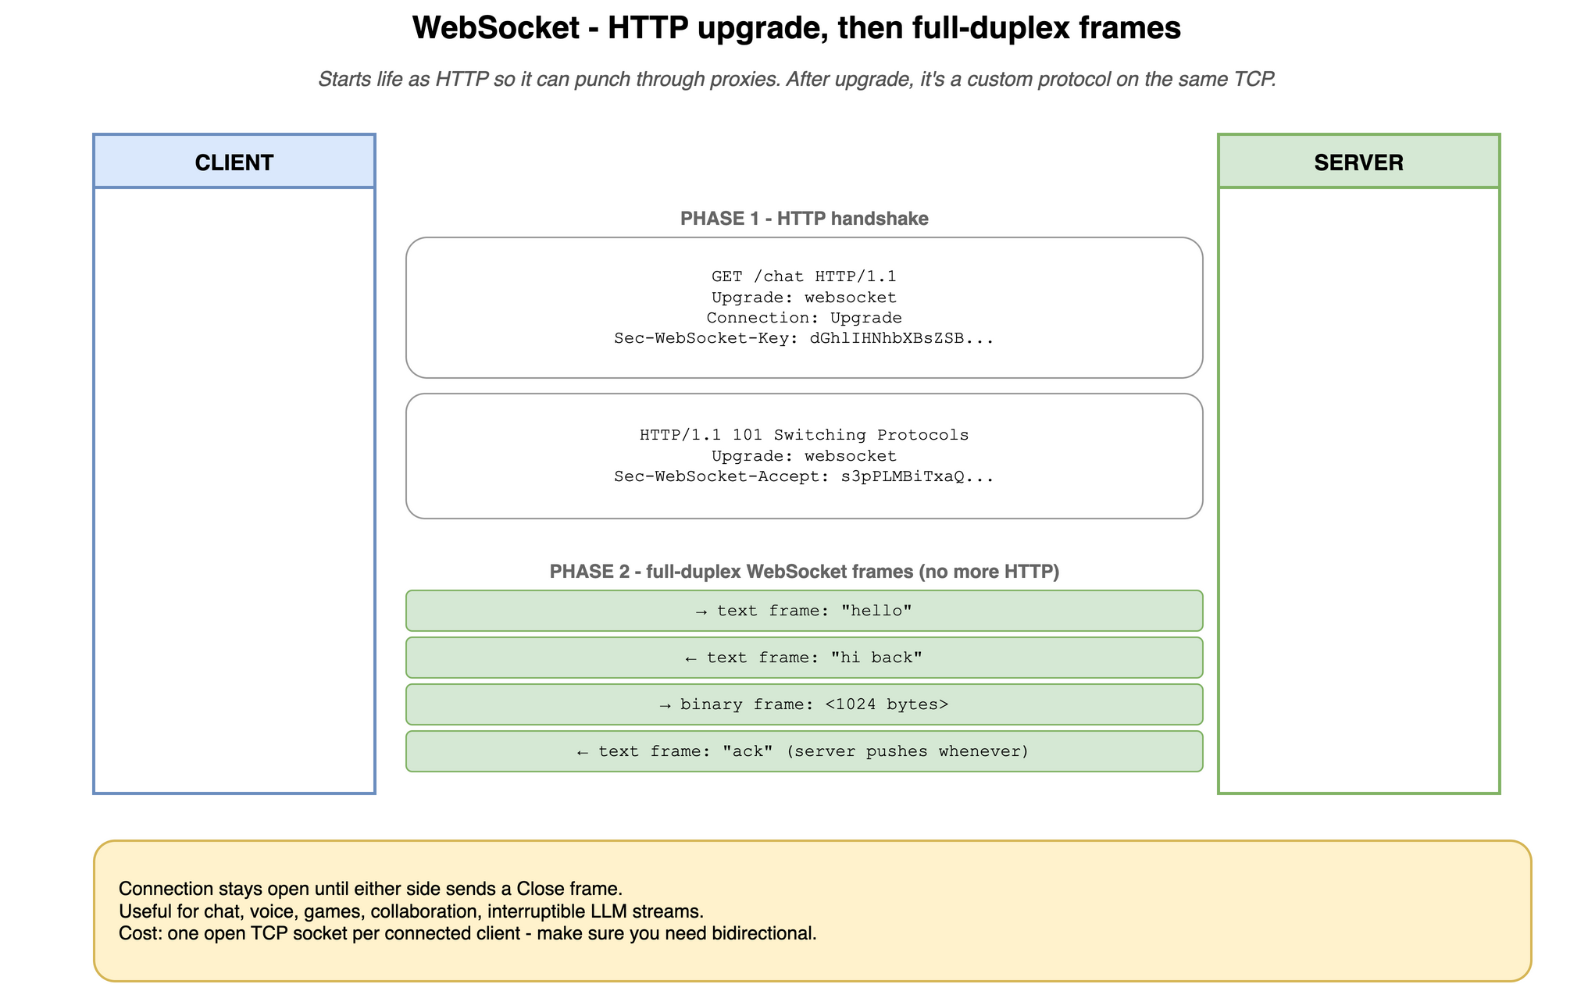
WEBSOCKET
CONCEPT
WebSocket - the handshake
Starts as HTTP. Upgrades to a custom frame protocol on the same TCP. Both sides talk freely.
datasense · Real-Time Patterns Workshop
48

Slide 49
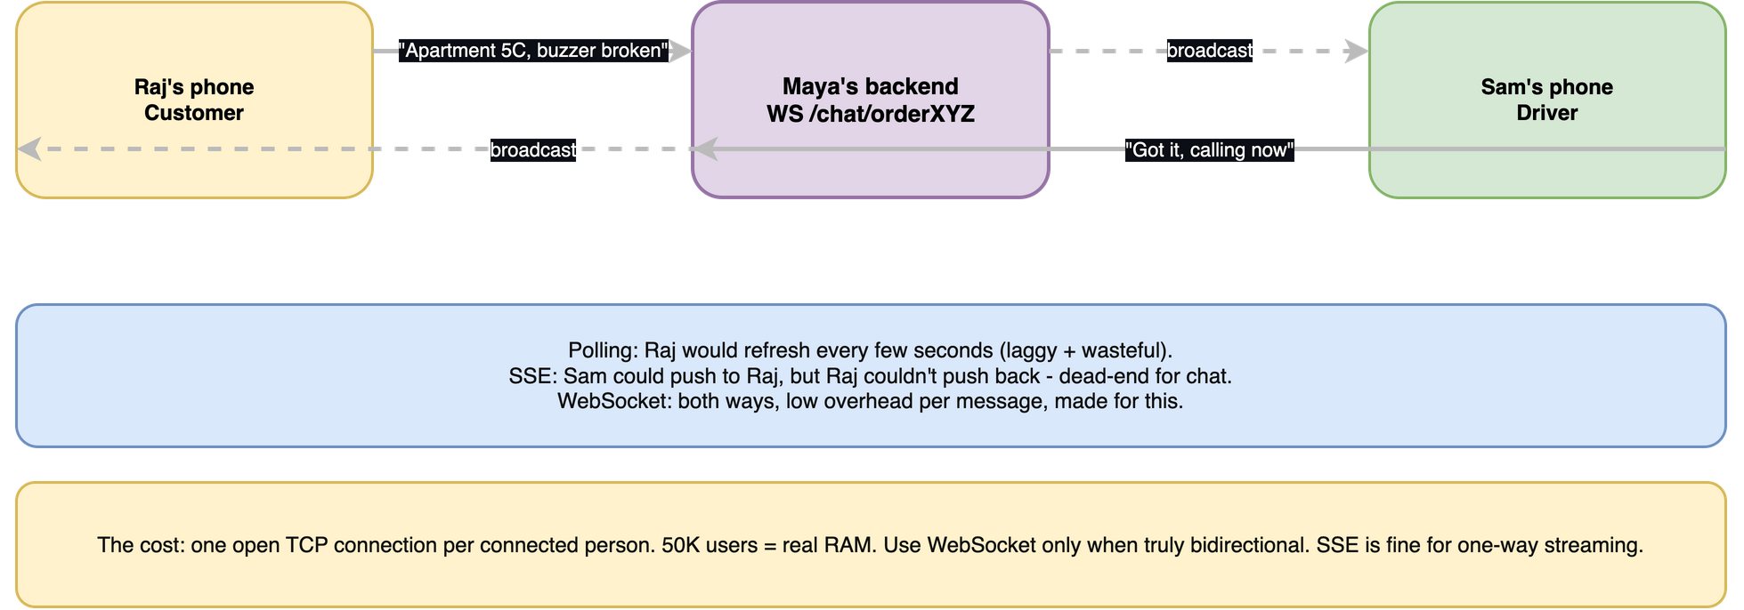
WEBSOCKET
EXAMPLE
Raj and Sam chat about the buzzer
Both can send anytime. Typing indicators are free. One TCP connection per chat.
datasense · Real-Time Patterns Workshop
49

Slide 50
WEBSOCKET
The handshake on the wire
Starts as HTTP. After 101 Switching Protocols, HTTP is gone - frames take over.
Client REQUEST
Server RESPONSE
GET /chat HTTP/1.1
Host: api.liveorder.app
Upgrade: websocket
Connection: Upgrade
Sec-WebSocket-Key: dGhlIHNhbXBsZSBub25jZQ==
Sec-WebSocket-Version: 13
HTTP/1.1 101 Switching Protocols
Upgrade: websocket
Connection: Upgrade
Sec-WebSocket-Accept: s3pPLMBiTxaQ9kYGzzhZRbK+xOo=
[after this point: WebSocket frames,
no more HTTP messages on this TCP socket]
Why the dance? Ports 80/443 are open everywhere; brand-new protocols on new ports get blocked.
Dress as HTTP, sneak through middleboxes, then upgrade.
datasense · Real-Time Patterns Workshop
50

Slide 51
WEBSOCKET
WebSocket frames - the unit of communication
Five frame types. Libraries handle framing for you, but knowing helps debugging.
Text
UTF-8 string. Most chat apps use these with JSON inside.
Binary
arbitrary bytes. Audio, images, protobuf, msgpack.
Ping
heartbeat. Library usually auto-replies with a Pong.
Pong
reply to a Ping. Used to detect dead-but-not-yet-closed connections.
Close
graceful shutdown with status code (1000 normal, 1006 abnormal, 1011 server error).
Each frame has: opcode + payload length + (client) mask key + payload bytes. Up to 2^63 bytes per message.
datasense · Real-Time Patterns Workshop
51

Slide 52
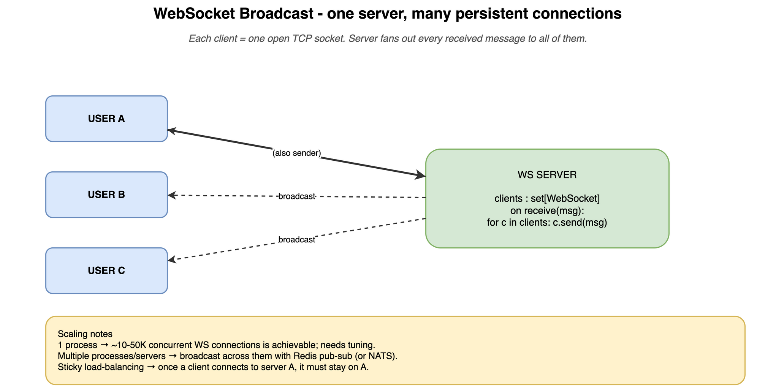
WEBSOCKET
CONCEPT
Broadcast topology
Server tracks connected clients and fans messages out. Across processes, use Redis pub-sub.
datasense · Real-Time Patterns Workshop
52

Slide 53
WEBSOCKET
The chat-protocol convention - type + envelope
Most production WS apps use a tiny JSON envelope with a 'type' field both sides agree on.
CLIENT -> SERVER
SERVER -> CLIENT
{ "type": "join", "order_id": 123 }
{ "type": "msg", "text": "I'm in 5C, buzzer broken" }
{ "type": "typing", "is_typing": true }
{ "type": "ping" } # heartbeat
{ "type": "history", "messages": [...] } # on join
{ "type": "msg", "from": "raj", "text": "...", "ts": 1700000000 }
{ "type": "typing", "from": "raj", "is_typing": true }
{ "type": "presence", "user": "sam", "online": true }
{ "type": "pong" } # heartbeat reply
Receiver dispatches on type. Same shape powers Slack, Discord, Linear, Figma comments, etc.
datasense · Real-Time Patterns Workshop
53

Slide 54
WEBSOCKET
You WILL write ReconnectingWS
Unlike EventSource, the WebSocket API gives you nothing for free. Here's the minimum.
class ReconnectingWS {
constructor(url) {
this.url = url;
this.backoff = 1000; // start at 1s
this.maxBackoff = 30000;
this.connect();
}
connect() {
this.ws = new WebSocket(this.url);
this.ws.onopen = () => { this.backoff = 1000; this.onopen?.(); }; // reset on success
this.ws.onmessage = (e) => this.onmessage?.(e);
this.ws.onclose = () => {
setTimeout(() => this.connect(), this.backoff + Math.random() * 500); // + JITTER
this.backoff = Math.min(this.backoff * 2, this.maxBackoff); // exponential
};
this.ws.onerror = () => this.ws.close(); // trigger onclose path
}
send(msg) {
if (this.ws.readyState === WebSocket.OPEN) this.ws.send(msg);
else this.queue.push(msg); // optional: buffer until reconnect
}
}
datasense · Real-Time Patterns Workshop
54

Slide 55
WEBSOCKET
Past 1 process: pub-sub or nothing reaches across servers
Sam connects to server-A; Raj to server-B. How does Raj's message reach Sam?
Sam's phone
WS server A
Redis pub-sub
WS server B
Raj
1. Raj's message arrives at server B (Raj's chat WS lives there)
2. Server B publishes to Redis channel chat:order:123
3. Server A is subscribed - it receives the published message
4. Server A forwards it down Sam's open WS -> Sam sees the message
datasense · Real-Time Patterns Workshop
55

Slide 56
WEBSOCKET
WebSocket scaling - what changes at each tier
Each level adds infrastructure. Know which one you're at.
Up to ~100
Anything works
One process. Default config. Pick by ergonomics.
100 - 10K
Tune the basics
Async I/O required. ulimit -n 65535. Heartbeat every 20s. LB idle timeout to 5 min.
10K - 100K
Pub-sub backbone
Multiple processes/instances. Redis or NATS pub-sub for cross-server broadcasts. Sticky LB sessions. Connection metrics.
100K - 1M
Specialised tools
Phoenix Channels (Elixir), Centrifugo, Ably, Pusher, PartyKit. Kernel tuning. Separate WS gateway tier from app servers. Edge delivery (Cloudflare/Fastly).
Over 1M
Specialised team
You're past blog-post territory. Hire someone who's done it before. This is a full ops surface.
datasense · Real-Time Patterns Workshop
56

Slide 57
WEBSOCKET
WebSocket bugs you'll hit, and how to ship around them
Most production WS pain comes from these.
No reconnect logic on the client
Network blips silently kill your client forever. Always write a reconnecting wrapper with exponential backoff + jitter.
No heartbeat
Half-open TCP (network died but TCP doesn't know) looks alive until you write. Send {type:'ping'} every 20-30s; force reconnect if no pong.
Server is sync (Flask sync, Django pre-Channels)
Exhausts worker pool at ~50 connections. WS needs async (asyncio/uvicorn, Node, Go) - period.
Custom auth via browser headers
Browser WebSocket API does NOT allow custom headers. Use cookies, a subprotocol-as-token, or a short-lived URL token (ws://...?ticket=xxx).
No backpressure handling
Slow client + fast server = OOM. Bound your send queues; close clients that fall behind.
Works on dev (one server) breaks on prod (LB + multiple servers)
Sticky sessions on LB; pub-sub backbone (Redis) so broadcasts cross processes; check LB actually supports Upgrade header.
datasense · Real-Time Patterns Workshop
57

Slide 58
WEBSOCKET
SSE vs WebSocket - when each one wins
Default to SSE. WebSocket only when you NEED bidirectional.
SSE
WebSocket
Direction
Server -> client only
Both ways
Protocol
Plain HTTP
HTTP upgrade to ws://
Browser API
EventSource (built in)
WebSocket (built in)
Auto-reconnect
Yes, free
No, you write it
Binary support
No (text only)
Yes
Through proxies
Almost always works
Sometimes blocked
Best for
LLM tokens, status, logs
Chat, voice, games, collab
datasense · Real-Time Patterns Workshop
58

Slide 59
SECTION
Decision Matrix
datasense · Real-Time Patterns Workshop
59

Slide 60
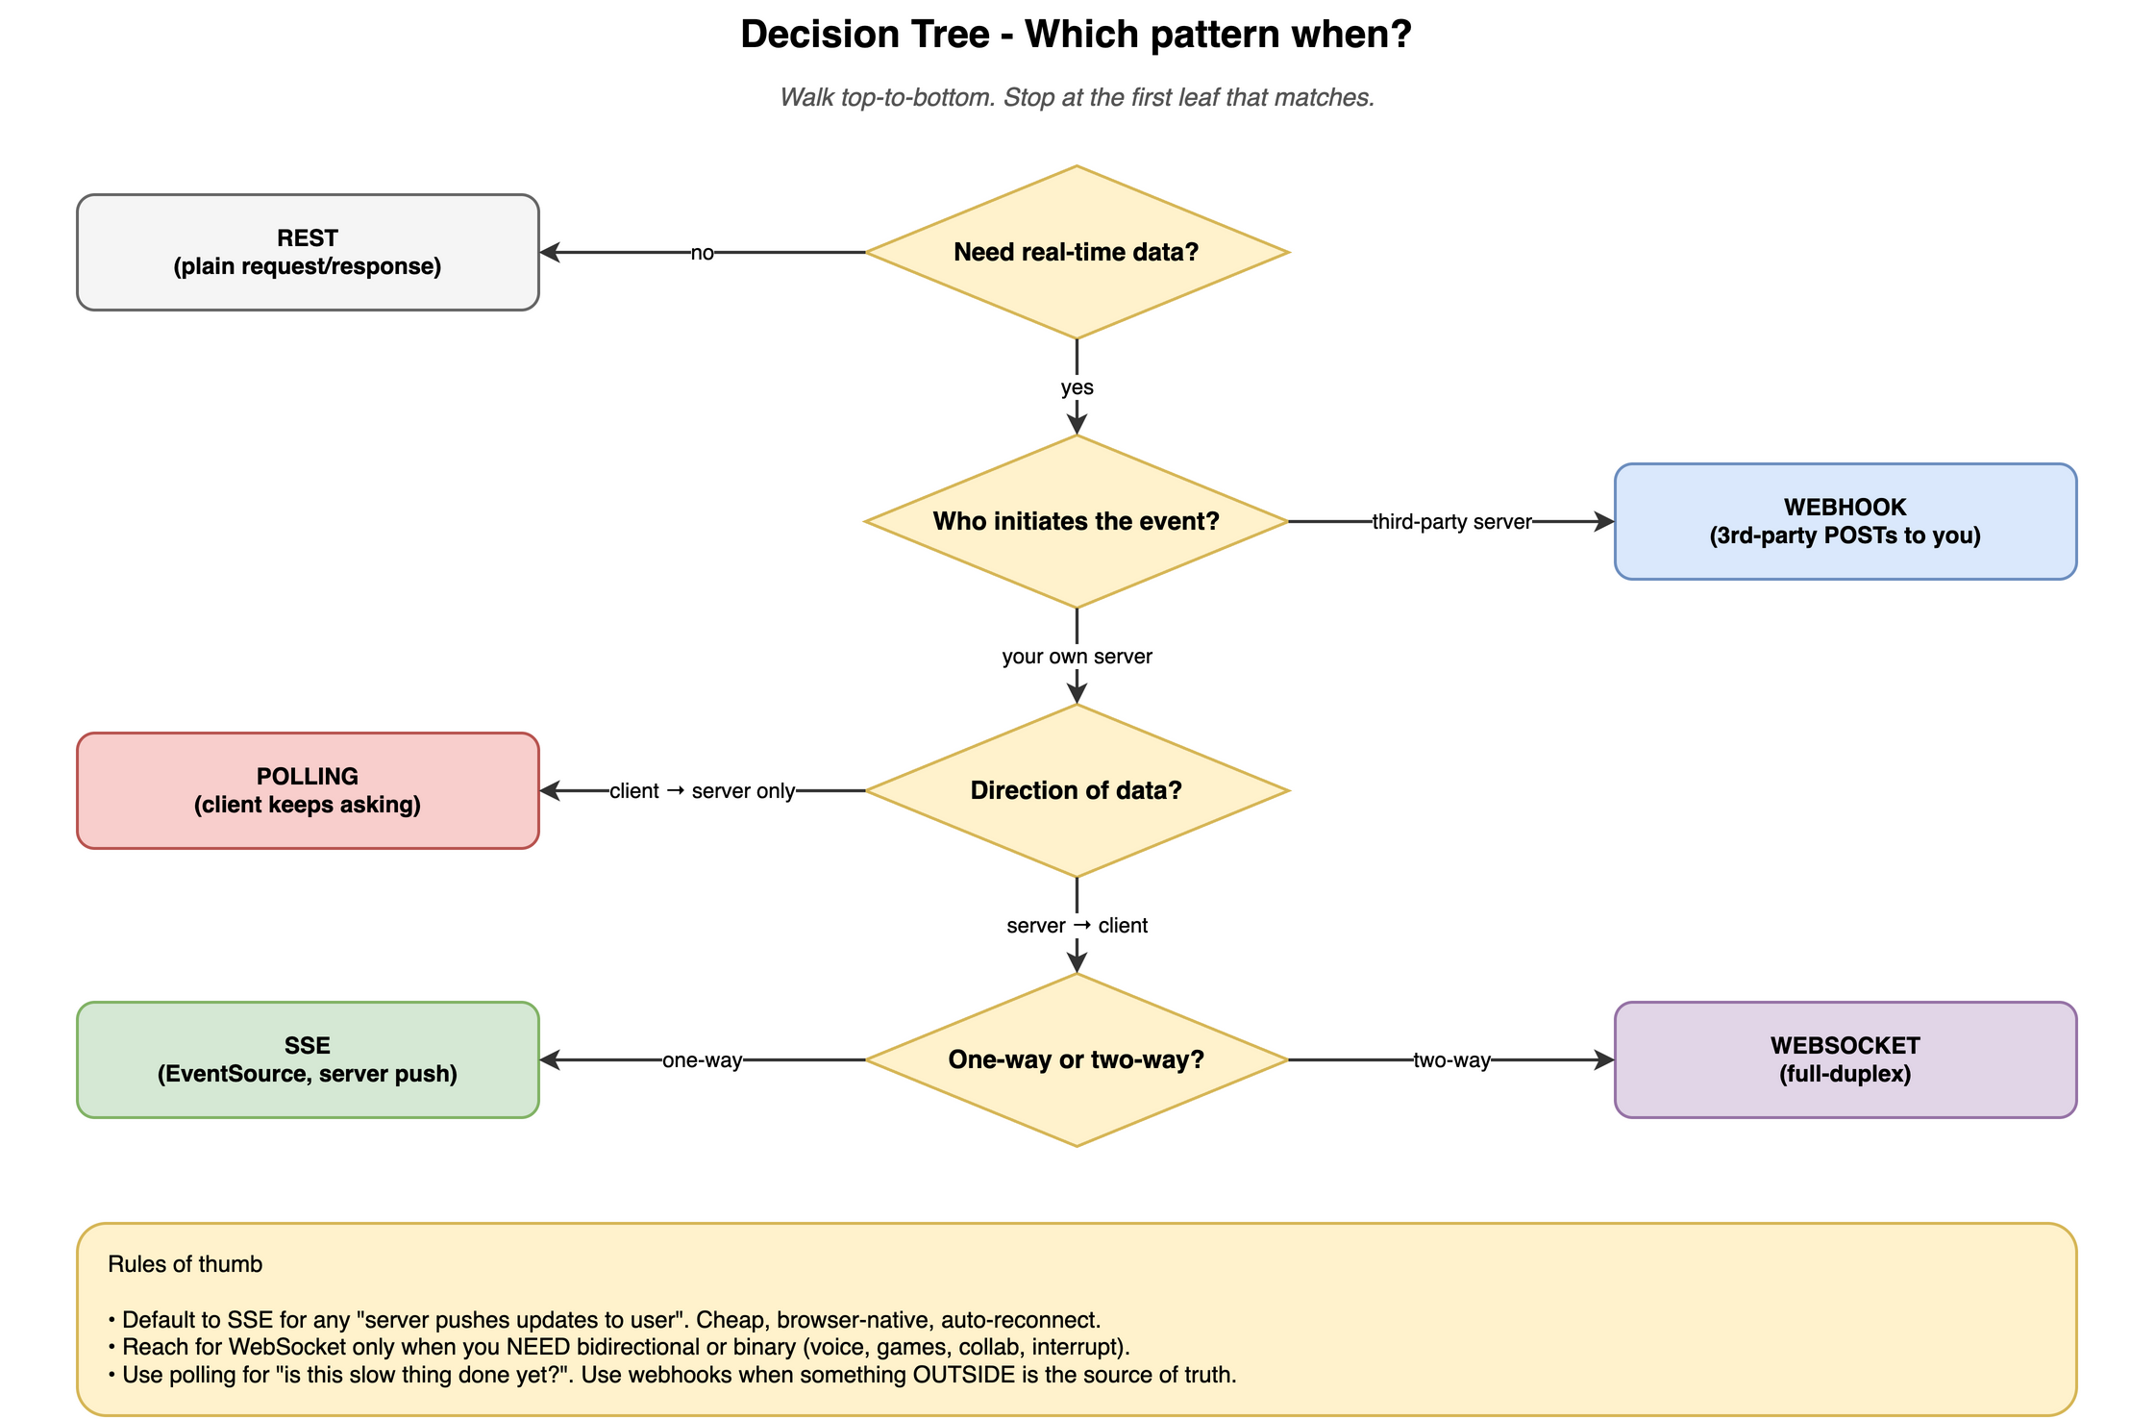
DECIDE
CONCEPT
The decision tree - generic
Walk top to bottom. The first leaf that matches your data flow is the answer.
datasense · Real-Time Patterns Workshop
60

Slide 61
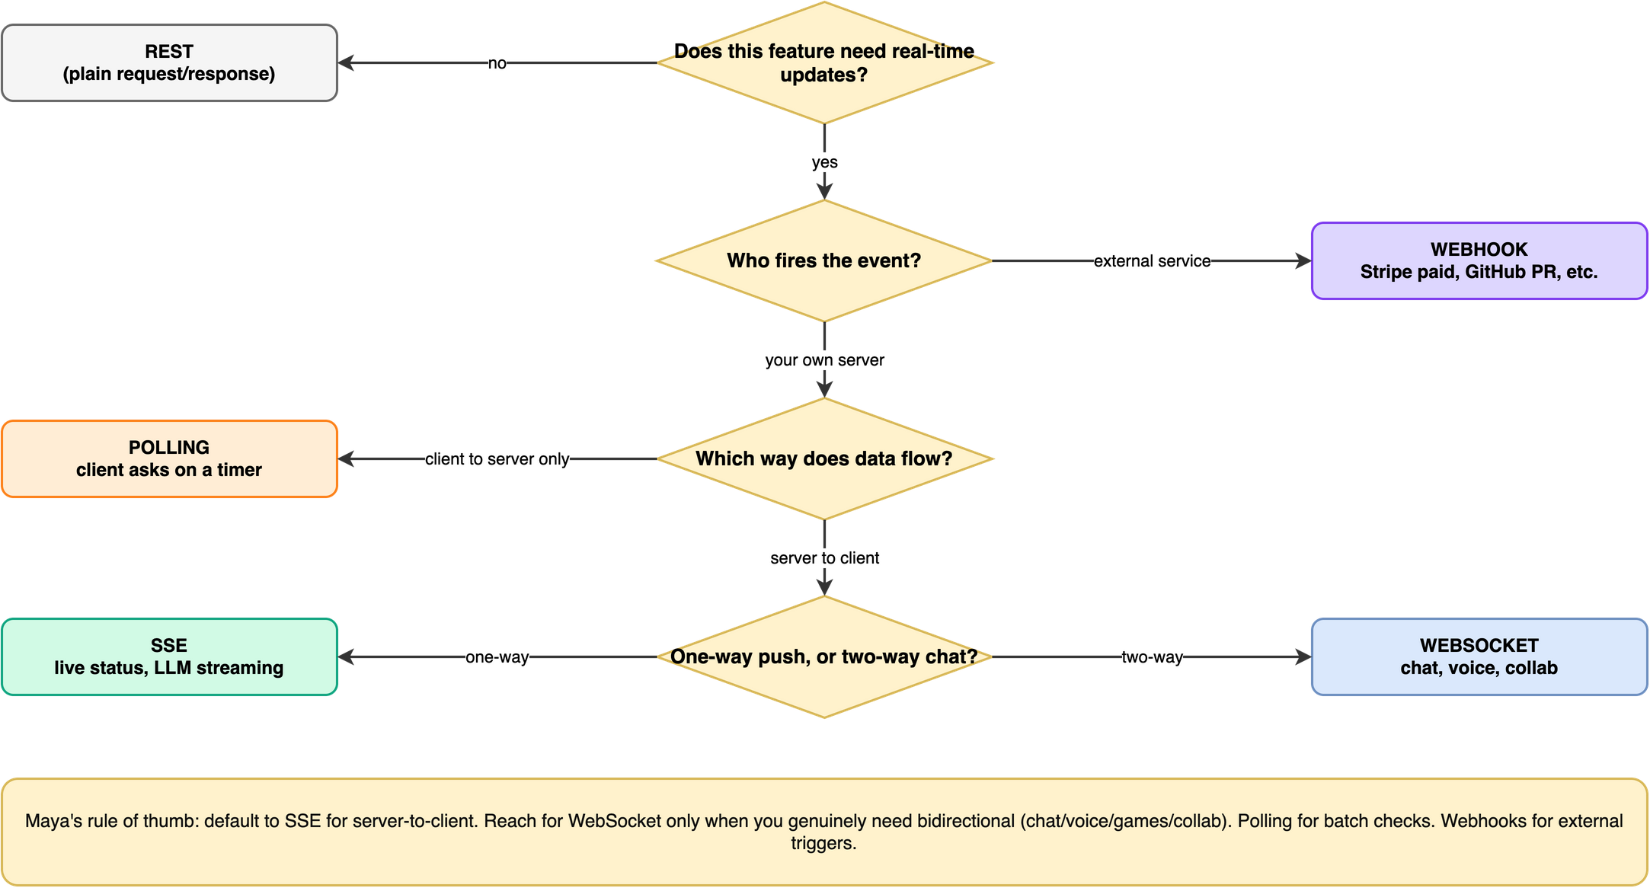
DECIDE
EXAMPLE
Maya picking the pattern for a new feature
Same tree, framed as Maya's design checklist. Same answer, more memorable.
datasense · Real-Time Patterns Workshop
61

Slide 62
DECIDE
Cost ranking - cheapest to most expensive per client
Runtime cost only. Engineering cost roughly tracks it too.
1.
Webhook receiver
Zero idle cost. Server only does work when events fire. Scales for free when nothing's happening.
2.
Short polling
N reqs/min/client. Each is cheap and stateless. Cost grows linearly with clients x rate.
3.
Long polling
One held connection per client, no CPU until data arrives. Memory similar to SSE.
4.
SSE
One held connection per client. Push cost when events fire. Tiny heartbeat overhead.
5.
WebSocket
SSE cost plus framing buffers + send queues + app-level reconnect/heartbeat state + pub-sub fanout.
datasense · Real-Time Patterns Workshop
62

Slide 63
DECIDE
'I'm building X' - 15 quick recipes
Most common AI / web scenarios mapped to the right pattern.
ChatGPT-style typewriter response
SSE
Slack-style team chat
WebSocket
Stripe payment confirmation
Webhook
Vercel-style live deploy logs
SSE
Multiplayer browser game
WebSocket
Voice agent (audio in + audio out)
WebSocket
GitHub PR opened -> trigger CI/agent
Webhook
'Is my batch job done yet?'
Polling
Real-time stock ticker
SSE
Google-Docs-style collaborative editing
WebSocket
MCP server you're building
SSE / Streamable HTTP
Push to a mobile app while it's CLOSED
APNs / FCM (not us)
File upload progress in one HTTP request
fetch streaming (not us)
Internal service-to-service event trigger
Webhook
Figma-style live cursors
WebSocket
datasense · Real-Time Patterns Workshop
63

Slide 64
DECIDE
What changes at scale - by tier
Same patterns. Different infrastructure decisions at each tier.
Up to 100 concurrent
Anything works. Single server. Pick by ergonomics.
100 - 10K
Async I/O. ulimit -n 65535. Heartbeats. LB idle timeout 60-300s. Monitor connection counts.
10K - 100K
Multiple processes. Pub-sub backbone (Redis / NATS / Kafka). Sticky LB sessions. Connection metrics & slow-consumer detection.
100K - 1M
Specialised tools - Phoenix Channels, Centrifugo, Ably, Pusher, PartyKit. Kernel tuning. Separate gateway tier. Edge delivery.
Over 1M
Past blog-post territory. Specialised infrastructure built by teams who think about this all day. Hire someone who's done it.
datasense · Real-Time Patterns Workshop
64

Slide 65
AI SCENARIO
Why AI apps push every pattern decision harder
Three forces that make these choices matter more in AI than in CRUD apps.
1
LLM output is naturally a stream
Static REST feels broken once you've seen ChatGPT type. Batch responses feel laggy even when they're objectively fast.
2
Tools can take seconds to minutes
Agent runs web search (5s), reads 3 docs (15s), summarises (10s), writes report (30s). The user is staring at a screen the whole time.
3
Agents are increasingly triggered by external events
GitHub fires -> agent reviews PR. Stripe fires -> agent processes refund. Slack fires -> agent answers. That's webhooks. Lots of webhooks.
datasense · Real-Time Patterns Workshop
65

Slide 66
AI SCENARIO
AI scenario - the agent kicks off a long task
Research agent takes 3-5 min. Three valid patterns to surface progress.
Polling
POST /jobs returns {id}. UI polls /jobs/{id} every 5s. Spinner -> done toast. Simplest, no progress detail.
SSE for progress
POST /jobs returns {id}. UI opens /jobs/{id}/stream. Server pushes 'searching web', 'reading 3 docs', 'writing'. Best UX - feels fast even when slow.
Webhook callback
When the worker is external (OpenAI Batch, your own remote service). Pass callback_url; remote service POSTs when done. Best for fully async.
Rule of thumb: SSE for progress within seconds. Webhook callback when the wait is hours.
datasense · Real-Time Patterns Workshop
66

Slide 67
AI SCENARIO
AI scenario - external event triggers the agent
Order delivered -> LiveOrder sends a personalised thank-you SMS via an LLM.
Order service
Post-delivery
service
Queue
Agent
(LLM call)
Twilio API
internal webhook -> verify+dedup+enqueue -> worker pulls -> LLM call (1-5s) -> send SMS
Three places people get this wrong:
1. Doing the LLM call inside the webhook handler. LLM takes 1-5s; sender times out at 5-10s; you get retries; you send duplicate SMS.
2. No dedup. Same delivered event processed twice = customer gets 2 SMSes and Twilio bills you twice.
3. No idempotency in the worker. Two workers race the same job. Wrap the LLM+send in a DB transaction that checks 'already sent?'.
datasense · Real-Time Patterns Workshop
67

Slide 68
AI SCENARIO
AI scenario - voice or interruptible streaming
Microphone in, speaker out, mid-stream interrupt. Only WebSocket fits.
ASR
Mic
Backend
TTS
Speaker
LLM
Audio frames flow both ways over one WebSocket · interrupting sends a 'stop' upstream while audio still streams down
SSE one-way (server -> client). Mic input has nowhere to go.
Polling latency is way too high; users would hear stutters.
Webhooks server-to-server only; no path from a user's microphone.
WebSocket binary + bidirectional + low overhead. Used by OpenAI Realtime, ElevenLabs, Vapi, Retell.
datasense · Real-Time Patterns Workshop
68

Slide 69
AI SCENARIO
MCP transports - three flavours, all SSE-shaped at the top
Model Context Protocol = how Claude Desktop / Cursor talk to your tool servers.
stdio
local
Server is a local process. Messages flow over stdin/stdout. Used for filesystem, git, sqlite tools. Not really a network pattern.
HTTP + SSE (older design)
remote, 2 endpoints
Client opens an SSE stream for server-to-client. Client sends via a separate HTTP POST. Two endpoints glued together.
Streamable HTTP (current standard)
remote, 1 endpoint
Single endpoint. The response body is itself an SSE stream. Bidirectional via paired POSTs and SSE responses. Still SSE-shaped underneath.
Why SSE? Tool calls take time. One request, many response events (progress + result). That's exactly SSE's shape.
datasense · Real-Time Patterns Workshop
69

Slide 70
SECTION
All Four, Together
datasense · Real-Time Patterns Workshop
70

Slide 71
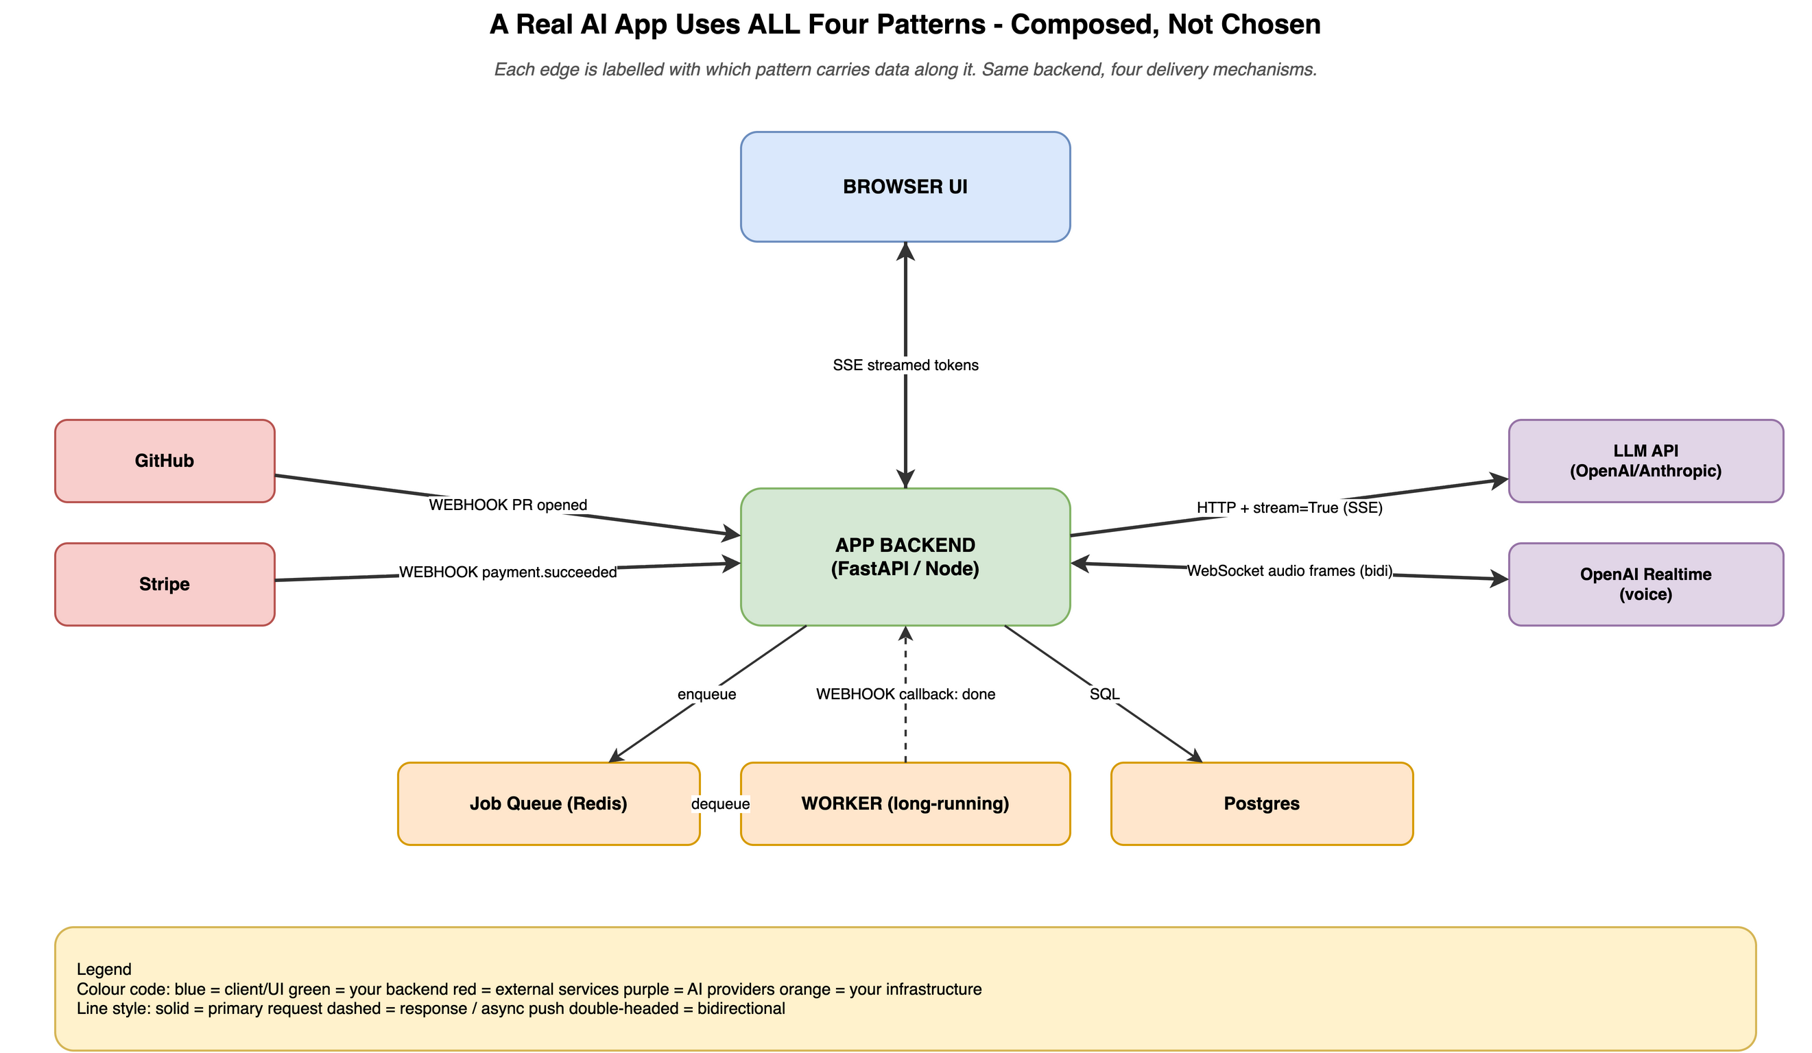
COMPOSE
CONCEPT
A real AI app uses all four
Generic architecture. Each edge labelled with which pattern carries it.
datasense · Real-Time Patterns Workshop
71

Slide 72
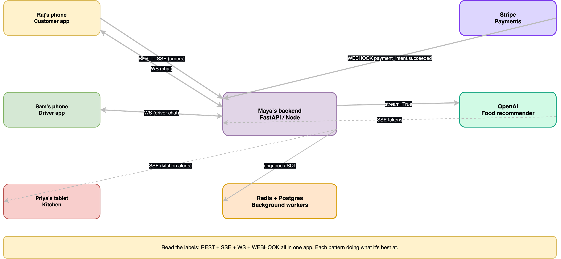
COMPOSE
EXAMPLE
LiveOrder - all 4 in Raj's order journey
Same composition, our personas. This is Project 3 in the repo.
datasense · Real-Time Patterns Workshop
72

Slide 73
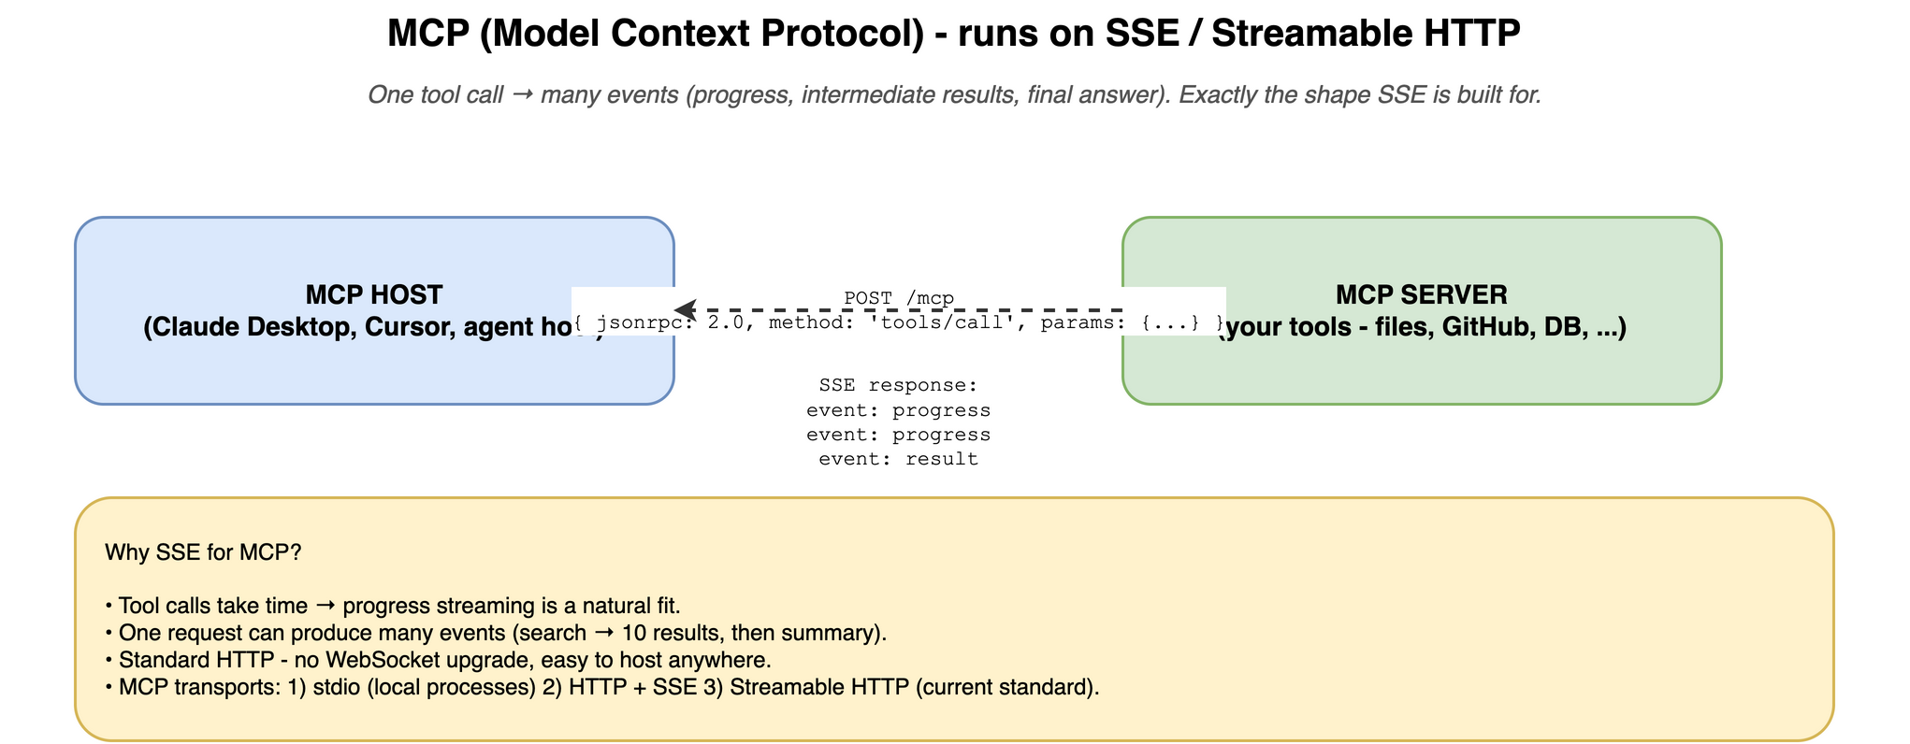
COMPOSE
CONCEPT
MCP - the transport
Claude calls tools over HTTP+SSE / Streamable HTTP. One request -> many progress events.
datasense · Real-Time Patterns Workshop
73

Slide 74
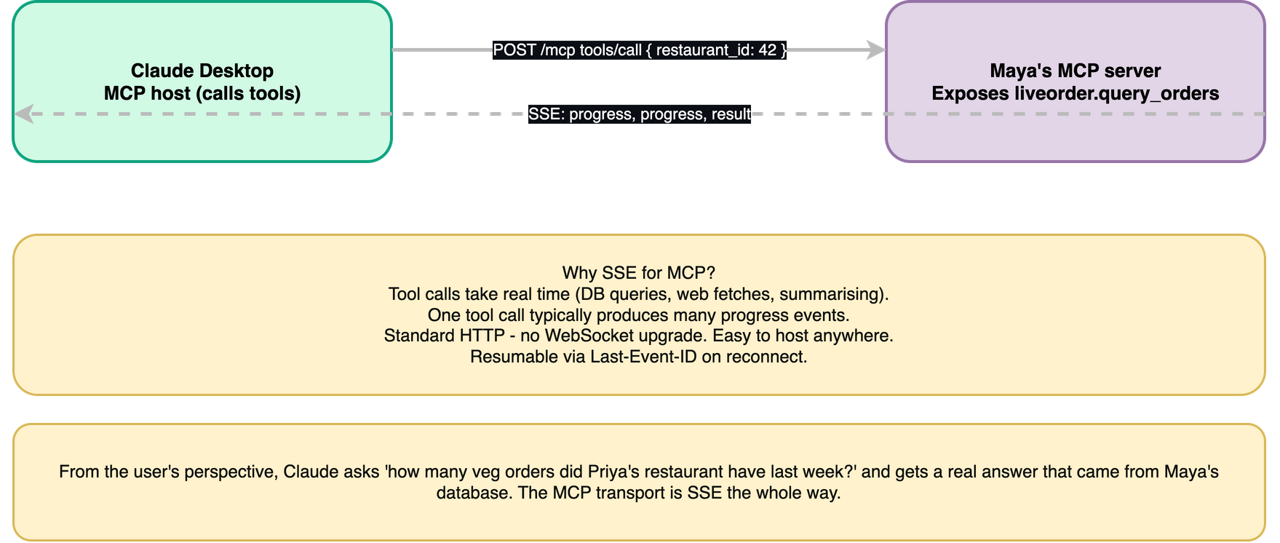
COMPOSE
EXAMPLE
Maya exposing LiveOrder data to Claude
Maya's MCP server lets Claude query LiveOrder. The transport is SSE you've already learned.
datasense · Real-Time Patterns Workshop
74

Slide 75
AI SCENARIO
Five questions to ask when building an AI feature
Walk through these in order. The answers pick the pattern for you.
1.
Where does the trigger come from?
User action -> REST / SSE / WS · External event -> WEBHOOK · Time-based -> cron
2.
Is the output stream-friendly?
Token text -> SSE · Binary audio / video -> WEBSOCKET · Single result <1s -> REST
3.
Can the user interrupt mid-response?
Yes -> WEBSOCKET (need a client->server signal mid-stream) · No -> SSE is enough
4.
How long does the work take?
<2s REST · 2-30s SSE for progress · 30s-min: job + SSE + webhook on done · Hours: webhook callback only
5.
How many concurrent users?
<100 anything · 100-10K SSE sweet spot · >10K pub-sub backbone, consider managed WS
datasense · Real-Time Patterns Workshop
75

Slide 76
SECTION
Workshop Kit
datasense · Real-Time Patterns Workshop
76

Slide 77
Three projects to fork
Each runs locally. Each compares or composes patterns differently.
Project 1
Streaming Chat - 3 ways
Same LLM chat exposed via polling, SSE, and WebSocket side-by-side. Feel the UX difference.
Project 2
Webhook Dashboard
Stripe-style webhook intake (HMAC, dedup, fast 200) + receiving-side polling vs SSE comparison.
Project 3
LiveOrder Capstone
All 4 patterns in one mini-app: order tracking (SSE), driver chat (WS), payment (webhook), revenue report (polling), AI recommender (SSE/LLM).
datasense · Real-Time Patterns Workshop
77

Slide 78
Lab folders + Postman collection
Read the code, run it, click Send, see the wire.
• examples/01..07 - one tiny self-contained folder per topic with server.py + client.py
• examples/qa.sh - runs every example end-to-end (49 assertions, all green)
• postman/ - 53 requests in 9 folders, with pre-request scripts for HMAC + JWT
• diagrams/ - 14 technical + 10 persona scenario diagrams, all generated from Python builders
• concepts/ - 8 deep-dive markdown docs (~2900 lines) as the workbook companion
• TEACHING.md - the live-class playbook with talking points per slide
datasense · Real-Time Patterns Workshop
78

Slide 79
Get the kit
Clone, run the QA, fork the project that fits what you're building.
github.com/fnusatvik07/real-time-events
git clone https://github.com/fnusatvik07/real-time-events
cd real-time-events
python -m venv .venv && source .venv/bin/activate
uv pip install fastapi 'uvicorn[standard]' httpx websockets python-dotenv openai
cd examples && bash qa.sh # 49 checks, ~2 minutes
datasense · Real-Time Patterns Workshop
79

Slide 80
What to remember
Print this on a sticky note.
POLLING
WEBHOOKS
SSE
WEBSOCKETS
Slow checks, rare events.
OK to be a few seconds late.
External trigger.
Sign + dedup + return 200 fast.
Server -> client streaming.
Default for live UI.
Both ways or binary only.
Reach last.
Default SSE. WebSocket only when bidirectional. Polling for slow. Webhooks for external.
datasense · Real-Time Patterns Workshop
80

Slide 81
Questions?
Bring your own use case. We'll map it to a pattern.
github.com/fnusatvik07/real-time-events
datasense · Real-Time Patterns Workshop
81

