Slide 1
CSE440: Natural Language Processing II
Dr. Farig Sadeque
Associate Professor
Department of Computer Science and Engineering
BRAC University

Slide 2
Lecture 4: Word Representations

Slide 3
Outline
Co-occurrence (SLP 6)
TF-IDF (SLP 6)
Embeddings (SLP 6 and lecture)

Slide 4
Intro
Computers do not understand semantics
Representation of text needs to include some sort of semantic information

Slide 5
Representation
Sentence-level representation problems
Co-occurrence
TF-IDF
Embeddings

Slide 6
Problems with BoW
Too sparse
What’s wrong with sparsity?
Completely ignores word order
Almost no semantic information preserved
But, works pretty well!

Slide 7
More problem with sentence-level representation
Dogs chew snacks
Canines eat treats

Slide 8
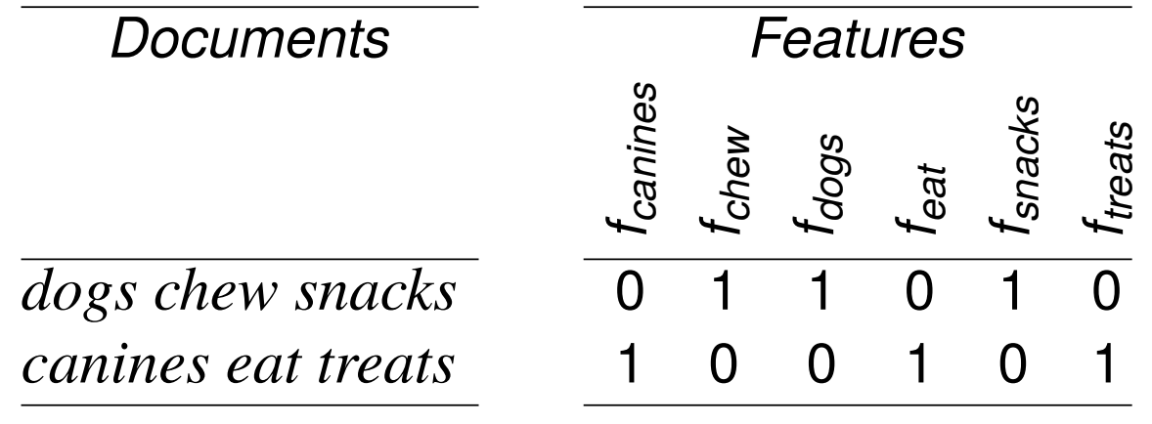
More problem with sentence-level representation
Dogs chew snacks
Canines eat treats
No feature overlap whatsoever. If we try to calculate similarity, they are 100% dissimilar. But are they?
Solution: instead of creating sentence level representations, let’s go to smaller units i.e. words

Slide 9
A smarter sentence representation: TF-IDF
TF-IDF: Term Frequency - Inverse Document Frequency
Intuition: An informative term should:
Occurs many times in some specific contexts (TF)
Does not occur in every context (IDF)
Examples:
high TF vector is informative; it’s frequent in these slides
high DF the is uninformative; it’s frequent everywhere

Slide 10
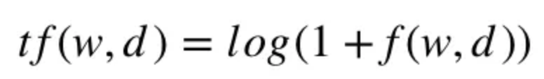
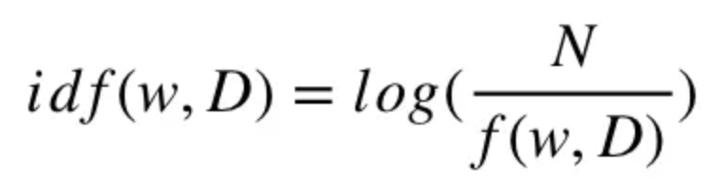
TF-IDF
w is a word, d is a document, D is the corpus, N = |D|
Intuitions:
frequent in a single context is good
avoid infinities
appearing in every document is bad
score of 100 (vs. 1) is not 100 times more relevant

Slide 11
Perfect word representations
shared lemmas: mouse/mice, dormir/duermes, etc.
different word senses: computer mouse vs. pet mouse, river bank vs. financial bank, etc.
synonyms: couch/sofa, car/automobile, etc.
antonyms: long/short, dark/light, etc.
word similarity: dog/cat, doctor/nurse, etc.
word relatedness: cup/coffee, scalpel/surgeon, etc.
word valence: excited and relaxed are high valence, depressed and angry are low valence
word arousal: excited and angry are high arousal, relaxed and depressed are low arousal

Slide 12
Neighboring words hint at semantics
Imagine you didn’t know what ignite meant:
. . . fusion fire does not ignite till temperatures . . .
. . . plumes of flame ignite from the smokestacks . . .
. . . over low heat. Ignite with a match …
But you had seen another word in similar contexts:
. . . the way the fire is lit or the heat source . . .
... flame couldn’t have lit a cigarette . . .
. . . kiln-dried logs that lit with a match ...
Intuition: if two words are semantically similar, they will appear in text with similar surrounding words

Slide 13
Term-term matrix
A term-term co-occurrence matrix X is a |V|x|V| matrix where:
|V| is the number of words in the vocabulary
each cell X_{i,j} records how often word j occurred in the context of word i
each row X_{i} is the vector representation for word i
Context may be defined in different ways:
The same document
The same sentence
Within ±n words of each other
V is typically the 10,000 - 50,000 most frequent words)
Each word is represented by a large vector

Slide 14
Easy way to build a term-term matrix
Build a binary BoW for the sentences
Transpose it
Multiply it with the original matrix
Voila
Try it: docs = ["any big cat", "big cat", "cat dog cat"]

Slide 15
Comparing word vectors
How do you know the vectors you built make any sense?
You need to compare these vectors
What techniques do we have?

Slide 16
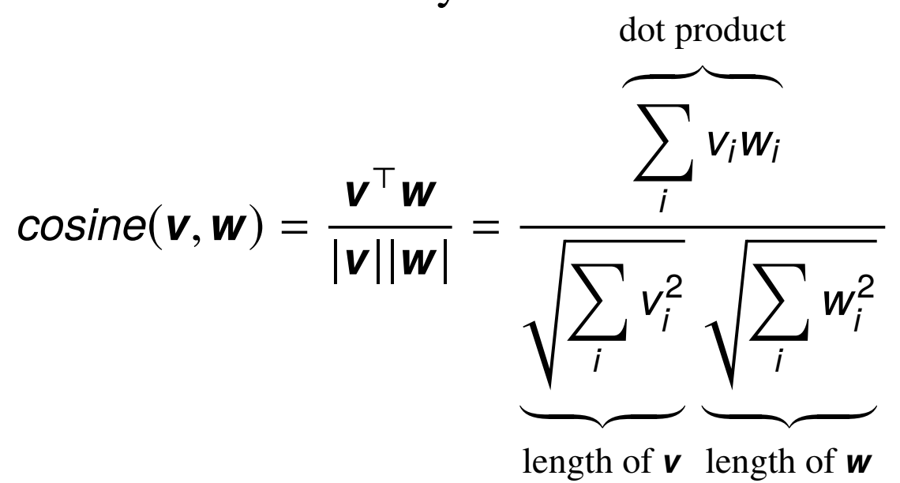
Cosine similarity
Most common similarity measure

Slide 17
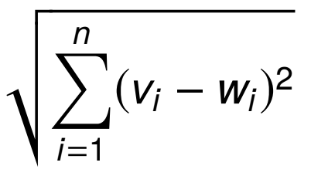
Cosine similarity: Why?
Range is between 1 and -1
Why not Euclidean distance?
Let’s try this for this three vectors: u = [0, 1, 0, 1] v = [1, 0, 1, 0] w = [3, 0, 3, 0]
What is the cosine similarity? What is the Euclidean distance? Which one makes more sense?

Slide 18
What’s wrong with term term matrix?
Sparse. Very sparse.
Does not carry any contextual information
Does not represent how important a word is in a sentence

Slide 19
Using word vectors
For word tasks:
finding synonyms via cosine
as classifier features when the input is one word
For sentence/document tasks:
First, combine all word vectors
You can combine yourself (using centroid technique): usually needed for classical ML models; or
You can let an RNN handle things
These vectors can then be used for classification

Slide 20
Sparse vs. dense vectors
Vectors we studied are very sparse
Advantages of small, dense word vectors:
fewer feature weights to learn in machine learning
fewer features can reduce overfitting
forces sharing; there are not enough dimensions for
each word to be completely independent

Slide 21


Word embeddings
Rather than count co-occurrence, let’s try to predict it
We can do it in two ways
Predict the target word given the neighboring words: CBOW
Predict the neighboring words given the target word: Skip-gram
CBOW is easy, but…
We will focus on Skip-gram

Slide 22
Skip-gram embeddings
Input: a word, taken from some text
Output: the 5 preceding and 5 following words
Try it!
Input: hippopotamus
Output: [?, ?, ?, ?, ?, hippopotamus, ?, ?, ?, ?, ?]

Slide 23
Skip-gram embeddings
Input: a word, taken from some text
Output: the 5 preceding and 5 following words
Try it!
Input: hippopotamus
Output: [?, ?, ?, ?, ?, hippopotamus, ?, ?, ?, ?, ?]
This task is impossible! But that’s okay because
Creating training data is easy
We’ll only use word vectors learned as part of training

Slide 24
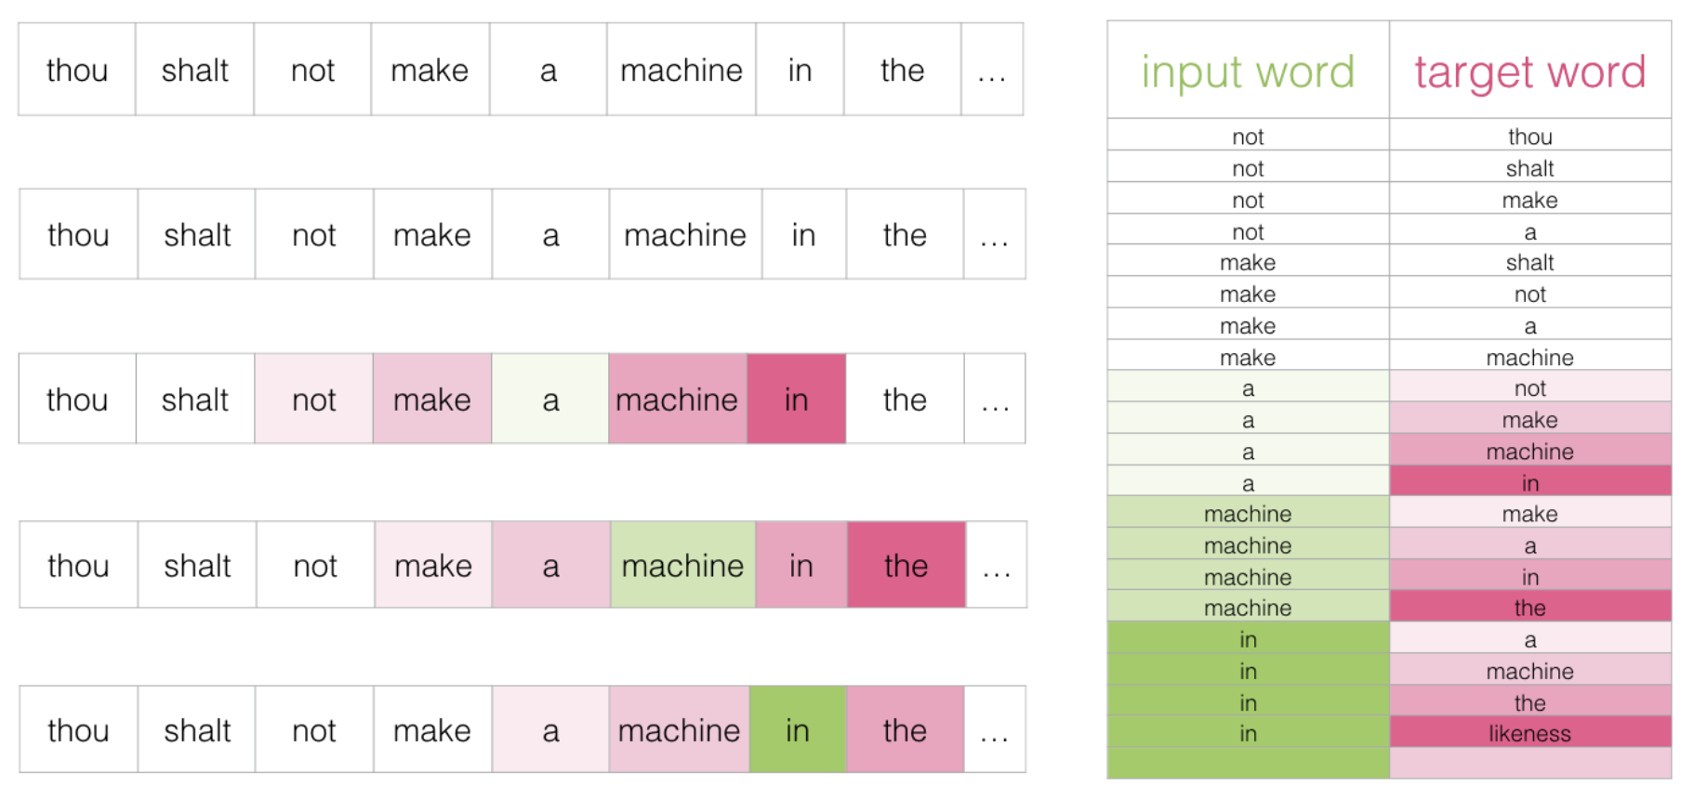
Creating Training Data is Easy

Slide 25
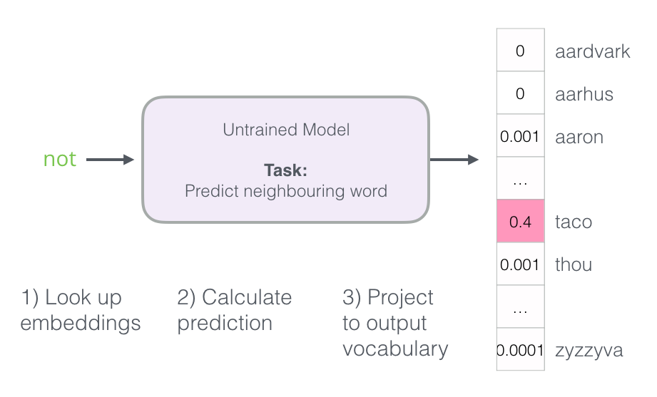
Training an embedding model

Slide 26
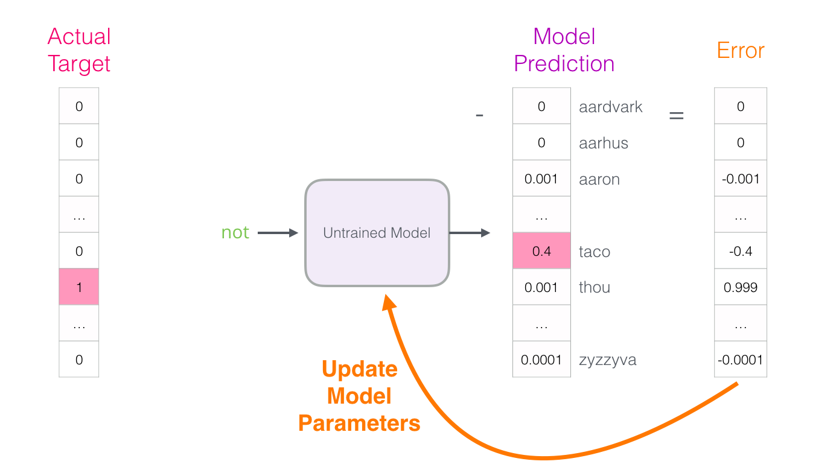
Training an embedding model

Slide 27
Problem with this model
Step 3 is very expensive as we have to project the output into the entire vocabulary space
Especially, we have to do it for every single step

Slide 28
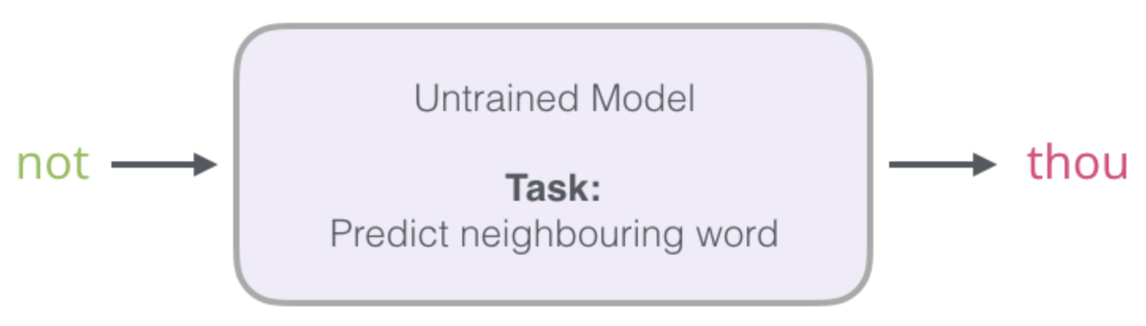
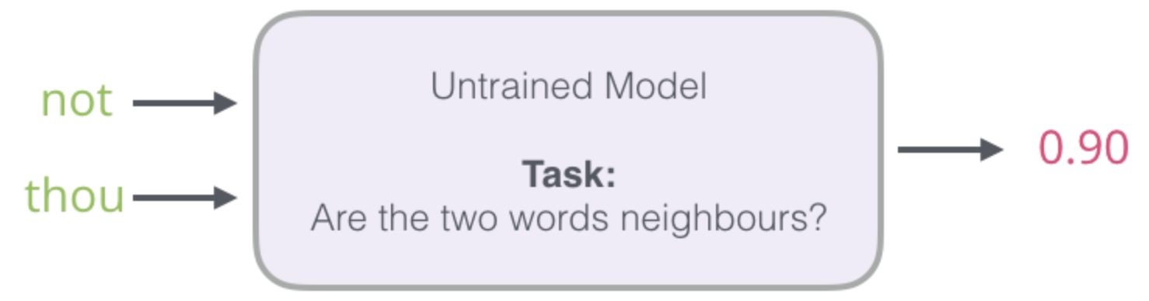
Let’s switch the task: Mikolov’s entry
This converts a complex neural learning task into a simple log-linear binary classification task

Slide 29
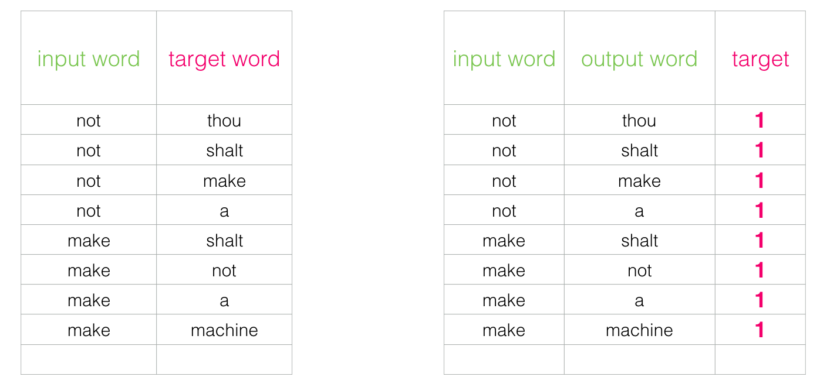
Converting the data for this task

Slide 30
Converting the data for this task
All one’s is no good for learning

Slide 31
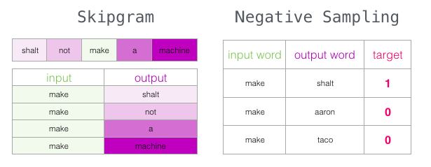
Negative sampling

Slide 32
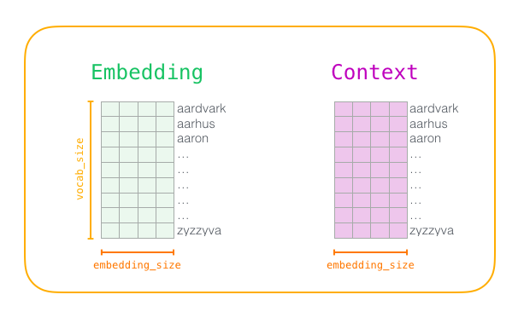
Word2vec Training
we determine the size of our vocabulary
create two matrices – an Embedding matrix and a Context matrix
Initialize these matrices with random values

Slide 33
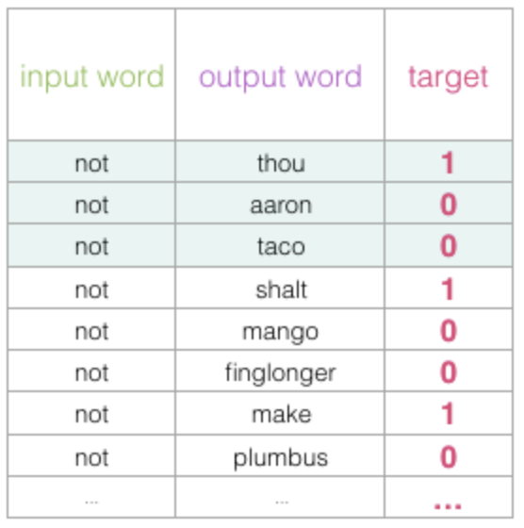
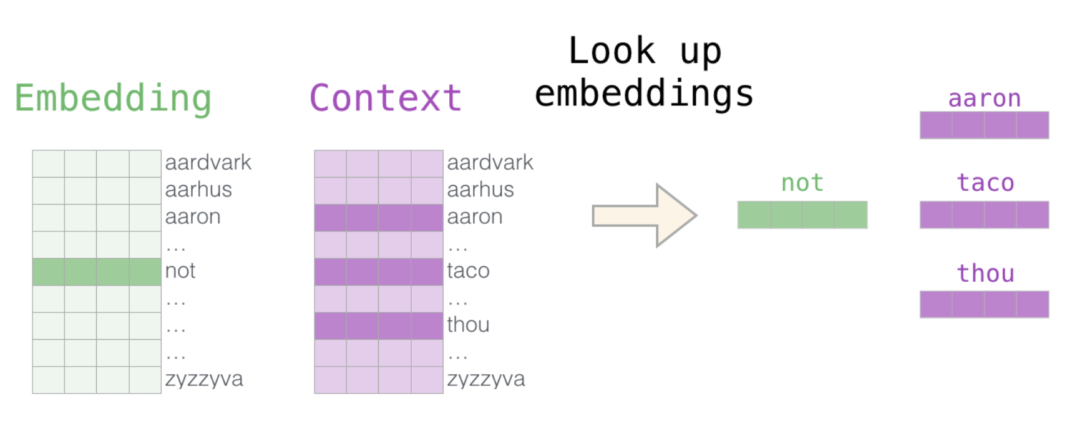
Word2vec Training

Slide 34
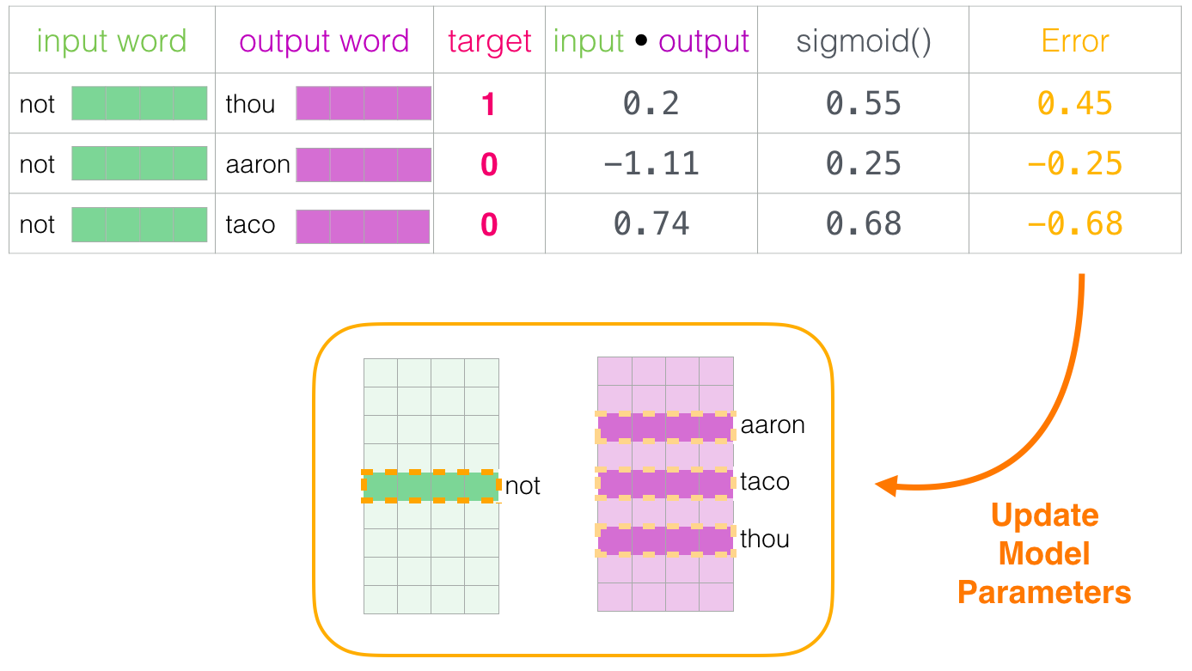
Word2vec Training

Slide 35
Using embeddings
It’s rarely necessary to train skip-gram or GloVe directly.
Download pre-trained word embeddings:
Skip-gram https://code.google.com/archive/p/word2vec/
GloVe https://nlp.stanford.edu/projects/glove/
Many models provide pre-trained embeddings: https://github.com/Hironsan/awesome-embedding-models
Which one should I choose? Try a few and see what works!

Slide 36
Semantic properties of embeddings
Different types of similarity or association
Based on the context window, word association changes
smaller window sizes (2-15) lead to embeddings where high similarity scores between two embeddings indicates that the words are interchangeable
Larger window sizes (15-50, or even more) lead to embeddings where similarity is more indicative of relatedness of the words
Analogy/relational similarity
Parallelogram model: Apple is to Tree as Grape is to _____
Historical context

Slide 37
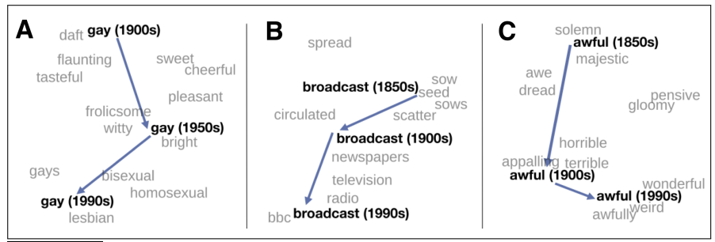
Historical semantic context

Slide 38
Inspecting embeddings
How do I know if my word embeddings make sense?
Check by hands
Project the words to a visible dimension
Use linear algebra

Slide 39
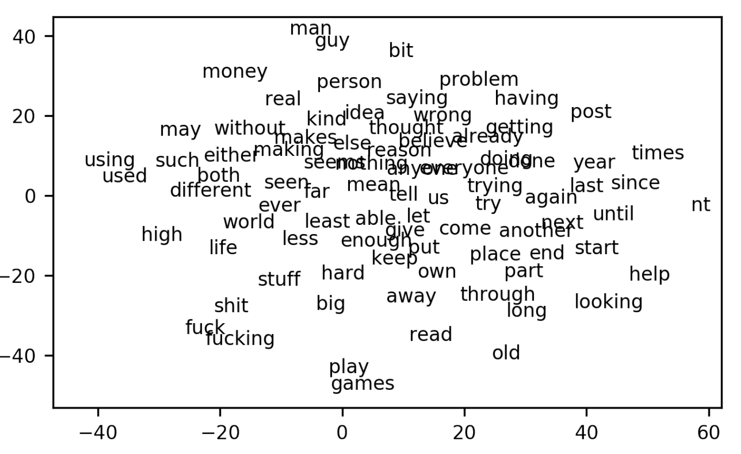
Visualizing embeddings
We usually have very high-dimensional vectors for each words. t-SNE can project down to 2.

Slide 40
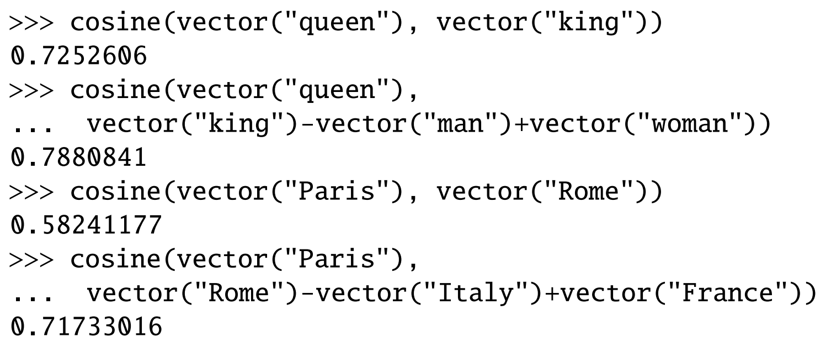
Algebra

Slide 41
Other standard evaluations
Correlation with human judgments of similarity
WordSim-353 noun similarity, e.g., (plane, car, 5.77)
SimLex-999 adjective, noun, and verb similarities
SCWS word similarity given sentential context
STS sentence-level similarity
Accuracy at similarity-based task
TOEFL e.g., Levied is closest in meaning to: imposed, believed, requested, correlated
analogies e.g., Athens is to Greece as Oslo is to ____

Slide 42
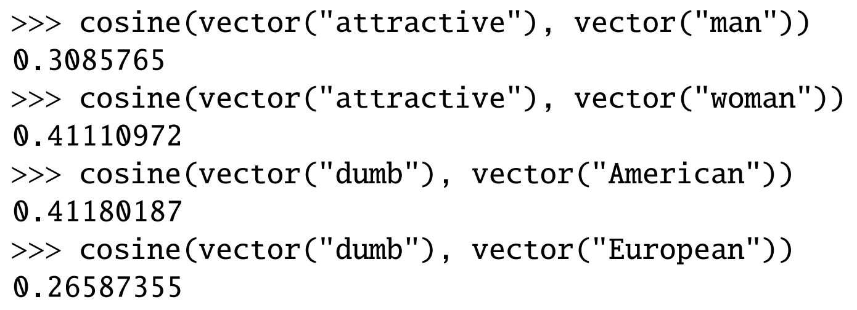
Bias in embeddings
Embeddings reflect the language they were trained on

Slide 43
Contextual word embeddings
Traditional word vectors ignore context
The river bank: [ 0.3, -0.1, -0.2] [ 0.1, -0.3, -0.2] [-0.6, 0.3, -0.1]
A bank deposit: [ 0.0 , 0.0 , -0.2] [-0.6, 0.3, -0.1] [-0.3, -0.3, 0.0]
Should these two banks really have the same vectors?

Slide 44
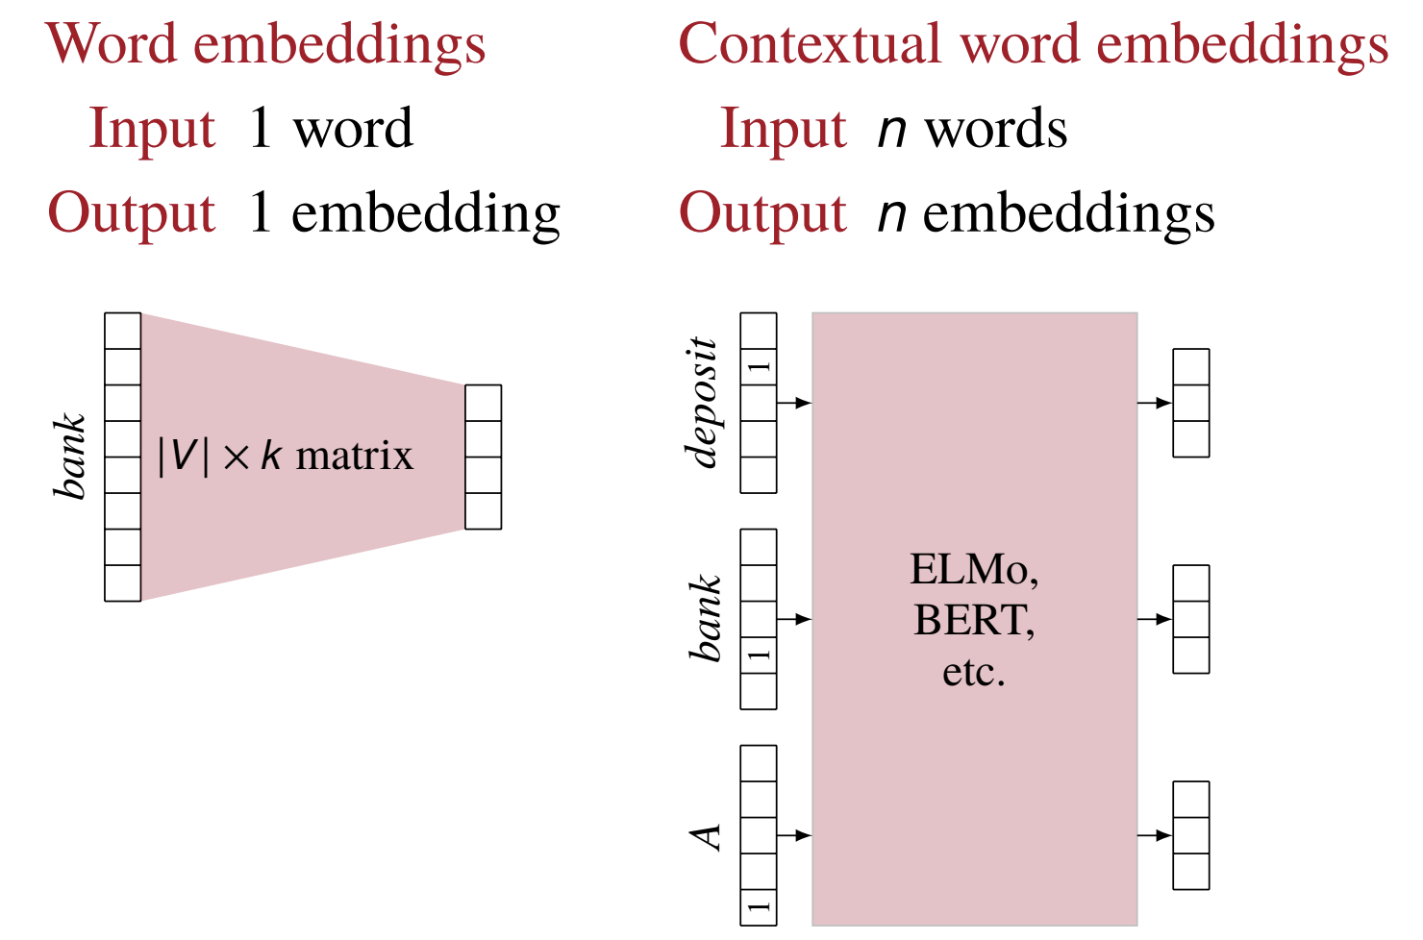
Contextual word embeddings

Slide 45
Learning contextual word embeddings
We need to make up a prediction task that
takes n words as input
produces n vectors as output
requires only unlabeled data

Slide 46
ELMo’s task: language modeling
What is a language model?
Given a sequence of words, what is the next most probable word?
Unsupervised, great for learning representations
ELMo combines a forward language model and a backward language model.
Transformers use the same idea, but in a much larger canvas.

Slide 47
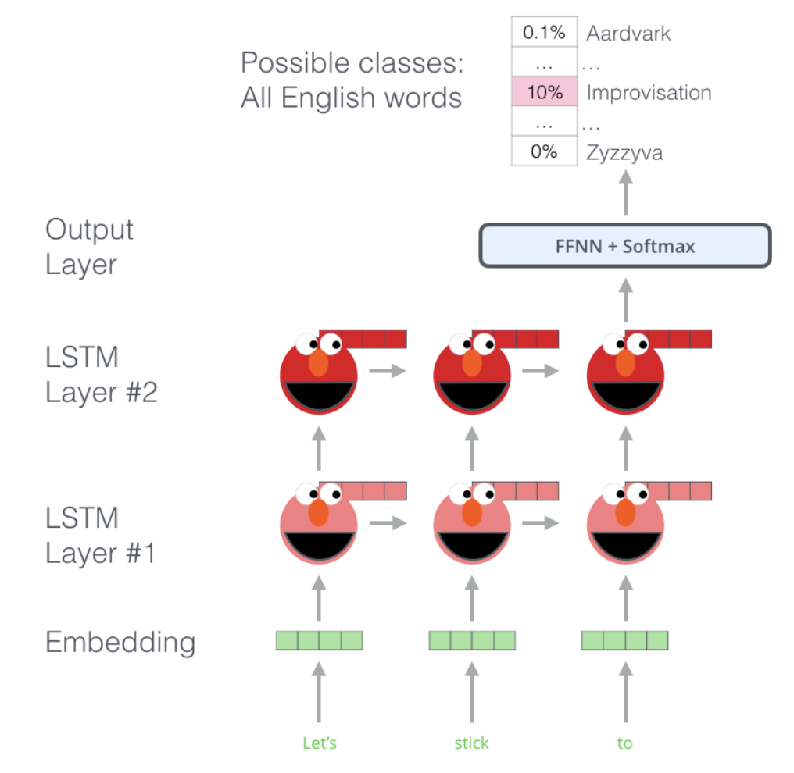
ELMo’s task: language modeling

Slide 48
How to use contextual word embeddings?
Contextual word embeddings are trained on unlabeled data. How do we use them on the task we care about?
Extract word vectors, use as features
Fine-tune contextual embedding model, i.e., continue training the model, but now on our labeled data instead of the unlabeled data

