Slide 1

Bangladesh Army University of Science & Technology (BAUST), Saidpur
Department : Computer Science & Engineering
Course Code : CSE2200
Course Title : Software Development Project II
Submitted By :
Submitted To :
Student Name: MD Fakhrul Islam Fuad
ID : 180201067
Batch : 8th
Level : 2 Term : II
Section :A (G2)
Date of Submission : Saturday, 28th nov, 2020
Teacher Name : MD. Toukir Ahmed
Designation : Lecturer

Slide 2
Name of the project:
Team Manager
Project Brief
This project is all about managing works and teammates. User can add either an individual work with no teammates or a teamwork with as many teammates as he want. For teamwork, user can add teammates from his friend list.Friend list feature is not available right now so we used a text field to put names of teammates. Chatting, uploading work files and reminder feature will also be available soon. Still now, this project is usable as a to do list. Three type of works can be added into the project. (i) In progress; (ii) On hold; (iii) Completed; Description of all the types will be given in the other slides.
Tools used in this project:
IDE: Netbeans.
Language: Java.
Framework: Javax Swing.
Database: MysQl
Status
Approximately 40% of the project is completed as my desires. Hope the rest will be completed soon.

Slide 3
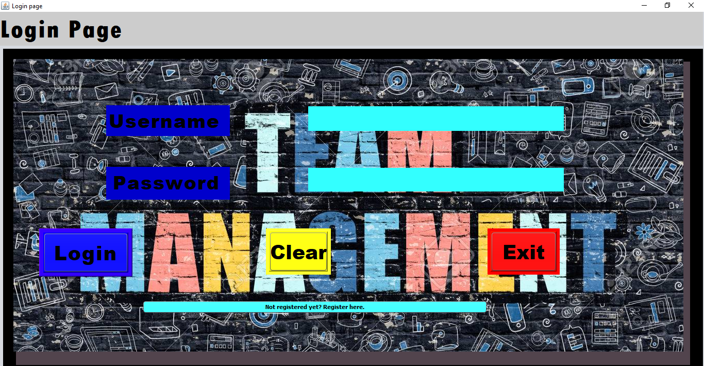



Some Screenshots of my project with descriptions
If user gives the right username and password and press the “login” button, the homepage will open. For username and password field, we used mysql to load user’s login info. Both of the fields will be cleared if user presses the “clear” button. The app will be closed if user presses “exit” button. If the user is new and don’t have any ID, he/she can do create a new ID by pressing the blue button of the bottom
If any of the fields are empty
For wrong username or password
If the informations are correct.

Slide 4
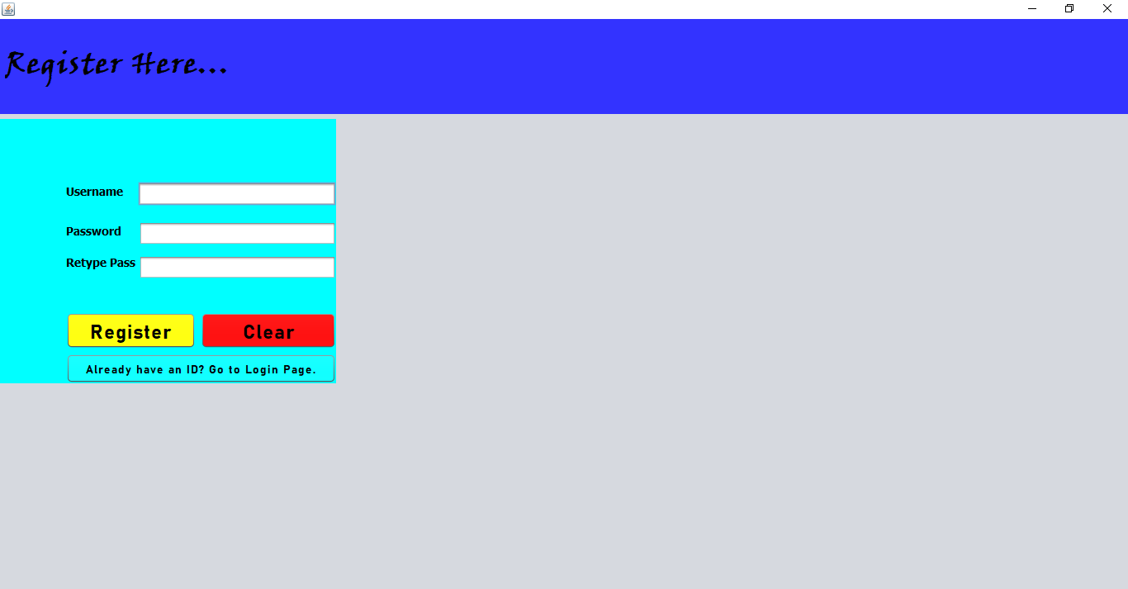


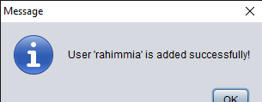
Some Screenshots of my project with descriptions
This is the page to register as a new user. Data will be added to mysql database if no users exist with the given username. After registration, user can simply go to the login page by tapping on the blue button located on the bottom.
If username already listed in the database.
If entered passwords are not same.
If user is successfully registered.

Slide 5
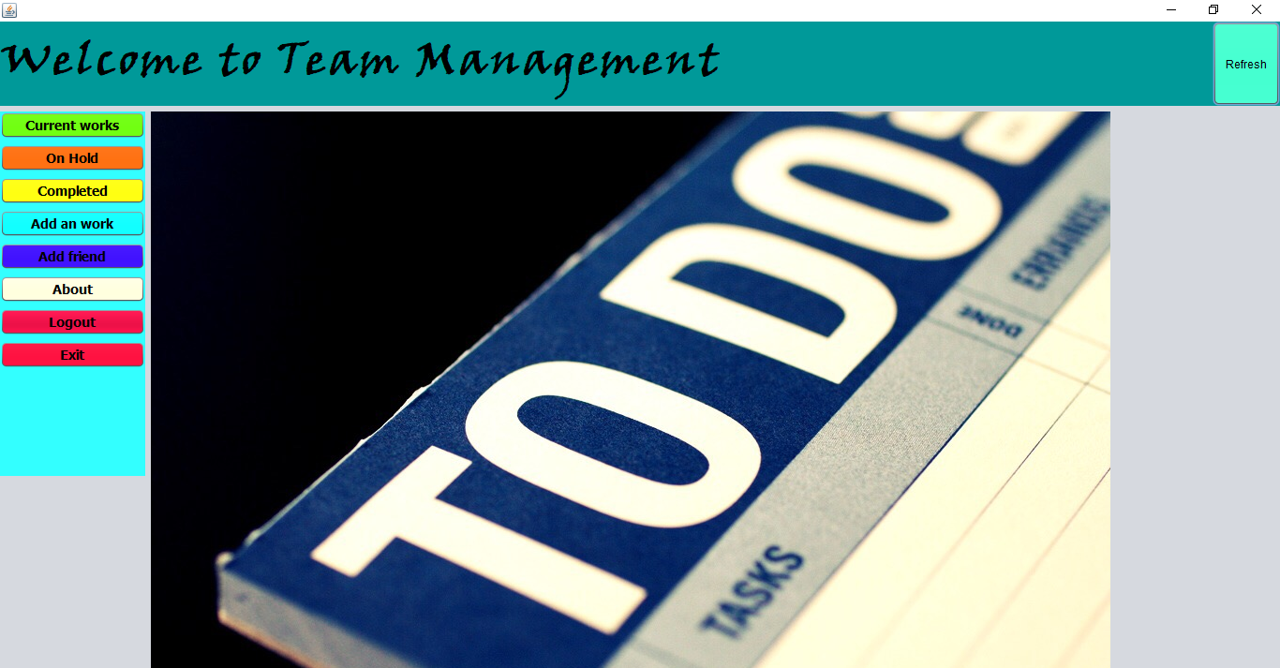
Some Screenshots of my project with descriptions
Homepage of my project
After doing any action as adding work, deleting work etc this page needs to be loaded again. This can be done by pressing the “refresh” button located on the top right corner.

Slide 6
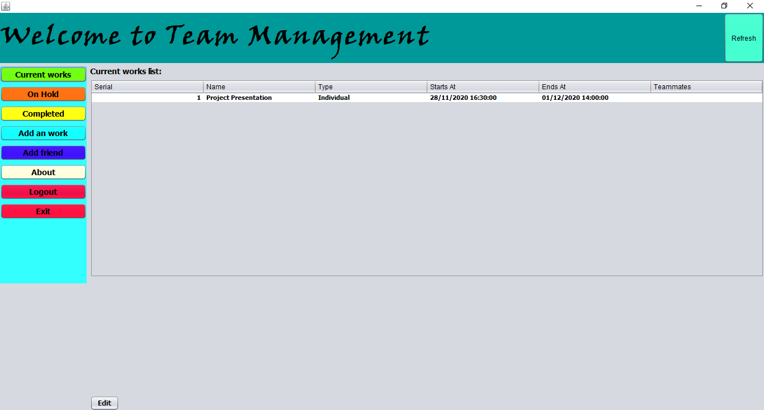
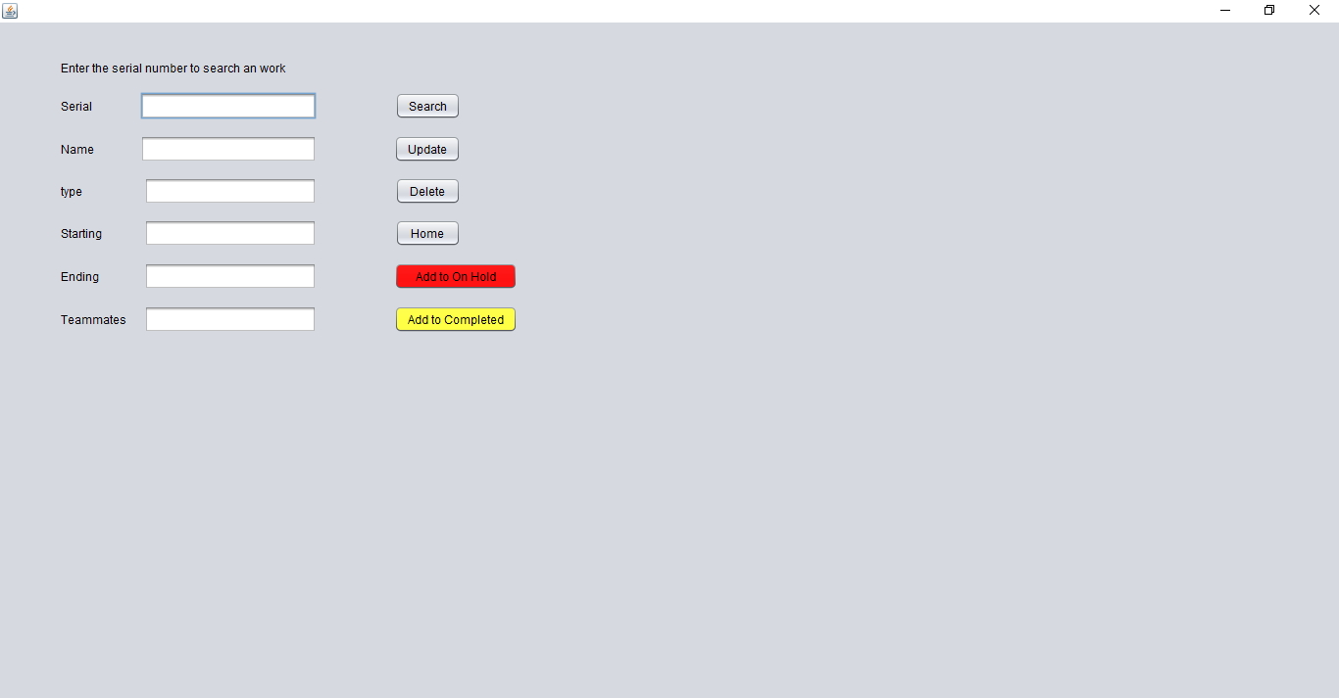
Some Screenshots of my project with descriptions
If user presses on the “current works” button, the current work table will be visible. Work list can be edited by pressing on the “edit” button.
If user presses the “edit” button, this edit page will be shown. User can search works by entering the serial number of his work. Work name, serial, type etc can be edited by entering new values and pressing the “update” button. He/she can move works to ‘completed’ or the ‘on hold’ list any time by pressing on the yellow or the red button.

Slide 7
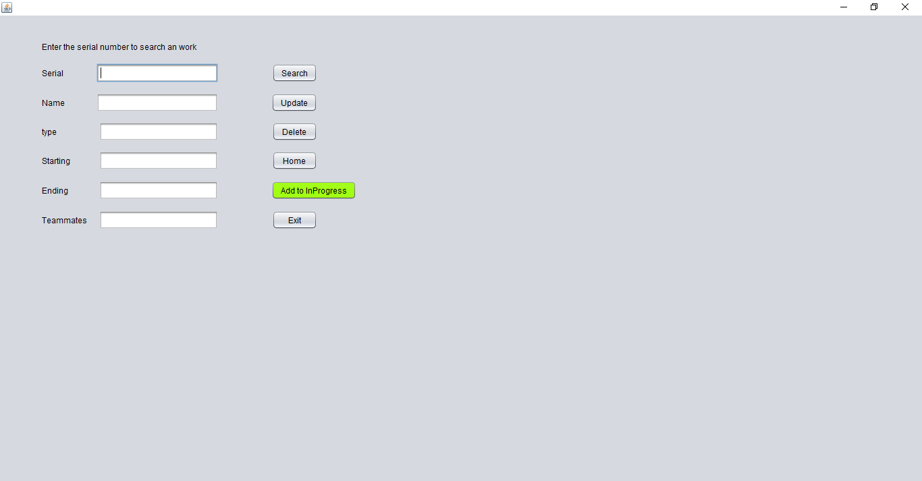
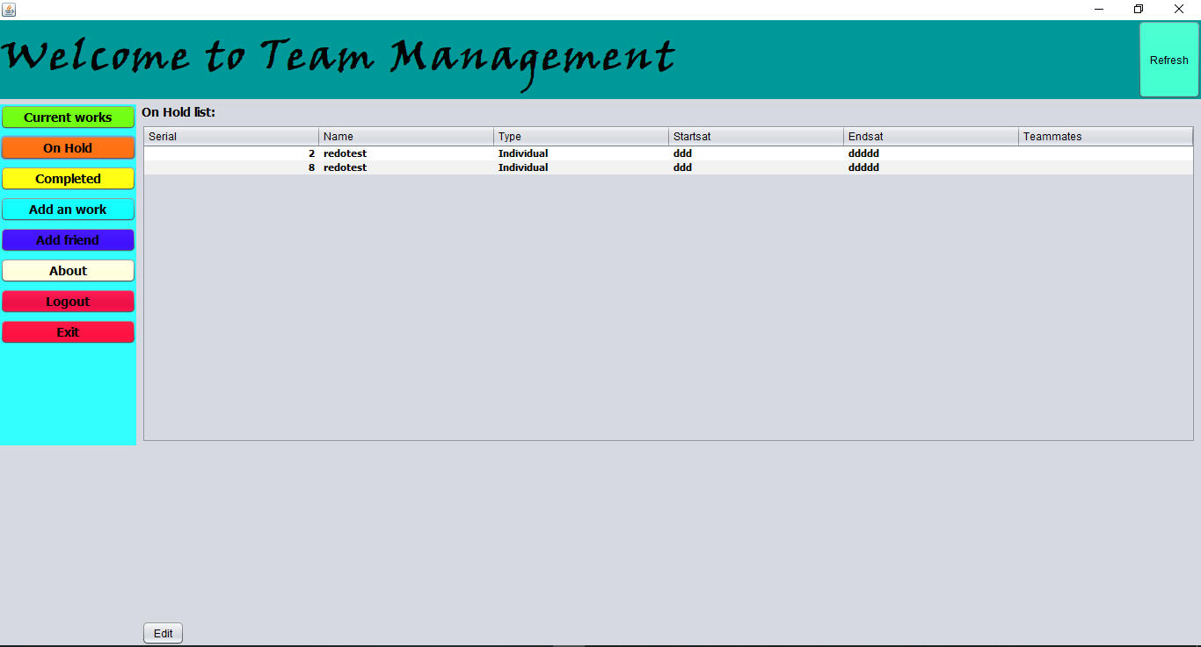
Some Screenshots of my project with descriptions
If user presses on the “On Hold” button, the current work table will be visible. Work list can be edited by pressing on the “edit” button.
If user presses the “edit” button, this edit page will be shown. User can search works by entering the serial number of his work. Work name, serial, type etc can be edited by entering new values and pressing the “update” button. He/she can move works to ‘in progress’ list any time by pressing on the green button.

Slide 8
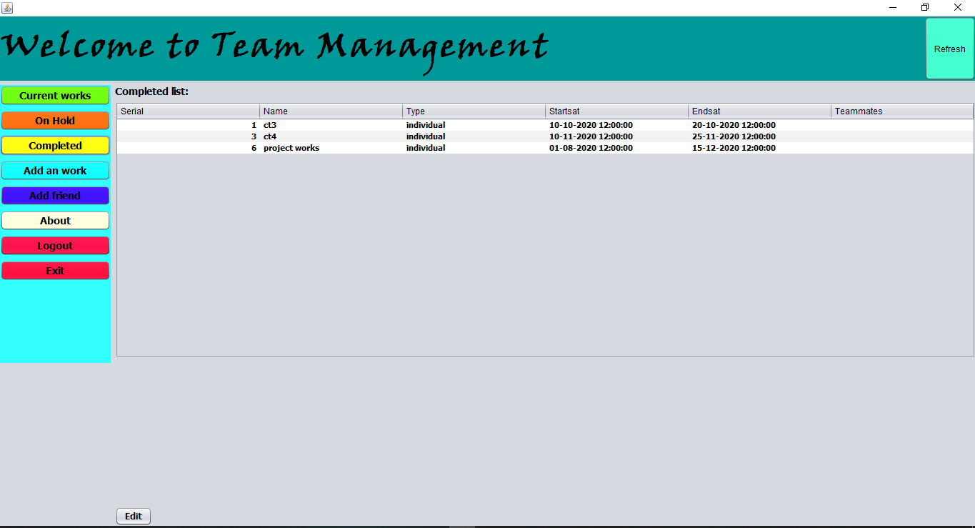
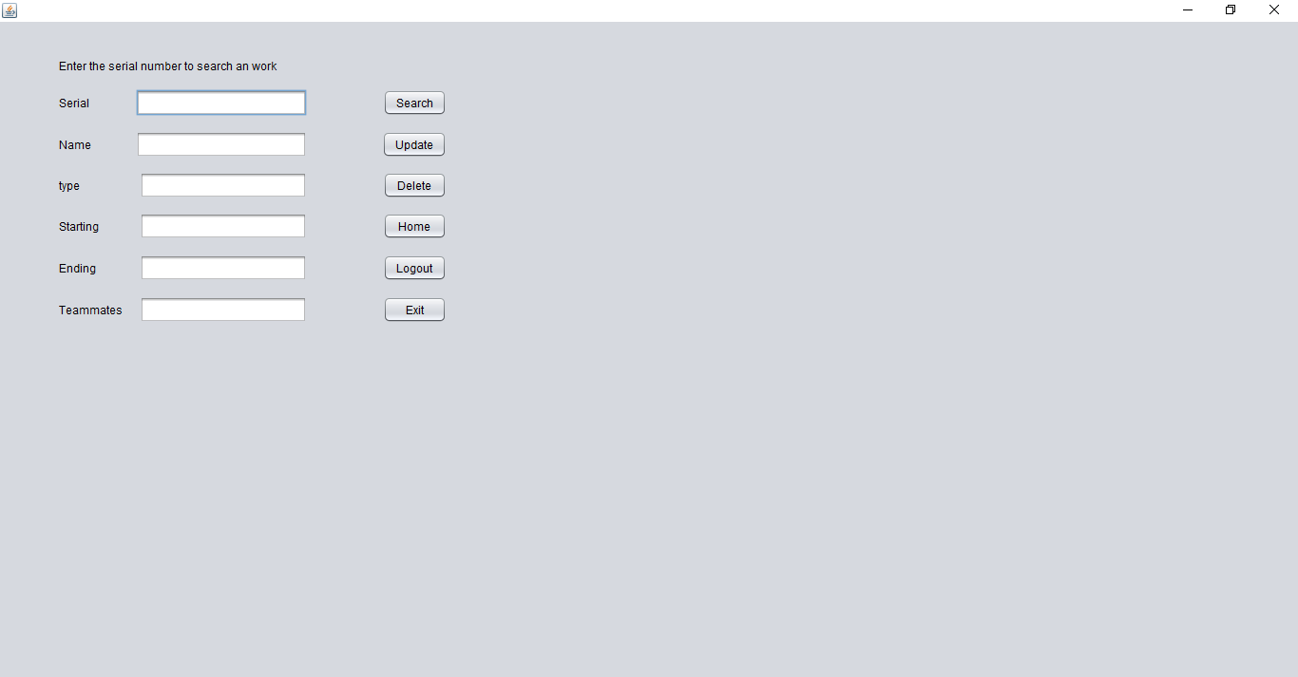
Some Screenshots of my project with descriptions
If user presses on the “completed” button, the current work table will be visible. Work list can be edited by pressing on the “edit” button.
If user presses the “edit” button, this edit page will be shown. User can search works by entering the serial number of his work. Work name, serial, type etc can be edited by entering new values and pressing the “update” button.

Slide 9
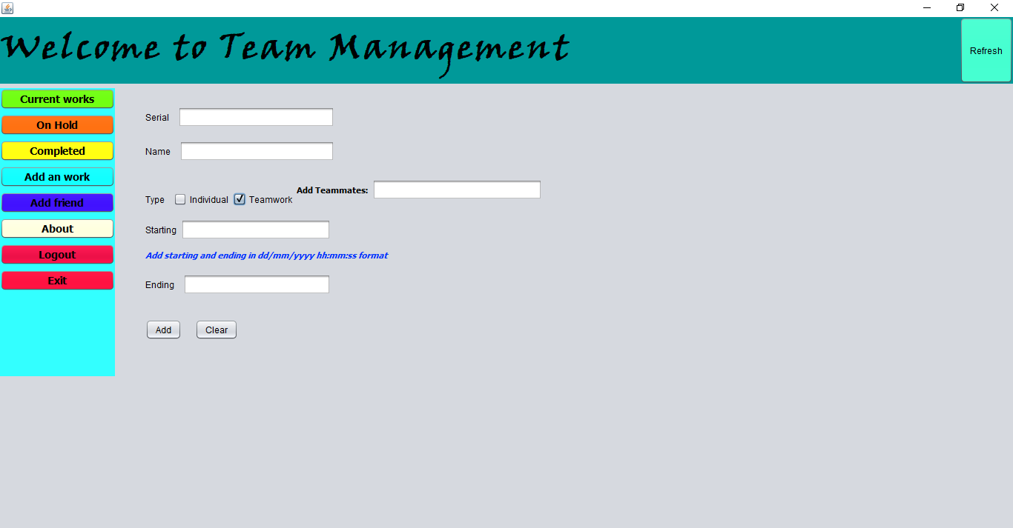
Some Screenshots of my project with descriptions
User can add works to the ‘in progress’ list by pressing “Add an work” button. If user selects work type as teamwork the ‘Add Teammates’ field will be visible. Here, user can add the names of his teammates by putting a comma after each names. The starting and ending should be entered as the given pattern. I could use the jcalander field for this action. But then only the date would be available excluding times. So I used text field to store date & time both. After filling all the fields, user need to press the “Add” button to add works.

Slide 10
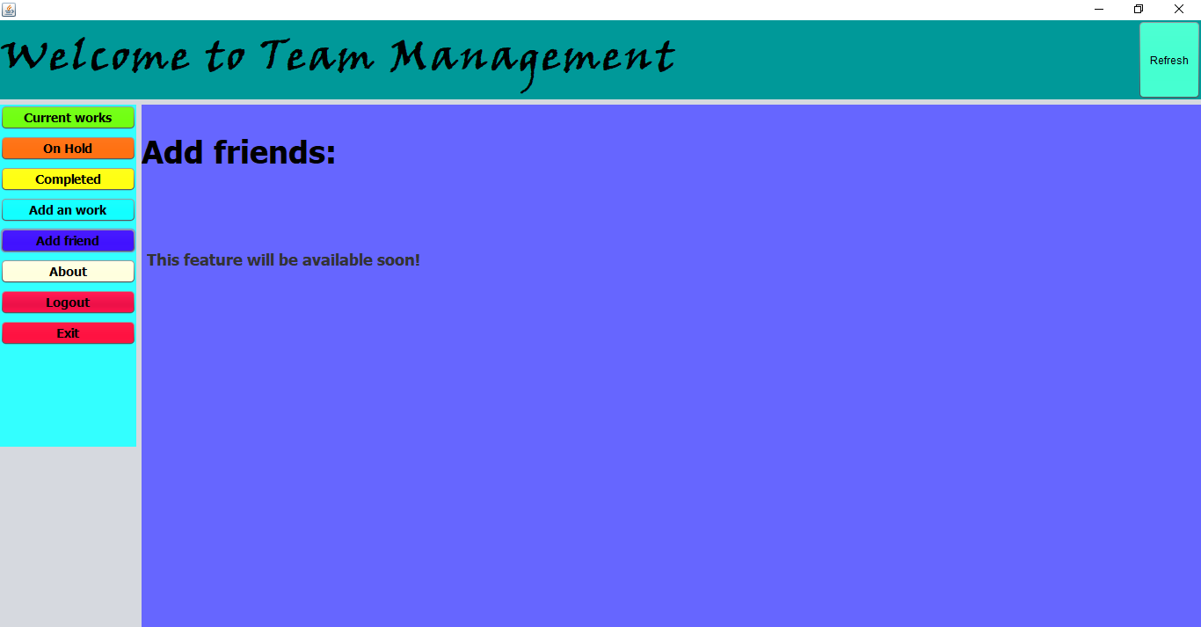
Some Screenshots of my project with descriptions
This “Add Friend” feature will be available soon.
The “Logout” button will take to the login page and to go to ‘Home Page’ , user will need to login again.
User can close the app anytime by pressing “Exit” button

Slide 11
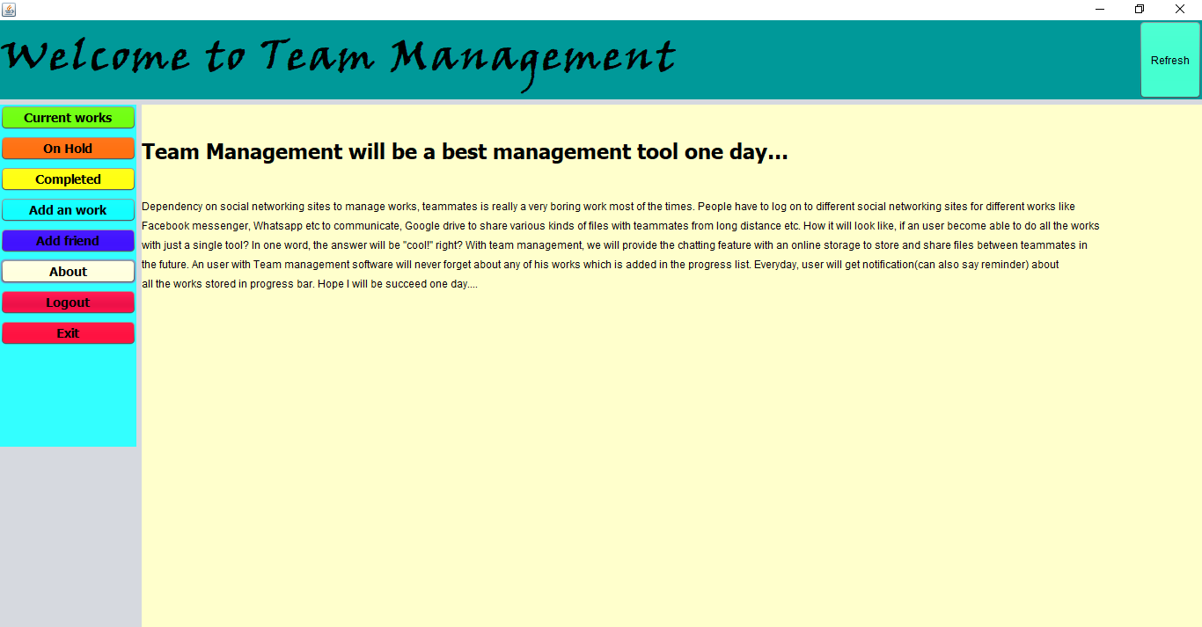
Some Screenshots of my project with descriptions
This is the “About” page of my project. Primarily, what else I could do with the project in future is given here. After completing the project, details of the developer with contact info will be replaced by these texts. Users will be able to contact with me to share their opinions.

Slide 12
Some code segments that are used to make my project look better
Code segment | Reason of use
setExtendedState(JFrame.MAXIMIZED_BOTH); | This was used to make the jframe fullscreen when the project runs.
dispose(); | This was used to vanish the previous page after loading a new page.

Slide 13
Conclusion
In our daily life, we face many problems to manage our works specially team works by social networking sites. We need to do so many unwanted things like chatting with friends for no reasons, view some ads, scroll newsfeed more and more to get the desired things etc which breaks our concentration and ultimately our works are hampered. To concentrate only on the work, we need a tool in which we will get all the necessary tools for our work like chatting with teammates, share our files of work, some kind of a reminder to keep in mind that the work is pending etc. Team management will be able to solve this problem and will become a great tool to do all these stuffs without any unwanted issues. We will provide a online storage where user will be able to store his work as files (the files could be some documents, some images, videos anything which is storable in the internet. The reminder feature will remind the user several times about the progress of his work. Our users will never forget their works which they’ve been added to the software. This team management software will not be only a team manager but also a to do list, a reminder, a messenger, a drive anything that user want to mention. This will be a master tool for works.
Thank You…

Slide 14
Github link: https://github.com/foadtkf/team-manager.git

