Slide 1


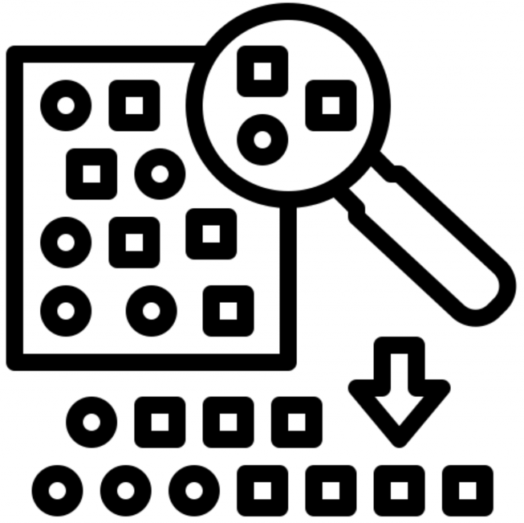





RQ2
RQ3
5
6
1
2
3
AI Project
7
Code search
Filtration
Extract Logging Statement
Stratified Random Sampling
Qualitative Analysis
4
RQ1
Qualitative Analysis

