Slide 1
Markerless cup tracking, end to end
Detection → 3D fusion → tracking accuracy → phase segmentation
Validated on 669 drinking reps · 22 participants · median 2.9 mm vs QTM mocap

Slide 2
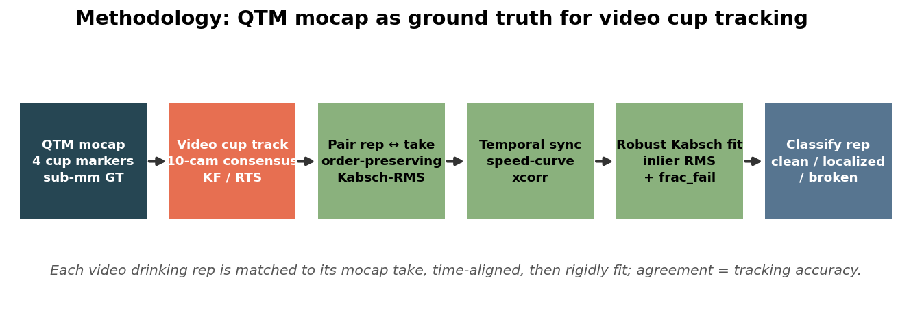
The pipeline
10 cameras → per-camera detection → ≥3-cam consensus + KF/RTS → one 3D cup track, validated frame-by-frame against sub-mm mocap.

Slide 3
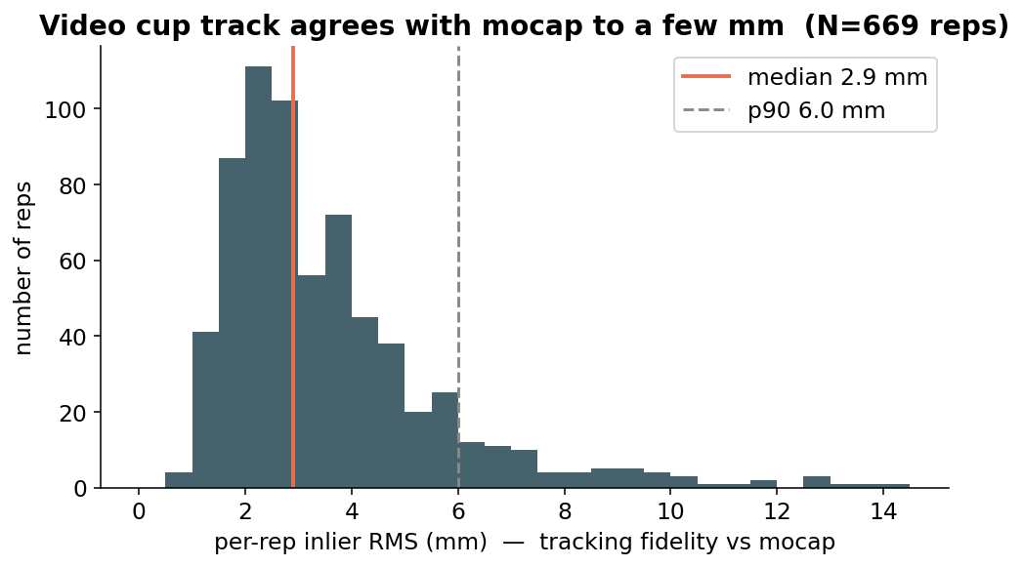
It tracks to a few millimetres
Per-rep inlier RMS vs mocap: median 2.9 mm, p90 6.0 mm over 669 reps — and consistent across all 22 participants.

Slide 4
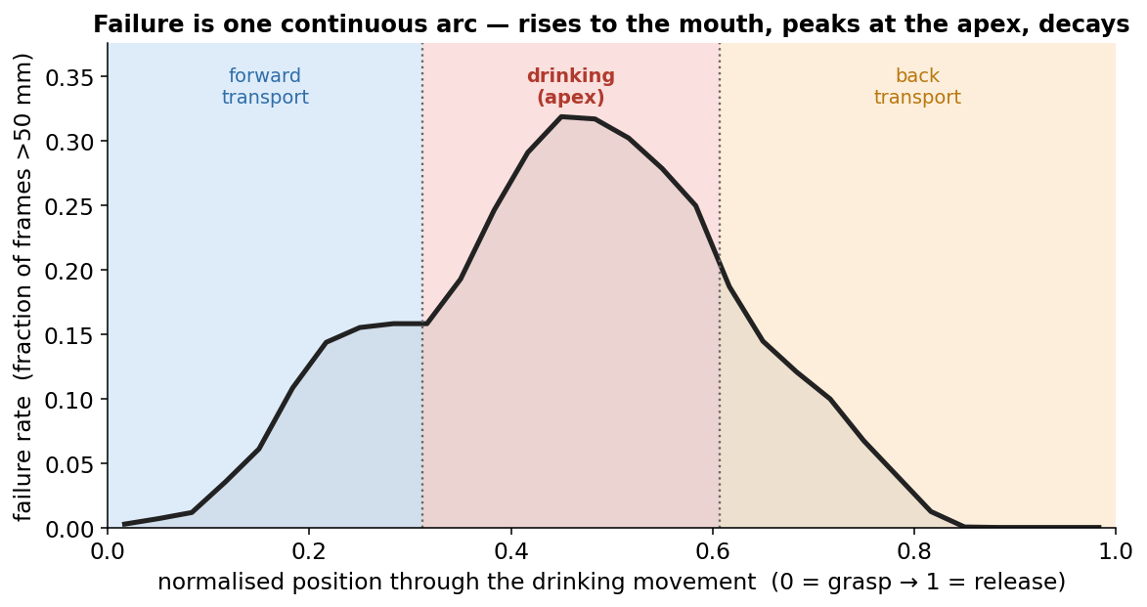
…except at the drinking apex
Failure is one continuous arc: ~0% in rest/transport, peaking mid-drink where the cup reaches the mouth. Everything downstream is about that apex.

Slide 5
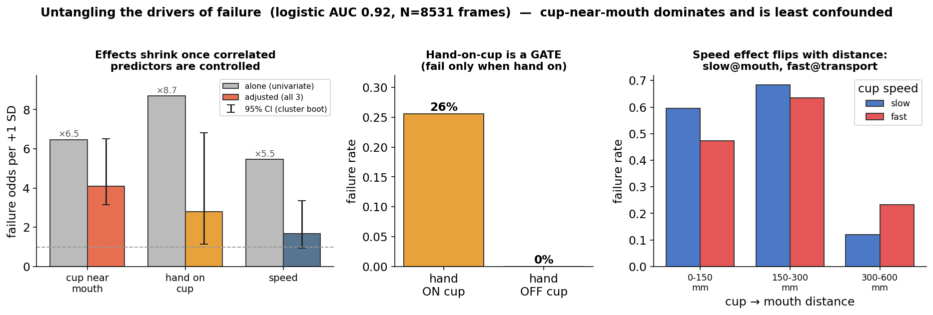
Why it fails: cup at the mouth
Cup-near-mouth dominates (and is least confounded); hand-on-cup is a gate; speed is non-monotonic. At the mouth the cameras are occluded and the consensus is confidently WRONG.

Slide 6
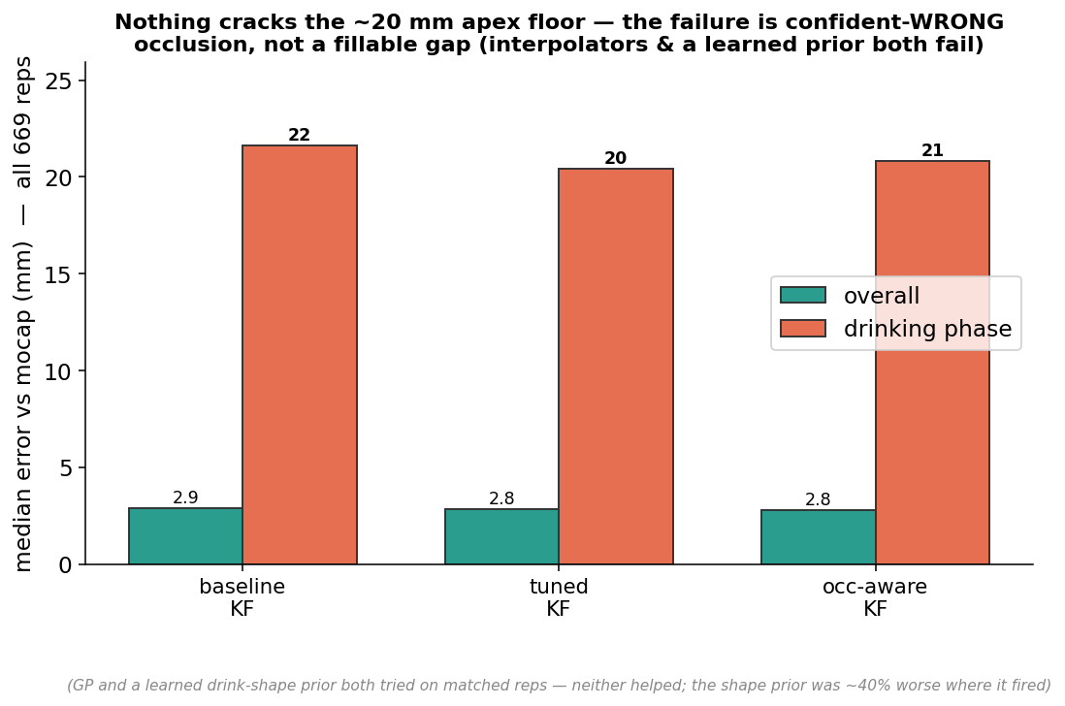
The apex is not a fillable gap
KF-tuning, occlusion-hold, a GP and a learned shape-prior all stall at the ~20 mm floor — the failure is confident-wrong occlusion, not missing data.

Slide 7
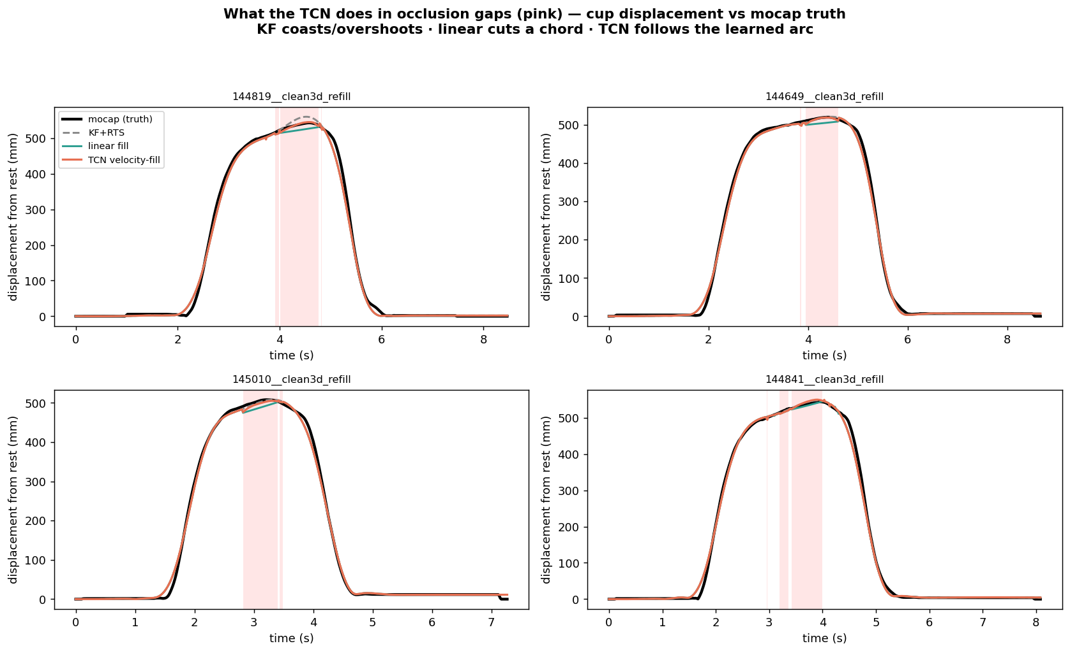
But short gaps ARE fillable — predict movement
Velocity-fill TCN predicts the cup's MOVEMENT (not position) across occlusion: −13% median / −33% p90 at the apex vs KF coast. (Only LOPO-surviving gains kept.)

Slide 8
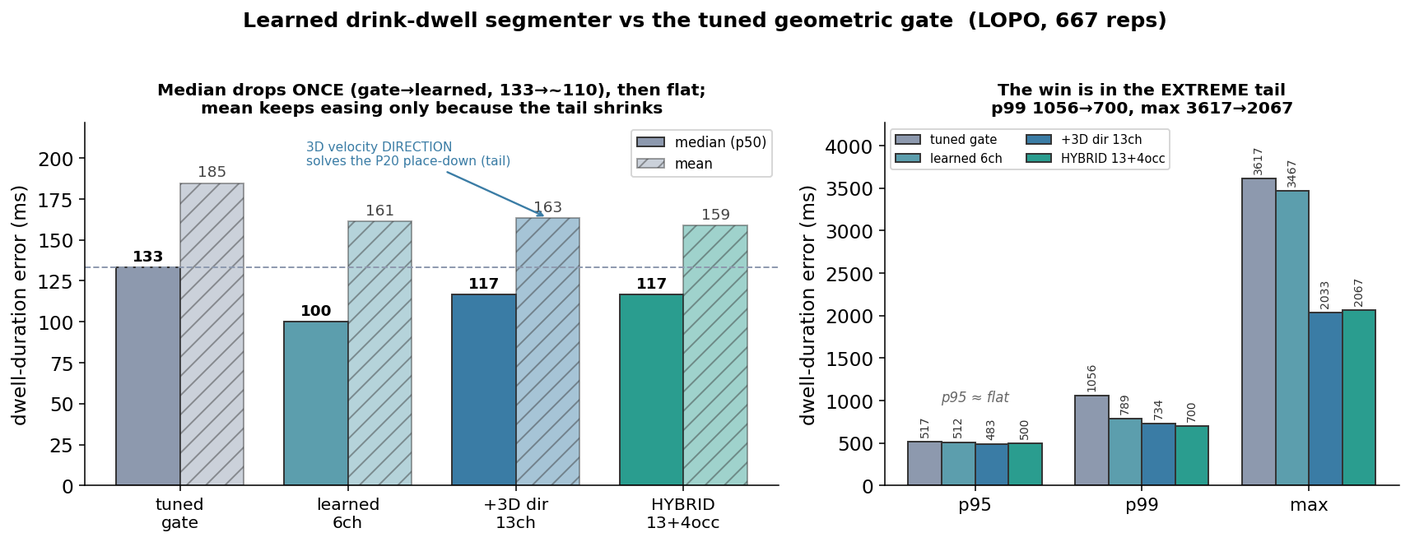
Phase segmentation: from a gate to a learned model
Cup-only dwell segmentation. Learning beats the gate on the TYPICAL rep once (median 133→~110), then flat; richer 3D-direction + occlusion features don't move the median further — they cut the EXTREME tail where a scalar gate structurally fails (p99 1056→700, max 3617→2067). Honest trade: hybrid over-extends ~26 easy reps — ship is a judgment call, gate still in production.

Slide 9
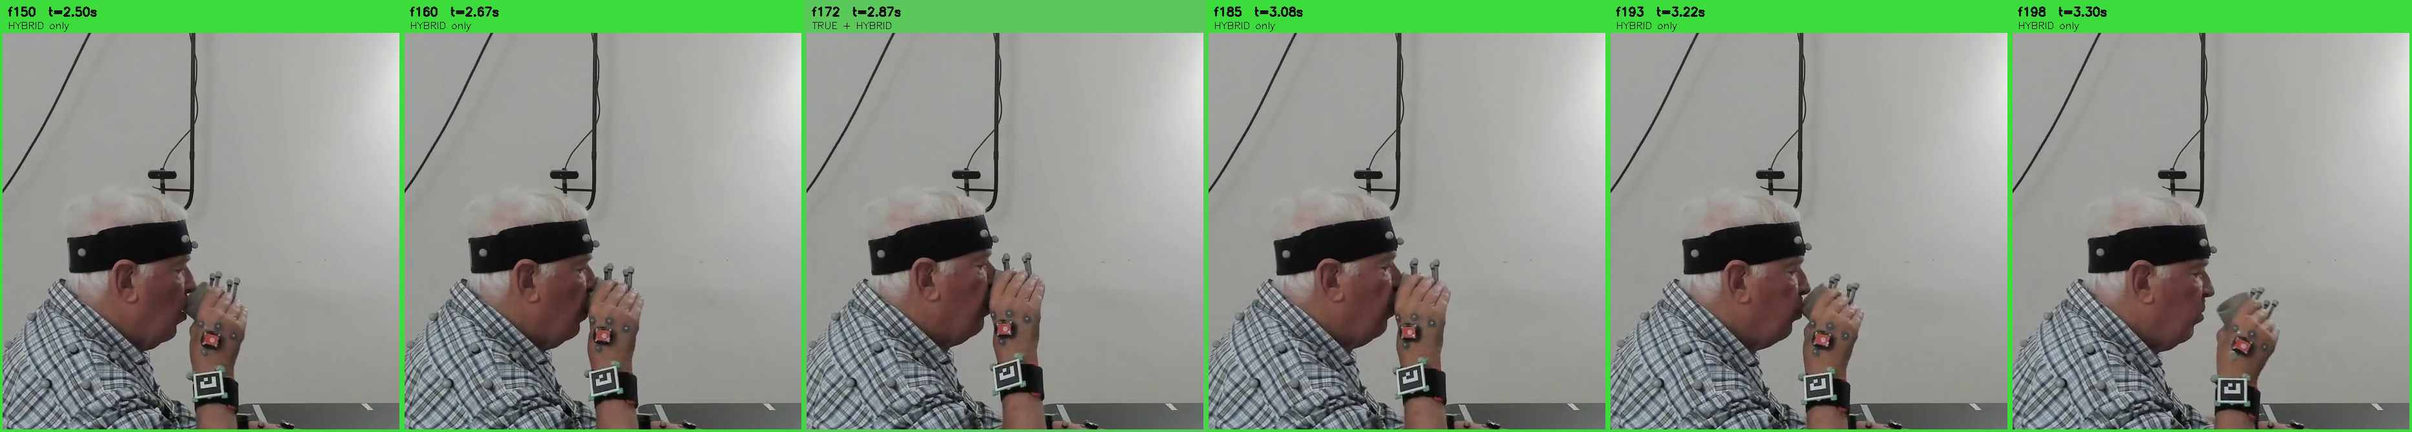
The catch: our 'truth' is itself imperfect
P23 cam4. Green = frames the HYBRID calls drinking but the mocap speed-gate 'truth' excludes. The cup is at the mouth in ALL of them — the model is MORE right than its label.
Truth = cup-nearly-STILL (speed gate, no mouth marker); real drinking = cup-AT-MOUTH, which brackets the still-phase. Some 'regressions' are the model catching onset/offset the label misses. True validation needs a mouth/face marker.

Slide 10
Where it stands & what's open
Summary and next steps
• Tracking: markerless video matches sub-mm mocap to a few mm; 0 broken reps.
• The only failure is the occluded drinking apex — confident-wrong consensus, not a fillable gap; better INPUT (view/appearance gating) is the lever, not a better filter.
• Gap-fill: velocity-fill TCN recovers short apex gaps by predicting movement.
• Segmentation: hybrid learned segmenter beats the tuned gate on mean + tail (a trade).
• Open — the real frontier:
– Add a mouth/face marker (van Andel 15%-of-steady-state) for a behaviourally correct dwell truth — our current speed-gate label is provably late.
– Decide ship: hybrid (worst-case/mean) vs tuned gate (never breaks easy reps).
– Port consensus-anchored KF into run_pipeline.

