Slide 1
Validating video cup-tracking against QTM mocap
669 drinking reps · 22 participants · median 2.9 mm agreement

Slide 2
Methodology — data & ground truth
What we compare and what counts as truth
• Two independent recordings of the same drinking reps:
– QTM optical mocap — 4 markers on the cup, 100/120 Hz, sub-mm 6-DoF pose. This is the ground truth.
– Video cup track — 10 calibrated cameras, per-camera detections fused by ≥3-cam gated triangulation (consensus), then a Kalman filter + RTS smoother → one 3D cup centroid in mm.
• Phases are segmented from the MOCAP trajectory (van Andel protocol: 6 Hz filter, velocity gates) → rest / forward-transport / drinking / back-transport / rest. GT-defined, so independent of video error.
• 669 valid drinking reps across 22 participants.

Slide 3
Methodology — pairing & temporal sync
How a video rep is put in correspondence with mocap
• Each video rep must be matched to its mocap take, then time-aligned:
– Pairing: mocap recorded extra/aborted takes, and drinking speed-curves are near-identical, so duration matching mis-registers. We pair by the order-preserving assignment that minimises 3D Kabsch fit residual (2 mm vs 30 mm is unambiguous).
– Sync: cross-correlate the two cup speed-curves; the lag at peak correlation aligns them in time. Reps below 0.7 correlation are rejected.
• Ground-truth quality gate: mocap takes that are dead/static or have non-physical jumps are dropped before scoring, so a bad GT can never be charged as tracking error.

Slide 4
Methodology — error metric & failure
From aligned trajectories to a failure label
• After sync, fit a robust rigid transform (Huber-weighted Kabsch) so we measure trajectory SHAPE, not absolute placement.
• Per frame: distance between the transformed video track and the mocap cup (mm). Two summary numbers per rep:
– inlier RMS — fidelity on the frames that agree (tracking accuracy).
– frac_fail — fraction of the trajectory >50 mm off (coverage of failure).
• A frame 'fails' when the mocap–video distance exceeds 50 mm. Each failing frame is attributed to its mocap phase to localise WHERE tracking breaks.
• Driver analysis: logistic regression of per-frame failure on physical factors (cup-near-mouth, hand-on-cup, speed), with cluster-bootstrap CIs (resample reps, not frames).

Slide 5
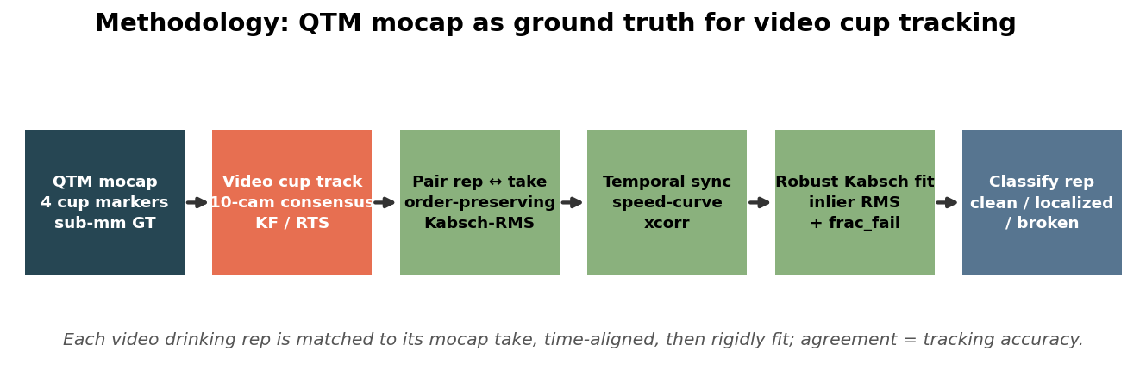
Methodology — pipeline at a glance
Mocap (sub-mm) is the ground truth; we measure how close the video track lands.

Slide 6
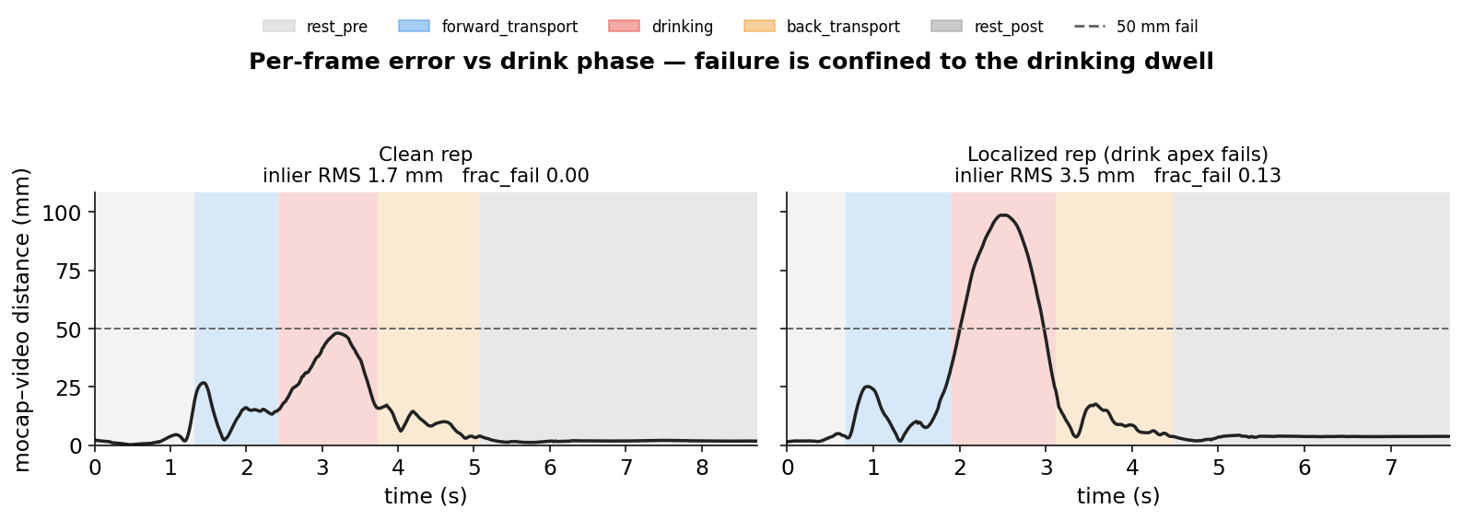
How each rep is scored
Two numbers: fidelity where it tracks, and how much of the trajectory fails.

Slide 7
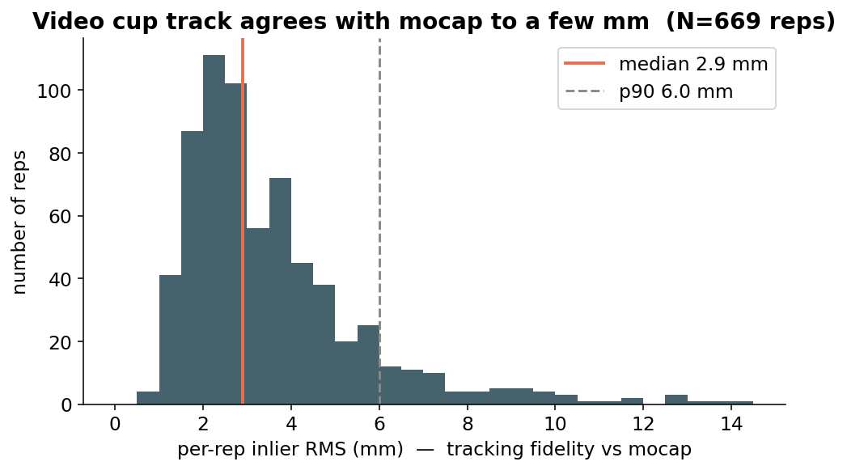
Result: agreement to a few millimetres
Median 2.9 mm, p90 6.0 mm over 669 reps.

Slide 8
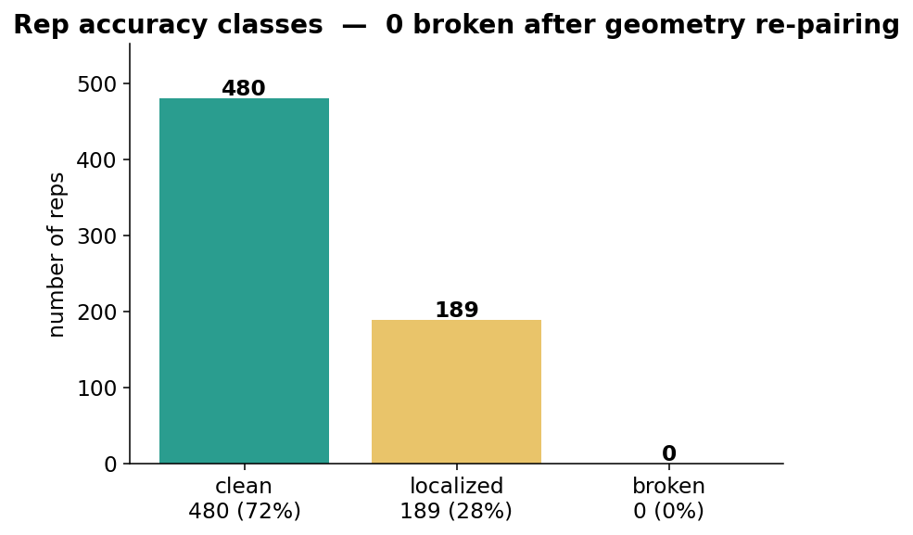
Result: accuracy classes
72% clean, 28% localized (brief occluded apex), 0 broken.

Slide 9
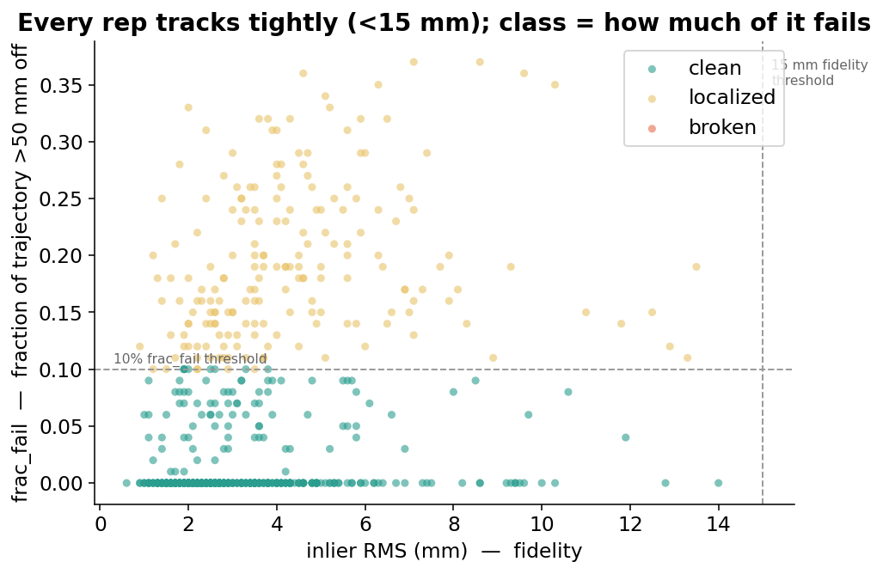
Result: fidelity vs failure coverage
Every rep tracks <15 mm; the class only reflects the occluded drink apex.

Slide 10
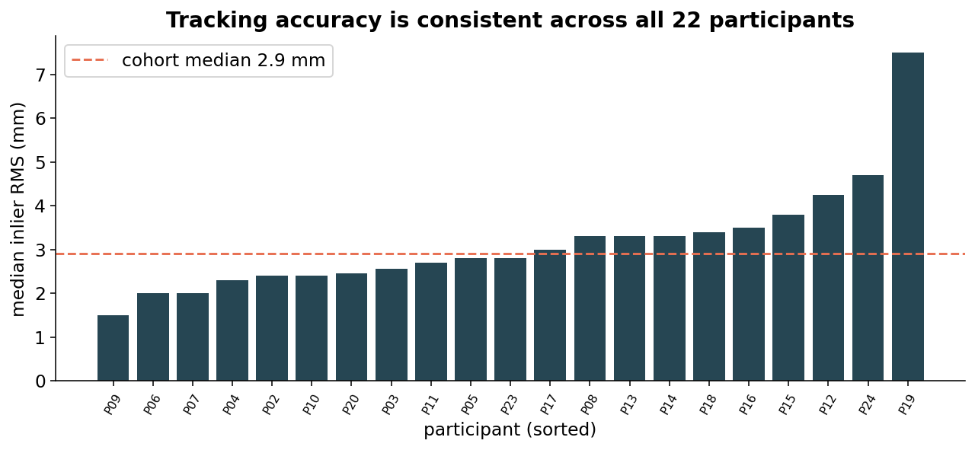
Result: consistent across participants

Slide 11
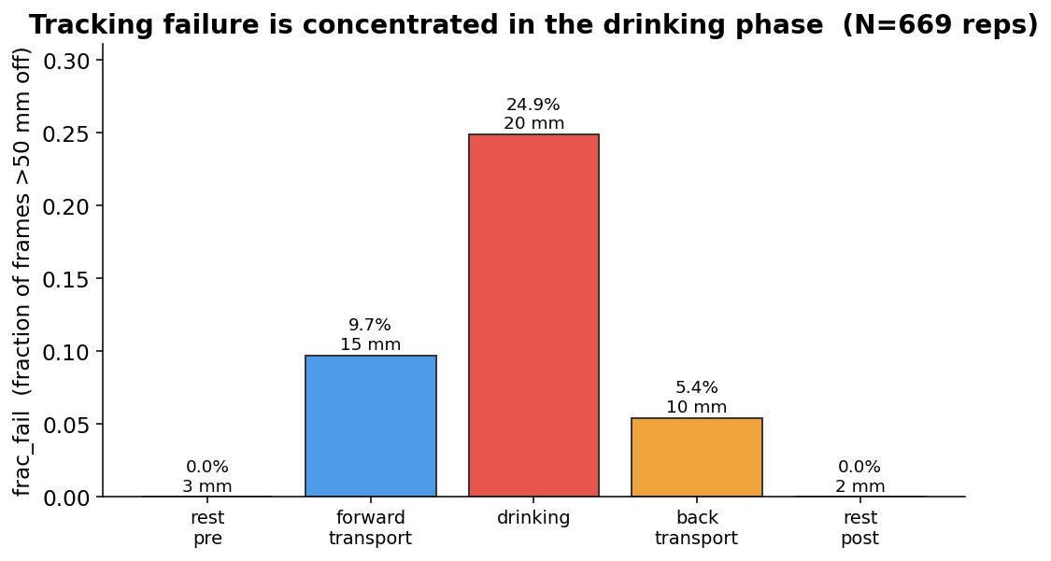
Result: failure is confined to the drinking phase
Rest phases ~0% fail (2–3 mm); only the occluded mouth dwell drives error.

Slide 12
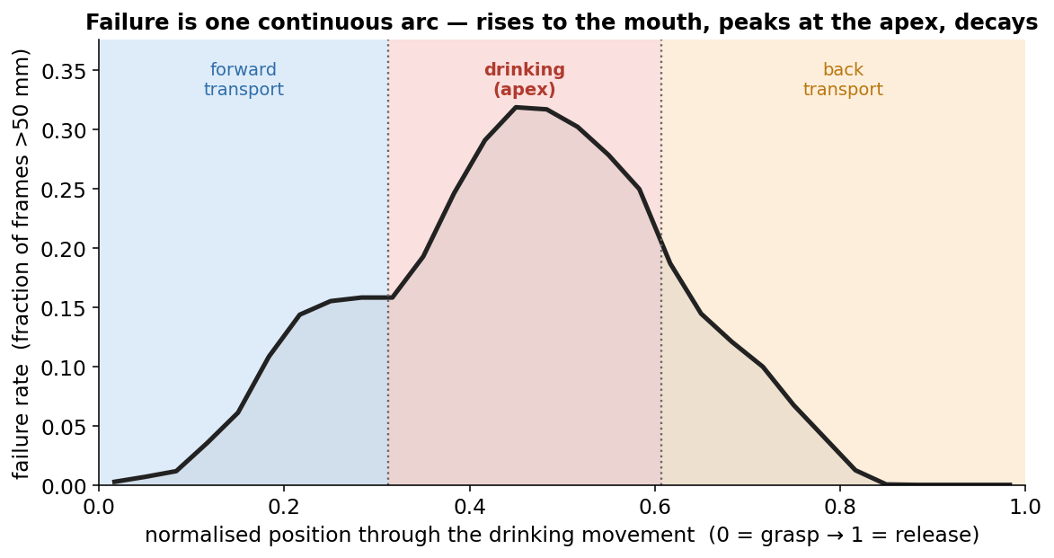
Result: where within the phase failure peaks
Failure rate peaks mid-drinking — the apex where the cup reaches the mouth.

Slide 13
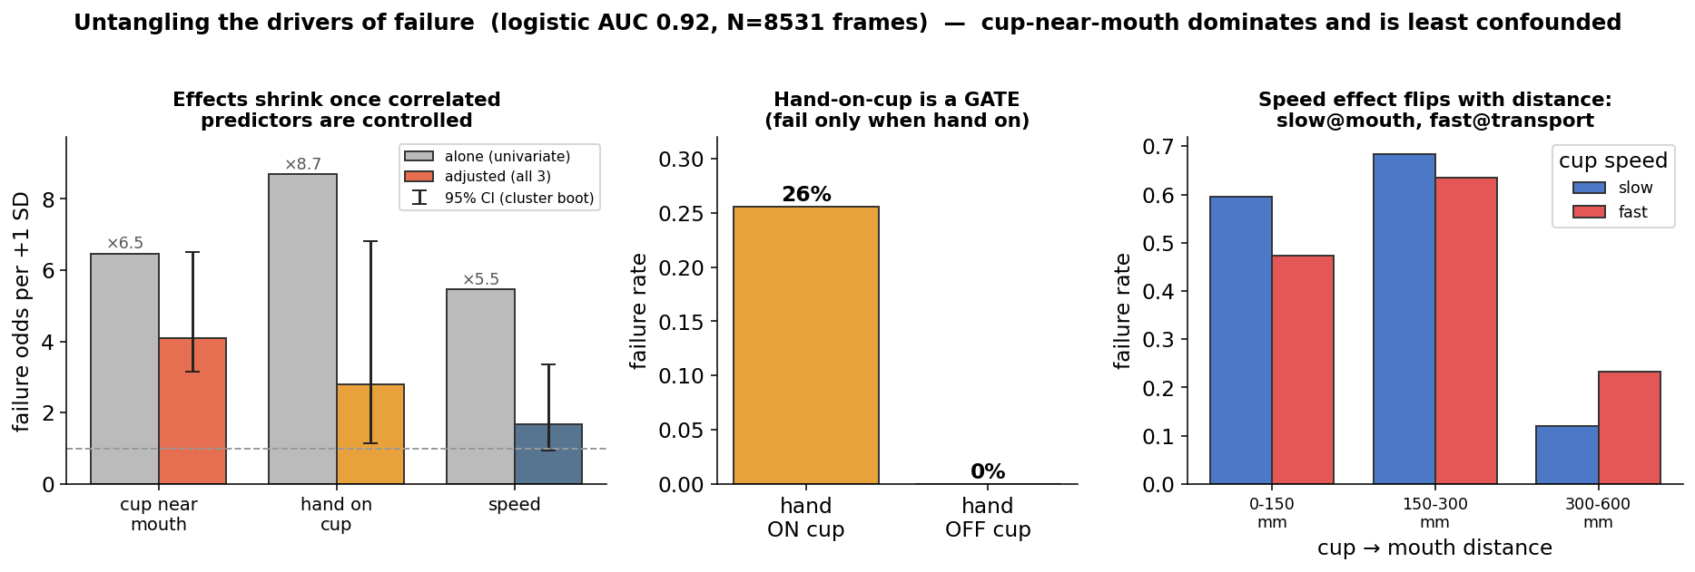
Result: what drives failure (untangled)
Cup-near-mouth dominates; hand-on-cup is a gate (fail only when on); speed is non-monotonic (slow@mouth, fast@transport).

Slide 14
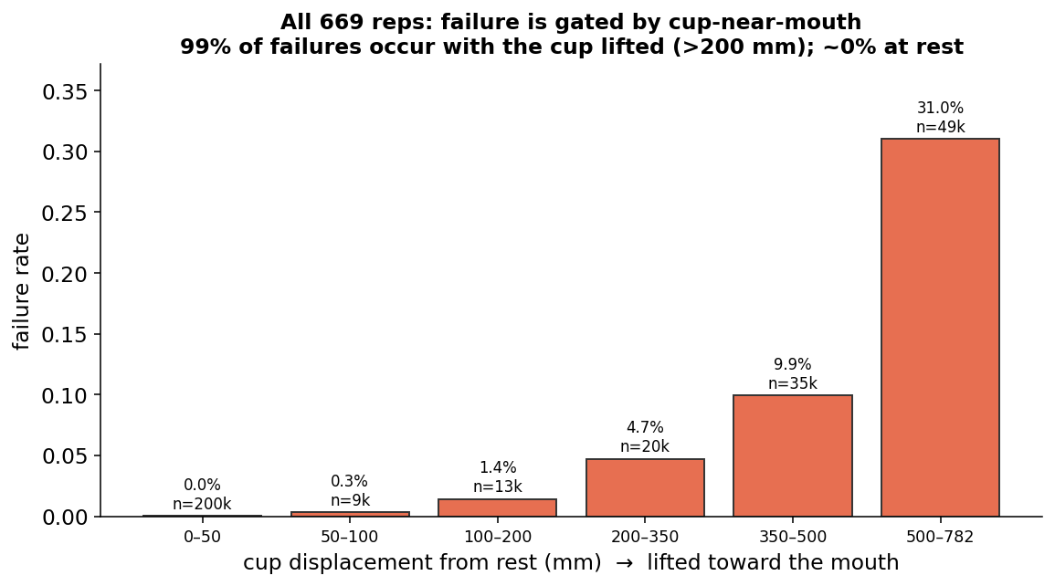
Result: confirmed on all 669 reps
Mocap proxy (cup displacement-from-rest, validated r≈−0.99 vs real cup→mouth): failure rises ~0%→31% with reach to the mouth.

Slide 15
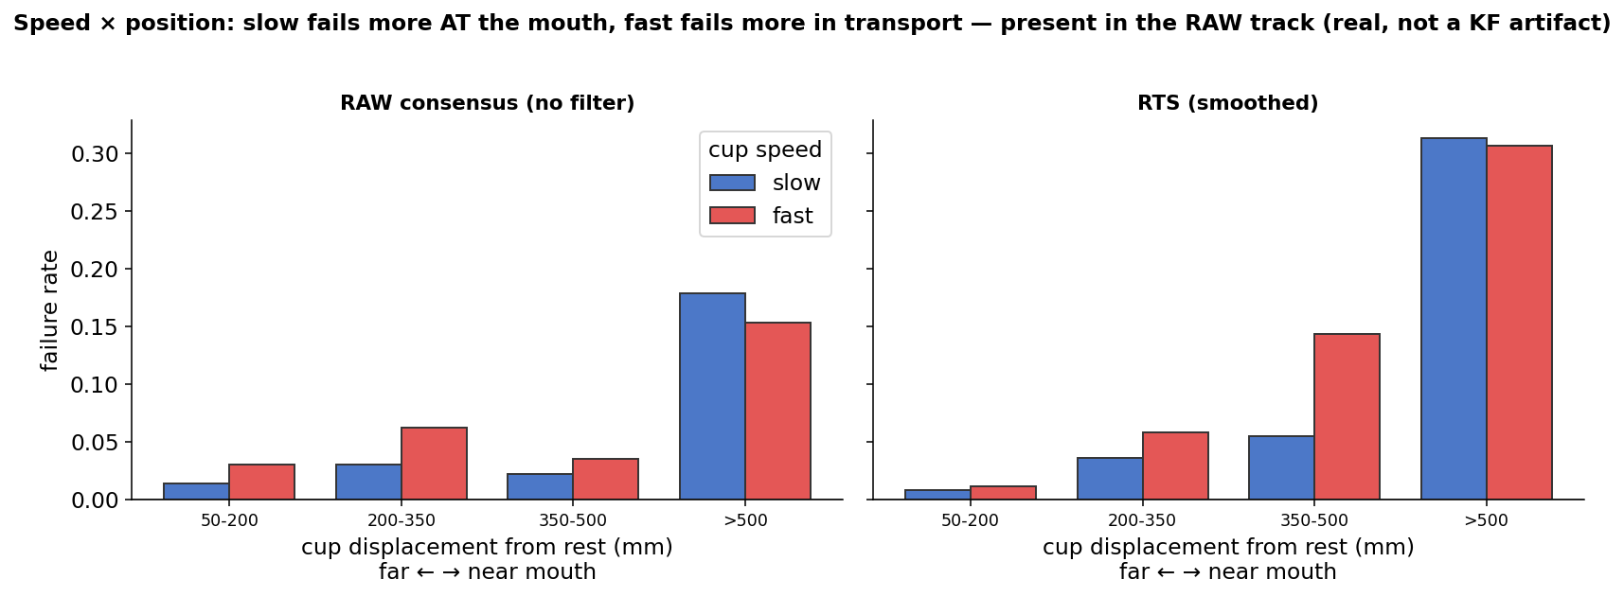
Result: speed × position (and the KF's role)
Slow fails more at the mouth, fast in transport — the sign-flip survives in the RAW track, so the interaction is real; the overall speed level is partly KF lag.

Slide 16
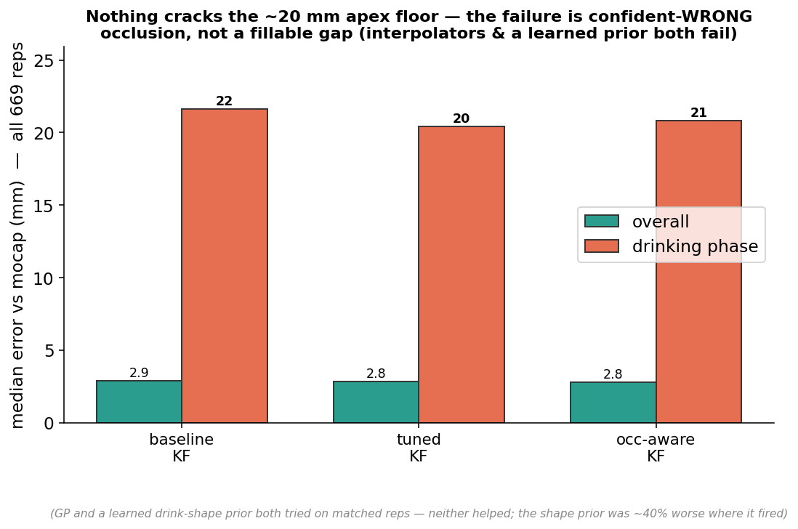
Can we improve the interpolator?
No — KF tuning, occlusion-hold, a GP, and a learned drink-shape prior all fail to beat ~20 mm (the shape prior was worse on matched reps). Occlusion at the mouth is near-universal and mostly confident-WRONG consensus, not a fillable gap; the fix is better input (camera view / appearance gating), not a better filter or prior.

Slide 17
Footnote: rep–take pairing
• Mocap recorded more takes than the video annotation logged (extra / aborted captures).
• Drinking speed curves are near-identical, so duration-based pairing mis-registered one side (P02 right).
• Fix: pair each rep to its take by the order-preserving assignment that minimises Kabsch fit residual (2 mm vs 30 mm is unambiguous).
• Effect: P02 broken reps 2 → 0; cohort broken 2 → 0; all other participants unchanged.

