Slide 1
DMEO - ICM auto-triage with ML
BingAds UCM组内部分享
刘杨 2017/11/17

Slide 2
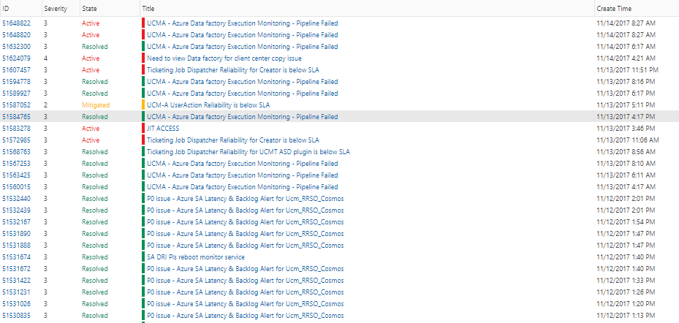
问题描述
Account Management
Daily Shipping
Classifier
DVF
Opportunities
Ticketing & Engagement

Slide 3
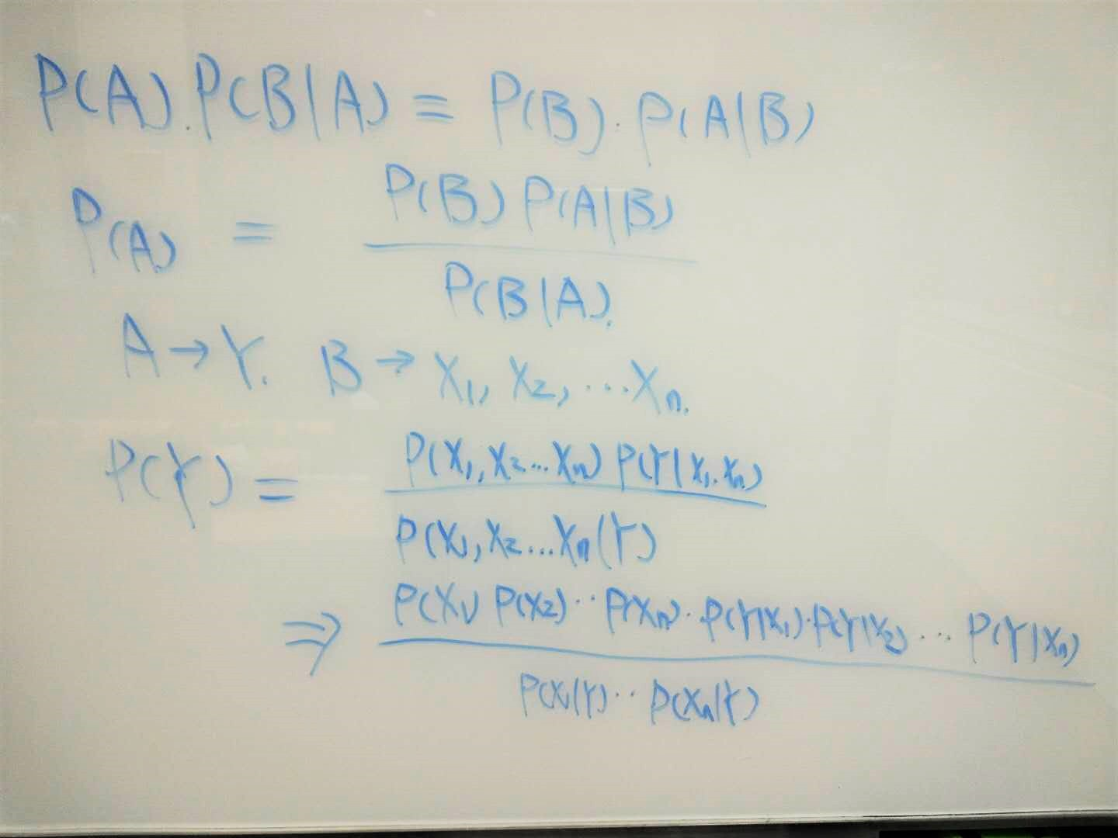
Naïve Bayes
贝叶斯定理：

Slide 4
DEMO

