Slide 1
R-net

Slide 2
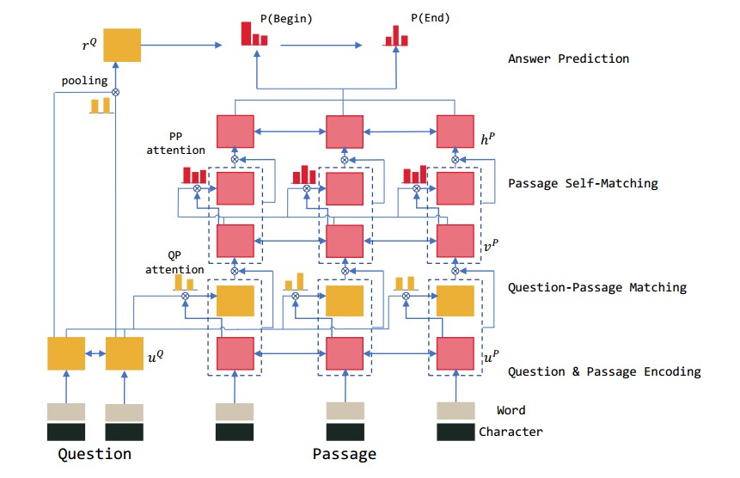

Slide 3
Reference

