Slide 1
Transfer Learning

Slide 2
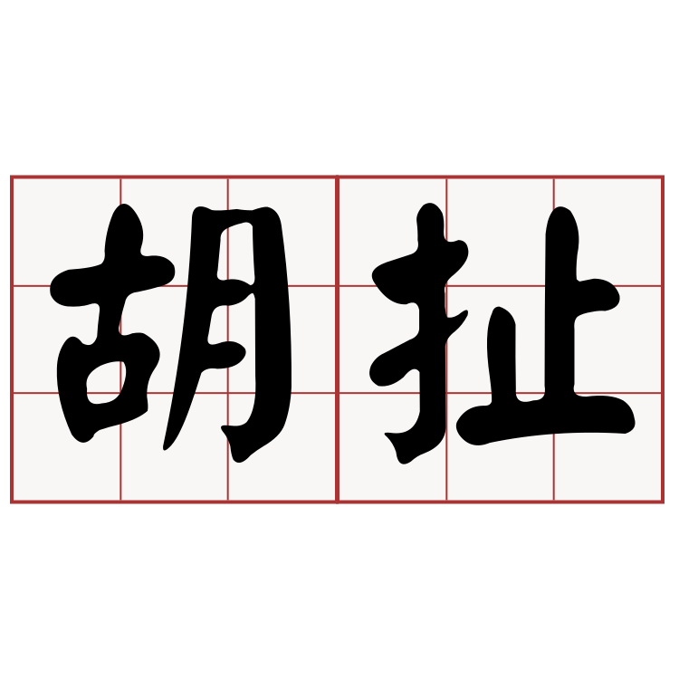
没有大量数据，想训练CNN，门都没有！

Slide 3
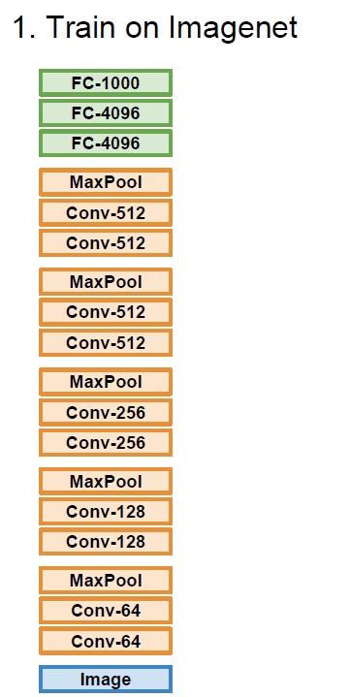
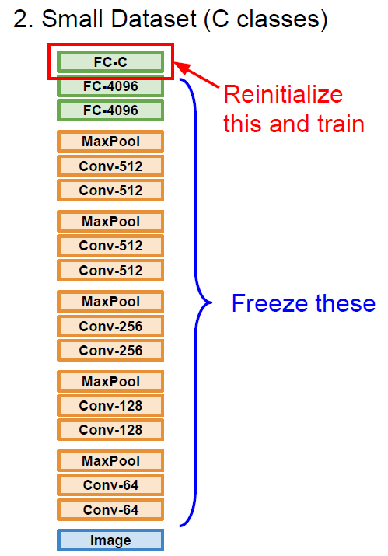
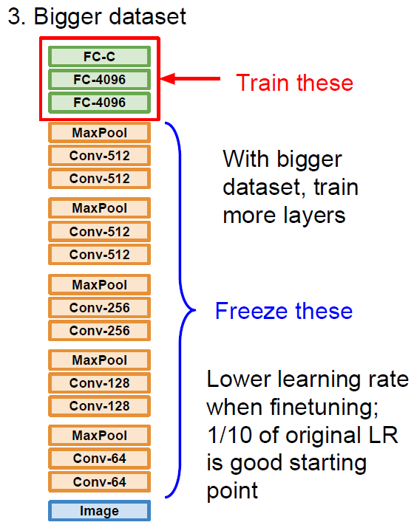
迁移学习

Slide 4
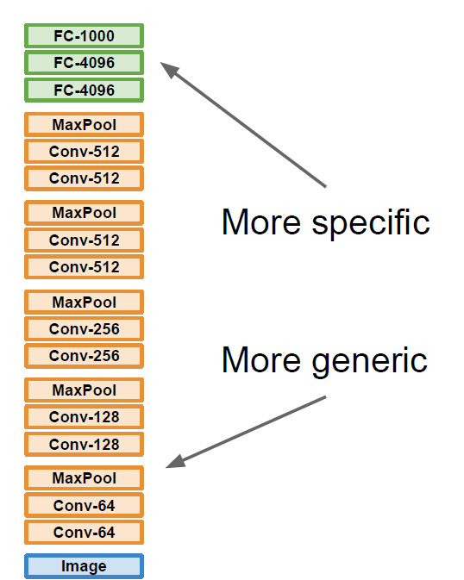
 | very similar dataset | very different dataset
very little data | ? | ?
quite a lot of data | ? | ?

Slide 5
 | very similar dataset | very different dataset
very little data | Use Linear Classifier on top layer | ?
quite a lot of data | Finetune a few layers | ?

Slide 6
 | very similar dataset | very different dataset
very little data | Use Linear Classifier on top layer | You’re in trouble… Try linear classifier from different stages
quite a lot of data | Finetune a few layers | Finetune a larger number of layers

Slide 7
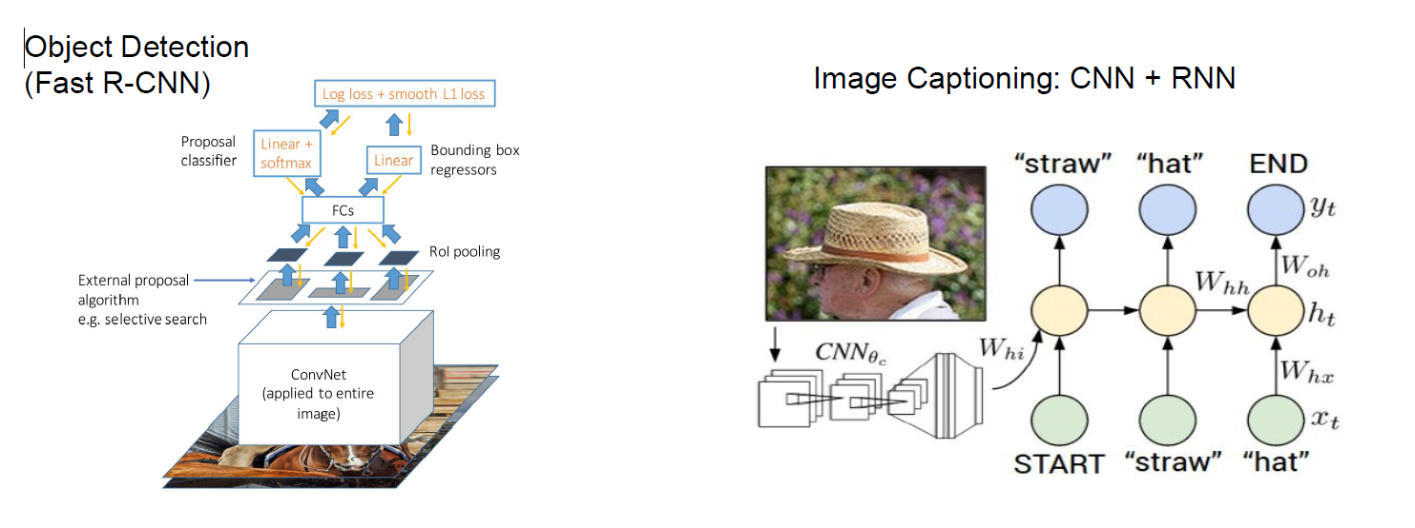
迁移学习是为常态

Slide 8
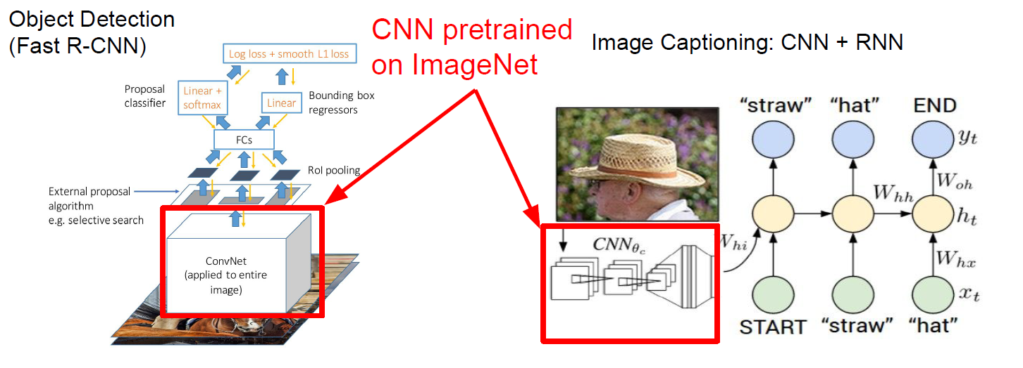
迁移学习是为常态

Slide 9
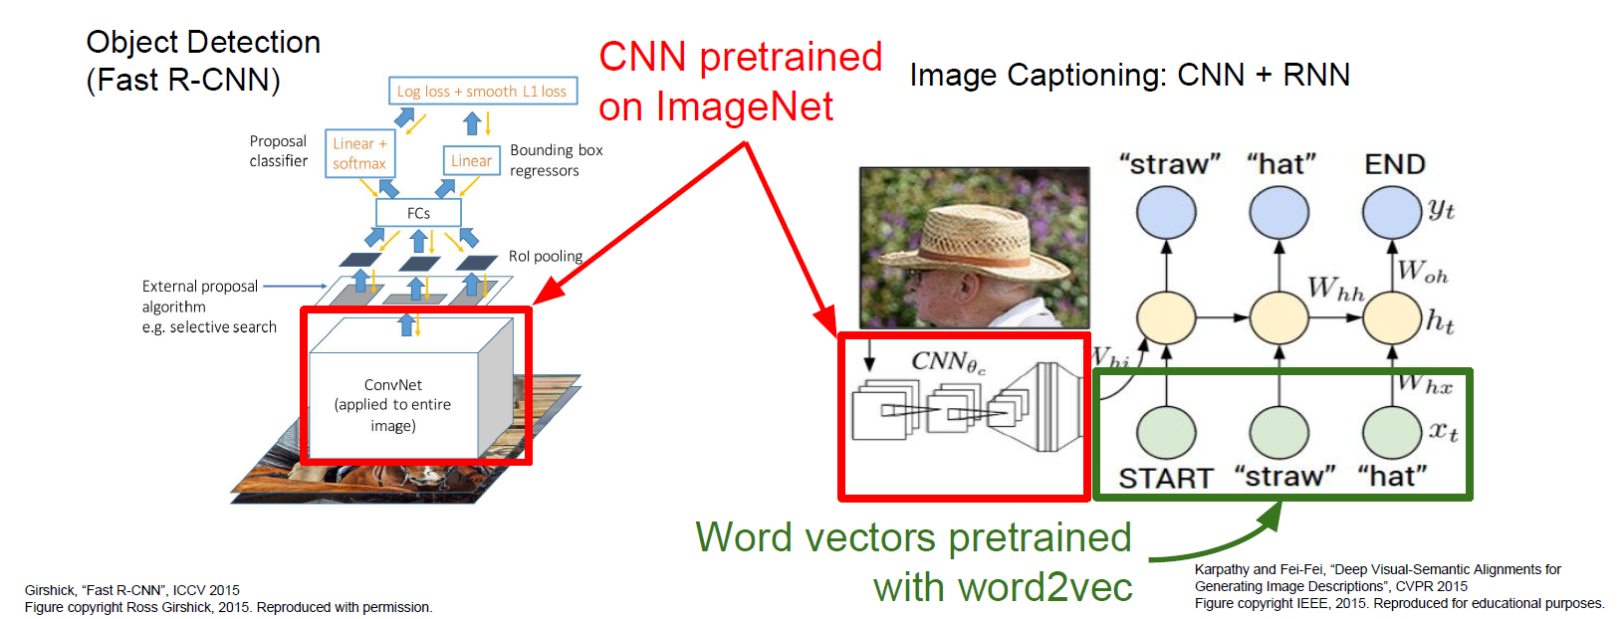
迁移学习是为常态

Slide 10
Takeaway
Have some dataset of interest but it has < ~1M images?
Deep learning frameworks provide a “Model Zoo” of pretrained models so you don’t need to train your own
Caffe: https://github.com/BVLC/caffe/wiki/Model-Zoo
TensorFlow: https://github.com/tensorflow/models
PyTorch: https://github.com/pytorch/vision

Slide 11
Reference
Fei-Fei Li. CS231n: Convolutional Neural Networks for Visual Recognition, Spring 2017.
https://github.com/flyyufelix/cnn_finetune

