Slide 1

Future-oriented Benchmarking Through Social Media Analysis
Claudino Alves
Harshil Haumeer

Slide 2
Client: Dr. Richard Griffith
Department of Psychology
Faculty
Sponsor:
Dr. Philip Chan
Department of Computer Science

Slide 3
Progress of Current Milestone
Task | Completion | Claudino | Harshil | To do
Investigate/Select Tools | 100% | 30% | 70% | None
Investigate and select algorithms | 100% | 40% | 60% | None
Select collaboration tools | 100% | 50% | 50% | None
Demo Sentiment Analysis tool, “Hello World” demo | 100% | 80% | 20% | None
Requirement Document | 100% | 0% | 100% | None
Design Document | 100% | 80% | 20% | None
Test Plan | 100% | 0% | 100% | None

Slide 4
Discussion of each accomplished task for current milestone:
Task 1: The proper tools, including programming language, framework, AI were investigated. We are using python as our programming language and Django as a framework. For our sentiment analysis, we are using IBM Watson.
Task 2: We looked up the algorithms that we will be using for our project. We researched on text classification algorithm which will be the first algorithm that will be used.
Task 3: For the collaboration tools, we are using Gmail, Google Drive, Google docs and GitHub. For easy and quick communication, text messaging system is being used.

Slide 5
Discussion of each accomplished task for current milestone:
Task 4: A demo for sentiment analysis has been done. A small program which takes text as input and gives out sentiment value with categorization and sentiment value.
Task 5: The software requirement specification documentation has been completed. It includes all the content and standards specified on the IEEE website.
Task 6: The design document has been completed. It includes all the content and standards specified on the IEEE website.
Task 7: The test plan has been completed. It includes all the content and standards specified on the IEEE website.

Slide 6
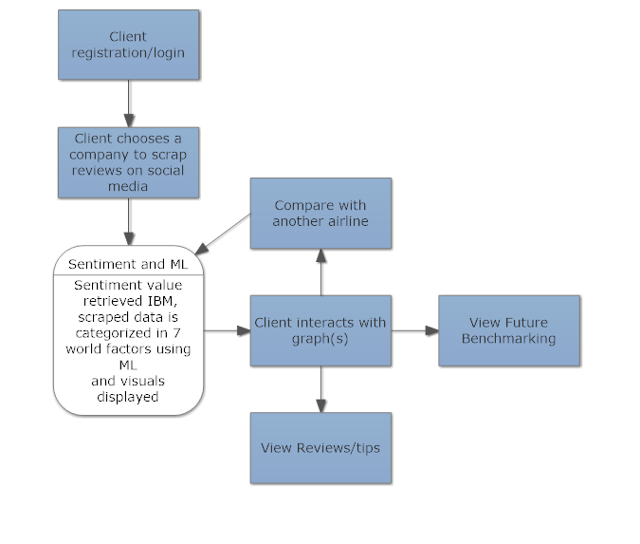
System Architecture Design

Slide 7
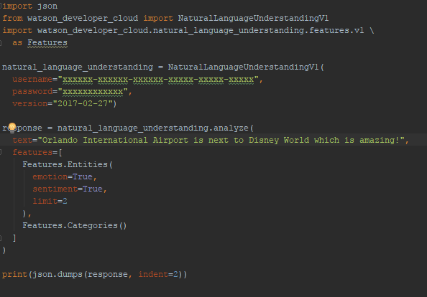

Sentiment Analysis, “Hello World” Demo

Slide 8
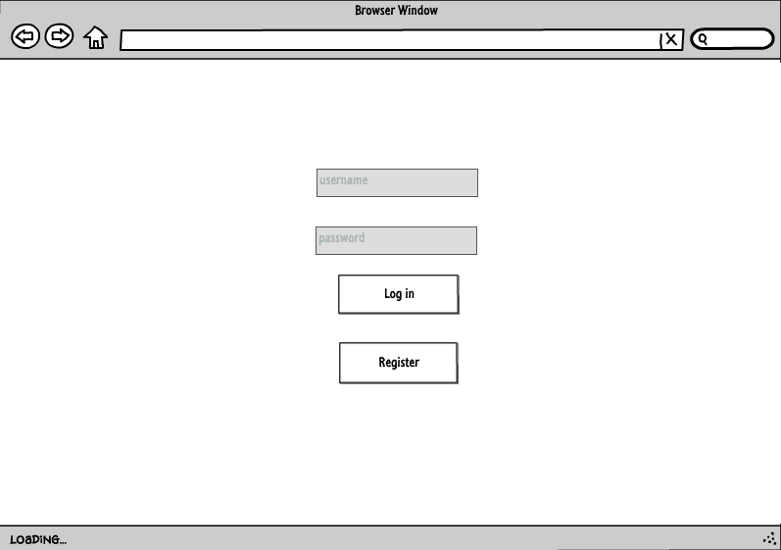
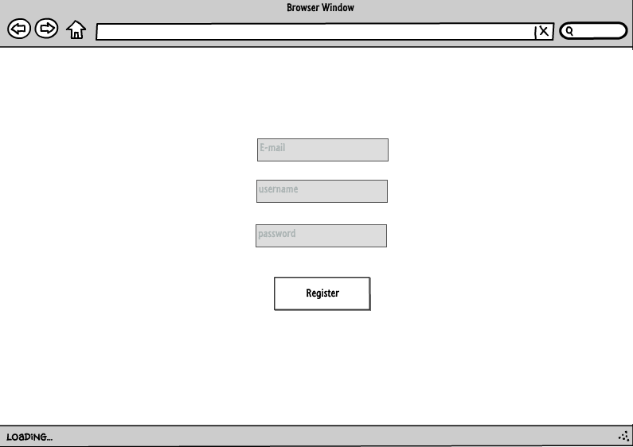
Design – User Interface
Log in / Register

Slide 9
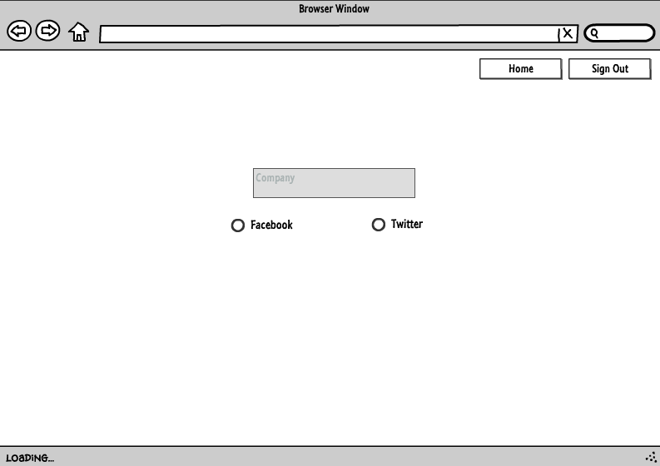
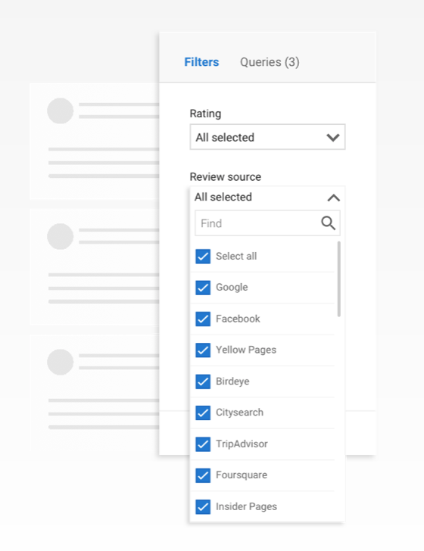
Design – User Interface
Web-Scrapping : Selection of Scrapping source

Slide 10
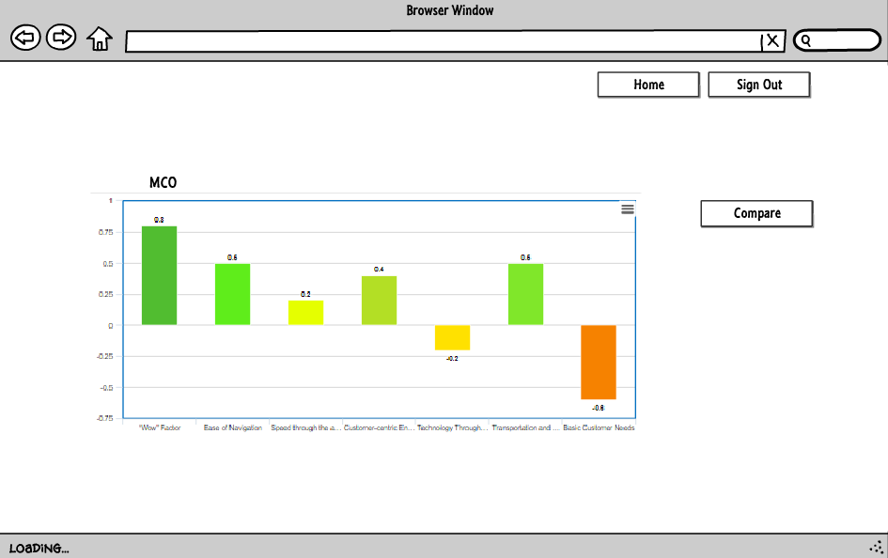
Design – User Interface
Result from Web-Scrapping

Slide 11
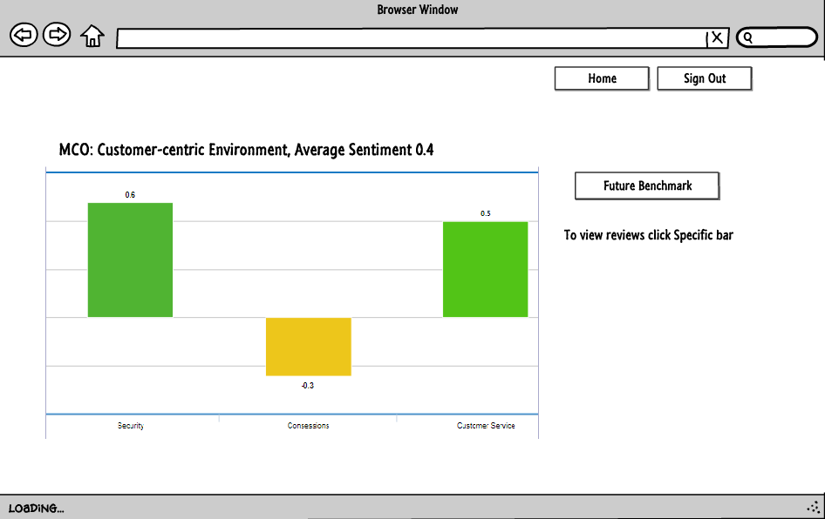
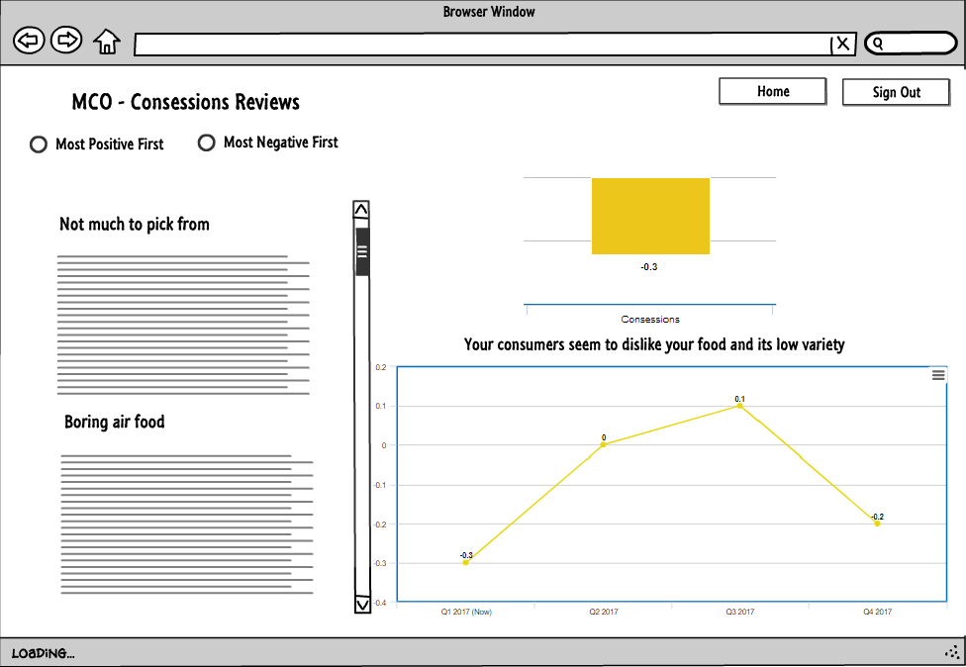
Design – User Interface
Drill-Down

Slide 12
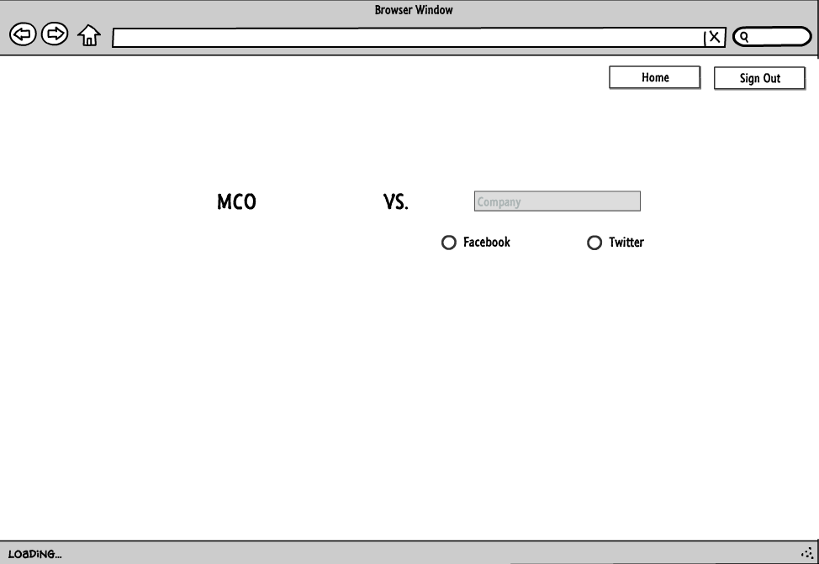
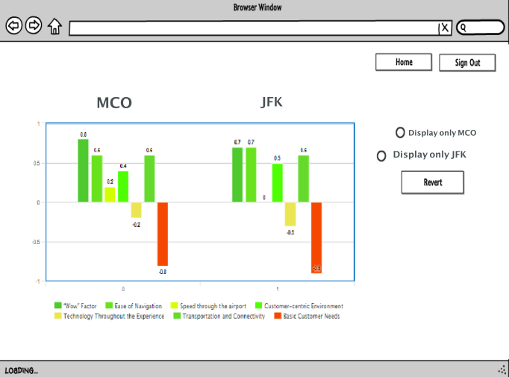
Design – User Interface
Benchmark Analysis : Overview of sentiment score

Slide 13
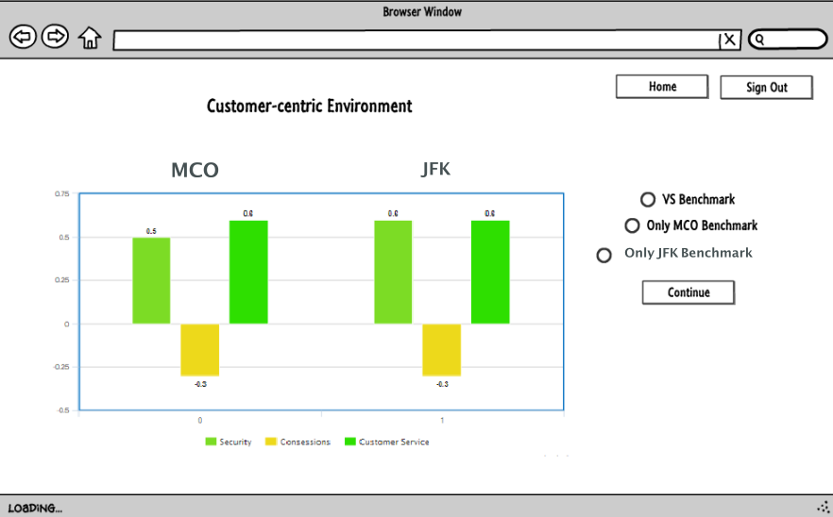
Design – User Interface
Benchmark Analysis : Specific Factor

Slide 14
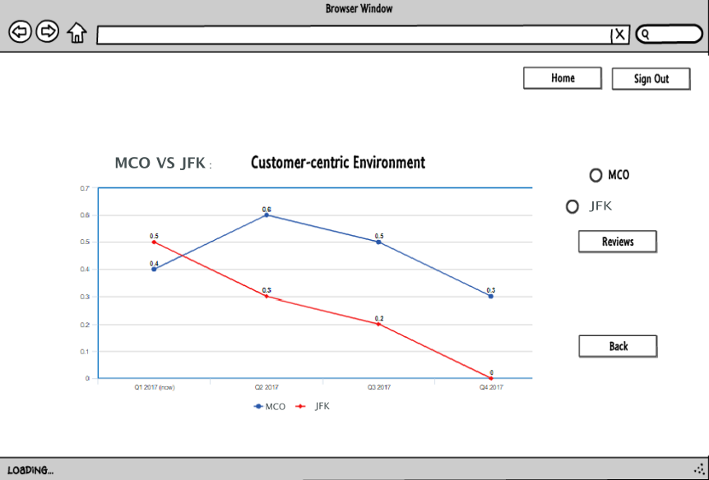
Design – User Interface
Trend Analysis : Specific Factor

