Slide 1

Crystal Advanced Analytics (Future-oriented Benchmarking Through Social Media Analysis)
Team Member: Harshil Haumeer

Slide 2
Client: Dr. Richard Griffith Faculty Sponsor: Dr. Philip Chan

Slide 3
Goals And Motivation
Create a system to:
Allow organizations(Airports) to improve their services based on customers’ feedback.
Show where an organization is performing well and underperforming.
Identify and analyze the root-cause of underperformance in a particular service.
Allow the organization to compare its services to that of a competitor.

Slide 4
Approach
Web Scraping for data retrieval
Reporting Platform; BrightLocal
Data retrieved through API calls.
Text Classification system
Use data(reviews/ratings) from BrightLocal
Sorted into categories
7 World class factors
Use of Naives Bayes Algorithm with machine learning
Use of Decision Tree Classifier (Back-up)

Slide 5
Approach
Sentiment Analysis
Identify the attitude/sentiments of the customers through their words and feedback
Sentiment score assigned to reviews without a rating
Use of TextBlob library
Benchmarking Analysis
Allow businesses to see how they are performing in comparison to their competitors
Compare a particular service to a competitor’s respective service
E.g. Comparing MCO’s speed to JFK’s speed category

Slide 6
Approach
Root-Cause Analysis
Identify the reason behind an underperformance
Identify keywords and repeating words in negative review

Slide 7
Novel Feature
The system will:
Allow users to get reviews from multiple social media under one main website
Reviews will automatically be classified into categories(services)
Sentiment scores will be assigned to reviews without ratings.
Identify root cause of under-performance.
All the features will be available under one platform; Website

Slide 8
Challenges
Text classification with machine learning Algorithms
Sentiment analysis
Advanced python usage
Speed and Efficiency
API endpoints

Slide 9
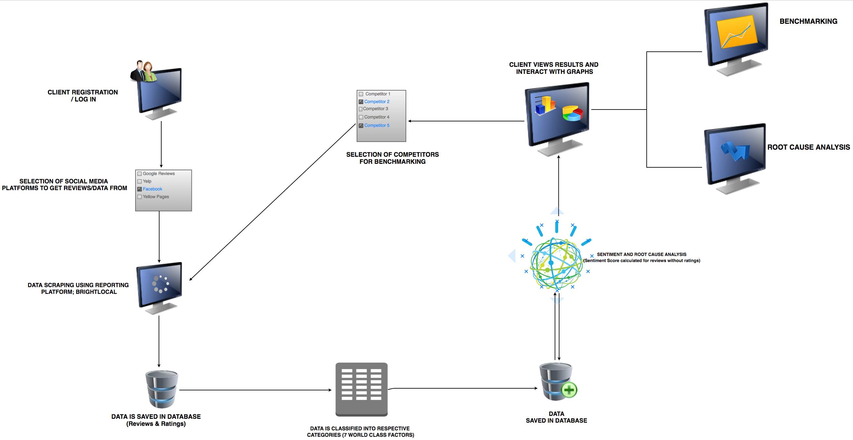
Overview Of System Architecture

Slide 10
Progress Summary
Task | Completion | To do
Implement web scrapper (Use of BrightLocal) | 100% | None
Implement Text Classifier | 80% | Train with more data. Accuracy at 57% (initially 25%)
Implement sentiment score analyzer | 100% | None
Setup up website | 60% | Improve Graphs, Add more features
Implement Benchmarking tool | 20% | Add option to select from multiple competitors
Implement Root Cause Analysis | 0% | Implement root cause analysis. Highlight and keywords

Slide 11
Milestone 4
Implement, Test and Demo Benchmarking tool
Add option to allow users to selected competitors
Improve website GUI to include benchmarking tool
Improve text classification accuracy
Currently at 57%

Slide 12
Milestone 5
Implement, test and demo root cause analysis
Improve website GUI to include root cause analysis tool

Slide 13
Milestone 6
Add specific features such as review original comments/reviews from customers sorted by categories and ratings/ sentiment score polarity.
Complete website
Test/Demo entire system
Create User Manual
Create Demo Video

