Slide 1

Crystal Advanced Analytics (Future-oriented Benchmarking Through Social Media Analysis)
Team Member: Harshil Haumeer

Slide 2
Client: Dr. Richard Griffith Faculty Sponsor: Dr. Philip Chan

Slide 3
Goals And Motivation
Create an automated system to retrieve and analysis data from social media platforms
Identify customers’ emotions through feedback
Compare services to competitors
Understand root cause of dissatisfaction
Allow businesses to see where there are performing well and underperforming

Slide 4
Approach
Web Scraping for data retrieval
Reporting Platform; BrightLocal
Text Classification system
Use data from BrightLocal
Sorted into categories
7 World class factord
Use of Naives Bayes Algorithm with machine learning
Use of Decision Tree Classifier

Slide 5
Approach
Sentiment Analysis
Identify the attitude/sentiments of the customers through their words and feedback
Classify content into leaf node based on categories; Positive or Negative
Benchmarking Analysis
Allow businesses to see how they are performing in comparison to their competitors
Compare particular categories to that of competitor’s respective category
E.g. Comparing MCO’s speed to JFK’s speed category

Slide 6
Approach
Root-Cause Analysis
Sort negative reviews
Identify keywords in negative reviews

Slide 7
Novel Feature
Live Data from reporting platform
Data will be classified into their respective categories
Sentiment scores will be assigned to reviews without ratings
Identify root cause of negative reviews
All the features will be available under one platform; Website

Slide 8
Challenges
Data Mining
Text classification with machine learning Algorithms
Advanced python usage
Speed and Efficiency
Api endpoints

Slide 9
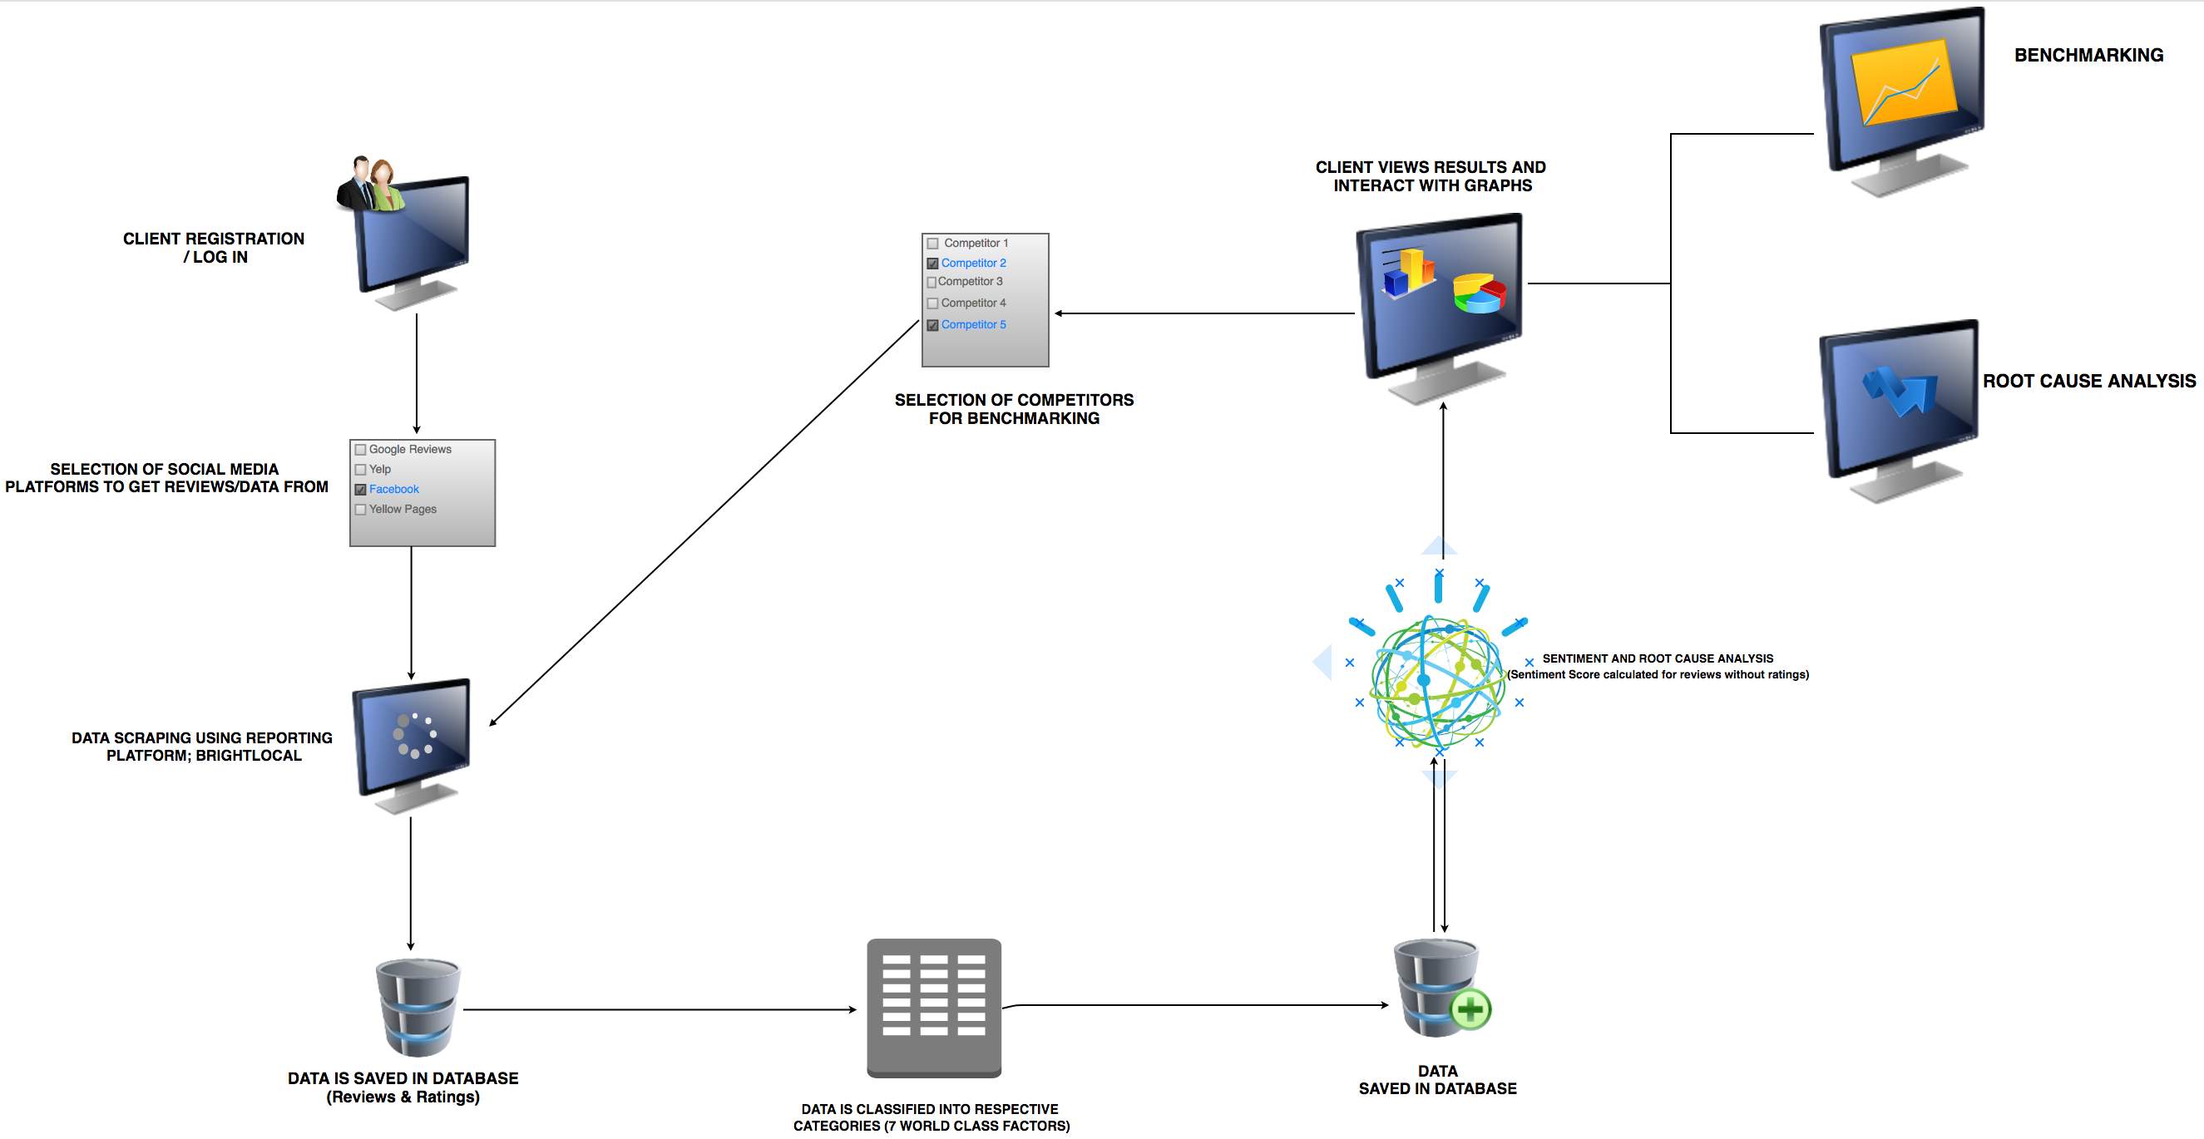
Overview Of System Architecture

Slide 10
Progress Summary
Task | Completion | To do
Implement web scrapper (Use of BrightLocal) | 100% | None
Implement Text Classifier | 80% | Train with more data. Accuracy at 57% (initially 25%)
Implement sentiment score analyzer | 100% | None
Setup up website | 60% | Improve Graphs, Add more features
Implement Benchmarking tool | 20% | Add option to select from multiple competitors
Implement Root Cause Analysis | 0% | Implement root cause analysis. Highlight and keywords

Slide 11
Milestone 4
Implement, Test and Demo Benchmarking tool
Add option to allow users to selected competitors
Improve website GUI to include benchmarking tool
Improve text classification accuracy
Currently at 57%

Slide 12
Milestone 5
Implement, test and demo root cause analysis
Improve website GUI to include root cause analysis tool

Slide 13
Milestone 6
Add specific features such as review original comments/reviews from customers sorted by categories and ratings/ sentiment score polarity.
Complete website
Test/Demo entire system
Create User Manual
Create Demo Video

