Slide 1


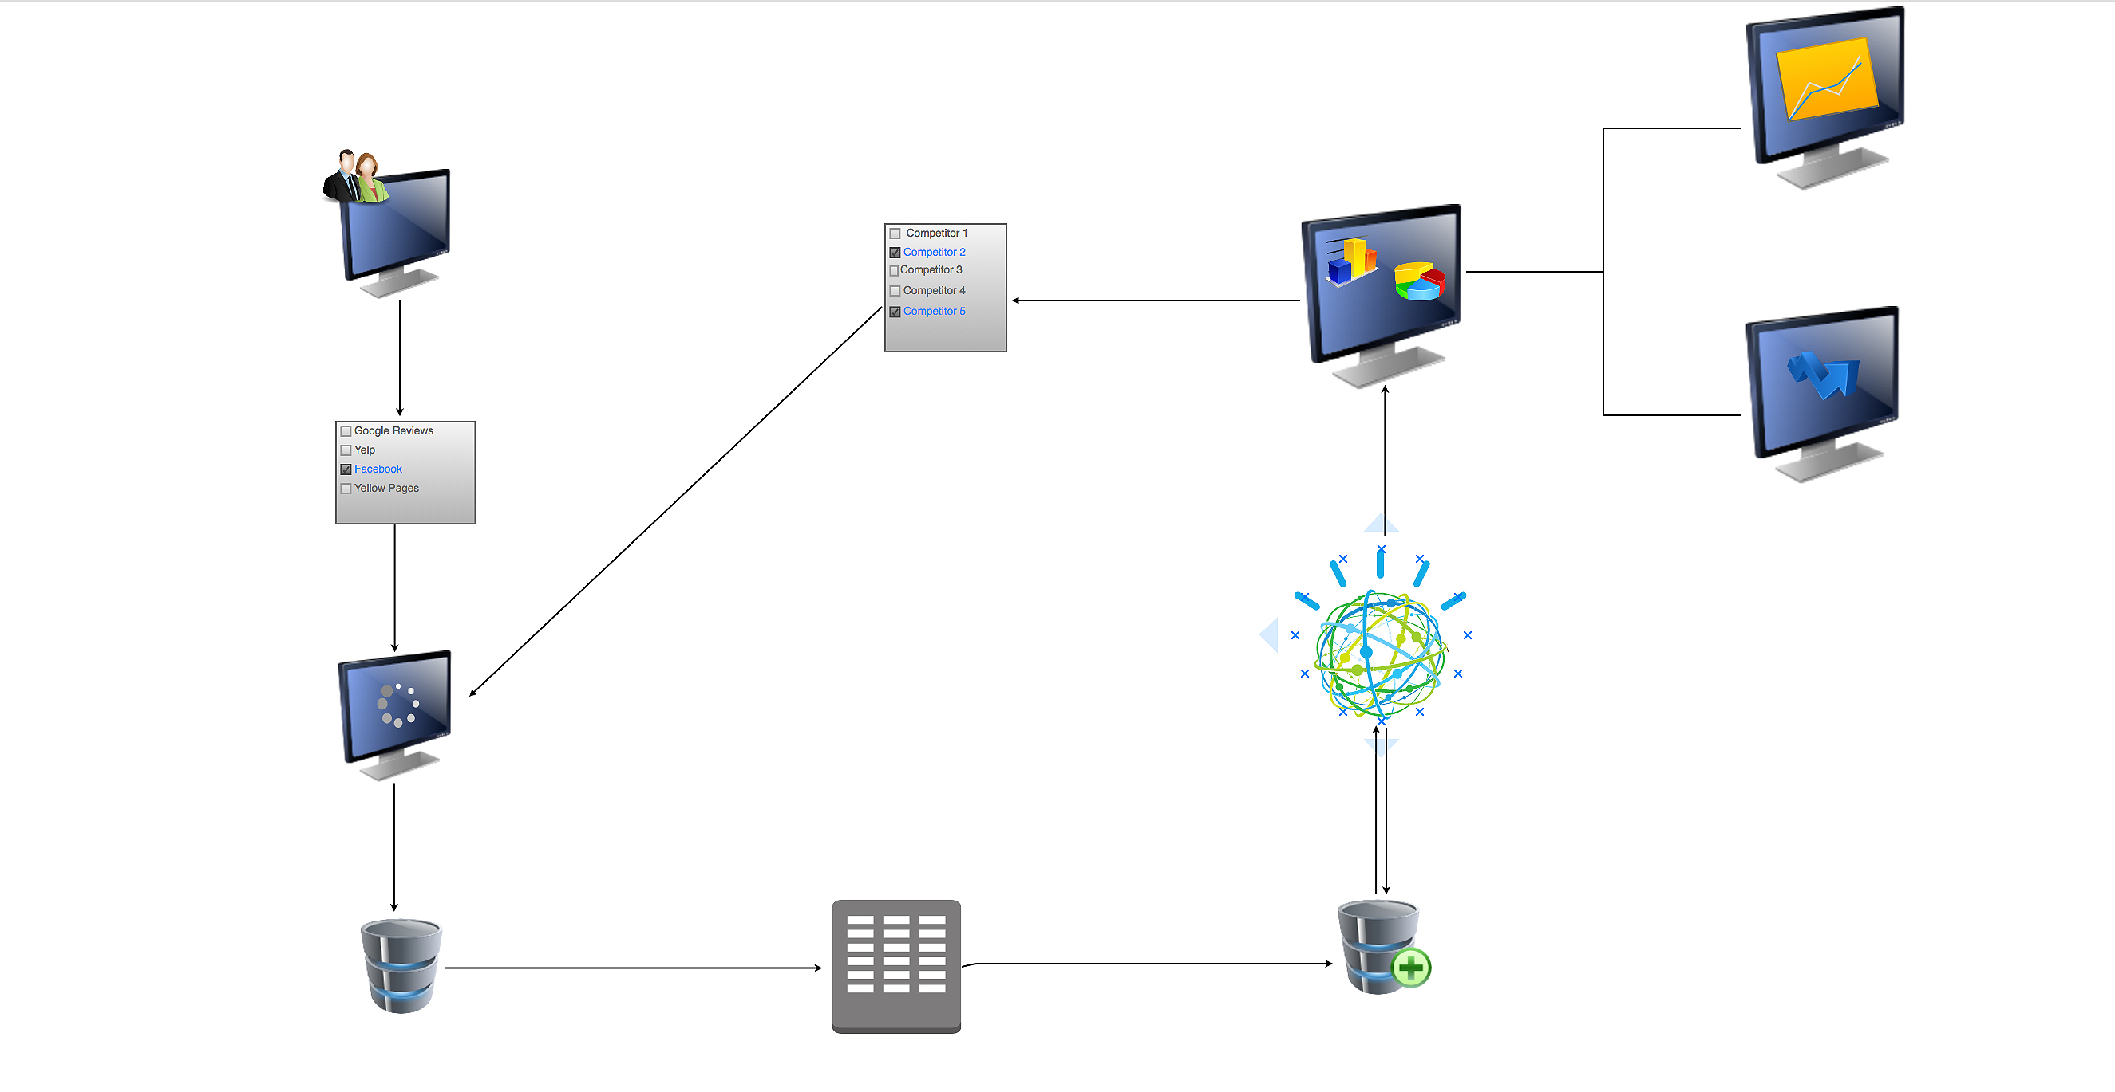
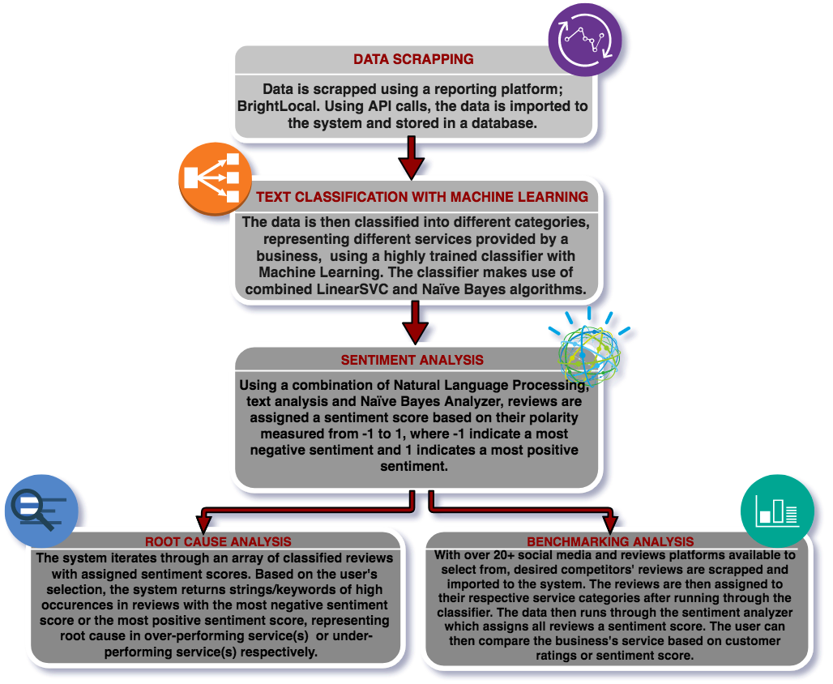
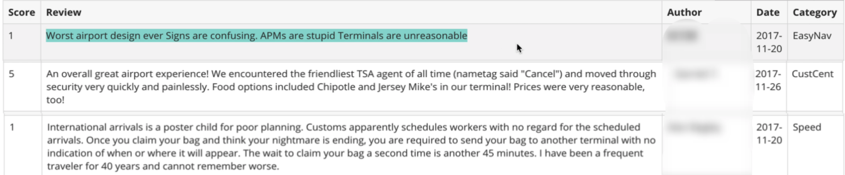
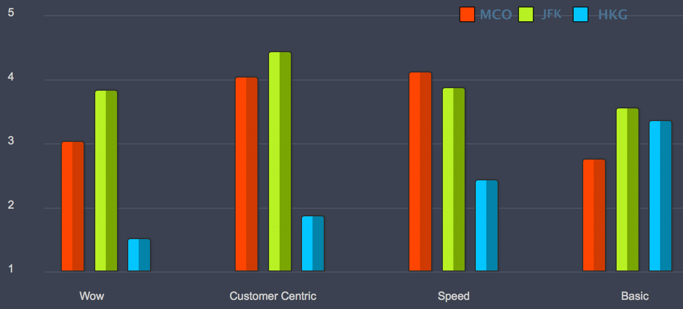
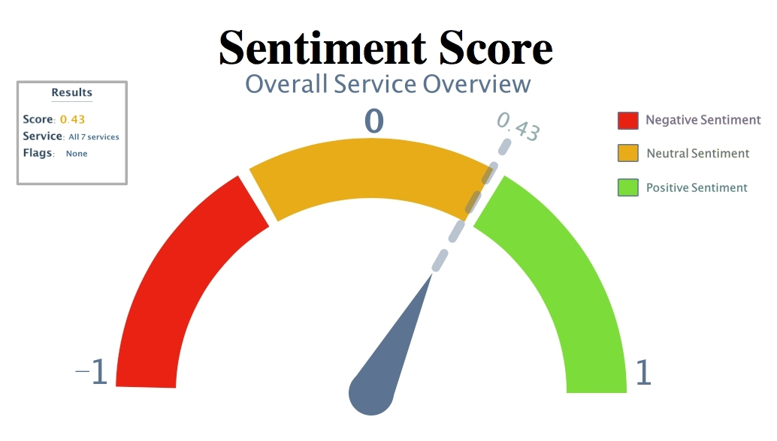
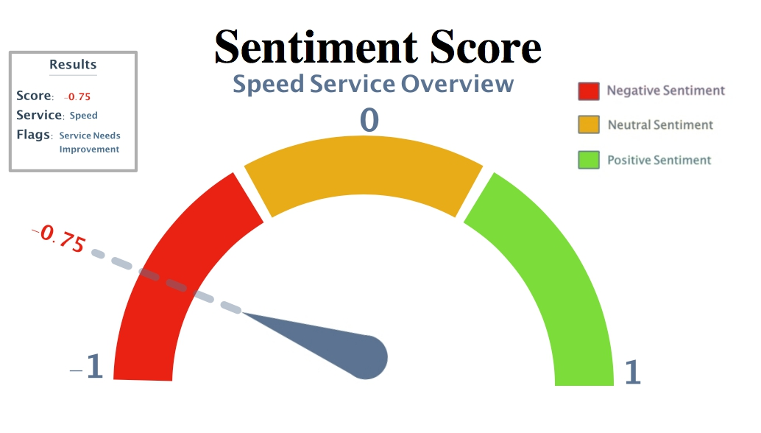
CRYSTAL ADVANCED ANALYTICS
Social Media Analysis
Harshil C. Haumeer
Faculty Advisor: Dr. Philip Chan, School of Computing, Florida Institute of Technology
Abstract
System Architecture
Tools
Crystal Advanced Analytics (CAA) is a web application designed to help businesses improve their services based on customers’ experiences and feedback retrieved from social media platforms. This project is focused mainly on customers’ experience at airports.
PyCharm: Used for backend development and api-endpoints
BrightLocal: Reporting Platform used for web scrapping.
Angular2: Front end Java Script framework.
Machine Learning: Used to train the system’s classifier unit.
Django 2.0: Python framework used for backend implementation. Standardizes relation between database, model, API endpoint and view.
Django Rest Framework API: Links backend to front end using industry standard REST API protocol.
Python 3.6: Language used for implementation of system.
User Log in/ Registration
Select competitors
Benchmarking
Select social media platform(s)
View results and interaction with graphs
Root Cause Analysis
Features
Data scraping
Sentiment & root cause analysis
Live Data: CAA allows businesses to retrieve and access real-time data from over 20+ social media platforms.
Automated Data Classification: Reviews retrieved from social media platforms are automatically classified into their respective categories for an easy service overview.
Sentiment Analysis: CAA has an integrated sentiment analyzer which allows businesses to better understand their customers’ sentiment expressed in their feedback.
Root-Cause Analysis: CAA identifies the root cause(s) for an over/under performance in particular service(s) which helps businesses understand what they are doing right/wrong, so they can maintain their service performance or fix the issue.
Benchmarking: CAA allows businesses to compare their service performance as well as their customers’ sentiment expressed towards their service to that of their competitors.
Store data in database
Data saved in database
Classification of data
Approach
Results
Fig 1.1
Fig 1.1- Sample of classified reviews into respective service category for Orlando International Airport
Fig 1.2
Fig 1.2 – Graph representing Benchmarking of individual services comparing Orlando International Airport v/s John F. Kennedy Intl’ Airport and Hong Kong Intl’ Airport
Fig 1.3
Fig 1.4
Fig 1.3 - Sentiment Score for overall service Overview including 7 services offered by Orlando International Airport
Fig 1.4 - Sentiment Score for Speed service of Orlando International Airport
Acknowledgements
Dr. Richard Griffith – Executive Director, Institute for Cross Cultural Management. School of Psychology, Florida Institute of Technology
Hairong Jiang – Research Scientist, Institute for Cross Cultural Management, Florida Institute of Technology

