Slide 1

NETWORK
FOCIAL

Slide 2
FOCIAL NETWORK
PITCH DECK
2024

Slide 3
About US
FOCIAL NETWORK is an organization that provides a WEB3-based, decentralized social media platform service and will continue to develop many projects in the field of SocialFi in the future.
FOCIAL is a cryptocurrency produced to be used in projects developed by the Focial Network Organization. FOCIAL is a token. It is a token produced according to BEP20 standards on the Binance Smart Chain network. It will be used in various projects of Focial Network and its usage areas will be further expanded.
NETWORK
FOCIAL

Slide 4
Vision &
Mission
Vision
Mission
It is the vision of protecting people's data while users interact on social media platforms produced in the Focial Network ecosystem and enabling them to earn money through interaction.
Focial Network has examined in detail the problems created by centralized WEB2 structures and aims to bring a new breath by examining the solutions provided by decentralized, WEB3 structures.
Our most important rule is to use decentralized platforms in a transparent, secure and unrestricted manner.
Focial Network's mission is to provide and continuously improve unique decentralized structure solutions to its users. It continues to develop its projects with new and unique solution proposals by producing projects in the field of SocialFi.
NETWORK
FOCIAL

Slide 5

NETWORK
FOCIAL
FOCIAL
PRODUCT

Slide 6



CHITCHAT!
ChitChat is Focial Network's WEB3 and Blockchain based SocialFi project. ChitChat is a social media platform where users can share their thoughts freely and safely. Users can also turn the interactions they get from the posts they share into profit. Thus, you will experience the privilege of making money while having fun!
NETWORK
FOCIAL

Slide 7

TOKEN NAME: FOCIAL NETWORK
SYMBOL: FOCIAL
CONTRACT ADDRESS (BSC):
HTTPS://BSCSCAN.COM/TOKEN/0X23FC11FA7F0A47308785B071A6A1FAA20DABAEF1
TOTAL SUPPLY: 500.000.000 FOCIAL
DECIMAL: 18
NETWORK
FOCIAL

Slide 8
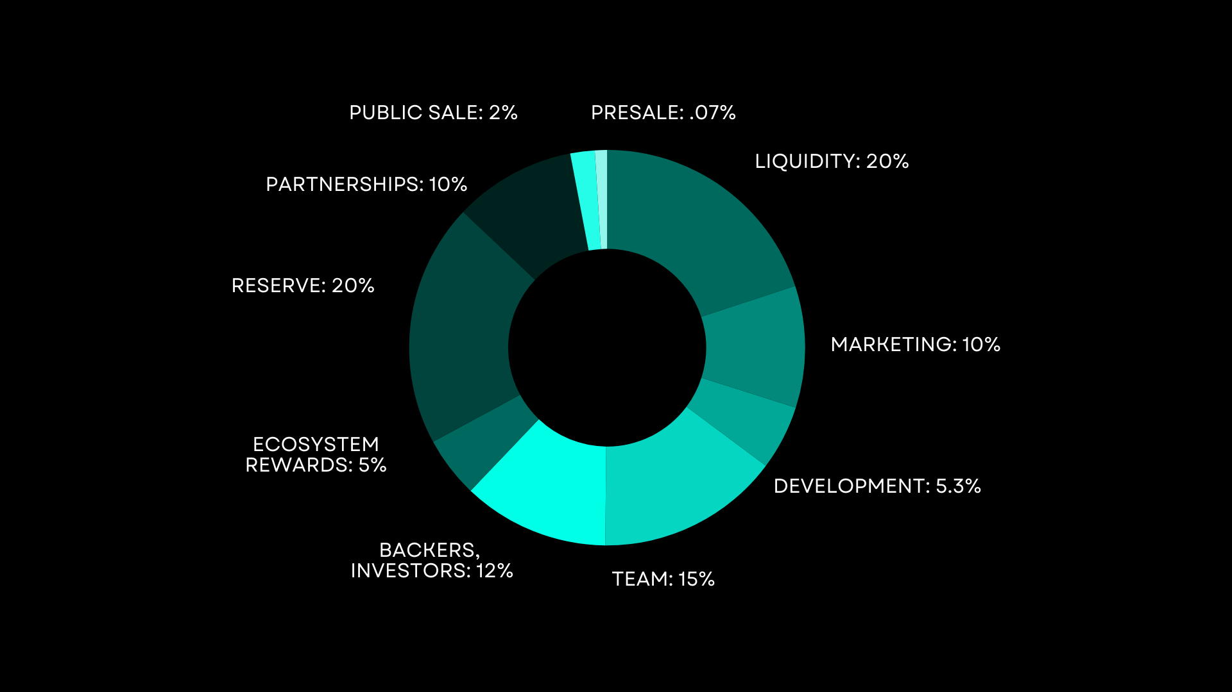
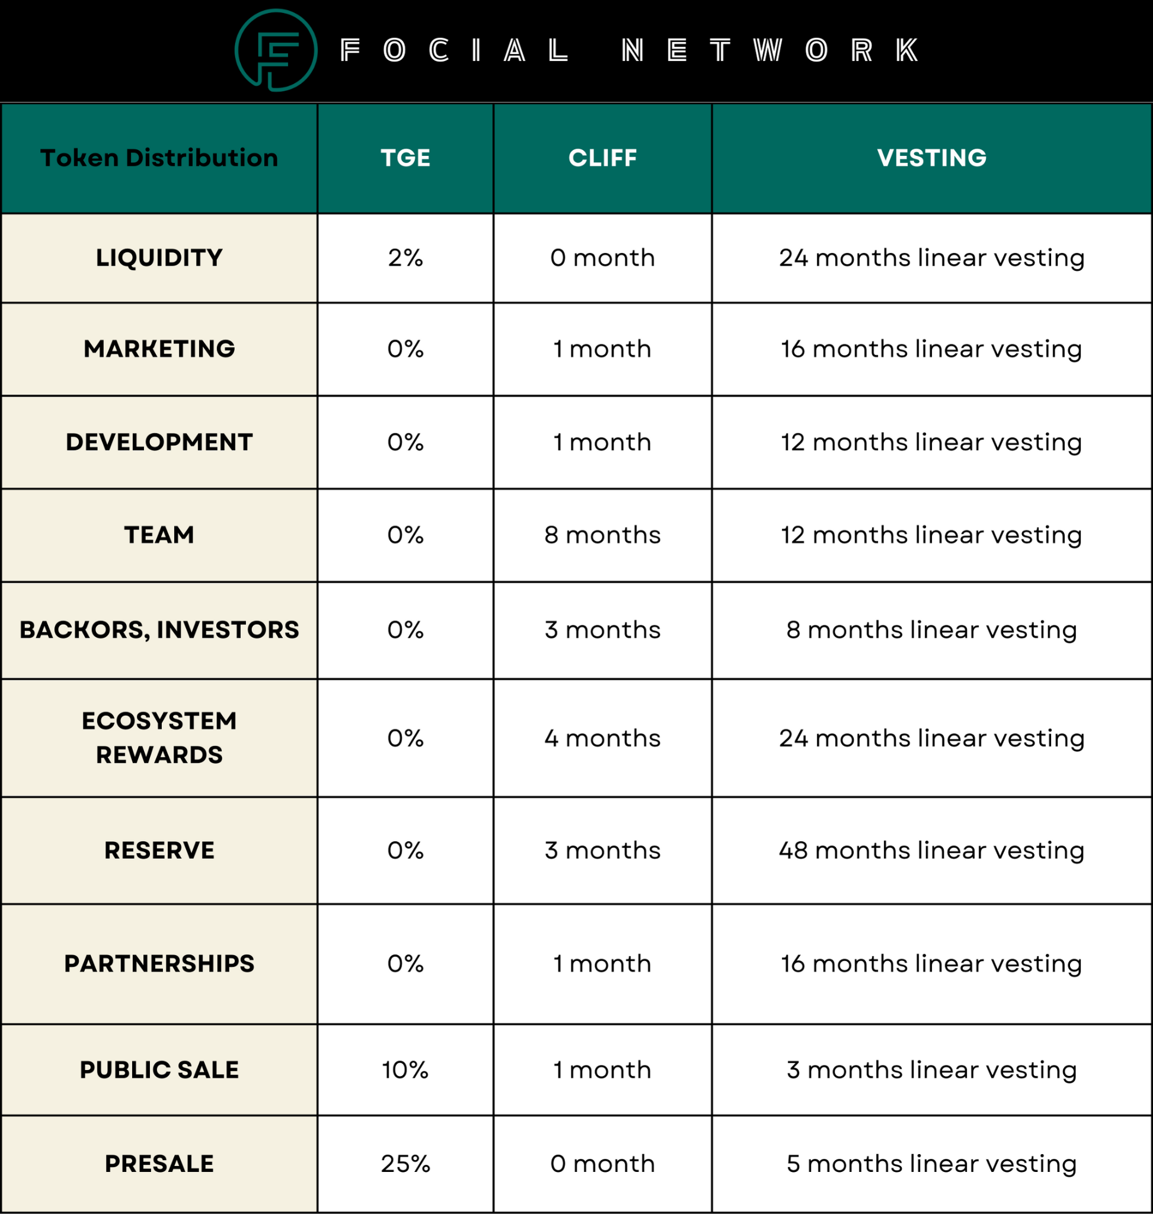
NETWORK
FOCIAL
Tokenomics

Slide 9

FOCIAL NETWORK ROADMAP
4TH Q, 2023
1ST Q, 2024
2ND Q, 2024
3RD Q, 2024
MARKET RESEARCH STAGE
DEVELOPMENT &
BUILDING STAGE
MARKETING & LISTING STAGE
NEW PROJECT
STAGE
NETWORK
FOCIAL

Slide 10
www.focialnetwork.com
docs.focialnetwork.com
CONTACT &
FOLLOW
US
dapp.focialnetwork.com
https://t.me/focialnetworkchat
https://t.me/focialnetworkchannel
https://twitter.com/focialnetwork
contact@focialnetwork.com
https://github.com/focialnetwork

