Slide 1
Model-driven development of Web Services and hypertext applications
Politecnico di Milano
Italy
M. Brambilla, S. Ceri, S. Comai,
P. Fraternali, I. Manolescu

Slide 2
Outline
Motivations
Model-driven Web application development
  Web Modeling Language
From data-centric to process and service centric applications
  Requirements
  Extending WebML with service modeling primitives
  Extending WebML with workflow modeling primitives
Implementation notes
(excursus) Workflow primitives
Ongoing and future work

Slide 3
Motivation: Extension of
Data-intensive Web applications
DDWA Enable users to access and/or manipulate content through the Web
A “complete” modelling language should support:
  Web Services as a means of interfacing to peer systems
  Workflow primitives to structure the interaction (human 2 application, application 2 application)
HTTP
HTTP
Data-intensive
Web appl.
Database communication
protocol (e.g. JDBC…)
Database

Slide 4
Conceptual modeling: where & why
Data Design:
  E/R or UML help describe data requirements visually in a platform independent way
  Easily mapped to different logical models
Hypertext Design:
  Hypertextual interfaces (content+navigation) should also be modelled at high level in a platform independent way
  Hypertext diagrams should be (easily) mapped to physical structures (page templates, data extraction components, ..)

Slide 5
Example: E-R schema for a ski portal web site
RoomOffer
ID
RoomType
StartDate
EndDate …
Hotel_Offer
User
1:1
ID
Name
Pwd
email
0:N
Hotel
Slope
Resort
ID
Name
Stars
Descr.
Hotel_Res
ID
Name
Map
Res_Sl
ID
Name
Difficulty
LiftType
1:1
1:N
1:N
1:1
0:N
Customer
Manager
Hotel_Rv
Reservation
Code
ID
RoomType
Details..
Rv_Client
CardNo
Address
PayMethod
1:1
1:1
0:N

Slide 6
Hypertext modeling:
SITEVIEW, AREA, PAGE
Siteview: a set of pages and/or areas forming a coherent view of the site. Multiple site views can be defined on the same data model for different users or publication media
Area: a set of logically homogeneous pages
  Example: Sections of a portal
Page: a container of one or more pieces of information shown to the user at the same time
Customer site view
Resort area
All
Resorts
Resort
Details
Slope
Details
Home
page
Contact
us

Slide 7
Ski Portal hypertext:
Customer site view
Resort details
ResData
Slopes
All resorts
Home page
ProdIndex
RIndex
Resort
Slope
[Res2Slope]
Resort
Slope details
ResData
Slope data
Arrows = links
Navigation
Context transport
Resort
[slope2res]
Slope

Slide 8
Ski Portal hypertext:
Manager site view
All resorts
All hotels
ProdIndex
ResortData
RIndex
New hotel
NewHotel
Resort
Resort
ProdIndex
HIndex
Hotel
DeleteHt
Hotel
[ResortToHotel]
CreateHt
Connect
Hotel
New Hotel
Name
Descr
Hotel
HotelToResort

Slide 9
From data-centric to service & process centric applications
WebML models synchronous user-driven applications
  Nothing happens until the user clicks
  Interfaces are displayed to humans
  Navigation is (quite) unconstrained
B2B applications and enterprise application integration demand:
  Application-to-application interfaces
  Asynchronous interactions
  Workflow enactment and control (constraints on users’ navigation)

Slide 10


Application scenario
Ski Portal stores touristic info on resorts and slopes plus name/address of hotels
  Reservations are done through the HMS web services
  Payment is done through the PS web services
  The HMS also delivers auxiliary services usable by the Ski Portal (e.g., hotel news, event notifications, user comment management)
Hotel management
system (HMS)
Ski portal
HTTP
Web appl.
Web service
operations
Resorts
Ski slopes
Hotels
Clients
Reservations
HTTP
Payment system (PS)

Slide 11
Types of interactions
(as envisioned in WSDL)
Central component of a web service: operation = 1 or 2 msg
Two-message operations may be used
  Synchronously: the sender waits between 1st and 2nd msg
  Asynchronously: the sender does not wait between msgs
  Request-response
  Solicit-response
  Notification
  One-way
Ski portal
HMS
One-way subscription to hotel news
Hotel news notification
Get room offers request
Room offer response
Concert tickets solicit
Concert tickets response

Slide 12
Conversations
A Web service conversation is a set of correlated messages involving one or more Web services (and Web applications)
Conversations entail additional semantics
  Messages belonging to the same conversation must be recognized and traced
  Timeouts or error conditions can be specified for the messages of a conversation
  Exceptions should be handled

Slide 13
Extending WebML to support interactions with web services
Goal: modeling the interaction between the Web application, the human users, and the remote systems
New modeling primitives are required:
  Data model: specific entities modeling the interaction history with Web services
  Hypertext model: primitives for handling the various classes of service operations
Run-time support for Web services
  Ability of exchanging messages
  Integration of application data and Web services XML messages
  Support for conversations

Slide 14
Meta-data model for supporting Web services
OperationType
OpName
ConvType
MessageType
In
PartOf
PortName
Name
1:1
0:1
Binding
1:1
1:N
Name
Timeout
Format
Out
ServiceName
1:1
0:1
NetworkAddress
0:N
0:N
Timeout
0:N
1:1
1:1
1:1
Message
In
Operation
PartOf
Conversation
Instance
1:1
0:1
Instance
Instance
1:1
1:N
Content
Out
TimeStamp
TimeStamp
1:1
0:1
Status

Slide 15
New WebML constructs for supporting Web services
One WebML operation for each class of Web service operations
ReqRsp
SolRsp
AsReqRsp
AsSolRsp
OneW
Notif
ConvName
ConvName
ConvName
ConvName
ConvName
ConvName
Marks for operations that start, resp. end conversations
ReqRsp
ReqRsp
ConvName
ConvName

Slide 16
WebML service operations are macros
Create a new Conversation Instance
Create a new Operation Instance
  Name=“getOffer", …
Connect the Operation Instance to the
Conversation Instance
Compose parameters of the incoming links into an XML message
Send XML message; block waiting for answer
Decompose XML answer
  may involve populating the entities of the underlying data schema
Export selected element from the answer as parameters of the outgoing links
getOffer
ReservConv

Slide 17
Hypertext of the Ski Portal with service calls (Customer Site View)
Confirmation
Confirmed
Room search
getOffer
Reservation
RoomCrit
User data
From
To
Reservation
ReservConv
User
[OID=CurrentUser]
Offers
Confirm
Book
New
RoomOffer
ReservConv
ReservConv
Reservation
CreditInfo
Pay
CCNo
Exp.
ReservConv

Slide 18
Hypertext with asynchronous messaging
Added new entity Comment(OID,subject, text, answer)
+ Relationship Comment_User
Answers to my comments
Connect
User data
Send comment
Create
Comment2User
User
[OID=currentUser]
User data
Comment
Comment
Subj
Text
Comment
MyComm
User
[OID=currentUser]
CommConv
Comment
[Comment2User]
[answer!=null]
A: text
C:Comment.OID
Update
Answered
Comment
<answer:=A>
Comment

Slide 19


WebML primitives for data tranformation
Web services communicate through XML messages (SOAP)
Marshalling and transformation between messages and from/into structured data is required
XML-in & XML-out:
marshalling
XML documents ←→ ER instance
Adapter unit:
transformations from XML
document to another XML document
(through user-defined XSL stylesheet)
XML
XML
Adapter

Slide 20
Examples
Book
New
Book
Adapt
Store
New
XML
ReservConv
Reservation
ReservConv
Reservation
Pay
Confirm
Pay
Adapt
Confirm
ReservConv
ReservConv
ReservConv
ReservConv

Slide 21
Workflow-driven hypertexts
An hypertext with “some” contraints on the use of the hypertextual interfaces
Constraints are other than those due to data dependencies to be preserved by navigation, they stem from the process to be followed
Constraints span the site views of multiple actors (e.g., “you cannot do this until I do that”)

Slide 22
The WF-hypertext continuum
Pure WFMS
WF-driven hypertexts
Contraints →
Pure hypertexts
Information & navigation richness →

Slide 23
Meta-data model for supporting workflows
Workflow Data Model
Group
0:N
0:N
ActivityType
Process
Assigned To
1:1
1:N
Name
PartOf
Name
0:N
0:N
0:N
0:N
Default
Type
Type
1:N
1:1
1:1
1:1
0:N
1:1
Activity Instance
Case
User
Assigned To
Status
1:1
1:N
Status
0:N
1:1
PartOf
Name
Executed By
StartTimeStamp
EndTimeStamp
StartTimeStamp
EndTimeStamp
0:N
Application data
0:N
Assigned To

Slide 24
WebML units for activity & case management
Managing activities
Managing cases
Meaning: they create and update the metadata describing the workflow progress
Start Activity
End Activity
ActivityName
ActivityName
Start Activity
End Activity
ActivityName
ActivityName
StartCase
EndCase

Slide 25
Units for conditional navigation
parameter 1
If
[true]
OK
IF unit
Switch unit
...
parameter N
[false]
OK
KO
Param
[1]
OK
parameter
Switch
Param
[2]
OK
[3]
Param
KO
OK
Param
OK

Slide 26


Units for work assignement and progress checking
Assign
OK
OID
Assign unit
Assigns an object to be processed in an activity
Get Activity Status
Retrieves the status
of an activity
Workflow-aware content unit
Shortcut: extracts relevant
data for a specific activity instance or user
KO
Relationship
GetActStatus
status
ActivityName
WF index
ActivityName

Slide 27
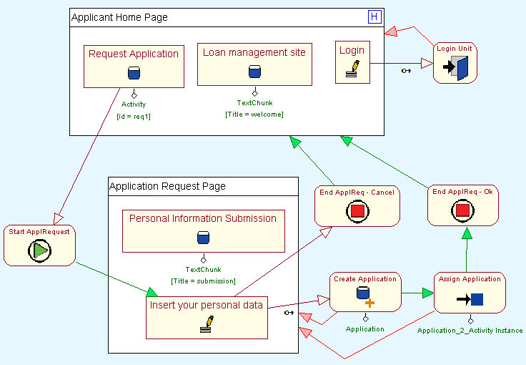
Applicant sv:
Application request activity
The customer submits his personal information to apply for a loan
A new
Application
is created and
assigned to
next activity
(Manager’s preliminary Validation)

Slide 28
Implementation status
WebML is implemented in a commercial CASE tool called Webratio (www.webratio.com)
WebRatio has a plugin architecture allowing developers to invent new content/operation units (Java2EE & Microsoft .NET)
Both Web Service and workflow primitives are implemented as plugins to the core of WebML
Online demo (use of real Web Services): http://www.webratio.com/WebServicesDemo/page1.do

Slide 29
Ongoing and future work
Web Services:
  Semantics of conversations
  Exception declaration and handling
  Full support to asynchronicity
Workflow-Driven Hypertext
  Automatic derivation of hypertext skeletons from WFMC schemas
  Checking of correspondence between WF and hypertext models
Integration of WF and WS dimensions, and deep analysis of the expressive power

Slide 30
References
WEBML
S. Ceri, P. Fraternali, A. Bongio, M. Brambilla, S. Comai, M. Matera,
Designing Data Intensive Web Applications, Morgan Kaufmann, 2003
www.webml.org
www.webratio.com
WEB SERVICES
[SOAP], [WSCL], [WSDL], [XQuery], [XSchema] http://www.w3.org/TR
[UDDI] http://www.uddi.org
[BPEL4WS] www.ibm.com/developerworks/webservices
[WSCI] http://wwws.sun.com/software/xml/developers/wsci
[XLang] http://www.gotdotnet.com/team/xml_wsspecs/xlang-c
WORKFLOW
Workflow Management Coalition: www.wfmc.org

