Slide 1
UMAP*
Alex Fout, Department of Statistics
May 26 2020
*McInnes, Leland, John Healy, and James Melville. "Umap: Uniform manifold approximation and projection for dimension reduction." arXiv preprint arXiv:1802.03426 (2018).

Slide 2
Agenda
UMAP in context
Elements of UMAP
UMAP in practice
Notes:
UMAP in context
What do we mean by dimensionality reduction?
Foundations of UMAP
The Big picture:
Create a weighted graph from data
Embed the graph low dimensional space.
The importance of Mathematical Theory
Manifolds
The Čech complex (“capture manifold” via nerve theorem)
Local representations
Fuzzy global representation
Embedding in low dimension (using cross entropy, force directed graph layout)
UMAP in practice:
Tuning Hyperparameters
Examples
Comparison to tSNE

Slide 3
UMAP In Context
What is UMAP?
Uniform Manifold Approximation and Projection (okay…)
We could talk about UMAP from many perspectives:
As a mathematical theory
As an algorithm
Through examples
I’m not qualified to talk about the details of the mathematical theory
So we’ll touch briefly on #1 and then focus on points 2 and 3.

Slide 4
UMAP In Context
Why Reduce Dimension (# of features)?
EDA / Visualization
Pre-processing for Data Pipeline
Post-hoc analysis of complex models
Identifying low level structure and/or relationships between variables.
UMAP Ethos:
Points come from a low dimensional manifold
We’d like to learn the shape of the manifold
Technique is mathematically rigorous
Much faster than t-SNE

Slide 5
UMAP In Context
Approaches to Dimensionality Reduction
Preserve distances
PCA
Multidimensional scaling
Sammon mapping
Distances are interpretable
Structure may be lost
Preserve local distances
t-SNE
Isomap
LargeVis
Laplacian eigenmaps
diffusion maps
UMAP
Distances are not interpretable
Structure may be better preserved
Notes:
Imagine trying to embed a sphere onto a plane

Slide 6
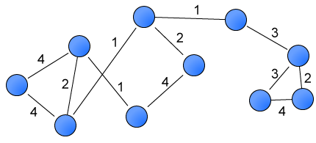
Elements of UMAP
The Big Picture
Two main steps:
Make a weighted graph out of the data points
Embed the graph into a lower dimension, let weights influence distance between embedded points
For visualization: 2 or 3
Can be any dimension!
Notes:
(Image is public domain)

Slide 7
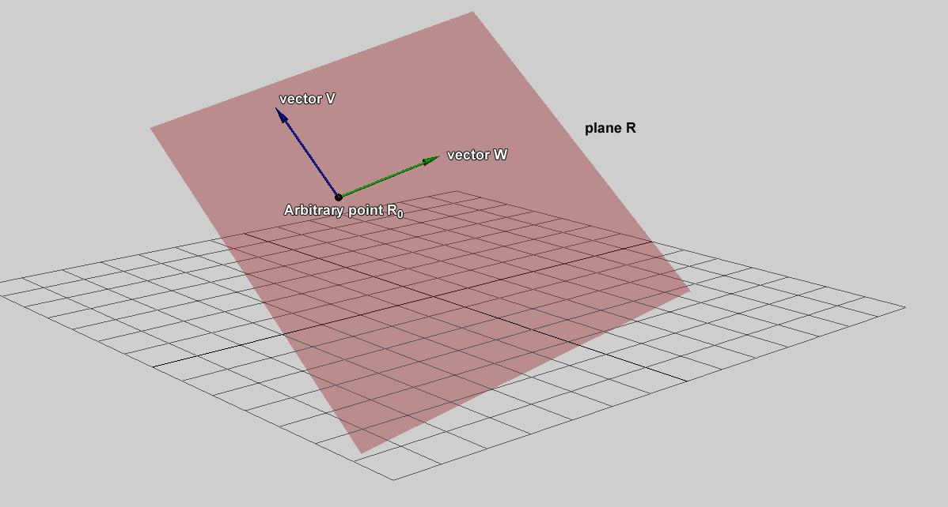
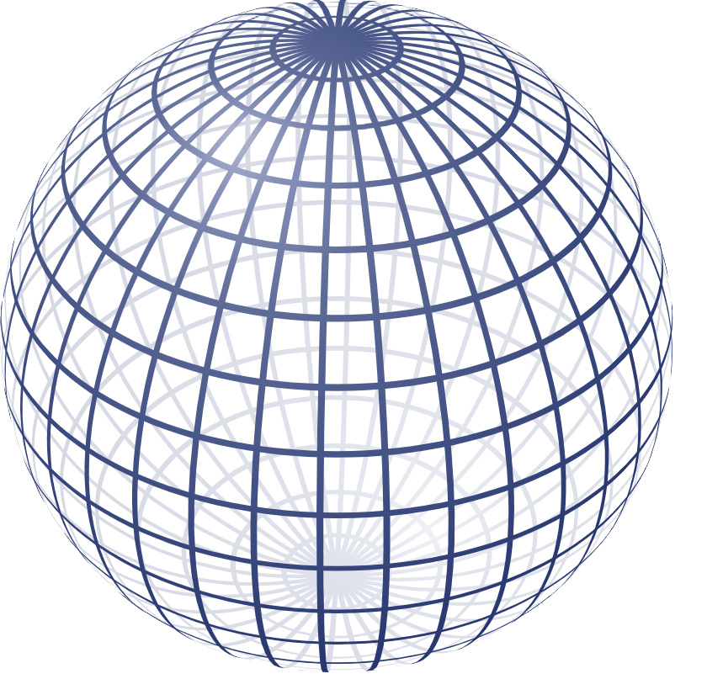
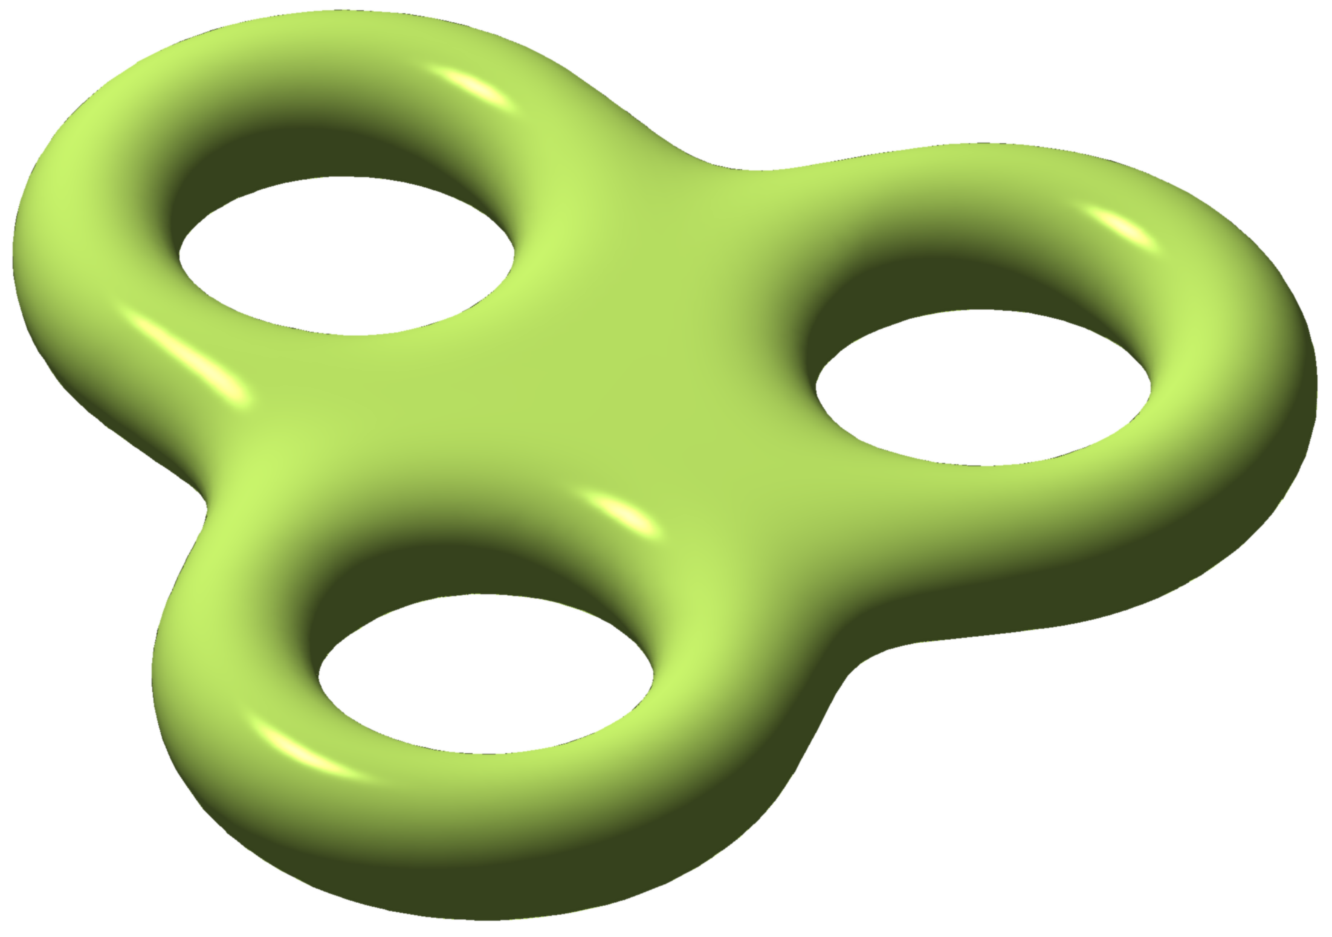
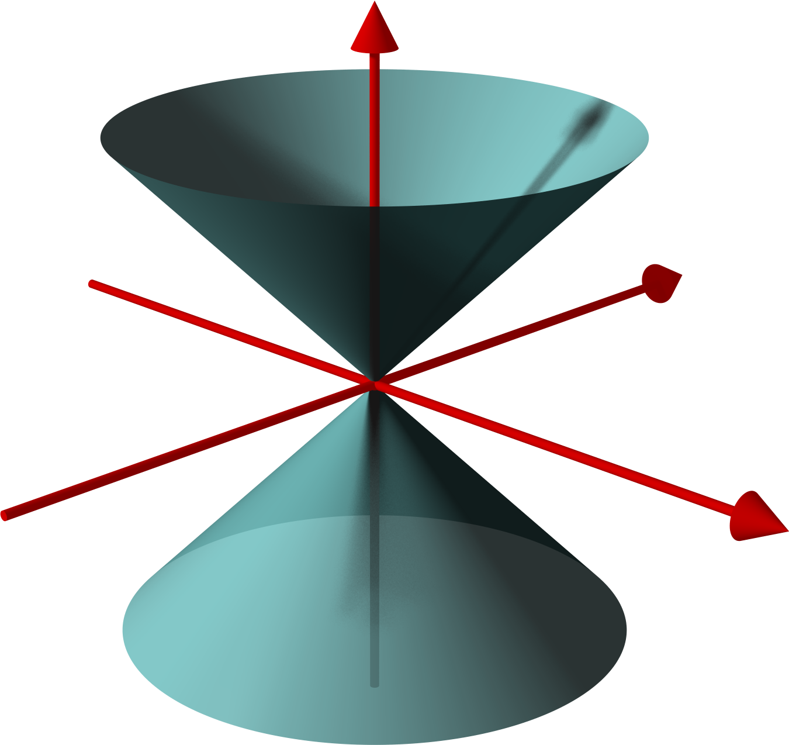
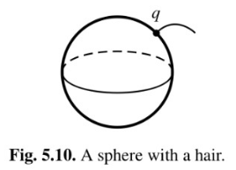
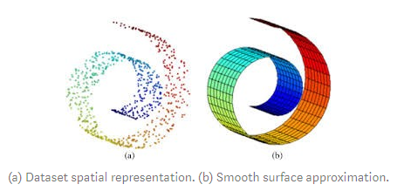
Elements of UMAP
Manifolds*
A set of points (not data points) , where each point has a small neighborhood which looks flat-ish
e.g.
UMAP: Assumes data are uniformly distributed on a Riemannian manifold
Not Manifolds
But we just have the points, not the manifold
Notes:
Data are not uniformly spread out.
Riemannian manifold: Manifold with extra properties.

Slide 8
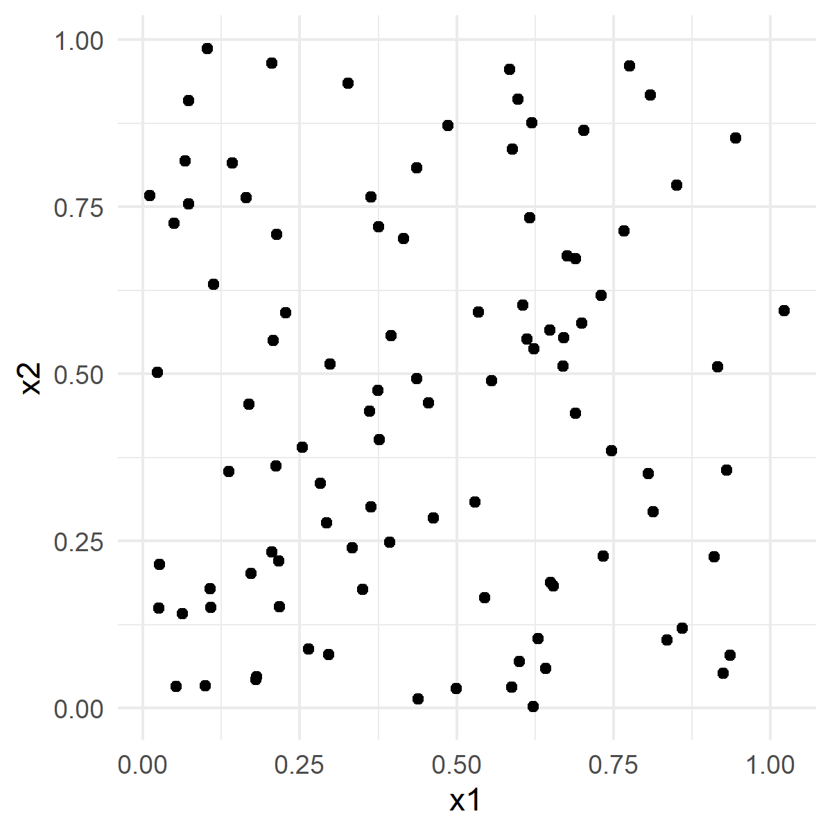
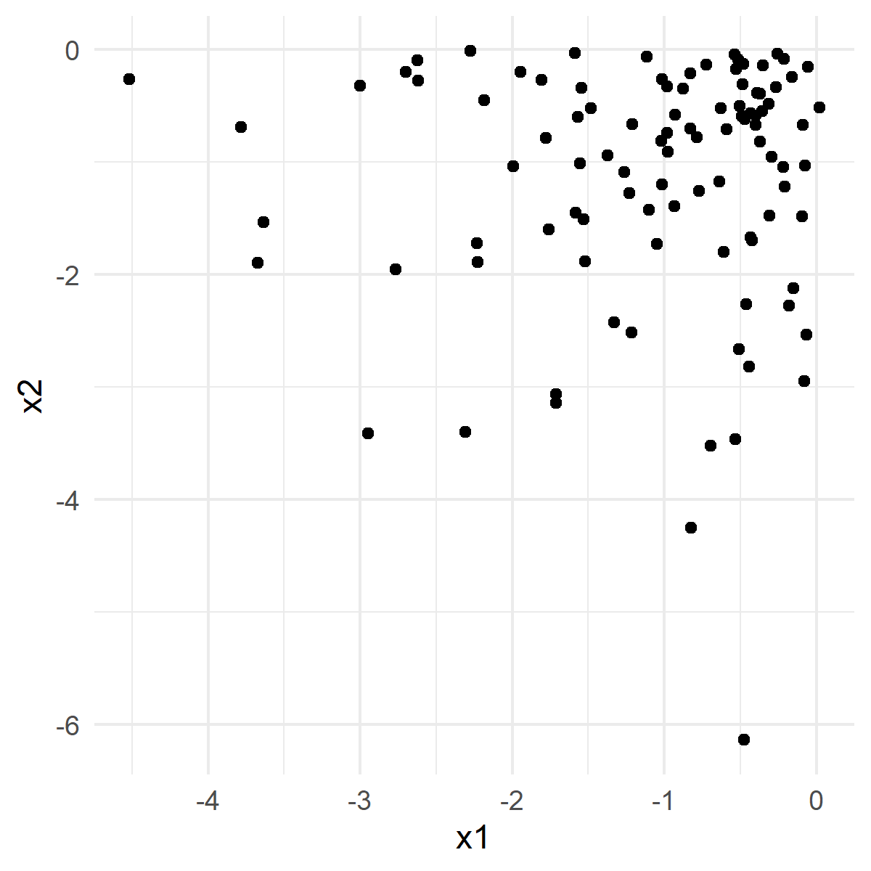
Elements of UMAP
The real meaning of “Uniform”
You might think
this is uniform
this is not uniform
Intuition: uniform = distance to nearest neighbor is roughly consistent
Notes:
Data are not uniformly spread out.
Riemannian manifold: Manifold with extra properties.

Slide 9
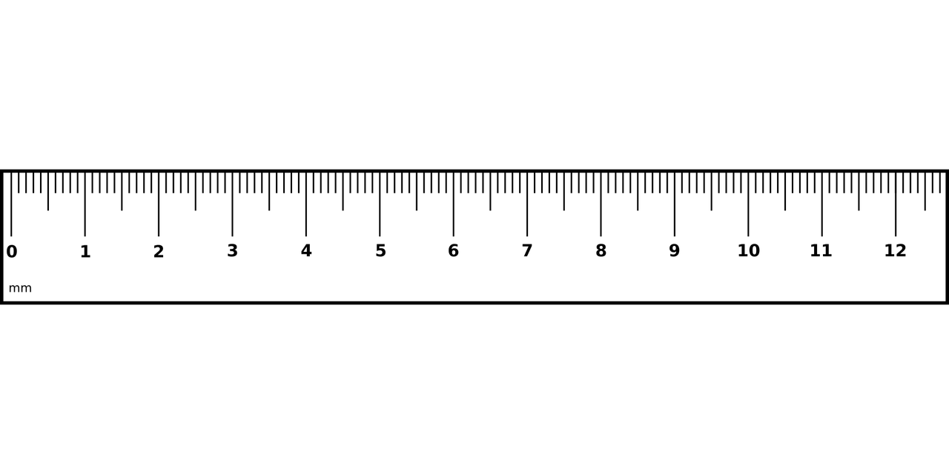
Elements of UMAP
The real meaning of “Uniform”
The trick is to allow the “ruler” to change size in different regions
So this can be thought of as uniform as well
Notes:
Data are not uniformly spread out.
Riemannian manifold: Manifold with extra properties.

Slide 10
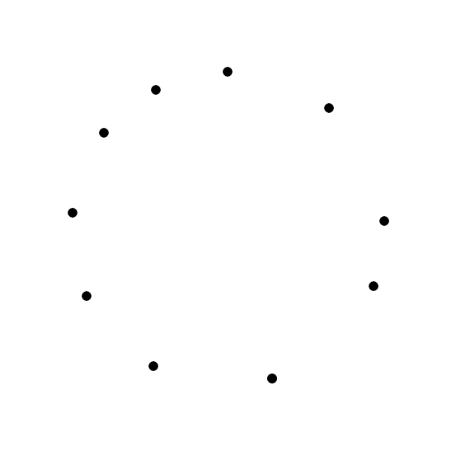
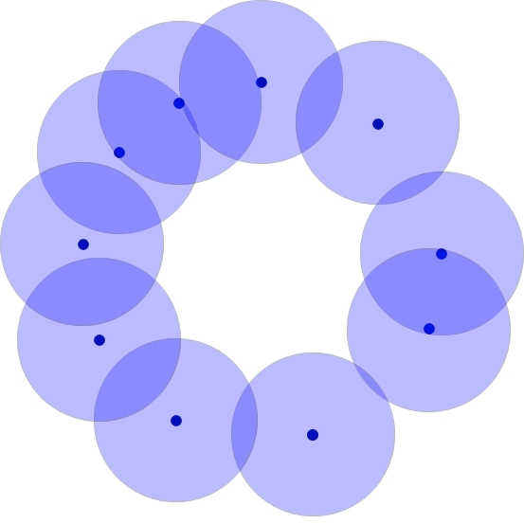
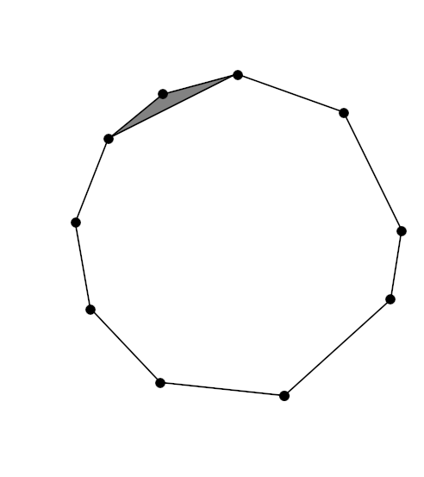
Elements of UMAP
Approximating the Manifold
Create a Čech complex
Cover points will balls
Connect points with overlapping balls
Nerve Theorem: Under certain conditions, the Čech complex captures “shape” of the manifold

Slide 11
Elements of UMAP
Approximating the Manifold
Create a Čech complex
2-simplex
1-simplex
0-simplex
UMAP uses only 0 and 1 simplices (i.e. we will have a graph)

Slide 12
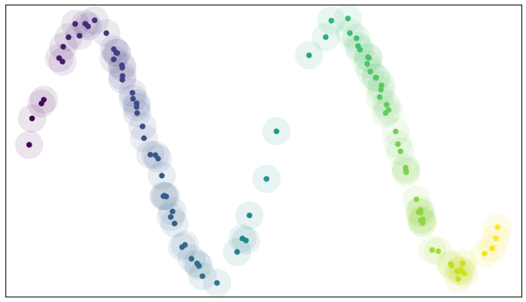
Elements of UMAP
Example
2D data, 1D manifold
Image credit: https://umap-learn.readthedocs.io/en/latest/how_umap_works.html
Notes:
Image credit: https://umap-learn.readthedocs.io/en/latest/how_umap_works.html

Slide 13
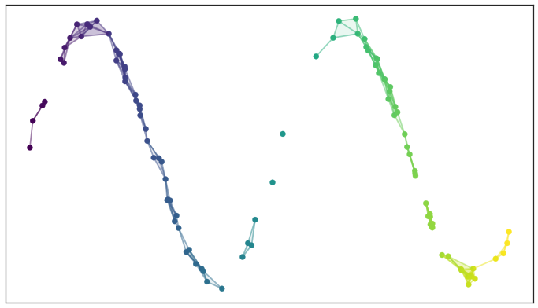
Elements of UMAP
Example
Problem: Gaps prevent reconstructing portions of the manifold
Image credit: https://umap-learn.readthedocs.io/en/latest/how_umap_works.html
Notes:
Image credit: https://umap-learn.readthedocs.io/en/latest/how_umap_works.html

Slide 14
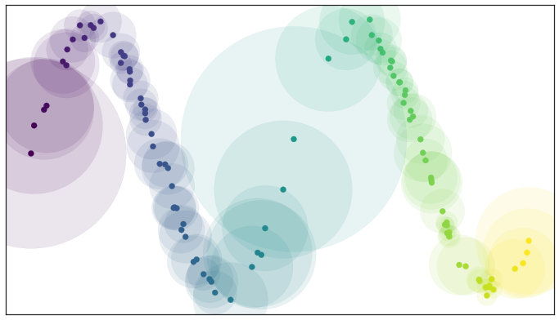
Elements of UMAP
Example
Trick: “Change the ruler”. Scale balls to include k nearest neighbors
Image credit: https://umap-learn.readthedocs.io/en/latest/how_umap_works.html
Notes:
Image credit: https://umap-learn.readthedocs.io/en/latest/how_umap_works.html

Slide 15
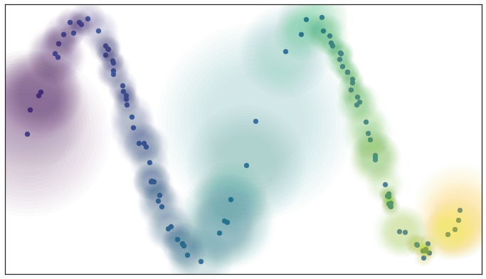
Elements of UMAP
Example
Thought: closer neighbors should matter more, so weight connections accordingly
Problem: points may end up isolated
Image credit: https://umap-learn.readthedocs.io/en/latest/how_umap_works.html
Notes:
Image credit: https://umap-learn.readthedocs.io/en/latest/how_umap_works.html

Slide 16
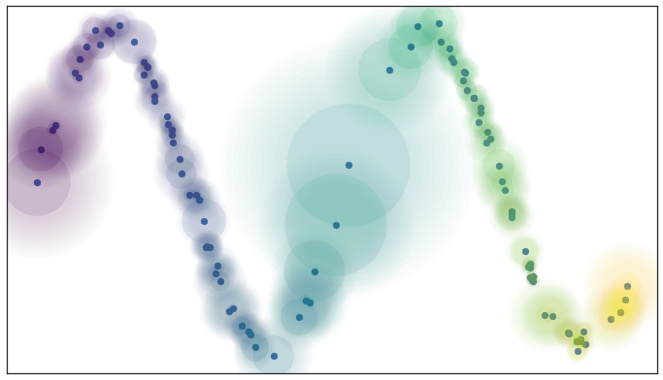
Elements of UMAP
Example
Solution: Ensure at least the closest neighbor is connected.
Image credit: https://umap-learn.readthedocs.io/en/latest/how_umap_works.html
Notes:
Image credit: https://umap-learn.readthedocs.io/en/latest/how_umap_works.html

Slide 17
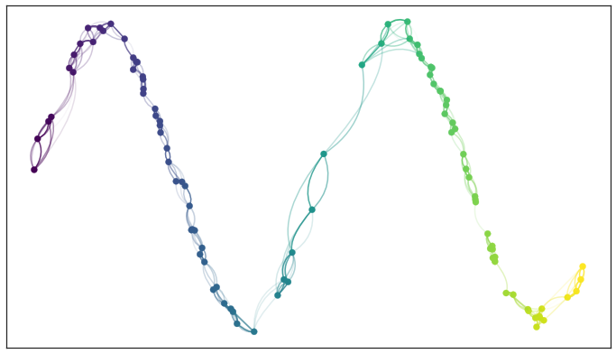
Elements of UMAP
Example
Resulting edge weights:
Note: “rulers” at x1 and x2 are different weight from x1 to x2 and weight from x2 to x1 may be different
Image credit: https://umap-learn.readthedocs.io/en/latest/how_umap_works.html
Notes:
Image credit: https://umap-learn.readthedocs.io/en/latest/how_umap_works.html

Slide 18
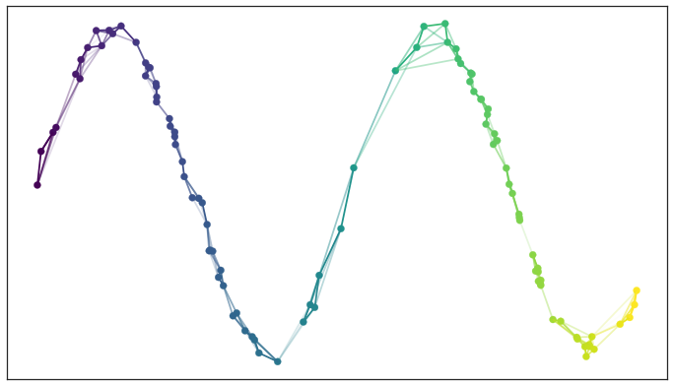
Elements of UMAP
Example
Consolidated weights. We have a weighted graph! (Step 1 complete)
In general, graph is very complicated
(high dimensional)
This example is easy to visualize
We still need to embed in a lower dimension
Image credit: https://umap-learn.readthedocs.io/en/latest/how_umap_works.html
Notes:
Image credit: https://umap-learn.readthedocs.io/en/latest/how_umap_works.html

Slide 19
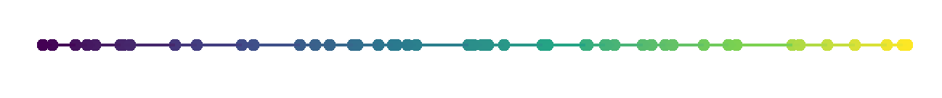
Elements of UMAP
Embedding (Projecting) the Graph
Graph in high dimensional space
Graph in low dimensional space
Minimize the fuzzy set cross entropy
(initialize with spectral embedding)
(stochastic gradient descent)
Image credit: https://umap-learn.readthedocs.io/en/latest/how_umap_works.html
Notes:
Image credit: https://umap-learn.readthedocs.io/en/latest/how_umap_works.html

Slide 20
UMAP in Practice
Choices you have to make
n: Number of neighbors to consider when making a “local ruler”
d: number of embedding dimensions (2 or 3 for vis)
min-dist: desired separation between close points in embedding space
n-epochs: number of training epochs for graph embedding
Notes:
https://en.wikipedia.org/wiki/%C4%8Cech_complex#/media/File:Cech-example.png

Slide 21
UMAP in Practice
Interesting Examples
Textbook requirements in college syllabi
Understanding word embeddings from BERT
1 million integers represented by their prime factors
Notes:
https://en.wikipedia.org/wiki/%C4%8Cech_complex#/media/File:Cech-example.png

Slide 22
UMAP in Practice
Cool Links
How UMAP Works
Understanding UMAP
UMAP Explorer
Notes:
https://en.wikipedia.org/wiki/%C4%8Cech_complex#/media/File:Cech-example.png

Slide 23
UMAP in Practice
Demo
See https://github.com/fouticus/umap_talk/
Notes:
https://en.wikipedia.org/wiki/%C4%8Cech_complex#/media/File:Cech-example.png

Slide 24
Thank You!
fout@colostate.edu

