Slide 1
Canteen Management System
Developed By:
Sakshi Negi

Slide 2
Agenda
Overview
Technology Stack
Flowcharts, DFD’s
Topics covered
References

Slide 3
Overview
Our application provides the functionality for Canteen Management System,
The application contains two roles : Admin and Employee .
The user need to provide credentials for login.
User as Admin can add items to the item list, add items of the day, filter Employees, make purchase on behalf of Employee, add money to Employee’s wallet and delete Employee’s details.
User as employee can view menu, view items of the day, view wallet balance, make purchase.

Slide 4
Technology Stack
S.no | Technology | Version
1. | Vs code | 1.82.0
2. | Python | 3.12.0
3. | Pip | 23.2.1
4. | Django | 5.1.1
5. | SQLite3 | 3.43

Slide 5
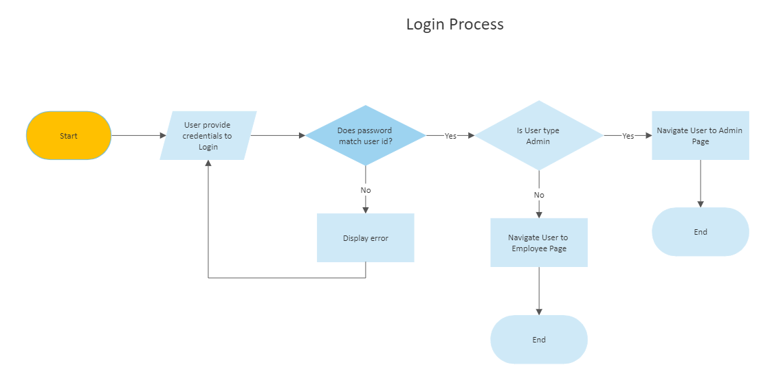
Login Flowchart

Slide 6
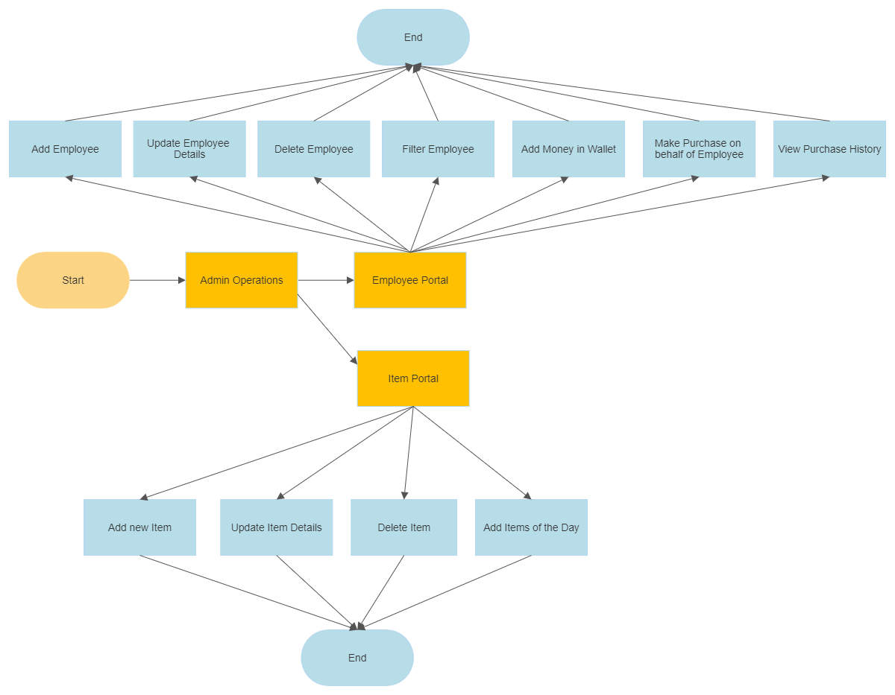
Admin Flowchart

Slide 7
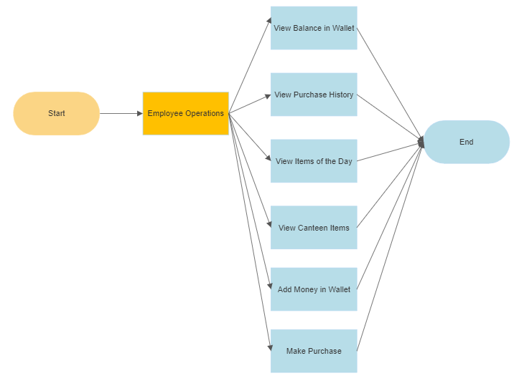
Employee Flowchart

Slide 8
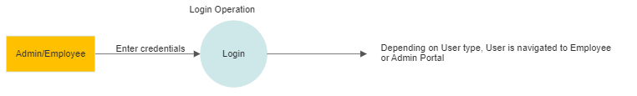
Login Operation DFD

Slide 9
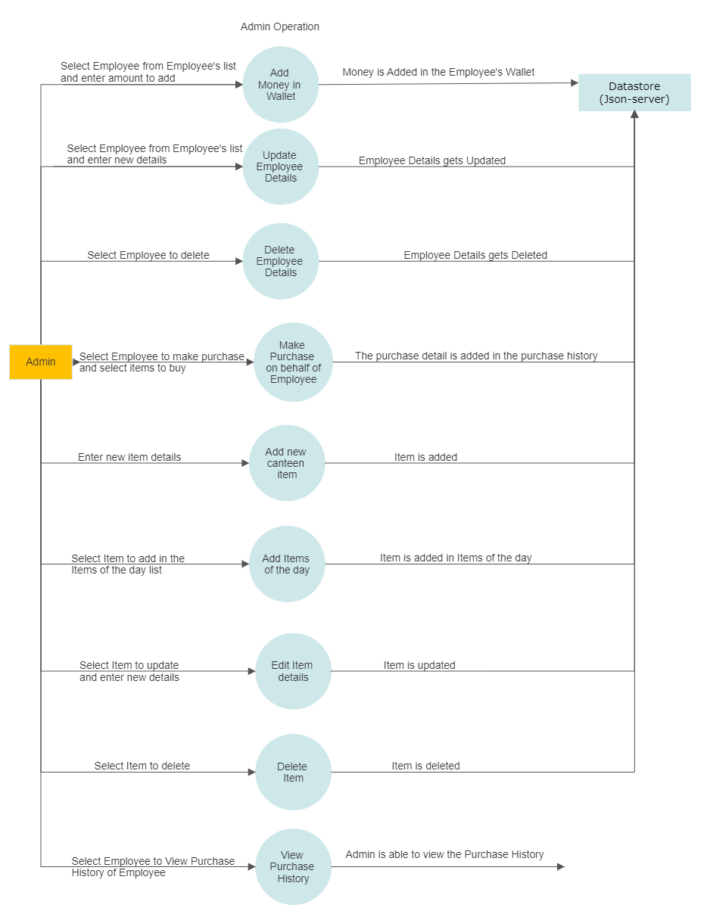
Admin Operations DFD

Slide 10
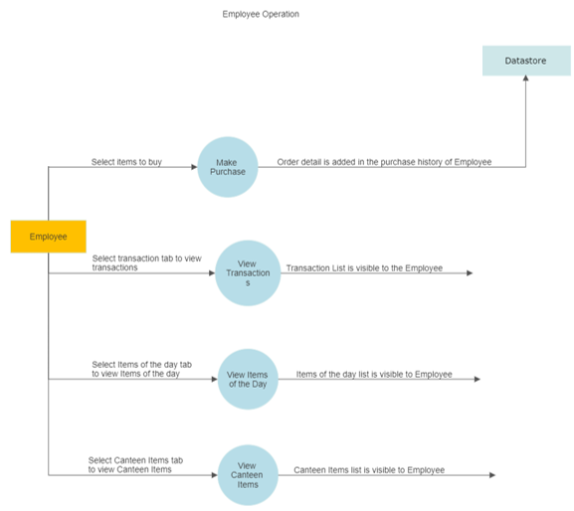
Employee Operations DFD

Slide 11
Topics Covered
Python Basics
Error handling and validation in python
Conditional views and redirection
Python frameworks( Django)
Django(form handling, ORM, template design and customization, URL routing)

Slide 12
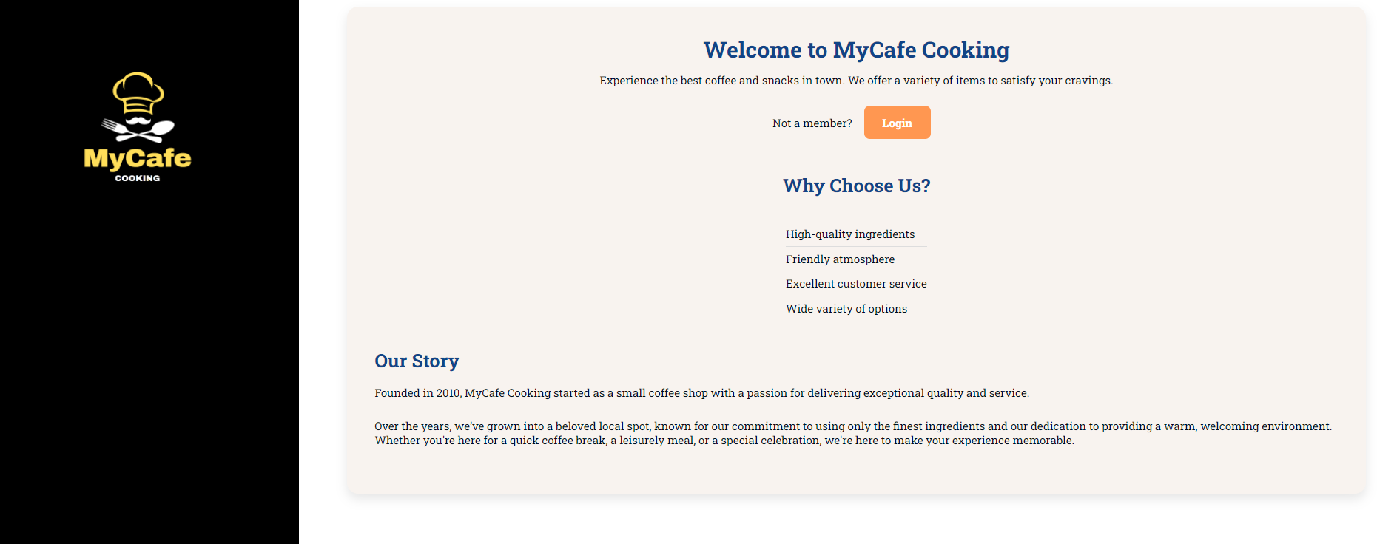
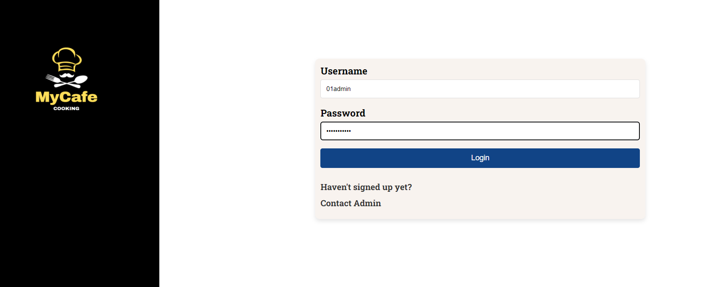
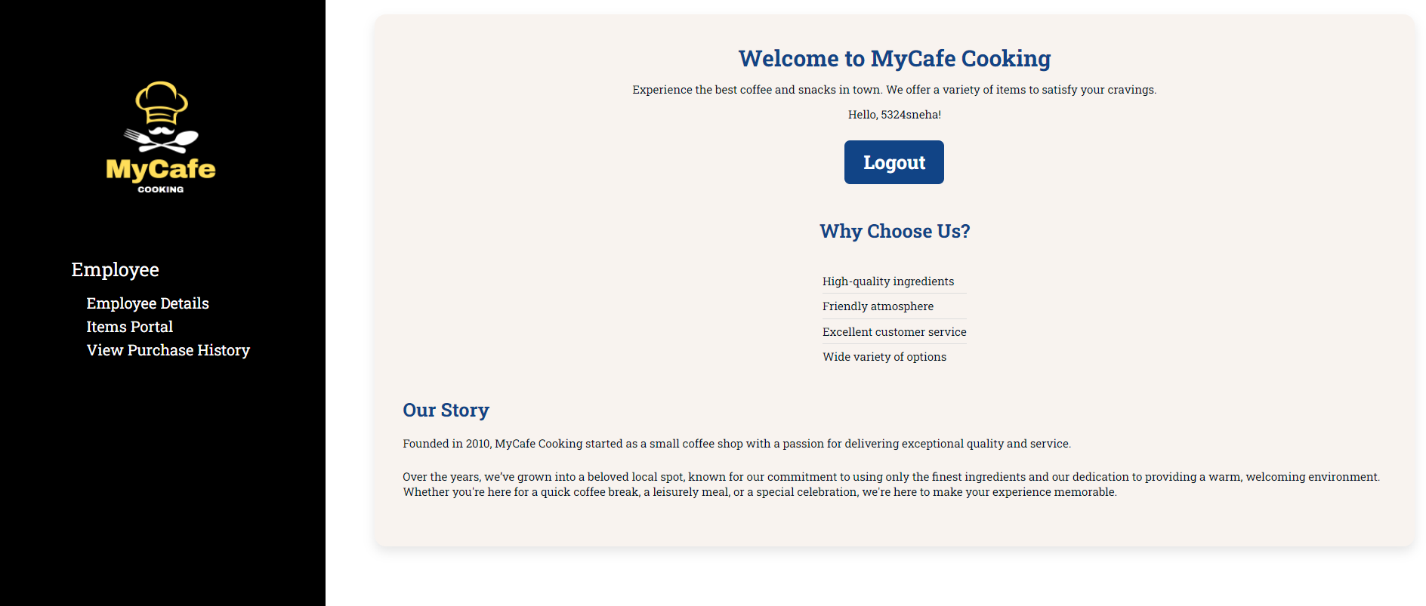
Home page Screenshot

Slide 13
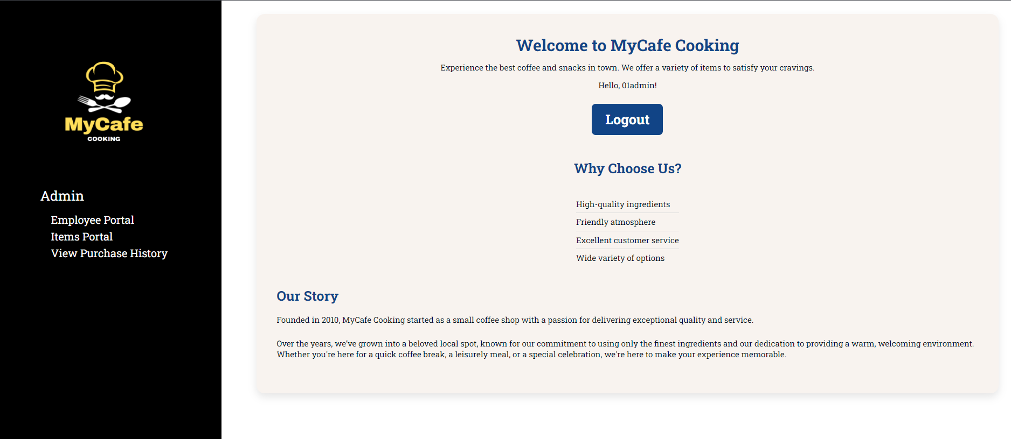
Login page Screenshot

Slide 14
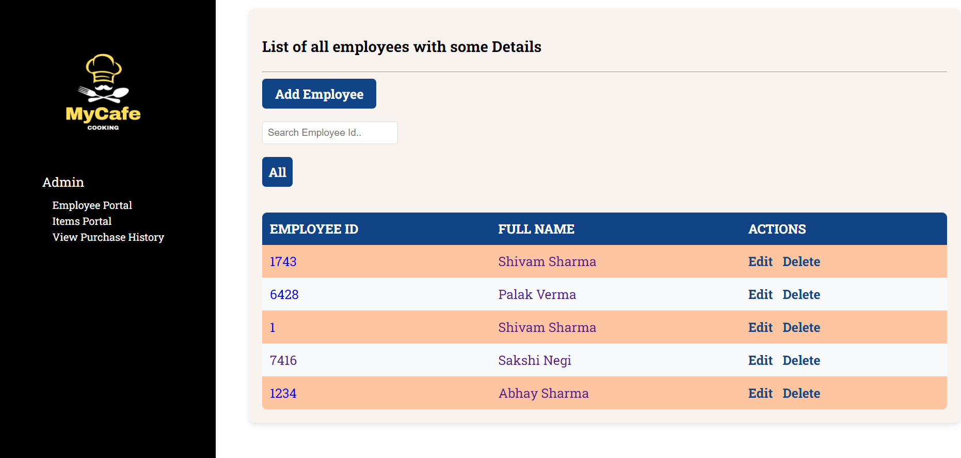
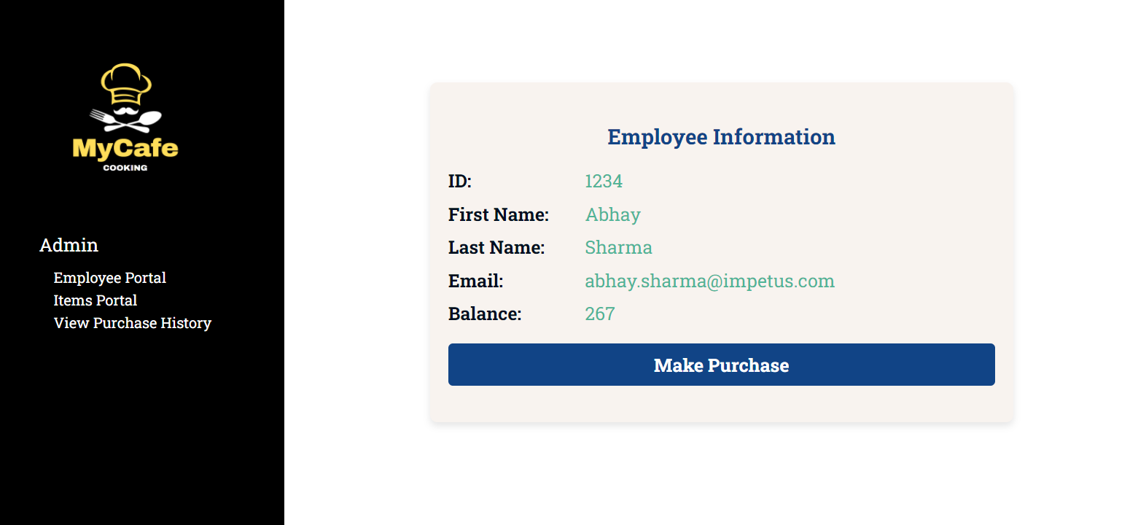
Employee Portal and Employee Info(Admin)

Slide 15
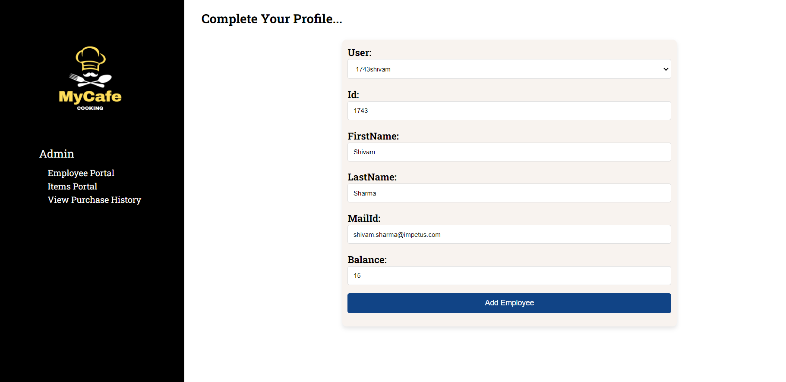
Edit employee details(Admin)

Slide 16
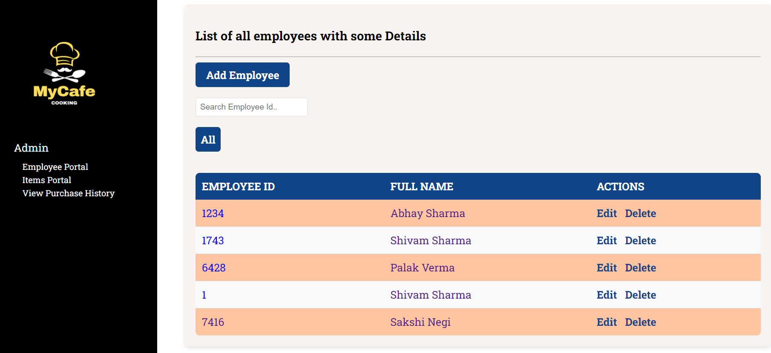
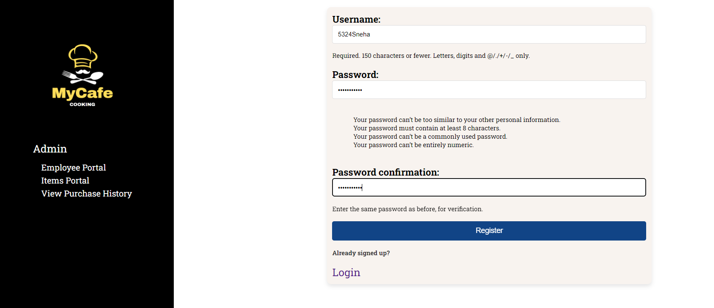
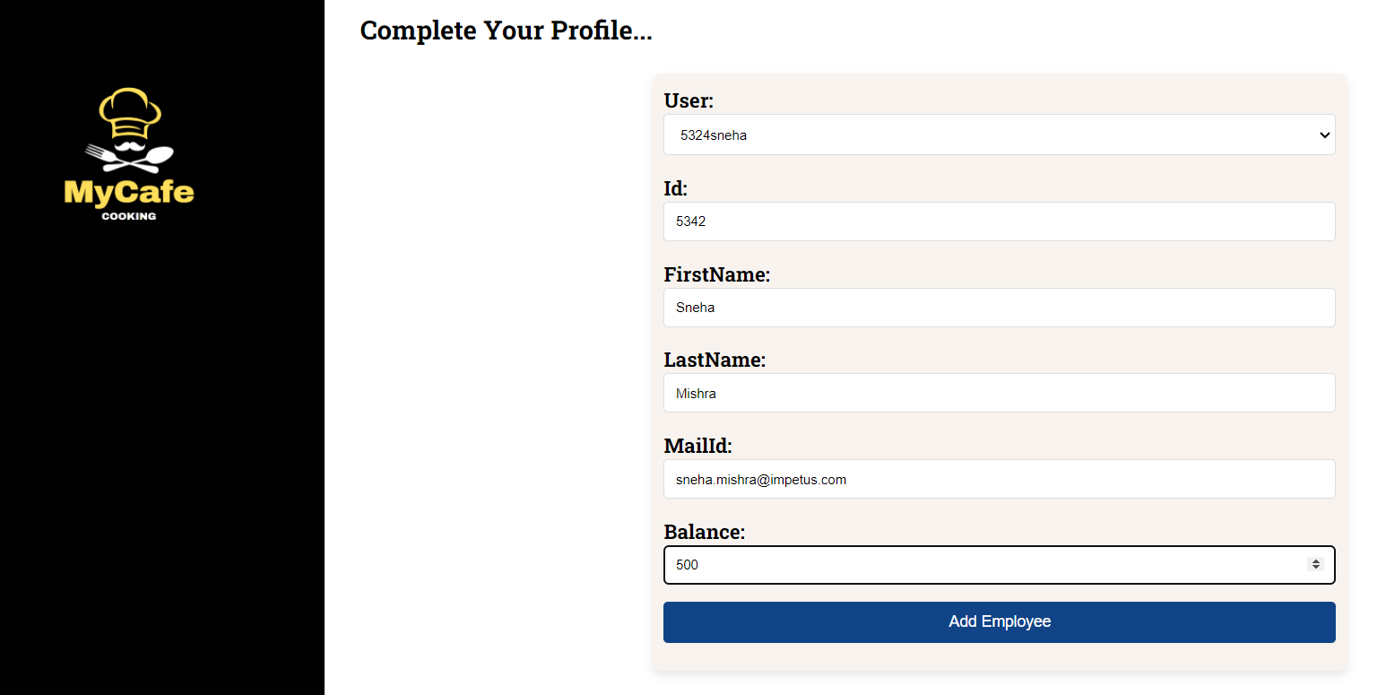
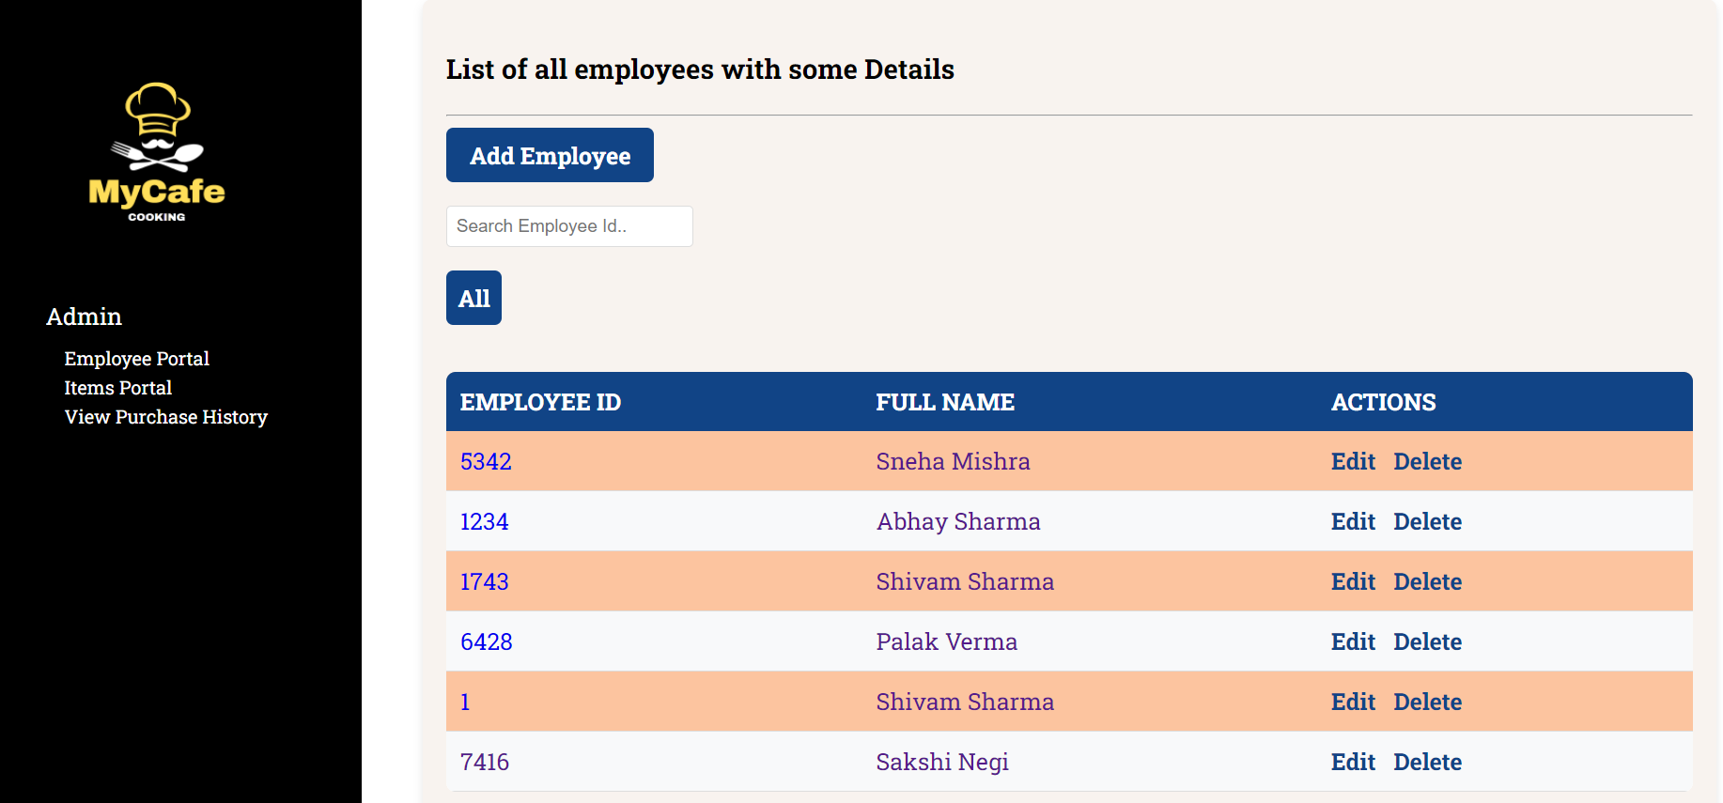
Add new user Modal Screenshot(Admin)

Slide 17
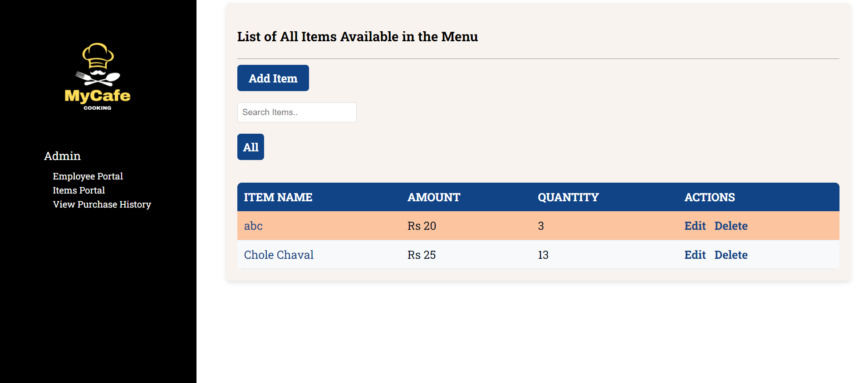
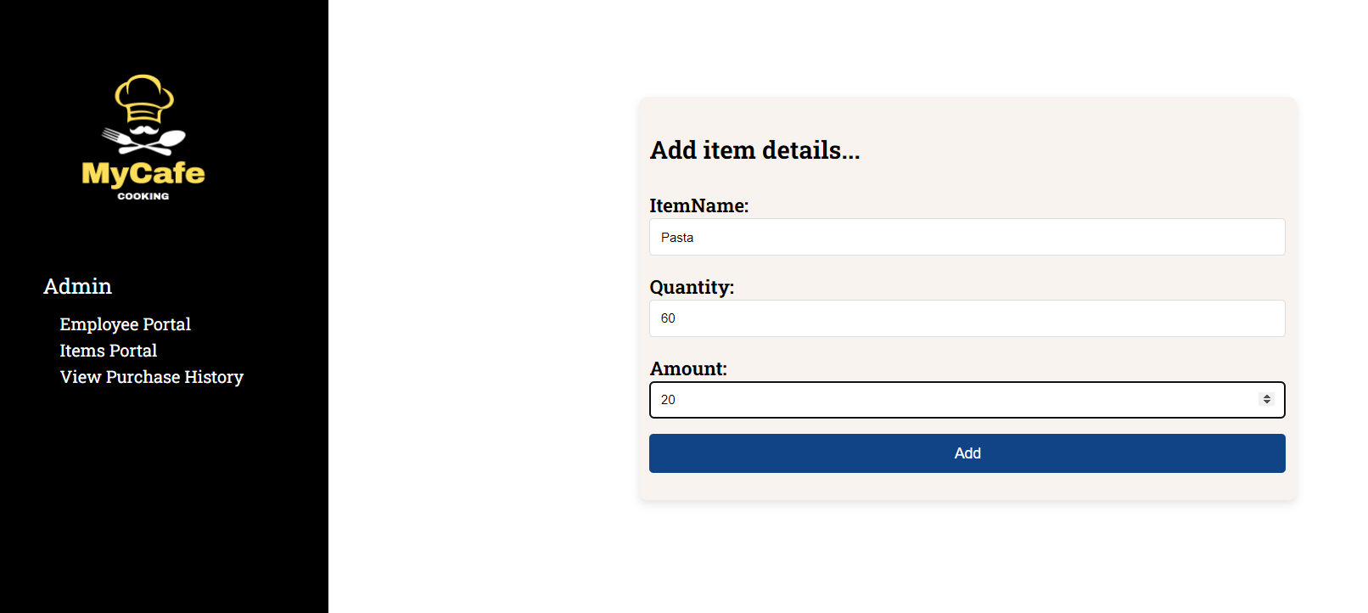
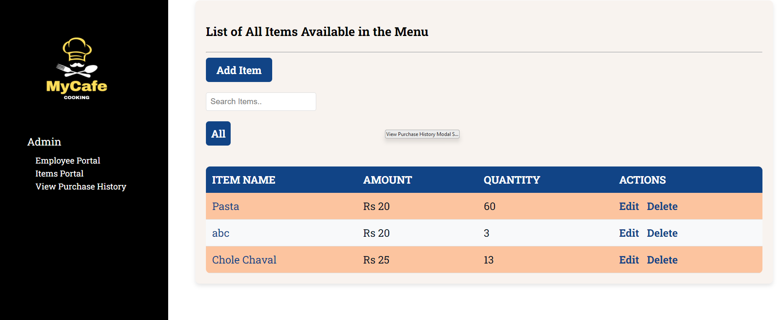
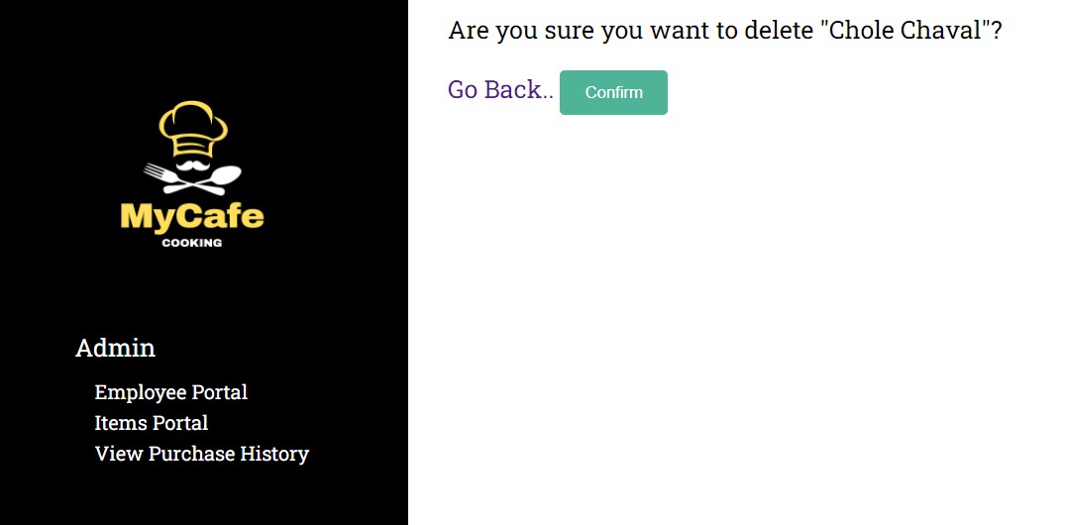
Items portal(Admin)

Slide 18
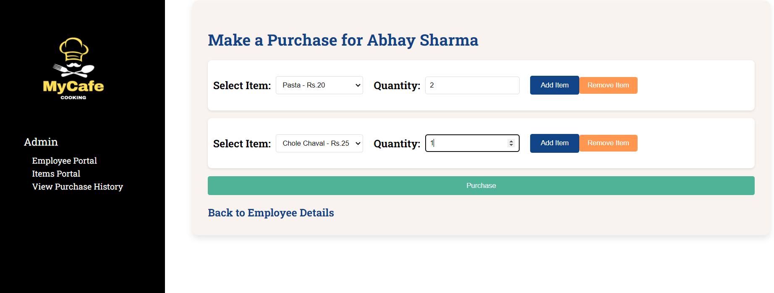
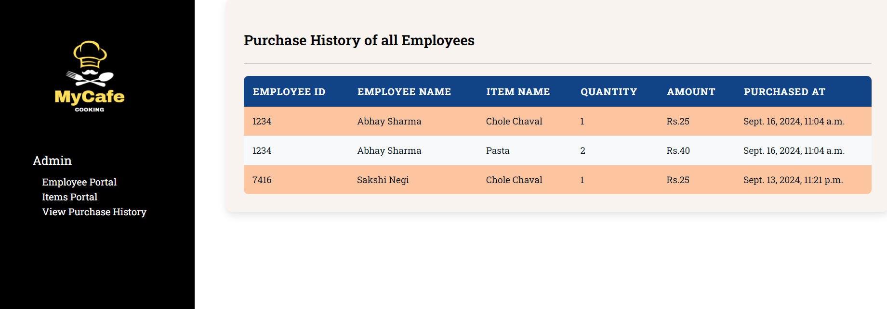
View Purchase History Modal Screenshot(Admin)

Slide 19
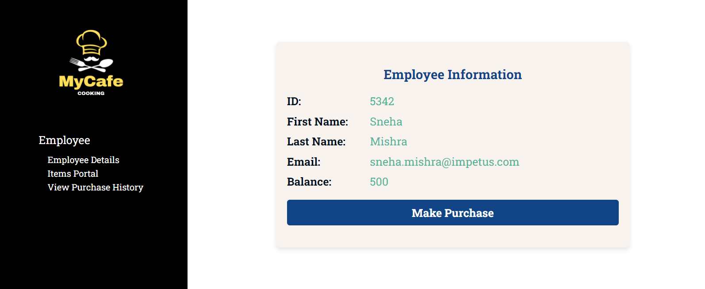
Employee Portal(Employee)

Slide 20
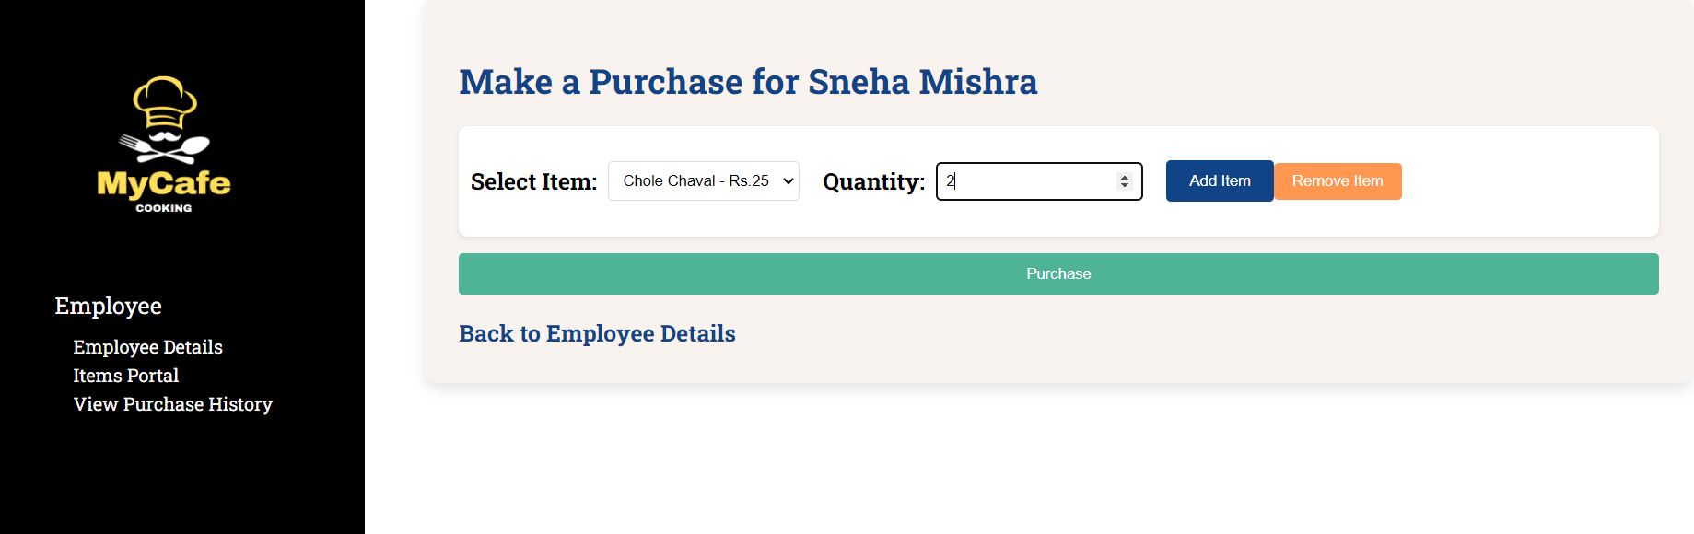
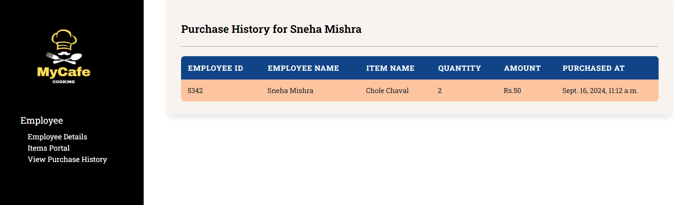
Make Purchase and purchase history(Employee)

Slide 21
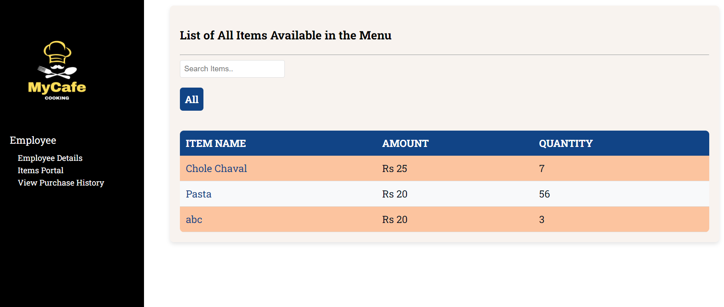
Items portal(Employee)

Slide 22
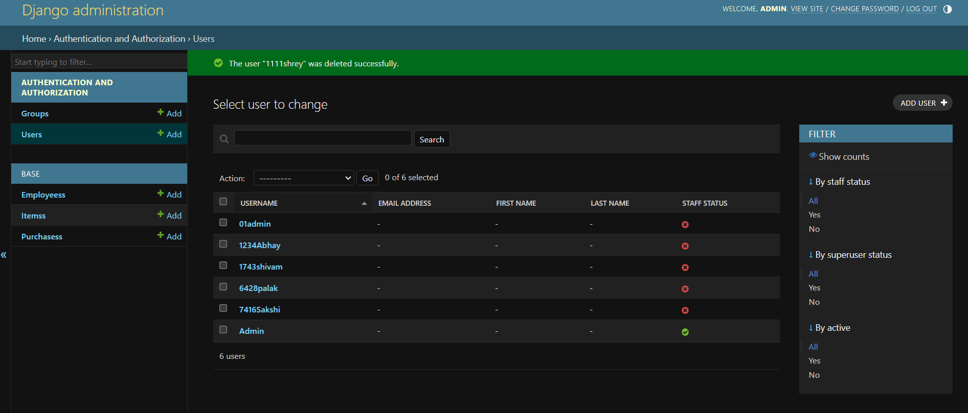
Django admin portal

Slide 23
References
Django documentation: https://docs.djangoproject.com/en/5.1/
Stack overflow: https://stackoverflow.com/
Youtube: https://youtube.com/

Slide 24
Thank you

