Slide 1


HOW GPU
DIFFERS FROM CPU
HOW GPU
DIFFERS FROM CPU
ONE SMART BOSS vs THOUSANDS OF WORKERS

Slide 2
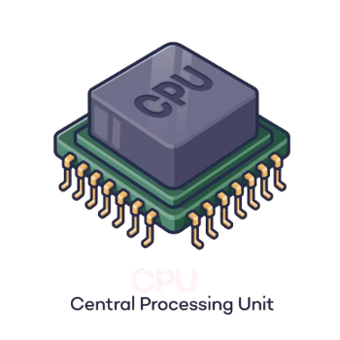



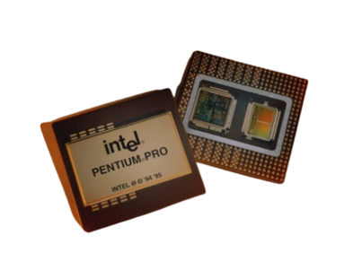

02 • COMPUTER SYSTEMS
Our Journey Today
Our Journey Today
1
2
3
Processor basics
Meet CPU
Meet GPU
Compare
Teamwork
Quiz
Click any stop to jump straight there

Slide 3
03 • COMPUTER SYSTEMS
Warm-up: Who Would You Hire?
Warm-up: Who Would You Hire?
ONE GENIUS
1,000 HELPERS
Solve one very hard puzzle
Colour 1,000 identical drawings
That choice is the whole story of CPU vs GPU.

Slide 4
04 • COMPUTER SYSTEMS
What Is a Processor Really?
What Is a Processor Really?
INPUT
receive data
PROCESS
follow instructions
OUTPUT
produce result
Every app = millions of tiny instructions: add • compare • move
GHz is the drummer’s beat — billions of ticks each second.

Slide 5

05 • COMPUTER SYSTEMS
Meet the CPU: The Head Chef
Meet the CPU: The Head Chef
CENTRAL
PROCESSING
UNIT
The general-purpose brain: a few powerful cores that make decisions, handle surprises, run apps, operate the OS, and manage the whole machine.

Slide 6
06 • COMPUTER SYSTEMS
Inside the CPU
Inside the CPU
CONTROL UNIT
Reads + directs
ALU
Maths + logic
REGISTERS
Tiny fast notebooks
CACHE
Close, fast memory
FETCH → DECODE → EXECUTE → REPEAT
Example instruction: 2 + 3

Slide 7
07 • COMPUTER SYSTEMS
Cores, Threads & Pipelines
Cores, Threads & Pipelines
1 CORE
one chef
4 CORES
4 chefs
8 CORES
8 chefs
THREADS
PIPELINING
BRANCH PREDICTION
One chef switches quickly between two jobs.
An assembly line: the next instruction starts early.
The chef guesses the next step to avoid waiting.

Slide 8

08 • COMPUTER SYSTEMS
Meet the GPU: An Army of Line Cooks
Meet the GPU: An Army of Line Cooks
GRAPHICS
PROCESSING
UNIT
Thousands of simple cores do the same kind of work together. Each core is modest; the combined throughput is enormous.
THOUSANDS → 10,000+ CORES

Slide 9
09 • COMPUTER SYSTEMS
Inside a GPU: SMs & Warps
Inside a GPU: SMs & Warps
Zoom in, one layer at a time: chip → SM → warp → thread
GPU
The whole chip
Dozens to 100+ SMs sharing one big pool of VRAM
SM
Streaming Multiprocessor
A mini-processor: ~128 cores, registers, shared memory, warp schedulers
WARP
32 threads, 1 instruction
The unit the scheduler issues. All 32 move in lockstep
THREAD
One tiny worker
Handles one data item, like a single pixel
Example: RTX 4090 = 128 SMs × 128 cores = 16,384 CUDA cores
Click to reveal →
← Agenda

Slide 10
10 • COMPUTER SYSTEMS
Why Was the GPU Invented?
Why Was the GPU Invented?
1920 × 1080
> 2 million pixels
× 60 refreshes each second
> 120 million tiny colour calculations every second
Repeated maths also powers AI.

Slide 11
11 • COMPUTER SYSTEMS
Big Idea: Serial vs Parallel
Big Idea: Serial vs Parallel
SERIAL
PARALLEL
1
2
3
4
5
6
GO
GO
GO
GO
GO
GO
One ticket counter
LOW LATENCY
CPU strength
100 counters open
HIGH THROUGHPUT
GPU strength

Slide 12
12 • COMPUTER SYSTEMS
Different vs Same Together
Different vs Same Together
CPU • MIMD
Different cores can do different jobs
GPU • SIMD / SIMT
One instruction, lots of data
Example: add 20 to every pixel
GPU threads march in teams called WARPS — usually 32 threads moving in lockstep.

Slide 13
13 • COMPUTER SYSTEMS
Latency Hiding: Never Idle
Latency Hiding: Never Idle
Memory is slow. Watch how each processor deals with the wait.
CPU core
stalls and waits
RUN
WAIT: memory takes 100s of cycles
RUN
GPU SM
swaps to another warp
Warp A
Warp B
Warp C
Warp D
Warp A again
CPU strategy
Hide slow memory with big caches and smart branch prediction.
GPU strategy
Keep thousands of threads in flight. When one warp stalls, the scheduler issues another at almost no cost.
Click to reveal →
← Agenda

Slide 14
14 • COMPUTER SYSTEMS
Where Does the Chip Space Go?
Where Does the Chip Space Go?
CPU
GPU
LARGE CONTROL LOGIC
BIG CACHE
FEW BIG ALUs
Silicon spent on management
MANY, MANY ALUs
SMALLER CONTROL
SMALLER CACHE
Silicon spent on workers

Slide 15
15 • COMPUTER SYSTEMS
Memory: Cache + RAM vs VRAM
Memory: Cache + RAM vs VRAM
REGISTERS
L1 / L2 / L3 CACHE
RAM / VRAM
STORAGE
CPU: sports car — low delay for a few passengers
GPU VRAM: bus — huge bandwidth for thousands

Slide 16
16 • COMPUTER SYSTEMS
Memory: Latency vs Bandwidth
Memory: Latency vs Bandwidth
Peak theoretical bandwidth of typical parts: how much data per second
CPU RAM
dual-channel DDR5
≈ 90 GB/s
Gaming GPU
GDDR6X, RTX 4090
≈ 1,000 GB/s
Data-centre GPU
HBM3, H100
≈ 3,350 GB/s
PCIe: the narrow bridge
PCIe 4.0 ×16 moves only ≈ 32 GB/s between CPU RAM and VRAM. Copy once, compute a lot.
Coalescing
Neighbouring threads read neighbouring addresses, so 32 small reads merge into one wide fetch.
Click to reveal →
← Agenda

Slide 17
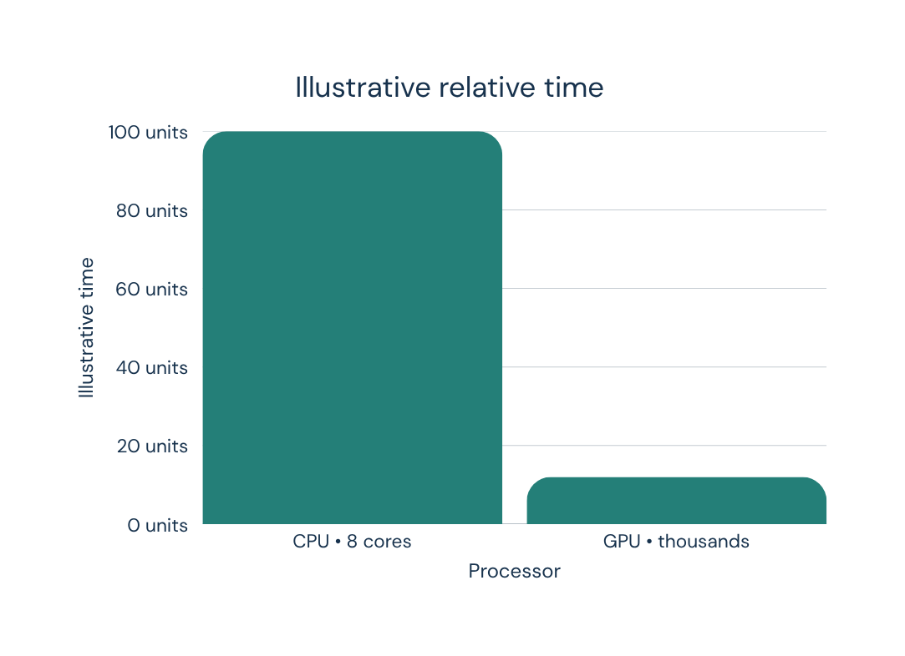
17 • COMPUTER SYSTEMS
Worked Example: Add 1,000,000 Numbers
Worked Example: Add 1,000,000 Numbers
CPU
~125,000 additions per core, step by step
GPU
Each core gets a few additions; thousands run together
THINK: what if every step needs the previous result?

Slide 18
18 • COMPUTER SYSTEMS
CPU Loop vs GPU Kernel
CPU Loop vs GPU Kernel
CPU: one loop
GPU: one thread per item
for (int i = 0; i < N; i++) {
c[i] = a[i] + b[i];
}
__global__ void add(a, b, c, N) {
int i = blockIdx.x * blockDim.x
+ threadIdx.x;
if (i < N) c[i] = a[i] + b[i];
}
Visits the items one after another.
Thread i handles item i. All threads launch together.
Thread ID = blockIdx × blockDim + threadIdx: a seat number for every worker
Click to reveal →
← Agenda

Slide 19
19 • COMPUTER SYSTEMS
When the GPU Does NOT Help
When the GPU Does NOT Help
DEPENDENT STEPS
BRANCH DIVERGENCE
SMALL TASKS
One result must wait for another
If/else makes warp members wait
PCIe copying costs more than it saves
Amdahl’s idea: parallel speedup is limited by the part that must stay serial — like a group project waiting on one person.

Slide 20
20 • COMPUTER SYSTEMS
Amdahl’s Law: Try the Numbers
Amdahl’s Law: Try the Numbers
Speedup = 1 / ((1 − p) + p / N)
p = share of the work that can run in parallel • N = 1,000 cores
50% parallel
≈ 2× (limit 2×)
90% parallel
≈ 9.9× (limit 10×)
95% parallel
≈ 19.6× (limit 20×)
99% parallel
≈ 91× (limit 100×)
Even 5% serial work caps 1,000 cores at about 20×.
Click to reveal →
← Agenda

Slide 21
21 • COMPUTER SYSTEMS
CPU vs GPU: Side by Side
CPU vs GPU: Side by Side
Full form
Central Processing Unit
Graphics Processing Unit
Cores
Few powerful
Thousands simple
Best at
Decisions + serial work
Repeated parallel maths
Goal
Low latency
High throughput
Memory
RAM + large caches
VRAM + high bandwidth
Style
Flexible MIMD
SIMD / SIMT
Typical
OS, apps, files
Graphics, AI, simulation
Analogy
Head chef
Army of line cooks

Slide 22
22 • COMPUTER SYSTEMS
Where They Are Used in Real Life
Where They Are Used in Real Life
CPU
GPU
Operating system
Gaming + video
Web + spreadsheets
3D animation
Compile code
AI training
File handling
Science + weather
Tensor cores are specialised GPU units for matrix maths.

Slide 23
23 • COMPUTER SYSTEMS
Better Together: CPU + GPU Workflow
Better Together: CPU + GPU Workflow
1
Program starts
on CPU
2
CPU prepares
data
3
Copy to GPU
memory
4
GPU computes
in parallel
5
Results return
to CPU
Integrated GPU: inside the same chip • Dedicated GPU: a separate card
The CPU still conducts the whole system.

Slide 24
24 • COMPUTER SYSTEMS
Pick the Processor!
Pick the Processor!
Decide first, then click to see the answer.
SCENARIO 1
Filter a 4K video: the same colour tweak on 8 million pixels
SCENARIO 2
Decide which of 20 menu items the user just clicked
GPU
Same maths on every pixel is pure data parallelism.
CPU
Small, branchy, one-off decisions: low latency wins.
SCENARIO 3
Train a neural network: billions of multiply-adds
SCENARIO 4
Add up 10 numbers, just once
GPU
Matrix maths suits thousands of cores plus tensor cores.
CPU
Too small: copying over PCIe costs more than the maths.
Click to reveal →
← Agenda

Slide 25
25 • COMPUTER SYSTEMS
Quiz Time!!
Quiz Time!!
1 Which has more cores?
GPU
2 Which runs the operating system?
CPU
3 What is VRAM?
GPU’s own fast memory
4 What is a warp?
32 threads in lockstep
5 Is a GPU always faster?
False

Slide 26
THANK YOU!
Questions?
CPU
GPU
few smart cores • low latency • flexible boss
thousands of simple cores • high throughput • parallel muscle
Neither is better. They are partners.

