Slide 1

Vim
The Editor
Francis B. Odisi

Slide 2
Overview
Vim (Vi IMitation Vi IMproved)
1991, Bram Moolenaar
(+ contributors)
Highly configurable and powerful Text editor (not word processor)
Charityware (Uganda)
Notes:
1.1. What is Vim? Vim stands for Vi IMproved. It used to be Vi IMitation, but there are so many improvements that a name change was appropriate. Vim is a text editor which includes almost all the commands from the Unix program "Vi" and a lot of new ones. All commands can be given with the keyboard. This has the advantage that you can keep your fingers on the keyboard and your eyes on the screen. For those who want it, there is mouse support and a GUI version with scrollbars and menus. Vim is an editor, not a word processor. A word processor is used mainly to do layout of text. This means positioning it, changing the way it appears on output. More often than not, the final document is meant to be printed or typeset or what have you, in order to present it in a pleasing manner to others. Examples of word processors are Microsoft Word, FrameMaker, and OpenOffice Writer. An editor is simply for entering text. Any typesetting or laying out of the document is secondary. With an editor, one's main concern is entering text, not making the text look good. Examples of editors other than Vim and Vi are Emacs, TextMate, Ultraedit and gedit. And Notepad.

Slide 3
Overview
All commands using keyboard (GUI available)
Cross-Platform
UNIX / Linux / MacOS / FreeBSD
Windows / DOS / MacOS
AmigaOS / Atari MiNT / BeOS
NextStep / OS/2 / OSF
RiscOS / SGI / VMS
Notes:
1.1. What is Vim? Vim stands for Vi IMproved. It used to be Vi IMitation, but there are so many improvements that a name change was appropriate. Vim is a text editor which includes almost all the commands from the Unix program "Vi" and a lot of new ones. All commands can be given with the keyboard. This has the advantage that you can keep your fingers on the keyboard and your eyes on the screen. For those who want it, there is mouse support and a GUI version with scrollbars and menus. Vim is an editor, not a word processor. A word processor is used mainly to do layout of text. This means positioning it, changing the way it appears on output. More often than not, the final document is meant to be printed or typeset or what have you, in order to present it in a pleasing manner to others. Examples of word processors are Microsoft Word, FrameMaker, and OpenOffice Writer. An editor is simply for entering text. Any typesetting or laying out of the document is secondary. With an editor, one's main concern is entering text, not making the text look good. Examples of editors other than Vim and Vi are Emacs, TextMate, Ultraedit and gedit. And Notepad.

Slide 4
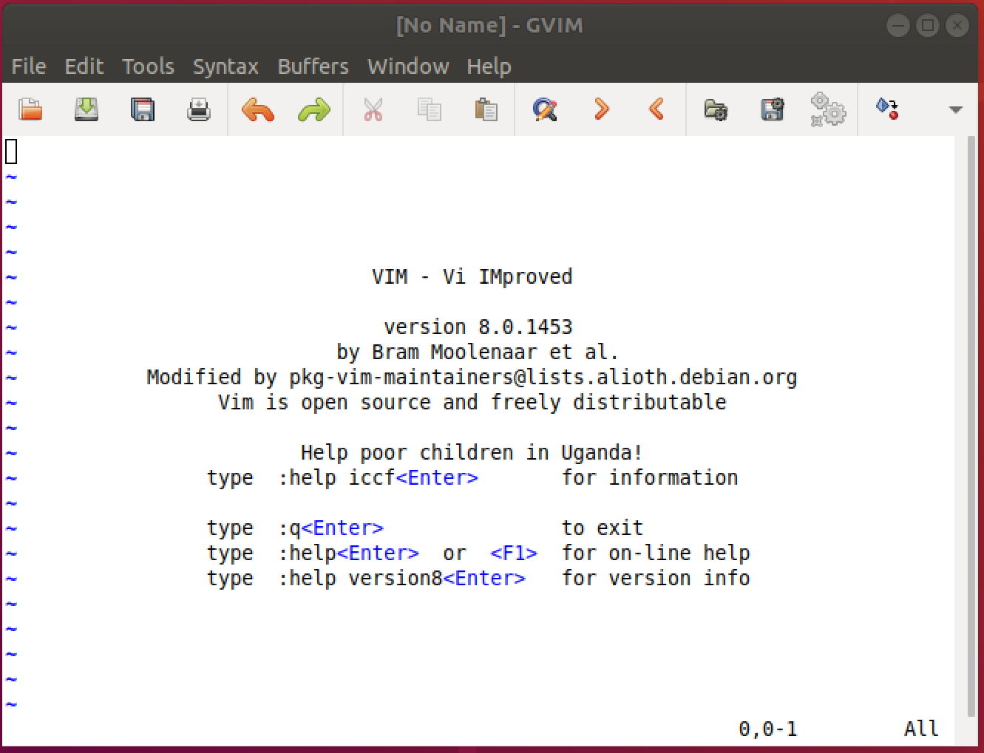
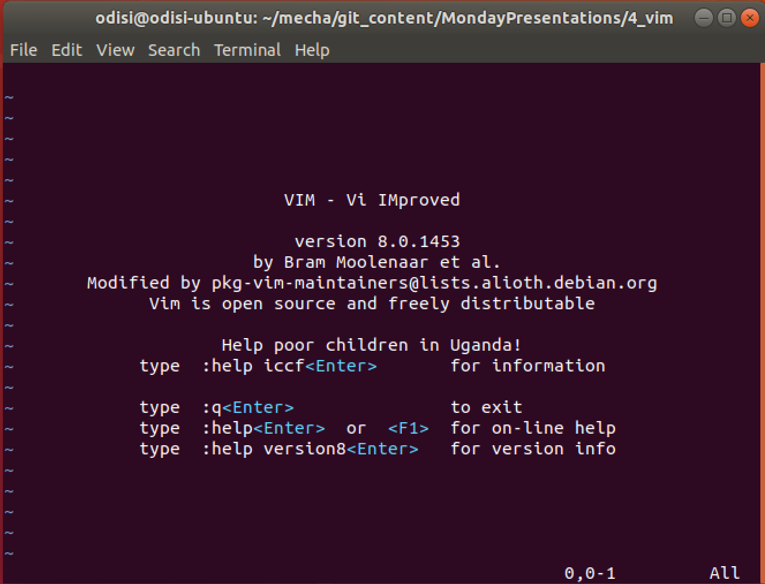

Slide 5
Modal Editor
Normal
Navigation and manipulation
Insert
Insert / edit text
Visual / Select
Normal + extra cmd selected text
Command-line / Ex-mode
Editor commands
Notes:
1.1. What is Vim? Vim stands for Vi IMproved. It used to be Vi IMitation, but there are so many improvements that a name change was appropriate. Vim is a text editor which includes almost all the commands from the Unix program "Vi" and a lot of new ones. All commands can be given with the keyboard. This has the advantage that you can keep your fingers on the keyboard and your eyes on the screen. For those who want it, there is mouse support and a GUI version with scrollbars and menus. Vim is an editor, not a word processor. A word processor is used mainly to do layout of text. This means positioning it, changing the way it appears on output. More often than not, the final document is meant to be printed or typeset or what have you, in order to present it in a pleasing manner to others. Examples of word processors are Microsoft Word, FrameMaker, and OpenOffice Writer. An editor is simply for entering text. Any typesetting or laying out of the document is secondary. With an editor, one's main concern is entering text, not making the text look good. Examples of editors other than Vim and Vi are Emacs, TextMate, Ultraedit and gedit. And Notepad.

Slide 6
Features
Word completion
Split Screen
File Format Detection
Syntax Coloring (200+ syntax files)
Comparison and Merging
Folding
Scripting and User-defined functions (Vim script)
Plugins available to extend functionalities

Slide 7
Basic Commands
h moves the cursor one character to the left.
j moves the cursor down one line.
k moves the cursor up one line.
l moves the cursor one character to the right.
d starts the delete operation.
dw will delete a word.
u will undo the last operation.
Ctrl-r will redo the last undo.

Slide 8
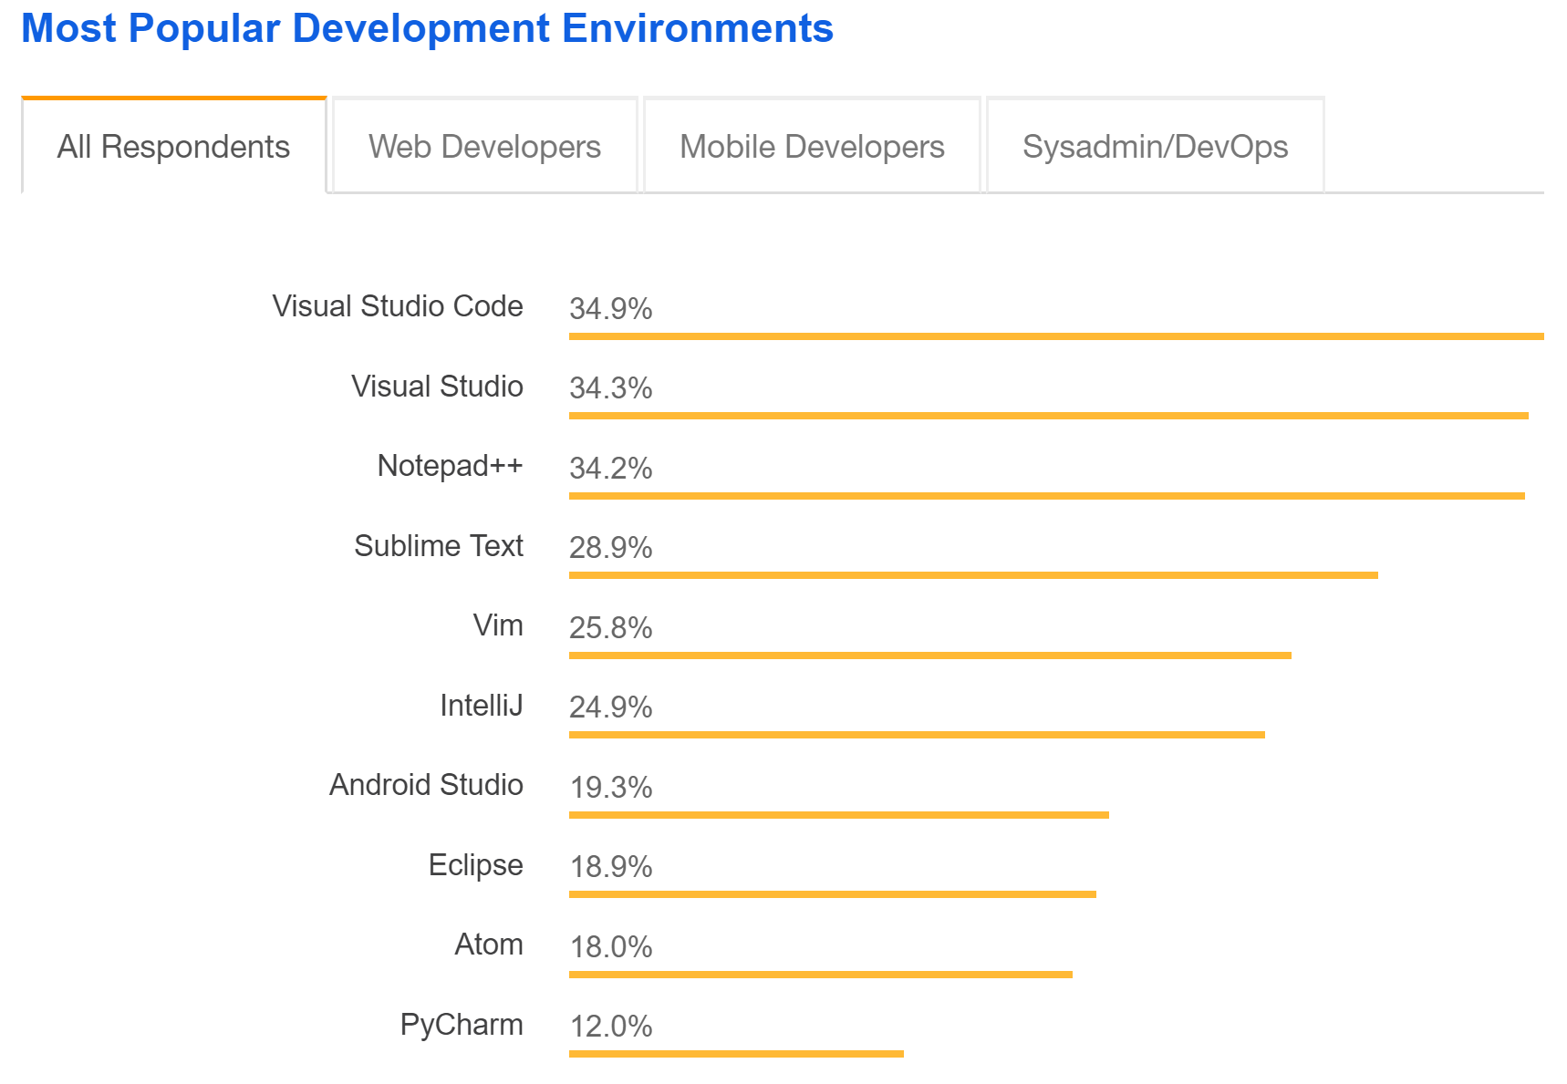
Stackoverflow Text Editor Survey
2015 – 3rd
2016 – 4th
2017 – 4th
2018 – 5th

Slide 9
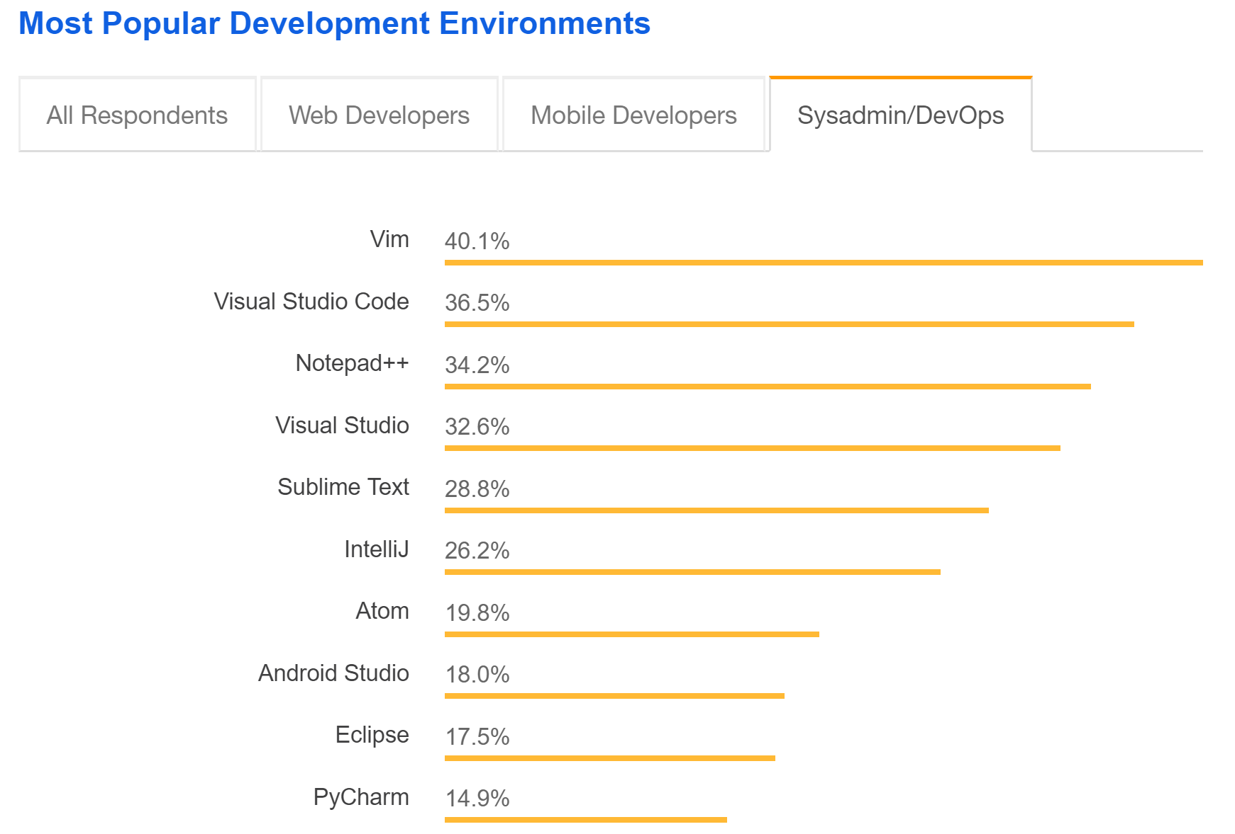
Stackoverflow Text Editor Survey
2018 – 1st
Sysadmin / DevOps

Slide 10
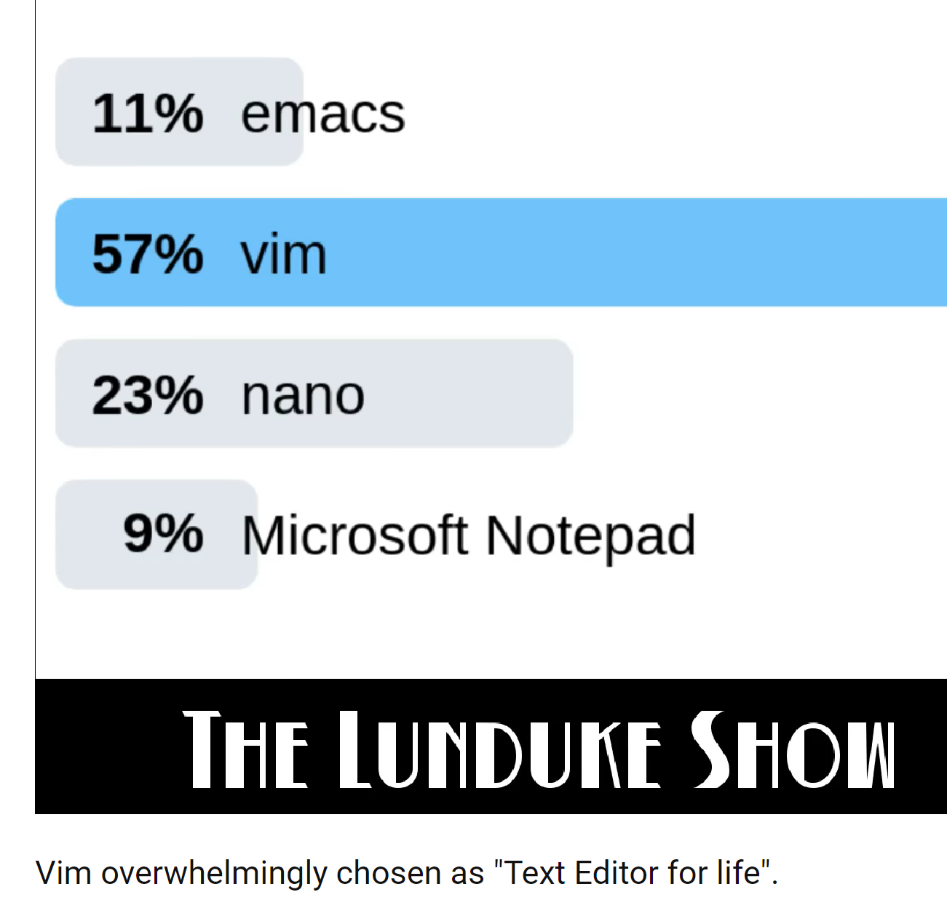
Text Editor for Life
https://www.youtube.com/watch?v=A8-rCdSRvSQ

Slide 11
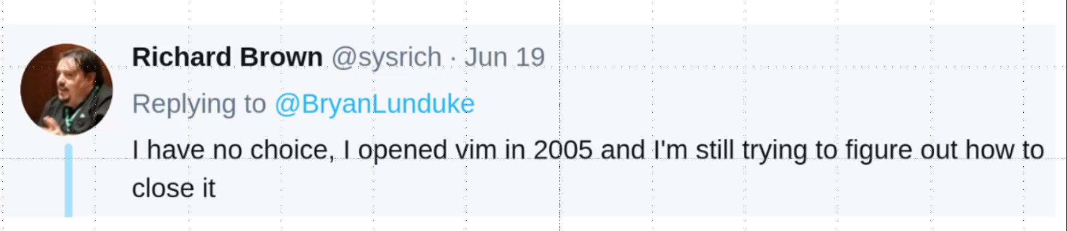

Slide 12
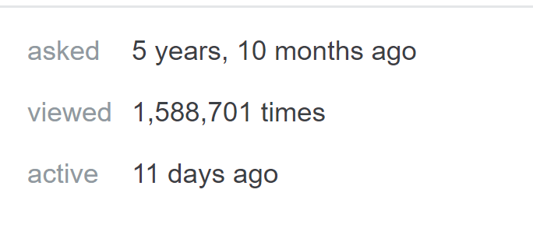
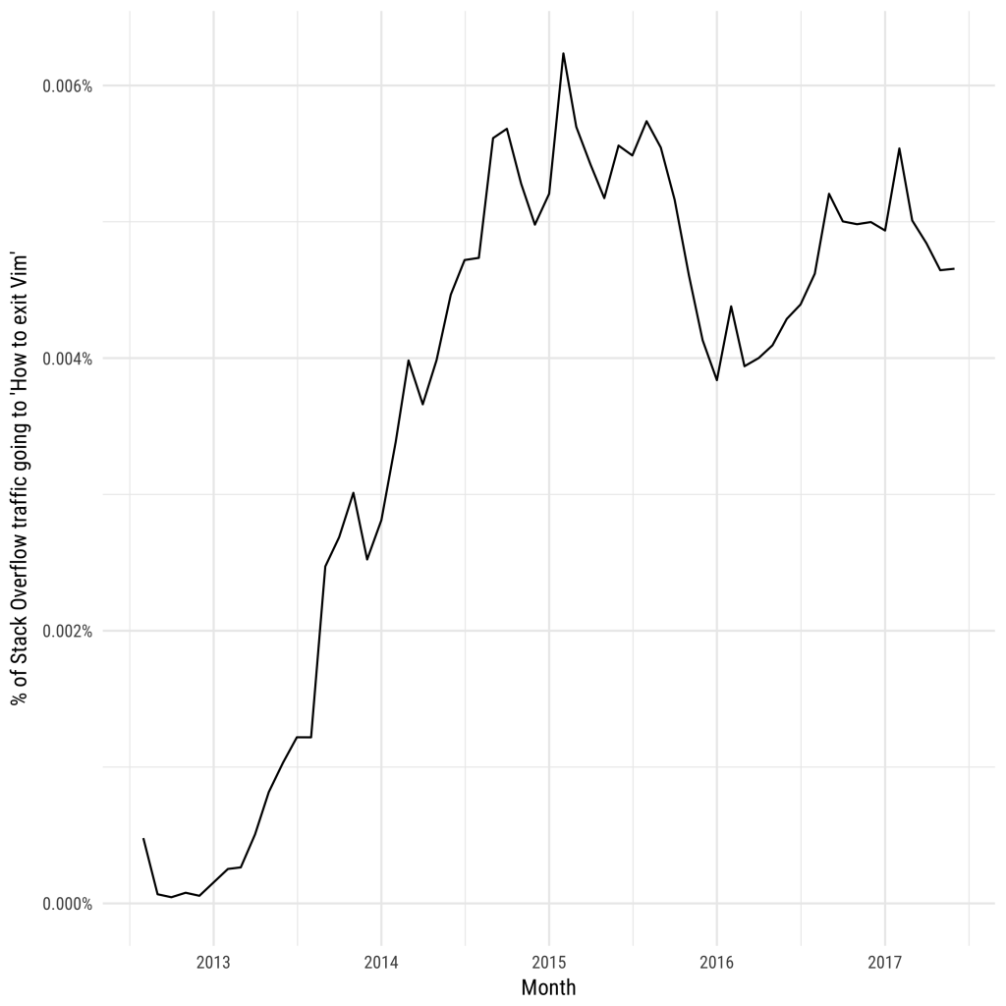
How to exit Vim?
.005% of question traffic
1 of every 20,000 visits to questions
80 people / hour (peak hours)
https://stackoverflow.com/questions/11828270/how-to-exit-the-vim-editor

Slide 13
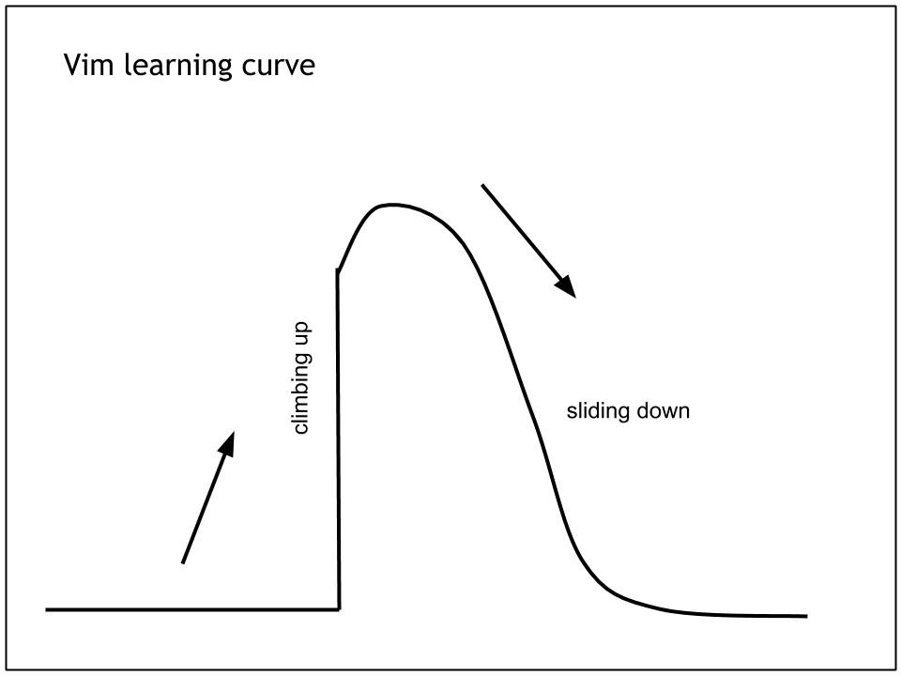
Vim Learning Curve Wall

Slide 14
Demo How to exit Vim

Slide 15
How to Exit Vim
:q to quit (short for :quit)
:q! to quit without saving (short for :quit!)
:wq to write and quit
:wq! to write and quit even if file has only read permission (force write)
:x to write and quit (similar to :wq, but only write if there are changes)
:exit to write and exit (same as :x)
:qa to quit all (short for :quitall)
:cq to quit without saving and make Vim return non-zero error
ZZ to save and quit (same as :x)
ZQ to just quit (same as :q!)

Slide 16
?

