Slide 1
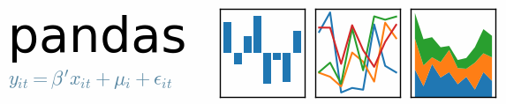
panel data structures A library for Data Analysis and Statistics
Francis B. Odisi

Slide 2

Notes:
Common issues:
Model specification (think R formulas)
Data cleaning
Attaching metadata (labels) to variables
To the extent possible, should make the user’s life easy

Slide 3
Problem

Slide 4
Item | Date | Price | Volume
AAAA | 2011-05-29 | 1.52 | 1000
AAAA | 2011-06-02 | 1.55 | 5000
BBBB | 2011-05-29 | 2.10 | 1500
CCCC | 2011-05-29 | 3.15 | 1200
Item | Date | Price | Vol. (K)
AAAA | “30-05-2011” | 1,52 | 1.5
AAAA | “01-06-2011”
BBBB | “30-05-2011” | 2,10 | 1.5
CCCC | “30-05-2011” | 3,15
Notes:
Problem / Opportunity
Challenges and needs when working with data analysis

Slide 5
Item | Date | Price | Volume
AAAA | 2011-05-29 | 1.52 | 1000
AAAA | 2011-06-02 | 1.55 | 5000
BBBB | 2011-05-29 | 2.10 | 1500
CCCC | 2011-05-29 | 3.15 | 1200
Table Modification
Indexing
Aggregation by group
Missing data
Merging and joining
Fast IO: files, DBs, etc.
Item | Date | Price | Vol. (K)
AAAA | “30-05-2011” | 1,52 | 1.5
AAAA | “01-06-2011”
BBBB | “30-05-2011” | 2,10 | 1.5
CCCC | “30-05-2011” | 3,15
Notes:
Problem / Opportunity
Challenges and needs when working with data analysis

Slide 6

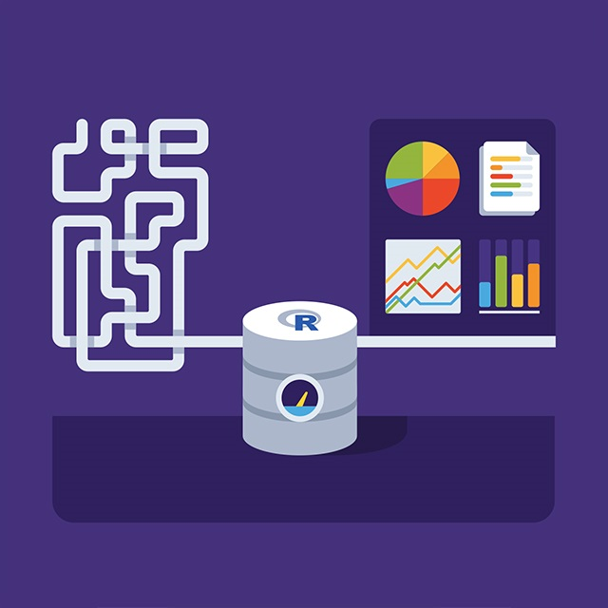
Data Munging and Preparation
Data Analysis and Modeling
Python
R, S+, MATLAB, Stata, SAS…
(Domain-Specific Language)
Notes:
Problem / Opportunity
Python has long been great for data munging and preparation, but less so for data analysis and modeling.
pandas helps fill this gap
pandas does not implement significant modeling functionality outside of linear and panel regression
, enabling you to carry out your entire data analysis workflow in Python without having to switch to a more domain specific language like R.
Combined with the excellent IPython toolkit and other libraries, the environment for doing data analysis in Python excels in performance, productivity, and the ability to collaborate.
pandas does not implement significant modeling functionality outside of linear and panel regression; for this, look to statsmodels and scikit-learn. More work is still needed to make Python a first class statistical modeling environment, but we are well on our way toward that goal.

Slide 7
Proposal

Slide 8
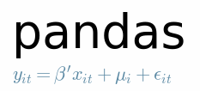



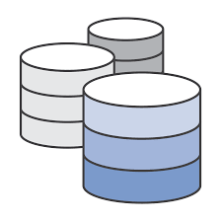
- Data structures and manipulation tools
- Statistical models and functions
HDF5
Python
Other libraries: NumPy, SciPy, matplotlib, Ipython, statsmodel
Notes:
Value proposition
pandas helps fill this gap
pandas does not implement significant modeling functionality outside of linear and panel regression
Other libraries
NumPy, SciPy (linear algebra, matrix operations)
Matplotlib (visualization, graphics)
Ipython (interactive research environment)
Application
Due to its status as a foundational data wrangling tool, pandas is used in virtually every large company in tech and finance (e.g. Athena Capital Research, Two Sigma) and at every major university. It is used in national research labs such as the Program for Climate Model Diagnosis and Intercomparison (PCMDI).
pandas is an open source, BSD-licensed library providing high-performance, easy-to-use data structures and data analysis tools for the Python programming language.
pandas is a NumFOCUS sponsored project. This will help ensure the success of development of pandas as a world-class open-source project, and makes it possible to donate to the project.
Industry
Business & Industry Applications Higher Education Research & Teaching Government
Features
Data Wrangling Modeling Visualization High Performance Computing Big Data Statistical Computing Numerical Computing Data Mining Text Processing Computing Language Educational Outreach Computational thinking
pandas is an open source library providing high-performance, easy-to-use data structures and data analysis tools for the Python programming language. pandas’ data analysis and modeling features enable users to carry out their entire data analysis workflow in Python without having to switch to a more domain-specific language like R.

Slide 9
How it works

Slide 10
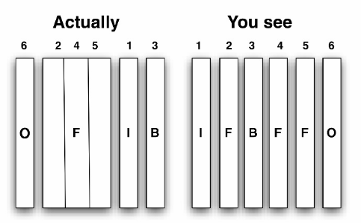
pandas
A DataFrame with automatic data alignment!
DataFrame - 2D tabular data structure with row and column indexes
- Simplified NymPy types: float, int, boolean, object
- Rich indexing operations, SQL-like join/merges, etc
Notes:
A fast and efficient DataFrame object for data manipulation with integrated indexing;
Tools for reading and writing data between in-memory data structures and different formats: CSV and text files, Microsoft Excel, SQL databases, and the fast HDF5 format;
Intelligent data alignment and integrated handling of missing data: gain automatic label-based alignment in computations and easily manipulate messy data into an orderly form;
Flexible reshaping and pivoting of data sets;
Intelligent label-based slicing, fancy indexing, and subsetting of large data sets;
Columns can be inserted and deleted from data structures for size mutability;
Aggregating or transforming data with a powerful group by engine allowing split-apply-combine operations on data sets;
High performance merging and joining of data sets;
Hierarchical axis indexing provides an intuitive way of working with high-dimensional data in a lower-dimensional data structure;
Time series-functionality: date range generation and frequency conversion, moving window statistics, moving window linear regressions, date shifting and lagging. Even create domain-specific time offsets and join time series without losing data;
Highly optimized for performance, with critical code paths written in Cythonor C.
Python with pandas is in use in a wide variety of academic and commercialdomains, including Finance, Neuroscience, Economics, Statistics, Advertising, Web Analytics, and more.

Slide 11
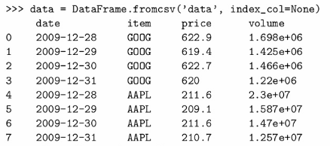
Reading from files:
Notes:
A fast and efficient DataFrame object for data manipulation with integrated indexing;
Tools for reading and writing data between in-memory data structures and different formats: CSV and text files, Microsoft Excel, SQL databases, and the fast HDF5 format;
Intelligent data alignment and integrated handling of missing data: gain automatic label-based alignment in computations and easily manipulate messy data into an orderly form;
Flexible reshaping and pivoting of data sets;
Intelligent label-based slicing, fancy indexing, and subsetting of large data sets;
Columns can be inserted and deleted from data structures for size mutability;
Aggregating or transforming data with a powerful group by engine allowing split-apply-combine operations on data sets;
High performance merging and joining of data sets;
Hierarchical axis indexing provides an intuitive way of working with high-dimensional data in a lower-dimensional data structure;
Time series-functionality: date range generation and frequency conversion, moving window statistics, moving window linear regressions, date shifting and lagging. Even create domain-specific time offsets and join time series without losing data;
Highly optimized for performance, with critical code paths written in Cythonor C.
Python with pandas is in use in a wide variety of academic and commercialdomains, including Finance, Neuroscience, Economics, Statistics, Advertising, Web Analytics, and more.

Slide 12

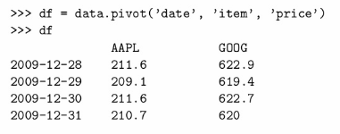
Group by:
Pivot tables:
Notes:
A fast and efficient DataFrame object for data manipulation with integrated indexing;
Tools for reading and writing data between in-memory data structures and different formats: CSV and text files, Microsoft Excel, SQL databases, and the fast HDF5 format;
Intelligent data alignment and integrated handling of missing data: gain automatic label-based alignment in computations and easily manipulate messy data into an orderly form;
Flexible reshaping and pivoting of data sets;
Intelligent label-based slicing, fancy indexing, and subsetting of large data sets;
Columns can be inserted and deleted from data structures for size mutability;
Aggregating or transforming data with a powerful group by engine allowing split-apply-combine operations on data sets;
High performance merging and joining of data sets;
Hierarchical axis indexing provides an intuitive way of working with high-dimensional data in a lower-dimensional data structure;
Time series-functionality: date range generation and frequency conversion, moving window statistics, moving window linear regressions, date shifting and lagging. Even create domain-specific time offsets and join time series without losing data;
Highly optimized for performance, with critical code paths written in Cythonor C.
Python with pandas is in use in a wide variety of academic and commercialdomains, including Finance, Neuroscience, Economics, Statistics, Advertising, Web Analytics, and more.

Slide 13
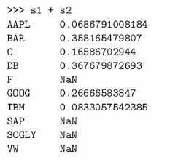
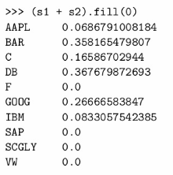
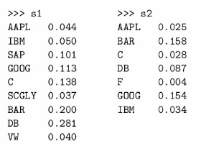
Joins / Merges:
Missing Data:
Notes:
A fast and efficient DataFrame object for data manipulation with integrated indexing;
Tools for reading and writing data between in-memory data structures and different formats: CSV and text files, Microsoft Excel, SQL databases, and the fast HDF5 format;
Intelligent data alignment and integrated handling of missing data: gain automatic label-based alignment in computations and easily manipulate messy data into an orderly form;
Flexible reshaping and pivoting of data sets;
Intelligent label-based slicing, fancy indexing, and subsetting of large data sets;
Columns can be inserted and deleted from data structures for size mutability;
Aggregating or transforming data with a powerful group by engine allowing split-apply-combine operations on data sets;
High performance merging and joining of data sets;
Hierarchical axis indexing provides an intuitive way of working with high-dimensional data in a lower-dimensional data structure;
Time series-functionality: date range generation and frequency conversion, moving window statistics, moving window linear regressions, date shifting and lagging. Even create domain-specific time offsets and join time series without losing data;
Highly optimized for performance, with critical code paths written in Cythonor C.
Python with pandas is in use in a wide variety of academic and commercialdomains, including Finance, Neuroscience, Economics, Statistics, Advertising, Web Analytics, and more.

Slide 14
Notes:
Common issues:
Model specification (think R formulas)
Data cleaning
Attaching metadata (labels) to variables
To the extent possible, should make the user’s life easy

