Slide 1

Francis B. Odisi

Slide 2


Slide 3

Data Storage Challenges

Slide 4




Data Variety
Performance
Security
Presentation

Slide 5
Microsoft SQL Server

Slide 6
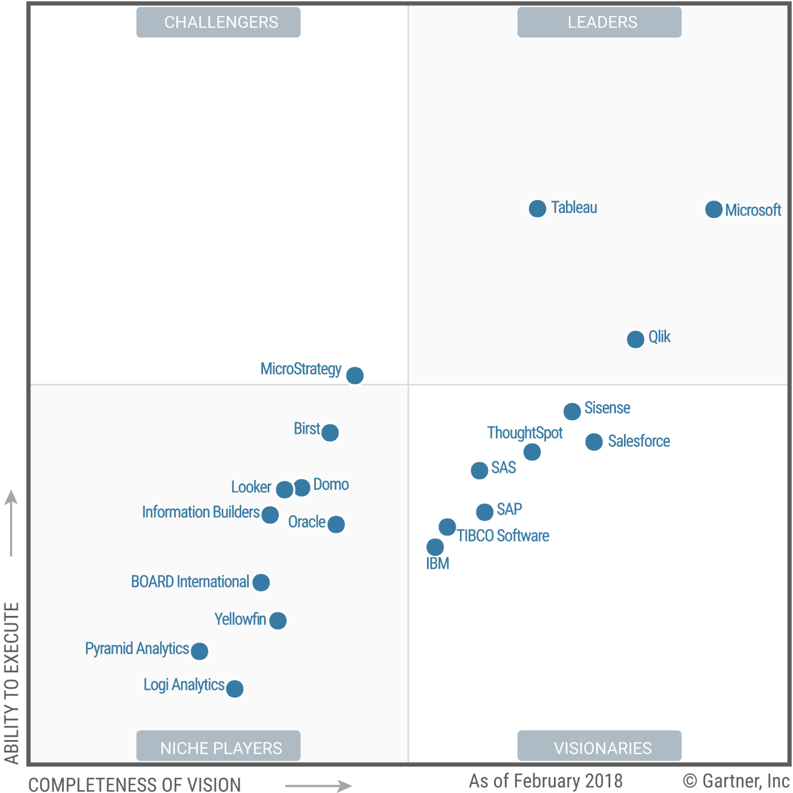
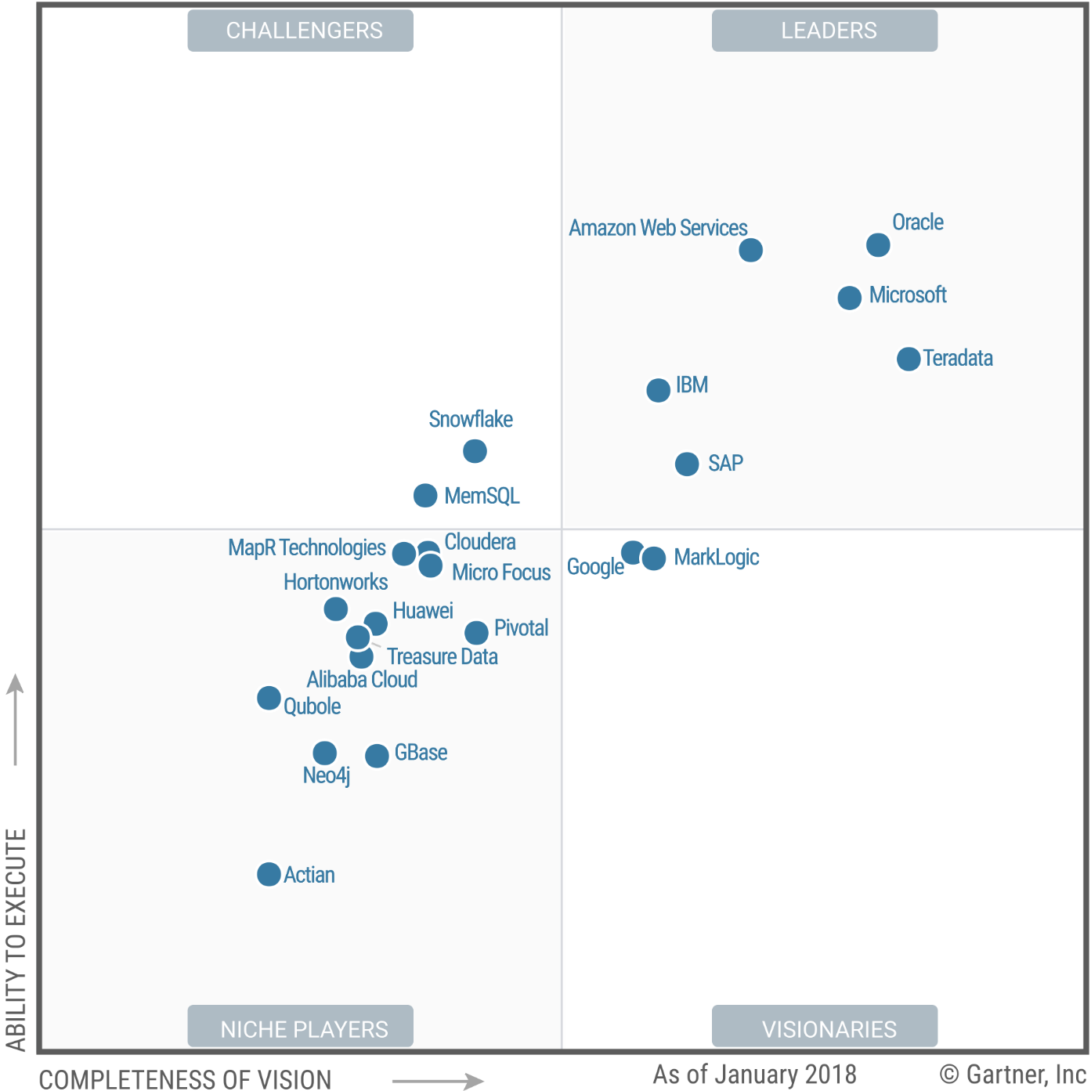
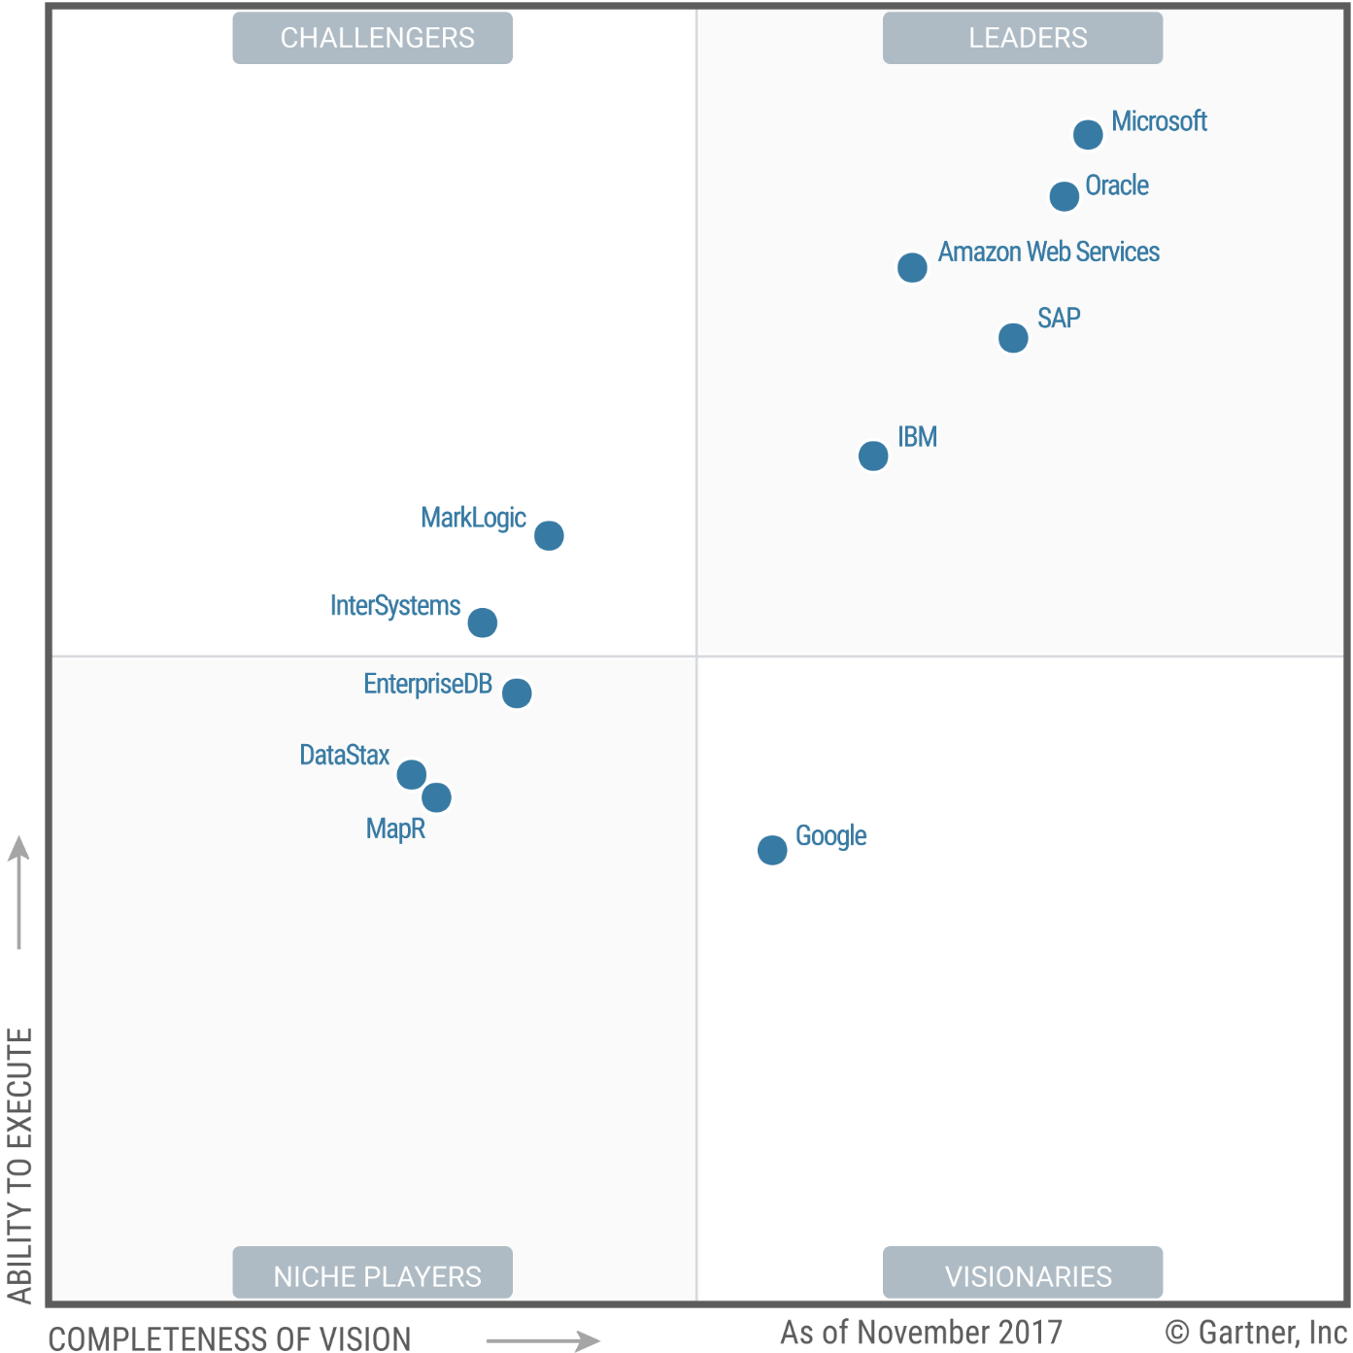
Gartner Magic Quadrant
Analytics and BI
Data Management
(Datawarehouse)
OPDBMS
(Relational / Non-Relational)

Slide 7
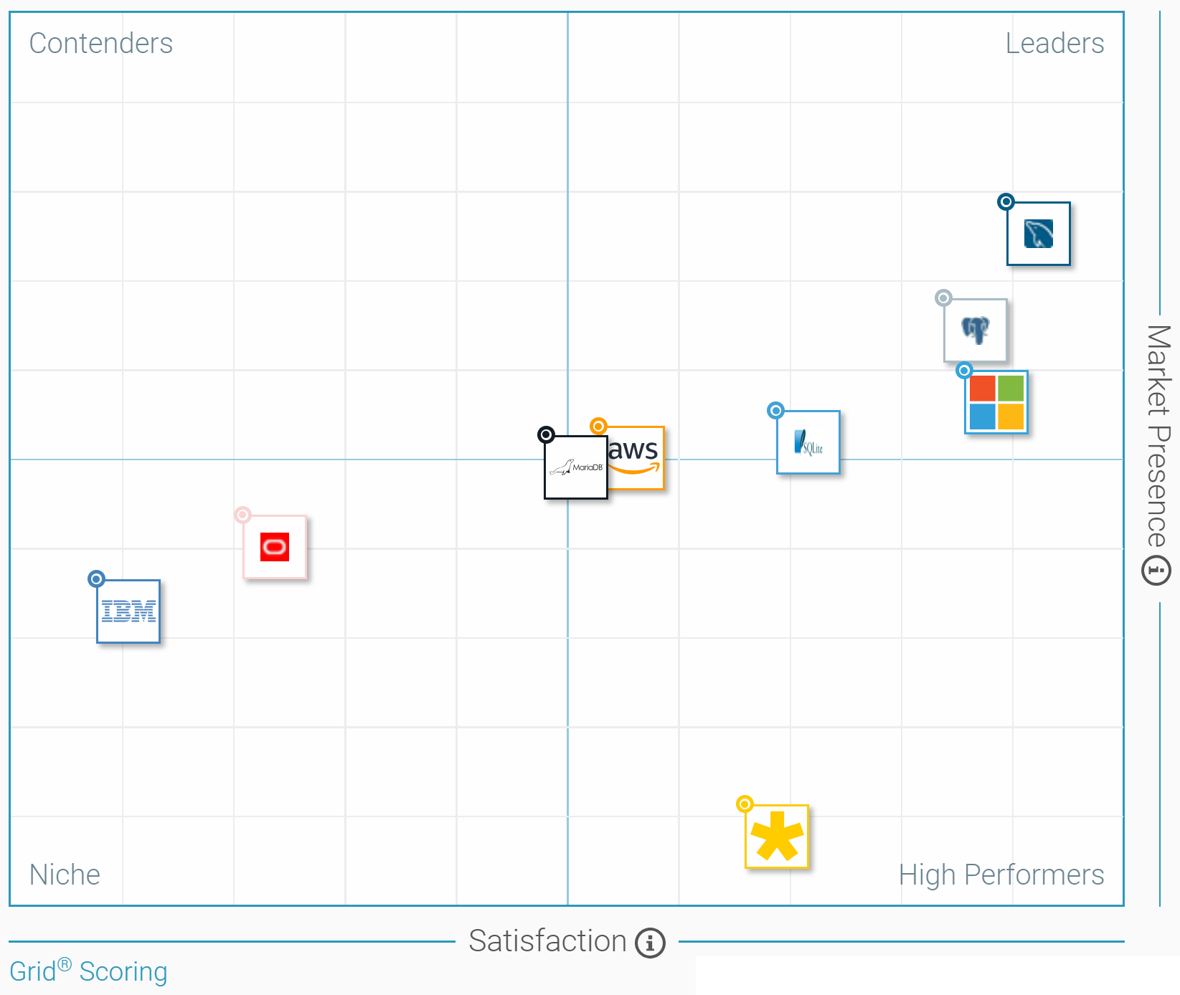
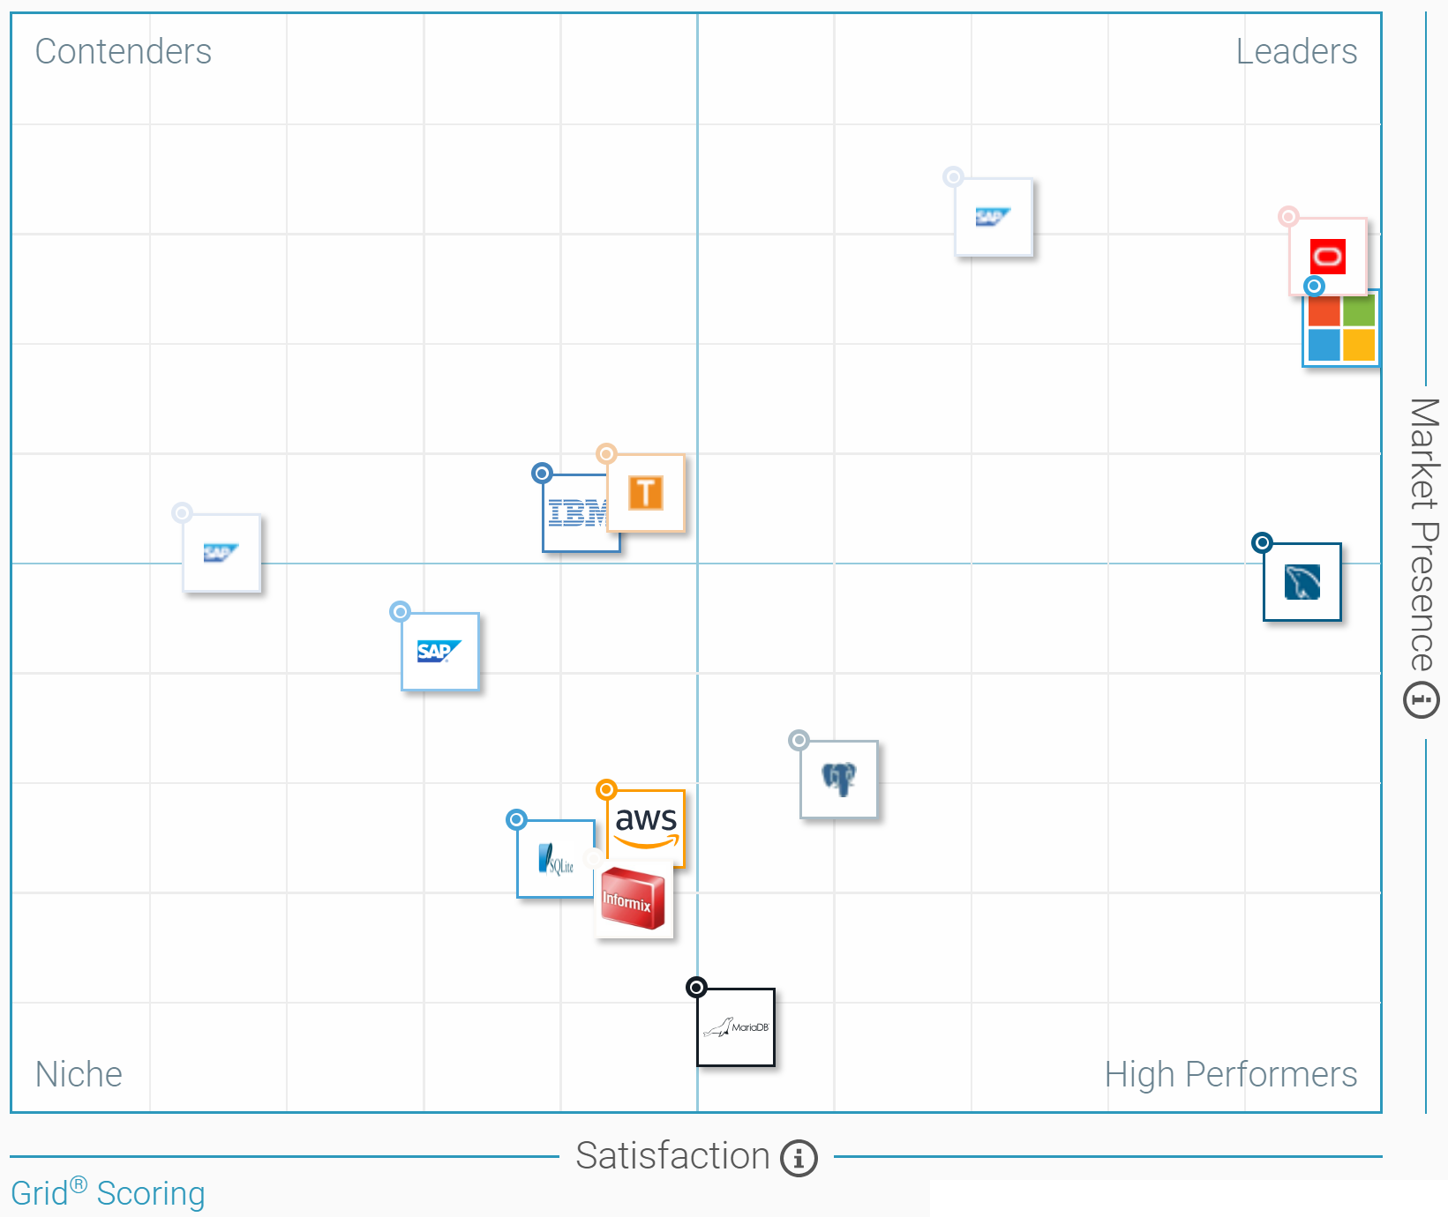
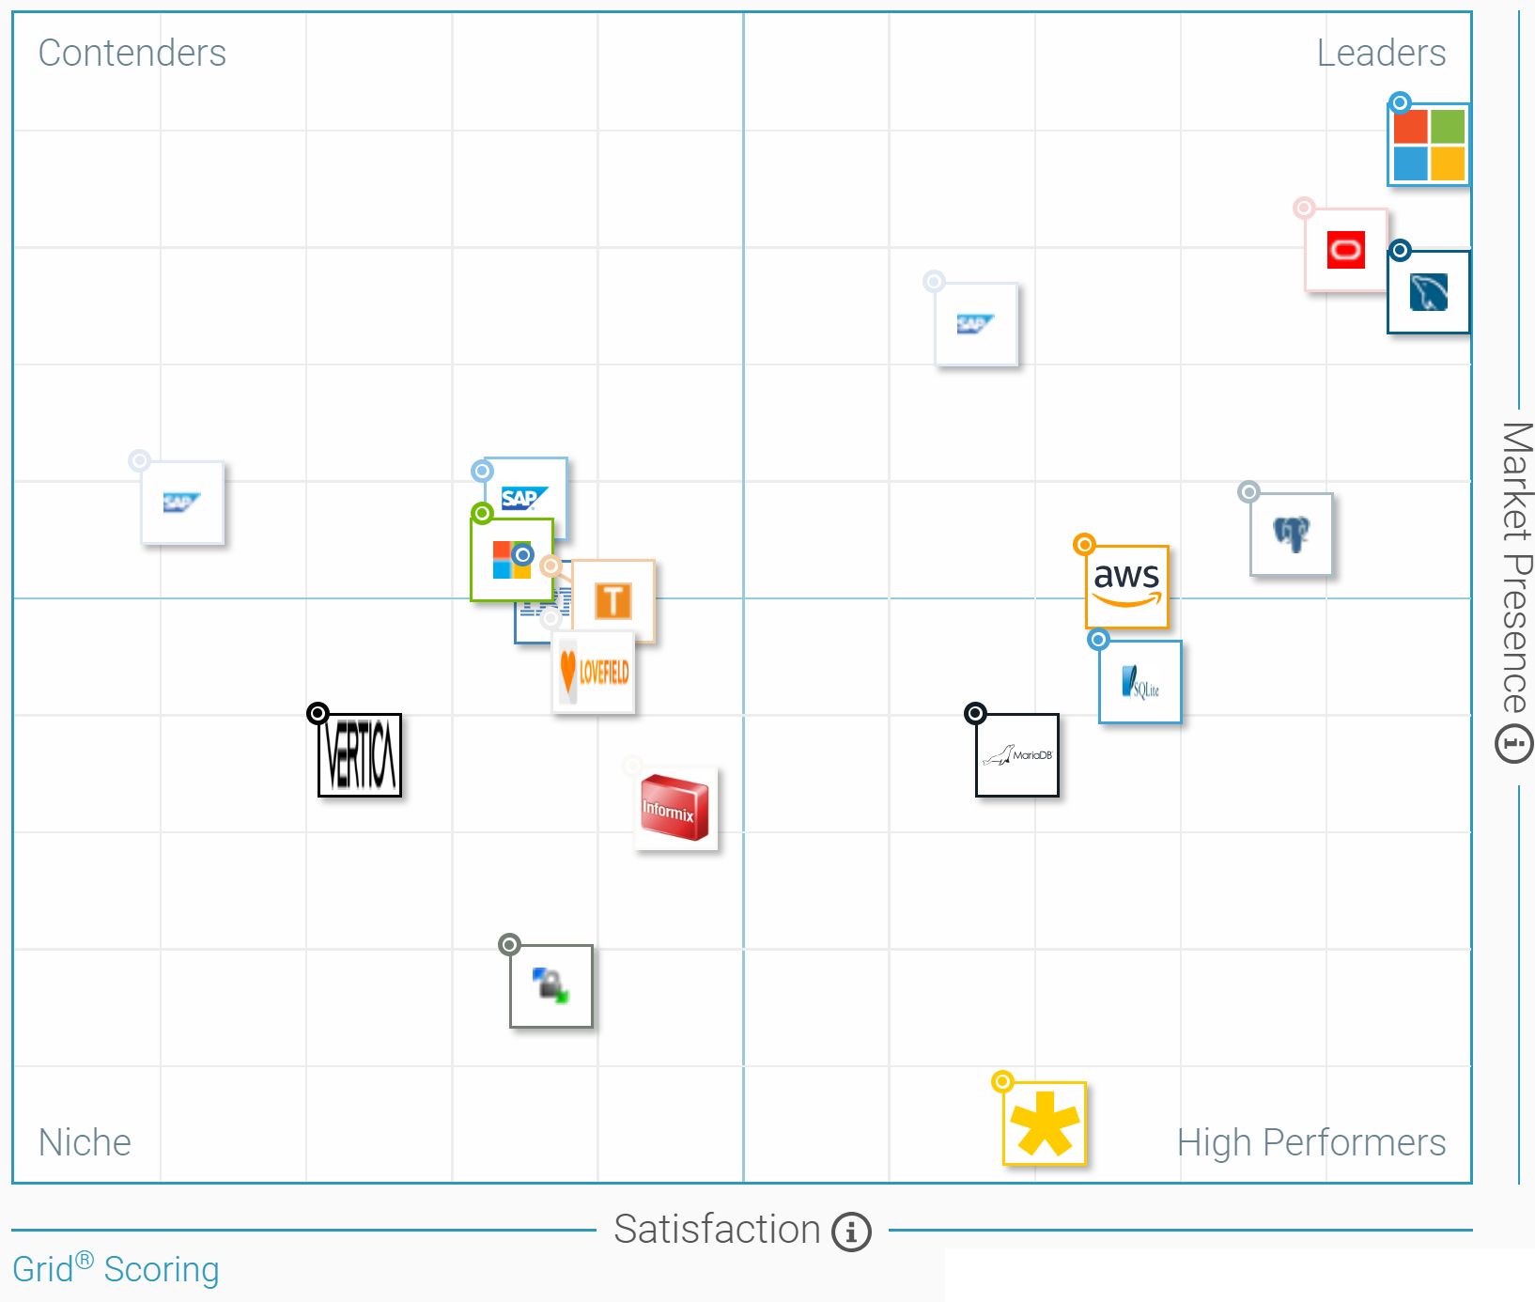
G2 Crowd
Small Business
Enterprise
All

Slide 8
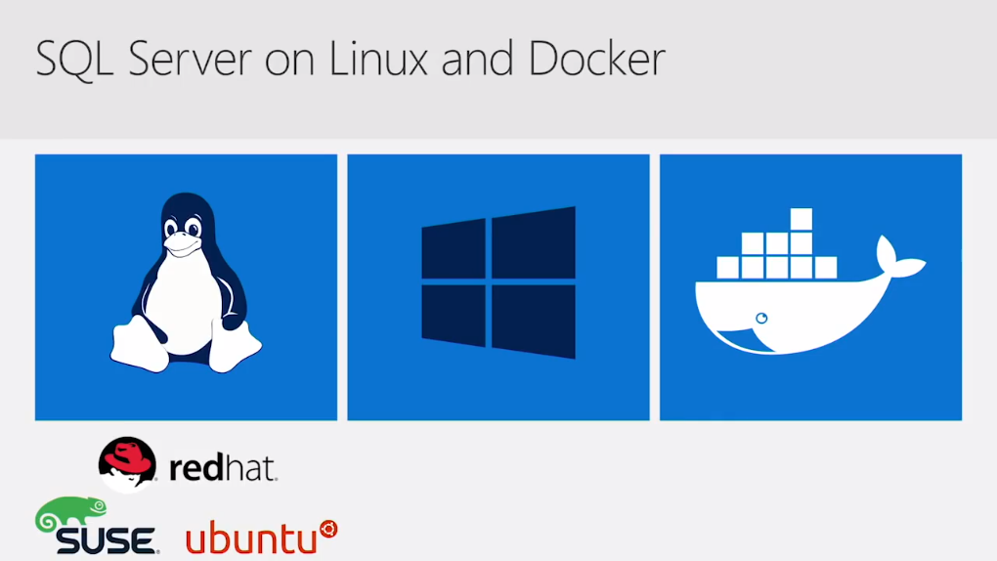

Slide 9
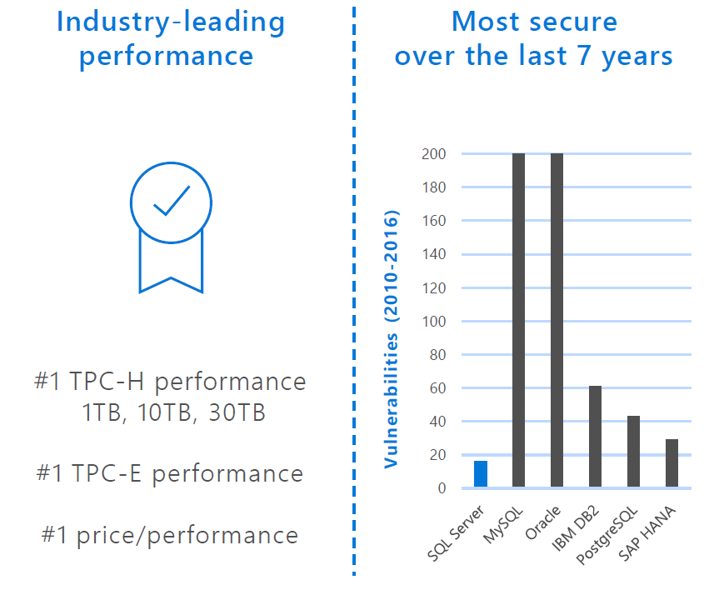

Slide 10
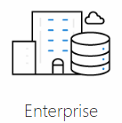
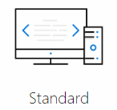
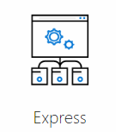
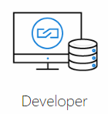
Maximum # cores | Unlimited | 24 cores | 4 cores | Unlimited
Memory (buffer pool) | OS maximum | 128 GB | 1410 MB | OS max
Max. DB size | 524 PB | 524 PB | 10 GB | 524 PB
Production use rights | Yes | Yes | Yes | No
Advanced Corporate BI | Yes | No | No | No
Advanced Analytics / Machine Learning (R, Python, Sparks, Hadoop) | Yes | No | No | No
Price | $ 14,256 per core | $ 3,717 per core $ 931 server + CAL | Free | Free
Version Comparison

Slide 11
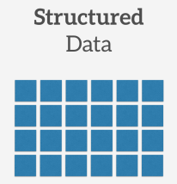
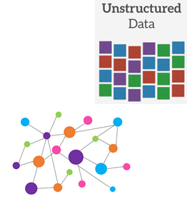


Features and Tools

Slide 12




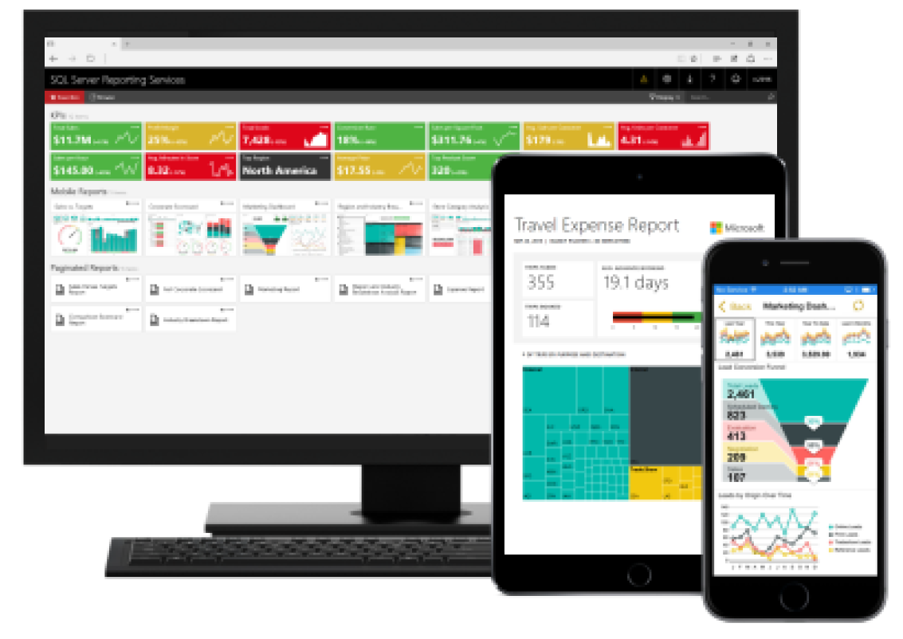



Features and Tools

Slide 13
Examples

Slide 14
JSON
DECLARE @json NVARCHAR(MAX)
SET @json =
N'[ { "id" : 2,"info": { "name": "John", "surname": "Smith" }, "age": 25 },
{ "id" : 5,"info": { "name": "Jane", "surname": "Smith", "skills": ["SQL", "C#", "Azure"] }, "dob": "2005-11-04T12:00:00" } ]'
SELECT *
FROM OPENJSON(@json)
WITH (id int 'strict $.id',
firstName nvarchar(50) '$.info.name', lastName nvarchar(50) '$.info.surname',
age int, dateOfBirth datetime2 '$.dob',
skills nvarchar(max) '$.skills' as json)
outer apply openjson( a.skills )
with ( skill nvarchar(8) '$' ) as b

Slide 15
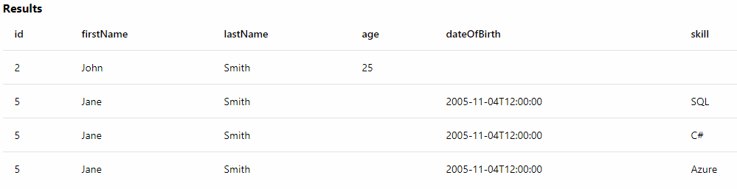
Result
[ { "id" : 2,"info": { "name": "John", "surname": "Smith" }, "age": 25 },
{ "id" : 5,"info": { "name": "Jane", "surname": "Smith",
"skills": ["SQL", "C#", "Azure"] }, "dob": "2005-11-04T12:00:00" } ]'

Slide 16
BUILT-IN PYTHON
import pandas as pd
Impots…
conn_str = 'Driver=SQL Server;Server=MYSQLSERVER;…'
#Define the columns we wish to import
column_info = { "Year" : { "type" : "integer" },…},
"Holiday" : { "type" : "factor", "levels" : ["1", "0"] },
"Snow" : { "type" : "factor", "levels" : ["1", "0"] } }
#Get the data from SQL Server Table
data_source = RxSqlServerData(…)
…
# import data source and convert to pandas dataframe
df = pd.DataFrame(rx_import(input_data = data_source))
columns = df.columns.tolist()

Slide 17
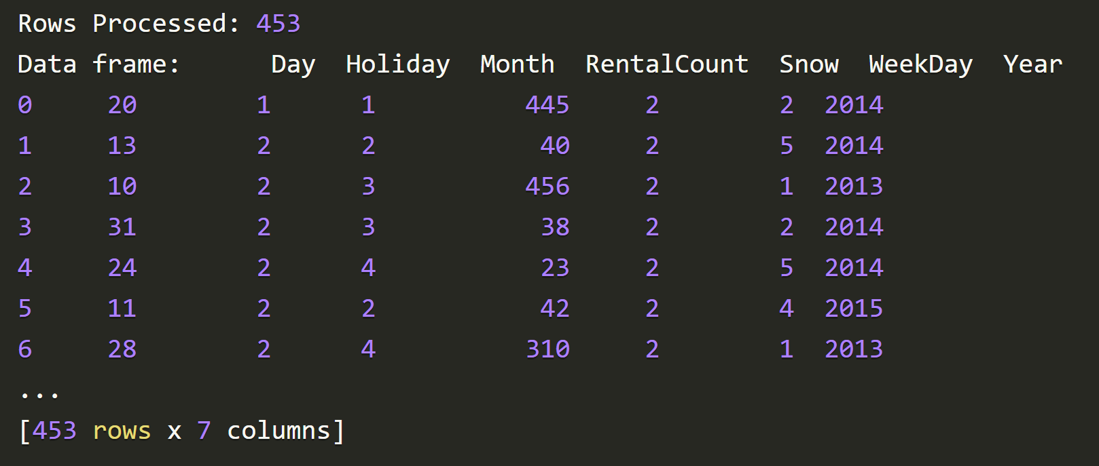
Result
[ { "id" : 2,"info": { "name": "John", "surname": "Smith" }, "age": 25 },
{ "id" : 5,"info": { "name": "Jane", "surname": "Smith",
"skills": ["SQL", "C#", "Azure"] }, "dob": "2005-11-04T12:00:00" } ]'

Slide 19
https://docs.microsoft.com/en-us/sql/relational-databases/json/json-data-sql-server?view=sql-server-2017
https://microsoft.github.io/sql-ml-tutorials/python/rentalprediction/step/2.html

Slide 20
Gartner quadrant OPDBMS - https://www.gartner.com/doc/reprints?id=1-3JD7HF0&ct=161005&st=sb
Gartner quadrant for analytics and business intelligence - https://www.gartner.com/doc/reprints?id=1-3TXXSLV&ct=170221&st=sb
Gartner – DMS for analytics(datawarehouse) - https://www.gartner.com/doc/reprints?id=1-3U1LC65&ct=170222&st=sb
Json support - https://docs.microsoft.com/en-us/sql/relational-databases/json/json-data-sql-server?view=sql-server-2017
R/Python processing - https://cloudblogs.microsoft.com/sqlserver/2017/04/19/python-in-sql-server-2017-enhanced-in-database-machine-learning/

