Slide 1

FAIL2BAN
Francis B. Odisi

Slide 2
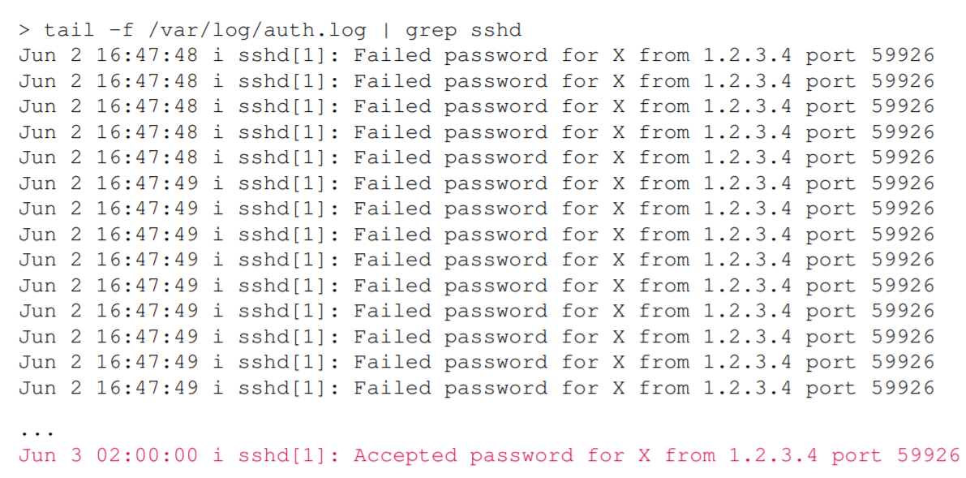
Source: http://www.onerussian.com/tmp/fail2ban-pycon2014.pdf
Notes:
Fail2Ban is an intrusion prevention software framework that protects computer servers from brute-force attacks.[2] Written in the Python programming language, it is able to run on POSIX systems that have an interface to a packet-control system or firewall installed locally, for example, iptables or TCP Wrapper.
Functionality
Fail2Ban operates by monitoring log files (e.g. /var/log/auth.log, /var/log/apache/access.log, etc.) for selected entries and running scripts based on them. Most commonly this is used to block selected IP addresses that may belong to hosts that are trying to breach the system's security. It can ban any host IP address that makes too many login attempts or performs any other unwanted action within a time frame defined by the administrator. Fail2Ban is typically set up to unban a blocked host within a certain period, so as to not "lock out" any genuine connections that may have been temporarily misconfigured. However, an unban time of several minutes is usually enough to stop a network connection being flooded by malicious connections, as well as reducing the likelihood of a successful dictionary attack.
Fail2Ban can perform multiple actions whenever an abusive IP address is detected:[3] update Netfilter/iptables or PF firewall rules, TCP Wrapper's hosts.deny table, to reject an abuser's IP address; email notifications; or any user-defined action that can be carried out by a Python script.
The standard configuration ships with filters for Apache, Lighttpd, sshd, vsftpd, qmail, Postfix and Courier Mail Server.[4] Filters are defined by Python regexes, which may be conveniently customized by an administrator familiar with regular expressions. A combination of a filter and an action is known as a "jail" and is what causes a malicious host to be blocked from accessing specified network services. As well as the examples that are distributed with the software, a "jail" may be created for any network-facing process that creates a log file of access.
Fail2Ban is similar to DenyHosts [...] but unlike DenyHosts which focuses on SSH, Fail2Ban can be configured to monitor any service that writes login attempts to a log file, and instead of using /etc/hosts.deny only to block IP addresses/hosts, Fail2Ban can use Netfilter/iptables and TCP Wrappers /etc/hosts.deny.
— Falko Timme[5]
Shortcomings
Fail2Ban fails to protect against a distributed brute-force attack.
There is no interaction with application-specific APIs/AGIs.

Slide 3
Brute-Force Attack
Source: http://www.onerussian.com/tmp/fail2ban-pycon2014.pdf
Notes:
Fail2Ban is an intrusion prevention software framework that protects computer servers from brute-force attacks.[2] Written in the Python programming language, it is able to run on POSIX systems that have an interface to a packet-control system or firewall installed locally, for example, iptables or TCP Wrapper.
Functionality
Fail2Ban operates by monitoring log files (e.g. /var/log/auth.log, /var/log/apache/access.log, etc.) for selected entries and running scripts based on them. Most commonly this is used to block selected IP addresses that may belong to hosts that are trying to breach the system's security. It can ban any host IP address that makes too many login attempts or performs any other unwanted action within a time frame defined by the administrator. Fail2Ban is typically set up to unban a blocked host within a certain period, so as to not "lock out" any genuine connections that may have been temporarily misconfigured. However, an unban time of several minutes is usually enough to stop a network connection being flooded by malicious connections, as well as reducing the likelihood of a successful dictionary attack.
Fail2Ban can perform multiple actions whenever an abusive IP address is detected:[3] update Netfilter/iptables or PF firewall rules, TCP Wrapper's hosts.deny table, to reject an abuser's IP address; email notifications; or any user-defined action that can be carried out by a Python script.
The standard configuration ships with filters for Apache, Lighttpd, sshd, vsftpd, qmail, Postfix and Courier Mail Server.[4] Filters are defined by Python regexes, which may be conveniently customized by an administrator familiar with regular expressions. A combination of a filter and an action is known as a "jail" and is what causes a malicious host to be blocked from accessing specified network services. As well as the examples that are distributed with the software, a "jail" may be created for any network-facing process that creates a log file of access.
Fail2Ban is similar to DenyHosts [...] but unlike DenyHosts which focuses on SSH, Fail2Ban can be configured to monitor any service that writes login attempts to a log file, and instead of using /etc/hosts.deny only to block IP addresses/hosts, Fail2Ban can use Netfilter/iptables and TCP Wrappers /etc/hosts.deny.
— Falko Timme[5]
Shortcomings
Fail2Ban fails to protect against a distributed brute-force attack.
There is no interaction with application-specific APIs/AGIs.

Slide 4

Intrusion Prevention Software Protects servers brute-force attacks
Cyril Jaquier, in 2004
1st Stable in 2006 (0.6.0)
Written in Python
POSIX (Unix-like OS)
Notes:
How it began (back in 2004)
Eager to learn a new programming language
Will be Python
First ADSL, permanent internet connection
Time to host a Linux server at home
with SSH for remote access
Soon, script kiddies tried to log-in onto my box
Many (failed) log-in attempts over SSH
Fail2ban is born Ban failed log-in attempts found in logs with iptables Could make a good project to learn Python Why not make it an open-source project? I’m using many open-source software I want to contribute something back The project ends up on sourceforge.net Licensed as GPLv2 First versions targeted at SSH only

Slide 5




How it Works
Monitors log files
Pattern
Do something

Slide 6

Components
Pattern -> Filter
Jail
Do… -> Action(s)

Slide 7
Components
Pattern -> Filter
Regular Expression
[iI](?:llegal|nvalid) user .* from <HOST>
Block <HOST> for 10 minutes
Jail
Scripts
Do… -> Action(s)

Slide 8
Filters
50+ Default
Supported Services:
SSH
Apache
Exim
Lighttpd
Postfix
ProFTPd
Courier Mail Server
Vsftpd … and more

Slide 9
Actions
80+ Default
Netfilter
IP Tables
TCP Wrapper (/etc/hosts.deny)
Many other firewalls
Python-based actions

Slide 10

Additional Features
Client/Server architecture
Multi-threaded
Database support
Highly configurable using split configuration files
Timeout on ban commands

Slide 11
Additional Features
Can handle multiple services at once
Resolves DNS hostname > IP address
Multi-line parsing in filters
Custom date time support for filters
Timezone awareness by default

Slide 12
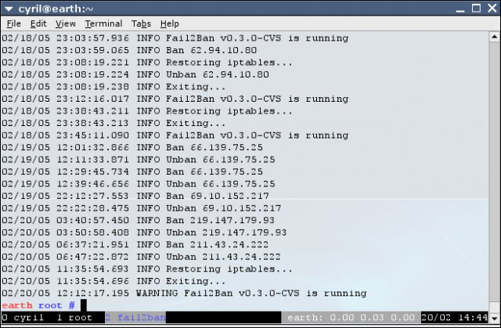

Slide 13
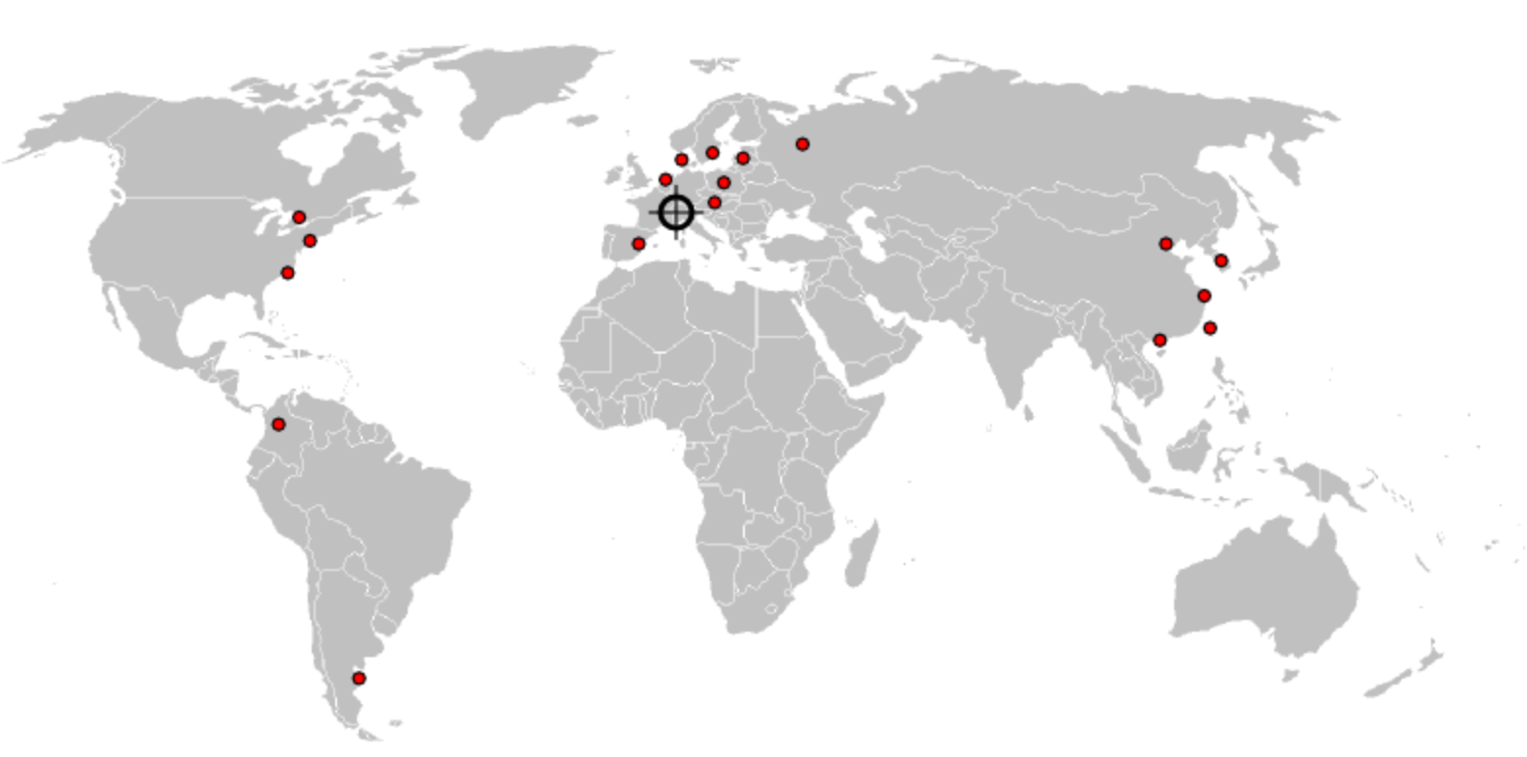
Created with RRD Tools

Slide 14
?
https://www.fail2ban.org
https://github.com/fail2ban

