Slide 1
One more PCA Example
Generalized linear models – Poisson distribution
Generalized linear models – Negative binomial distribution
Generalized linear models – logistic regression (binomial distribution)

Slide 2
What about binary variables.
voting democratic or republican
has cancer/does not have cancer

Slide 3
Here we simulate a classification problem (more on this later)
rm(list=ls())
numDataPoints <- 100
classBlue <- rnorm(10,mean=1);
classOrange <- rnorm(10, mean=0);
blueDataX1 <- vector();
orangeDataX1 <- vector();
for( i in 1:numDataPoints)
{
blueDataX1[i] <- rnorm(1, mean=classBlue[ sample(1:10,1) ], sd = 1/5)
orangeDataX1[i] <- rnorm(1, mean=classOrange[sample(1:10,1)],sd = 1/5)
}
colors <- c( rep("BLUE", numDataPoints), rep ("ORANGE", numDataPoints))
values <- c( rep(0, numDataPoints), rep (1, numDataPoints))
mergedDataX1 <- c( blueDataX1, orangeDataX1 );
plot(mergedDataX1, values,col=colors)
https://github.com/afodor/metagenomicsTools/blob/master/src/machineLearningExamples/logisticRegressionSims.txt

Slide 4
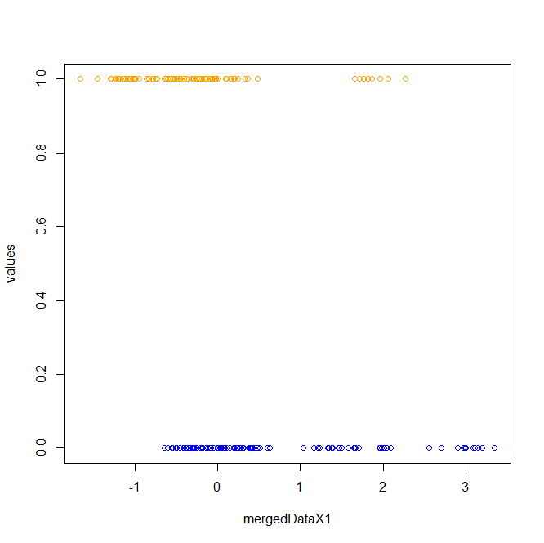
plot(mergedDataX1, values,col=colors)

Slide 5
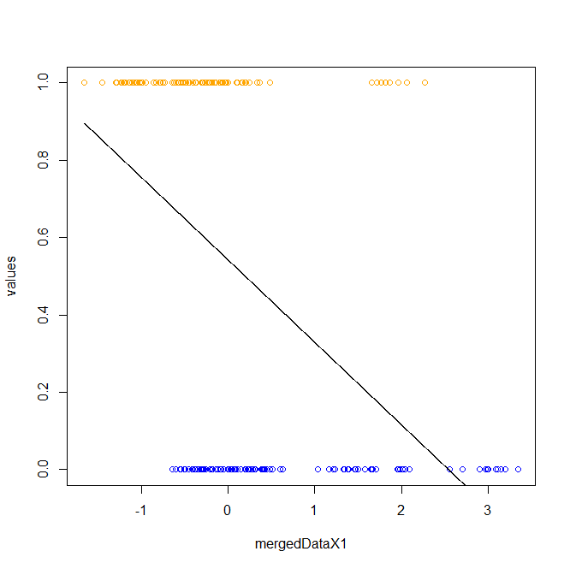
We can of course fit a linear model to these data
xSeq <- seq(min(mergedDataX1), max(mergedDataX1), 0.001)
myLm <- lm( values ~ mergedDataX1)
getProbLm <- function( x, B0, B1)
{
return ( B0 + B1 * x )
}
lines( xSeq, getProbLm(xSeq, coef(myLm)[1], coef(myLm)[2]),col="black")
We can think of the y-values as the p(blue|x value)
But our model can
Return values > 1 or <0, which doesn’t make sense for a probability

Slide 6
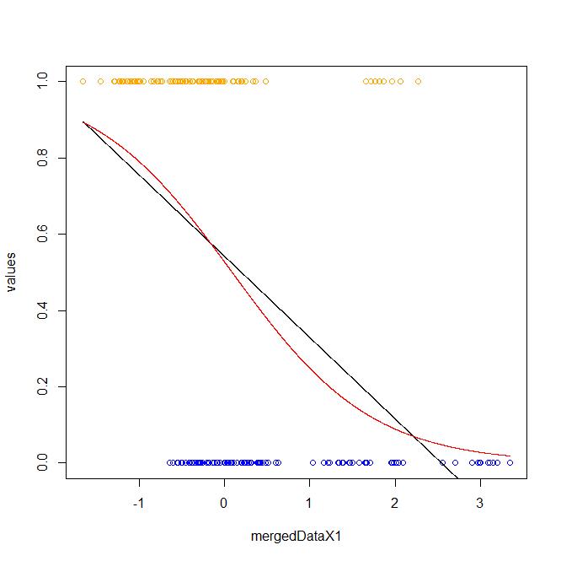
myLogReg <- glm( values ~ mergedDataX1 ,family = binomial)
summary(myLogReg)
xSeq <- seq(min(mergedDataX1), max(mergedDataX1), 0.001)
getProb <- function(x, B0, B1)
{
return (1 / (1 + exp(-(B0 + B1 * x ))))
}
lines( xSeq, getProb(xSeq, coef(myLogReg)[1], coef(myLogReg)[2]),col="red")
An alternative is a logistic regression
where the model can’t go >1 or <0

Slide 7
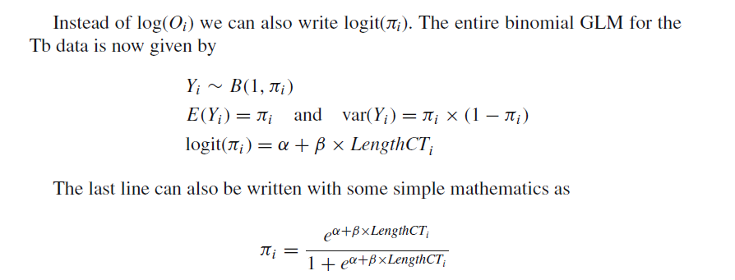
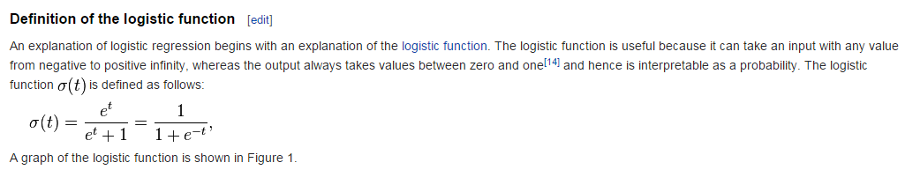
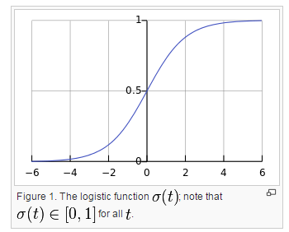
Here are the rules for a logistic regression…(Chapter 10 of the Zuur book..)
Binomial probability of 1 coin flip
Linker function
N * p * (1-p) with N = 1
Whatever intercept and
explanatory variables in your
design matrix
This constrains us to between 0 and 1
http://en.wikipedia.org/wiki/Logistic_regression

Slide 8
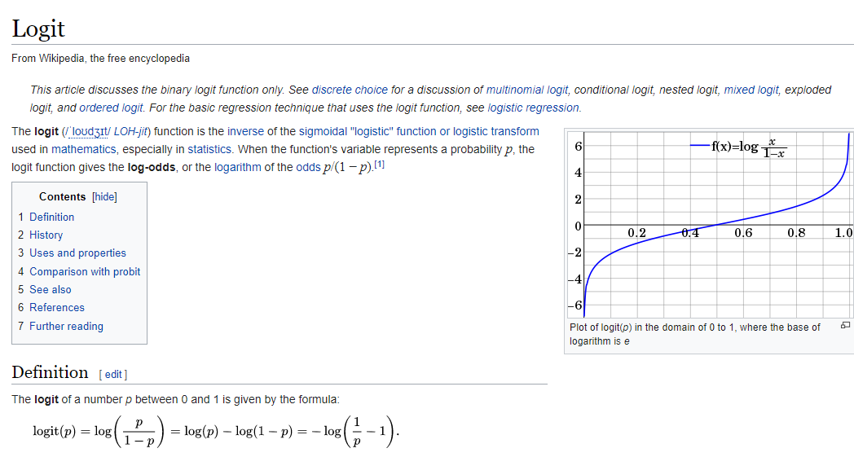

Slide 9

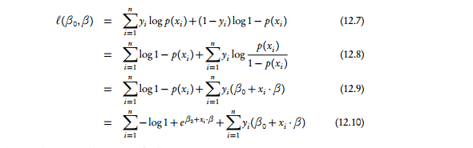
Put all this together into the likelihood…
Binomial distribution with n = 1
Yi is 1 or 0
This is π if a head (1- π) if a tail
Find the parameters to maximize this and we are good to go….
http://www.stat.cmu.edu/~cshalizi/uADA/12/lectures/ch12.pdf

Slide 10
The linear regression and logistic regression can vary in how closely they agree…
(Here we look at 3 different runs….)

Slide 11
Next:
Zero inflated Poisson and Negative Binomial

