Slide 1
Calculating the likelihood of models
Linear models with higher exponential terms
AIC criteria

Slide 2
Consider a two parameter model for LogBurk vs. time from our last lecture…
myT <- read.table("qPCRWithSampleDays.txt", sep="\t", header=TRUE)
myLm <- lm( myT$LogBurk ~ myT$sampleDays)
plot( myT$sampleDays , myT$LogBurk)
abline( myLm)

Slide 3
The residuals is the distance between the model (y-hat) and the datapoints (Y_{i})
hist(residuals(myLm))
We define the likelihood as the product of the probabilities of all the residues relative to this
distribution…
sum(log( dnorm( res, mean=mean(res), sd=sd(res))))

Slide 4
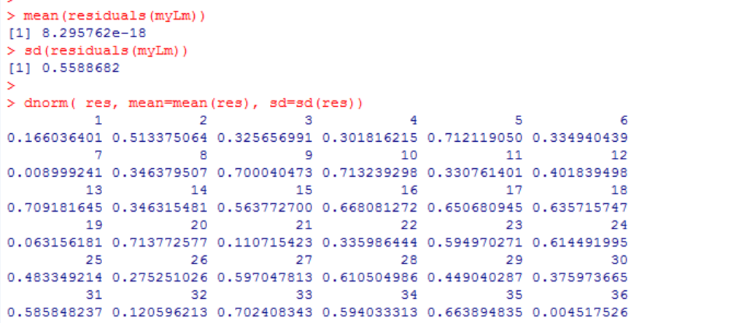
Some datapoints are right on the model line and others are further away…

Slide 5
res = residuals(myLm)
seqs <- seq(min(res), max(res), (max(res)-min(res))/1000)
plot(seqs, dnorm(seqs,mean=mean(res), sd = sd(res)))
points( res[1], dnorm( res[1], mean=mean(res), sd=sd(res)), col="red",pch=15, cex=3)
myT <- read.table("qPCRWithSampleDays.txt", sep="\t", header=TRUE)
myLm <- lm( myT$LogBurk ~ myT$sampleDays)
plot( myT$sampleDays , myT$LogBurk)
points( myT$sampleDays[1], myT$LogBurk[1], col="red", pch=15, cex=3)
abline( myLm)
(to simplify, we only show one of the four model lines!)

Slide 6
myT <- read.table("qPCRWithSampleDays.txt", sep="\t", header=TRUE)
myLm <- lm( myT$LogBurk ~ myT$sampleDays)
plot( myT$sampleDays , myT$LogBurk)
points( myT$sampleDays[17], myT$LogBurk[17], col="red", pch=15, cex=3)
abline( myLm)
myT <- read.table("qPCRWithSampleDays.txt", sep="\t", header=TRUE)
myLm <- lm( myT$LogBurk ~ myT$sampleDays)
plot( myT$sampleDays , myT$LogBurk)
points( myT$sampleDays[17], myT$LogBurk[17], col="red", pch=15, cex=3)
abline( myLm)
We can fit models by finding parameters that maximize the likelihood
(more on that later…)

Slide 7
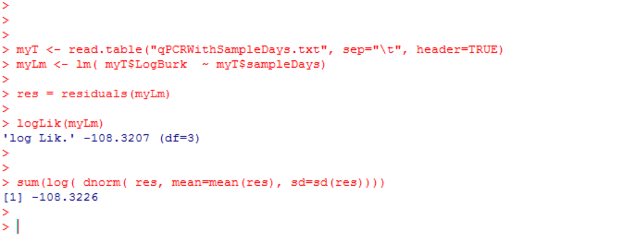
R has a built in function that will make this calculation for us…

Slide 8
Calculating the likelihood of models
Linear models with higher exponential terms
AIC criteria

Slide 9
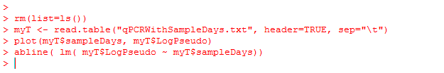
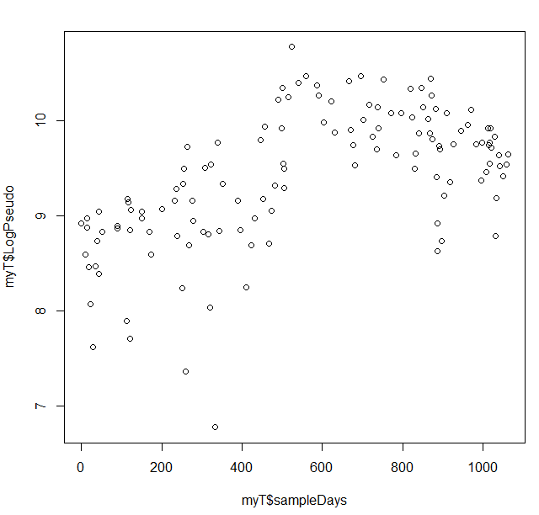
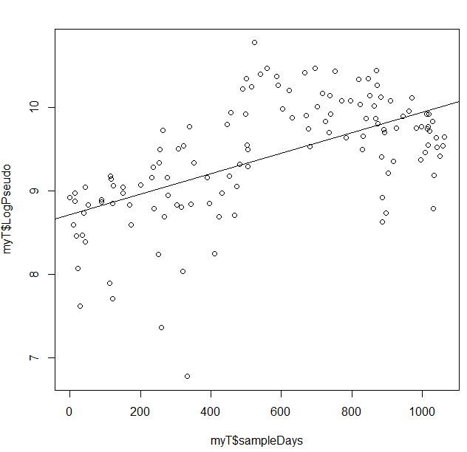
Another taxa (Pseudomonas) clearly does not meet the assumption of linearity….

Slide 10
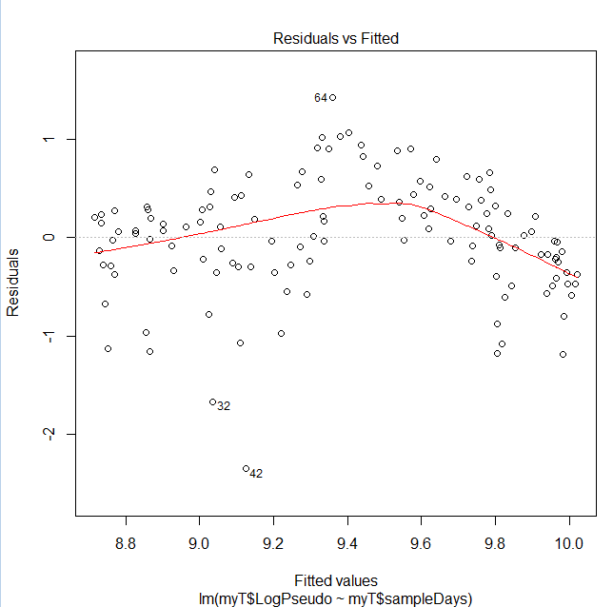
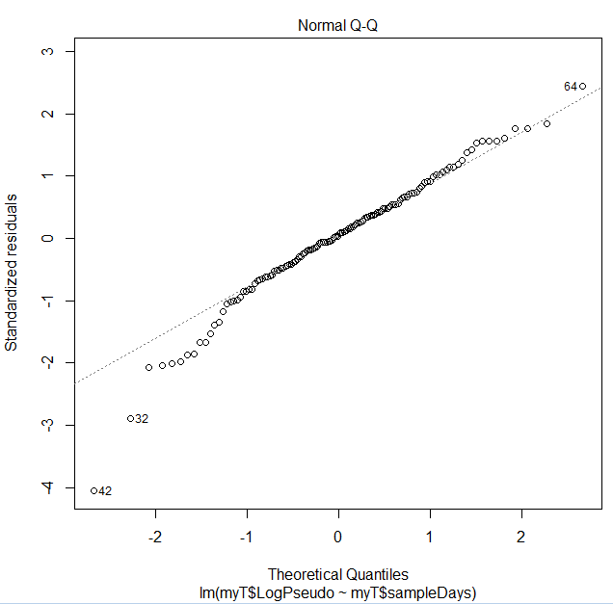
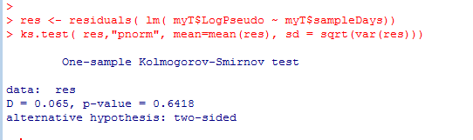
We see systematic deviation from the assumption of linearity…
Although we could justify
Pushing ahead with our linear model

Slide 11
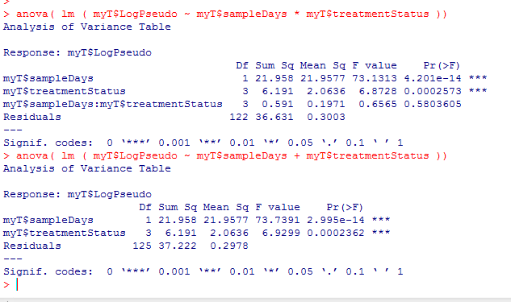
One alternative is just to accept the deviation from linearity..
As before we can remove
the interaction terms

Slide 12
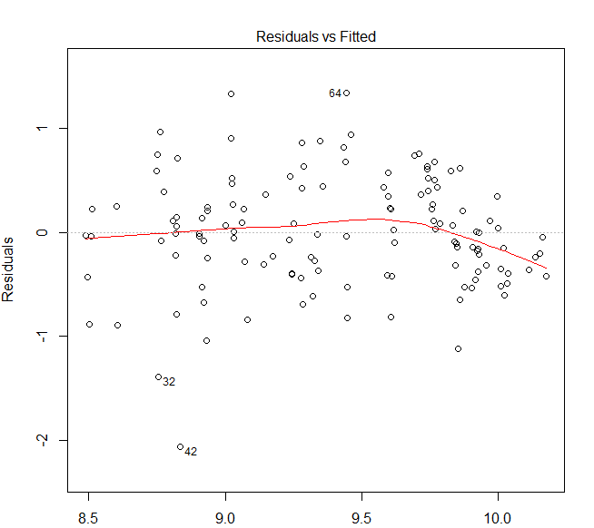
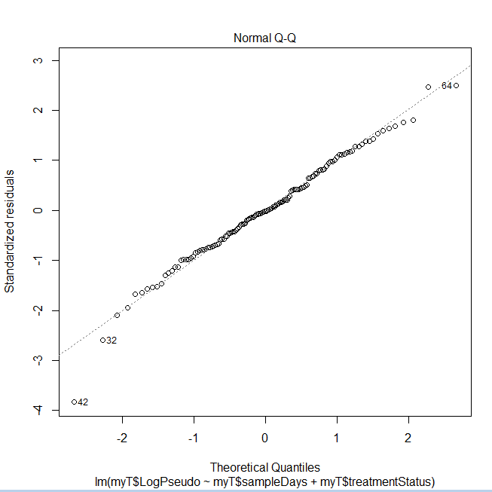
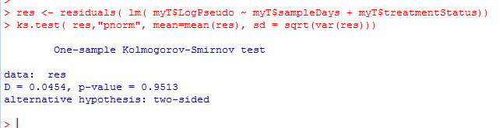
Our 5 parameter model does not appear to deviate substantially from its assumptions…

Slide 13
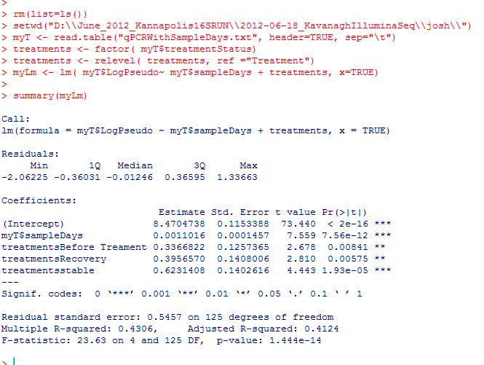
Treatment with antibiotic appears to be significantly associated with decreased amounts of
this bug….

Slide 14
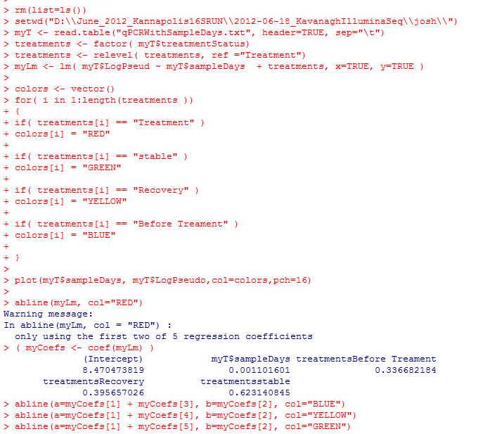
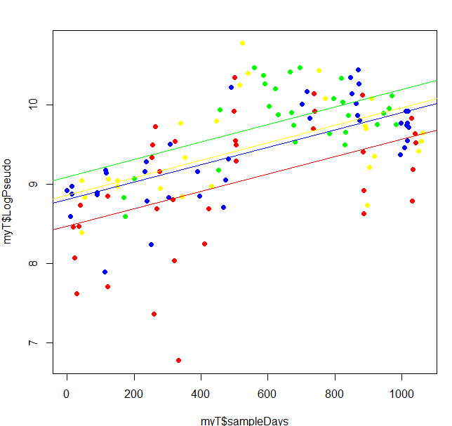
The model is in the ballpark (but is not really linear)

Slide 15
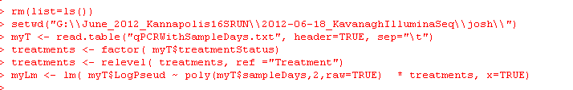
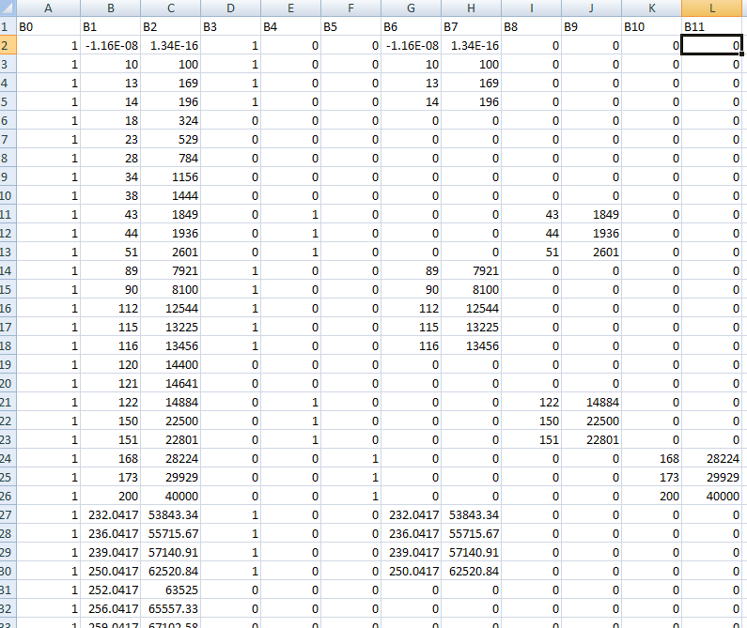
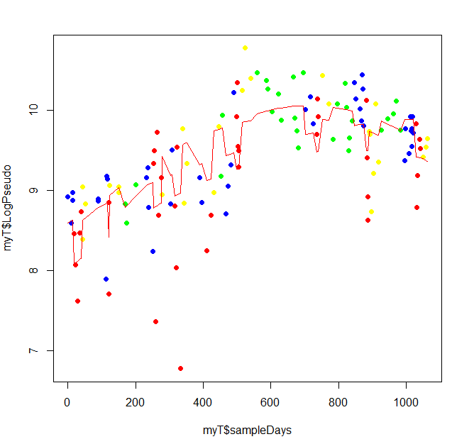

Another alternative.. Add additional parameters to the model…
Here is a 12 parameter
model…
B0 +
B1 * time +
B2 * time^2 +
3 dummy parameters for intercept +
3 dummy parameters *time +
3 dummy parameters * Time ^2

Slide 16
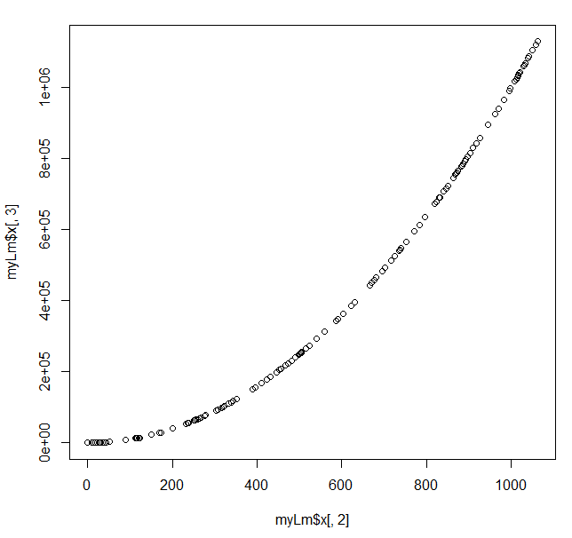

One problem, days and days^2 are highly correlated.
Correlated inputs will cause numerical instability in the model!
You can double one
parameter and compensate
by halving another…
With correlated input data,
there are an infinite number
of ways to achieve the minimal
sum of squares.

Slide 17
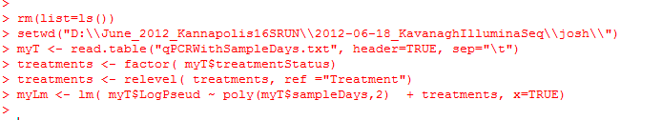
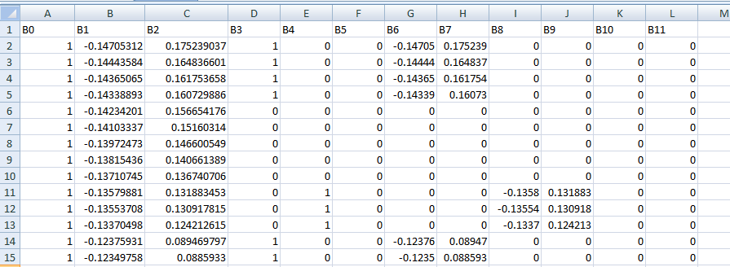
R will fix this by default… (We drop “raw=true” from our poly call)
R will rotate the data to an orthogonal basis where the X and X^2 terms are not correlated..
Much more on orthogonal bases later (the PCA lecture)
Note that B1 and B2 are no longer simply days and days^2
This will make interpreting the results of the model with respect to our original data more difficult..

Slide 18
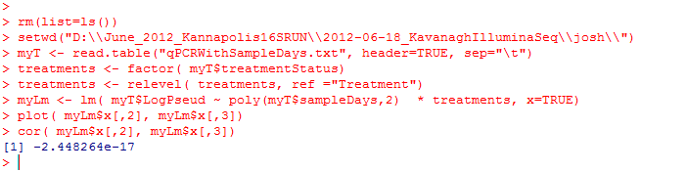
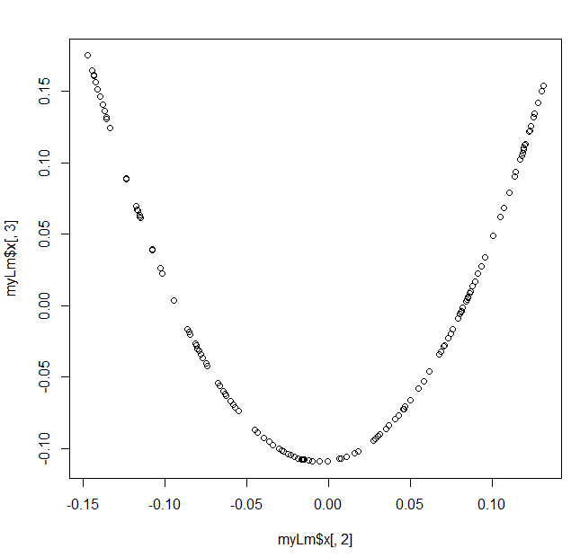
However our x and x^2 are no longer linearly correlated, so numerical stability is reintroduced into our model…

Slide 19
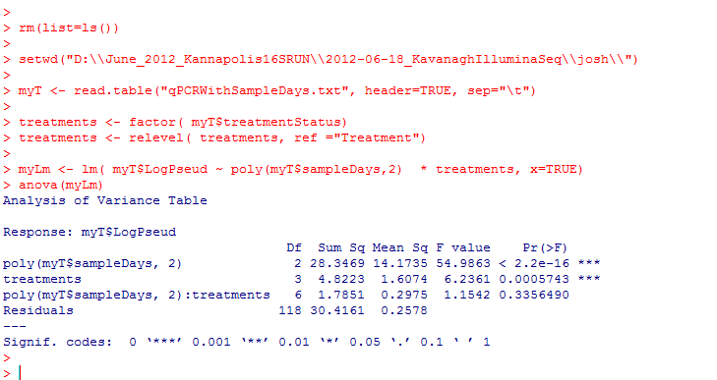


We proceed to look for the simplest model; we start by dropping six interaction terms!
Full model
Reduced model

Slide 20
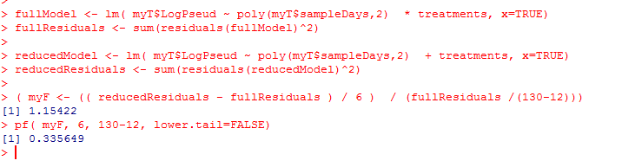
(Or with more typing…)
Full model
Reduced model

Slide 21
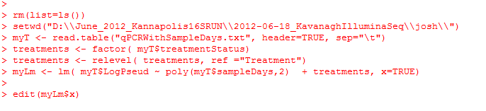
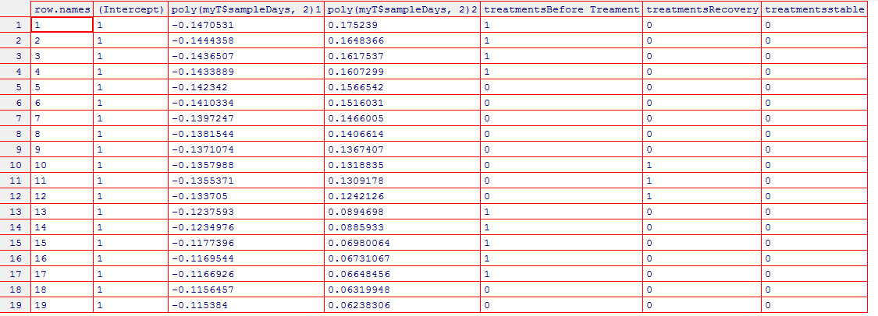
We drop the interaction terms and end up with a much more manageable six parameter model…
B0 +
B1 * time +
B2 * time^2 +
3 dummy parameters for intercept

Slide 22
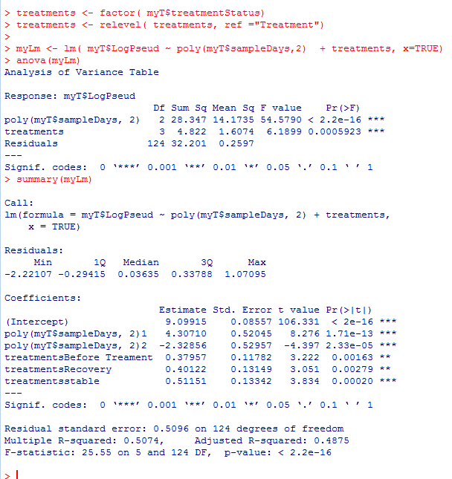
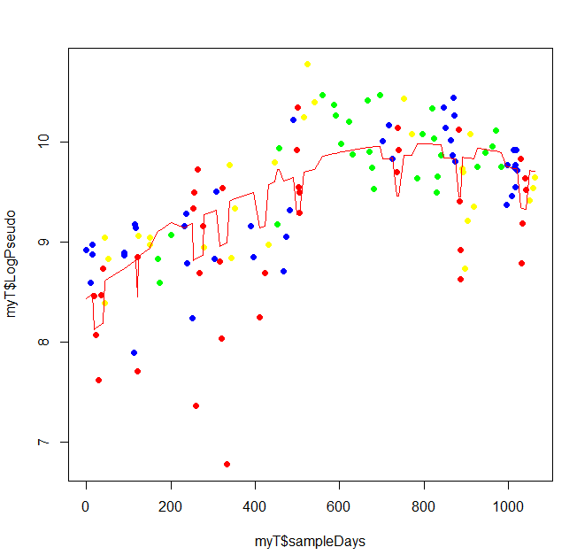
Treatment is still significantly different for all cases

Slide 23
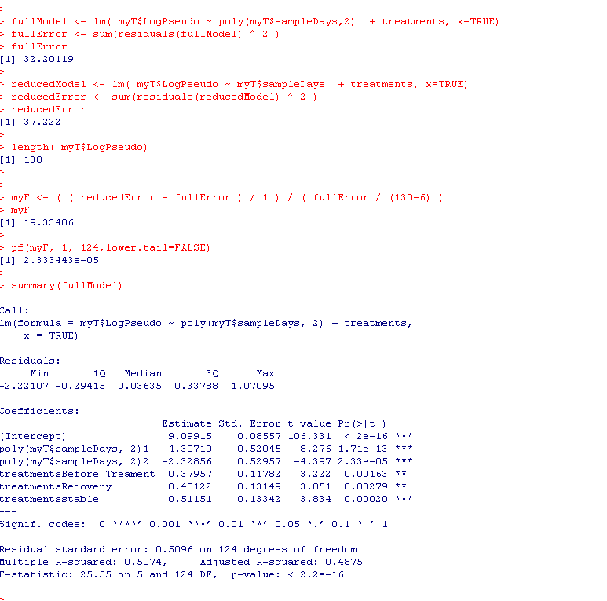
The p-value tells us whether each additional parameter of higher order is significant
Full: B0+ B1 *days + B2 * days^2
+ 3 dummy intercept terms
Reduced: B0+ B1 *days + 3 dummy intercept terms
Our 6 parameter model captures
significantly more variability that
the 5 parameter model..

Slide 24
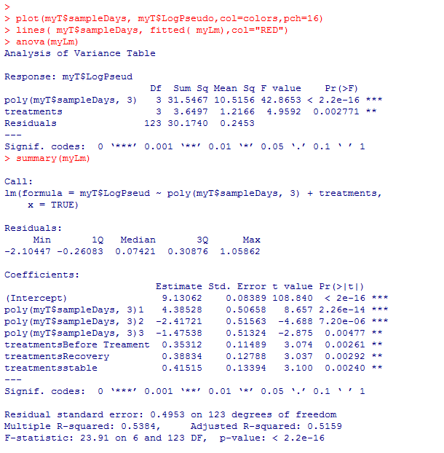
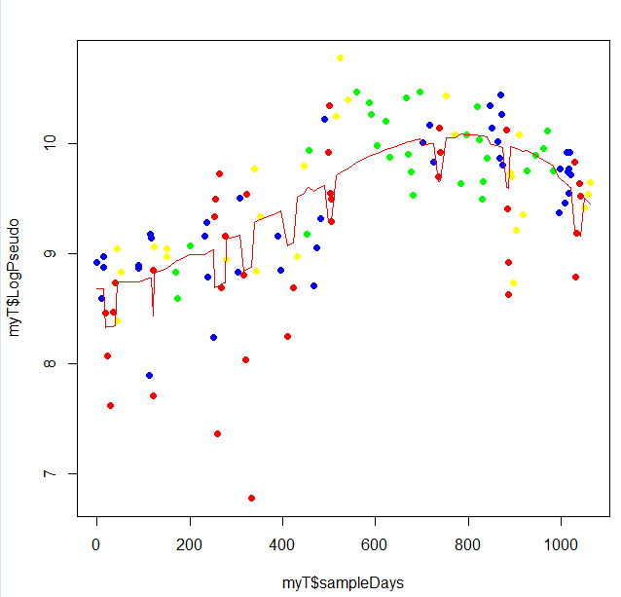
We can add a term for X^3 ( 7 parameter model) ; we still explain significantly more variance

Slide 25
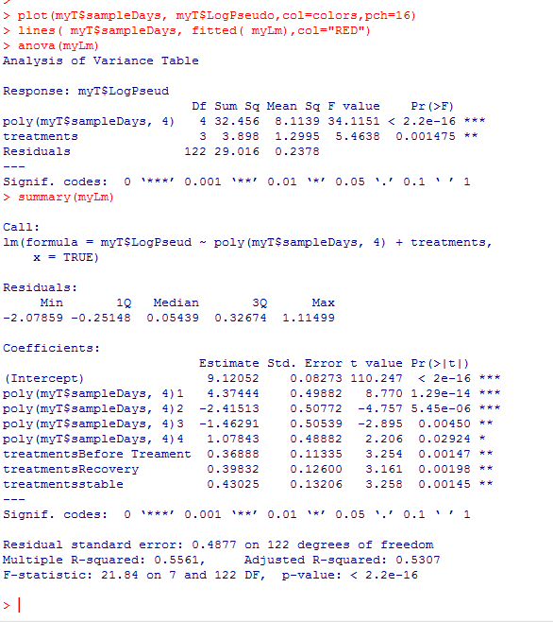
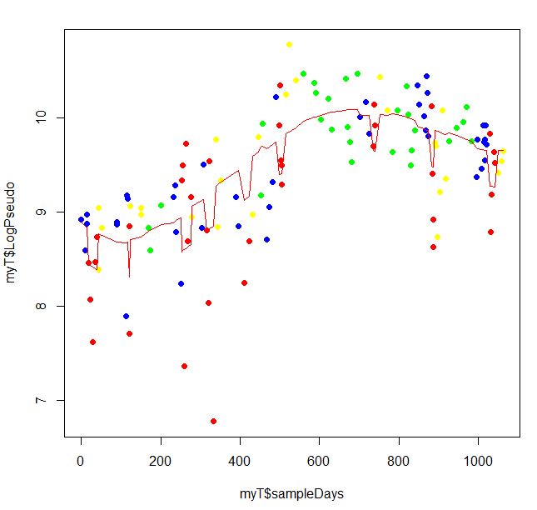
We can add a term for X^4 ( 8 parameter model) ; we still explain significantly more variance

Slide 26
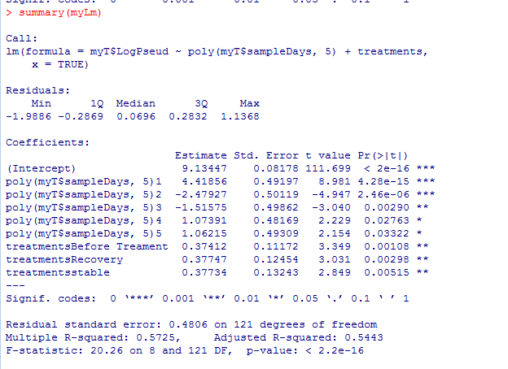
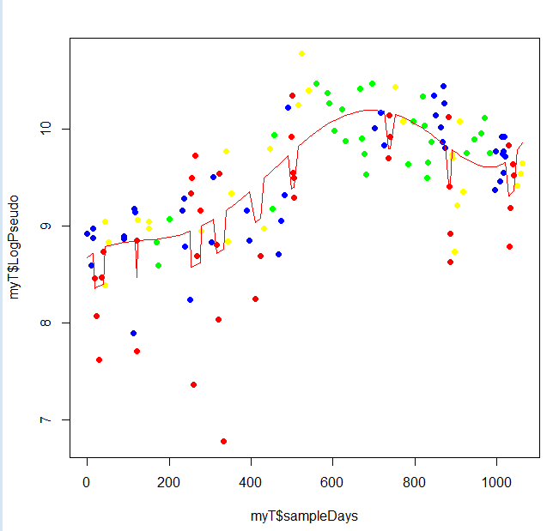
We can add a term for X^5 ( 9 parameter model) ; we still explain significantly more variance

Slide 27
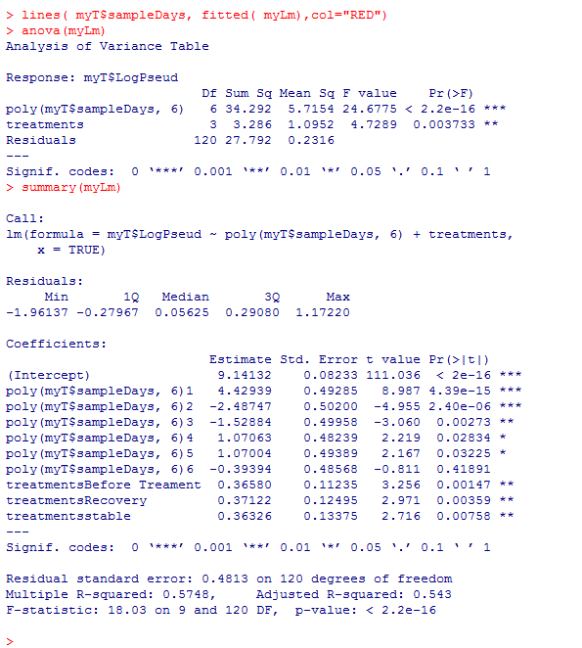
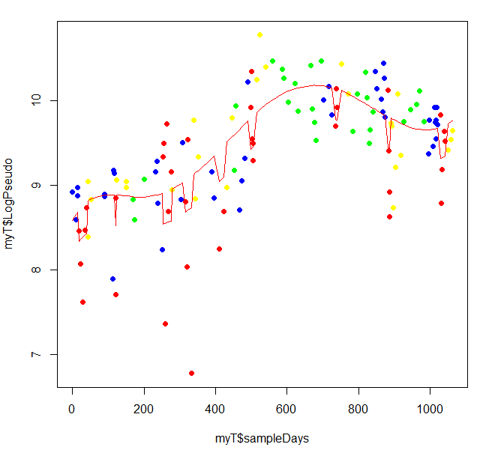
We can add a term for X^6 ( 10 parameter model); the additional parameter doesn’t matter!

Slide 28
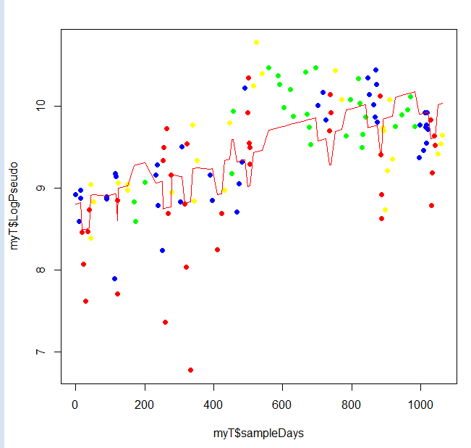
We can visually see the improvement to the fit with increasing parameters…
X
X^2
X^3
X^4
X^5
X^6

Slide 29
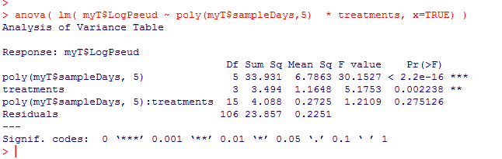
Confirm that the interaction terms are still irrelevant to our x^5 model
They still don’t help. (Which is good because there are 15 interaction terms!)
(5 exponent terms * 3 dummy variables)
{ x, x^2, x^3, x^4, x^5 } * { 3 dummy variables}
So we end up with a 9 parameter model instead of a 24 parameter model
B0 + B1*X + B2*X^2 + B3*X^3 + B4*X^4 + B5*X^5 + 3 dummy intercept params

Slide 30
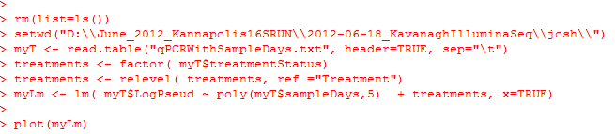
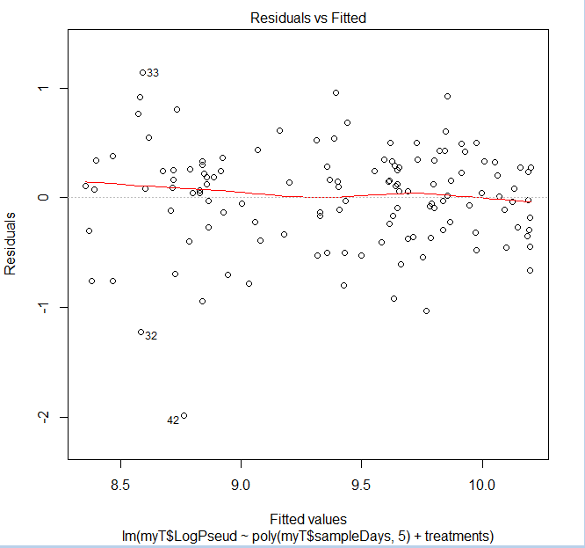
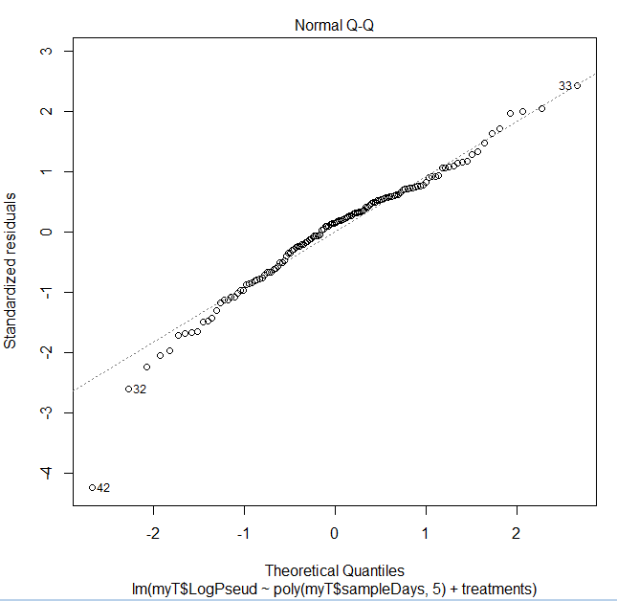
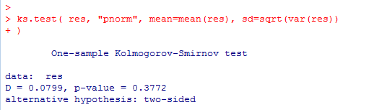
We confirm that the assumption of normality is not blatantly violated by our 9 parameter model

Slide 31
Calculating the likelihood of models
Linear models with higher exponential terms
AIC criteria

Slide 32
But which of these models is the “best” –
As you increase the # of parameters, the error will go to zero.
But that is just over-fitting the data!

Slide 33

The question of when a model is over-fit is not merely academic!
http://www.wsj.com/articles/how-computers-trawl-a-sea-of-data-for-stock-picks-1427941801

Slide 34
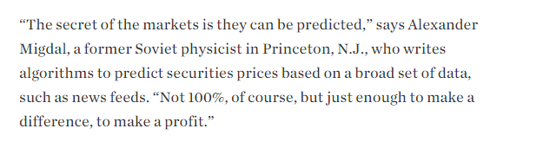
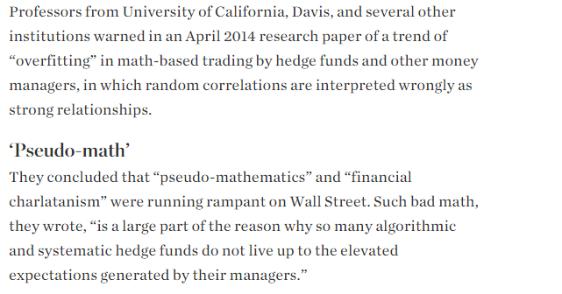
or

Slide 35
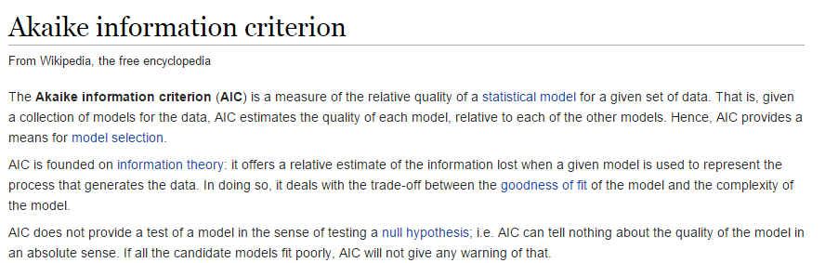
How do we choose between different models?
No perfect answer (of course) but a popular method is the AIC
http://en.wikipedia.org/wiki/Akaike_information_criterion

Slide 36
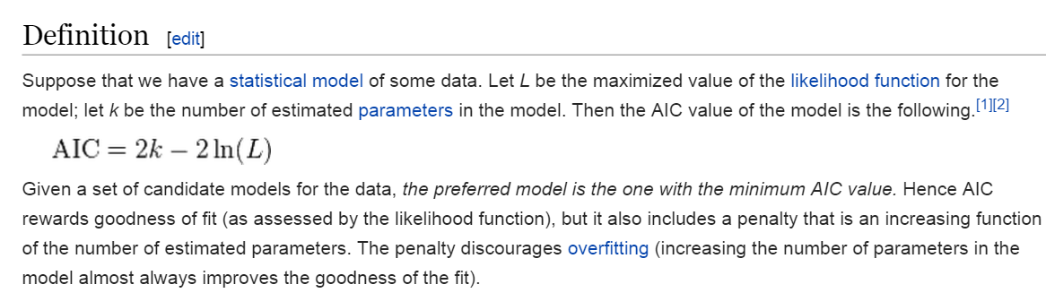
The AIC has a very simple way of balancing model complexity and fit
http://en.wikipedia.org/wiki/Akaike_information_criterion

Slide 37
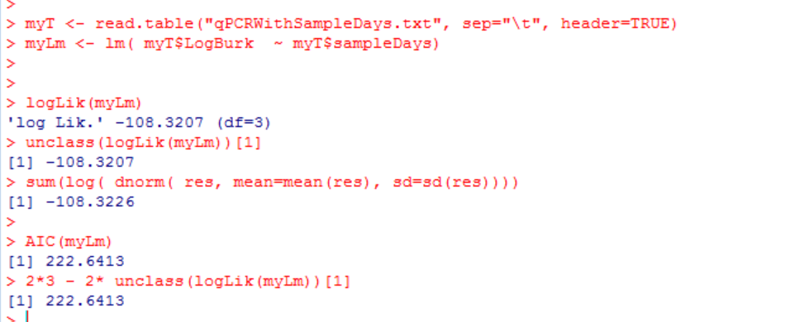
Easy to calculate…
Three parameters: slope, intercept and mean of the residuals…

Slide 38
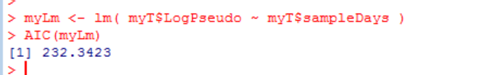

The AIC criteria seems to like the 5 parameter model…

Slide 39


A closely related alternative to this is the Bayesian information criterion
Add a term for
the sample size

Slide 40

In practice AIC and BIC tend to pretty similar…
We won’t be covering this literature this semester…
http://en.wikipedia.org/wiki/Akaike_information_criterion

Slide 41
Next time:
Linear models with multiple continuous variables.
Ordination and PCA variables

