Slide 1
One last prior
The negative binomial distribution
Simulating constant and non-constant variance with poisson and negative binomial inference
Dataset for the next lab

Slide 2
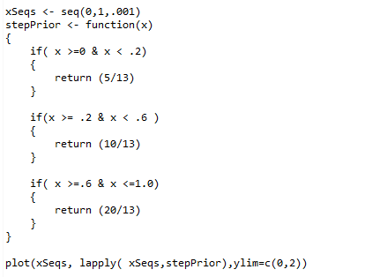
One last prior to consider (to again watch the prior belief melt away with new data….)
These constants are chosen so the integral sums to one….
lapply applies our function
to every element in the vector
https://github.com/afodor/metagenomicsTools/blob/master/src/metropolitan/realTimeGraphUpdates2.txt

Slide 3
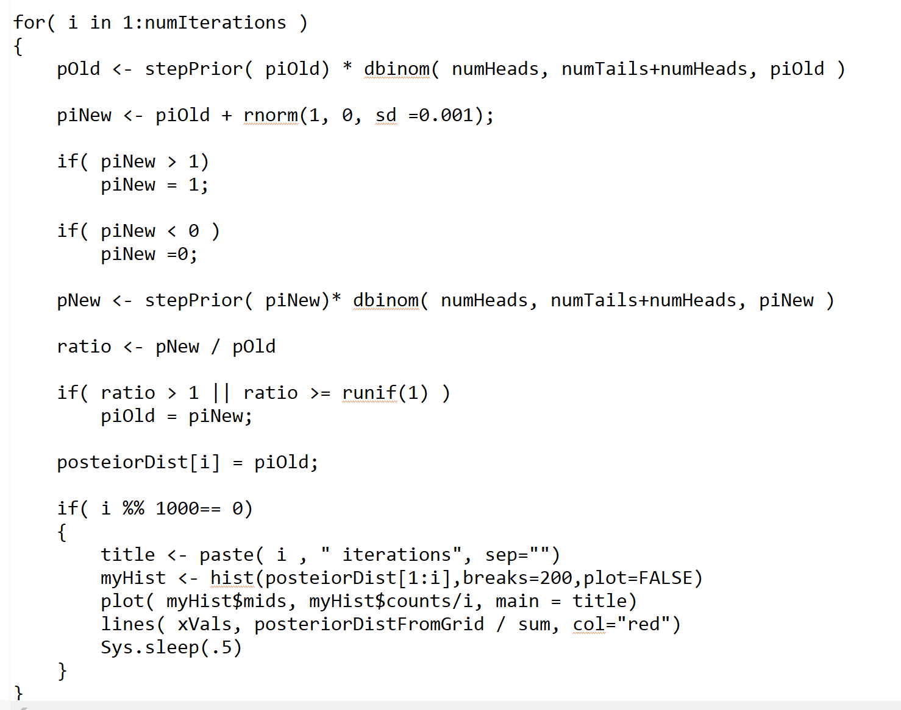
It is trivial to make this our new prior…

Slide 4
As is the case for the exponential prior, with enough steps, we find our posterior…
Notice the slight discontinuity left from our prior…

Slide 5
One last prior
The negative binomial distribution
Simulating constant and non-constant variance with poisson and negative binomial inference
Dataset for the next lab

Slide 6
You enter a tournament
You can play until you have 3 losses.
Your rate of winning games is 60%.
What is the distribution of your expected number of wins?
This is the negative binomial distribution…

Slide 7


The negative binomial distribution:
The # of wins (k) before we see r losses….
There are k wins
r losses
prob = p is the probability of a loss
K = # of wins …
r = # of losses before you are dropped from the tournament
P = 0.4 = prob(loss)
(so the probability of win = 0.6)
The probability of each individual sequence of wins and losses is
Since the last game must be a loss, there are
ways of organizing the “flips”
The PDF is defined by multiplying these two values together…

Slide 8
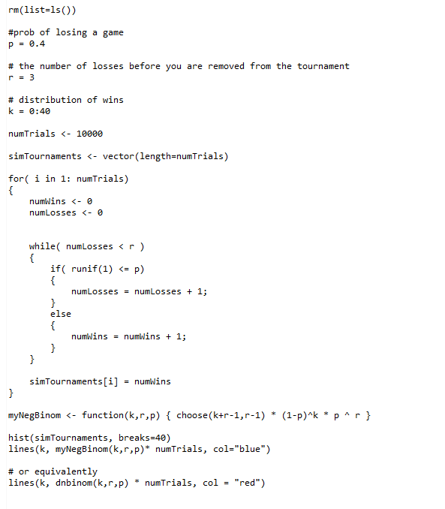
Here we simulate 10,000 tournaments
https://github.com/afodor/metagenomicsTools/blob/master/src/classExamples/simDist/negativeBinomial.txt

Slide 9
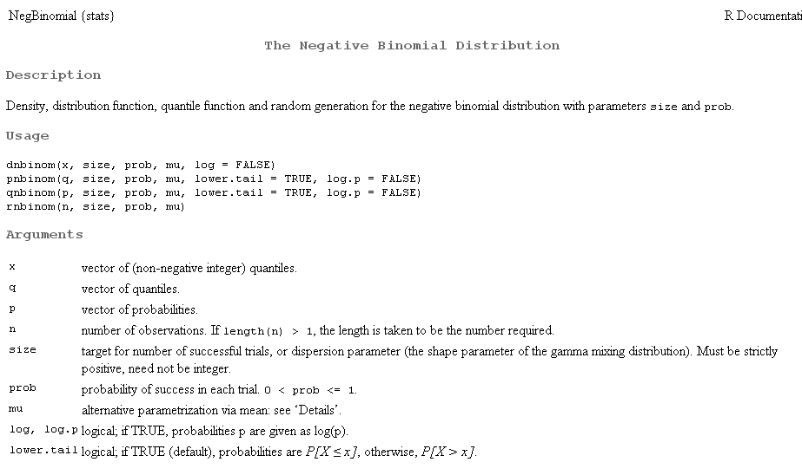
R, of course, has this distribution built in…

Slide 10

We state without proof for the negative binomial distribution:
Mean =
(1-p) * r
(1-p) * r
Variance =
p
p *p
Let’s say p =0.4 and r = 3.
The expected number of wins is:
.6 * 3 / 4 = 4.5
The variance associated with those wins is:
.6 * 3 / (.4*.4) =11.25
So for a player who wins 60% of the games,
mean +- SD = 4.5 +- 3.4
(To convert to the Wiki’s formulas, replace p with 1-p; we will stick with R’s notation in the class)

Slide 11
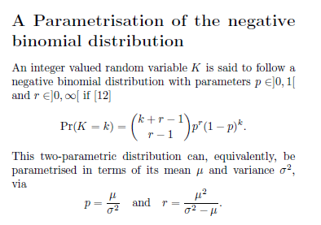
The reason the negative binomial distribution is the most popular algorithm for sequence count data in genomics….
If you know the mean and variance, you can calculate p and r…
(We also state this without proof…)
Mean # of wins
variance
p = 4.5 / 11.25 = 0.4
r = 4.5*4.5 / (11.25-4.5) = 3
So knowing the mean and the variance is the same as knowing r and p.
In the Dseq paper, for each gene, we can estimate the mean and the variance.
Then we can use a test based on the negative binomial distribution!

Slide 12
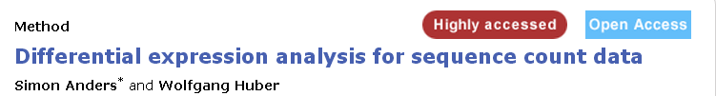
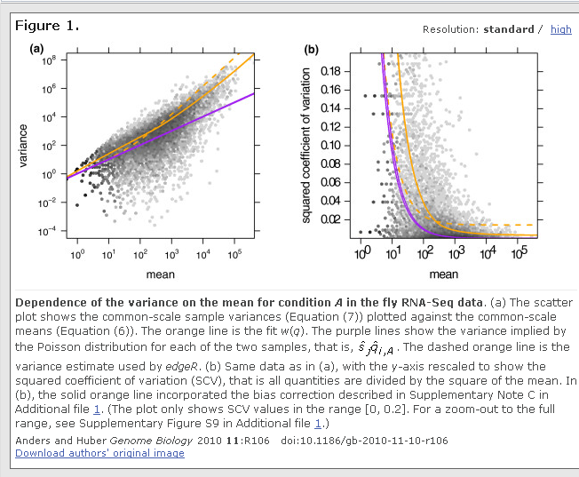
Using the negative
binomial distribution
gives us another
free parameter to
play with!
Relaxes the assumption
that mean == variance
Allows us a better
fit to the data than
the Poisson (or
binomial) distribution.
More on this next time…

Slide 13
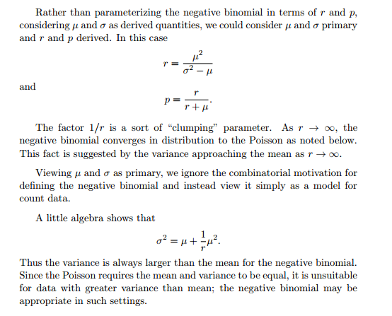
In the negative binomial distribution, the variance is always greater than the mean
So if we are going to use the negative binomial, we have to define
the variance as the mean plus something…
http://www.johndcook.com/negative_binomial.pdf

Slide 14
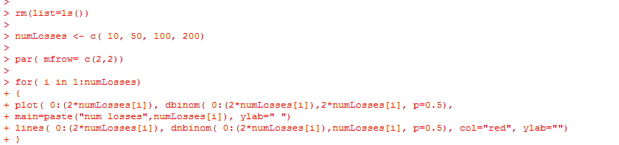
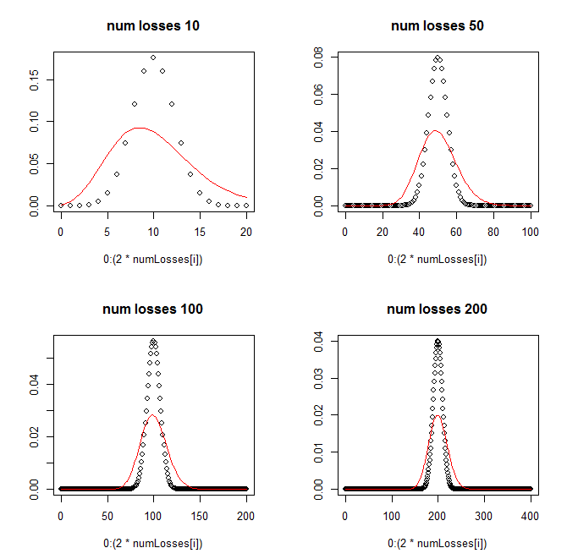
In comparing the binomial and the negative binomial, we see that the negative binomial
has a different variance….
Dbinom = flip the fair coin 20 times
and count the heads
Dnbinom = flip the coin until
you get 10 tails and count the
heads…
https://github.com/afodor/metagenomicsTools/blob/master/src/classExamples/negativeBinomialExamples.txt

Slide 15
One last prior
The negative binomial distribution
Simulating constant and non-constant variance with poisson and negative binomial inference
Dataset for the next lab

Slide 16
From last time:
Under a Poisson distribution
mean = variance =
prob(event) * # of samples = expected number of events
Under a negative binomial distribution:
p = prob(loss)
r = # of losses before you are removed from the tournament
mean = expected # of wins = (1-p)* r / p
variance = (1-p) * r / p * p
And re-arranging the above two equations…

Slide 17
From last time, we had the observation that in “real” datasets the mean != variance

Slide 18
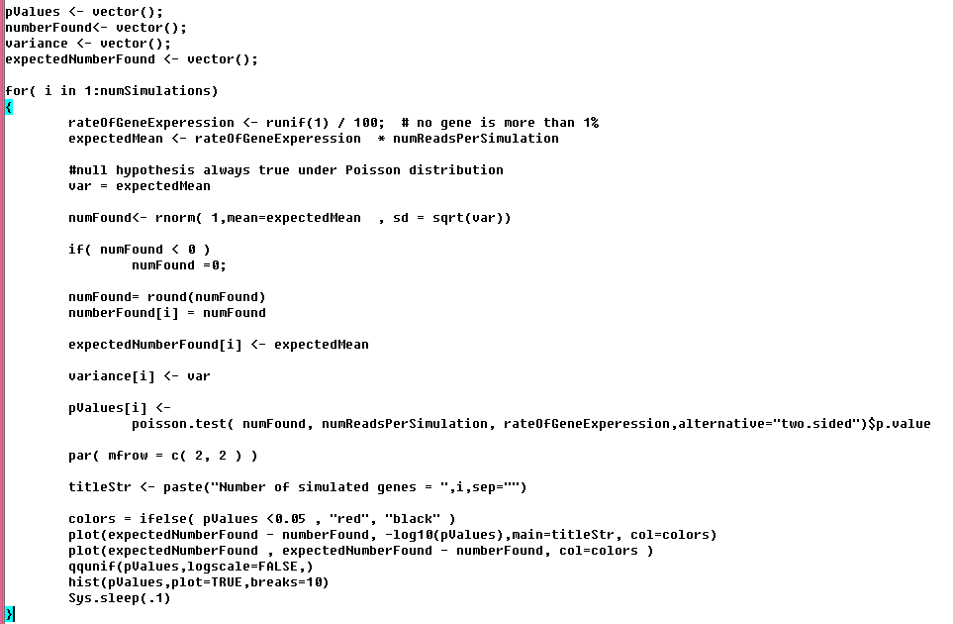
Here is a simulation under the Poisson assumption…
We sample under the
Poisson assumption
The # of sequences assigned to a gene from a normal distribution with
mean == variance
Just a two-sided Poisson test
https://github.com/afodor/metagenomicsTools/blob/master/src/classExamples/simDist/PoissonWithNormalBasedSampling.txt

Slide 19
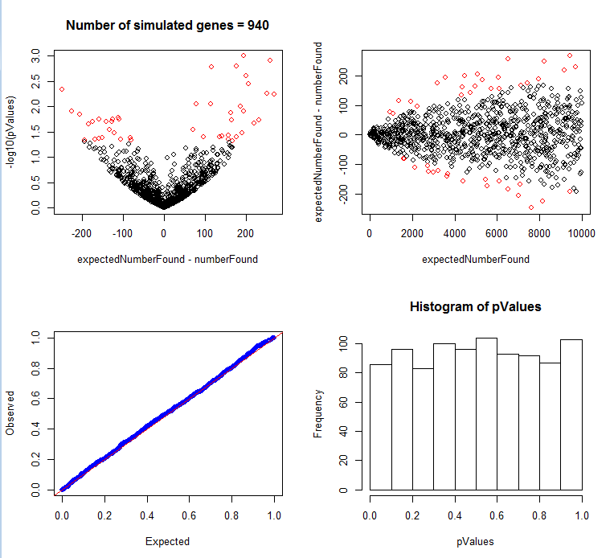
Here are the results of our simulation….

Slide 20
This is sometimes called a volcano plot (although usually it is fold-change on the x-axis)
The red symbols are p <0.05

Slide 21
This is sometimes called an “m vs. a” plot (although again usually with fold change on the y-axis)

Slide 22
As we expect under the Poisson, all the p-values are uniform…

Slide 23
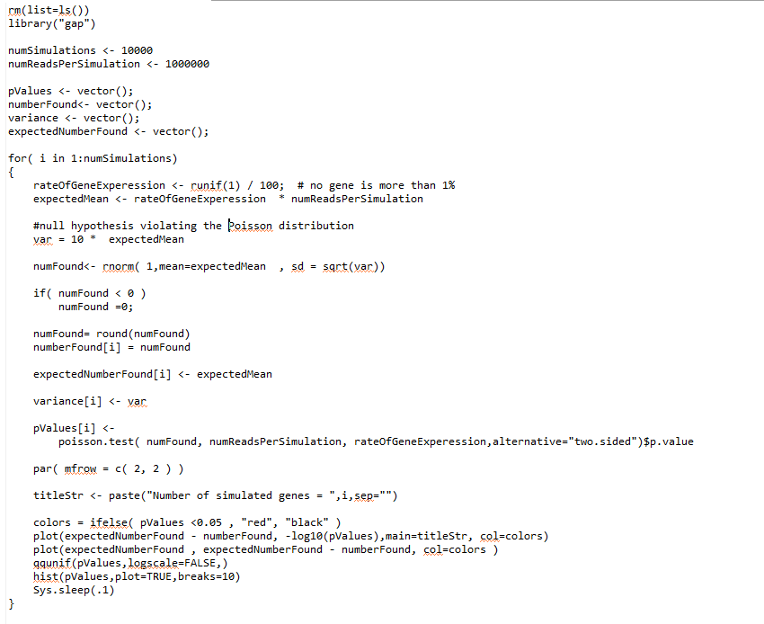
We now violate the Poisson assumption in our sampling….
The only change from the previous script

Slide 24
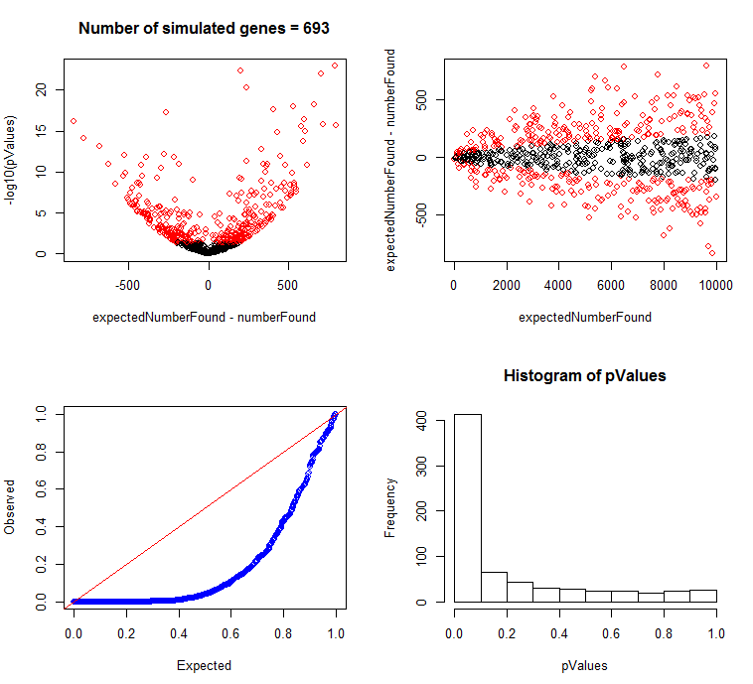
The increased variance completely breaks our Poisson test

Slide 25
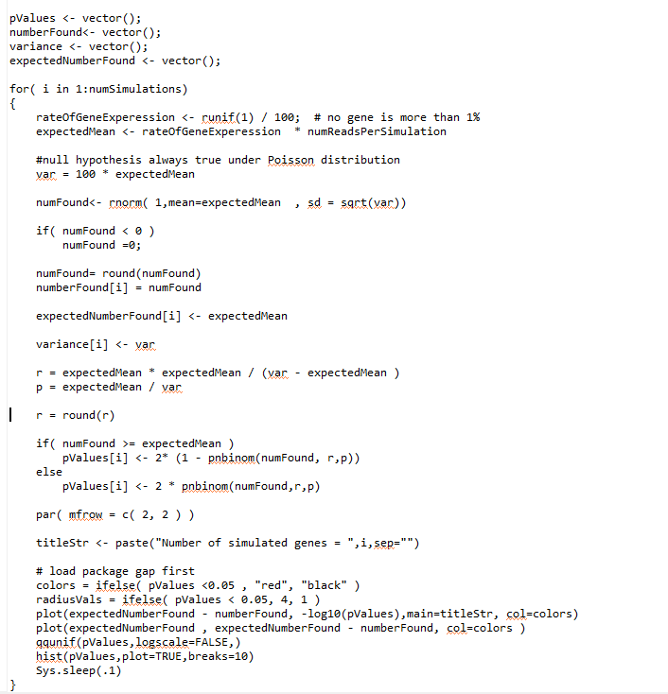
Here we use the
negative binomial
test for inference…
We calculate r and p
under our null hypothesis
This is two-sided test
https://github.com/afodor/metagenomicsTools/blob/master/src/classExamples/simDist/NegativeBinomialWithNormalBasedSampling.txt

Slide 26
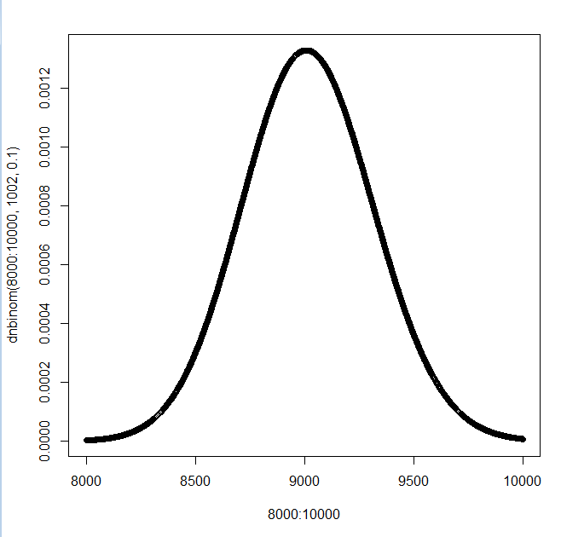
Let’s say that r = 1002 and p = 0.1
so the expected number of wins = (1-p)* r / p = .9*1002 / 0.1 = 9018
and our distribution looks like this…
If we see 8,500 “wins”, our probability is ~ 2 * pnbinom(8500,1002,.1)

Slide 27
Let’s say that r = 1002 and p = 0.1
so the expected number of wins = (1-p)* r / p = .9*1002 / 0.1 = 9018
and our distribution looks like this…
If we see 9,500 “wins”, our probability is ~ 2 *(1- pnbinom(8500,1002,.1))
We have enough sequencing depth that our curve will be approximately symmetrical
around the mean….

Slide 28
And hence our two-
sided test…
R does not have a built
in dnbinom.test

Slide 29
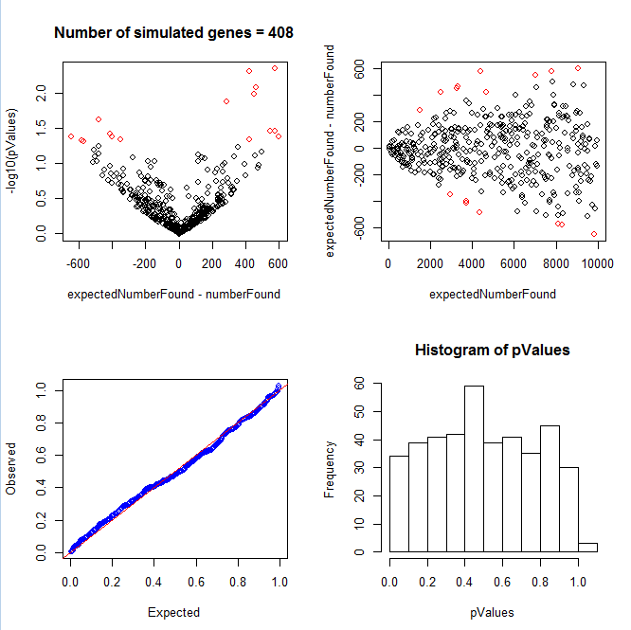
The negative binomial gets us much closer to a uniform distribution…

Slide 30
One last prior
The negative binomial distribution
Simulating constant and non-constant variance with poisson and negative binomial inference
Dataset for the next lab

Slide 31
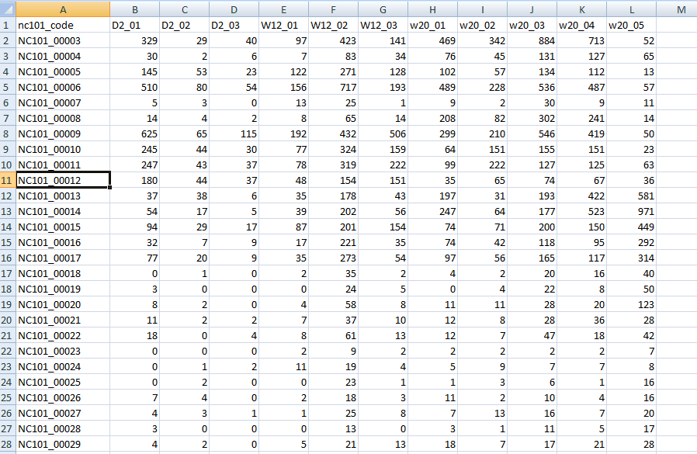
The dataset is at github…
http://afodor.github.io/classes/stats2015/longitdunalRNASeqData.zip
File = nc101_scaff_dataCounts.txt

Slide 32
The dataset is at github…
Week 2
Week 12
Week 20
File = nc101_scaff_dataCounts.txt

Slide 33
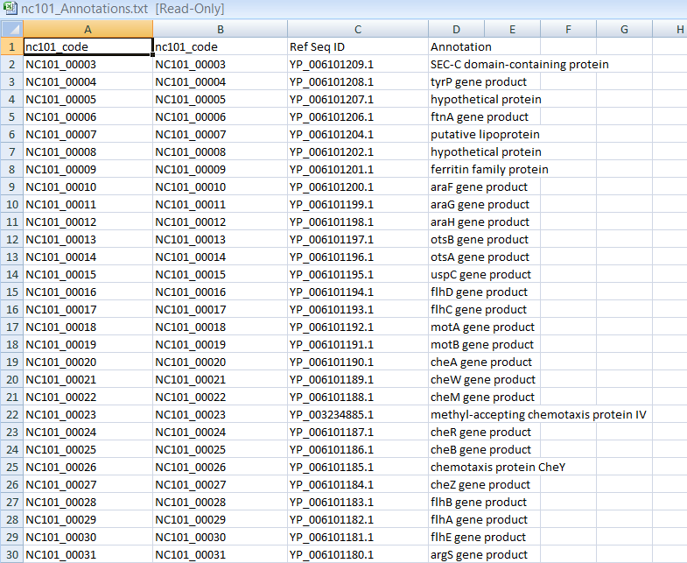
In case you care what these genes are…
File = nc101_Annotations.txt

Slide 34
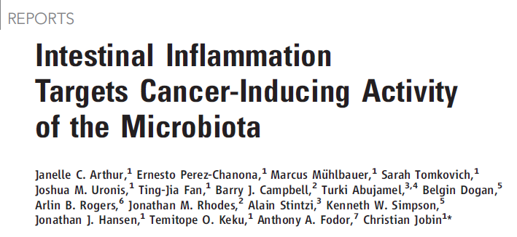
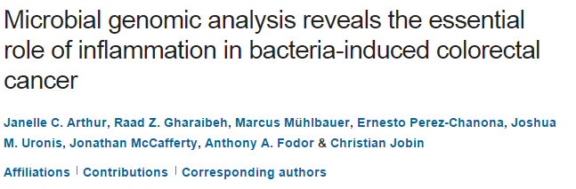
Two papers that describe this experimental system….
http://www.sciencemag.org/content/338/6103/120.full.pdf
Proofs are here: http://afodor.github.io/classes/stats2015/proofs_NatureCommunications.pdf
(since UNCC doesn’t have access to this journal!!)

Slide 35
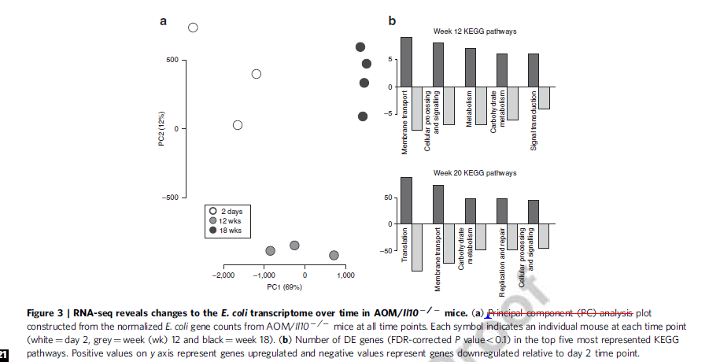
Fig.3 in the 2nd paper is the dataset you have…

Slide 36
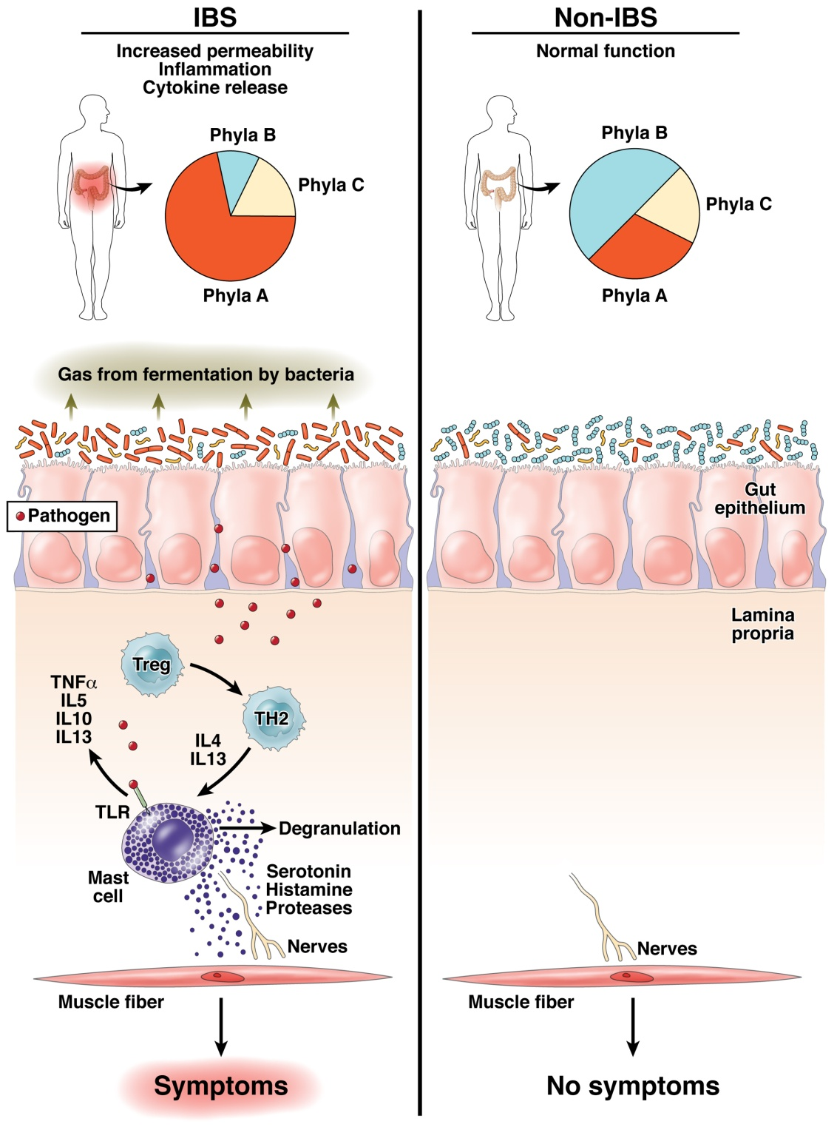
The “dysbiosis” hypothesis linking risk for inflammation related diseases to the microbiome
Fodor & Talley. Gastroenterology. 2011

Slide 37
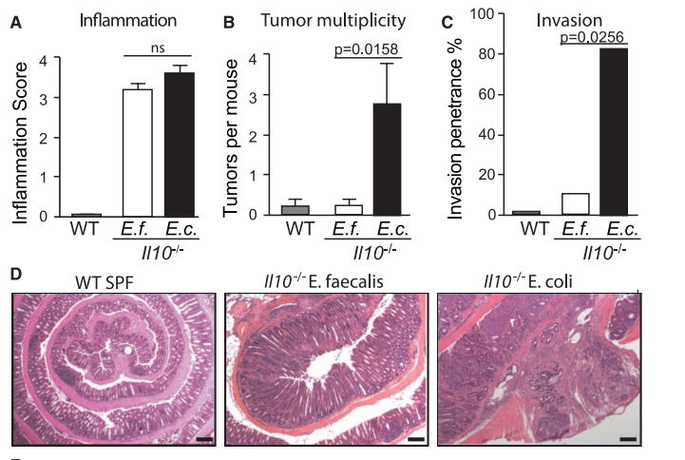
Some bugs, but not others, can cause inflammation to progress to cancer…
Arthur et al, Science, 2012

Slide 38
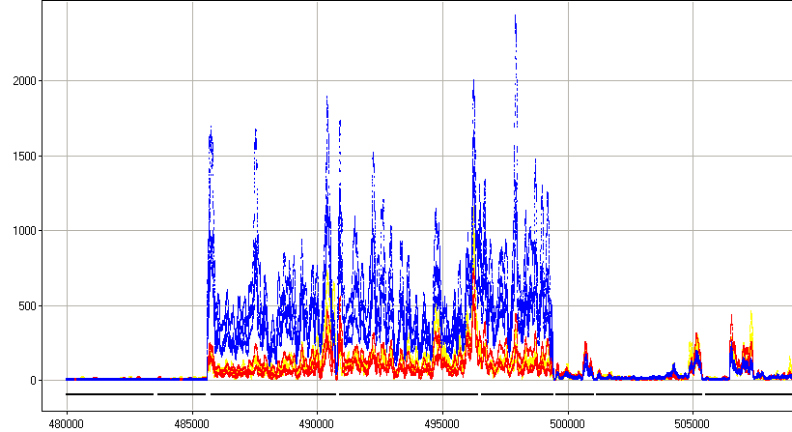



rna-seq shows us gene expression of host-associated E. Coli
Sterile mice
Inoculate with E. Coli
RNA from fecal samples characterized
by RNA-seq on the Illumina platform
2 days
12 weeks (inflammation)
18 weeks (cancer)
Normalized Read Count
Position along the genome
30S ribosomal protein
50S ribosomal protein
preprotein translocase subunit
DNA-directed RNA polymerase subunit

Slide 39
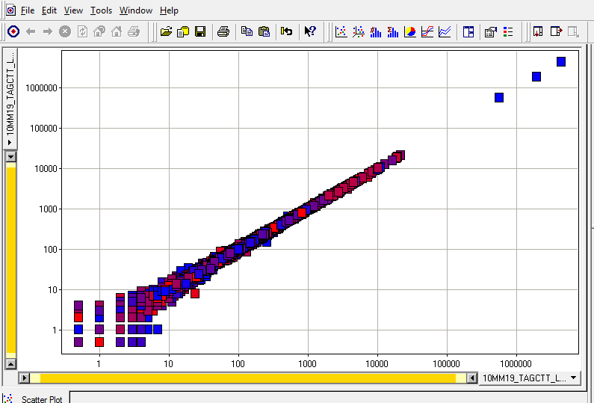
Features of the dataset:
Paired ends are nearly exactly the same
rRNA
unmapped
In your spreadsheet for the homework, we simply merged the paired ends…

Slide 40
One potential problem with this dataset.
Most of the sequences were 16S and 23S rRNA
(Bacteria do not have a poly-A tail on their mRNA )
(We used a bead capture method to remove the rRNA signature with limited success)
rRNA
unmapped

Slide 41
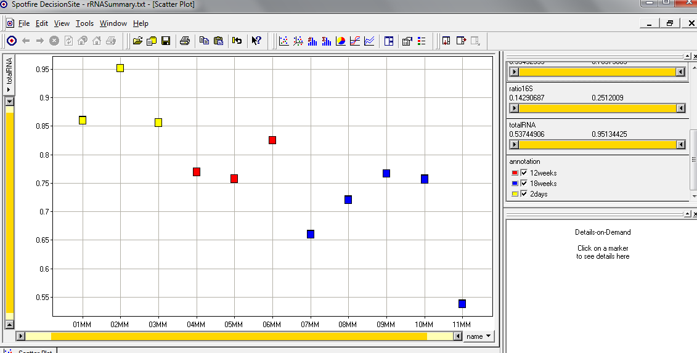
The fraction of 16S rRNA was correlated with time!
(The ribosomal machinery changes with the state of the bug?)
A potentially confounding variable…
16s rRNA reads + 23s rRNA reads
Sample names
In your spreadsheet, we removed the 16S and 23S rRNA sequences
and we will do normalization on the resulting counts…

