Slide 1
Lab #4 due 10/13 ; code and/or links to afodor@uncc.edu
For Lab #4:
Make a static factory method that parses a Fasta file and returns a list
of FastaSequence objects
public static List<FastaSequence> readFastaFile(String filepath) throws Exception
{…}
Your FastaSequence class should have at least 3 methods:
// returns the header of this sequence without the “>”
public String getHeader()
{ … }
// returns the Dna sequence of this FastaSequence
public String getSequence()
{ …}
// returns the number of G’s and C’s divided by the length of this sequence
public float getGCRatio()
{ … }
(SEE NEXT SLIDE!!!!)

Slide 2
The following main() code should work on your FastaSequence class
(when, obviously, pointing to a real fasta file!)
public static void main(String[] args) throws Exception
{
List<FastaSequence> fastaList =
FastaSequence.readFastaFile("c:\\pointsToSome\\FastaFile.txt");
for( FastaSequence fs : fastaList)
{
System.out.println(fs.getHeader());
System.out.println(fs.getSequence());
System.out.println(fs.getGCRatio());
}
}
(SEE NEXT SLIDE!!!!)

Slide 3
Next, to your FastaSequence class add a static method
public static void writeUnique(File inFile, File outFile )
throws Exception
{ }
that writes each unique sequence to the output file with the # of times each sequence was
Seen in the input file as the header (sorted with the sequence seen the fewest times the first)
So if the input was
>Seq1
AC
>Seq2
AC
>Seq3
AA
>Seq4
AA
>Seq5
AC
>Seq6
AT
The output would be
>1
AT
>2
AA
>3
AC
Send you code (or links to your checked in code) to afodor@uncc.edu with subject Lab #4

Slide 4
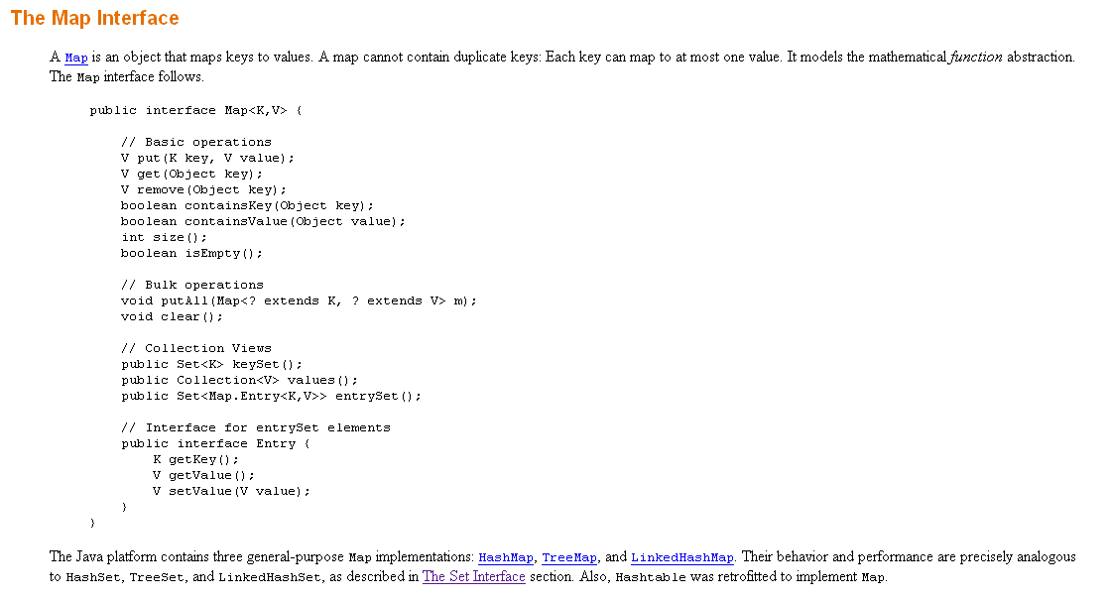
The HashMap class will be very useful for this assignment

Slide 5

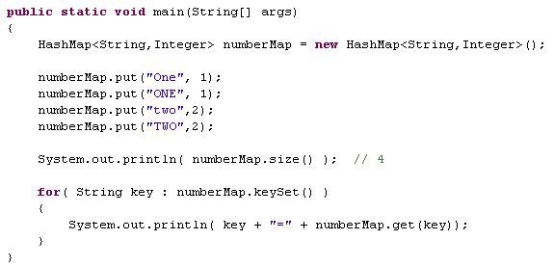
A map maps keys to values…

Slide 6
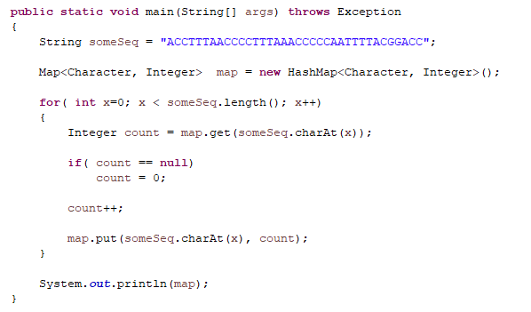
Maps are really great for counting things….
Maps only hold objects (not primitives)
So we have this awkward switch
HashMaps are not ordered, so the
order of the keys is arbitrary

Slide 7
For extra-credit:
Create a class that allows a user to parse an arbitrarily large Fasta file
one sequence at a time but does not hold the sequences in memory.
This class should have a function called something like
public FastaSequence getNextSequence()
that returns the next FastaSequence in the file or null if there are
no more sequences…

