Slide 1
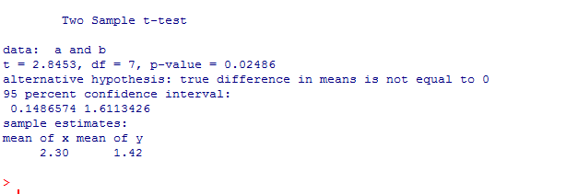
Previously: We saw the two sample t-test.
So consider two samples (weight of mice on Drug A vs. Drug B)
Consider the equal variance version of the t-test
rm(list=ls())
a <- c(2.1,3.2,2.0,1.9)
b <- c(1.8,1.3,1.7,1.2,1.1)
t.test(a,b, var.equal=TRUE)
(In the ANOVA version of the t-test, the samples must have equal variance!)

Slide 2
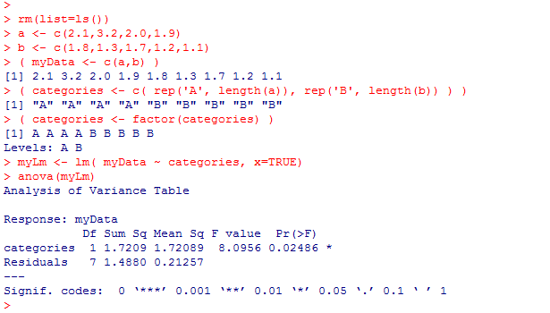
We can make an alternative version of this test cast as an ANOVA
rm(list=ls())
a <- c(2.1,3.2,2.0,1.9)
b <- c(1.8,1.3,1.7,1.2,1.1)
( myData <- c(a,b) )
( categories <- c( rep('A', length(a)), rep('B', length(b)) ) )
( categories <- factor(categories) )
myLm <- lm( myData ~ categories, x=TRUE)
anova(myLm)
We tell R that we have a categorical variable
This is a ONE-way
ANOVA
(with 2 levels)
One factor (two levels)

Slide 3
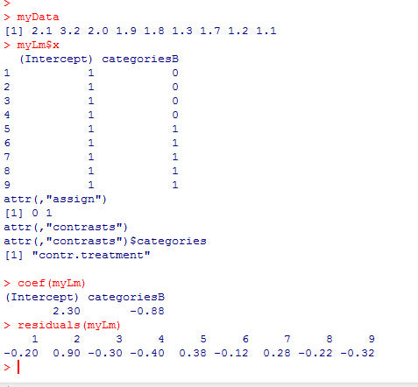





The full model has sum squared residual of 1.488 with 7 d.f.
=
B₀
+
B₁
+

Slide 4

The reduced model (B1=0) has sum squared residual 3.208889 with 8 d.f.
=
B₀
+
The errors will be minimized when
B₀ = mean of data

Slide 5
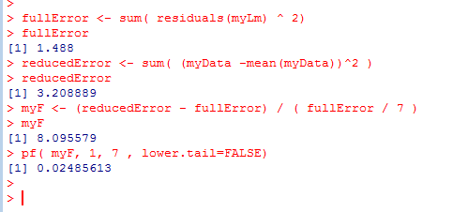
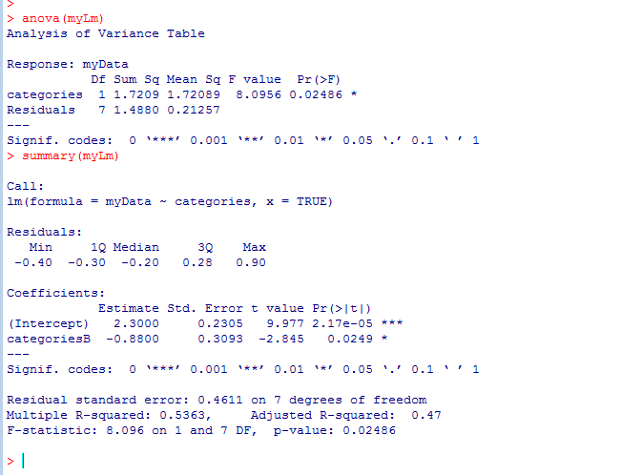
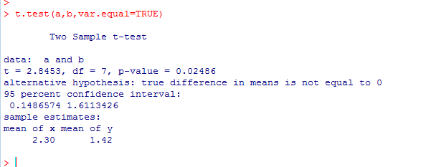
Our ANOVA statistic is f=:
(reduced error – full error)/ (reduced DF – full DF)
(Full error)/ (full DF)
( ( 3.208889 - 1.488 ) / 1 ) / (1.488 /7 )
So t.test, anova and summary all yield identical results..

Slide 6
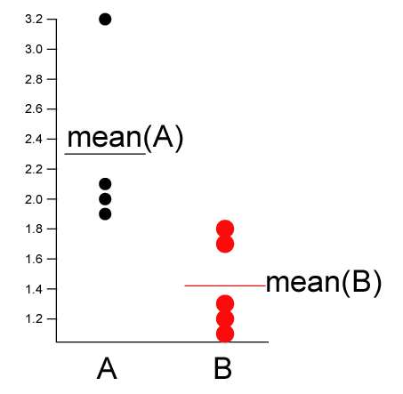
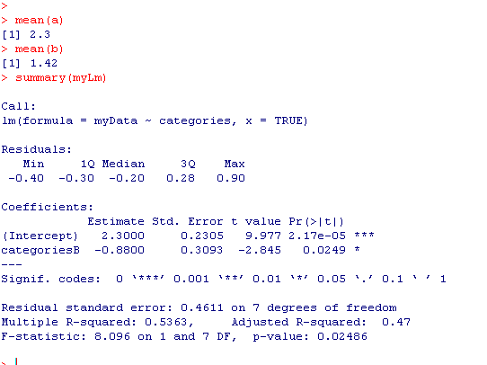
“Full model” ; 7 degrees of freedom (n=9 – 2 parameters).
The mean of A and B are modeled as distinct
The mean of A
The difference between the mean of
A and the mean of B.
The null hypothesis is that this is zero
(i.e. that mean(A) == mean(B))
A is the “background” ; B is compared to A.
We can switch that with relevel

Slide 7
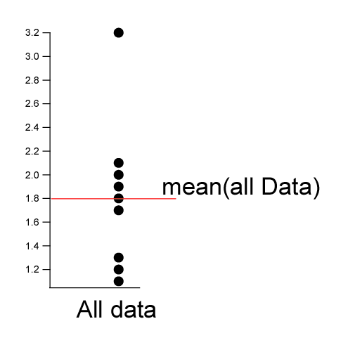
“Reduced model” ; 8 degrees of freedom (n=9 – 1 parameters).
There is only one grand mean.
The ANOVA asks does the full model explain significantly more of the data than does
the reduced model?
The null hypothesis is that the data is explained as well by one mean

Slide 8
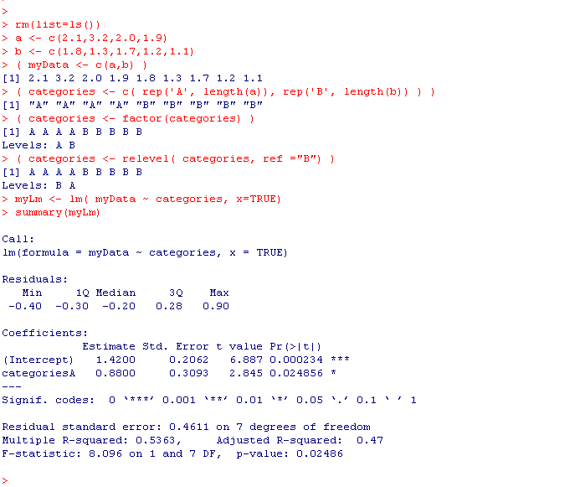
In the previous slide, A is the “background” ; B is compared to A.
We can switch that with relevel ; now “B” is the background
The mean of A
The mean of B
The difference between the mean
of B and the mean of A.
The null hypothesis is that this
is zero
(i.e. that mean(A) == mean(B))
For the 2 level ANOVA it doesn’t matter which is “background”; we get the same p-value

Slide 9
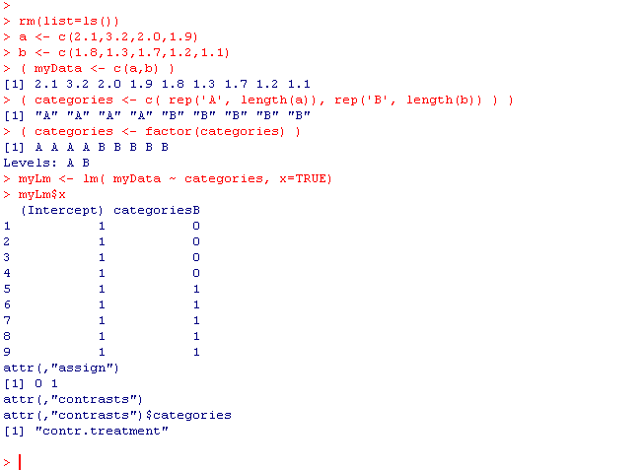
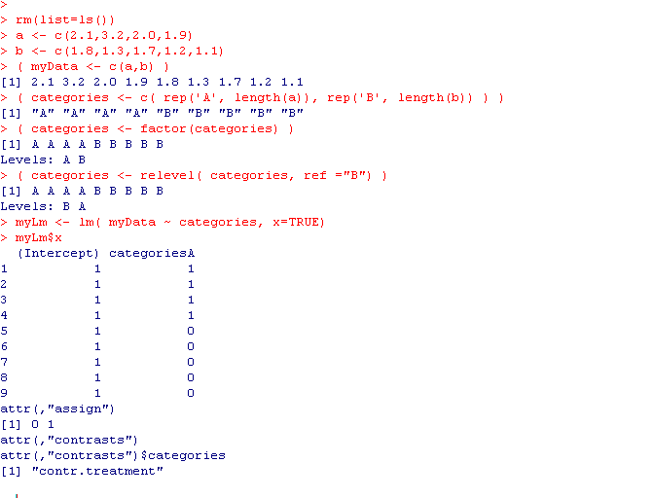

With “A” as the background….
=
B₀
+
+
B₁
With “B” as the background….
=
B₀
+
B₁
+
For the 2 level case, these models produce identical inference (it doesn’t matter which is background);
This gets more complicated as we move to multiple levels.

Slide 10
With “A” as the background….
=
B₀
+
B₁
+
Extra credit:
Prove in general for the above model that
B₀ = mean(A) and B₁ = mean(B)- mean(A)

Slide 11
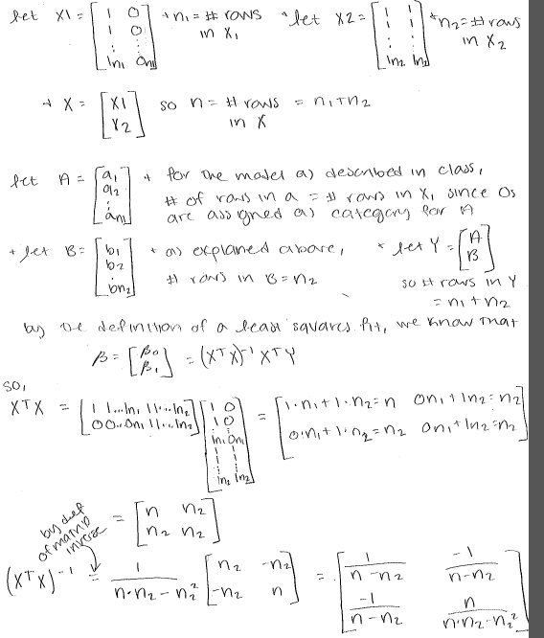
Proof! From Brittany Smith
and then…

Slide 12
