Slide 1
Correlated variables in linear models
PCA in concepts
PCA in equations
PCA in Java (for your reference; not covered in class or in final)

Slide 2
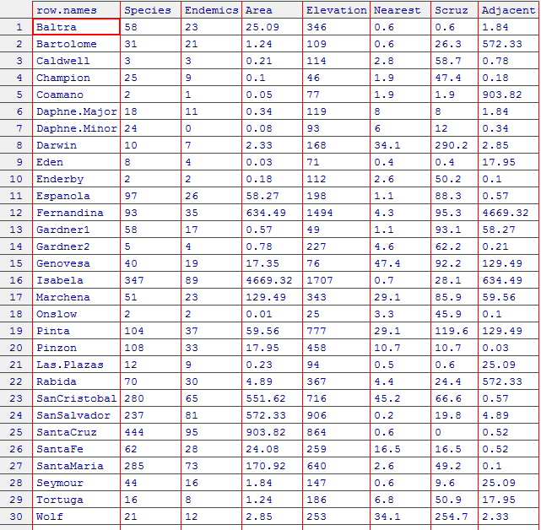

We will use a dataset from the Galapagos islands to think about correlated independent variables

Slide 3
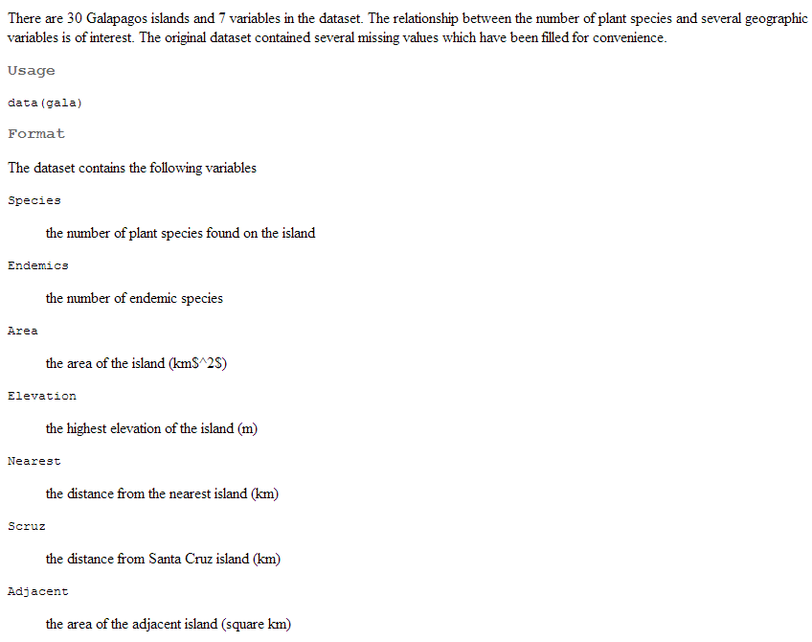
?gala

Slide 4

http://en.wikipedia.org/wiki/Endemism

Slide 5
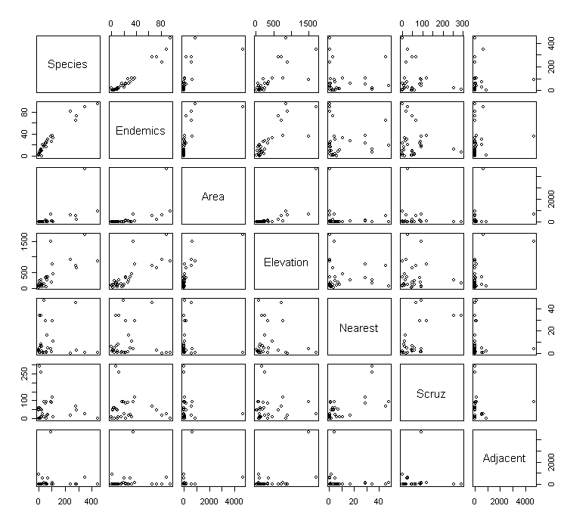
plot(gala) performs all by all scatterplots
Clearly there is redundant information here.

Slide 6
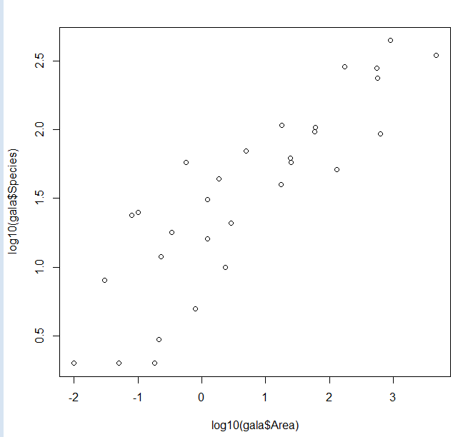
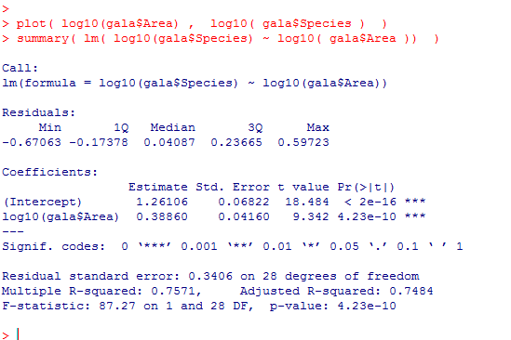
Area, elevation and species count are all correlated with one another…
Species Vs. Area

Slide 7
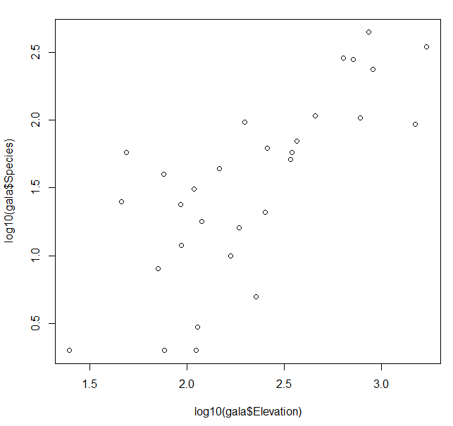
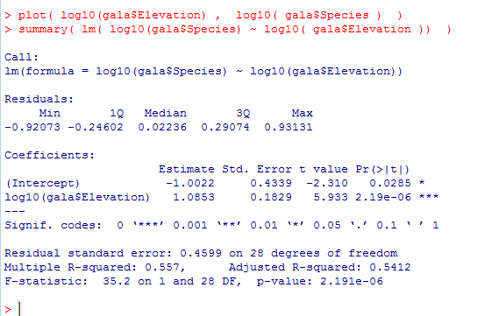
Area, elevation and species count are all correlated with one another…
Species Vs. Elevation

Slide 8
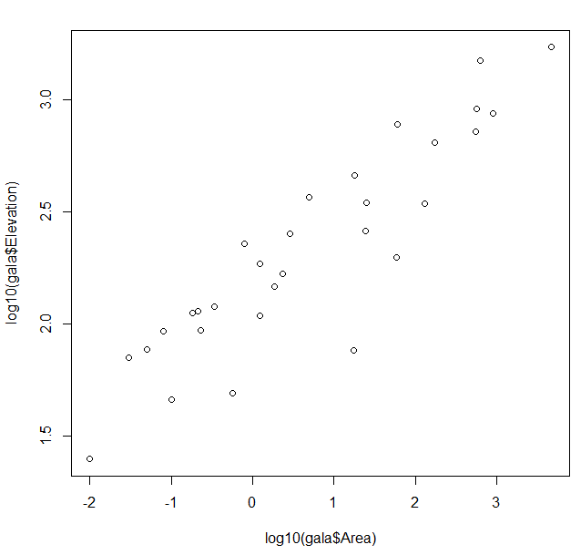
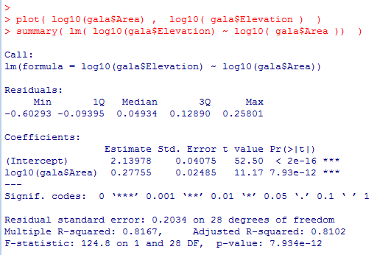
Area, elevation and species count are all correlated with one another…
Elevation Vs. Area

Slide 9
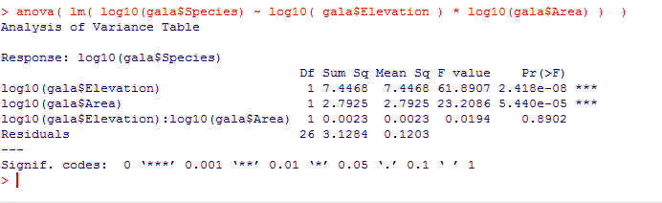
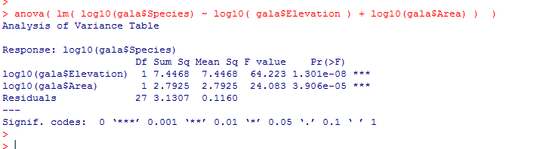
We put them together into a linear model…
We can drop the interaction term…
In the ANOVA view, both Elevation and Area are important
(zeroing them out significantly increases residual sum squared)

Slide 10
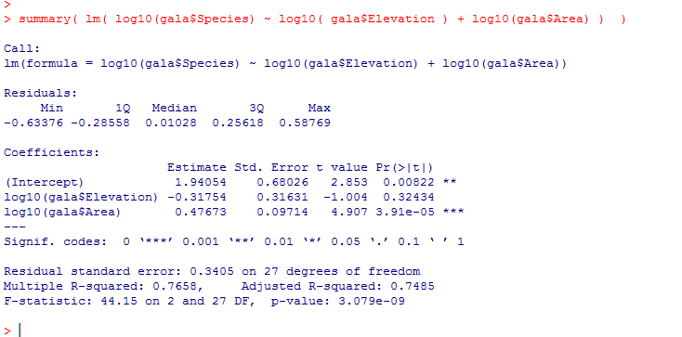
But in the summary view
Here Area “masks” elevation.
Species = B0 + B1 * area + B2 * elevation
Because area and elevation are well correlated, changes in B1 can be compensated for by changes in B2.
This makes joint estimates of B1 and B2 unreliable and messes up our inference in
this case potentially leading to the incorrect conclusion that Elevation is not correlated with species

Slide 11
There are many possible solutions to problems with correlated data
(that could be a whole class onto itself).
We look at one approach that rotates the data onto new coordinates that
by definition are uncorrelated!
This is PCA (Principle Components Analysis)

Slide 12
Correlated variables in linear models
PCA in concepts
PCA in equations
PCA in Java (for your reference; not covered in class or in final)

Slide 13
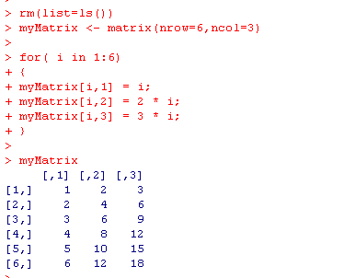
Consider a table that looks like this….
There are 18 data points here, but clearly we could represent this table is a compressed form…

Slide 14
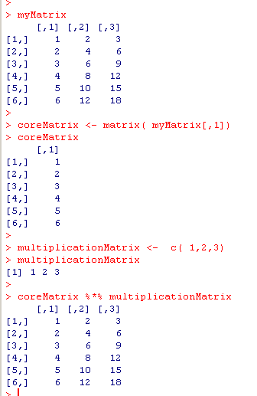
There are 18 data points here, but clearly we could represent this table is a compressed form…
The original matrix with 18 values…
The compressed form of the matrix with 9 total values
in two matrices
Our decompression algorithm!!!
We have achieved lossless compression by removing the redundant information!
We can store the entire table in 9 values instead of 18.

Slide 15
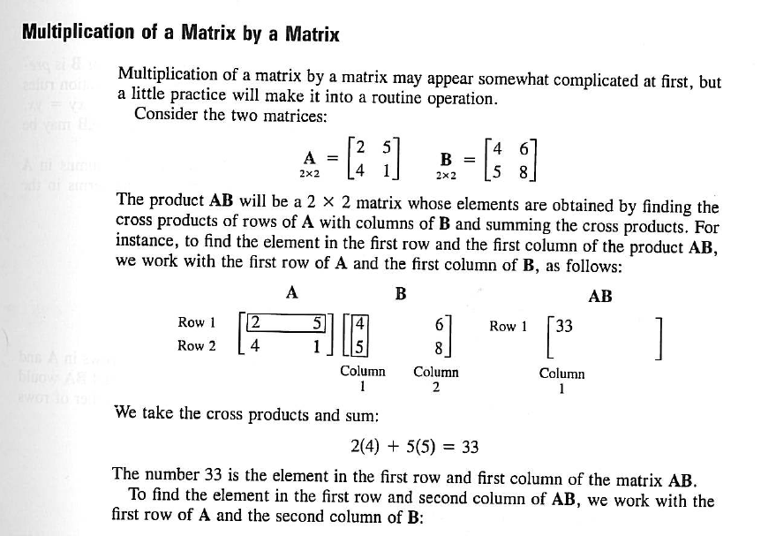
Matrix multiplication in R is the %*% operator
From your textbook…. (Matrix approach to Simple Linear Regression Analysis)

Slide 16
So the definition of matrix multiplication allows us to recover our original matrix
(6,1)
(1,3)
= (6,3)

Slide 17
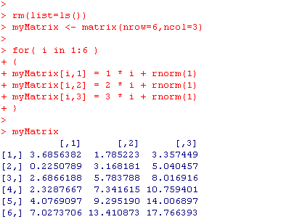
But what about if there is not perfect redundancy in the data?
Now the correlations are not as perfect. The level of redundancy has been reduced.
We can’t compress these data perfectly, but we can still devise a lossy compression strategy

Slide 18
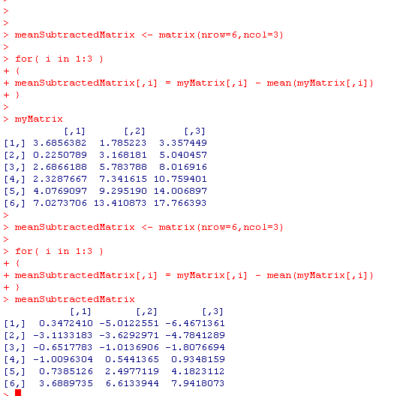
We are going to transform the matrix by subtracting from each column
the mean of each column… (this makes the math easier)
(We can always add them back later if we need to!)
Before subtracting the mean of each column
After subtracting the mean of each column

Slide 19
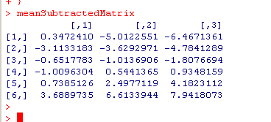
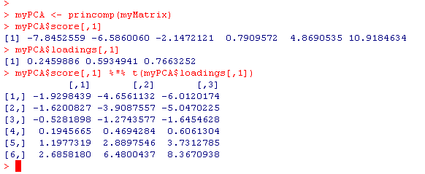
We seek the compressed form of this matrix
The compressed form is in fact…
1st eigen vector
1st principle component
(6,1) * (1,3) = (6,3)
(We will see shortly how R calculates these…)

Slide 20
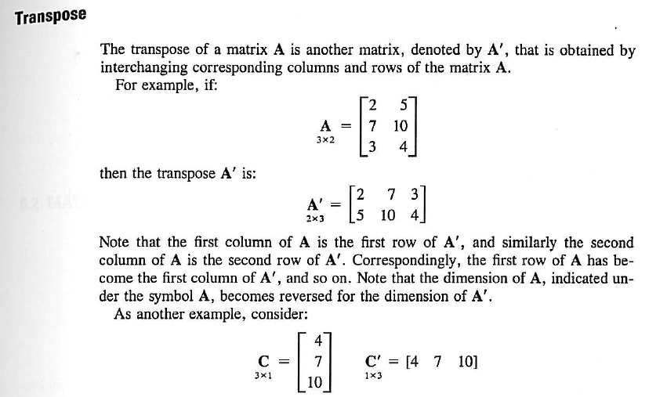
t is transpose. From the Linear Algebra chapter of Neter et al.
(Chapter 5 in 3rd edition)

Slide 21
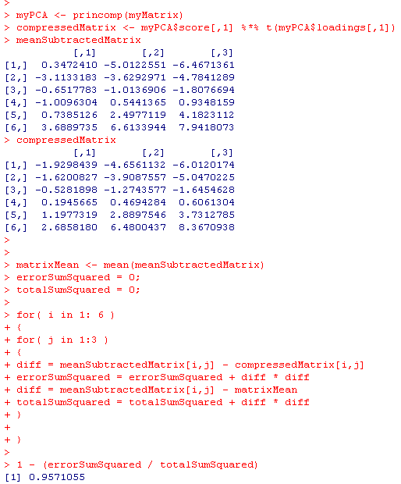
How much did we lose in our lossy compression???
We went from 18 data points to 9 data points, but how much information did we lose?
Error sum squared =
sum(compressed – original)² for all points
in the matrix
Total sum squared = sum(x – x_{avg})²
for all points in the uncompressed matrix.
The compression captures 95.7% of the variance

Slide 22
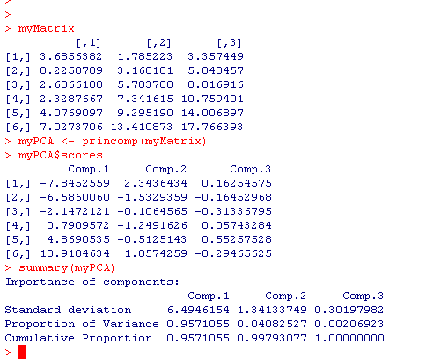
More formally…
This is the first principle component of myMatrix.
It explains 95.7% of the data in myMatrix
That is, if you replace the three columns in myMatrix with this one column
you can still capture 95.7% of the variation.
We are forming a new one-dimensional basis that replaces our three-dimensional dataset.
The PCA guarantees that this new component is the best possible one; that is, no
other possible component could explain more variance

Slide 23
We can improve our compression if we use more data.
If we use two components, we can get 99.8% of our data back…

Slide 24
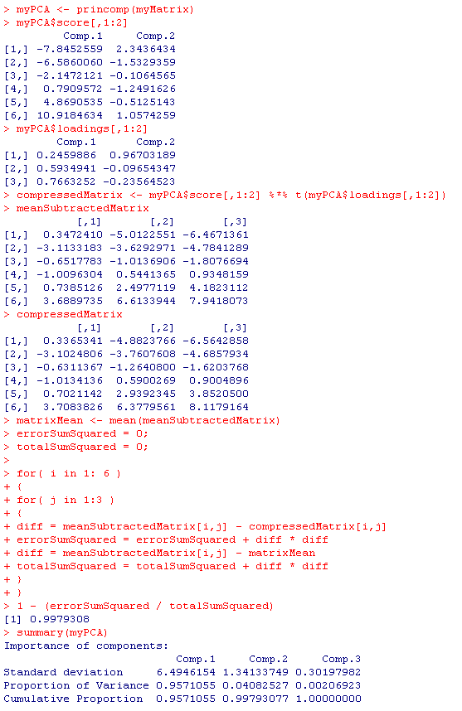
We’ll use out first two components
These are now nearly identical
We’ve captured 99.8% of the data but reduced
the dimensionality from 3D to 2D

Slide 25
Of course, if we use all 3 components, we can get
100% of the data back!
But that is trivial. Essentially just copying the data.

Slide 26
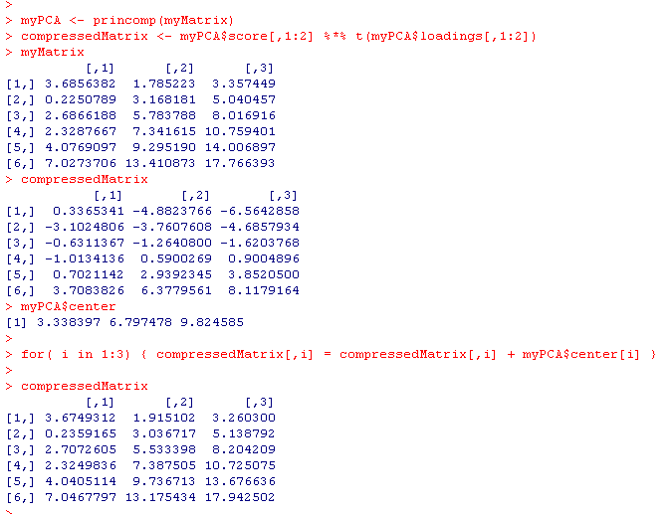
The PCA object stores the means so that we can get all the way back to the original matrix
Use two components
The original matrix
The mean centered compressed matrix
with 2 principle components…
The compressed version with the means added back in

