Slide 1
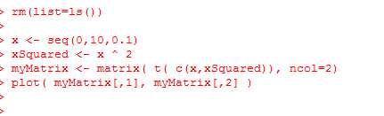
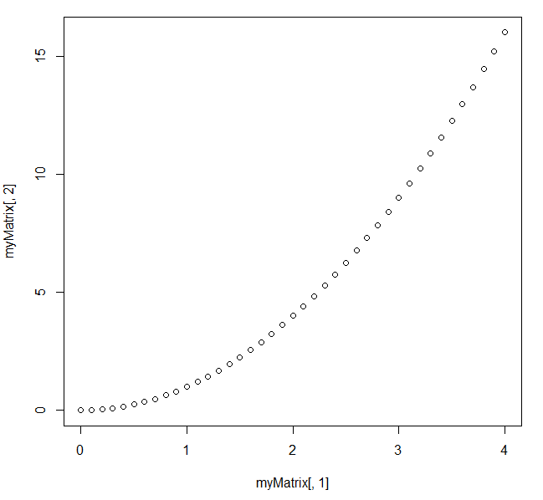
Consider the relationship between x and x ^ 2
https://github.com/afodor/metagenomicsTools/blob/master/src/machineLearningExamples/pcaRotation.txt

Slide 2
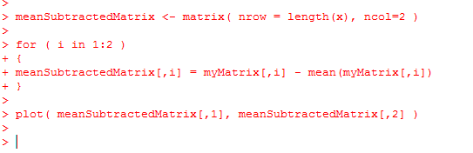
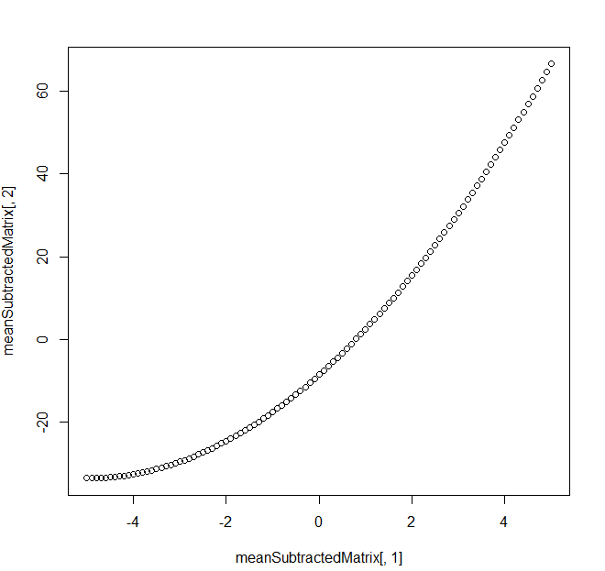
Mean subtracting doesn’t much change the basic shape…
https://github.com/afodor/metagenomicsTools/blob/master/src/machineLearningExamples/pcaRotation.txt

Slide 3
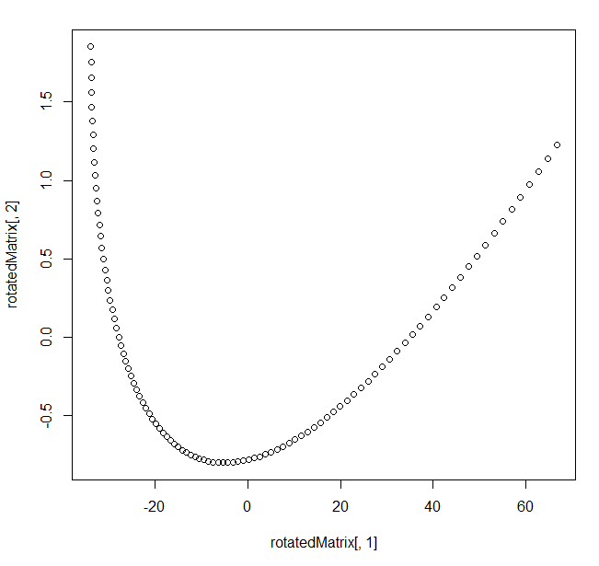
We can perform the PCA via Eigen value rotation
[200, 2] * [2,2] = [200,2]
https://github.com/afodor/metagenomicsTools/blob/master/src/machineLearningExamples/pcaRotation.txt

Slide 4
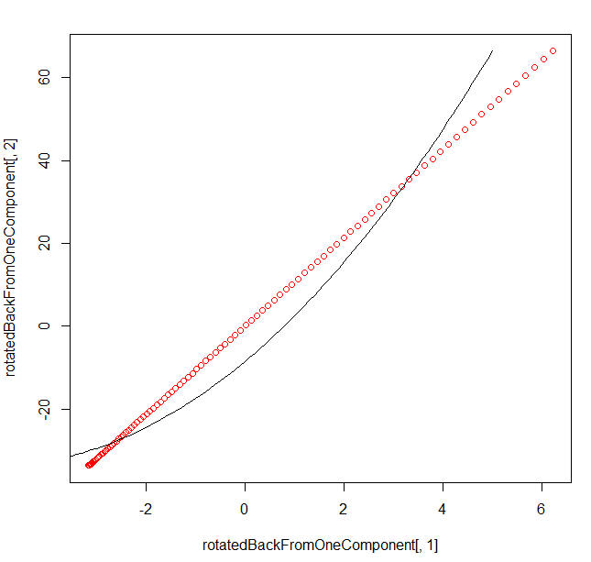
Here, we rotate it back but only use the first PCA component
[200 * 1]
[ 1 * 2 ]
= [200 * 2]
In one linear component,
we can only hold linear
Information…
https://github.com/afodor/metagenomicsTools/blob/master/src/machineLearningExamples/pcaRotation.txt

Slide 5
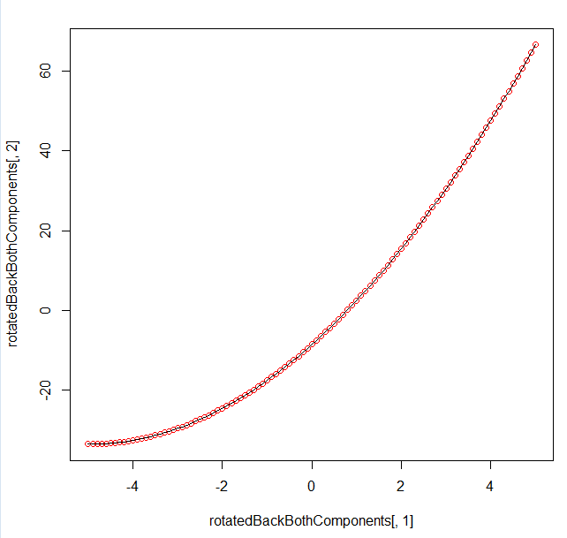
Of course, if we use both components, we can get the original data back…
[200 * 2] * [2,2] = [200 * 2]
https://github.com/afodor/metagenomicsTools/blob/master/src/machineLearningExamples/pcaRotation.txt

Slide 6
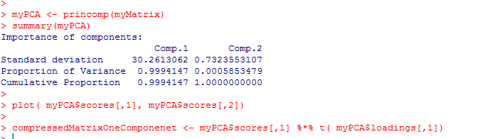
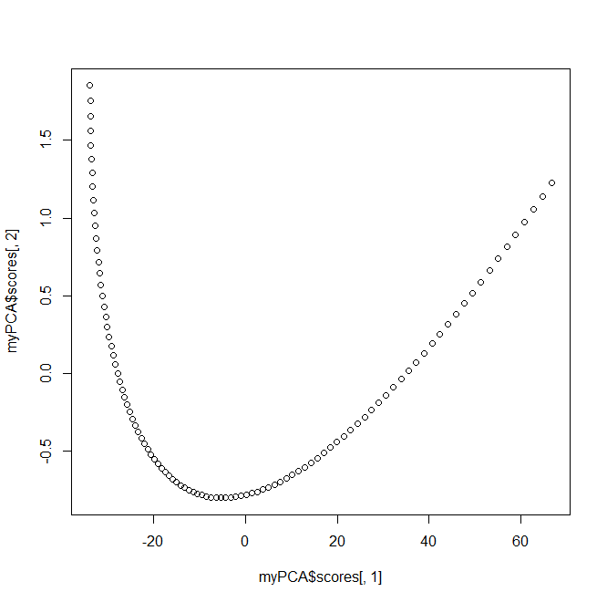
With alternative syntax (but identical results…)
https://github.com/afodor/metagenomicsTools/blob/master/src/machineLearningExamples/pcaRotation.txt

Slide 7
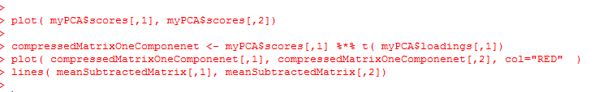
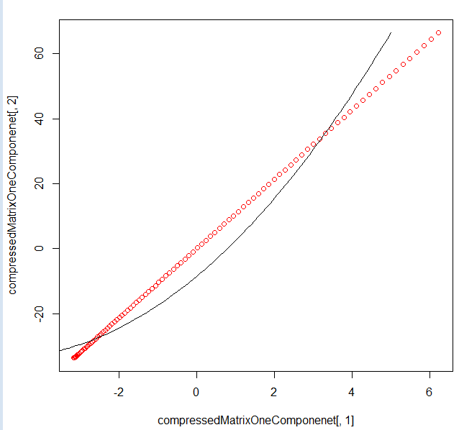
With alternative syntax (but identical results…)
https://github.com/afodor/metagenomicsTools/blob/master/src/machineLearningExamples/pcaRotation.txt

Slide 8
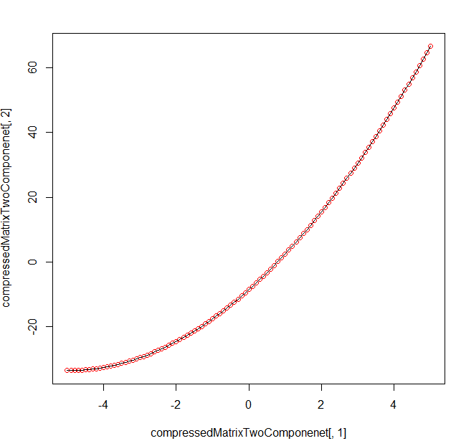
With alternative syntax (but identical results…)
https://github.com/afodor/metagenomicsTools/blob/master/src/machineLearningExamples/pcaRotation.txt

Slide 9
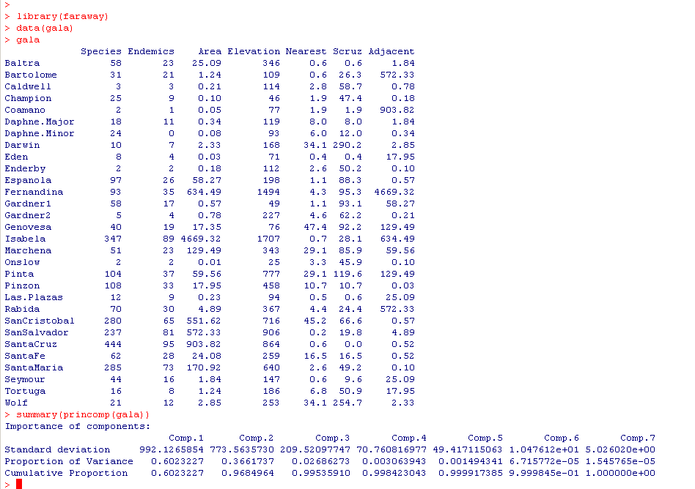
Let’s return to the gala dataset…
There are only 2-3 columns of non-redundant information

Slide 10
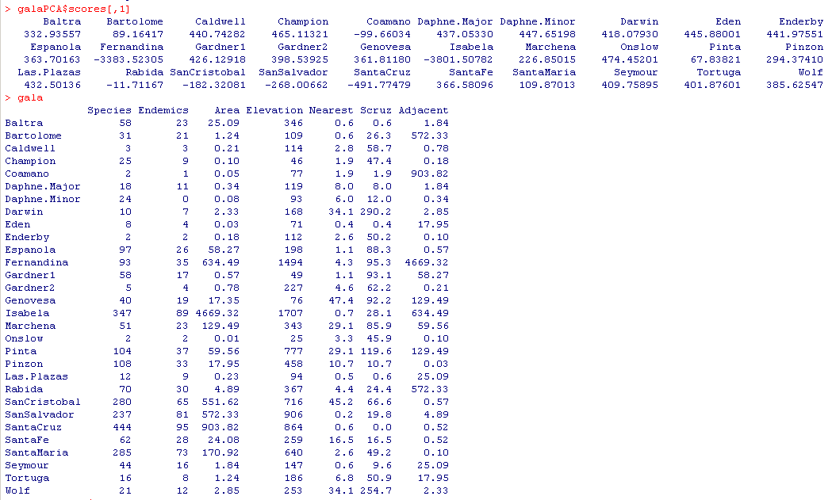
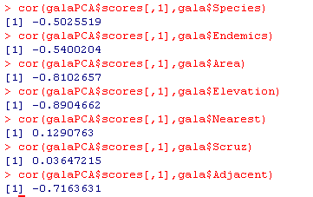
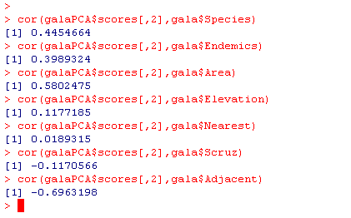

The first component correlates with many of the measured variables…
The second component has much
Less correlation with elevation
The two components, of course,
are not correlated with each other (that’s the point!):

Slide 11

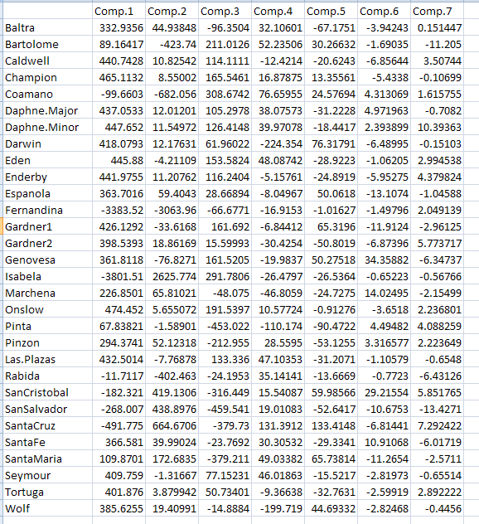

Slide 12
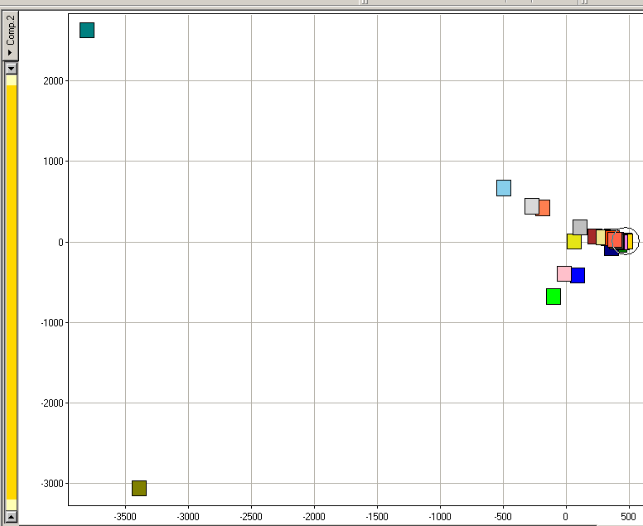
Isabella
Isabella and Fernandina seem really different…
Component 2
Fernandina
Component 1

Slide 13
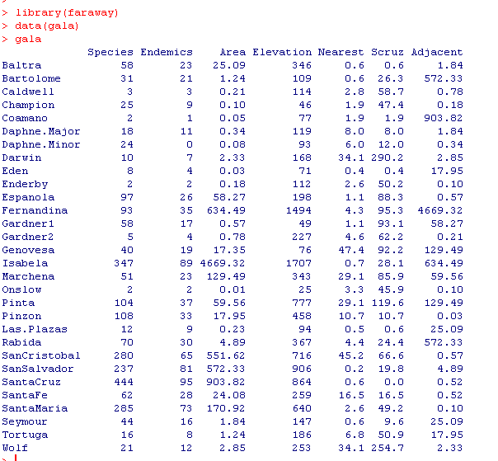
Fernandina is adjacent to Isabela.
The large area of Isabela causes both points to be outliers….
Limitations of PCA become apparent for this dataset…
A single datapoint drives the outliers

Slide 14
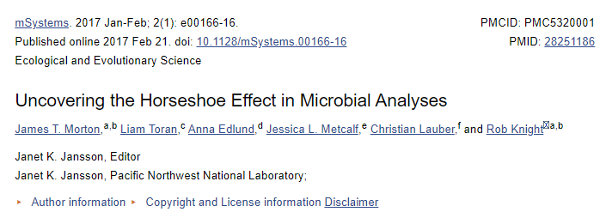
When the first axis dominates, you often get a “horseshoe effect”

Slide 15
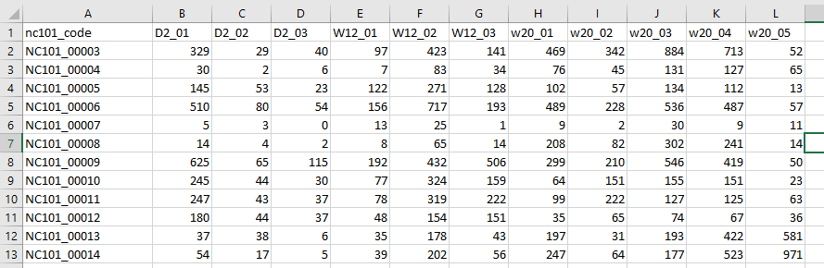
If we return to our RNA-seq dataset from previous lectures…

Slide 16
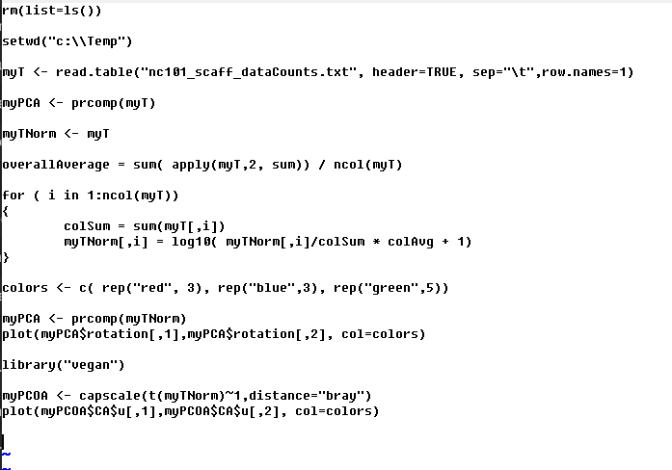
We can perform the ordination in a few lines of R code
https://github.com/afodor/metagenomicsTools/blob/master/src/classExamples/pcaForSlides.txt

Slide 17
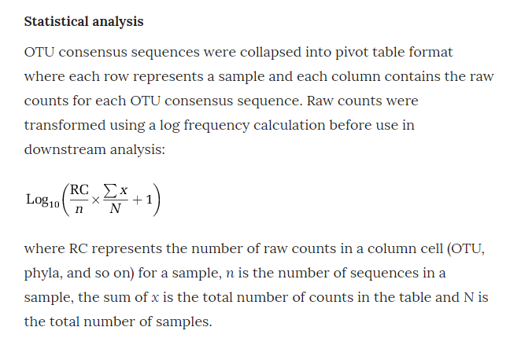
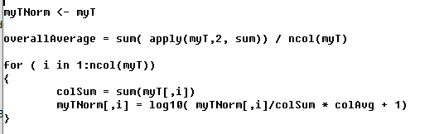
Our normalization strategy attempts to minimize the impact of the psuedo-count
https://www.nature.com/articles/ismej2013106/

Slide 18
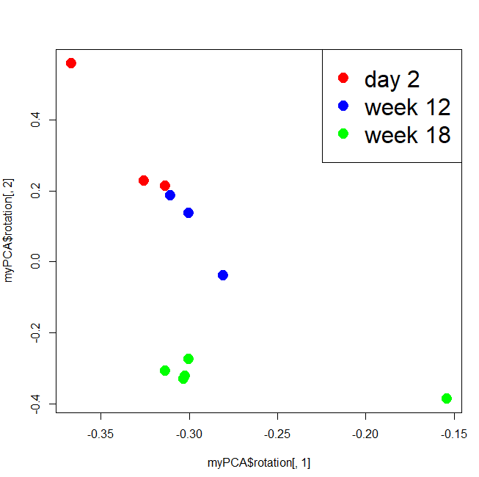
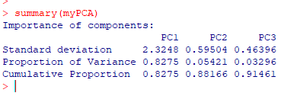
When you have more taxa than samples, you need to use prcomp
(and the PCA axes are identified by “rotation” in the return object”)
Our first axis is dominated
by a single outlier

Slide 19
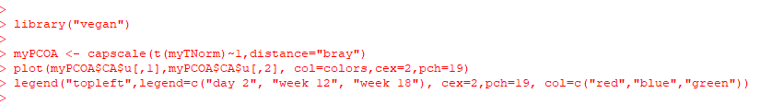
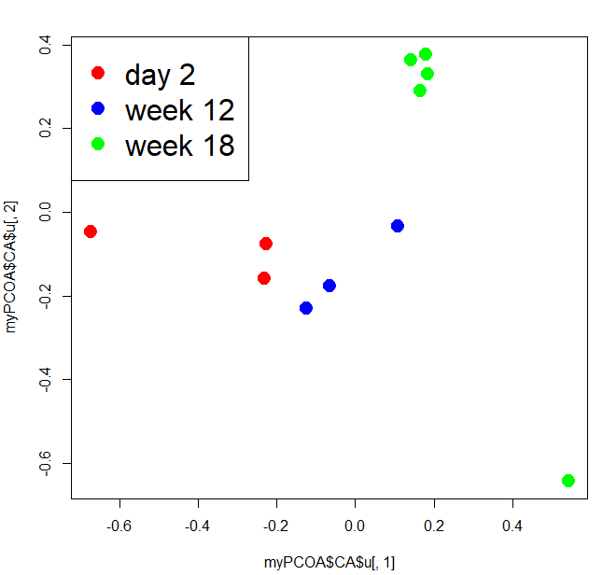

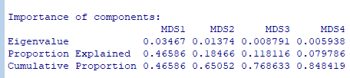
Often in ecology, we use other distance matrixes

Slide 20
