Slide 1
Standard error and the z-test.
The chi-square distribution.
The chi-square (Pearson) test
The t-distribution
The t-test

Slide 2
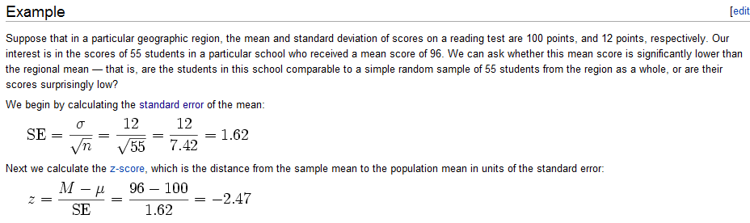
Because of the central limit theorem, the normal distribution is often used for
Inference in canonical statistics…
We start our exploration of using dnorm for inference with an example from the Wiki…
http://en.wikipedia.org/wiki/Z-test

Slide 3


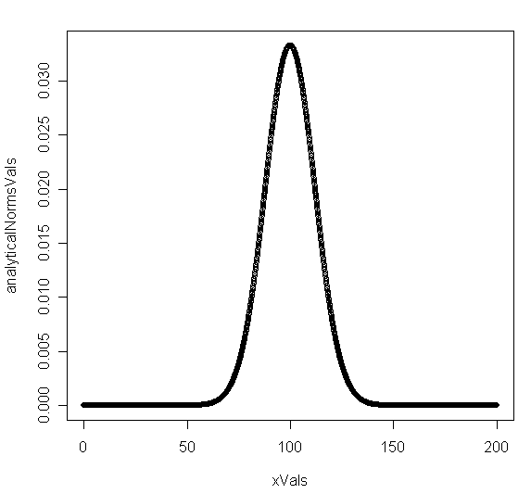
http://en.wikipedia.org/wiki/Z-test
We can model this analytically…
In this case, the mean and variance
are known with certainty…

Slide 4
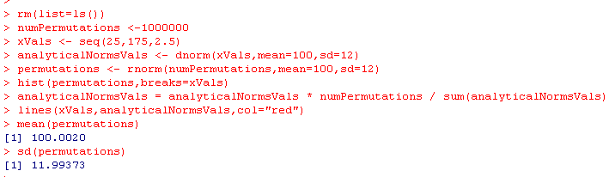
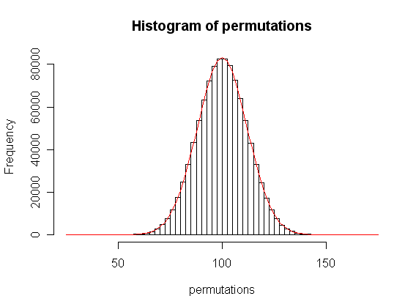
We can model this analytically or through permutations
A mean of 100 and SD of 12 means
the distribution shown to the right…
We are going to transform this
into standard normal form…
Subtract off the mean.
Divide the standard deviation..

Slide 5
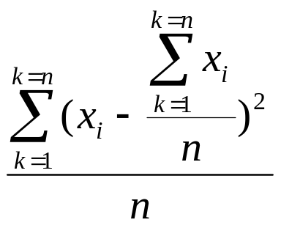
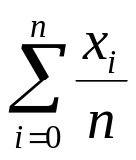
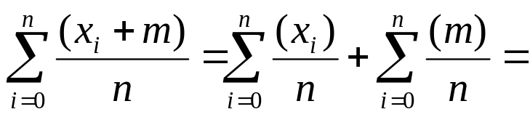
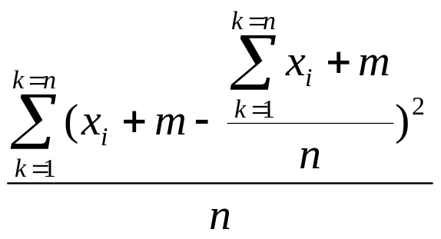
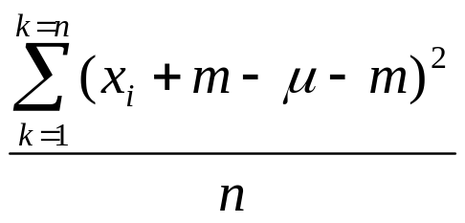
Given a mean μ and a variance σ²
μ =
σ² =
If we add a constant m to each data point:
μ’ =
μ + m
σ^{2’} =
=
=
σ²
So adding a constant to each data point shifts the location of the curve without
changing the variance…

Slide 6
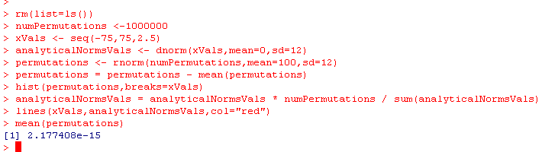
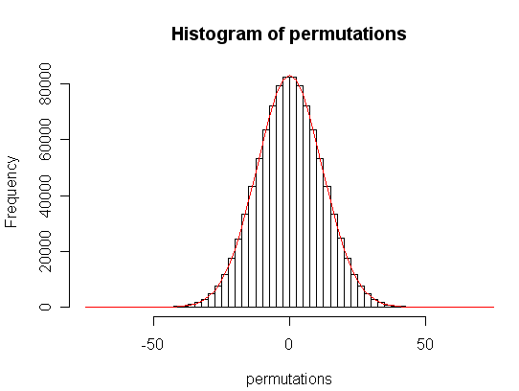
We subtract the mean….

Slide 7
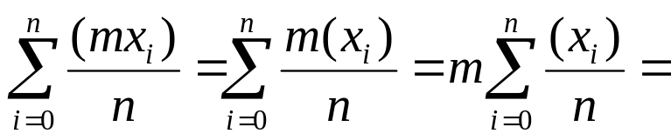
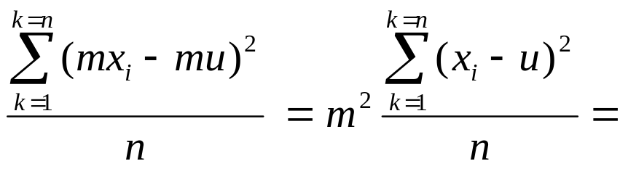
Given a mean μ and a variance σ²
μ =
σ² =
If we multiply each data point by a constant m:
μ’ =
mμ
σ^{2’} =
m²σ²
Since
So each data point by a constant shifts the variance (by m²) (or the SD by m)
as well as shifting the location of the curve by factor of m

Slide 8
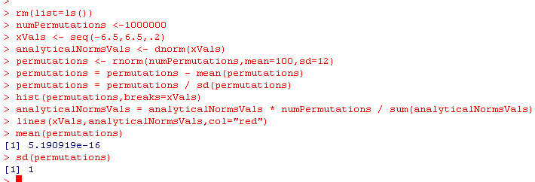
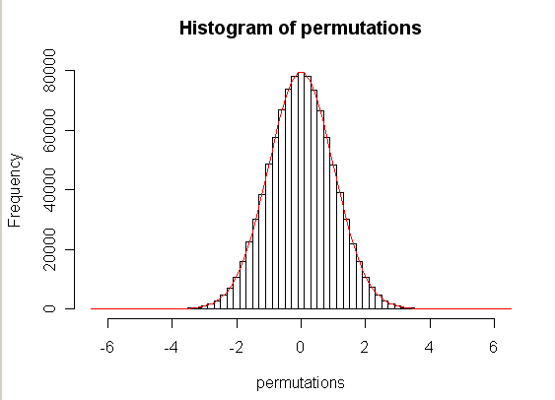
Divide the standard deviation….
mean=0; sd =1 by default
New mean = 0 * (1/sd) = 0
This is now a
standard normal distribution..
mean = 0
sd = 1

Slide 9
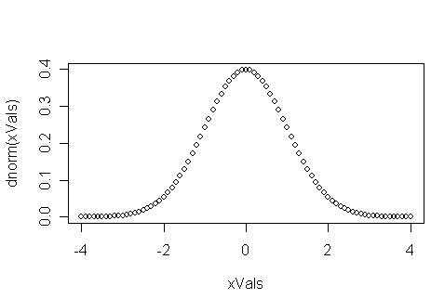

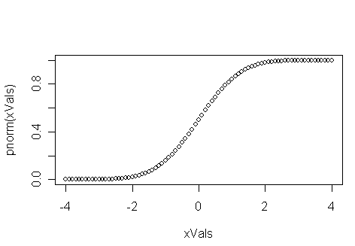


The standard normal distribution….
Intuitively, what is the probability of falling the # of Standard deviations shown on
the x-axis
So for a two-sided test, 2 standard deviations is ~ 0.05

Slide 10
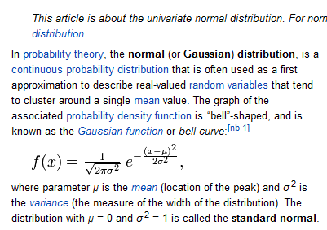
http://en.wikipedia.org/wiki/Normal_distribution

Slide 11

Just with this, we can do some inference
We have a single student who scores a 125.
Null hypothesis: The student was drawn from the same geographic region
Z = (125 – 100 )
12
Correct for
2 sided test…

Slide 12
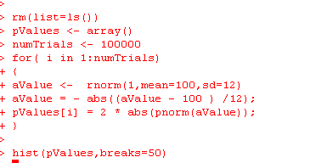
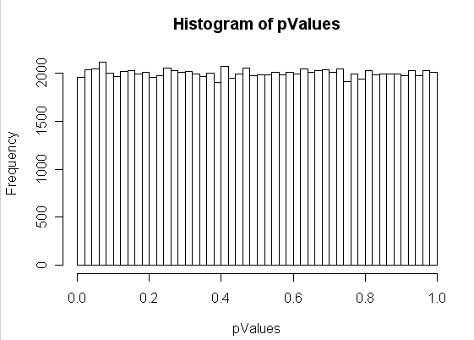
Sanity check. Choosing a single value from a norm(u=100; sd=15) distribution will yield
a uniform distribution of p-values..

Slide 13
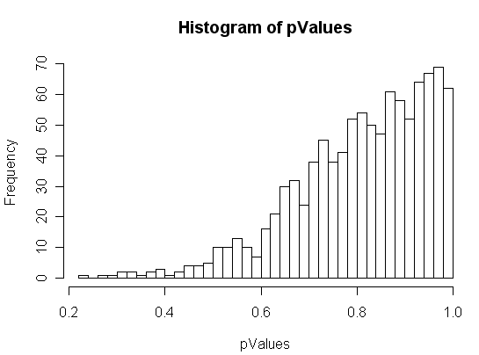
Let’s say that we increase the # of students we see with a score of 100 to 10
rm(list=ls())
pValues <- array()
numTrials <- 1000
for( i in 1:numTrials)
{
manyValues <- rnorm(10,mean=100,sd=12)
manyValues = - abs(( mean(manyValues) - 100 ) /12);
pValues[i] = 2 * abs(pnorm(manyValues));
}
hist(pValues,breaks=50)
This breaks.
The averages are closer to 100 than
our z-test is expecting!
Seeing a score of 100 one time
is different than seeing an average
of 100 from an n of 10.
We need to put into our test
statistic information about how
large our sample sizes are…

Slide 14
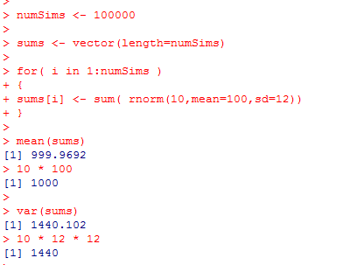
How does the variance change with increased sample size?
We sample 10 students (with an average exam score μ=100 and SD = 12)
Define Σ Y as the sum of these 10 scores.
The expected value (mean) for Σ Y is n * μ = 1,000
The expected variance of the sum is n * sd²
For each draw, we expect a variance from the mean of:
Σ (Yi – μ )² = sd²
1
So for n draws, we expect to see
n * the variance for one draw =
n *sd²
(remember the SD is known ahead of time and
is not dependent on a particular observed sample
size)

Slide 15
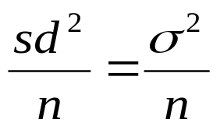
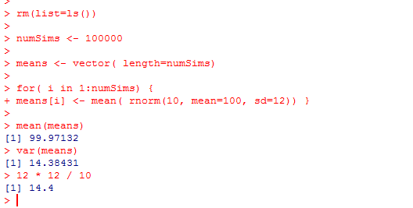
The expected variance of the sum is n * sd²
What we want is the variance of the mean
We get this by dividing each of the n observations by n
If we divide each data point by n
E(value of mean) = n * μ / n = μ
E(variance of the mean) =
n *sd²
=
2
n
(since the mean will shift by 1/n and the variance will shift by (1/n)²
when dividing each data point by n )

Slide 16
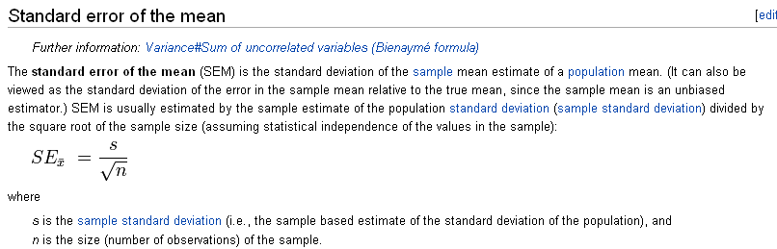
The square root of
defines the standard error of the mean
How much error can we expect in an estimate of a mean from a normal sample
given a sample size n…
http://en.wikipedia.org/wiki/Standard_error#Standard_error_of_the_mean

Slide 17
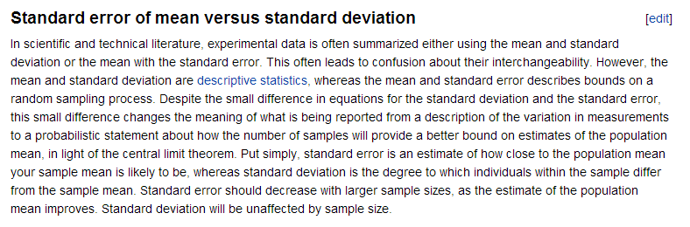
The Wiki has a nice description of standard error of the mean vs. SD
http://en.wikipedia.org/wiki/Standard_error#Standard_error_of_the_mean

Slide 18
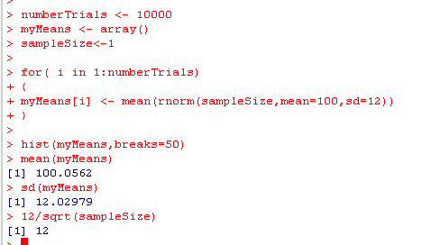
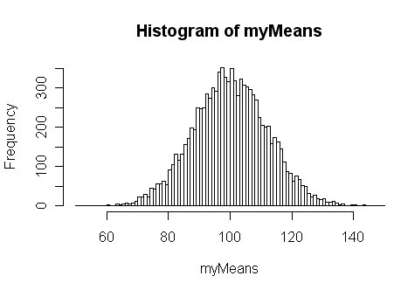
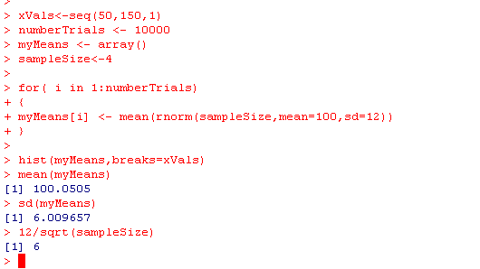
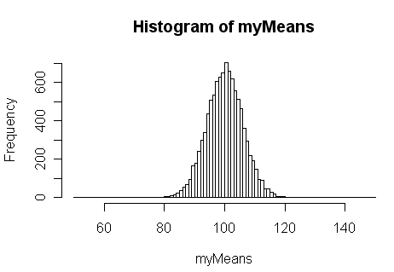
With a sample size of 1…
Sample size =1
E(mean)=100
E(SD) = 12 / 1
Sample size =4
E(mean)=100
E(SD) = 12 / sqrt(4)

Slide 19
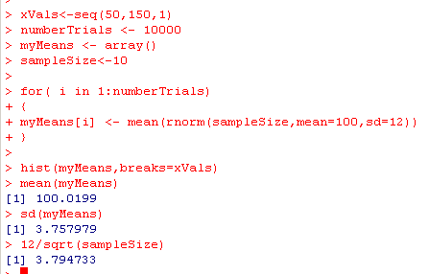
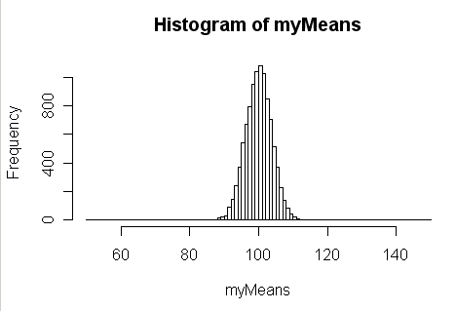
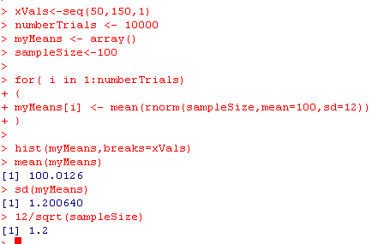
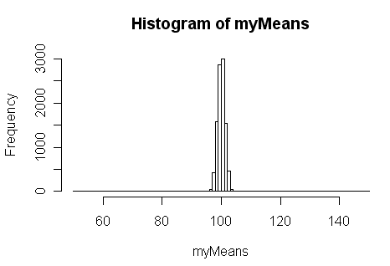
Sample size =10
E(mean)=100
E(SD) = 12 / sqrt(10)
Sample size =100
E(mean)=100
E(SD) = 12 / sqrt(100)

Slide 20
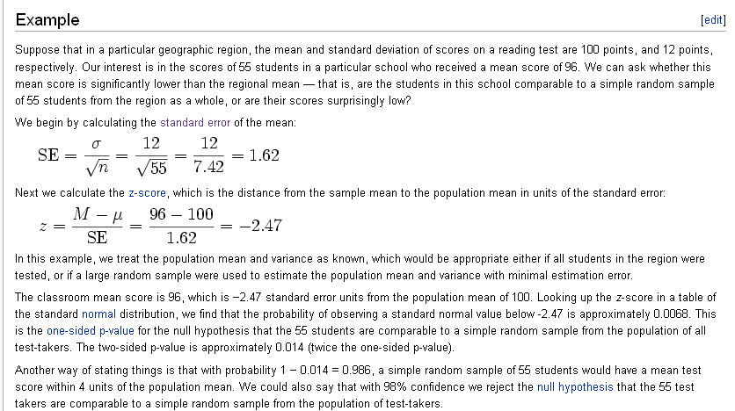
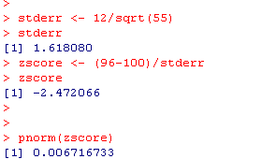
The Z-test compares a sample distribution to a known normal distribution
An example of inference from the Z-test.
http://en.wikipedia.org/wiki/Z-test
One sided

Slide 21
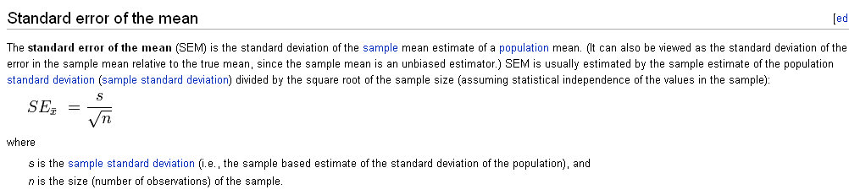

If n=1, the Z-test =
M-u
s
Your p-value is just determined by the # of standard deviations you are from the mean
If n > 1, sampling from a null population (i.e. that has no real difference)
will be closer to the mean because of the repeated sampling.
If n = infinity, any difference from the mean, no matter how small, can
be significant with a p-value of 0.
A problem if your assumptions are not exactly true.
This is a problem for bioinformatics, since we have very large sample sizes
(as we will see)

Slide 22
To return to our broken example…
rm(list=ls())
pValues <- array()
numTrials <- 1000
for( i in 1:numTrials)
{
aValue <- rnorm(10,mean=100,sd=12)
aValue = - abs(( mean(aValue) - 100 ) /12);
pValues[i] = 2 * abs(pnorm(aValue));
}
hist(pValues,breaks=50)
This breaks.
Seeing a score of 100 one time
is different than seeing it 10 times.
We need to put into our test
statistic information about how
large our sample sizes are…

Slide 23
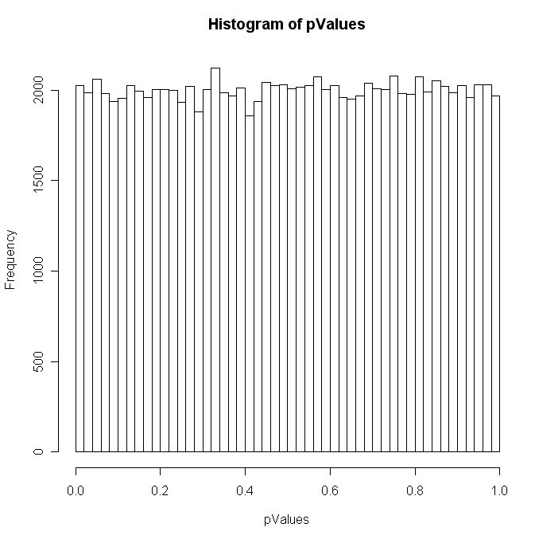
Replace the standard deviation with the standard error of the mean and all is well…
rm(list=ls())
pValues <- array()
numTrials <- 100000
for( i in 1:numTrials)
{
aValue <- rnorm(10,mean=100,sd=12)
aValue = - abs(( mean(aValue) - 100 ) / (12/sqrt(10)));
pValues[i] = 2 * abs(pnorm(aValue));
}
hist(pValues,breaks=50)

Slide 24
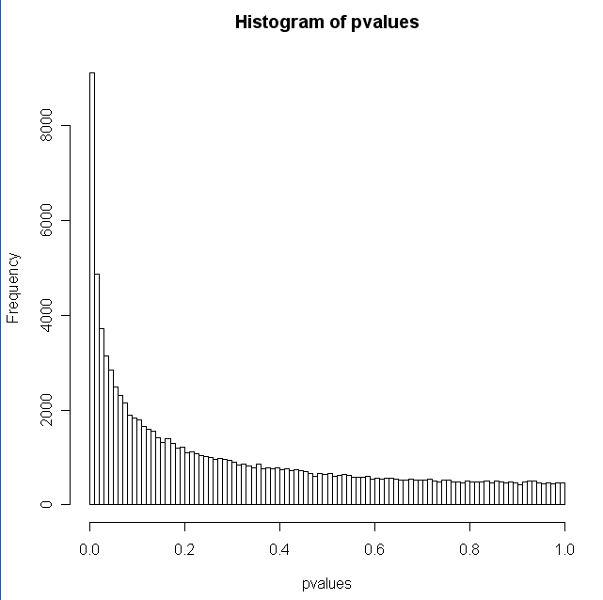
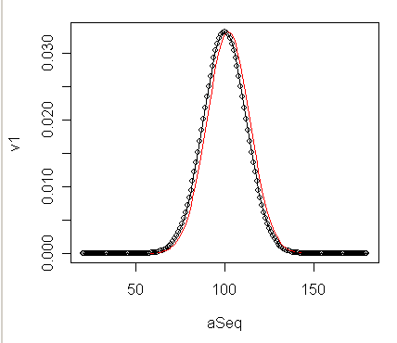
A sanity-check.
P-values calculated by the z-test from a differently distributed sample,
should be non-uniform
rm(list=ls())
s <- seq(1,100000)
pvalues <- array();
for( i in s )
{
sampleSize <-55
myVector <- rnorm(sampleSize,mean=102,sd=12)
stderr = 12 / sqrt(sampleSize)
zVal = -abs( (mean(myVector)-100)/stderr)
pvalues[i]=2 * pnorm(zVal)
}
hist(pvalues,breaks=100)
Move it over a little
You always have to ask yourself: it’s a significant difference, but is it a meaningful difference?

Slide 25
Standard error and the z-test.
The chi-square distribution.
The chi-square (Pearson) test
The t-distribution
The t-test

Slide 26
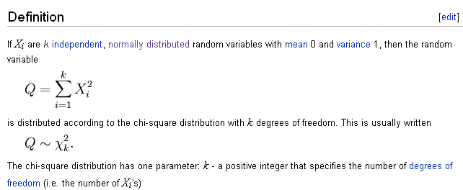
The chi-square distribution
http://en.wikipedia.org/wiki/Chi-square_distribution

Slide 27
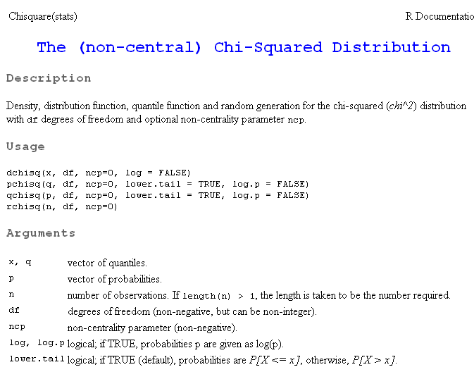
As usual. We have dchisq, pchisq, qchisq amd rchisq

Slide 28
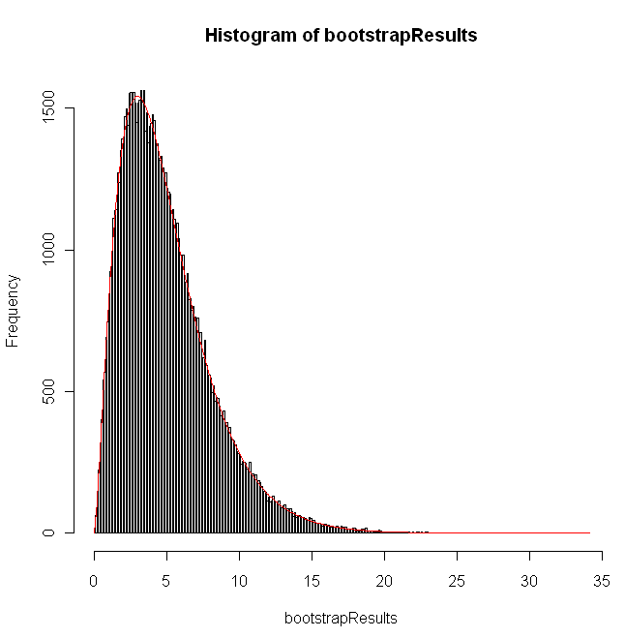
Comparing the bootstrap results to theory in R for the chi-square sum with k=5
rm(list=ls())
numTrials =10000;
s <- seq(1,numTrials)
bootstrapResults <- vector()
for( i in s)
{
chiSquareSum = 0
sampleSize <- 5
for( j in 1: sampleSize)
{
normVal= rnorm(1)
chiSquareSum = chiSquareSum + normVal * normVal
}
bootstrapResults[i] <- chiSquareSum;
}
lowerBound = min(bootstrapResults)-0.2
lowerBound = max(lowerBound,0)
histBreaks <- seq(lowerBound,max(bootstrapResults)+0.2,0.1)
hist(bootstrapResults,breaks=histBreaks)
theoryResults <- dchisq(histBreaks,sampleSize)
theoryResults = theoryResults * numTrials / sum(theoryResults);
lines(histBreaks, theoryResults, col="red")

Slide 29
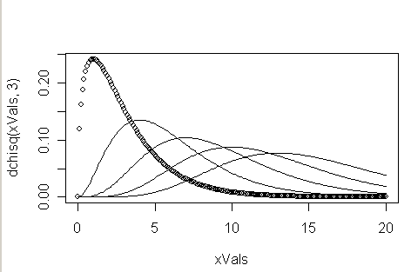
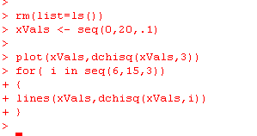
We can easily visualize chi-square distributions for different values…
3
6
9
12
15

Slide 30
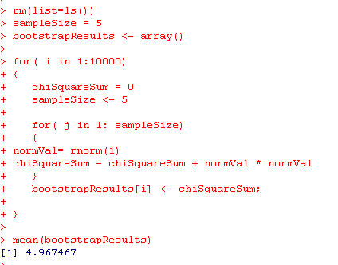
The average value of Q is K….

Slide 31
Standard error and the z-test.
The chi-square distribution.
The chi-square (Pearson) test
The t-distribution
The t-test

Slide 32
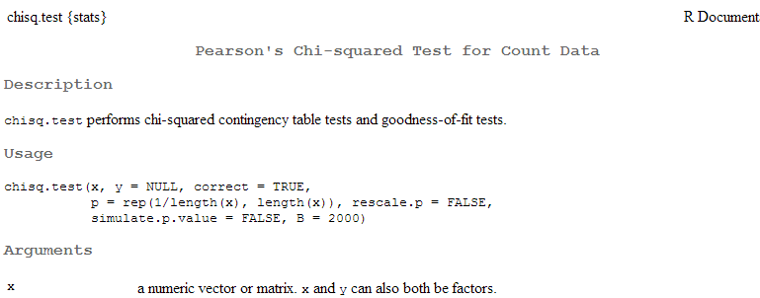
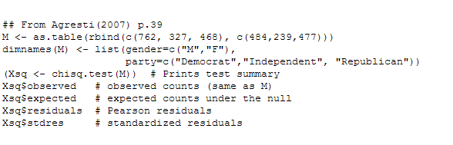
The Pearson’s chi-squared test is a very elegant test that is built on the chi-square distribution

Slide 33
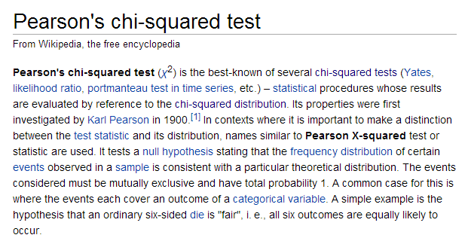
The Wiki has a nice write-up (as usual)
http://en.wikipedia.org/wiki/Pearson%27s_chi-squared_test

Slide 34
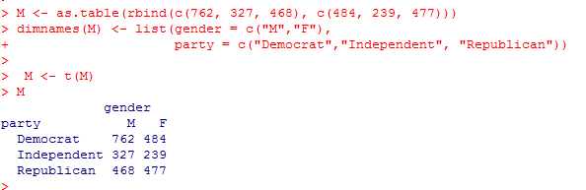

Let’s take an example from the R documentation for chisq.test
Is party registration independent of gender?
Doesn’t
matter which
are the rows
and which
are the columns
The basic idea is that the expected values are based only on the row
and column sums..
http://en.wikipedia.org/wiki/Pearson%27s_chi-squared_test

Slide 35


It is easy to implement the Chi-square test…
(or we can just use chisq.test() ) .
This tests that that the two categories are
independent
Using R’s built-in chi-square test
Our own quick implementation

Slide 36


Note that the chi-square test has to be a one-sided test.
The sum needs to be higher than you expect by chance.

Slide 37
To see the justification for the expected values, consider a 2 * 2 table
All democrats
 | Male | Female
Dem | 40 | 80 | 120
Rep | 100 | 50 | 150
 | 140 | 130
All republicans
All males
All females
p(dem) = 120/270
p(rep ) = 150/270
p(male) = 140/270
p(female) = 130/270
If party and gender were independent, then:
p(Dem, Male) = p(Dem) * p(Male) = (120/270) * (140/270) = 0.230
p(Dem, Female) = p(Dem) * p(Female) = (120/270) * (130/270) = 0.213
p(Rep, Male) = p(Rep) * p(Male) = (150/270) * (140/270) = 0.288
p(Rep, Female) = p(Rep) * p(Female) = (150/270) * (130/270) = 0.267
To get the expected # of voters, multiply those probabilities by N
(the total number of voters)

Slide 38

So the formula for expected valued in each cell is N * (row sum/N) * (column sum/N) =
rowSum * columnSum /N
 | Male | Female
Dem |  |  | 120
Rep |  |  | 150
 | 140 | 130
 | Male | Female
Dem | 120*140/270 | 130*120/270
Rep | 140*150/270 | 130*150/270
 | Male | Female
Dem | 62.22222 | 57.77778
Rep | 77.77778 | 72.22222

Slide 39

Here is a sanity test that independent assignments of categories produces uniform p-values….
rm(list=ls())
sampleSize <- 1000
numPermutations <- 10000
numColumns <- 4
numRows <- 3
pValues <- vector()
rowIndices <- 1:numRows
colIndices <- 1:numColumns
for( i in 1 : numPermutations )
{
myTable <- matrix(0,nrow=numRows, ncol = numColumns );
    for( j in 1 : sampleSize )
    {
    aRowIndex <- sample( rowIndices,1 )
    aColIndex <- sample( colIndices,1)
    myTable[aRowIndex,aColIndex] = myTable[aRowIndex,aColIndex] + 1
    }
pValues[i] <- chisq.test(myTable)$p.value
hist(pValues,breaks=50)
}

Slide 40

Showing the chisquare test for uniform distirbution
http://en.wikipedia.org/wiki/Pearson%27s_chi-squared_test

Slide 41




In this case, we can use a chi-square to test the results of a chi-square test!
Now we can put a p-value on a null hypothesis that a distribution is uniform!

Slide 42
Standard error and the z-test.
The chi-square distribution.
The t-distribution
The t-test

Slide 43

Why can’t we just use the Z-test all the time
Let’s re-visit our sanity check, this time with a sampleSize of 10
rm(list=ls())
s <- seq(1,100000)
pvalues <- array();
for( i in s )
{
sampleSize <-10
myVector <- rnorm(sampleSize,mean=100,sd=12)
stderr = 12 / sqrt(sampleSize)
zVal = -abs( (mean(myVector)-100)/stderr)
pvalues[i]=2 * pnorm(zVal)
}
hist(pvalues,breaks=100)
All is well, but we have to know ahead of time that the
distribution standardDeviation is 12.
Most of the time, we don’t know the standard Deviation.
We have to estimate it!

Slide 44

If we try and estimate the standard deviation from our 10 samples,
our z-test is no longer accurate
rm(list=ls())
s <- seq(1,100000)
pvalues <- array();
for( i in s )
{
sampleSize <-10
myVector <- rnorm(sampleSize,mean=100,sd=12)
stderr = sd(myVector) / sqrt(sampleSize)
zVal = -abs( (mean(myVector)-100)/stderr)
pvalues[i]=2 * pnorm(zVal)
}
hist(pvalues,breaks=100)
Very bad!
We have to estimate the standard deviation from the data we have…
Now our test that we have a mean different from 100 fails (even
though the data was generated with a mean of 100).
There is “error” in our estimate of standard error that we need to account for…

Slide 45

The t-distribution is used when you have to estimate the standard deviation from
the sample (i.e. you don’t know it ahead of time).
As v approaches infinity, the t-distribution becomes the normal distribution.
Which makes sense; as our sample size grows larger, we are more
confident that we know the true standard deviation, so we don’t have to
correct for our error in our estimate of standard error.
By the law of large numbers, as d.f. approaches infinity, the
chi-squared sum will approach the expected sum and the denominator will
approach 1
http://en.wikipedia.org/wiki/Student%27s_t-distribution

Slide 46


As usual, we can prove to ourselves that we understand dt…
https://github.com/afodor/metagenomicsTools/blob/master/src/classExamples/tExample

Slide 47



As v approaches infinity, the
denominator approaches 1
and the t-distribution approaches the
z-distribution
Since the sum can’t be below zero,
at small d.f., V has more of its area below v,
So V/v is often > 1, which means T is wider than Z…

Slide 48


At df=5, there is a big difference between the t-distribution and normal
dT is wider than dNorm

Slide 49




At df=5, there is a big difference between the t-distribution and normal
-log10(pValue)
# of standard deviations
You have to get further away from the center to get the same pValue (at df=5)

Slide 50


At df=1000, the normal and t distributions are essentially the same…

Slide 51

At df=1000, the normal and t distributions are essentially the same…

Slide 52
If we try and estimate the standard deviation from our 10 samples,
our z-test is no longer accurate
rm(list=ls())
s <- seq(1,100000)
pvalues <- array();
for( i in s )
{
sampleSize <-10
myVector <- rnorm(sampleSize,mean=100,sd=12)
stderr = sd(myVector) / sqrt(sampleSize)
zVal = -abs( (mean(myVector)-100)/stderr)
pvalues[i]=2 * pnorm(zVal)
}
hist(pvalues,breaks=100)
Very bad!
We have to estimate the standard deviation from the data we have…
Now our test that we have a mean different from 100 fails (even
though the data was generated with a mean of 100).
There is “error” in our estimate of standard error that we need to account for…

Slide 53

So the vast majority of the time, we have to estimate the standard deviation.
We can make one more change to our code to recover our uniform distribution..
rm(list=ls())
s <- seq(1,100000)
pvalues <- array();
for( i in s )
{
sampleSize <-10
myVector <- rnorm(sampleSize,mean=100,sd=12)
stderr = sd(myVector) / sqrt(sampleSize)
zVal = -abs( (mean(myVector)-100)/stderr)
pvalues[i]=2 * pt(zVal,sampleSize-1)
}
hist(pvalues,breaks=100)
The t-distribution is used when you have to estimate the standard deviation from
the sample (i.e. you don’t know it ahead of time).
We switch from pnorm to pt and all is well

Slide 54




Why does this work?
We define
with mean μ and variance σ²
If we define the Z distribution as
the mean of Z will be zero (because we have subtracted μ
and the variance will be 1 since the variance of
)
= variance of (
) = σ² / n
So to correct for that we multiply by
since multiplying a distribution by X changes the variance by X²
So we can use the Z distribution for inference if we know μ and the variance is σ²
ahead of time…
https://en.wikipedia.org/wiki/Student%27s_t-distribution

Slide 55


So we can use the Z distribution for inference if we know μ and the variance is σ²
ahead of time…
rm(list=ls())
s <- seq(1,100000)
pvalues <- vector(length=length(s));
zVals <- vector(length=length(s));
for( i in s )
{
sampleSize <-10
myVector <- rnorm(sampleSize,mean=100,sd=12)
zVals[i] = (mean(myVector)-100) * sqrt(sampleSize)/12
pvalues[i]=2 * pnorm(-abs(zVals[i]))
}
hist(pvalues,breaks=100)
mean(zVals)
sd(zVals)

Slide 56



If we estimate the variance from the data, our Z test breaks…
rm(list=ls())
s <- seq(1,100000)
pvalues <- vector(length=length(s));
zVals <- vector(length=length(s));
for( i in s )
{
sampleSize <-10
myVector <- rnorm(sampleSize,mean=100,sd=12)
zVals[i] = (mean(myVector)-100) * sqrt(sampleSize)/sd(myVector)
pvalues[i]=2 * pnorm(-abs(zVals[i]))
}
hist(pvalues,breaks=100)
mean(zVals)
sd(zVals)
becomes
The only change
We are no longer standard normal distributed

Slide 57



We state without proof…
https://en.wikipedia.org/wiki/Student%27s_t-distribution
https://github.com/afodor/metagenomicsTools/blob/master/src/classExamples/VisChiSquared

Slide 58


This allows us to derive the proof that the t-distribution is appropriate for variance estimated from the data
The z distribution with the variance known ahead of time
The t distribution
with the variance
estimated

Slide 59

We switch from the Z to the T, and we restore our ability to do inference
rm(list=ls())
s <- seq(1,100000)
pvalues <- vector(length=length(s));
zVals <- vector(length=length(s));
for( i in s )
{
sampleSize <-10
myVector <- rnorm(sampleSize,mean=100,sd=12)
zVals[i] = (mean(myVector)-100) * sqrt(sampleSize)/sd(myVector)
pvalues[i]=2 * pt(-abs(zVals[i]),df=sampleSize-1)
}
hist(pvalues,breaks=100)
becomes

Slide 60
Standard error and the z-test.
The chi-square distribution.
The t-distribution
The t-test

Slide 61

Here, finally, is the familiar t-test
http://en.wikipedia.org/wiki/Student%27s_t-test

Slide 62

In R: ?t.test

Slide 63

Pretty straightforward in R….
the assumptions…
Independence, Normality, Equal Variance

Slide 64


t.test() saves us some typing…
Making our own implementation
The d.f. are here 8 because we
“lose” one degree of freedom for
each estimate of the mean
Two-sided by default
Using R’s
t.test
If we use t.test() we don’t have to
remember the rule about degrees
of freedom

Slide 65

As usual, we can use str(…) to tell us what we can grab from a t.test object

Slide 66


We can use this “sanity check” to make sure all is well with out t-test…
Yes

Slide 67


The t-test breaks if you mess with the assumption of equal variance

Slide 68


Of course, you can fix this easily in R
We’ll talk about this algebra behind this next-time…

