Slide 1
What can you do when you don’t have a normal distribution (or you don’t know?)
You can transform
log(x), sqrt(x), cubeRoot(x), etc. etc.
Alternatively, you can use a non-parametric test….
Replace every value by its rank…

Slide 2
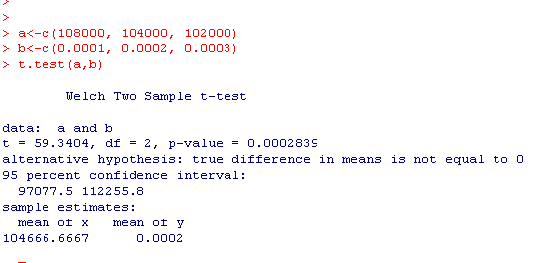
Some made up data:
The weight of three blue whales (kg) : 108000, 104000, 102000
The weight of three mice (kg): 0.0001, 0.0002, 0.0003
Null hypothesis: the weight of blue whales is the same at the weigh of mice
except for sampling error…
To use a t-test:
But this p-value is subject to the assumption of normality..

Slide 3
The Wilcoxon test. Replace each value by its rank.
Replacing an unknown distribution with a known one.
We ask.. What are the odds that we would see a separation of ranks as good
as the separation we did see..
The weight of three blue whales (kg) : 108000, 104000, 102000
The weight of three mice: 0.0001, 0.0002, 0.0003
Becomes….
The weight of three blue whales (kg) : 1,2,3
The weight of three mice: 4,5,6
We know (6,3) = 20.
We could choose 1,2,3 (with a prob. of 0.05) or 4,5,6 (with a prob. of 0.05).
Our p-value for the two-sided test is therefore .1
(or the one-sided test is 0.05)

Slide 4
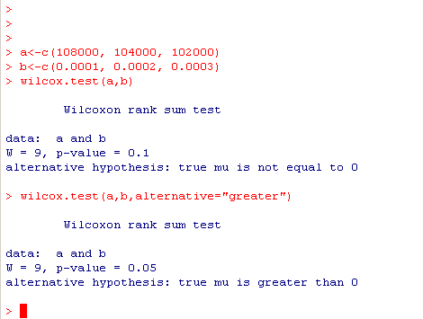
In R….

Slide 5
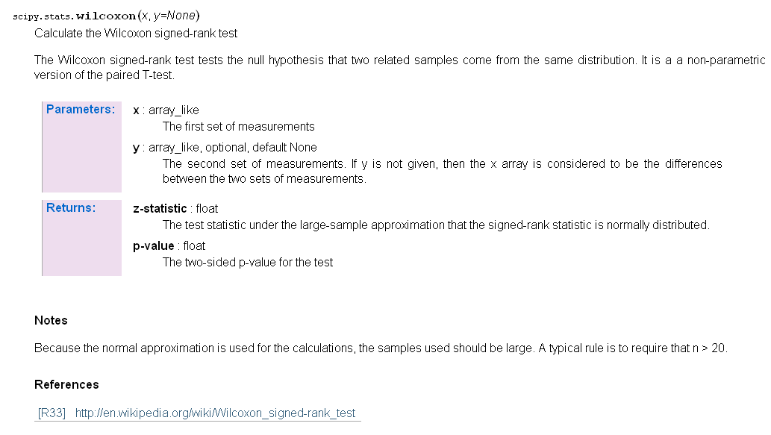
In scypy (but only for large sample sizes)

Slide 6
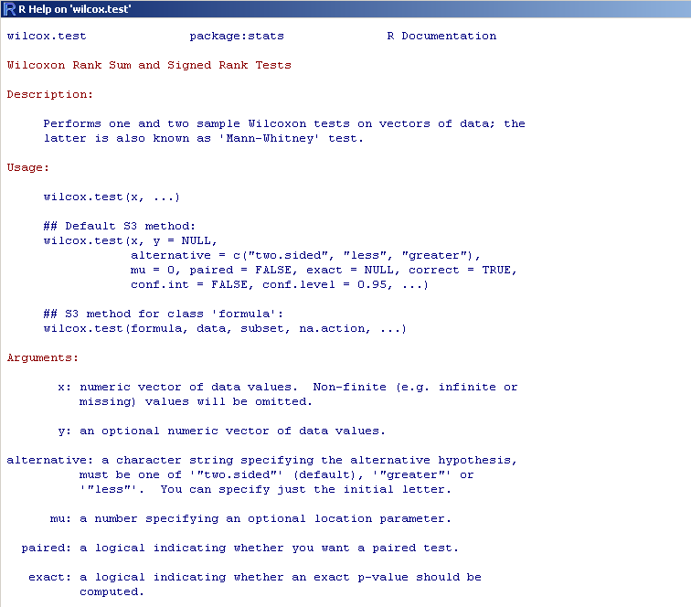
Wilcox.test has the options we have come to expect in R

Slide 7
Advantage of Wilcoxon test: No parametric assumptions!
Disadvantage: Low power for small sample sizes…
Often in genomics, we don’t have a big enough sample size to take
full advantage of the non-parametric tests..

