Slide 1
Starting on GUIs
A version of the “Double or Nothing” gui is here:
https://github.com/afodor/metagenomicsTools/blob/master/src/classExamples/gui/DoubleOrNothing.java

Slide 2
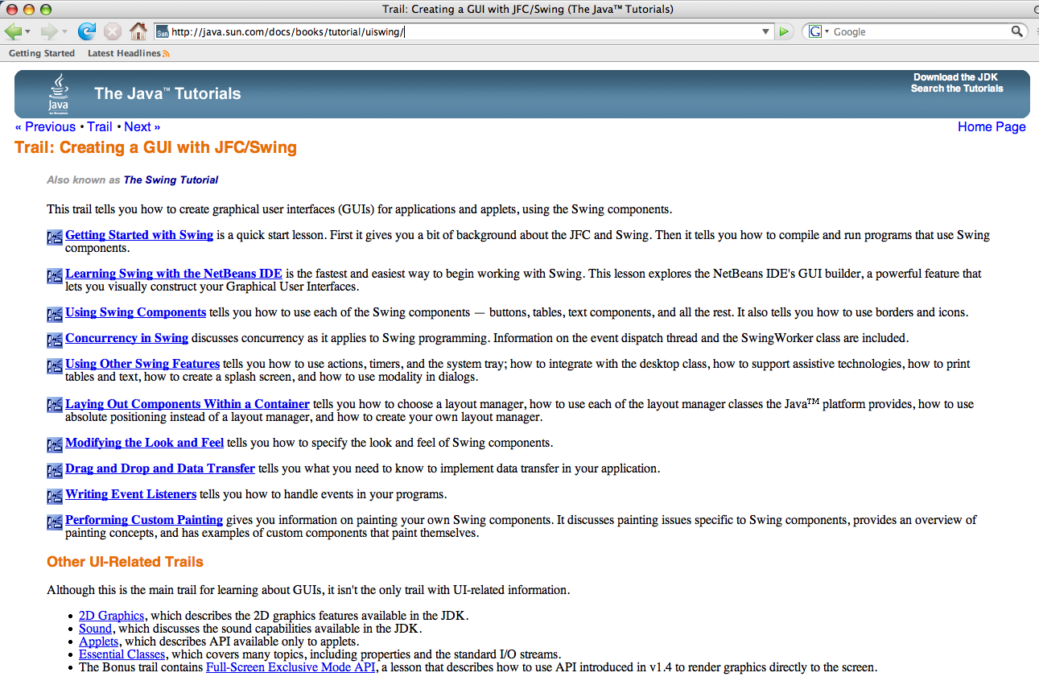
http://java.sun.com/docs/books/tutorial/uiswing/

Slide 3
A JFrame is the top GUI level to which we add stuff.
(Alternatively, if you want your program to run inside
a browser, you can use a JApplet - we won’t talk about that
this semester unless by popular demand).
(Most interactive web pages were done in Macromedia Flash
but now we havelots of fancy JavaScript tricks collectively called
AJAX (e.g. Google Maps, gmail, etc.) or with the many
capabilities in HTML5)

Slide 4
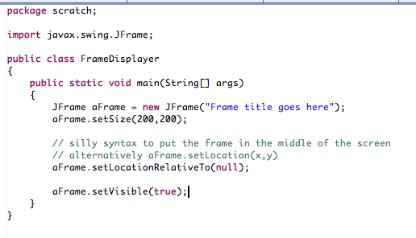

Slide 5
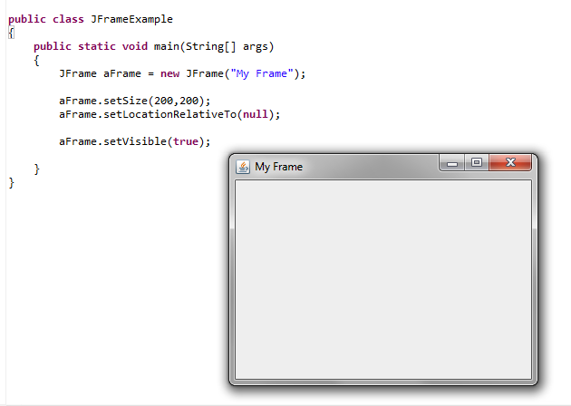
In some ways not too exciting.
But we get a lot of stuff “for free” - resizing, minimization
Minimize
Maximize
I can resize here

Slide 6
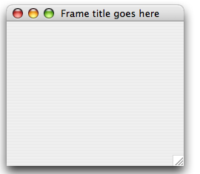

One thing we don’t exactly get for free is when we close
the Frame, the Java VM is still in memory..
The VM is still in memory, even though the Frame is not visible.

Slide 7
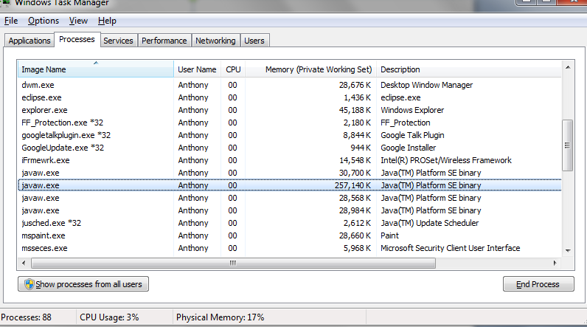
On Windows 7, the Java symbol is not in the taskbar, but
the Java processes are still hanging around in the background!
Each time I open and close a JFRAME, I lose another 30MB
of memory! Not Good!

Slide 8
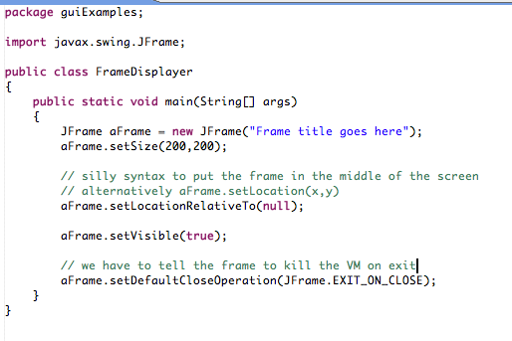
Easy to fix this problem…

Slide 9
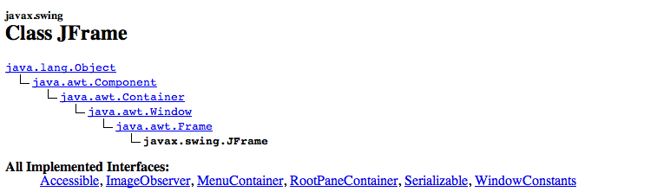
So what is a JFrame?
A JFrame is a Frame is a Window is a Container is a Component
(is a Object)
We’ll see these classes over and over again over the next few
weeks…

Slide 10
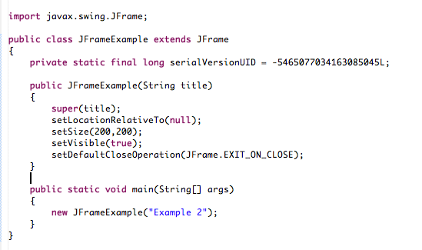
Usually, you want to extend JFrame.
We are making our own JFrame that will be our application.
Don’t worry
about this yet..

Slide 11
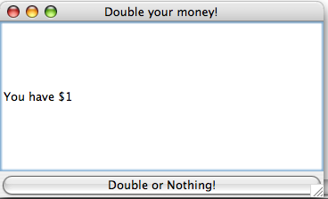
How do we add stuff to our JFrame?
Here is a (not very exciting) application.
When the user clicks the button, they will get either
double or nothing…

Slide 12
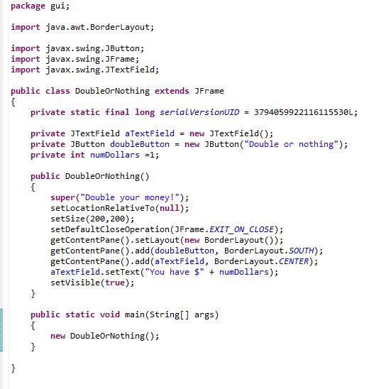
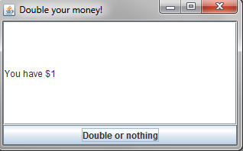

Slide 13
The first thing that we define is a “LayoutManager”.
Tells Java how we want the Components in our Frame
to be laid out in space..
There are many different LayoutManagers (and, of course,
you can make your own).
The two I use the most (and will talk about) are GridLayout
and BorderLayout

Slide 14
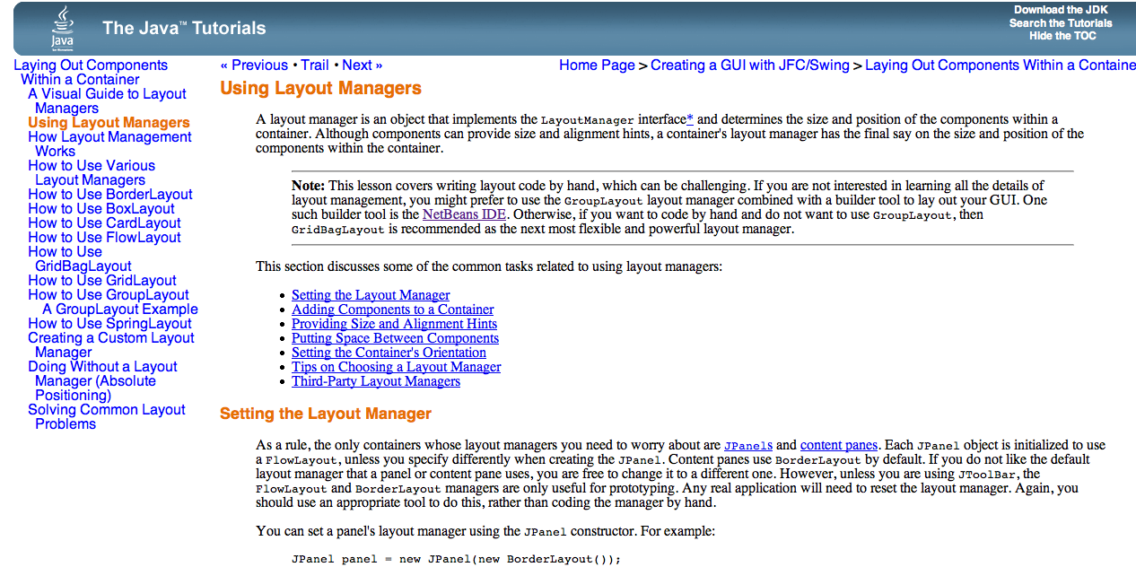
Here is the Sun tutorial…
http://java.sun.com/docs/books/tutorial/uiswing/layout/using.html

Slide 15
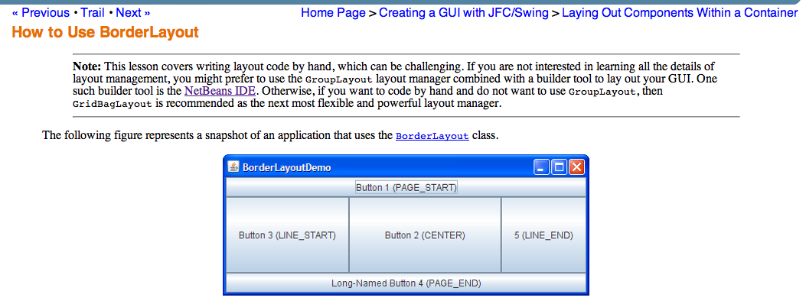
The BorderLayout class has 5 zones, which are EAST, WEST, NORTH, SOUTH and CENTER

Slide 16
We use SOUTH and CENTER in our application

Slide 17
We have a JButton that the user can click (it doesn’t yet do anything!)

Slide 18
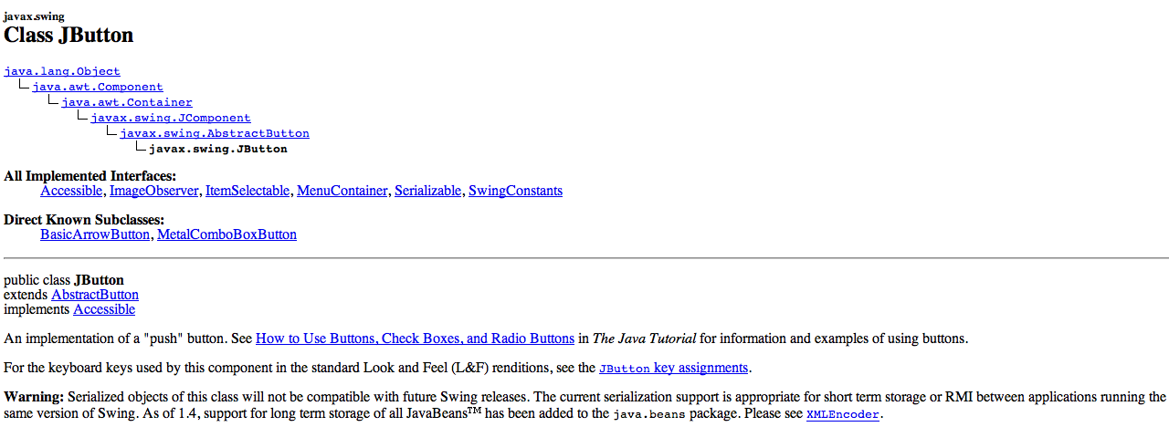
So what’s a JButton?
A JButton is an AbstractButton is a JComponent
is a Container is a Component (is an Object)
Remember that A JFrame is a Frame is a Window
is a Container is a Component (is an Object)

Slide 19
We also have a JTextField to display the results of our doubling

Slide 20
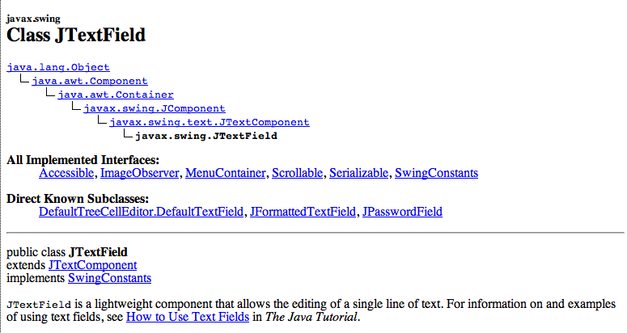
A JTextField is a JTextComonent is a JComponent
is a Container is a Component (is an Object)
A JButton is an AbstractButton is a JComponent
is a Container is a Component (is an Object)

Slide 21
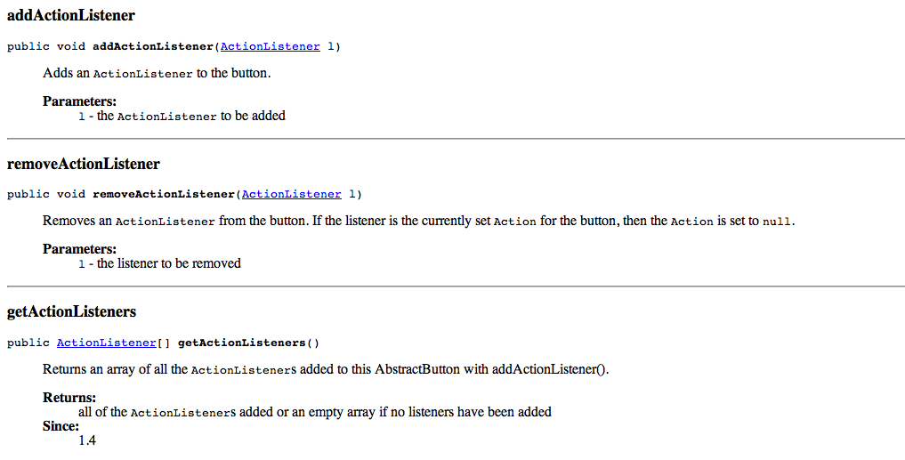
So the question in all of your minds is how do we make the
button DO something?
Answer: We add an ActionListener!
AbstractButton defines a method called addActionListener.
We pass in a class that will be notified when the button is pressed.

Slide 22

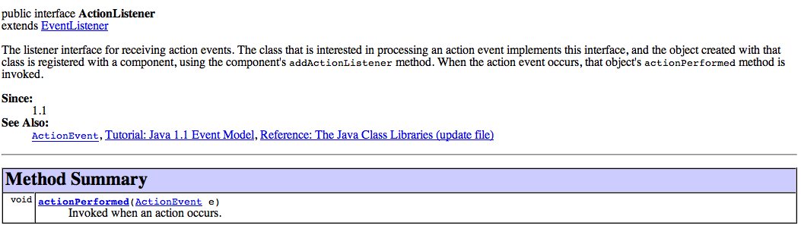
ActionListener is just an interface with a single method

Slide 23
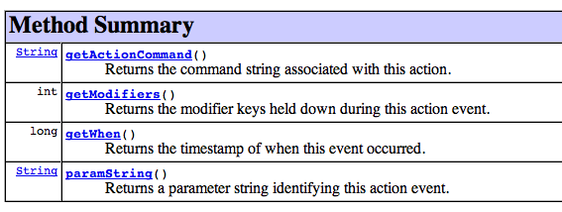
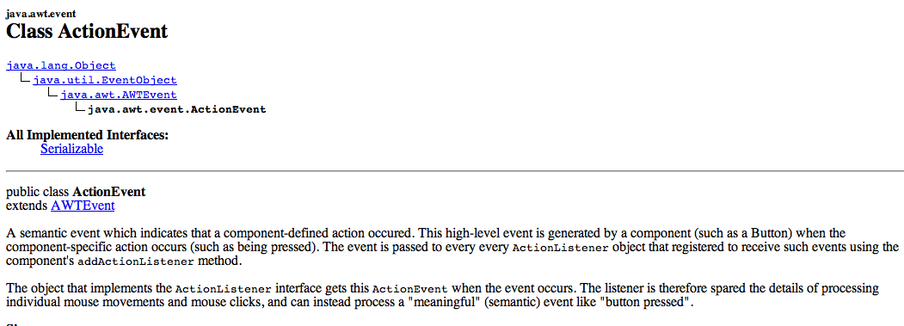
You can use the ActionEvent that Java will pass you
to find out such conditions as a modifier key (alt,shift,cntrl, etc)
being held-down.

Slide 24
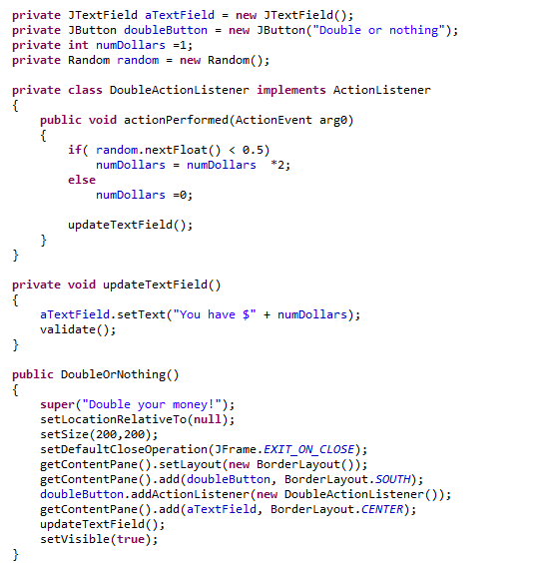
Our ActionerListner is an inner class
A helper method to update
the display
Connects the button
to its function

Slide 25
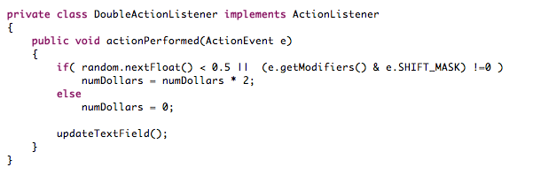
Let’s make a “cheat” mode. If you hold down the shift key,
you always win!!
A small change…
The bitwise and operator tells us if the rightmost bit
in e.getModifiers() is down, which corresponds to shift
being pressed.

Slide 26
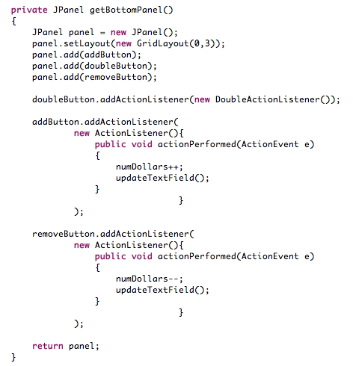
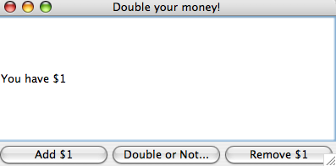
Let’s make things a little bit more complicated.
This method creates the buttom panel
GridLayout
Anonymous ActionListeners!
Add some graphics, you have a video slot machine!

Slide 27
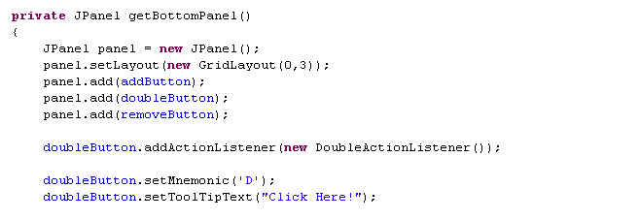
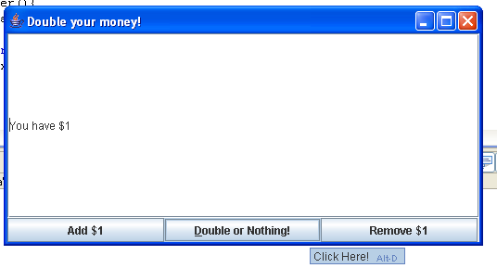
Java lets you do a lot of useful stuff “for free”
Keyboard shortcut
Hover text

Slide 28
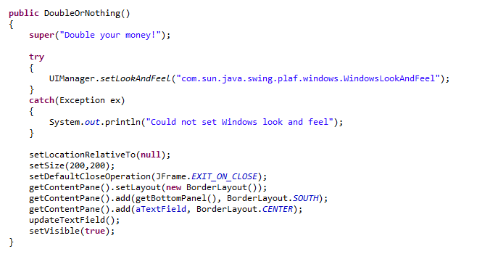
You can change the “Look and Feel” from the default metal
Set look and feel

Slide 29
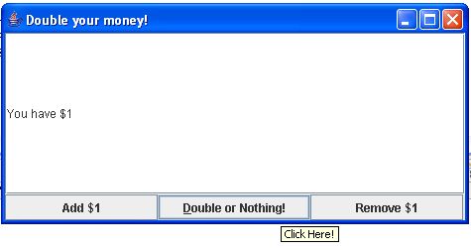
Metal (default)
Windows
Because of IP issues, you can only get the Windows look and
feel on Windows.

Slide 30
Coming up: Our first threads…

