Slide 1
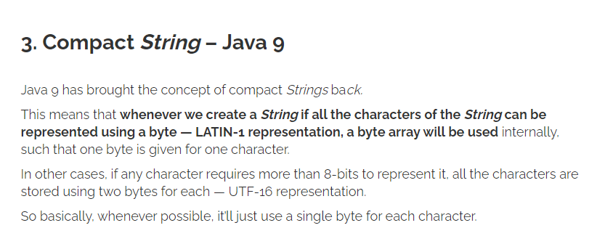
If you know a sequence will only have A,C,G and T, Strings are memory inefficient…
When you write String s = “ACGT”
Java (before Java 9 ) represents this as 4 characters (so 16 bits * 4 = 64 bits )
after Java 9 this gets represented as 4 bytes (so 8 bits * 4 = 32)
https://www.baeldung.com/java-9-compact-string
A = 00
C = 01
G = 10
T = 11
But we could represent this in 8 bits
We make a code..
Then “ACGT” becomes “00011011”
We could store this in a byte or in half of a character.
So we could use a single “char” to represent an 8-mer…

Slide 2
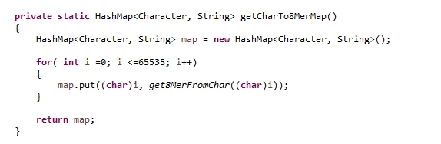
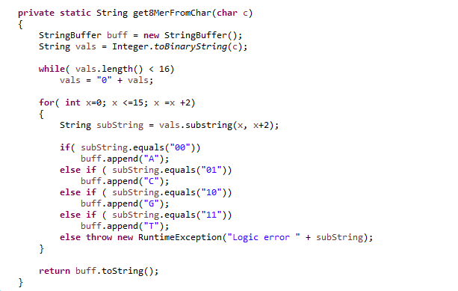


If we use the “char” type to hold our code…
There 16 bits in a Character, so each single character can hold 8 nucleotides of {A,C,G or T}
There are 65,536 (=2^16) possible characters.
We can assign an 8-mer to each of these possible
characters
https://github.com/afodor/metagenomicsTools/blob/master/src/compress/EncodeACGT.java

Slide 3
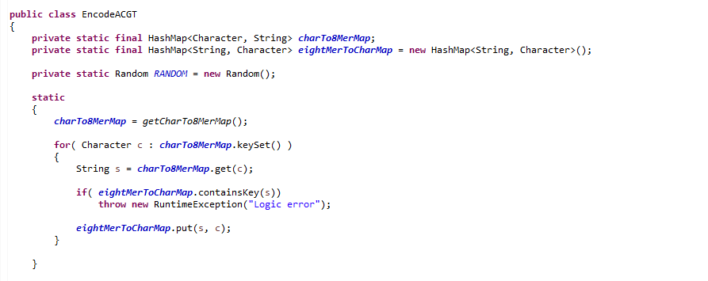
We define a static constructor to store the 8-mer map (and a reverse map for decoding)
https://github.com/afodor/metagenomicsTools/blob/master/src/compress/EncodeACGT.java

Slide 4
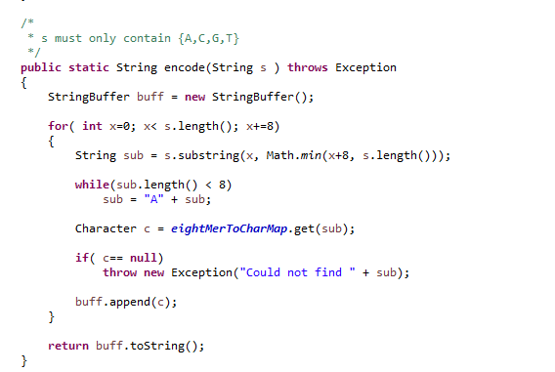


We can then encode an ACGT string by breaking it into 8-mers
(and if the String length is not divisible by 8, we pad it with “A” )
We can get up to a factor of 8 data compression (which will be a factor of 4 in memory since we are forcing Java to use 16 bit chars for the String )
https://github.com/afodor/metagenomicsTools/blob/master/src/compress/EncodeACGT.java

Slide 5
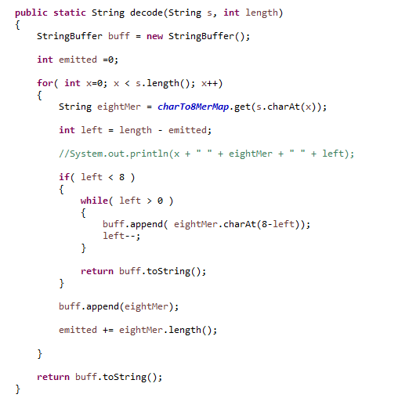
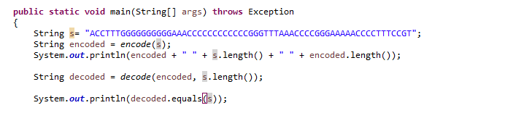

Decoding is straight-forward ( but the user has to know the length of the original string
because we don’t include an “end” character in our simple 2 bit code)
We ignore the padded “A”’s in
our last 8-mer

Slide 6
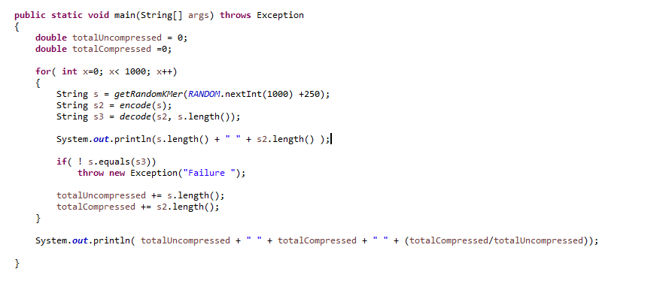
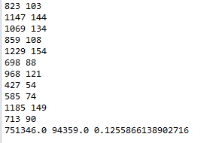
Here is a more thorough test case…
https://github.com/afodor/metagenomicsTools/blob/master/src/compress/EncodeACGT.java

Slide 7
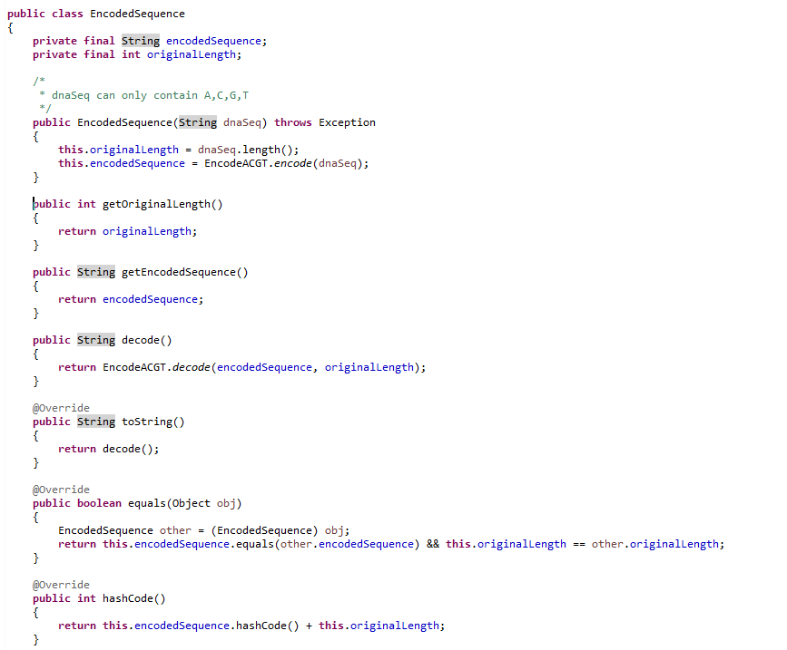
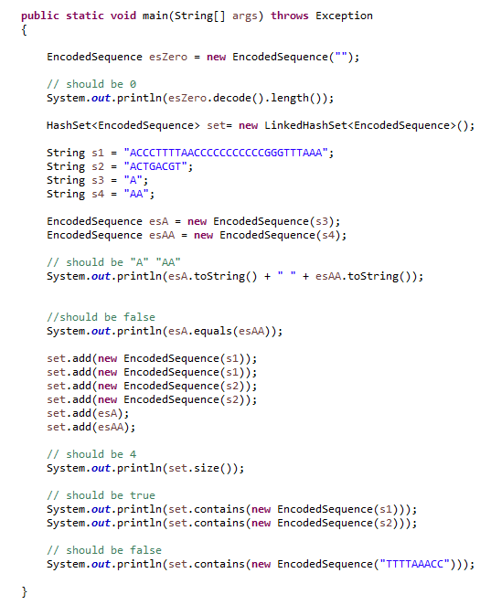
We can make a class that will manage the length of the original sequence for the user…
.equals and .hashCode return the state of the encoded sequence; toString() decodes
https://github.com/afodor/metagenomicsTools/blob/master/src/compress/EncodedSequence.java

Slide 8
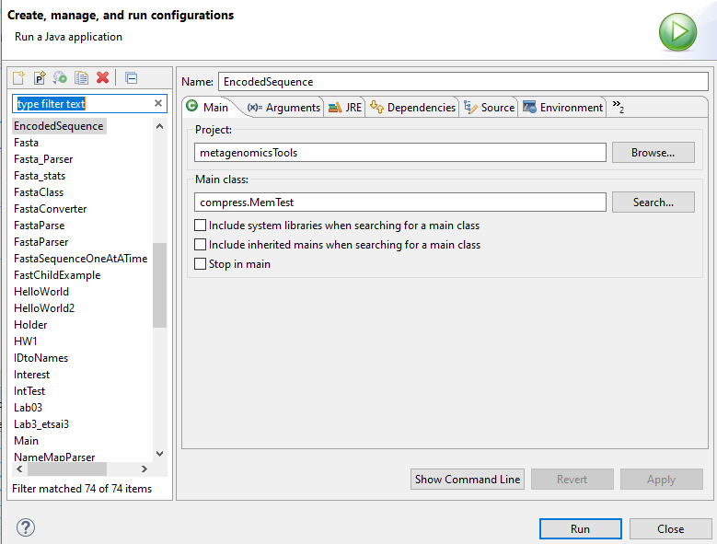
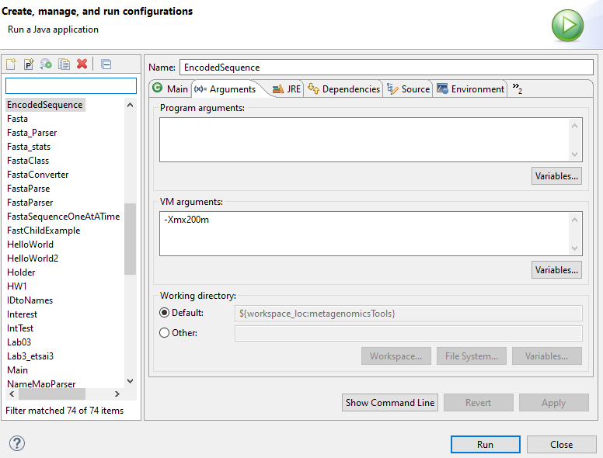
From Eclipse, we do Run -> Run Configurations to set the heap space to 0.2G for our virtual machine

Slide 9
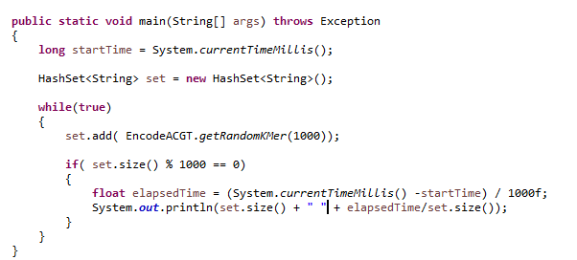
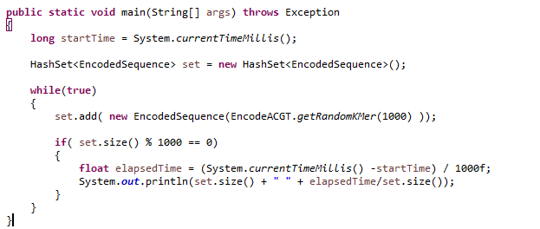
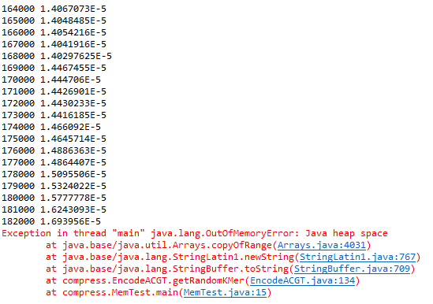
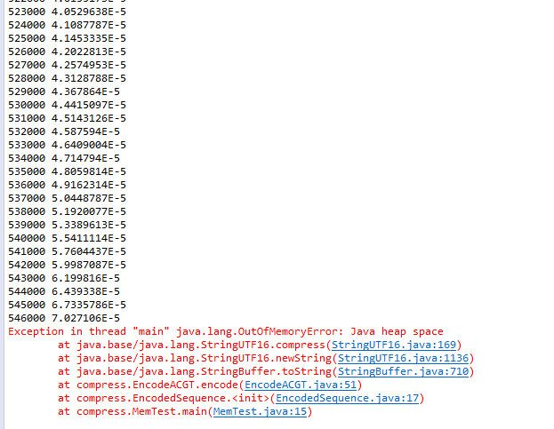
In this test, our Encoded Sequence allows us to hold ~3X more sequences
(but the we do pay a cost in run-time for the encoding)
https://github.com/afodor/metagenomicsTools/blob/master/src/compress/MemTest.java

Slide 10
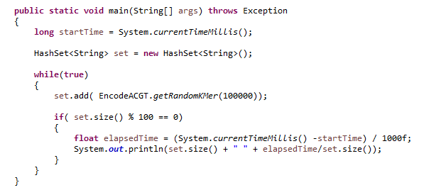
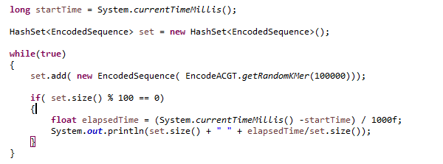
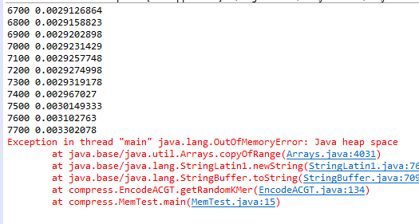
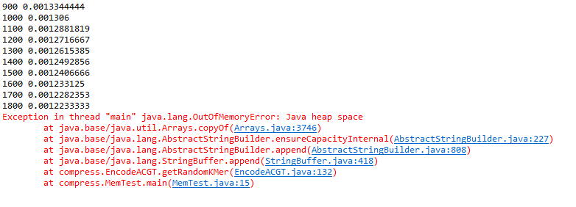
Changing the parameters of our load test changes the benefit; here we get ~4 fold increase in the # of sequences we can hold

