Slide 1
ROC curves in WEKA
Visually estimating variance via null permutations
Comparing classifiers

Slide 2
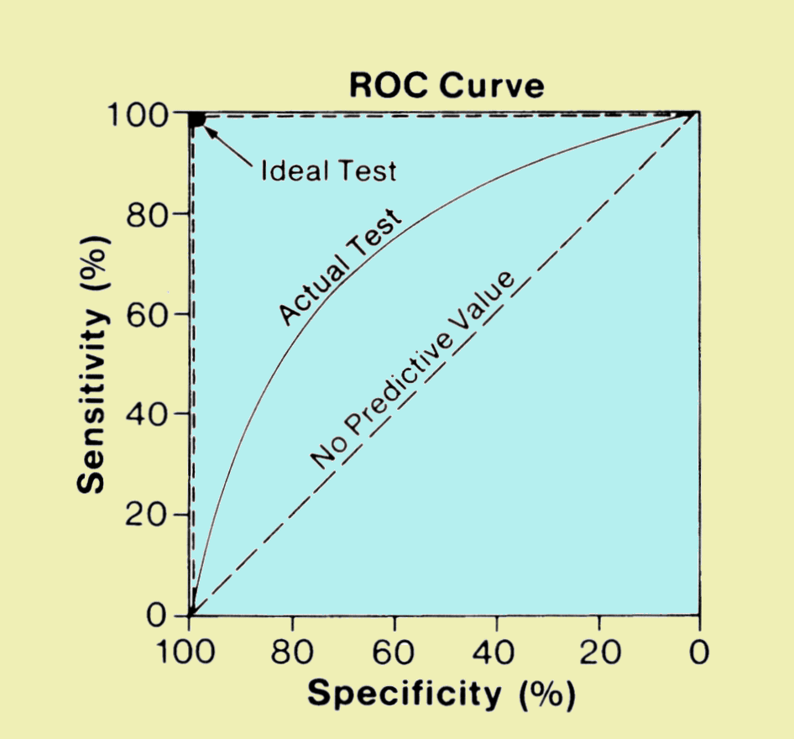
An ROC curve is a efficient visualization to observe classification performance
The “big data” approach to classification problems
Is a voter democratic or republican?
Voters with known affiliation
Training set
Test set
Find features
(income, zip code, gender)
that predict affiliation
Build statistical model
Make predictions on test set
Image: http://www.sprawls.org/ppmi2/IMGCHAR/1IMCHAR12.gif

Slide 3
The “big data” approach to classification problems
Is a sample case or control?
Whole-genome metagenome sequencing
on samples with known disease status
Training set
Test set
Find features
(taxa, genes)
that predict status
Build statistical model
Make predictions on test set
Image: http://www.sprawls.org/ppmi2/IMGCHAR/1IMCHAR12.gif

Slide 4
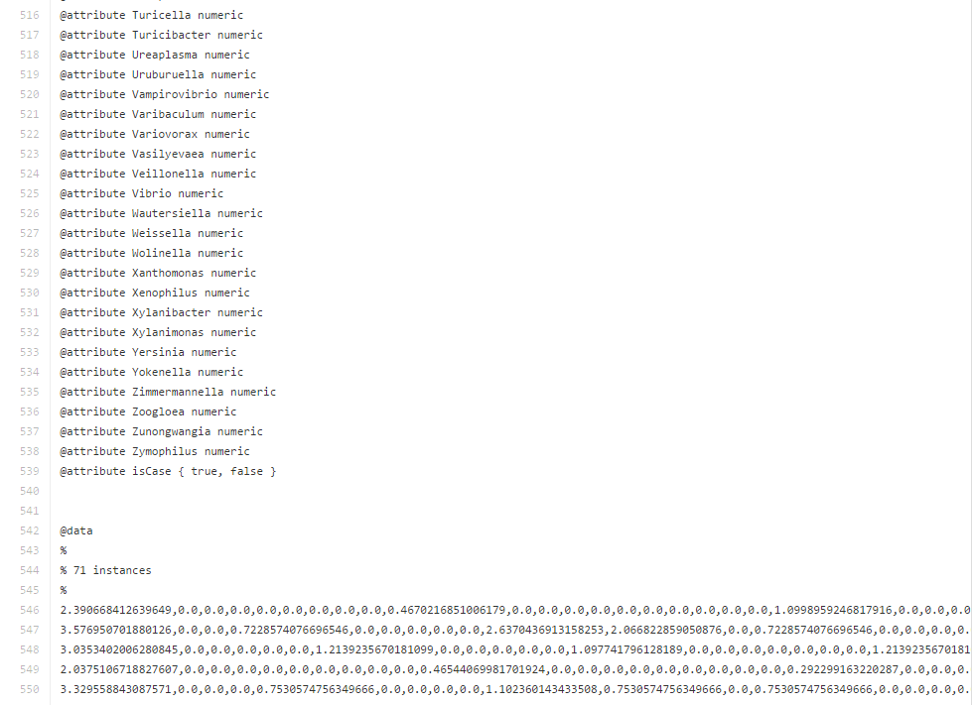
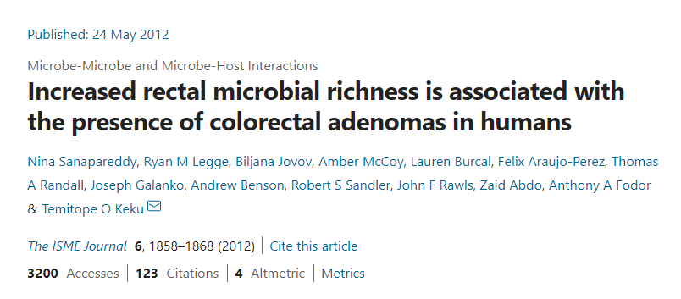
Our data file contains data from 71 patients…
https://github.com/afodor/afodor.github.io/blob/master/classes/prog2016/pivoted_genusLogNormalWithMetadata.arff
Data are described in this paper:
genera from PCR experiment
Patient did or did not have colorectal adenomas

Slide 5
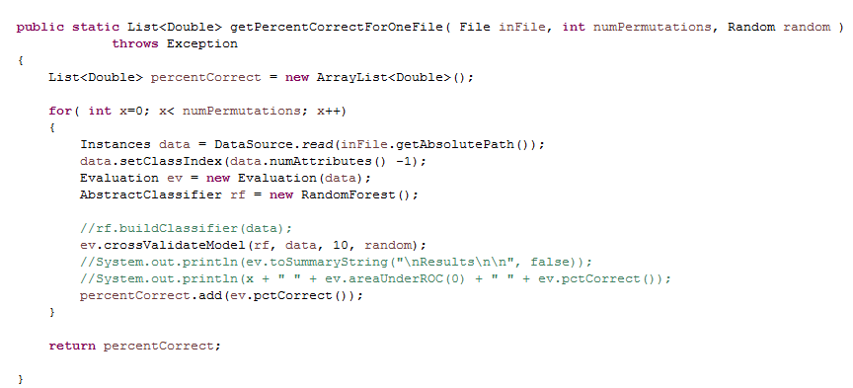
This code performs 10-fold cross validation…
Random Forest is one of many classifiers
This is a great
Example of
OO abstraction
https://github.com/afodor/WekaExamples/blob/master/src/examples/TestClassify.java

Slide 6
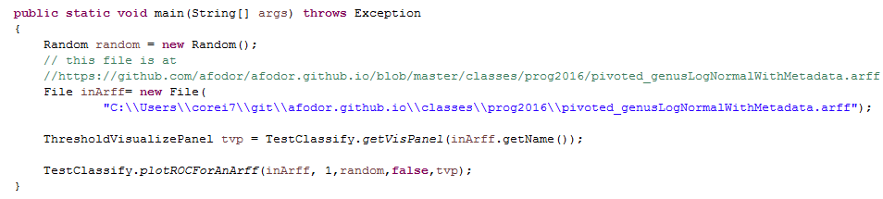
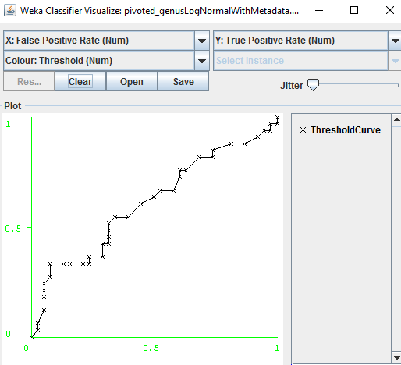
We can easily visualize the ROC code associated with this ten-fold cross validation
https://github.com/afodor/WekaExamples/blob/master/src/examples/RunOneROCCurve.java

Slide 7
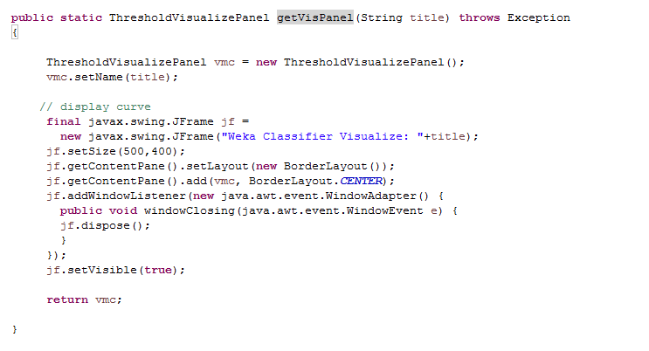
Our initial method just creates a “ThresholdVisualizePanel” and returns it…
(this won’t make a lot of sense till we get to GUIs later..)
https://github.com/afodor/WekaExamples/blob/master/src/examples/TestClassify.java

Slide 8
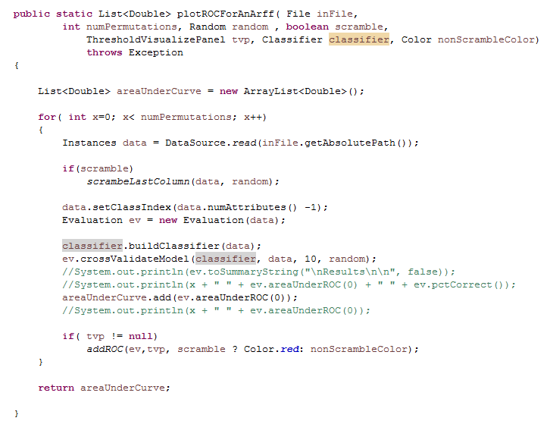
This method proceeds as before, building a classifier and testing it via ten-fold cross-validation
but we add a line for visualization
https://github.com/afodor/WekaExamples/blob/master/src/examples/TestClassify.java

Slide 9
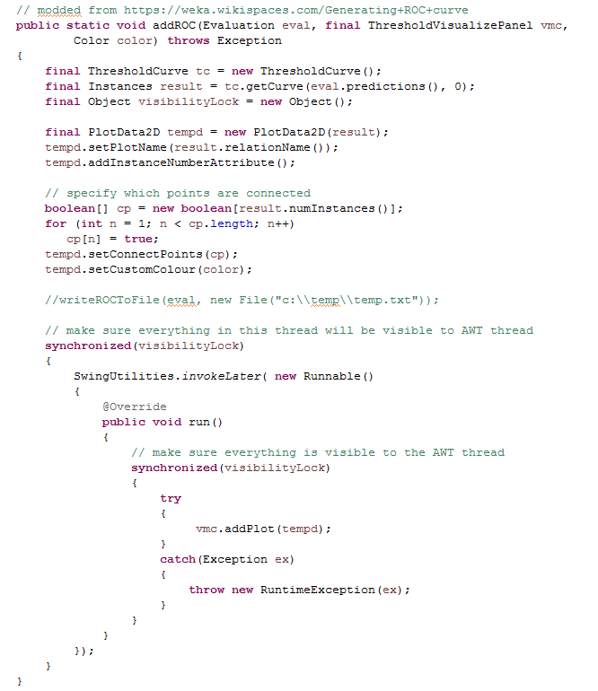
This code does the calculations of true positive and
true negative
All of the helper classes are stack confined,
but do not make visibility guarantees
(this is thread stuff we will talk about later)
Force visibility to any other thread that grabs this lock
Make sure AWT thread has full visibility
Actually write the plot; should happen on AWT thread
This won’t make sense to we talk about GUIs and multi-threaded code later
https://github.com/afodor/WekaExamples/blob/master/src/examples/TestClassify.java

Slide 10
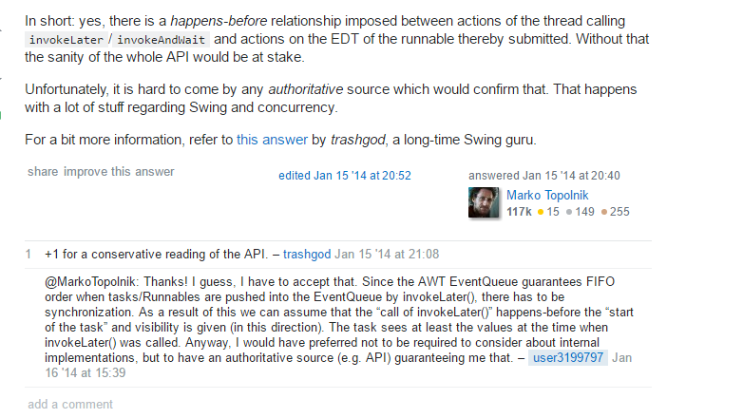
Do I need to manually force the visibility?
Probably not, but the documentation is a bit unclear, so better safe than sorry.
(It is a very small performance hit to grab the lock twice….)
http://stackoverflow.com/questions/21147240/is-happens-before-relation-given-in-case-of-invokelater-or-invokeandwait

Slide 11
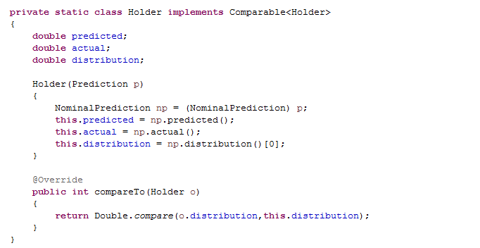
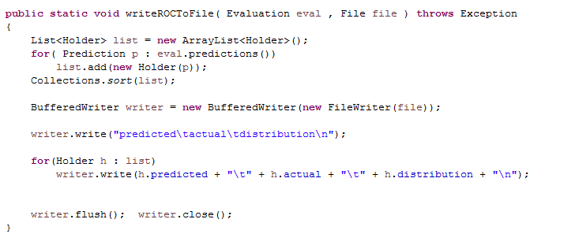
We can easily write out the ROC data to a file if we want to use an alternative visualization
or analysis platform….
https://github.com/afodor/WekaExamples/blob/master/src/examples/TestClassify.java

Slide 12
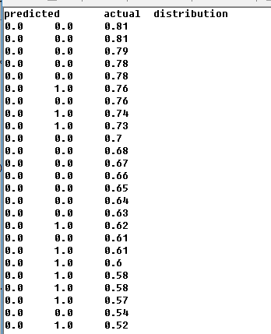
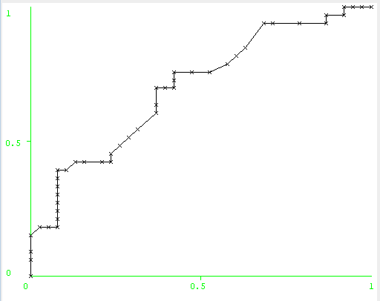
The “distribution” variable shows how much confidence the predictor has in each prediction and is
used to order the ROC curve

Slide 13
ROC curves in WEKA
Visually estimating variance via null permutations
Comparing classifiers

Slide 14
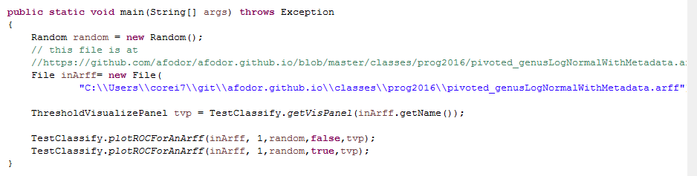
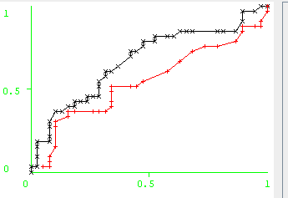
We can compare our “true” classification to
a classification with the case/control labels scrambled
https://github.com/afodor/WekaExamples/blob/master/src/examples/RunOneROCCurve.java

Slide 15
Our data gets scrambled
Our color turns red
https://github.com/afodor/WekaExamples/blob/master/src/examples/TestClassify.java

Slide 16
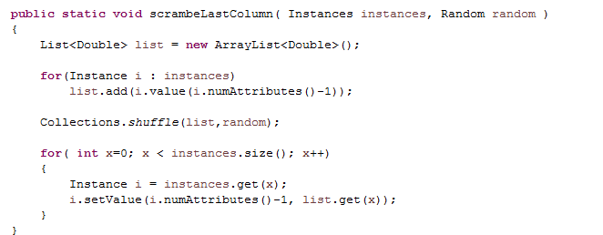
Scrambling the columns is trivial…
https://github.com/afodor/WekaExamples/blob/master/src/examples/TestClassify.java

Slide 17
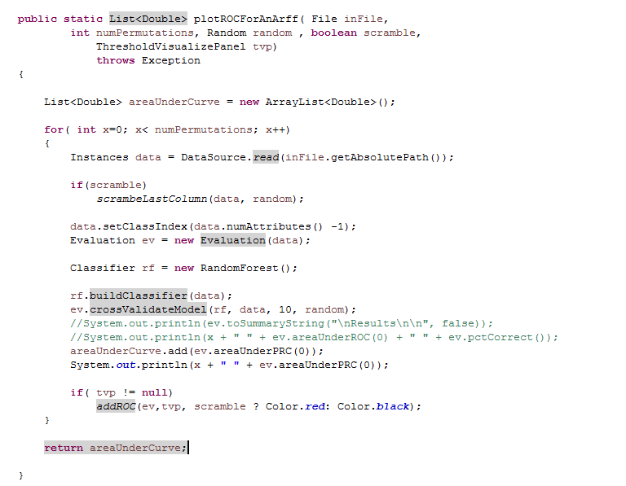
We can easily do this for multiple permutations…
https://github.com/afodor/WekaExamples/blob/master/src/examples/TestClassify.java

Slide 18
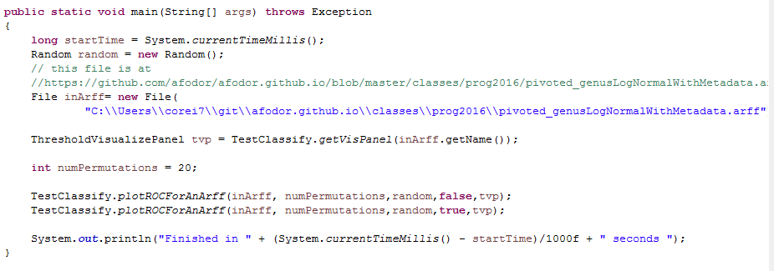
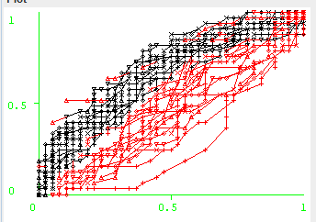
This makes a very compelling and informative visualization (here for 20 permutations)
https://github.com/afodor/WekaExamples/blob/master/src/examples/RunOneROCCurve.java
Commit comment: Do 20 permuations

Slide 19
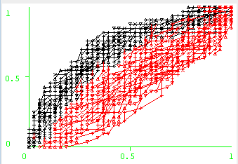
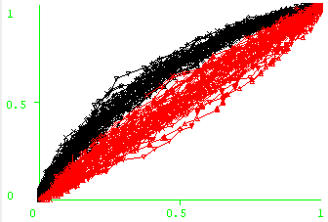
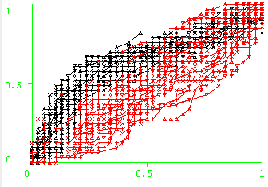
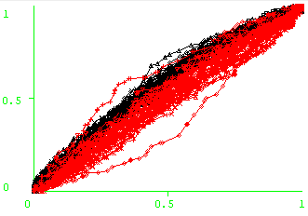
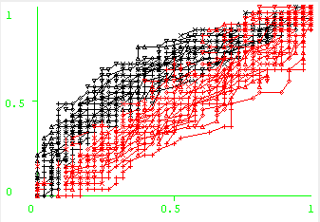
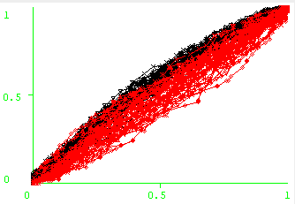
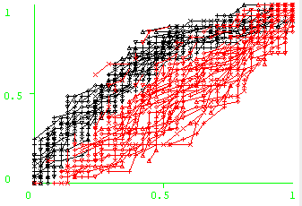
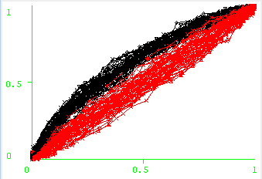
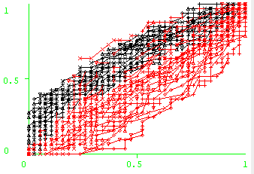
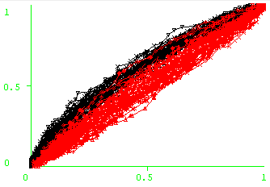
Comparison of two 16S microbiome datasets for colorectal adenomas from my lab…
2012
2015
2012
2015
phylum
family
class
genus
order

Slide 20
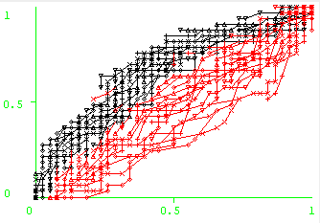

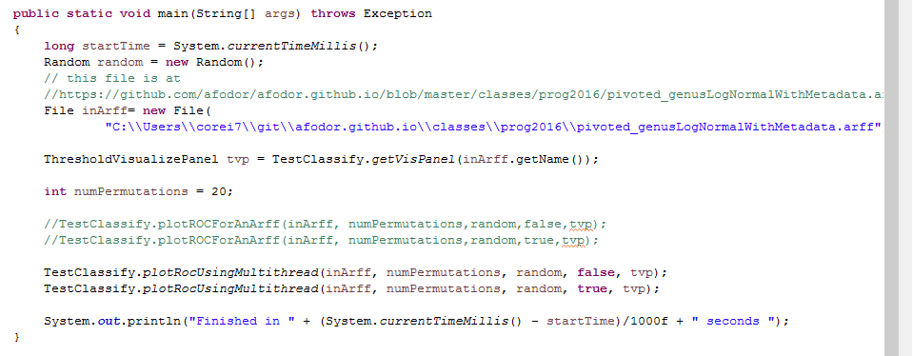
Multi-threaded application seems straight-forward…
A very robust 7.87 fold speedup on an 8 core box!
(but more on that later; we will return to how we did the speed up
after we review multi-threading)

Slide 21
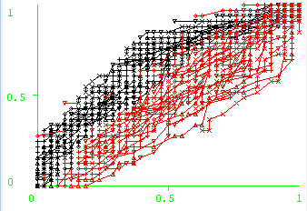
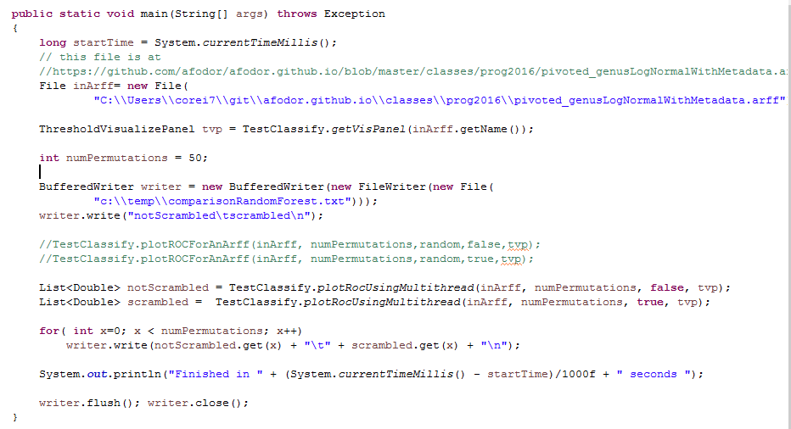

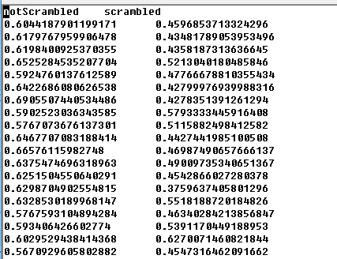
We can ask, does scrambled do worse than not scrambled to a statistically significant degree?
Increase our permutations

Slide 22
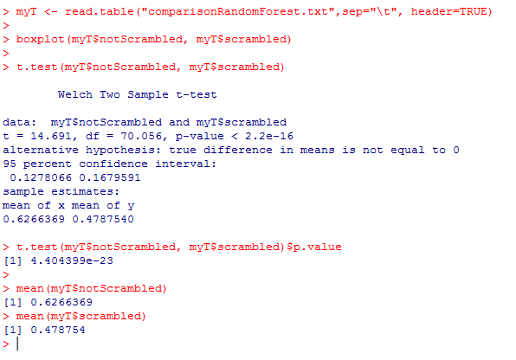
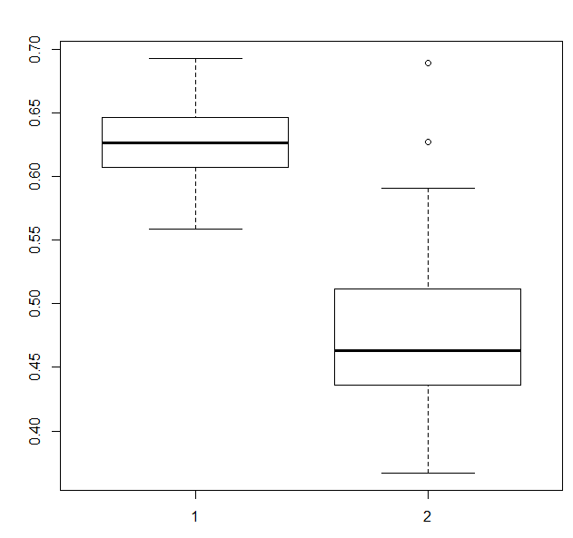
We switch to R for the visualization and the statistical test
On the hand, our predictor has modest power
(mean AUC = 0.63)
On the other hand, clearly better than shuffling
labels!

Slide 23
ROC curves in WEKA
Visually estimating variance via null permutations
Comparing classifiers

Slide 24
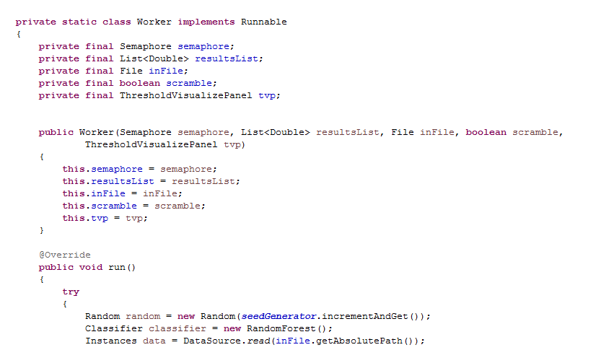
We’d like to be able to pass in a Classifier to our Worker, but we don’t want our workers to
share a Classifier object (as that would violate thread safety on mutable objects)
We can solve this problem by using Java’s ability to dynamically control which class is instantiated…

Slide 25
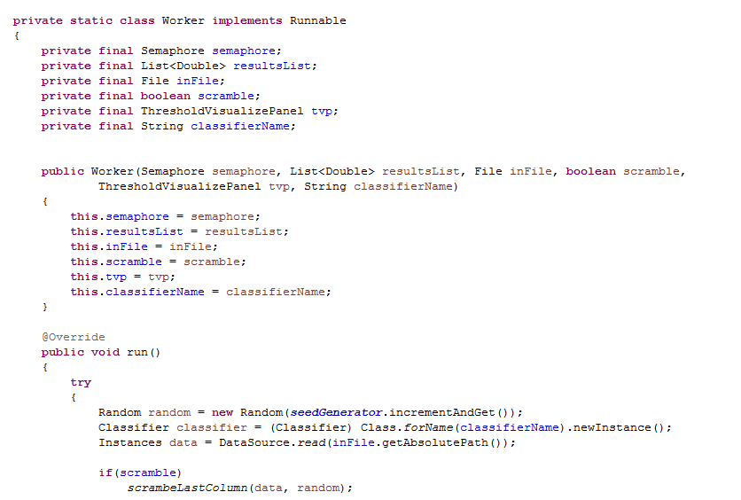
We can tell the Worker at run time which classifier to instantiate…
(This will, of course, throw a runtime Exception if classifierName does not name a valid Classifier with
a default constructor…)
https://github.com/afodor/WekaExamples/blob/master/src/examples/TestClassify.java

Slide 26
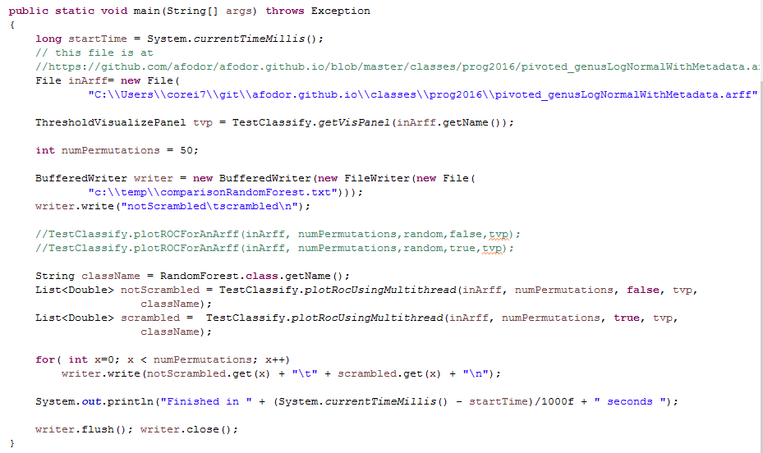
We can get the classifier name from the class itself

Slide 27
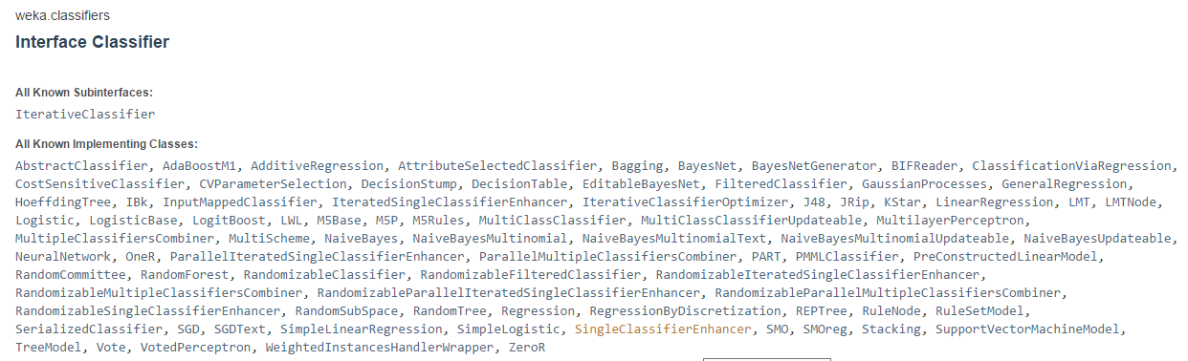
This allows us to use all of the classifiers that are implemented in Weka…
http://weka.sourceforge.net/doc.dev/weka/classifiers/Classifier.html

Slide 28
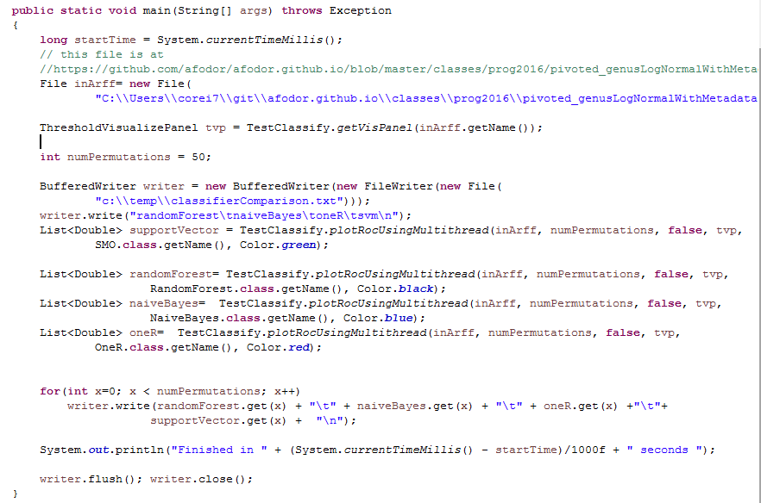
We can now directly compare classifiers (we modify the worker to pass in the color as well as the classifier)
https://github.com/afodor/WekaExamples/blob/master/src/examples/CompareClassifiers.java

Slide 29
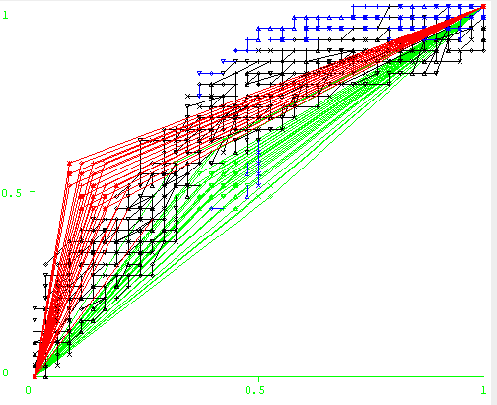
We can look at the ROC curves for a visual comparison…

Slide 30

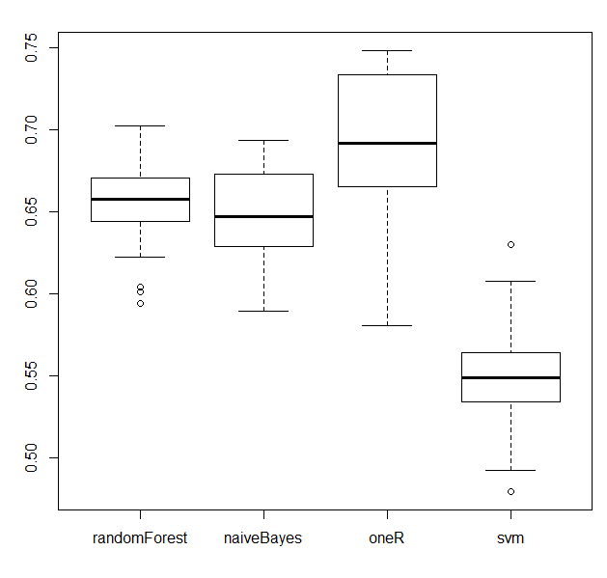
It has been noted many times in the literature, RandomForest works best for microbiome data…
Here the “OneR” algorithm does well…

Slide 31
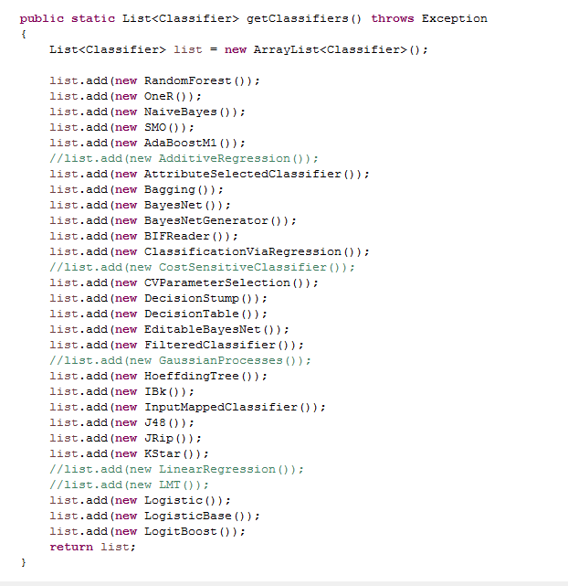
We can easily expand our classifier pool (commented out classifiers don’t work on binary data or don’t have
Default constructors/parameter sets or otherwise threw an Exception…)
Great use of OO abstraction
Each classifier classifies in its own way, but our
code works at an abstract level to interact with many different
Classifiers.
(I got as far as L….)
https://github.com/afodor/WekaExamples/blob/master/src/metaMergers/RunAllClassifiersVsAllDataLocal.java

Slide 32
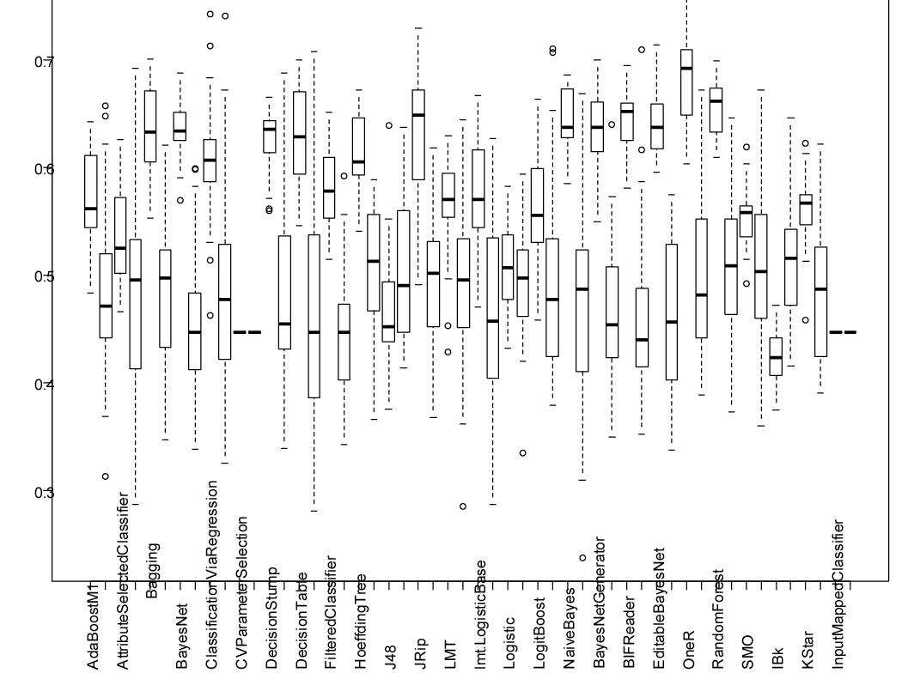
On our adenomas dataset at the genus level, OneR does well…
https://github.com/afodor/WekaExamples/blob/master/src/metaMergers/plotAllVsAll.txt

Slide 33
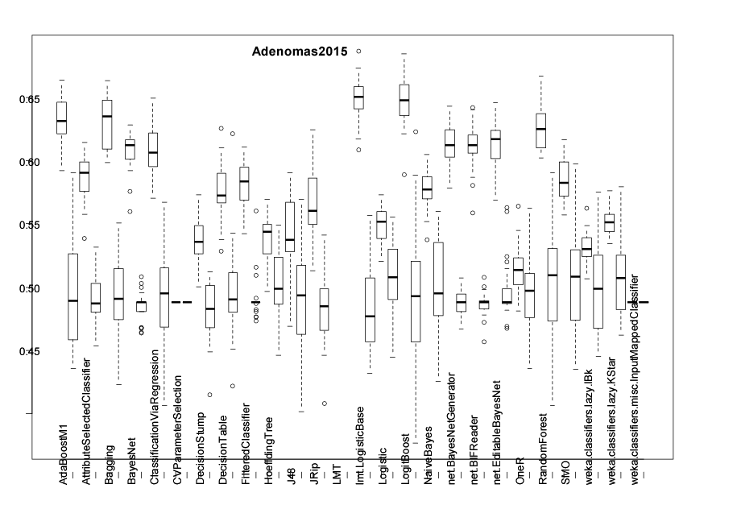
But RandomForest is more reliable across other datasets…

Slide 34
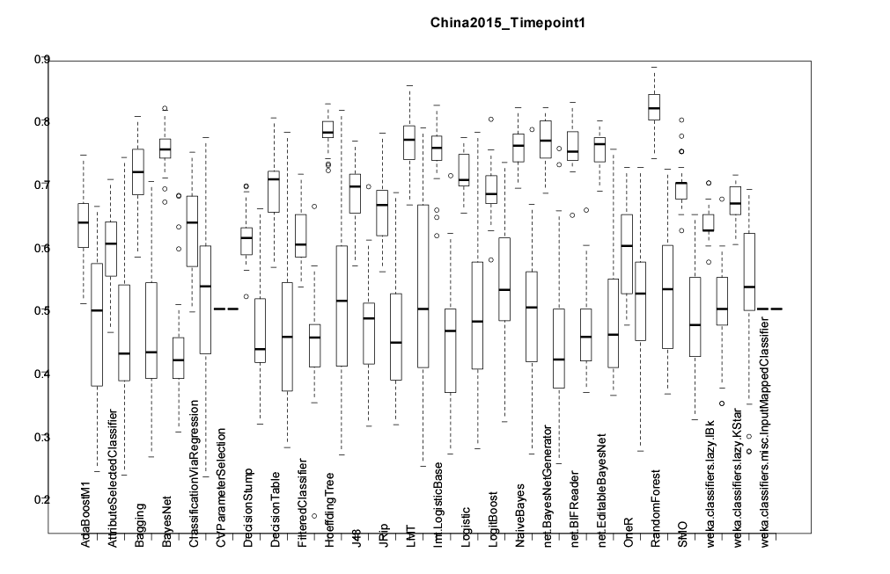

Slide 35
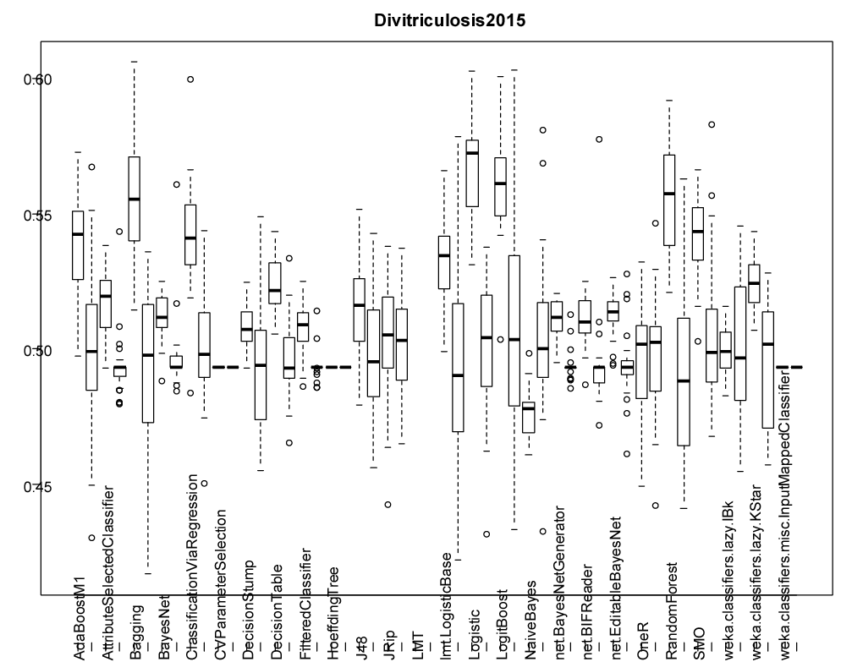
Models that have the words “boosting” or “Bagging” take a weighted average across many classifiers
(Random Forest does this as well).
This is often a good strategy for genomic (and metagenomics data)

Slide 36
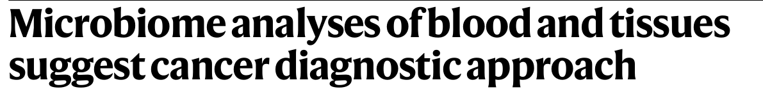

ROC curves are at the heart of the retracted paper…
https://www.nature.com/articles/s41586-020-2095-1
This paper claims close to perfect ability to
discriminate different kinds of cancers

Slide 37


This paper argued for a major
flaw in the normalization
scheme…
https://journals.asm.org/doi/10.1128/mbio.01607-23

Slide 38

https://www.nature.com/articles/s41388-024-02974-w
This paper responded that the original analysis was, despite flaws, correct.
You can access the data in the supplementary materials.
Can you design an analysis to determine who is right? Possible independent project idea.
(You can use ChatGPT to generate Java or R code to run machine learning algorithms and produce ROC curves
if you don’t want to use WEKA!)s

