Slide 1
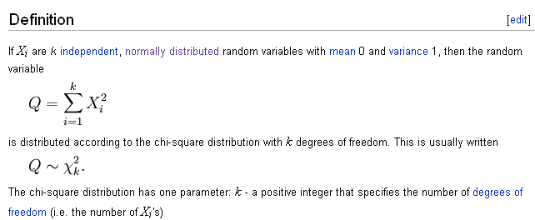
The chi-square distribution
http://en.wikipedia.org/wiki/Chi-square_distribution

Slide 2
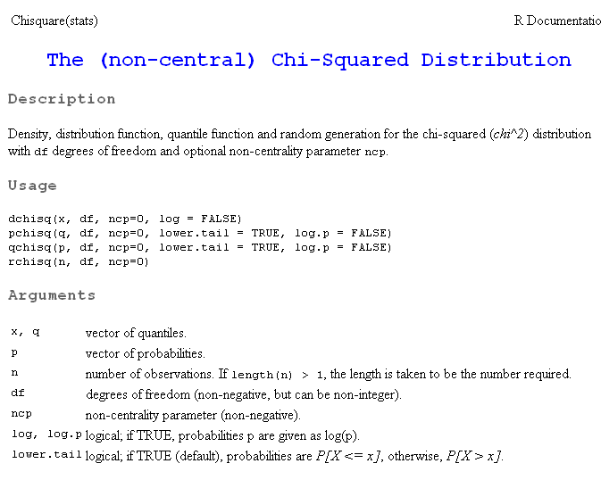
As usual. We have dchisq, pchisq, qchisq amd rchisq

Slide 3
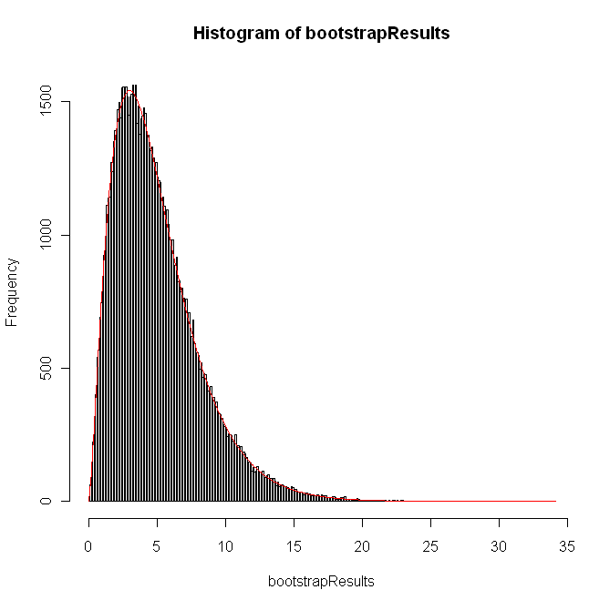
Comparing the bootstrap results to theory in R for the chi-square sum with k=5
rm(list=ls())
numTrials =10000;
s <- seq(1,numTrials)
bootstrapResults <- vector()
for( i in s)
{
chiSquareSum = 0
sampleSize <- 5
for( j in 1: sampleSize)
{
normVal= rnorm(1)
chiSquareSum = chiSquareSum + normVal * normVal
}
bootstrapResults[i] <- chiSquareSum;
}
lowerBound = min(bootstrapResults)-0.2
lowerBound = max(lowerBound,0)
histBreaks <- seq(lowerBound,max(bootstrapResults)+0.2,0.1)
hist(bootstrapResults,breaks=histBreaks)
theoryResults <- dchisq(histBreaks,sampleSize)
theoryResults = theoryResults * numTrials / sum(theoryResults);
lines(histBreaks, theoryResults, col="red")

Slide 4
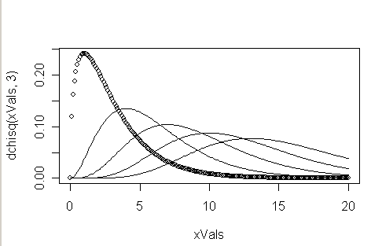
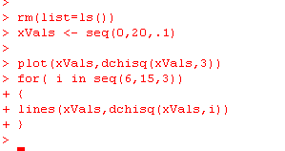
We can easily visualize chi-square distributions for different values…
3
6
9
12
15

Slide 5
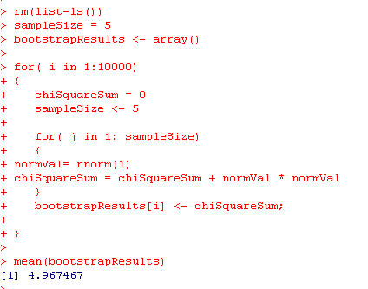
The average value of Q is K….

Slide 6
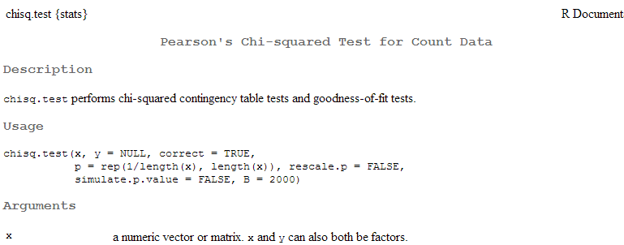
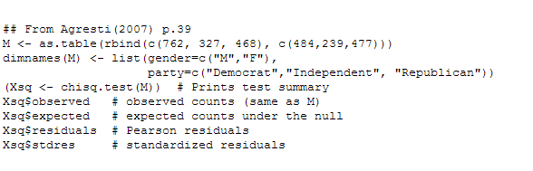
The Pearson’s chi-squared test is a very elegant test that is built on the chi-square distribution

Slide 7
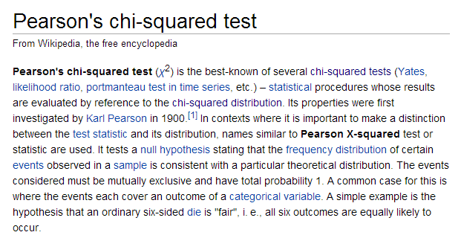
The Wiki has a nice write-up (as usual)
http://en.wikipedia.org/wiki/Pearson%27s_chi-squared_test

Slide 8
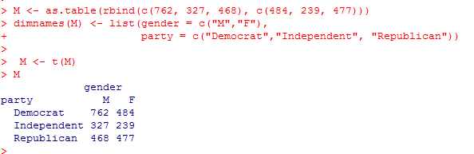
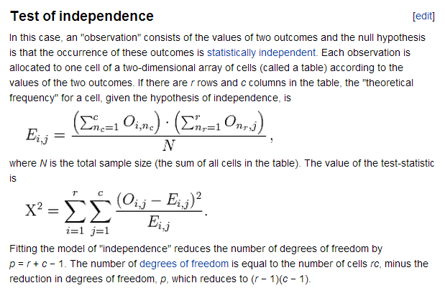
Let’s take an example from the R documentation for chisq.test
Is party registration independent of gender?
Doesn’t
matter which
are the rows
and which
are the columns
The basic idea is that the expected values are based only on the row
and column sums..
http://en.wikipedia.org/wiki/Pearson%27s_chi-squared_test

Slide 9
To see the justification for the expected values, consider a 2 * 2 table
All democrats
 | Male | Female
Dem | 40 | 80 | 120
Rep | 100 | 50 | 150
 | 140 | 130
All republicans
All males
All females
p(dem) = 120/270
p(rep ) = 150/270
p(male) = 140/270
p(female) = 130/270
If party and gender were independent, then:
p(Dem, Male) = p(Dem) * p(Male) = (120/270) * (140/270) = 0.230
p(Dem, Female) = p(Dem) * p(Female) = (120/270) * (130/270) = 0.213
p(Rep, Male) = p(Rep) * p(Male) = (150/270) * (140/270) = 0.288
p(Rep, Female) = p(Rep) * p(Female) = (150/270) * (130/270) = 0.267
To get the expected # of voters, multiply those probabilities by N
(the total number of voters)

Slide 10
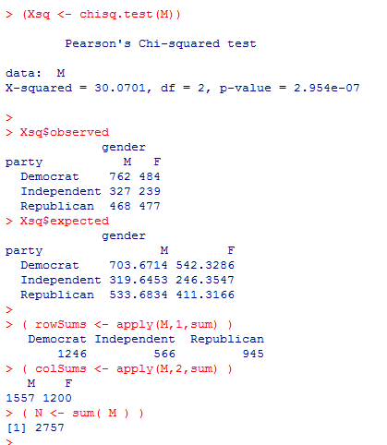
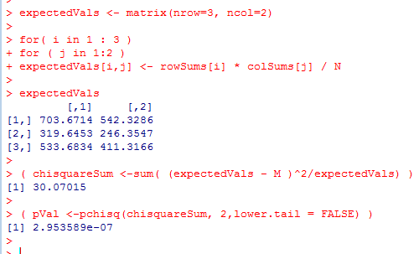
It is easy to implement the Chi-square test…
(or we can just use chisq.test() ) .
This tests that that the two categories are
independent
Using R’s built-in chi-square test
Our own quick implementation

Slide 11
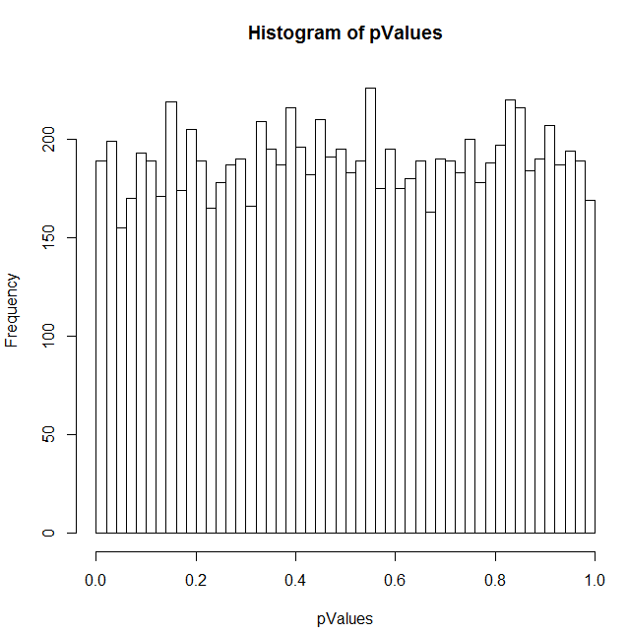
Here is a sanity test that independent assignments of categories produces uniform p-values….
rm(list=ls())
sampleSize <- 1000
numPermutations <- 10000
numColumns <- 4
numRows <- 3
pValues <- vector()
rowIndices <- 1:numRows
colIndices <- 1:numColumns
for( i in 1 : numPermutations )
{
myTable <- matrix(0,nrow=numRows, ncol = numColumns );
    for( j in 1 : sampleSize )
    {
    aRowIndex <- sample( rowIndices,1 )
    aColIndex <- sample( colIndices,1)
    myTable[aRowIndex,aColIndex] = myTable[aRowIndex,aColIndex] + 1
    }
pValues[i] <- chisq.test(myTable)$p.value
hist(pValues,breaks=50)
}

Slide 12
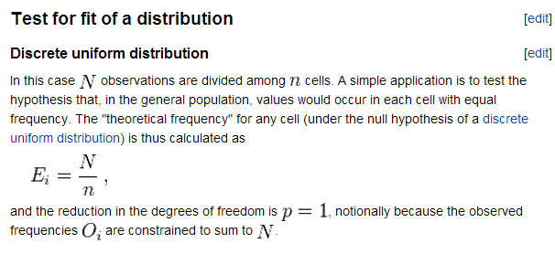
Showing the chisquare test for uniform distirbution
http://en.wikipedia.org/wiki/Pearson%27s_chi-squared_test

Slide 13
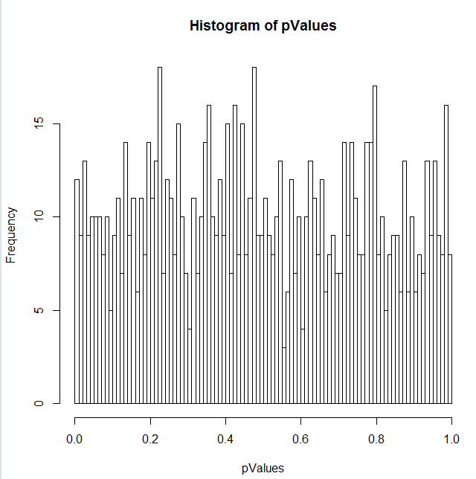
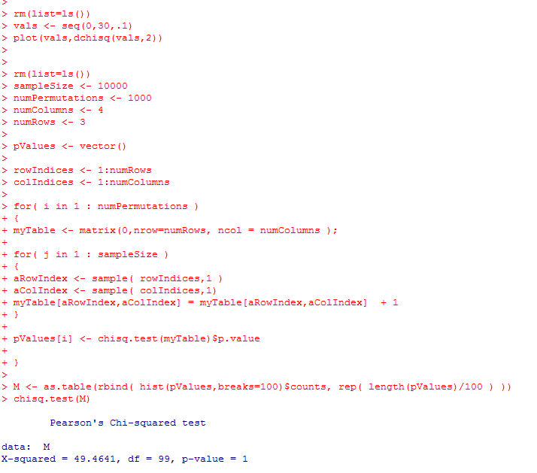
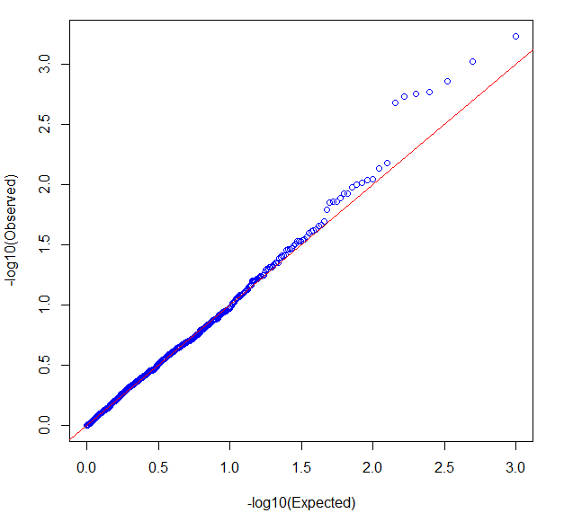

In this case, we can use a chi-square to test the results of a chi-square test!
Now we can put a p-value on a null hypothesis that a distribution is uniform!

