Slide 1
Lab 0 (not turned in):
Goals:
Install Java
Install Eclipse (or equivalent)
Get Eclipse connected to github (or equivalent)
publish a few versions of “Hello World”

Slide 2
Set up a GitHub account…
https://github.com/join
The free version of git does have some private repositories.
You could also use bitbucket or an equivalent service

Slide 3
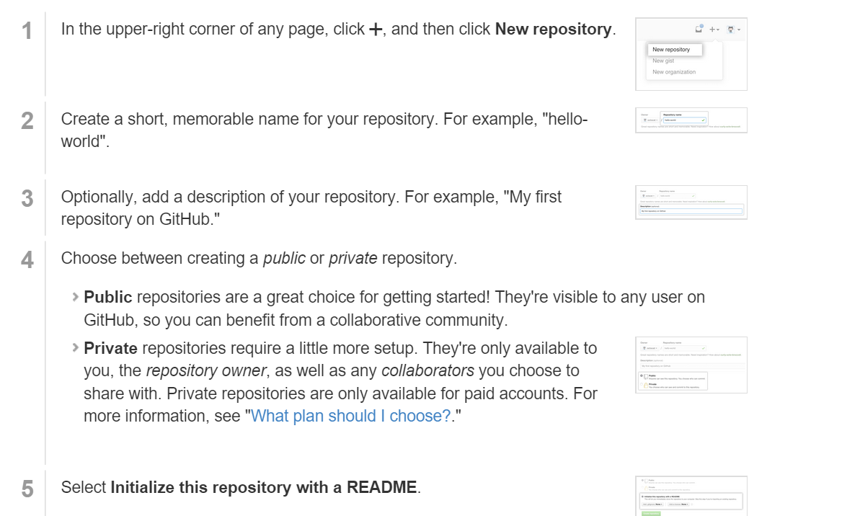
Create a github repository
(This assumes you have a “HelloWorld.java” class in some project in Eclipse

Slide 4
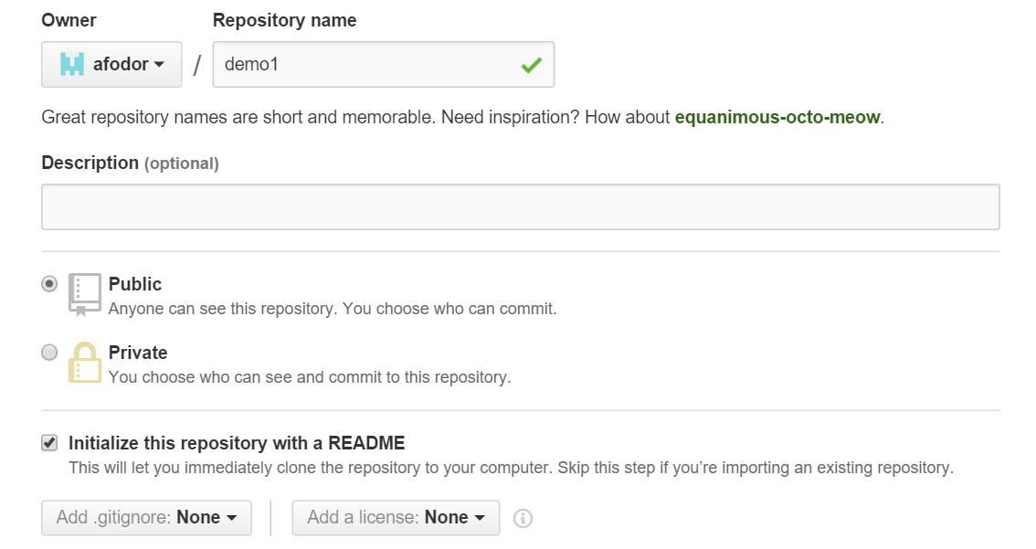
Give your repository a catchy name

Slide 5
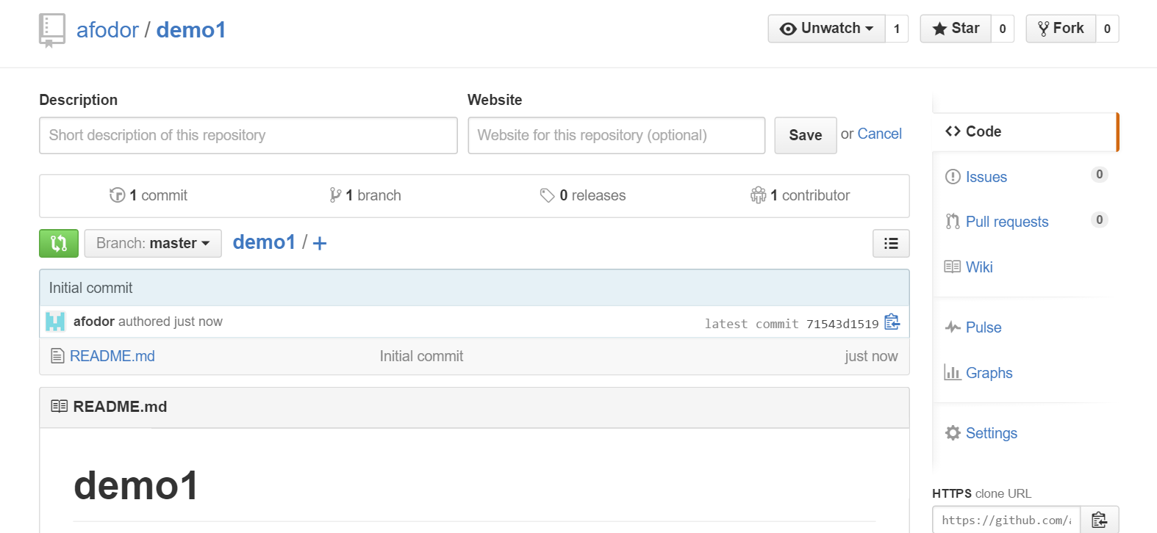
After you create your repository, it will have its own web page at GitHub

Slide 6
You have to generate a “temporary” password (or “token”) from the website…
Go to settings-> Developer Settings ->Personal Access Tokens -> Generate New Token
This is a bit
tedious from
the command line
If you use
“git config --global credential.helper store”
you won’t have to keep reentering
the password but this stores your
password in plain text.
I usually
just click
everything…
See https://stackoverflow.com/questions/35942754/how-can-i-save-username-and-password-in-git

Slide 7
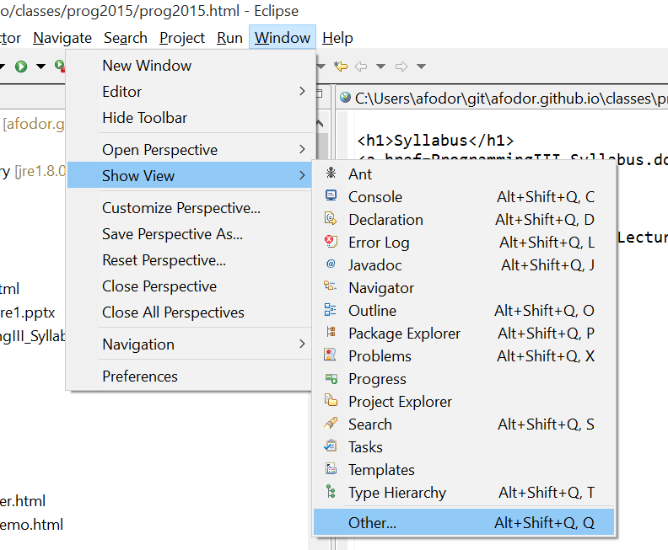
From Eclipse, “checkout” your repository….
Do “Show View”->”Other…”

Slide 8
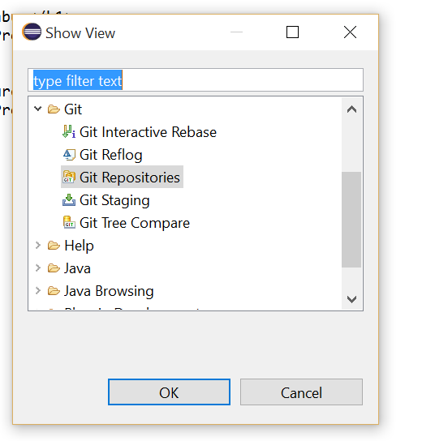
Choose “Git repositories”

Slide 9
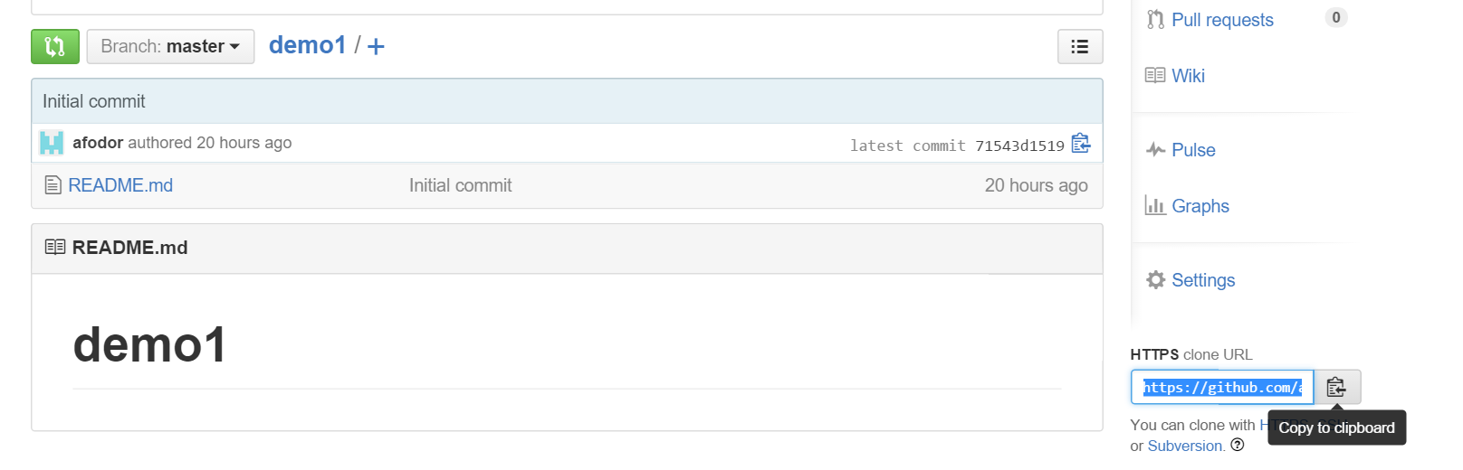
From the “github.com” web site for your project, choose code->local ->
“cloneURL…”

Slide 10
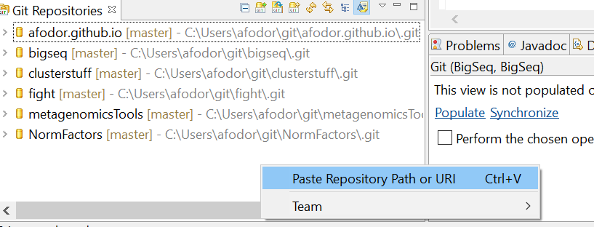
Back in Eclipse, find your “Git Repositories” window…
Right-click and choose “Paste Repository Path or URI”

Slide 11
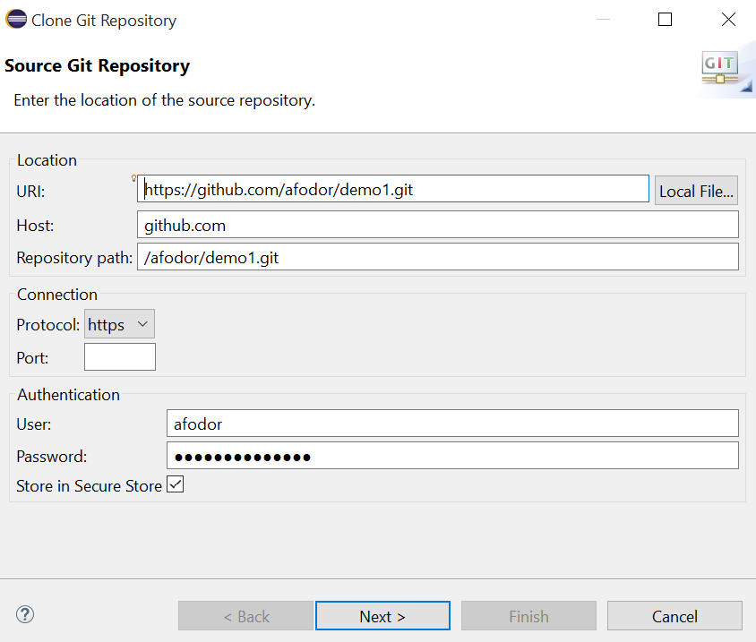
Click through the dialog screens…

Slide 12
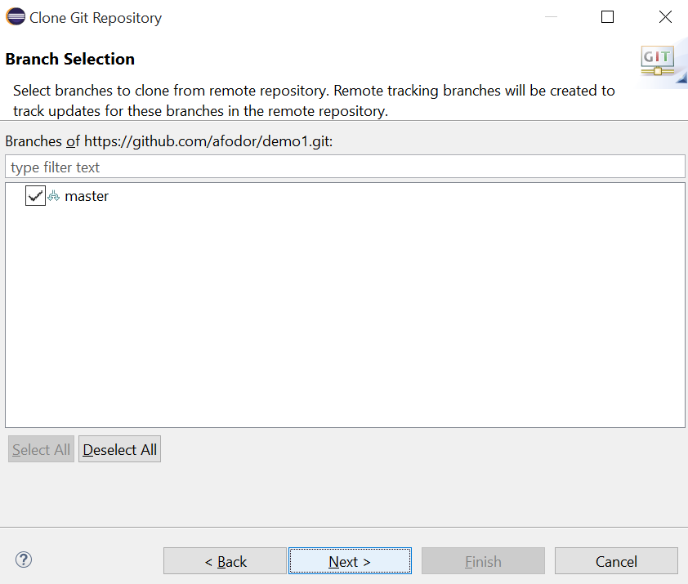
Click through the dialog screens…

Slide 13
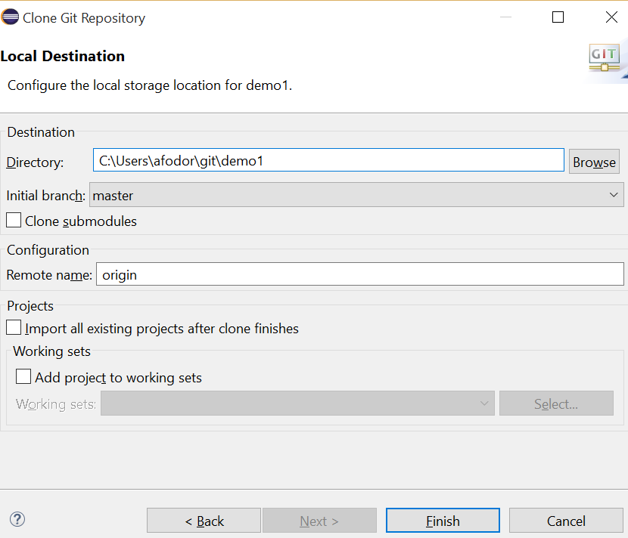
Click through the dialog screens…
remember this…

Slide 14
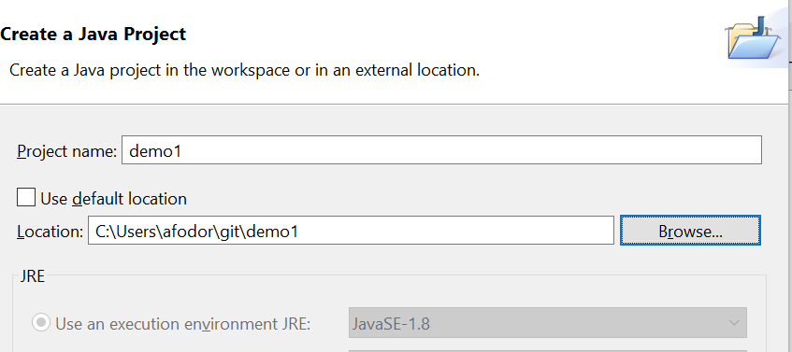
Now find the “Package Explorer” window…
Right-click and choose new -> “Java Project”
Give your new project the same name as the GIT project
Navigate to where you put your GIT project
uncheck
Click “finish”

Slide 15
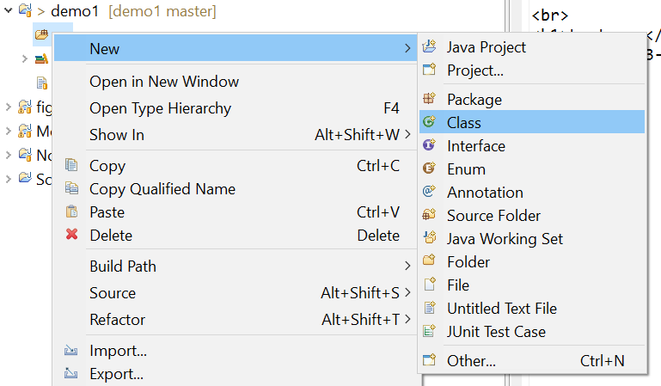
In the “src” directory in your new project, make a “HelloWorld.java” class as before
(or copy it from the file system or from another Eclipse project)

Slide 16
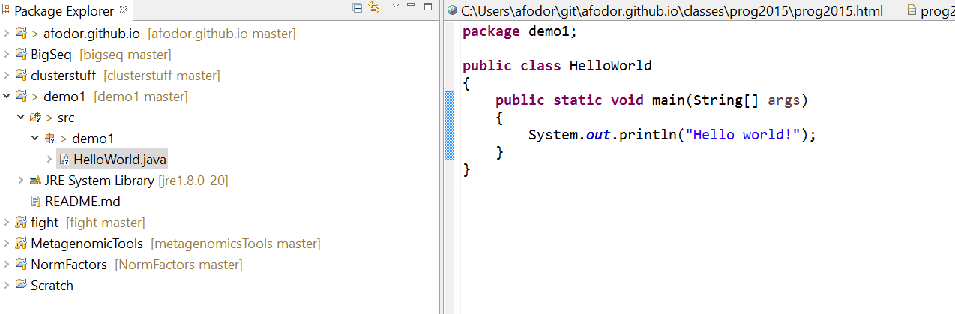

Slide 17
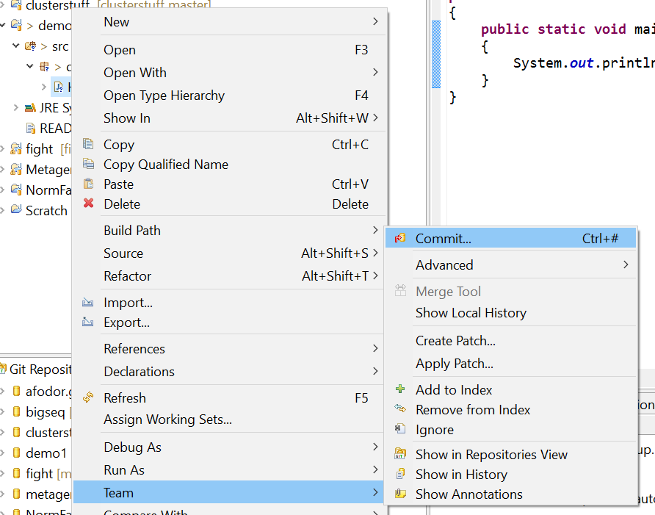
Now we will publish it to the web… In the “Package Explorer” frame, right-click and
Choose “Team→Commit”

Slide 18
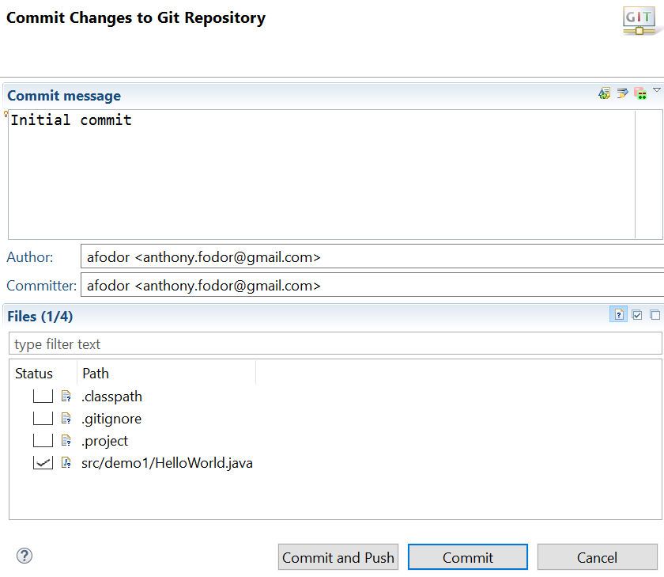
You have to type something here…
Choose (only) your class
Hit commit and push
(to push your code to GitHub)

Slide 19
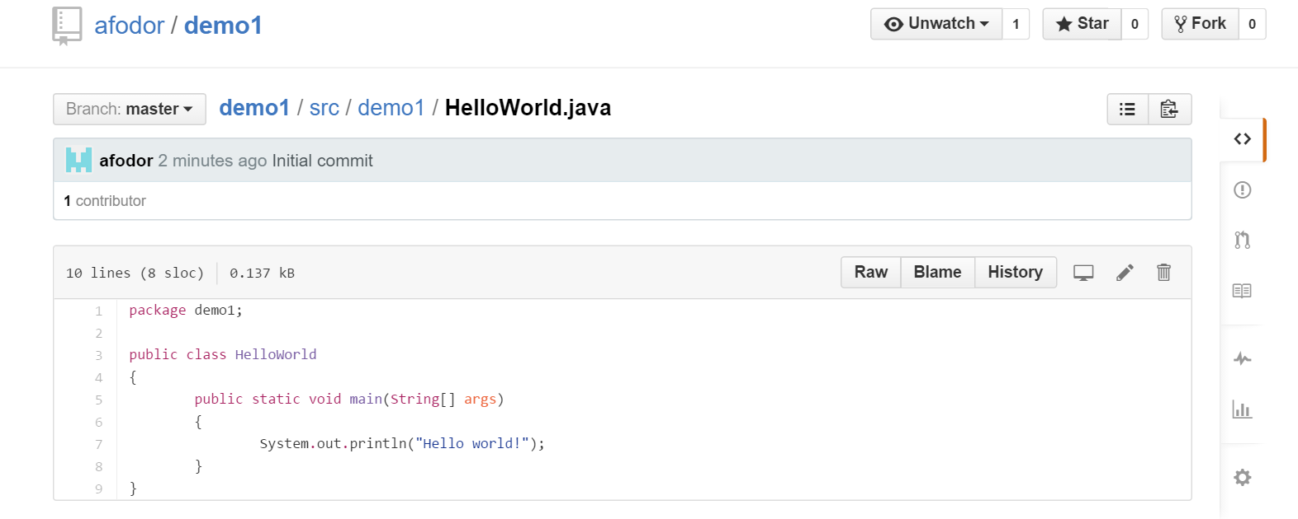
With any luck, your code is on the web.
You can invite people into your project to collaborate..
https://github.com/afodor/demo1/blob/master/src/demo1/HelloWorld.java

Slide 20
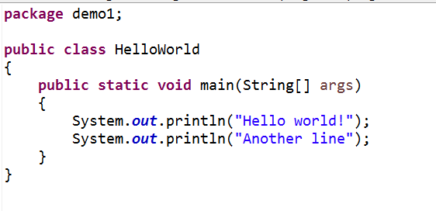
Go back to Eclipse and change your code…

Slide 21
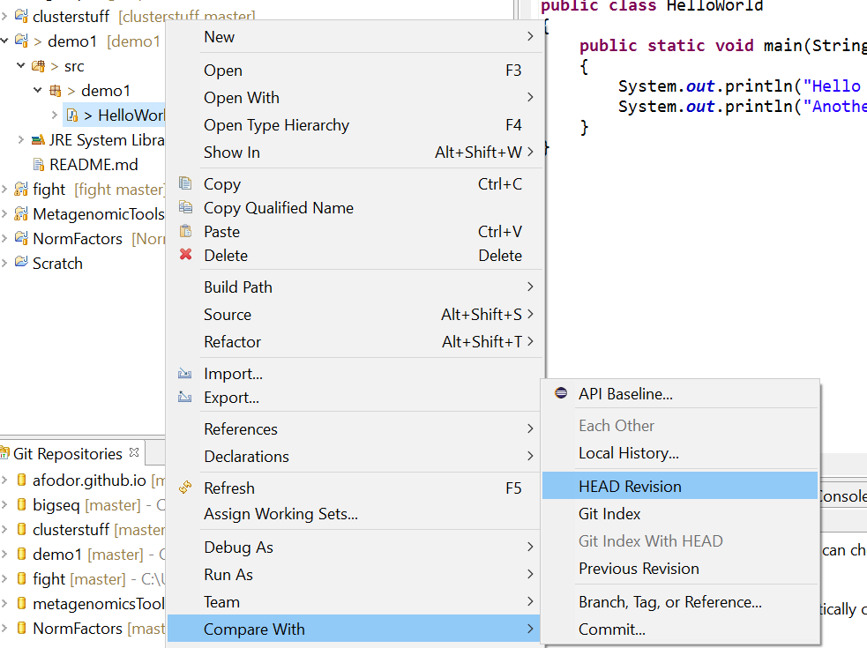
We can compare our current code to what is at GitHub
Right-click in the Project Explorer -> Compare With -> Head Revision

Slide 22
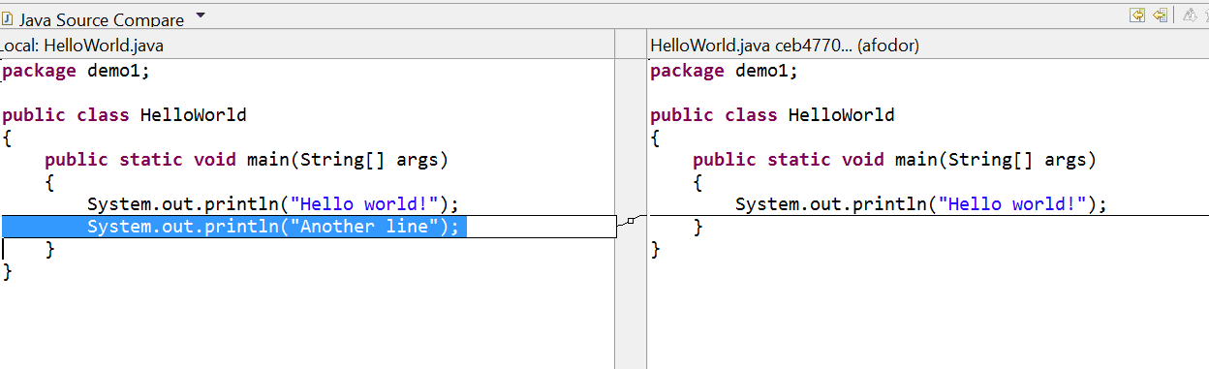
This is an invaluable tool.
Iterative development one small change at a time!
You can also replace the code with any previous version
Right click -> “Replace With…”
If you want to keep these changes, right-click -> team -> commit and they will be published

Slide 23
Important! Try to avoid checking in the .classpath and .project files to git
(these are used locally by your Eclipse install)
In the “Package Explorer” view, you can choose the files and select “team”->”ignore”
Then do the same thing for the .gitignore file (tell the .gitignore file to ignore itself!)

Slide 24
Try not to check in:
.classpath
.project
.gitignore
(you can add these to .gitignore and then git won’t offer you the
option of checking them in!)
Likewise, try to avoid checking in compliled (.class) files

Slide 25
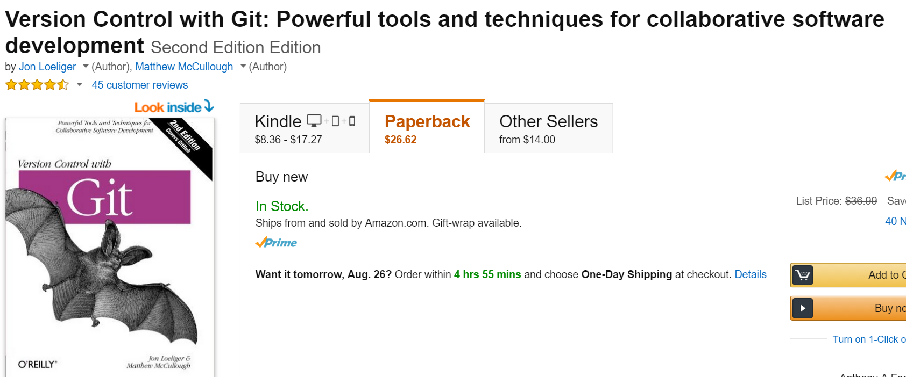
Git is a bit complex.
This is a useful reference (not sure if there is a free version).
Mastering GIT is a useful skill, but will not be a focus of the class.
I am happy to answer any GIT questions I can in lab (my knowledge of GIT is incomplete).
It takes a while to get the hang of GIT, but it very useful once you figure out the basics..

Slide 26
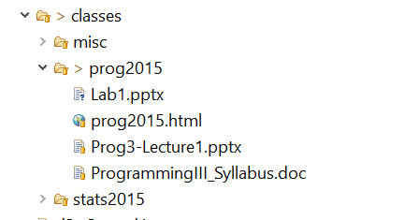
By the way, the class web site is published on Git/GitHub
I just add stuff to the directory and commit it.
Automatically backed up, shared across multiple machines,
Free to publish web site.

