Slide 1
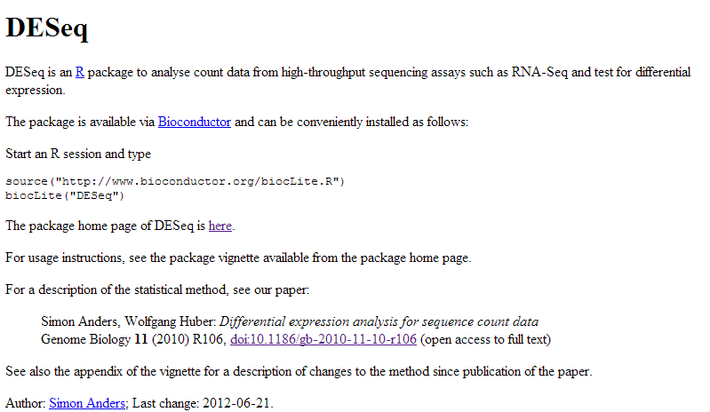
We are going to load the RNA-seq dataset into DSEQ.

Slide 2
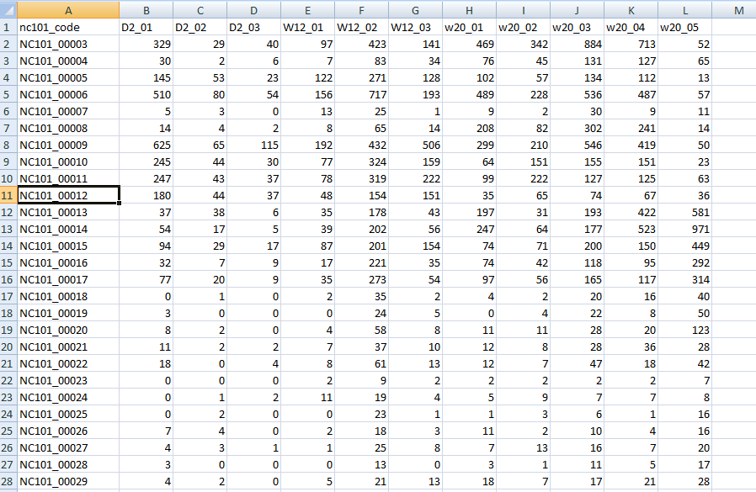
From lecture 9A…
http://afodor.github.io/classes/stats2015/longitdunalRNASeqData.zip
File = nc101_scaff_dataCounts.txt

Slide 3
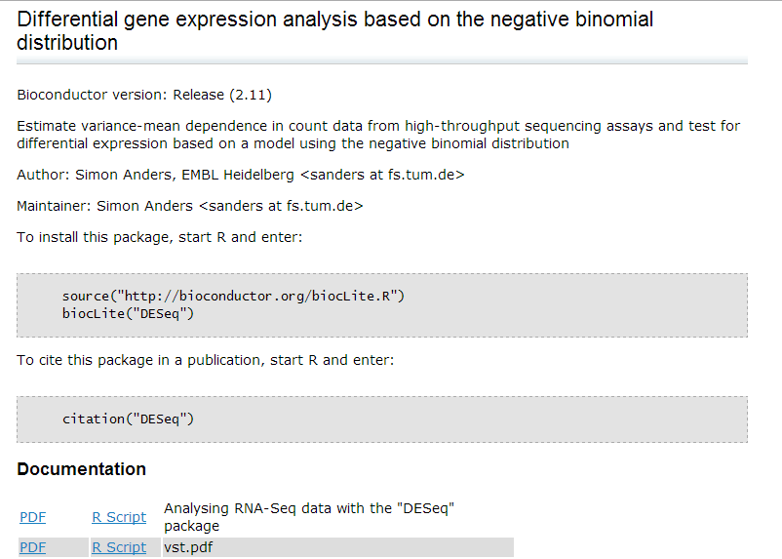
We are going to follow this vignette
(from http://bioconductor.org/packages/release/bioc/html/DESeq.html )
http://bioconductor.org/packages/release/bioc/vignettes/DESeq/inst/doc/DESeq.pdf

Slide 4

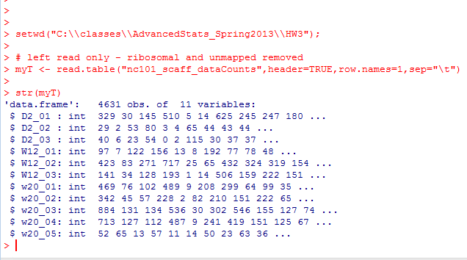
We can install DeSEQ from R…
We start by reading the data in as usual…

Slide 5
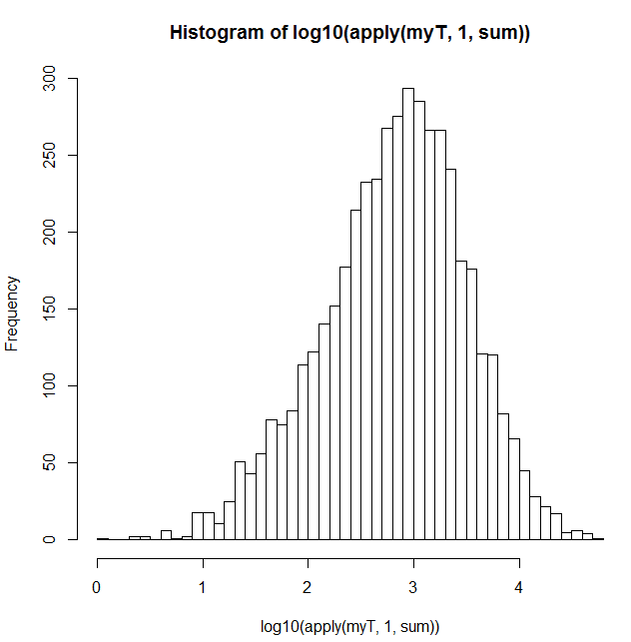


Before we even use DeSeq, we can do some nice QA/QC on the data
Here is a histogram of the number of sequences assigned to each gene..
Apply “sum” to every row in
the data frame.
Returns the number of reads for each gene…

Slide 6

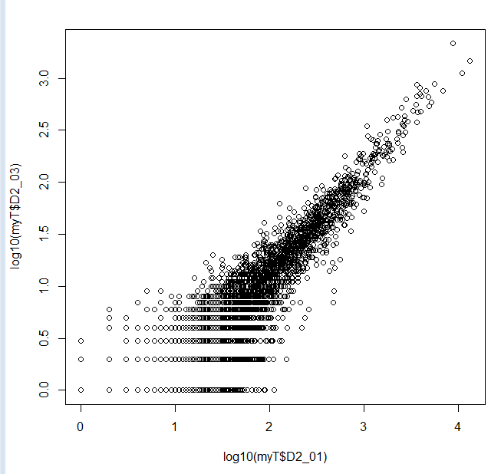
Likewise, we can ask how many reads per sample..
Sample D2_03 (with only 76,684 sequences) seems a little low.
We could think about taking it out…
However, it seems reasonably
well behaved, so we will leave it
in for now…

Slide 7

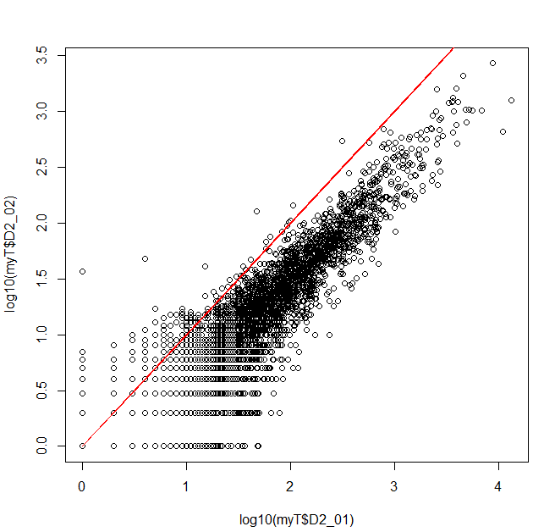
We can take some initial looks at the data…
There is a good correlation
between these 2 biological
replicates

Slide 8
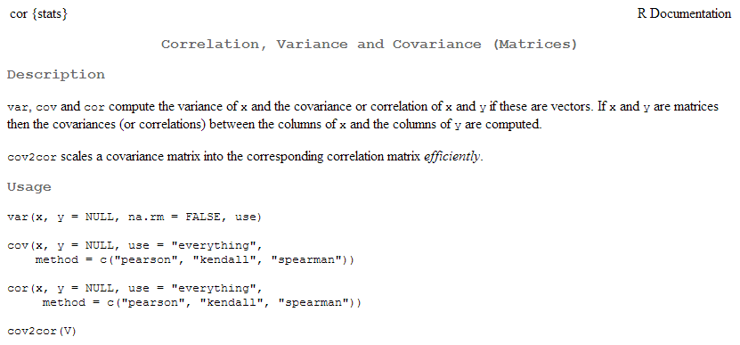
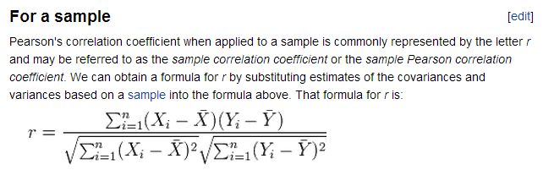
cor gives us the correlation co-efficient…
How much information about the y-axis can you get given the x-axis?
(More on this as we get to linear models in the 2nd half of the class)
http://en.wikipedia.org/wiki/Pearson_product-moment_correlation_coefficient

Slide 9
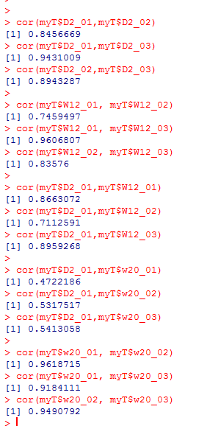
Typing a (very quick and informal) set of commands
suggests there will be a big shift between 2 days and 20 weeks
The day 2 samples seem well correlated with each other
There seems to be a little more variance in the week 12
samples
There was some shift day 2 to week 12
There was a big shift from day 2 to week 18
The week 18s are well correlated to each other

Slide 10


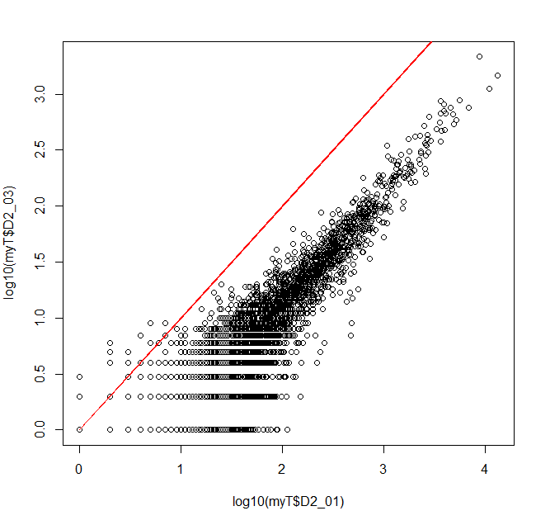
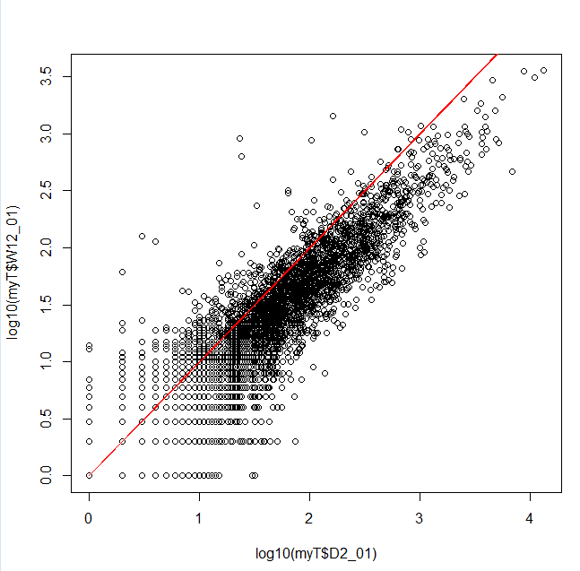
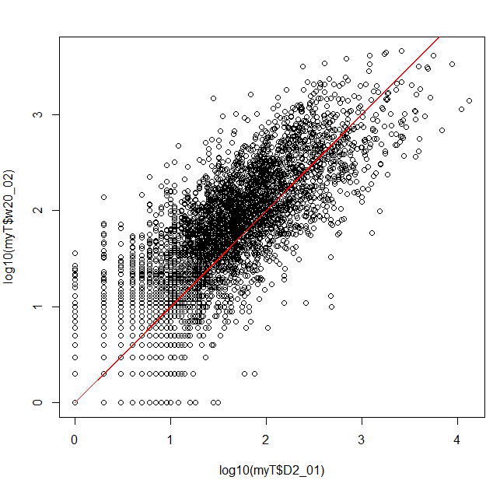
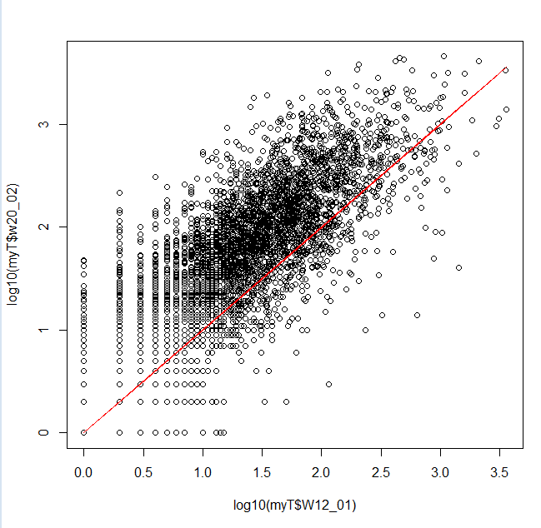


D2 vs D2
D2 vs W12
D2 vs W18
W12 vs W18

Slide 11
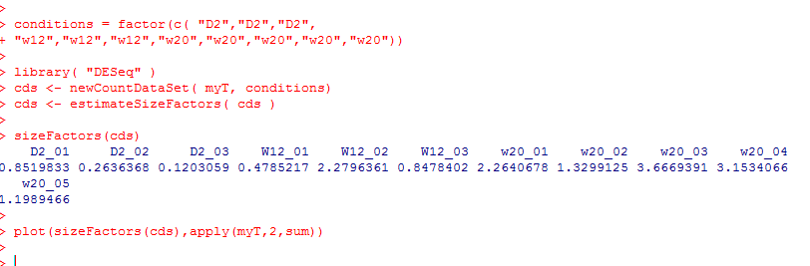
The samples are not on the red lines because each sample has a different number of sequences
The first thing we will use DeSeq for is to normalize the data
(adjust all of the samples so we can treat them as if they had an identical number of reads).
This will allow us to, for example, take an average across samples
We see that the size factor is very
closely related to the total
number of sequences in each
sample

Slide 12
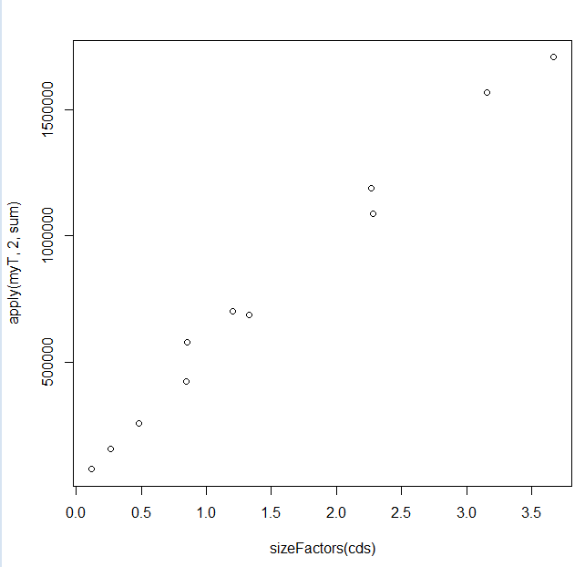
We see that the size factor is very
closely related to the total
number of sequences in each
sample

Slide 13
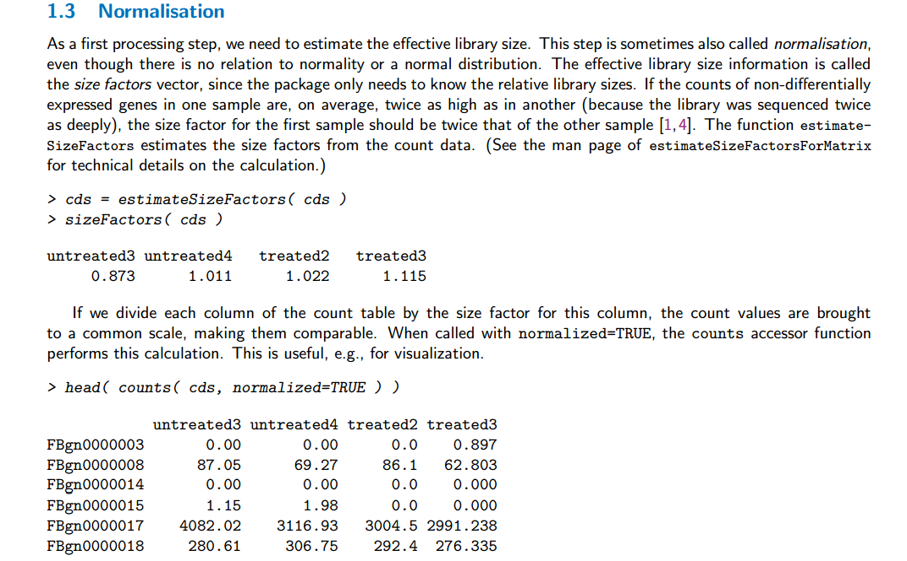
We are here following the directions in the vignette
http://bioconductor.org/packages/release/bioc/vignettes/DESeq/inst/doc/DESeq.pdf

Slide 14
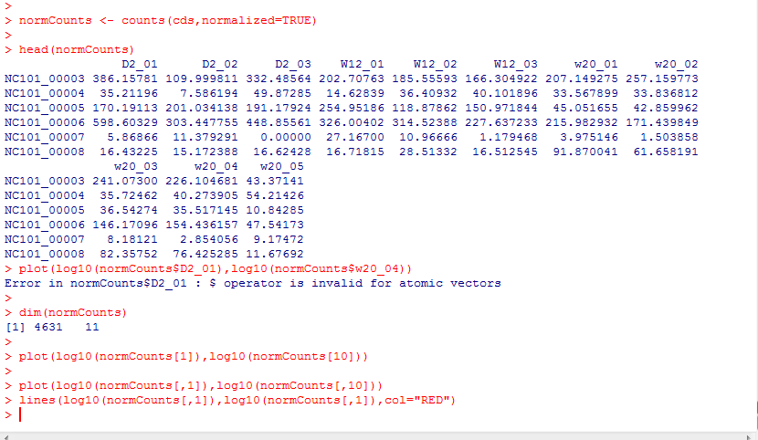
With the normalization done, scatter plots will fall on the identity lines
Accessing by names fails on the returned matrix
We retreat to column indexes

Slide 15
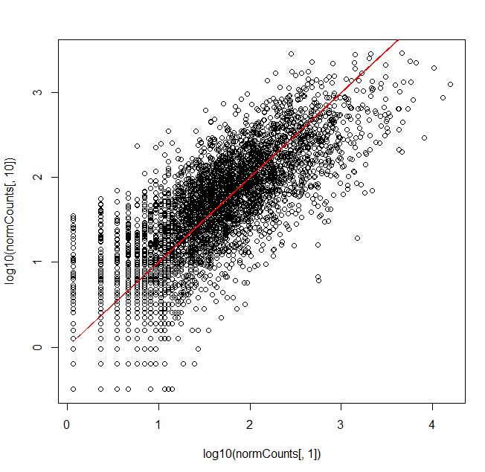
With the normalization done, scatter plots will fall on the identity lines

Slide 16
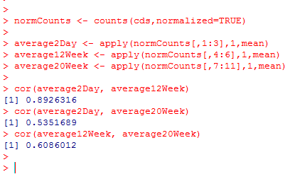
By working with average samples we only have 3 plots to worry about in our visualization

Slide 17


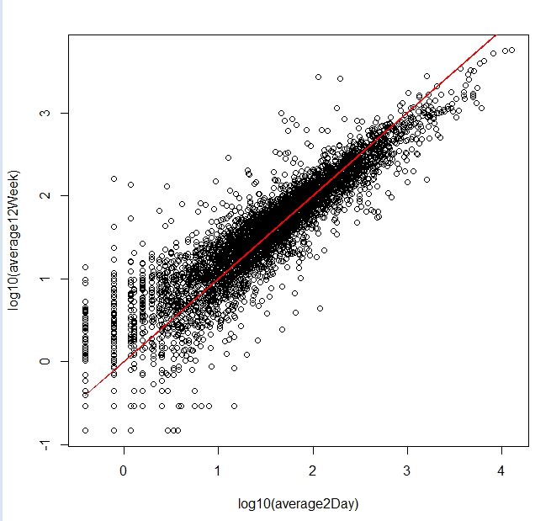
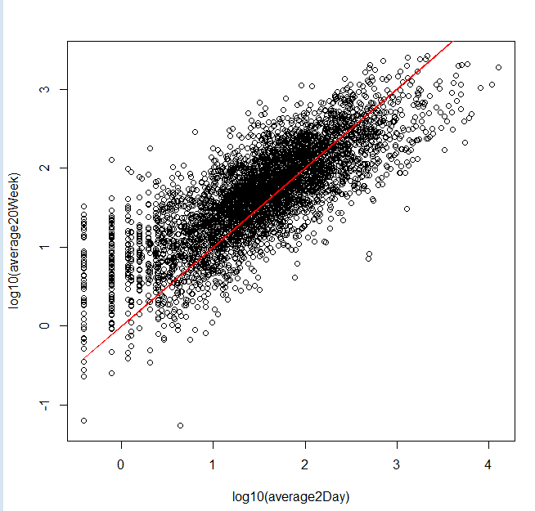
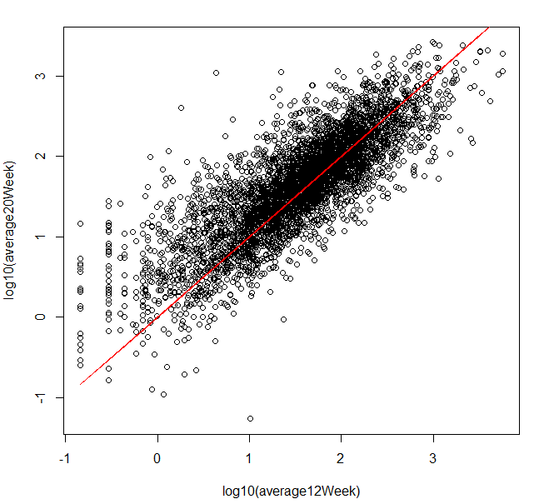

Average 2 day vs 12 weeks
Average 2 day vs. 20 weeks
Average 12 week vs. 20 week

Slide 18
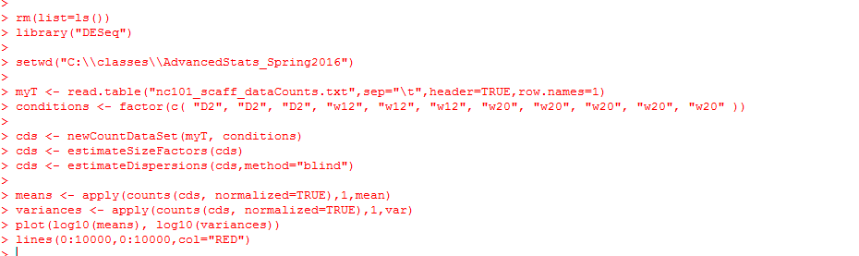
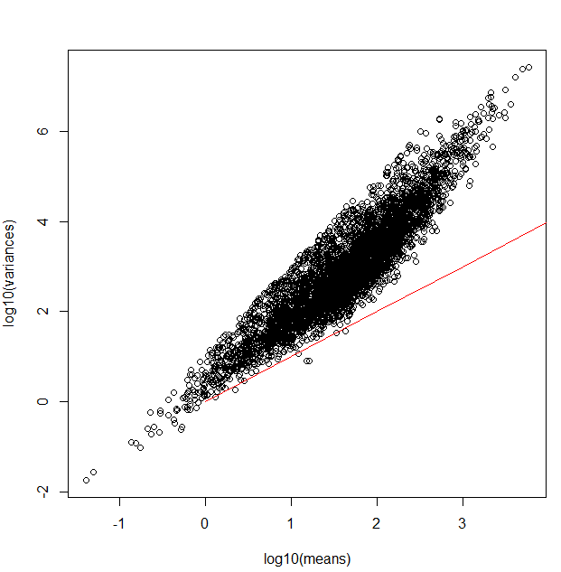
As we would expect, the Poisson assumption (“shot noise”) does not model our data
(here visualized with canonical variance)

Slide 19
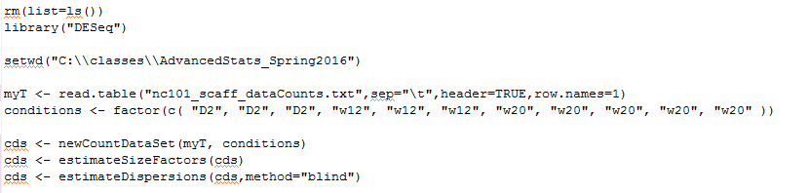
Next, we want to see which genes are differentially expressed…
We start by getting our DeSeq variance estimates…
This says get one variance for each gene ignoring the different conditions (we do this here to keep our math a little simpler…)

Slide 20

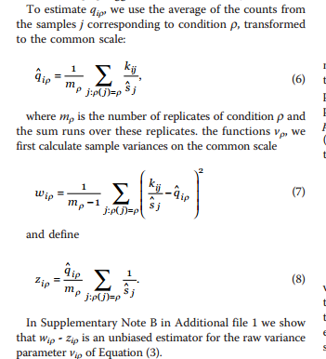
We will estimate a single
variance across all conditions…
(rather than have 3 variances for
each gene…)
(Just to keep the math simpler…)

Slide 21
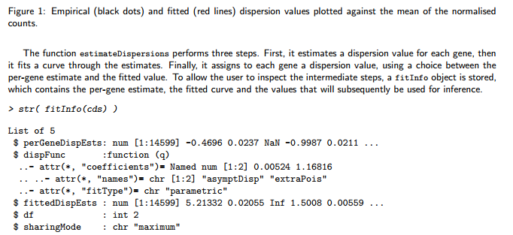
According to the vignette there are a number of sets of estimates we might be interested in…
http://bioconductor.org/packages/release/bioc/vignettes/DESeq/inst/doc/DESeq.pdf
fitInfo(cds)$perGeneDispEsts – gives us the Deseq’s formula for the “raw” variance estimated for the gene
i in condition j..

Slide 22
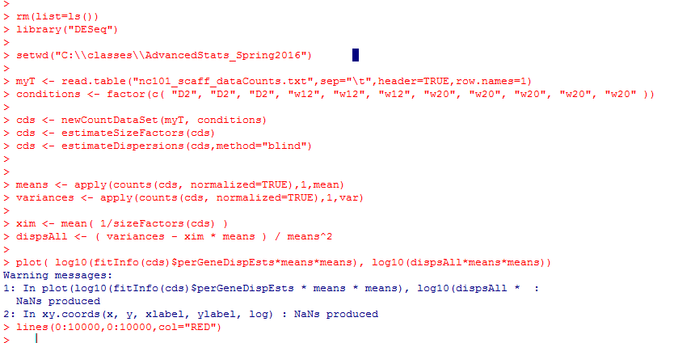
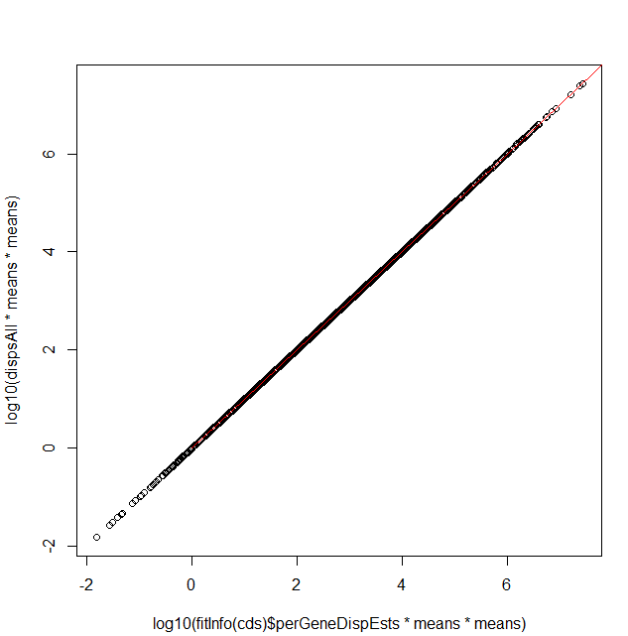

Deseq scales by dividing by the square
of the mean
Cannonical variance
Deseq’s “raw” variance is the
cannonical variance minus the means
(correcting for size factors)

Slide 23
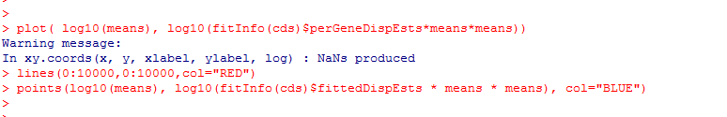
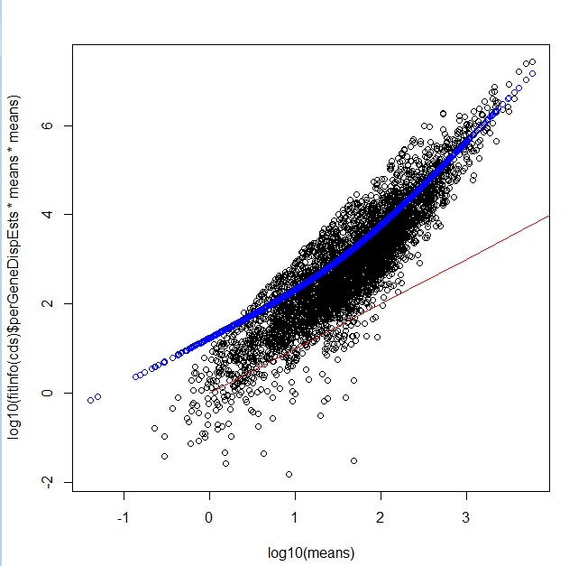
Here is the fitted line based on all of the raw variances.
This allows for pooling of the estimate of the raw variances
In the deSeq paper, this was a local
regression, but according to the
vignette it is now a two-parameter
Gamma function…
(so just some smooth function)

Slide 24

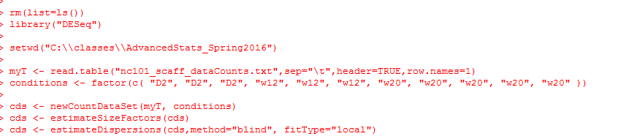
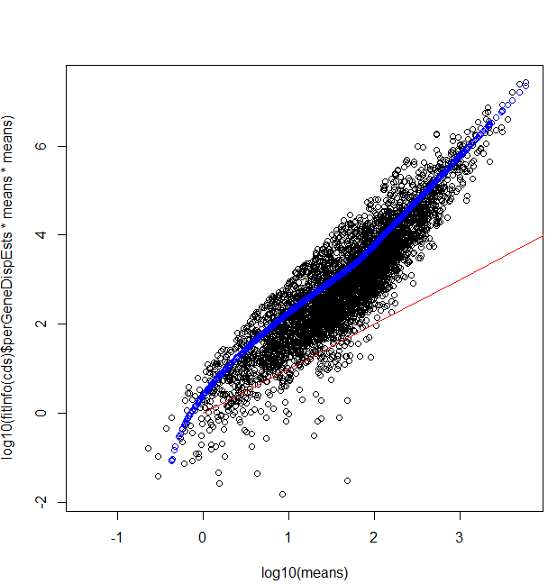
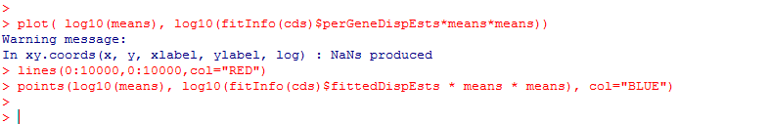
We can, if we want, switch to the “local regression” method.
You can kind of see why they switched…
Some of these variances seem much too small

Slide 25
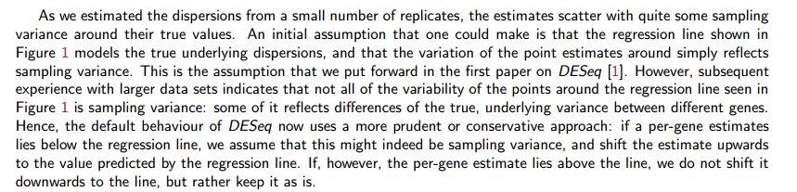
Another difference with the published paper.
In the published paper, the variance came from the fit.
In the software: the variance for downstream analysis is the max(observed variance, fit variance)
The variance used for downstream analysis can be gotten by fData(cds)[,1]

Slide 26
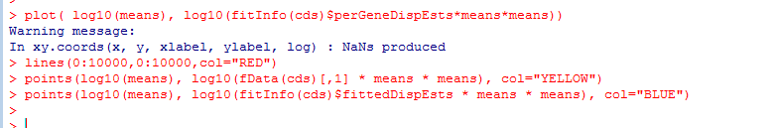
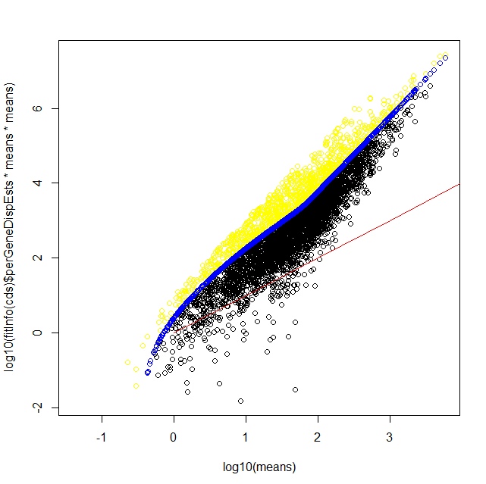
the raw variance for downstream analysis is the max(observed raw variance, fit raw variance)
Essentially, for some genes,
their method sets a
“floor” of the variance.
This is conservative
(since the variance sets
the width of the
dbinomial distribution).
So the yellow ends up being
DeSeqs (somewhat complicated)
conservative estimate of the extra raw “variance” that is to be provided by the negative binomial
And then they end up doing something else in DeSeq 2!

Slide 27
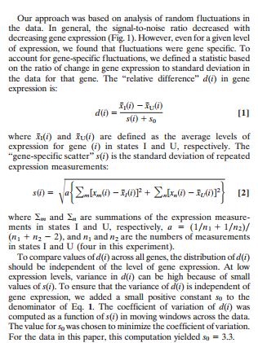

This procedure belongs in a long history of adding small constants to the variance…
(which often seems poorly justified by theory…)
Adding an arbitrary damper to the variance
(9,951 citations)

Slide 28
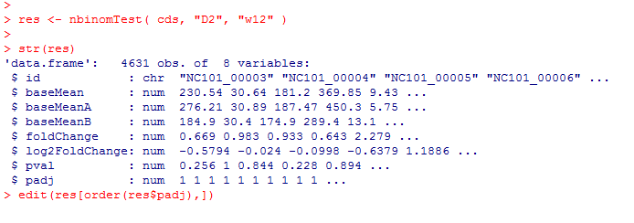
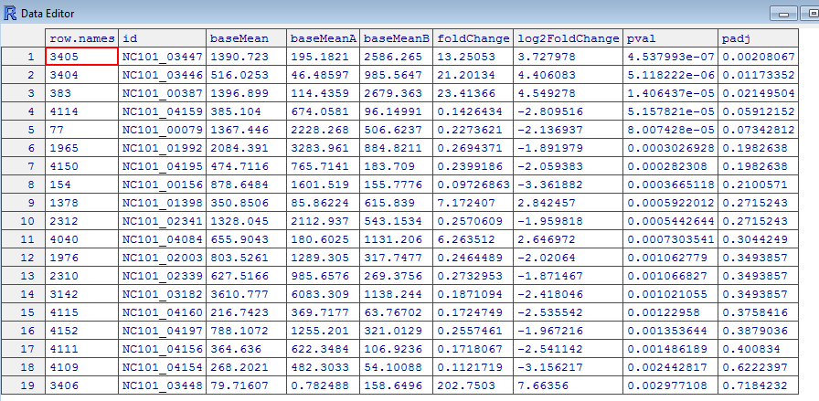
Finally, we are ready to perform inference (here we remove the “blind” option for the variance to allow DeSeq to estimate a variance for each condition…)
2 weeks vs. 12 weeks yields only 5 significant genes at a 10% FDR -

Slide 29

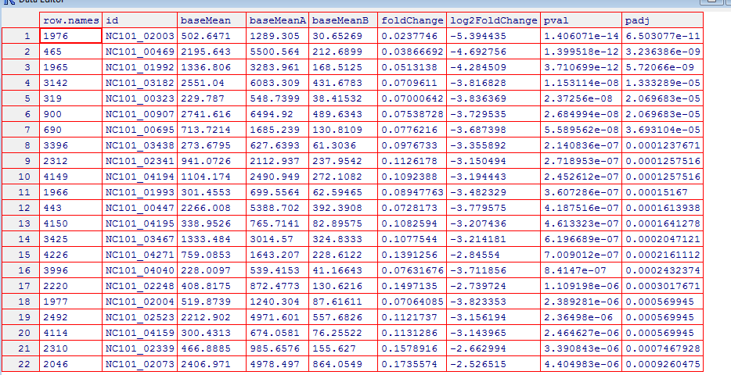

However day 2 vs. week 20 yields many more (136) significant genes

