Slide 1
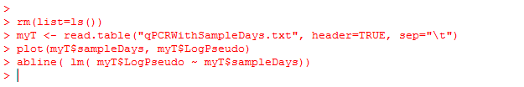
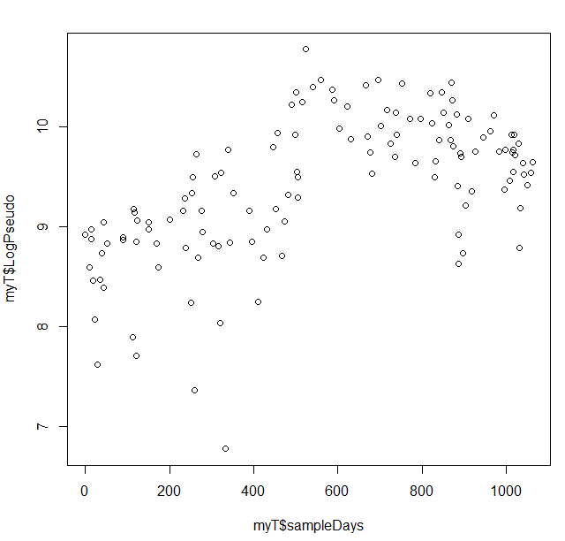
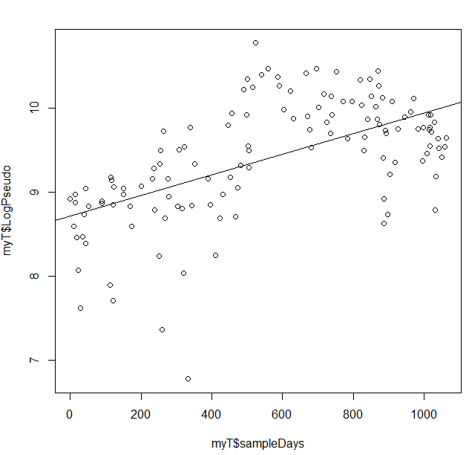
In our datasets, Pseudomonas qPCR data clearly do not meet the assumption of linearity….

Slide 2
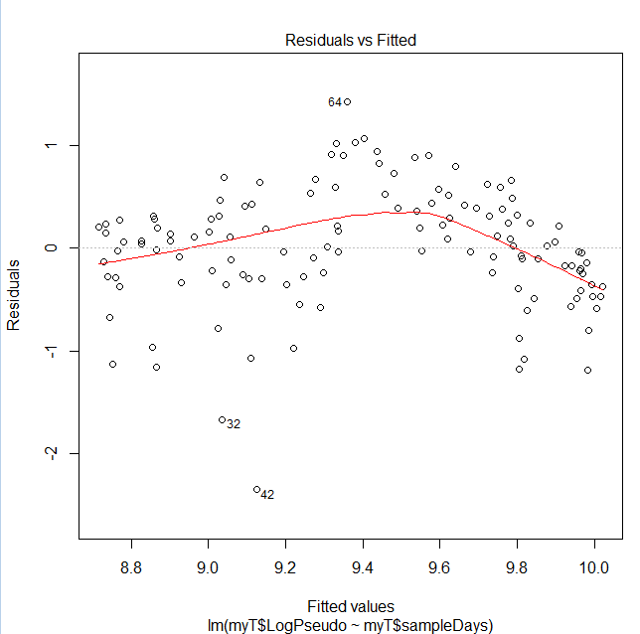
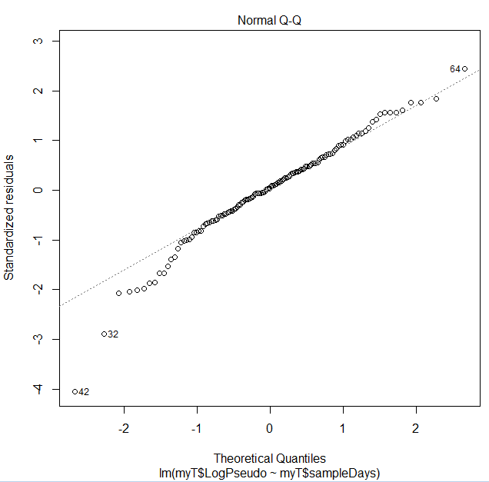
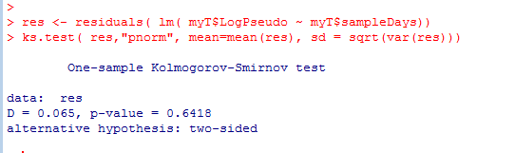
We see systematic deviation from the assumption of linearity…
Although we could justify
pushing ahead with our linear model

Slide 3
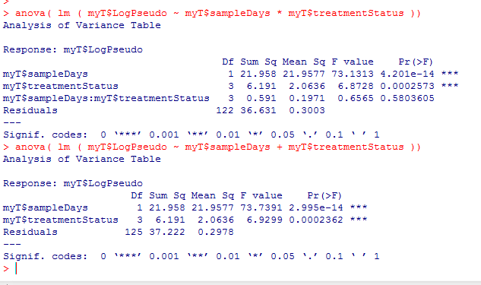
One alternative is just to accept the deviation from linearity..
As before we can remove
the interaction terms

Slide 4
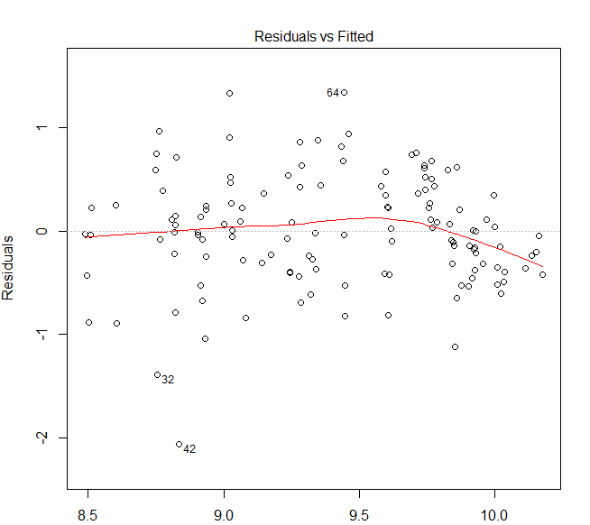
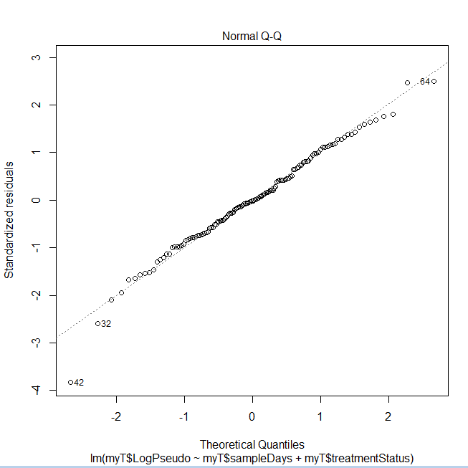
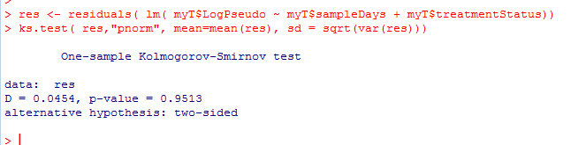
Our 5 parameter model does not appear to deviate substantially from its assumptions…

Slide 5
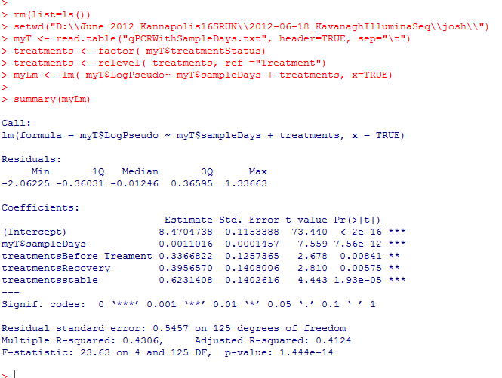
Treatment with antibiotic appears to be significantly associated with decreased amounts of
this bug….

Slide 6
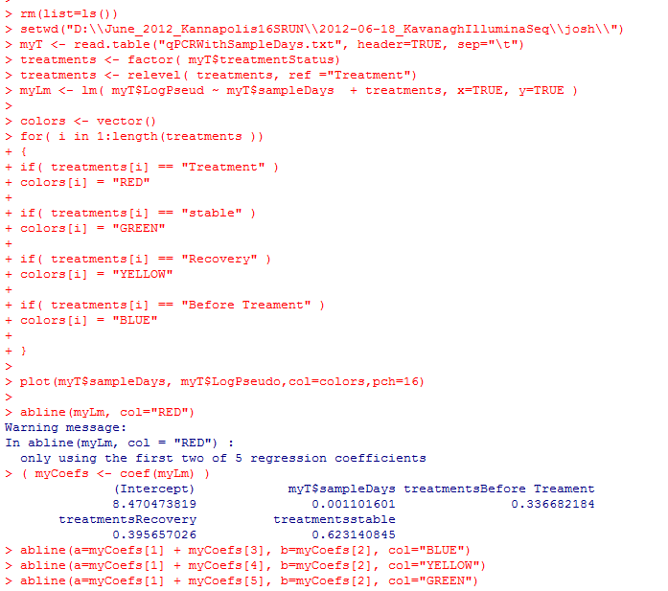
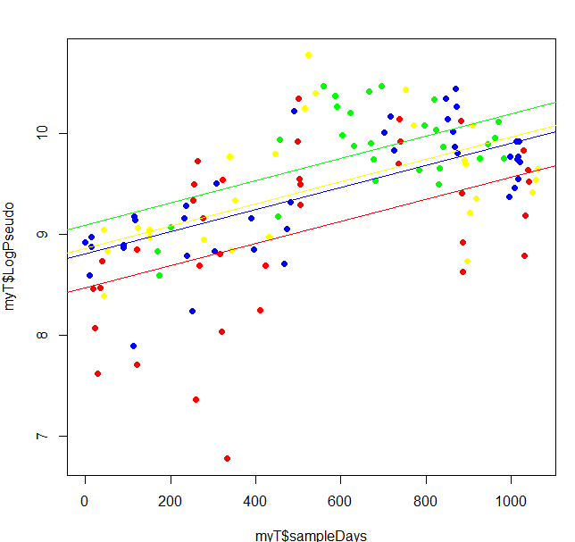
The model is in the ballpark (but is not really linear)

Slide 7
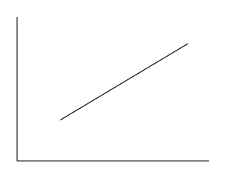
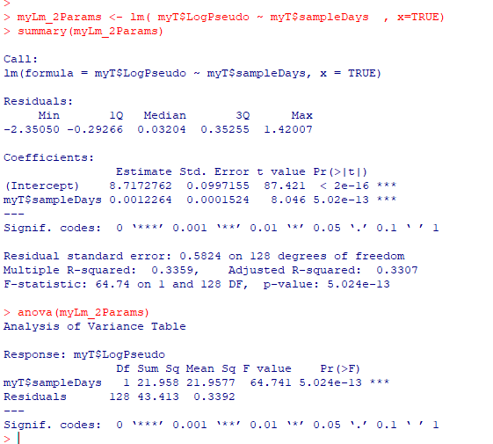
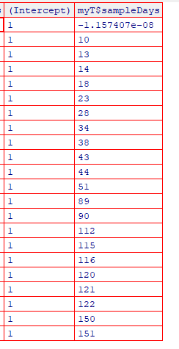
A two-parameter model with only time
B0
B1

Slide 8
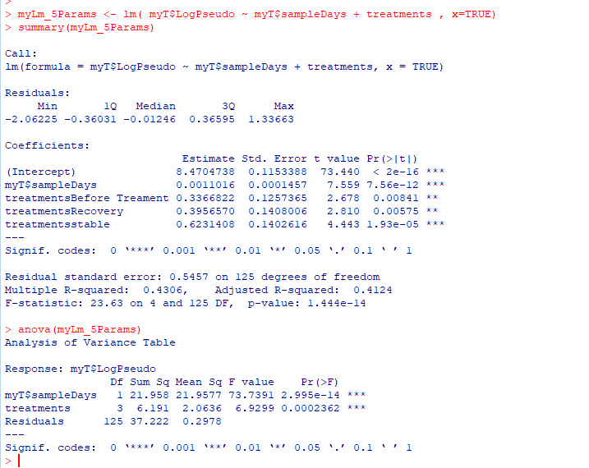
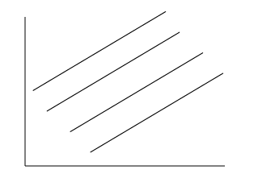
A five-parameter model with differing intercepts and a constant slope

Slide 9
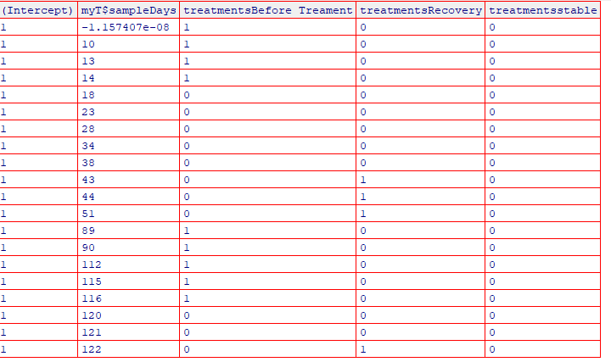
A five-parameter model with differing intercepts and a constant slope
B0
B1
B2
B3
B4

Slide 10
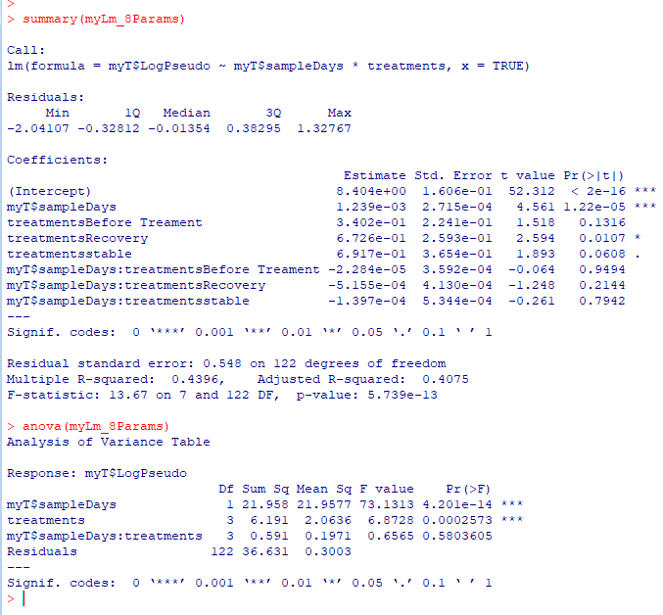
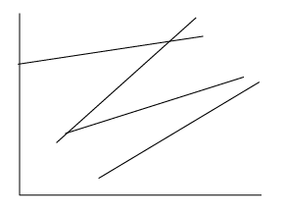
An eight-parameter model with 4 independent lines

Slide 11
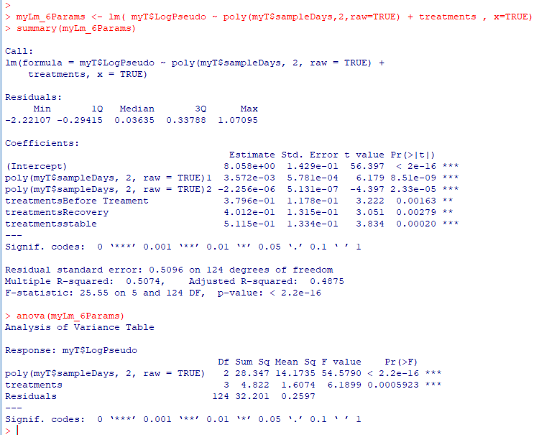

A six-parameter model with 4 parabolas all the same shape

Slide 12
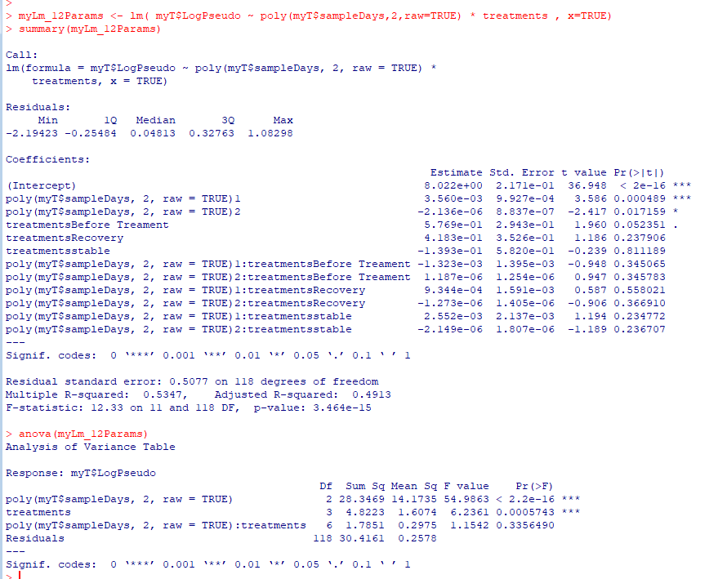

A twelve-parameter model with 4 independent parabolas

Slide 13
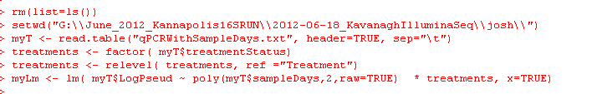
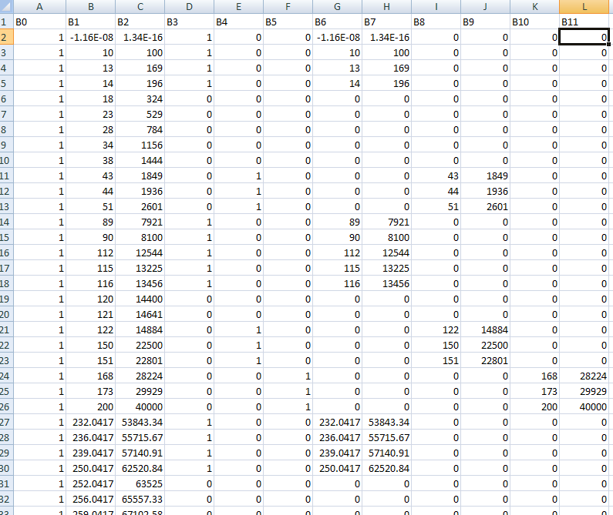
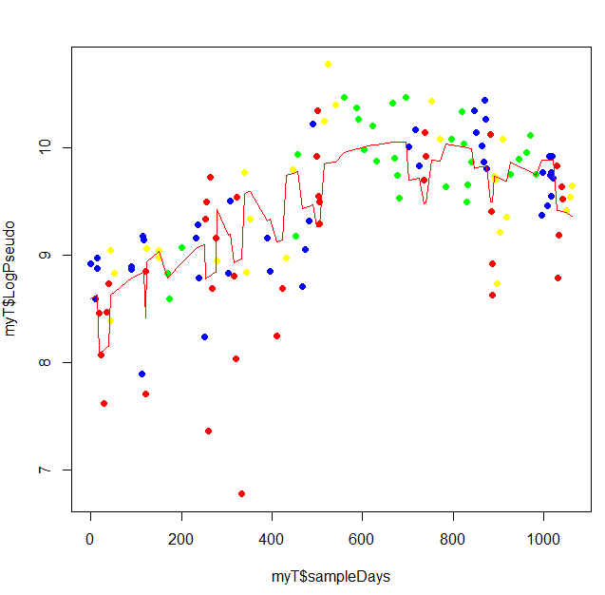

Our 12 parameter model…
Here is a 12 parameter
model…
B0 +
B1 * time +
B2 * time^2 +
3 dummy parameters for intercept +
3 dummy parameters *time +
3 dummy parameters * Time ^2

Slide 14
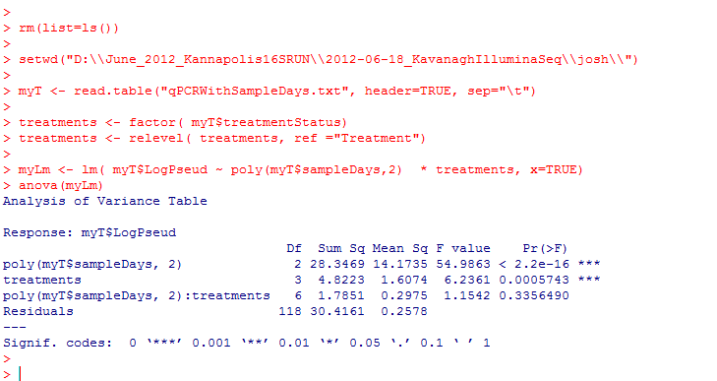
We proceed to look for the simplest model; we start by dropping six interaction terms!
Full model
Reduced model

Slide 15

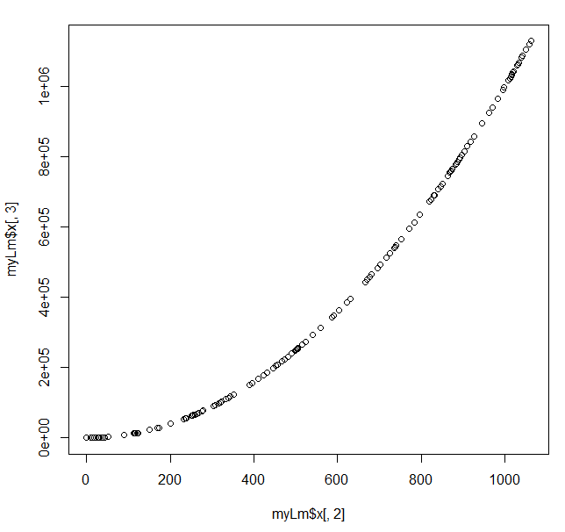
One problem, days and days^2 are highly correlated.
Correlated inputs will cause numerical instability in the model!
You can double one
parameter and compensate
by halving another…
With correlated input data,
there are an infinite number
of ways to achieve the minimal
sum of squares.

Slide 16
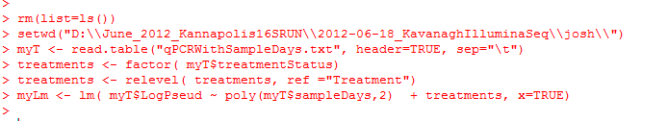
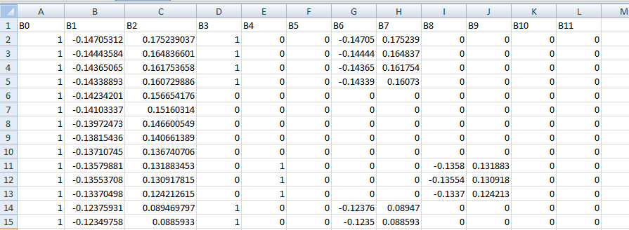
R will fix this by default… (We drop “raw=true” from our poly call)
R will rotate the data to an orthogonal basis where the X and X^2 terms are not correlated..
Much more on orthogonal bases later (the PCA lecture)
Note that B1 and B2 are no longer simply days and days^2
This will make interpreting the results of the model with respect to our original data more difficult..

Slide 17
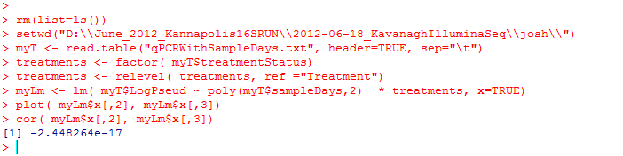
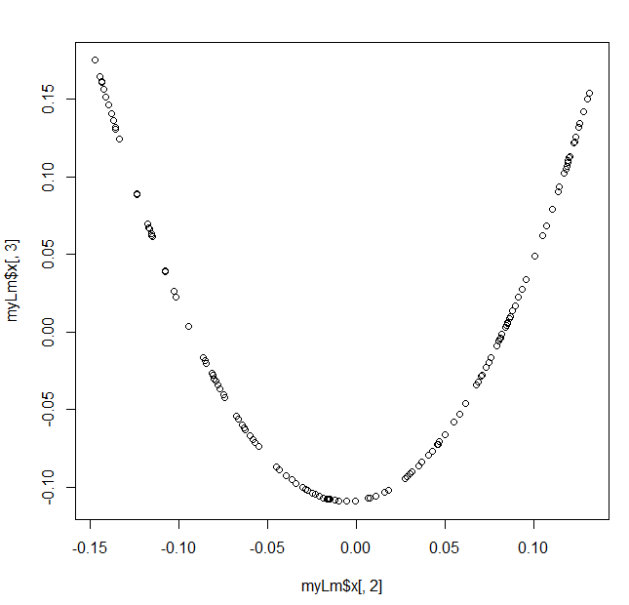
However our x and x^2 are no longer linearly correlated, so numerical stability is reintroduced into our model…

Slide 18
We proceed to look for the simplest model; we start by dropping six interaction terms!
Full model
Reduced model

Slide 19
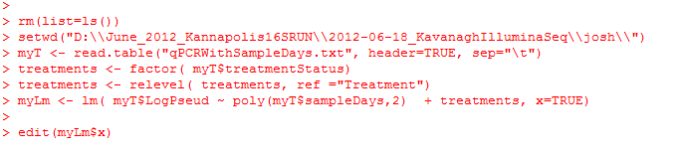
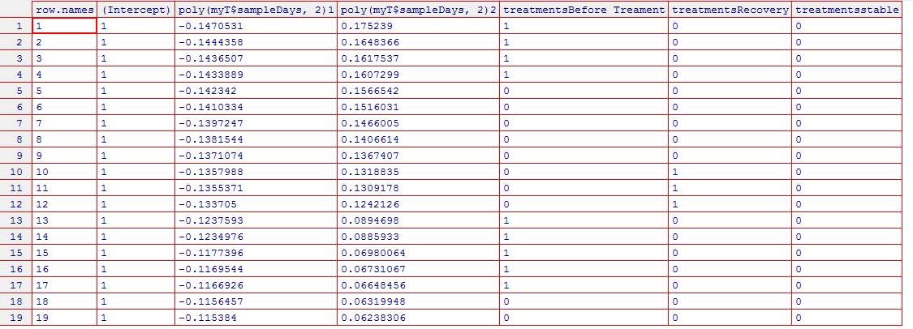
We drop the interaction terms and end up with the much more manageable six parameter model…
B0 +
B1 * time +
B2 * time^2 +
3 dummy parameters for intercept

Slide 20
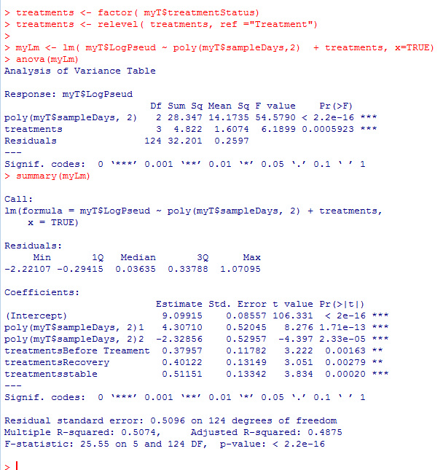
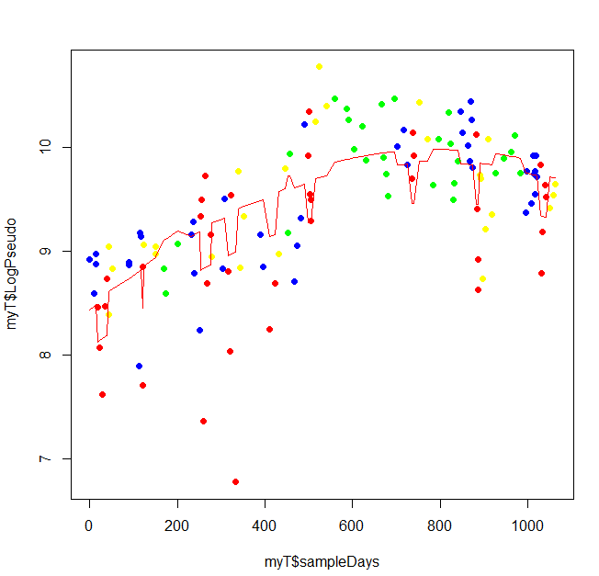
Treatment is still significantly different for all cases

Slide 21
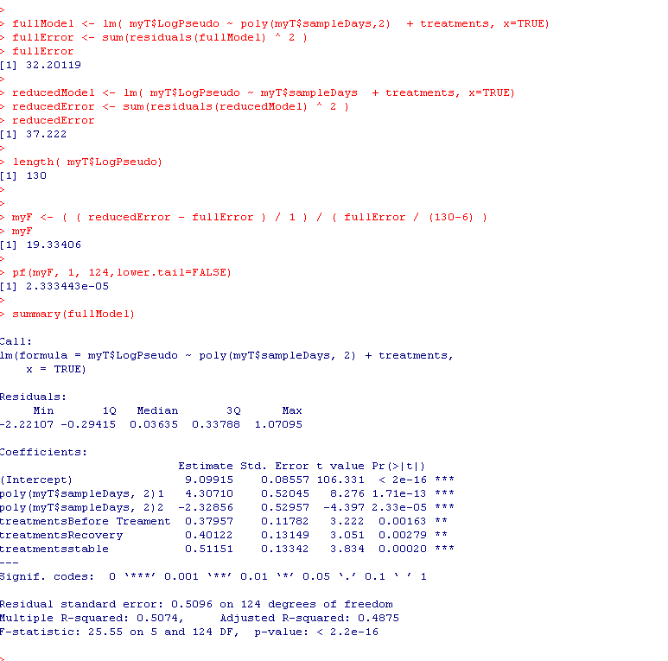
The p-value tells us whether each additional parameter of higher order is significant
Full: B0+ B1 *days + B2 * days^2
+ 3 dummy intercept terms
Reduced: B0+ B1 *days + 3 dummy intercept terms
Our 6 parameter model captures
significantly more variability
than the 5 parameter model..

Slide 22
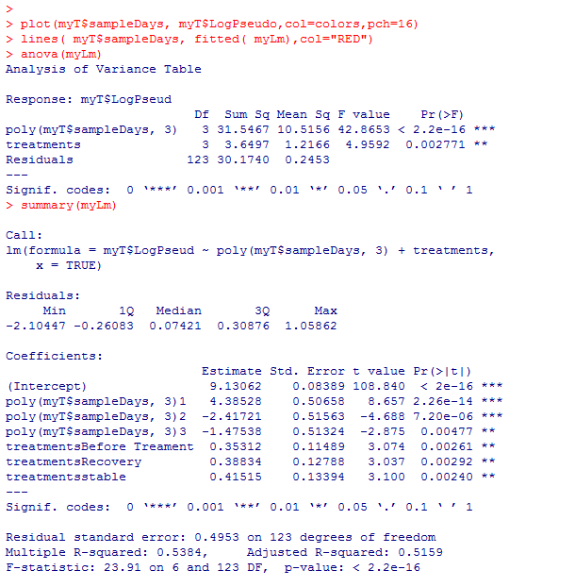
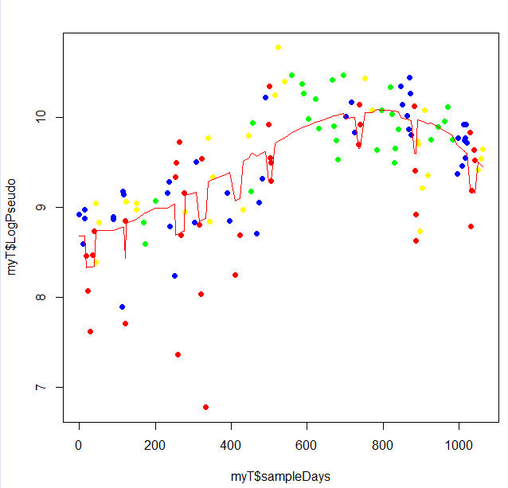
We can add a term for X^3 ( 7 parameter model) ; we still explain significantly more variance

Slide 23
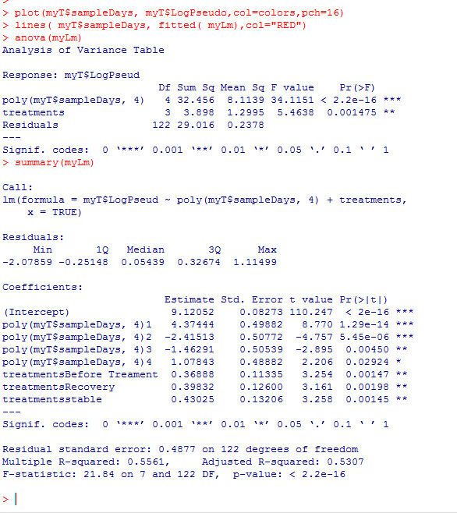
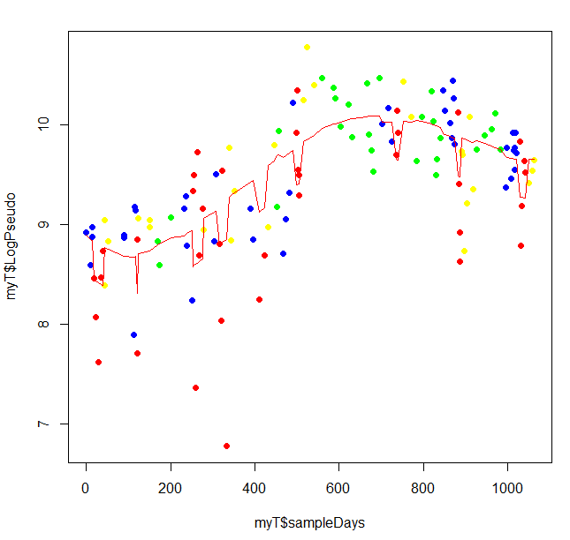
We can add a term for X^4 ( 8 parameter model) ; we still explain significantly more variance

Slide 24
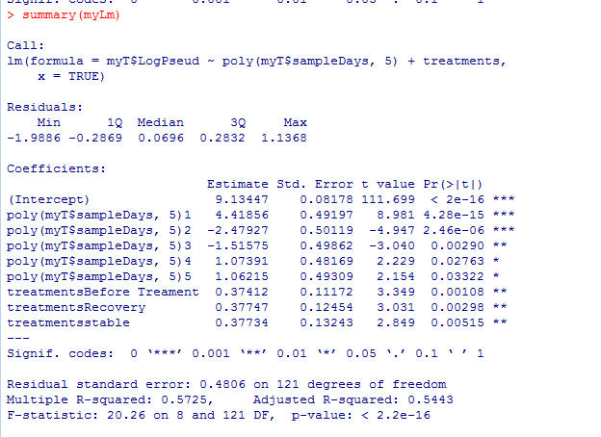
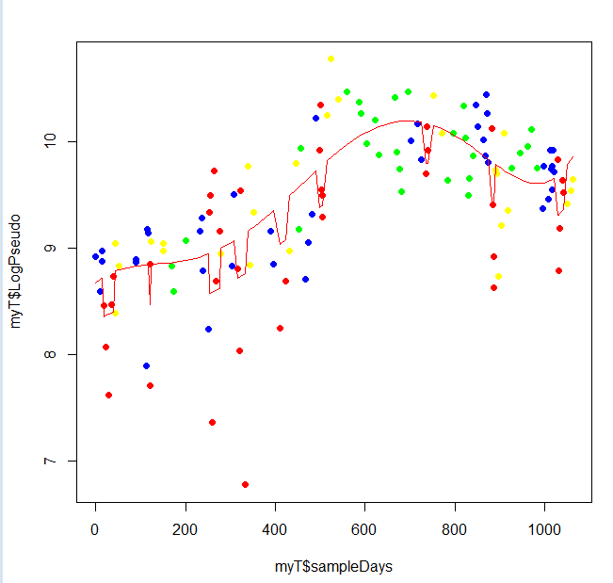
We can add a term for X^5 ( 9 parameter model) ; we still explain significantly more variance

Slide 25
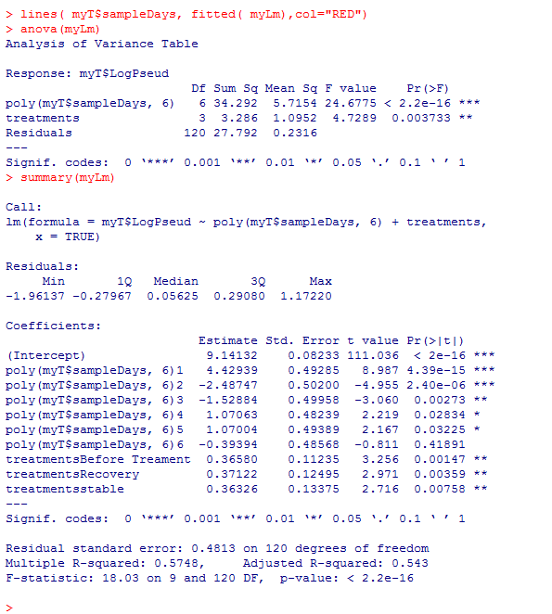
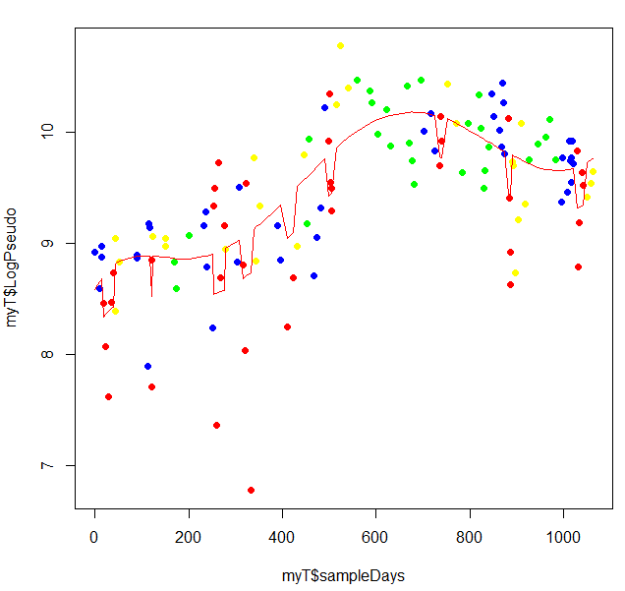
We can add a term for X^6 ( 10 parameter model); the additional parameter doesn’t matter!

Slide 26
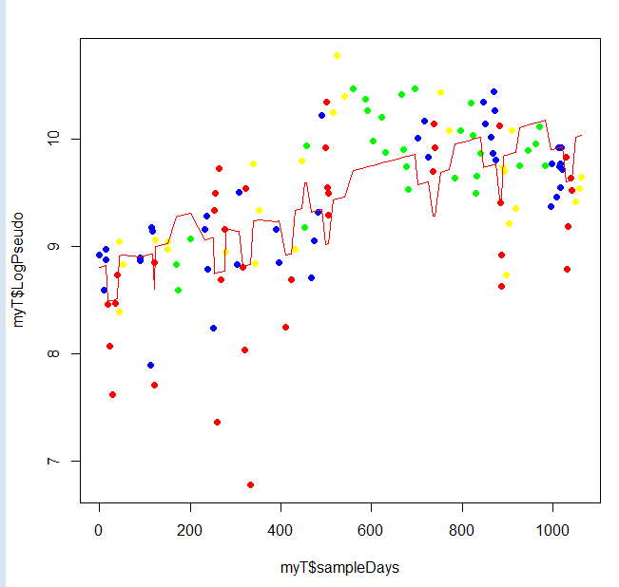
We can visually see the improvement to the fit with increasing parameters…
X
X^2
X^3
X^4
X^5
X^6

Slide 27
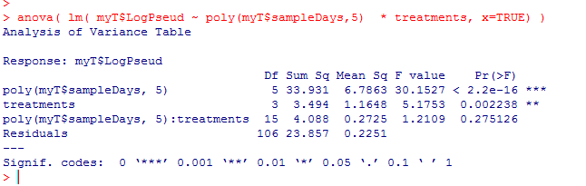
Confirm that the interaction terms are still irrelevant to our x^5 model
They still don’t help. (Which is good because there are 15 interaction terms!)
(5 exponent terms * 3 dummy variables)
{intercept, x, x^2, x^3, x^4, x^5 } + { 3 dummy variables}
So we end up with a 9 parameter model instead of a 24 parameter model
B0 + B1*X + B2*X^2 + B3*X^3 + B4*X^4 + B5*X^5 + {3 dummy intercept params}
+ { 3 dummy variables * 5th order coefficients }

Slide 28
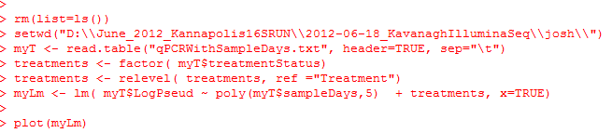
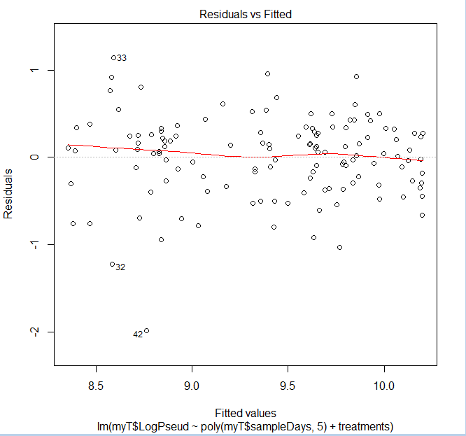
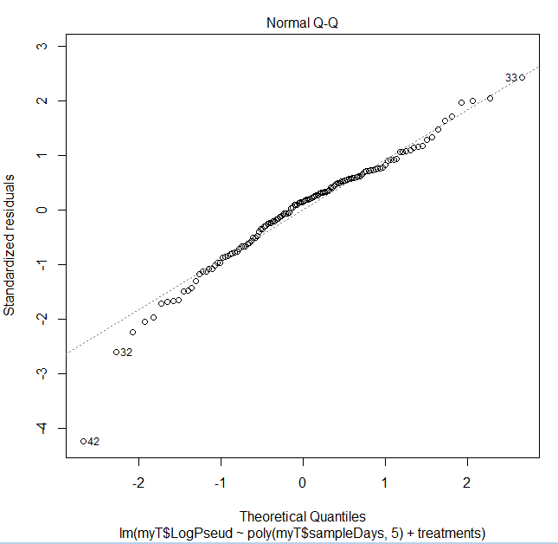

We confirm that the assumption of normality is not blatantly violated by our 9 parameter model

