Slide 1
Assignment #1 - Due Sep 6:
Check your code into a GitHub repository
send afodor@uncc.edu and dwils152@charlotte.edu an e-mail with the link when the code
is checked in and ready to grade.
Alternatively, just send your code to afodor@uncc.edu (but GitHub is preferred)

Slide 2
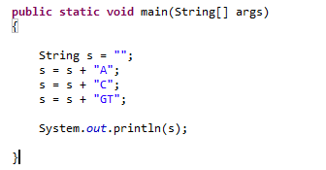
Lab 1 – Random DNA sequences…
The “+” operator is defined to produce String concatenation…
This yields “ACGT”
(For performance reasons, this is sometimes not a good idea, but more on that later!)

Slide 3
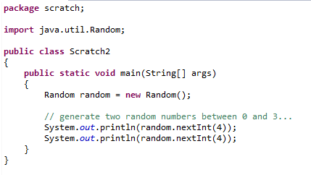
We can use Java’s random number generator to randomly sample
the numbers { 0,1,2,3} from the uniform distribution…
Tell Java we will use the Random class

Slide 4
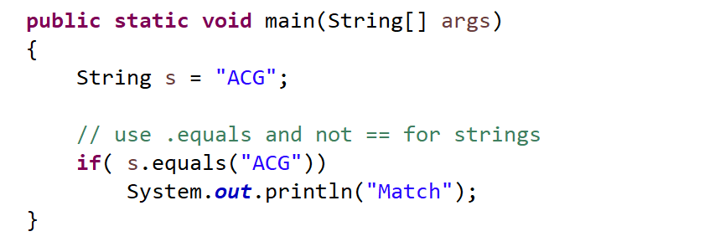
Use .equals (and not ==) to check for the contents of a String
(more on this later….)

Slide 5
For these problems, do not use ChatGPT
(1) Write code to print to the console 1,000 randomly generated
DNA 3 mers (e.g. “ACA”, “TCG” )
where the frequency of A,C,G and T is 25% and is uniformly sampled.
Have your code track how often it prints out the 3 mer (“AAA”)
How often would you expect to see this 3mer by chance? Is Java’s number
close to the number that you would expect?
(3) Modify your code so that the frequency of A,C,G and T is
p(A) = 0.12
p(C) = 0.38
p(G) = 0.39
p(T) = 0.11
What is the expected frequency now of “AAA”? Does Java produce “AAA”
at close to the expected frequency?
Hint the code:
Random random = new Random();
float f = random.nextFloat();
produces a random number uniformly between 0 and 1.
(see next slide….)

Slide 6
Extra credit
Use ChatGTP to generate code for (3) on the previous slide.
What are some ways to prove that your code and ChatGTP’s code are
working identically despite the output of random sequences?
(One possible solution: compare the distribution of nucleotides from ChatGTP with your
code and use a chi-square to test the null hypothesis that the two distributions are the same.
Repeat this chi-square test on independent runs and show that the resulting distribution
of p-values are uniformly distributed )
Hint: This might help
http://www.vvlasov.com/2013/06/how-to-calculate-pvalue-from-chisquare.html

