Slide 1
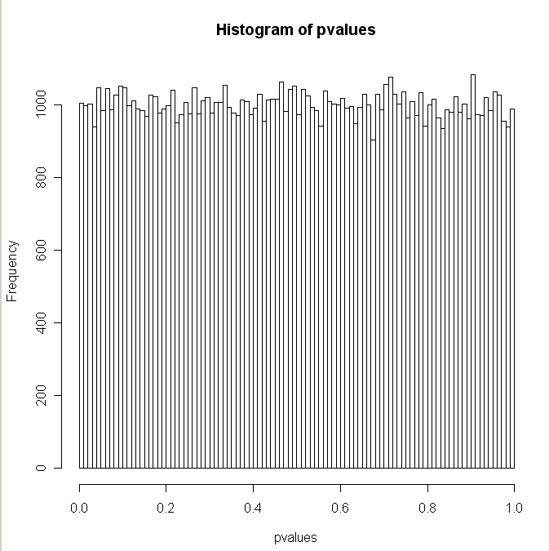
Why can’t we just use the Z-test all the time
Let’s re-visit our sanity check, this time with a sampleSize of 10
rm(list=ls())
s <- seq(1,100000)
pvalues <- array();
for( i in s )
{
sampleSize <-10
myVector <- rnorm(sampleSize,mean=100,sd=12)
stderr = 12 / sqrt(sampleSize)
zVal = -abs( (mean(myVector)-100)/stderr)
pvalues[i]=2 * pnorm(zVal)
}
hist(pvalues,breaks=100)
All is well, but we have to know ahead of time that the
distribution standardDeviation is 12.
Most of the time, we don’t know the standard Deviation.
We have to estimate it!

Slide 2
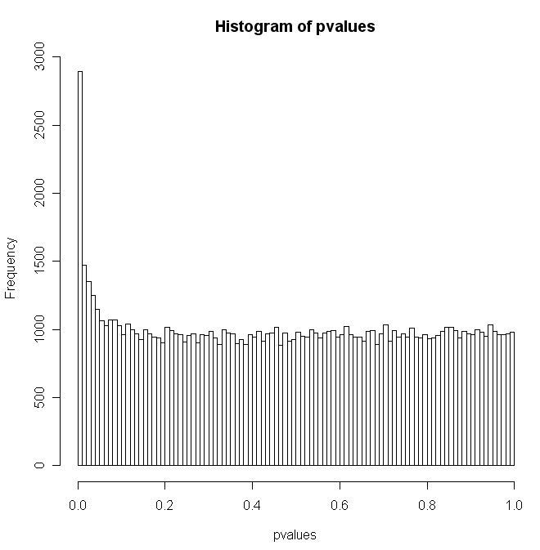
If we try and estimate the standard deviation from our 10 samples,
our z-test is no longer accurate
rm(list=ls())
s <- seq(1,100000)
pvalues <- array();
for( i in s )
{
sampleSize <-10
myVector <- rnorm(sampleSize,mean=100,sd=12)
stderr = sd(myVector) / sqrt(sampleSize)
zVal = -abs( (mean(myVector)-100)/stderr)
pvalues[i]=2 * pnorm(zVal)
}
hist(pvalues,breaks=100)
Very bad!
We have to estimate the standard deviation from the data we have…
Now our test that we have a mean different from 100 fails (even
though the data was generated with a mean of 100).
There is “error” in our estimate of standard error that we need to account for…

Slide 3
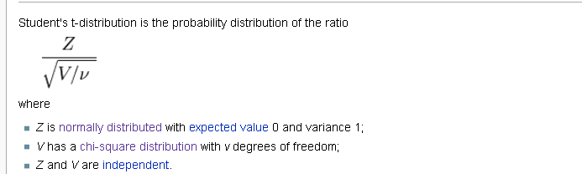
The t-distribution is used when you have to estimate the standard deviation from
the sample (i.e. you don’t know it ahead of time).
As v approaches infinity, the t-distribution becomes the normal distribution.
Which makes sense; as our sample size grows larger, we are more
confident that we know the true standard deviation, so we don’t have to
correct for our error in our estimate of standard error.
By the law of large numbers, as d.f. approaches infinity, the
chi-squared sum will approach the expected sum and the denominator will
approach 1
http://en.wikipedia.org/wiki/Student%27s_t-distribution

Slide 4
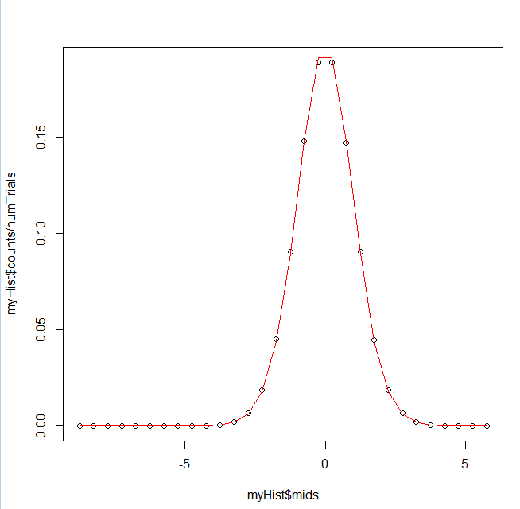
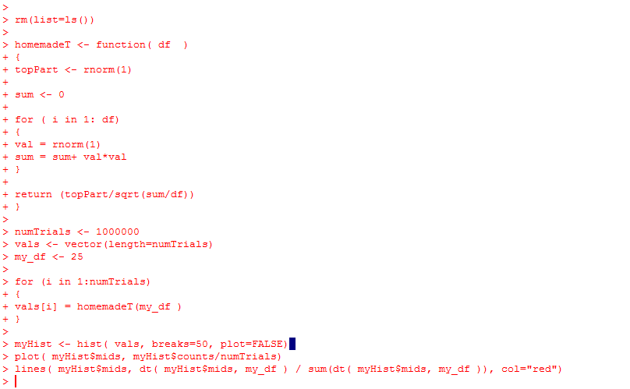
As usual, we can prove to ourselves that we understand dt…
https://github.com/afodor/metagenomicsTools/blob/master/src/classExamples/tExample

Slide 5
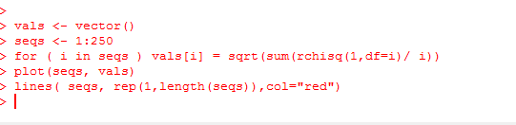
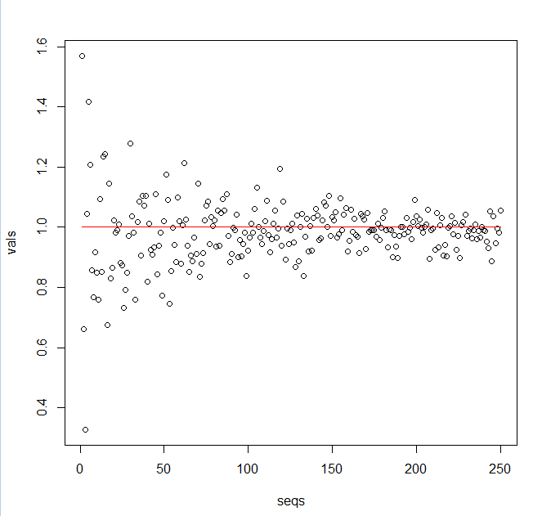
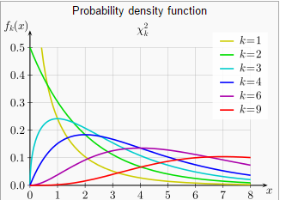
As v approaches infinity, the
denominator approaches 1
and the t-distribution approaches the
z-distribution
Since the sum can’t be below zero,
at small d.f., V has more of its area below v,
So V/v is often > 1, which means T is wider than Z…

Slide 6
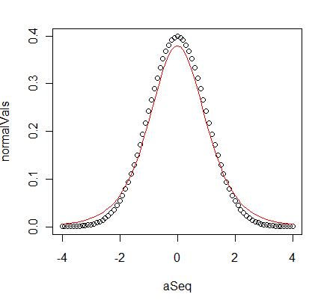
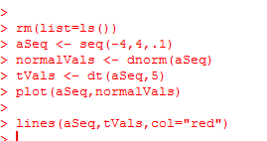
At df=5, there is a big difference between the t-distribution and normal
dT is wider than dNorm

Slide 7
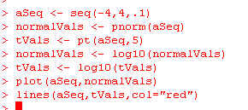
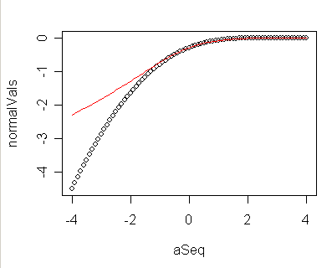
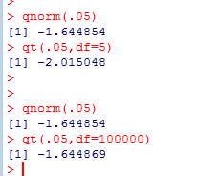
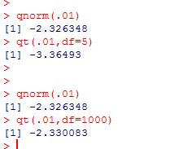
At df=5, there is a big difference between the t-distribution and normal
-log10(pValue)
# of standard deviations
You have to get further away from the center to get the same pValue (at df=5)

Slide 8
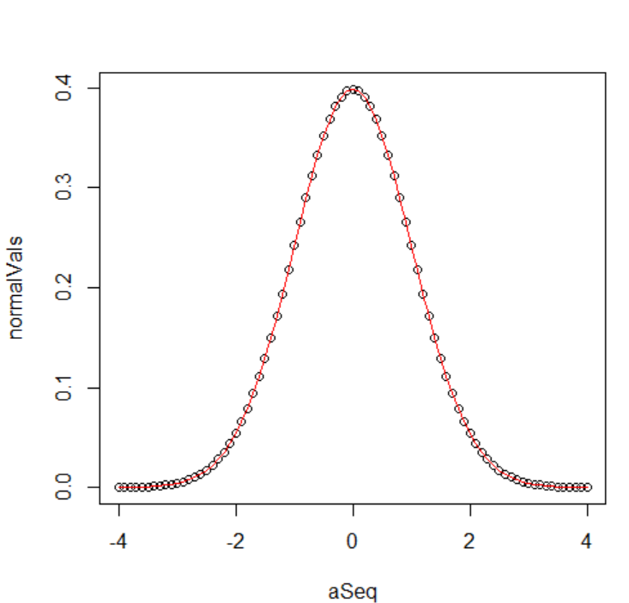
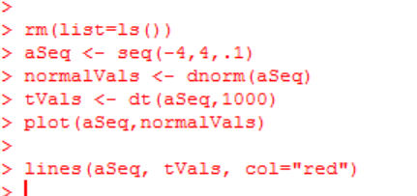
At df=1000, the normal and t distributions are essentially the same…

Slide 9
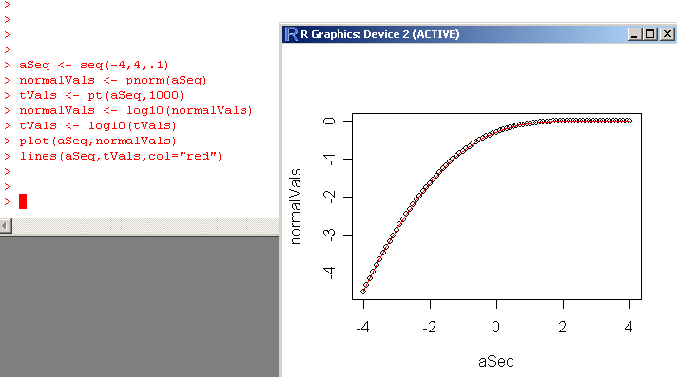
At df=1000, the normal and t distributions are essentially the same…

Slide 10
If we try and estimate the standard deviation from our 10 samples,
our z-test is no longer accurate
rm(list=ls())
s <- seq(1,100000)
pvalues <- array();
for( i in s )
{
sampleSize <-10
myVector <- rnorm(sampleSize,mean=100,sd=12)
stderr = sd(myVector) / sqrt(sampleSize)
zVal = -abs( (mean(myVector)-100)/stderr)
pvalues[i]=2 * pnorm(zVal)
}
hist(pvalues,breaks=100)
Very bad!
We have to estimate the standard deviation from the data we have…
Now our test that we have a mean different from 100 fails (even
though the data was generated with a mean of 100).
There is “error” in our estimate of standard error that we need to account for…

Slide 11
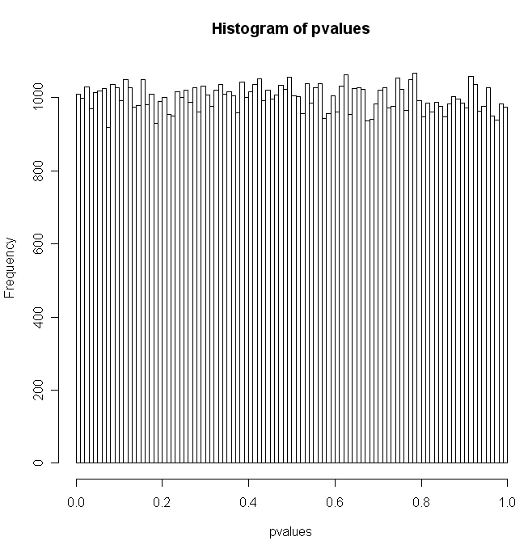
So the vast majority of the time, we have to estimate the standard deviation.
We can make one more change to our code to recover our uniform distribution..
rm(list=ls())
s <- seq(1,100000)
pvalues <- array();
for( i in s )
{
sampleSize <-10
myVector <- rnorm(sampleSize,mean=100,sd=12)
stderr = sd(myVector) / sqrt(sampleSize)
zVal = -abs( (mean(myVector)-100)/stderr)
pvalues[i]=2 * pt(zVal,sampleSize-1)
}
hist(pvalues,breaks=100)
The t-distribution is used when you have to estimate the standard deviation from
the sample (i.e. you don’t know it ahead of time).
We switch from pnorm to pt and all is well

Slide 12




Why does this work?
We define
with mean μ and variance σ²
If we define the Z distribution as
the mean of Z will be zero (because we have subtracted μ
and the variance will be 1 since the variance of
)
= variance of (
) = σ² / n
So to correct for that we multiply by
since multiplying a distribution by X changes the variance by X²
So we can use the Z distribution for inference if we know μ and the variance is σ²
ahead of time…
https://en.wikipedia.org/wiki/Student%27s_t-distribution

Slide 13
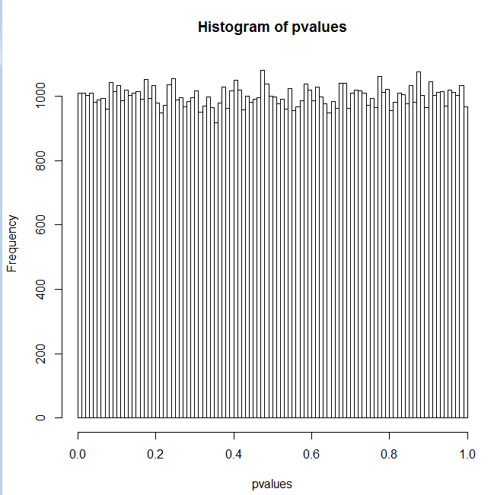

So we can use the Z distribution for inference if we know μ and the variance is σ²
ahead of time…
rm(list=ls())
s <- seq(1,100000)
pvalues <- vector(length=length(s));
zVals <- vector(length=length(s));
for( i in s )
{
sampleSize <-10
myVector <- rnorm(sampleSize,mean=100,sd=12)
zVals[i] = (mean(myVector)-100) * sqrt(sampleSize)/12
pvalues[i]=2 * pnorm(-abs(zVals[i]))
}
hist(pvalues,breaks=100)
mean(zVals)
sd(zVals)

Slide 14

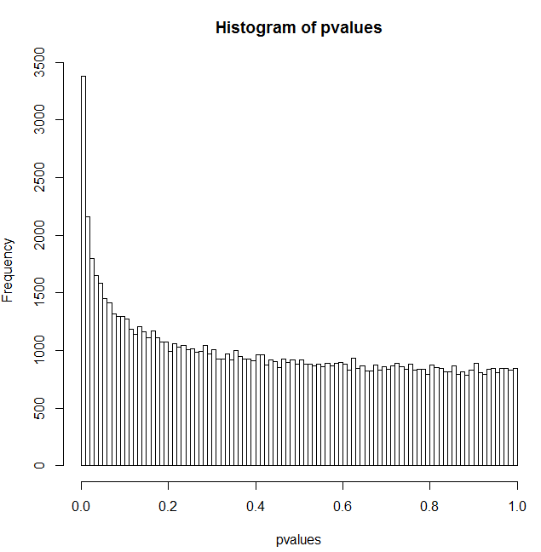

If we estimate the variance from the data, our Z test breaks…
rm(list=ls())
s <- seq(1,100000)
pvalues <- vector(length=length(s));
zVals <- vector(length=length(s));
for( i in s )
{
sampleSize <-10
myVector <- rnorm(sampleSize,mean=100,sd=12)
zVals[i] = (mean(myVector)-100) * sqrt(sampleSize)/sd(myVector)
pvalues[i]=2 * pnorm(-abs(zVals[i]))
}
hist(pvalues,breaks=100)
mean(zVals)
sd(zVals)
becomes
The only change
We are no longer standard normal distributed

Slide 15
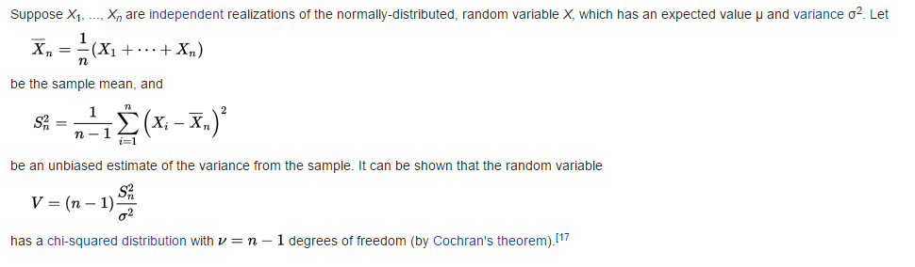
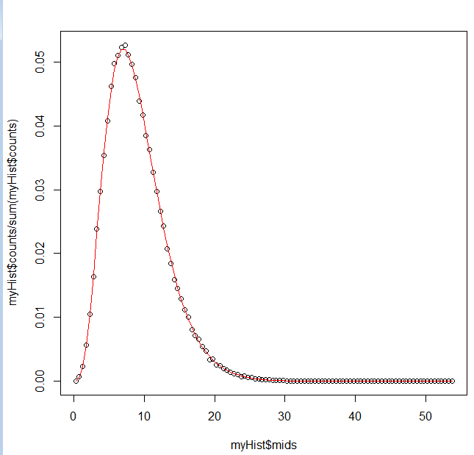
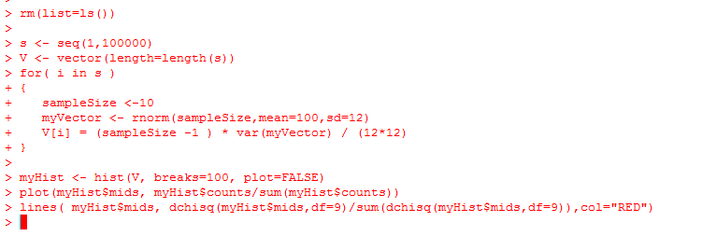
We state without proof…
https://en.wikipedia.org/wiki/Student%27s_t-distribution
https://github.com/afodor/metagenomicsTools/blob/master/src/classExamples/VisChiSquared

Slide 16
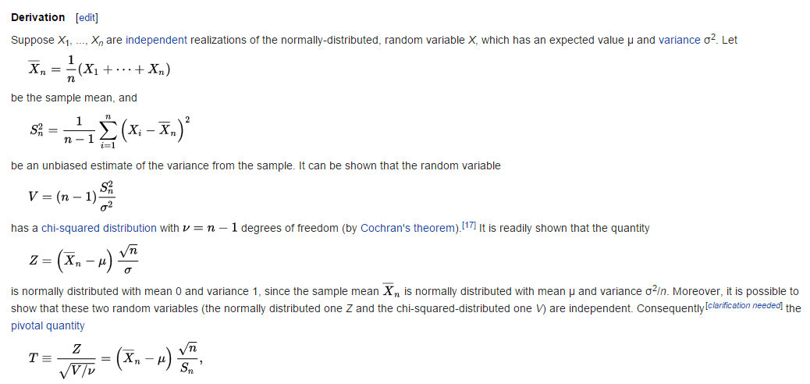
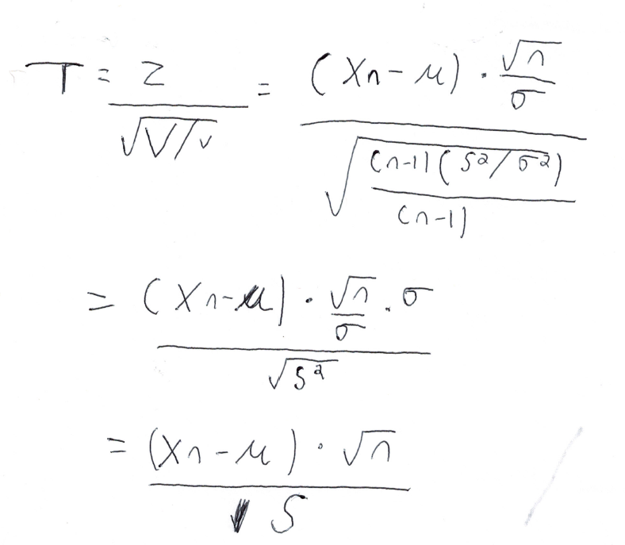
This allows us to derive the proof that the t-distribution is appropriate for variance estimated from the data
The z distribution with the variance known ahead of time
The t distribution
with the variance
estimated

Slide 17
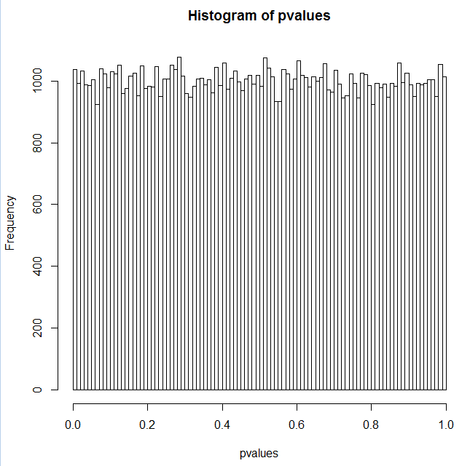
We switch from the Z to the T, and we restore our ability to do inference
rm(list=ls())
s <- seq(1,100000)
pvalues <- vector(length=length(s));
zVals <- vector(length=length(s));
for( i in s )
{
sampleSize <-10
myVector <- rnorm(sampleSize,mean=100,sd=12)
zVals[i] = (mean(myVector)-100) * sqrt(sampleSize)/sd(myVector)
pvalues[i]=2 * pt(-abs(zVals[i]),df=sampleSize-1)
}
hist(pvalues,breaks=100)
becomes

