Slide 1
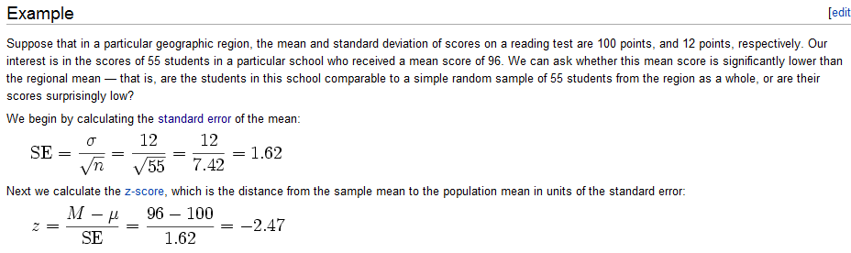
Because of the central limit theorem, the normal distribution is often used for
Inference in canonical statistics…
We start our exploration of using dnorm for inference with an example from the Wiki…
http://en.wikipedia.org/wiki/Z-test

Slide 2


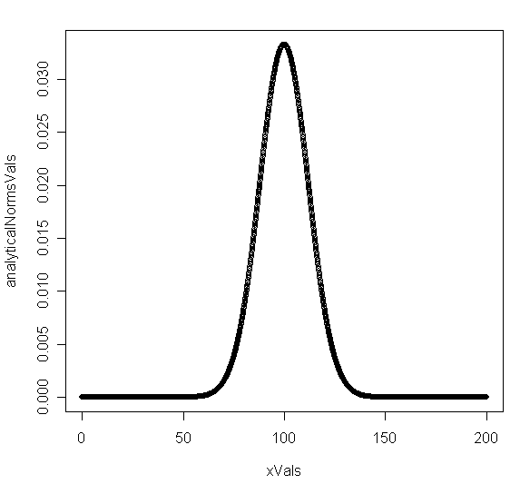
http://en.wikipedia.org/wiki/Z-test
We can model this analytically…
In this case, the mean and variance
are known with certainty…

Slide 3
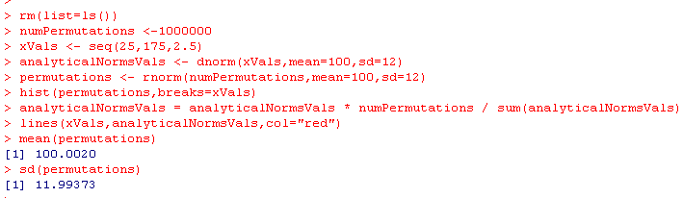
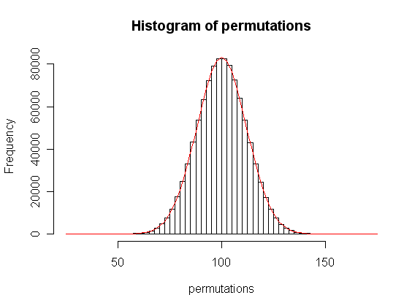
We can model this analytically or through permutations
A mean of 100 and SD of 12 means
the distribution shown to the right…
We are going to transform this
into standard normal form…
Subtract off the mean.
Divide the standard deviation..

Slide 4
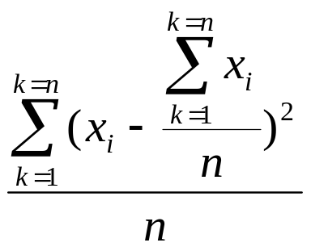
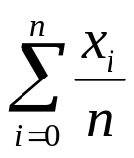
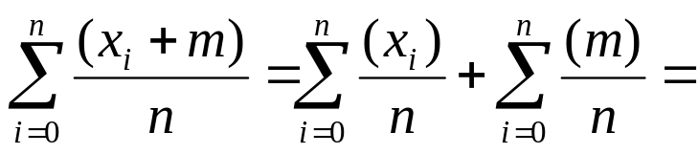
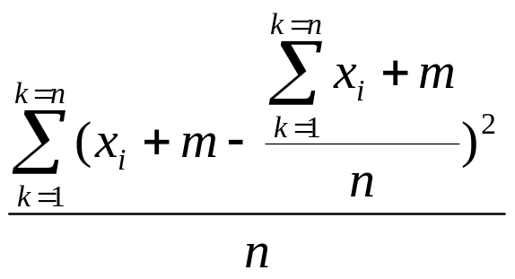
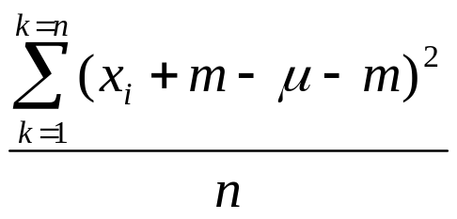
Given a mean μ and a variance σ²
μ =
σ² =
If we add a constant m to each data point:
μ’ =
μ + m
σ^{2’} =
=
=
σ²
So adding a constant to each data point shifts the location of the curve without
changing the variance…

Slide 5
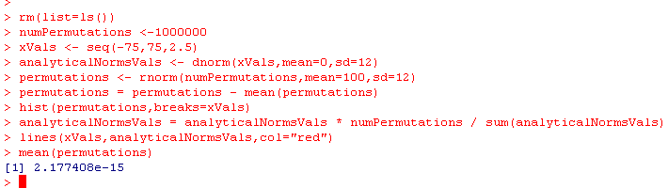
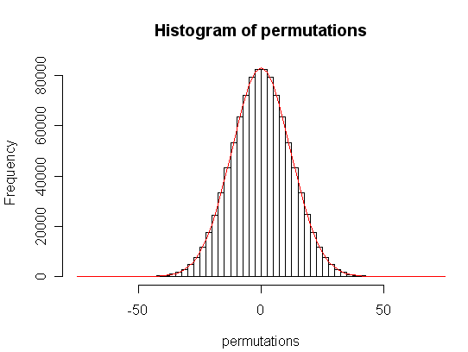
We subtract the mean….

Slide 6
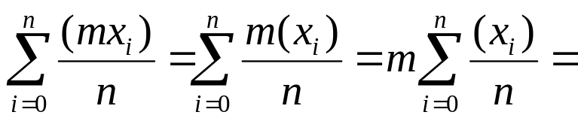
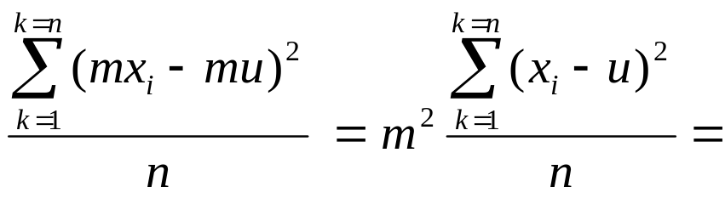
Given a mean μ and a variance σ²
μ =
σ² =
If we multiply each data point by a constant m:
μ’ =
mμ
σ^{2’} =
m²σ²
Since
So each data point by a constant shifts the variance (by m²) (or the SD by m)
as well as shifting the location of the curve by factor of m

Slide 7
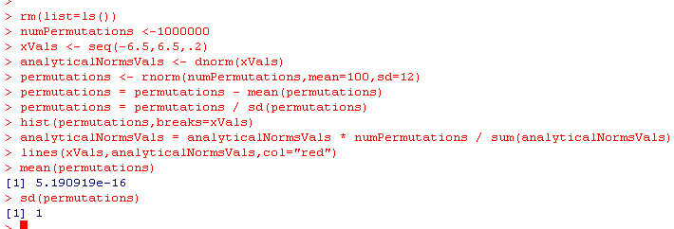
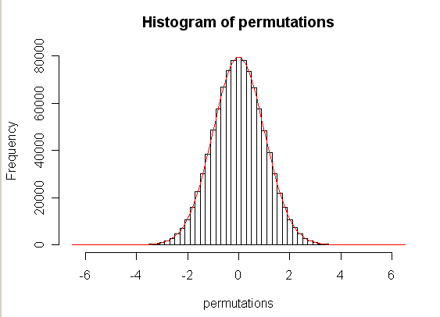
Divide the standard deviation….
mean=0; sd =1 by default
New mean = 0 * (1/sd) = 0
This is now a
standard normal distribution..
mean = 0
sd = 1

Slide 8
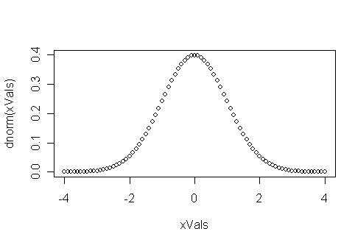

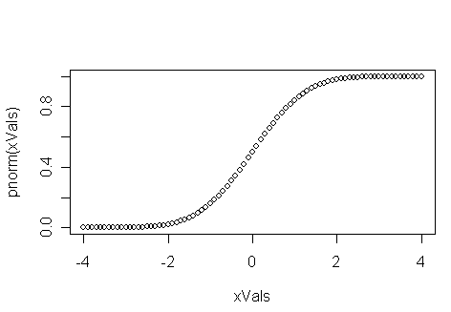


The standard normal distribution….
Intuitively, what is the probability of falling the # of Standard deviations shown on
the x-axis
So for a two-sided test, 2 standard deviations is ~ 0.05

Slide 9
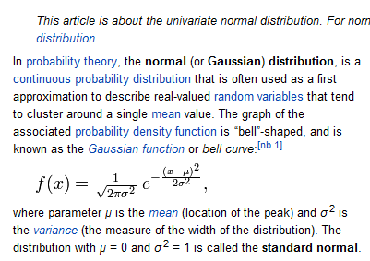
http://en.wikipedia.org/wiki/Normal_distribution

Slide 10

Just with this, we can do some inference
We have a single student who scores a 125.
Null hypothesis: The student was drawn from the same geographic region
Z = (125 – 100 )
12
Correct for
2 sided test…

Slide 11
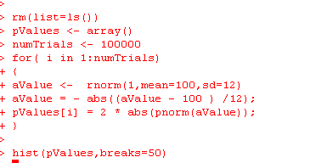
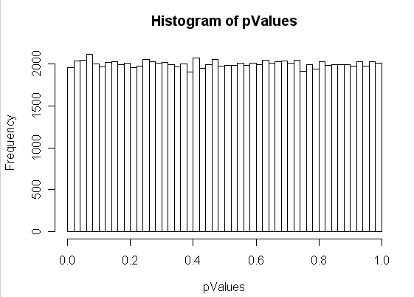
Sanity check. Choosing a single value from a norm(u=100; sd=15) distribution will yield
a uniform distribution of p-values..

Slide 12
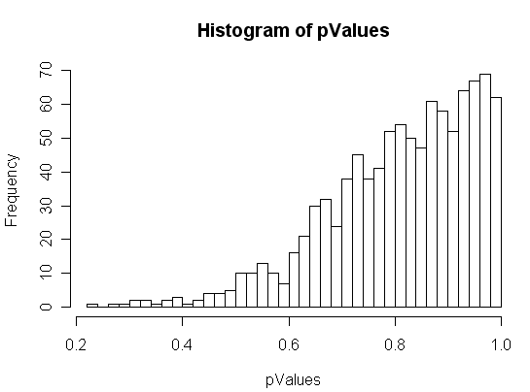
Let’s say that we increase the # of students we see with a score of 100 to 10
rm(list=ls())
pValues <- array()
numTrials <- 1000
for( i in 1:numTrials)
{
manyValues <- rnorm(10,mean=100,sd=12)
manyValues = - abs(( mean(manyValues) - 100 ) /12);
pValues[i] = 2 * abs(pnorm(manyValues));
}
hist(pValues,breaks=50)
This breaks.
The averages are closer to 100 than
our z-test is expecting!
Seeing a score of 100 one time
is different than seeing an average
of 100 from an n of 10.
We need to put into our test
statistic information about how
large our sample sizes are…

Slide 13
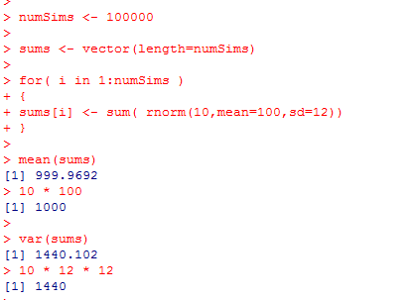
How does the variance change with increased sample size?
We sample 10 students (with an average exam score μ=100 and SD = 12)
Define Σ Y as the sum of these 10 scores.
The expected value (mean) for Σ Y is n * μ = 1,000
The expected variance of the sum is n * sd²
For each draw, we expect a variance from the mean of:
Σ (Yi – μ )² = sd²
1
So for n draws, we expect to see
n * the variance for one draw =
n *sd²
(remember the SD is known ahead of time and
is not dependent on a particular observed sample
size)

Slide 14
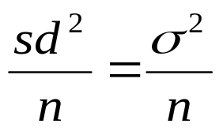
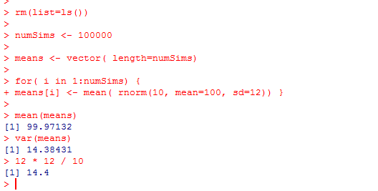
The expected variance of the sum is n * sd²
What we want is the variance of the mean
We get this by dividing each of the n observations by n
If we divide each data point by n
E(value of mean) = n * μ / n = μ
E(variance of the mean) =
(since the mean will shift by 1/n and the variance will shift by (1/n)²
when dividing each data point by n )

Slide 15
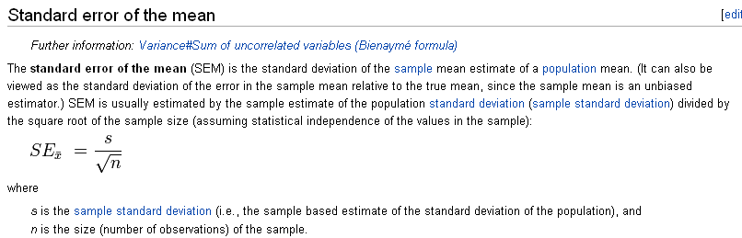
The square root of
defines the standard error of the mean
How much error can we expect in an estimate of a mean from a normal sample
given a sample size n…
http://en.wikipedia.org/wiki/Standard_error#Standard_error_of_the_mean

Slide 16
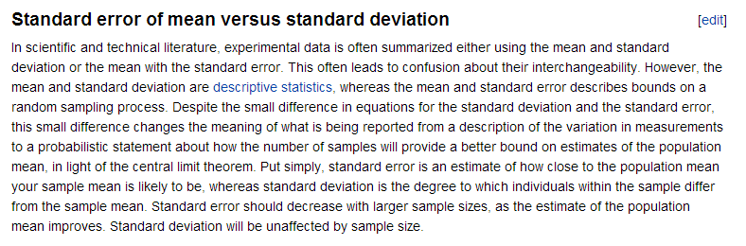
The Wiki has a nice description of standard error of the mean vs. SD
http://en.wikipedia.org/wiki/Standard_error#Standard_error_of_the_mean

Slide 17
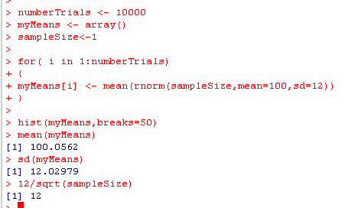
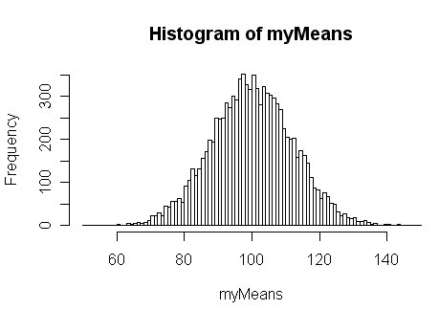
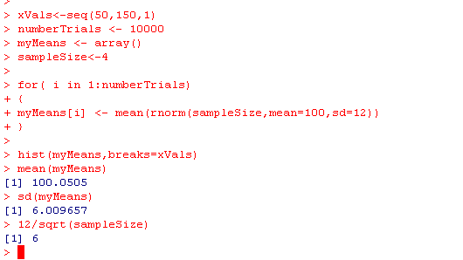
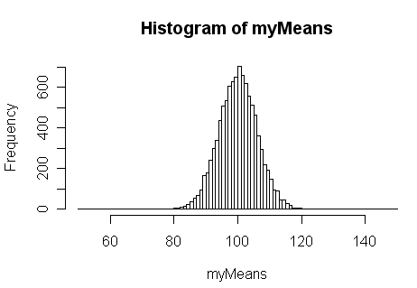
With a sample size of 1…
Sample size =1
E(mean)=100
E(SD) = 12 / 1
Sample size =4
E(mean)=100
E(SD) = 12 / sqrt(4)

Slide 18
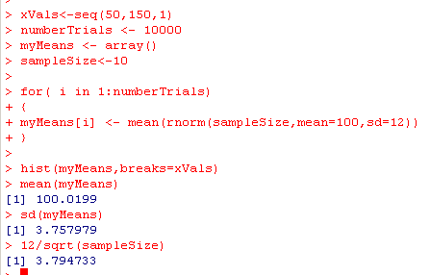
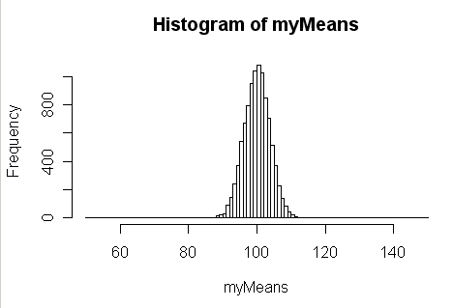
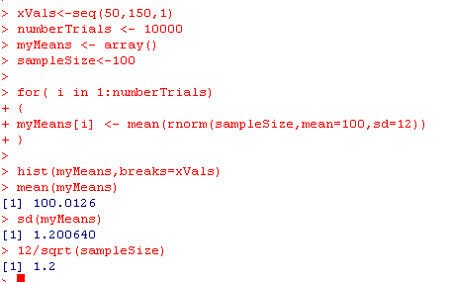
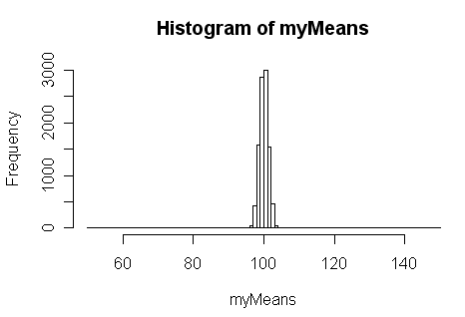
Sample size =10
E(mean)=100
E(SD) = 12 / sqrt(10)
Sample size =100
E(mean)=100
E(SD) = 12 / sqrt(100)

Slide 19
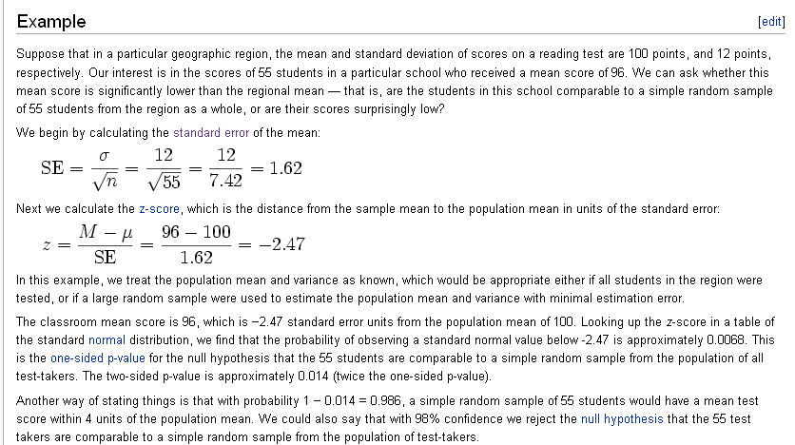
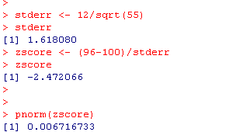
The Z-test compares a sample distribution to a known normal distribution
An example of inference from the Z-test.
http://en.wikipedia.org/wiki/Z-test
One sided

Slide 20
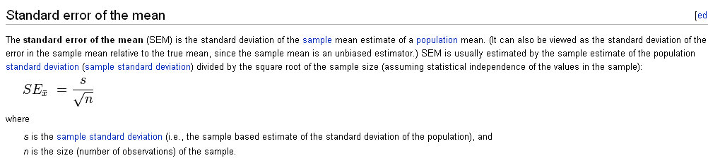

If n=1, the Z-test =
M-u
s
Your p-value is just determined by the # of standard deviations you are from the mean
If n > 1, sampling from a null population (i.e. that has no real difference)
will be closer to the mean because of the repeated sampling.
If n = infinity, any difference from the mean, no matter how small, can
be significant with a p-value of 0.
A problem if your assumptions are not exactly true.
This is a problem for bioinformatics, since we have very large sample sizes
(as we will see)

Slide 21
To return to our broken example…
rm(list=ls())
pValues <- array()
numTrials <- 1000
for( i in 1:numTrials)
{
aValue <- rnorm(10,mean=100,sd=12)
aValue = - abs(( mean(aValue) - 100 ) /12);
pValues[i] = 2 * abs(pnorm(aValue));
}
hist(pValues,breaks=50)
This breaks.
Seeing a score of 100 one time
is different than seeing it 10 times.
We need to put into our test
statistic information about how
large our sample sizes are…

Slide 22
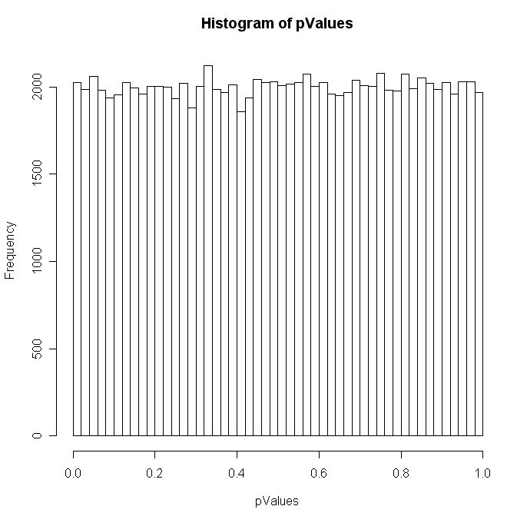
Replace the standard deviation with the standard error of the mean and all is well…
rm(list=ls())
pValues <- array()
numTrials <- 100000
for( i in 1:numTrials)
{
aValue <- rnorm(10,mean=100,sd=12)
aValue = - abs(( mean(aValue) - 100 ) / (12/sqrt(10)));
pValues[i] = 2 * abs(pnorm(aValue));
}
hist(pValues,breaks=50)

Slide 23
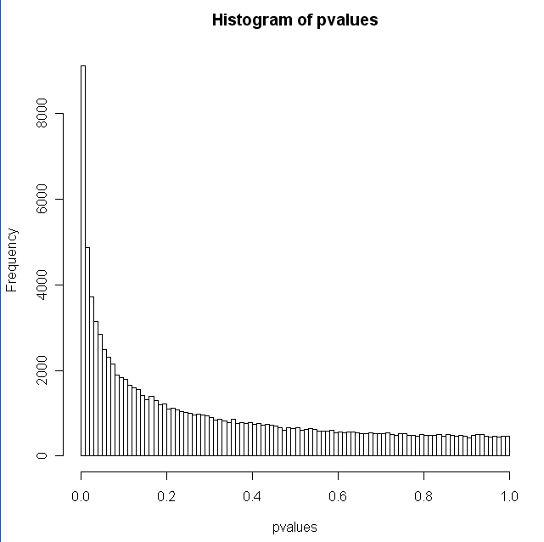
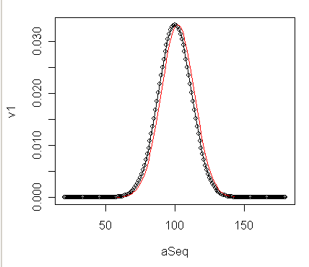
A sanity-check.
P-values calculated by the z-test from a differently distributed sample,
should be non-uniform
rm(list=ls())
s <- seq(1,100000)
pvalues <- array();
for( i in s )
{
sampleSize <-55
myVector <- rnorm(sampleSize,mean=102,sd=12)
stderr = 12 / sqrt(sampleSize)
zVal = -abs( (mean(myVector)-100)/stderr)
pvalues[i]=2 * pnorm(zVal)
}
hist(pvalues,breaks=100)
Move it over a little
You always have to ask yourself: it’s a significant difference, but is it a meaningful difference?

