Slide 1
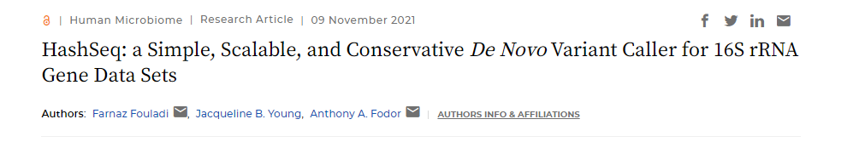
https://journals.asm.org/doi/full/10.1128/mSystems.00697-21

Slide 2
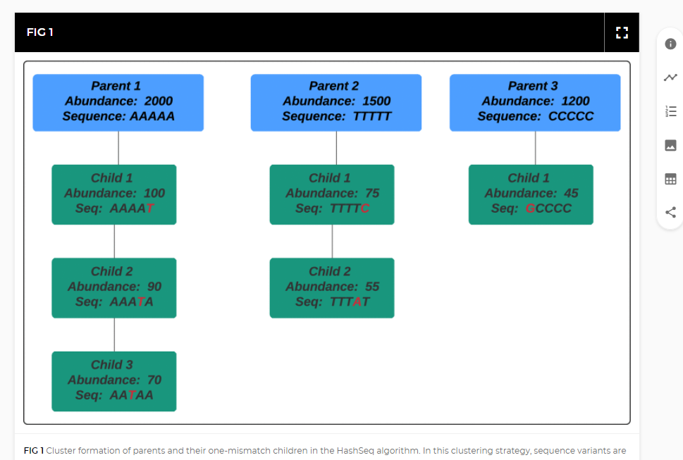

Slide 3
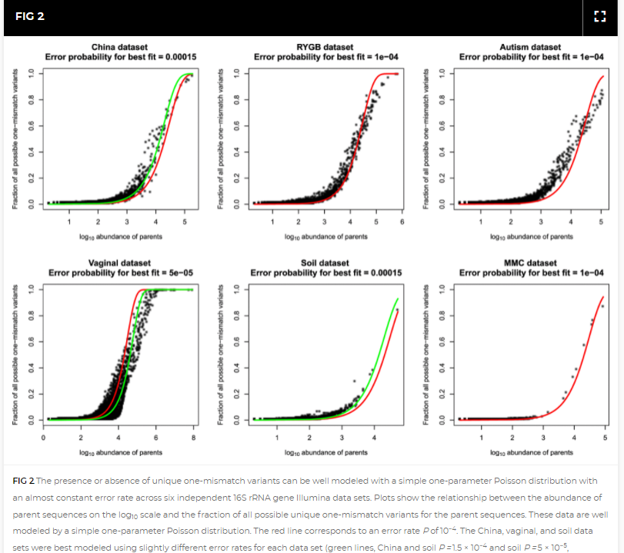

Slide 4
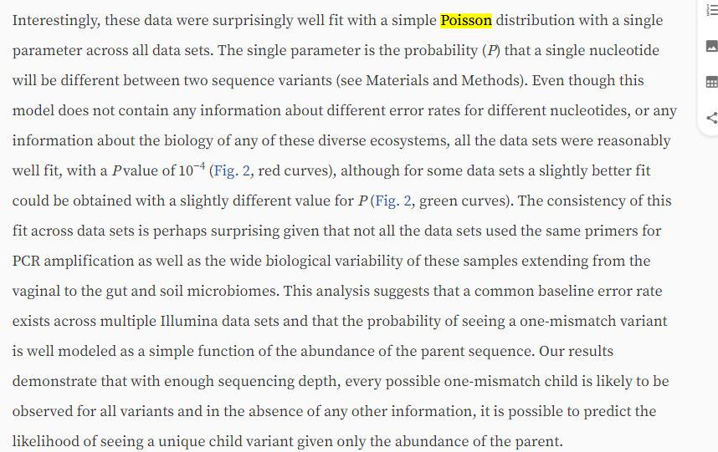

Slide 5
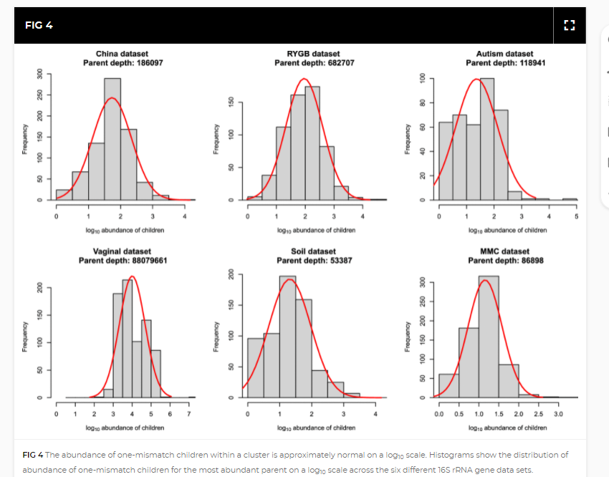

Slide 6
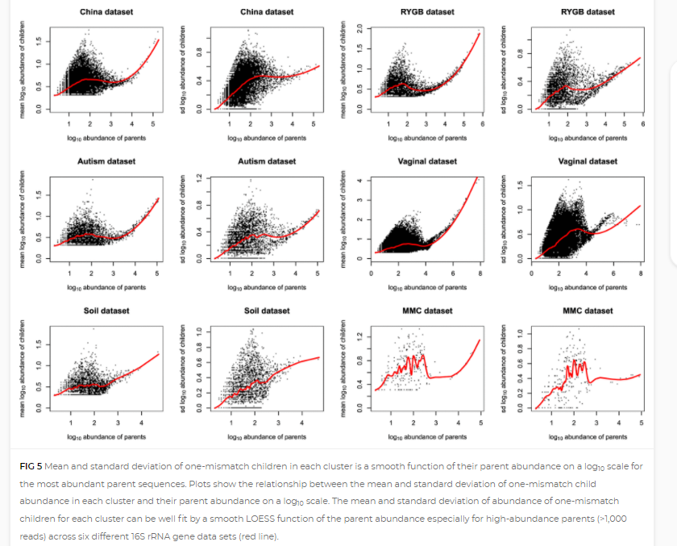

Slide 8
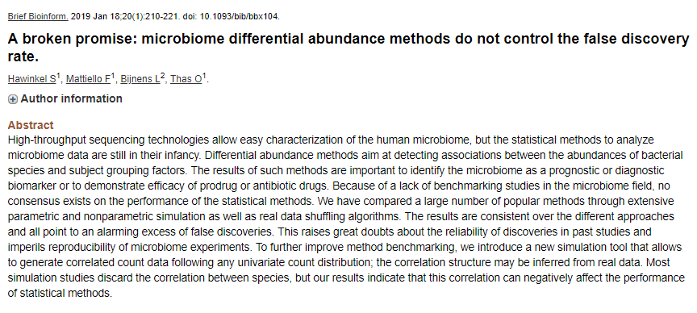
How to set threshold of significance in genomics is not a solved problem..

Slide 9
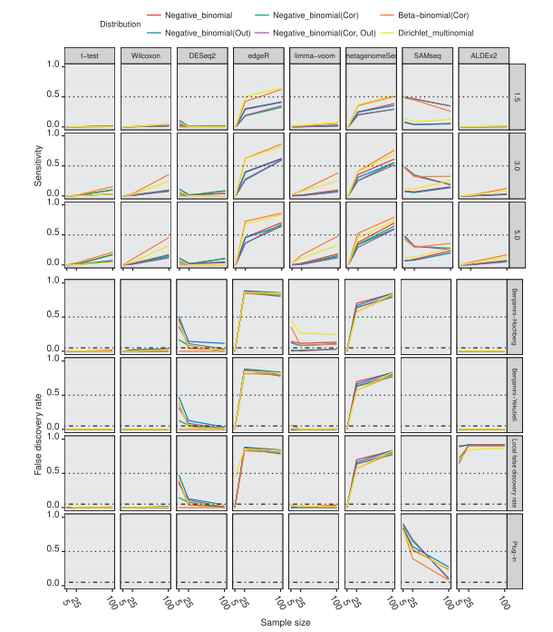
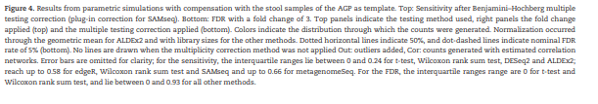
It is not difficult to find simulated datasets that “break”
the FDR thresholds produced by popular software
packages (such as DeSeq and FDR).
Often simpler models (such as the t-test and
Wilcoxon, that we will cover shortly) offer better
performance…

Slide 10
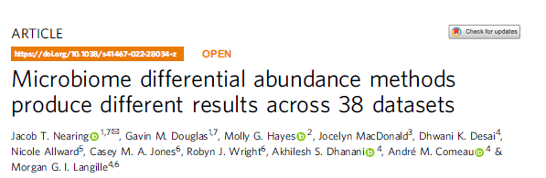
If you are interested in further reading…

Slide 11
