Slide 1
Assignment #1 - Due Sep 4:
Check your code into a GitHub repository
send afodor@uncc.edu an e-mail with the link when the code
is checked in and ready to grade.
Alternatively, just send your code to afodor@uncc.edu (but GitHub is preferred)

Slide 2
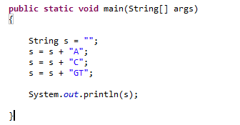
Lab 1 – Random DNA sequences…
The “+” operator is defined to produce String concatenation…
This yields “ACGT”
(For performance reasons, this is sometimes not a good idea, but more on that later!)

Slide 3
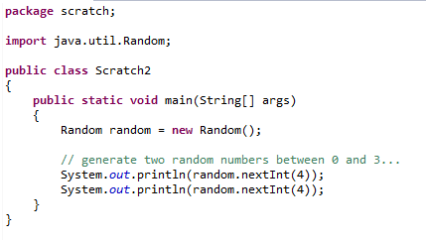
We can use Java’s random number generator to randomly sample
the numbers { 0,1,2,3} from the uniform distribution…
Tell Java we will use the Random class

Slide 4
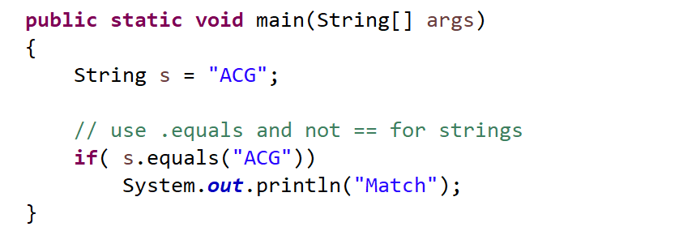
Use .equals (and not ==) to check for the contents of a String
(more on this later….)

Slide 5
For these problems, try not to use ChatGPT (or another AI)
(if you get stuck on (3) you can use an AI or check with me for hints)
(1) Write code to print to the console 1,000 randomly generated
DNA 3 mers (e.g. “ACA”, “TCG” )
where the frequency of A,C,G and T is 25% and is uniformly sampled.
Have your code track how often it prints out the 3 mer (“AAA”)
How often would you expect to see this 3mer by chance? Is Java’s number
close to the number that you would expect?
(3) Modify your code so that the frequency of A,C,G and T is
p(A) = 0.12
p(C) = 0.38
p(G) = 0.39
p(T) = 0.11
What is the expected frequency now of “AAA”? Does Java produce “AAA”
at close to the expected frequency?
Hint the code:
Random random = new Random();
float f = random.nextFloat();
produces a random number uniformly between 0 and 1.
(see next slide….)

Slide 6
Use ChatGTP or another AI to generate code for (3) on the previous slide.
What are some ways to establish that the AI code is working
correctly despite the output of random sequences?
Outline your attempts to test the code and whether you think it is working correctly.
(Include the AI code and any code you or the AI wrote to test the AI code!)
(One advanced possible solution for those that have had some stats:
compare the distribution of nucleotides from ChatGTP to
the expected value and use a chi-square to test the null hypothesis that the two
distributions are the same. Repeat this chi-square test on independent runs and show that the
resulting distribution of p-values are uniformly distributed )
Hint: This might help
http://www.vvlasov.com/2013/06/how-to-calculate-pvalue-from-chisquare.html
Or ask ChatGPT for implementations!
Remember to properly document when you have used AI-generated code!

Slide 7
Extra credit:
Modify your code and test code to work on protein sequences
so that random sequences are generated with the background frequency
of proteins in SwissProt:
https://web.expasy.org/protscale/pscale/A.A.Swiss-Prot.html
How do you test your (or AI code) to make sure that protein sequences
match the expected background levels?

