Slide 1
Boxing and autoboxing
Towards GUIs

Slide 2
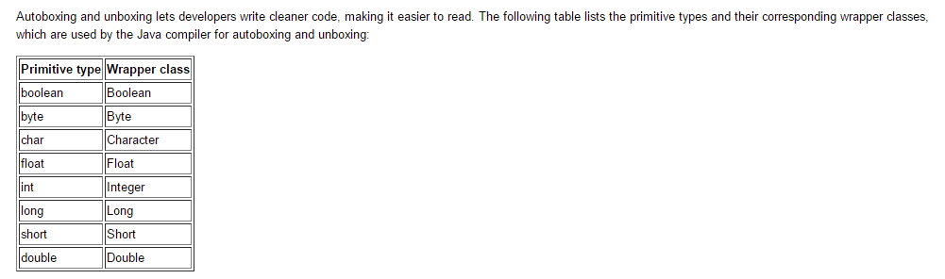
The basic types in Java all have “wrapper” classes
int
Integer
basic type
Wrapper class
https://docs.oracle.com/javase/tutorial/java/data/autoboxing.html

Slide 3
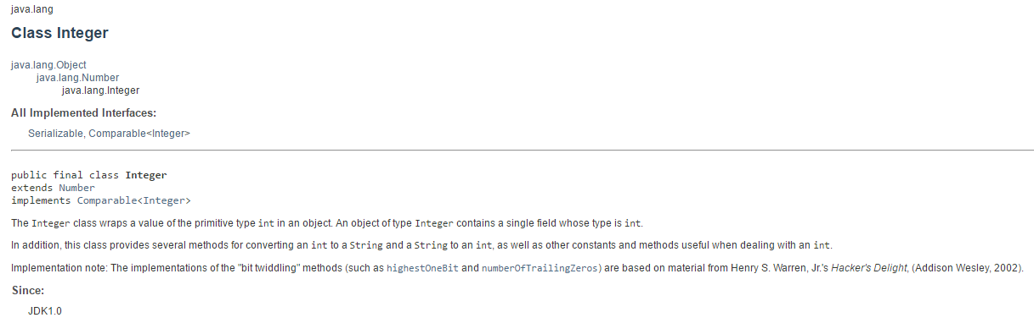

Slide 4
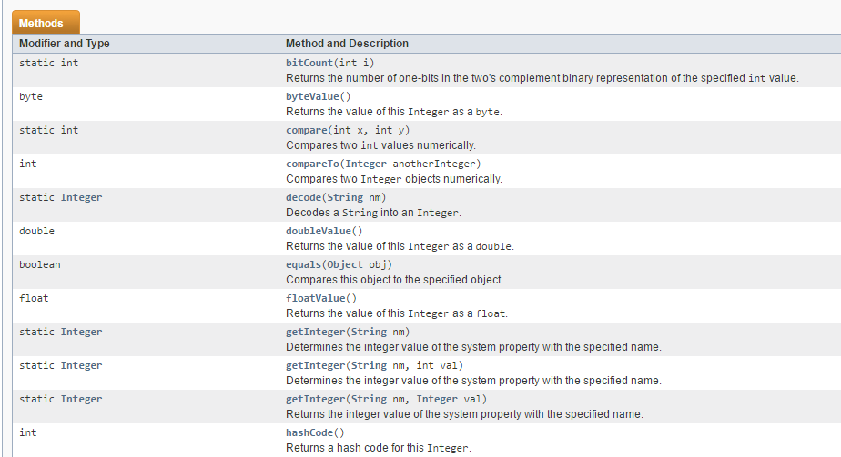
The methods are generally quite easy to understand…

Slide 5
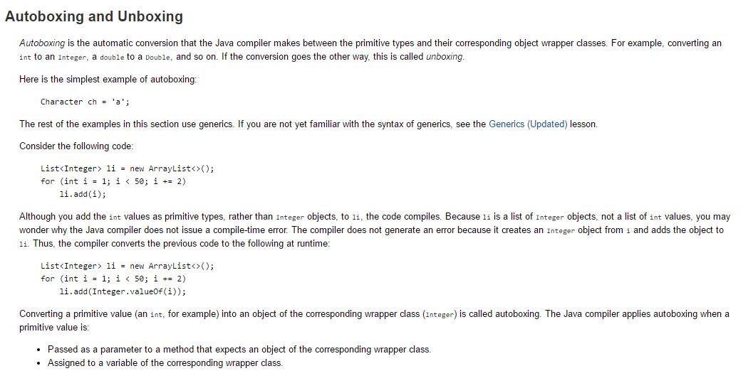
Java’s collection API requires the Wrapper classes and not
the basic types…
Java will convert back and forth automatically.
This is called “autoboxing” and “unboxing”
https://docs.oracle.com/javase/tutorial/java/data/autoboxing.html

Slide 6
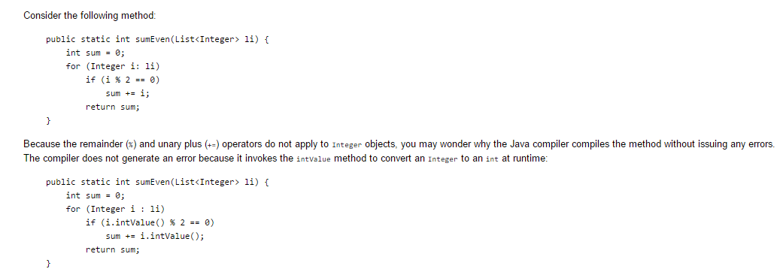
This is so intuitive that you don’t really need to think about it most of the time…
https://docs.oracle.com/javase/tutorial/java/data/autoboxing.html

Slide 7
Starting on GUIs
A version of the “Double or Nothing” gui is here:
https://github.com/afodor/metagenomicsTools/blob/master/src/classExamples/gui/DoubleOrNothing.java

Slide 8
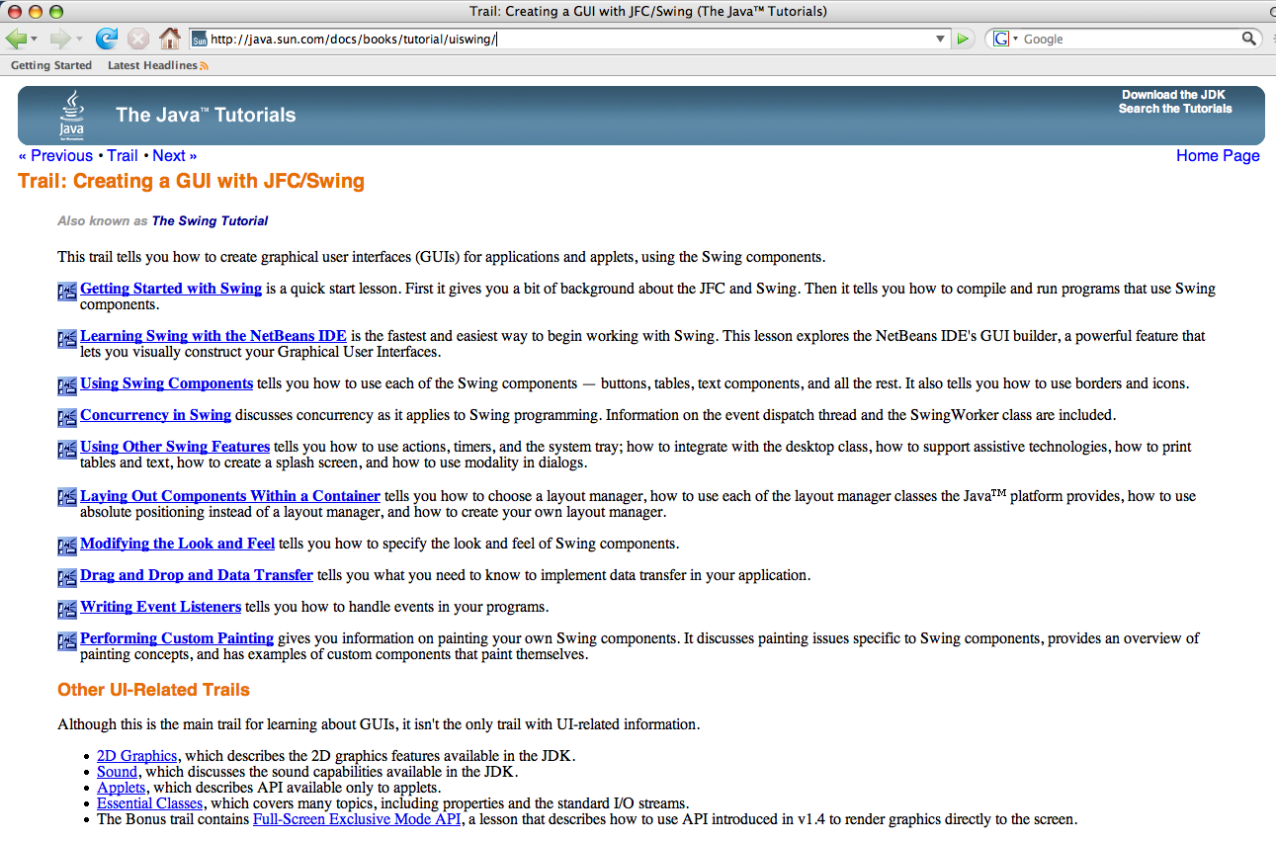
http://java.sun.com/docs/books/tutorial/uiswing/

Slide 9
A JFrame is the top GUI level to which we add stuff.
(Alternatively, if you want your program to run inside
a browser, you can use a JApplet - we won’t talk about that
this semester unless by popular demand).
(Most interactive web pages were done in Macromedia Flash
but now we havelots of fancy JavaScript tricks collectively called
AJAX (e.g. Google Maps, gmail, etc.) or with the many
capabilities in HTML5)

Slide 10
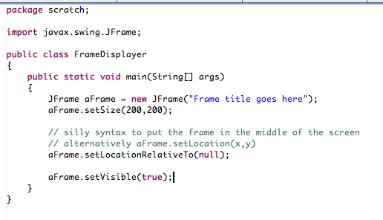

Slide 11
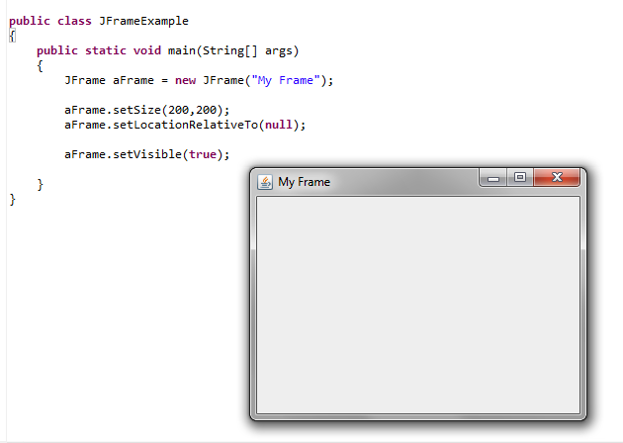
In some ways not too exciting.
But we get a lot of stuff “for free” - resizing, minimization
Minimize
Maximize
I can resize here

Slide 12
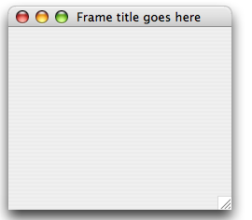

One thing we don’t exactly get for free is when we close
the Frame, the Java VM is still in memory..
The VM is still in memory, even though the Frame is not visible.

Slide 13
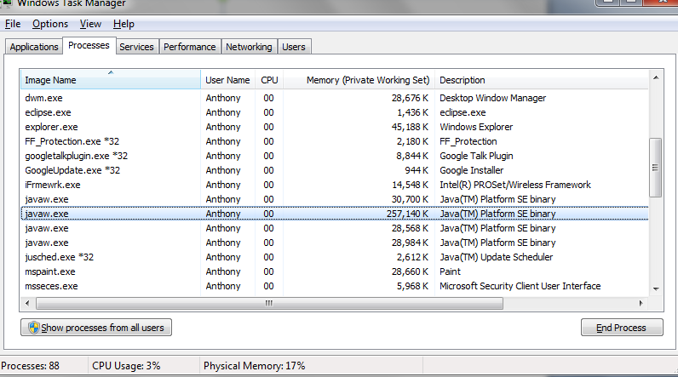
On Windows 7, the Java symbol is not in the taskbar, but
the Java processes are still hanging around in the background!
Each time I open and close a JFRAME, I lose another 30MB
of memory! Not Good!

Slide 14
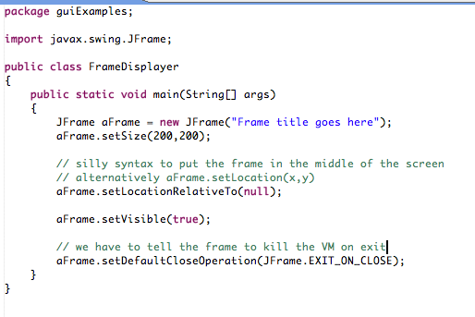
Easy to fix this problem…

Slide 15
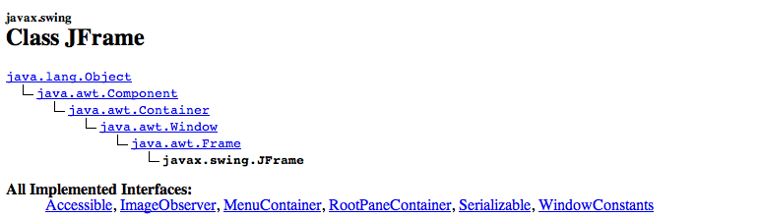
So what is a JFrame?
A JFrame is a Frame is a Window is a Container is a Component
(is a Object)
We’ll see these classes over and over again over the next few
weeks…

Slide 16
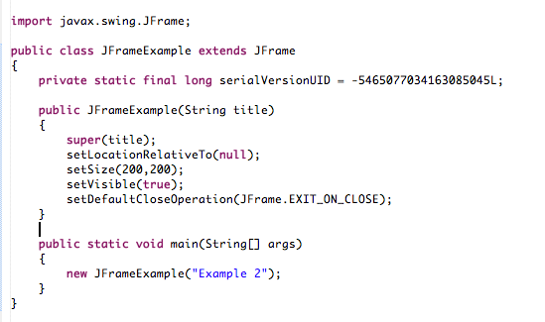
Usually, you want to extend JFrame.
We are making our own JFrame that will be our application.
Don’t worry
about this yet..

Slide 17
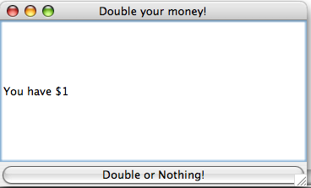
How do we add stuff to our JFrame?
Here is a (not very exciting) application.
When the user clicks the button, they will get either
double or nothing…

Slide 18
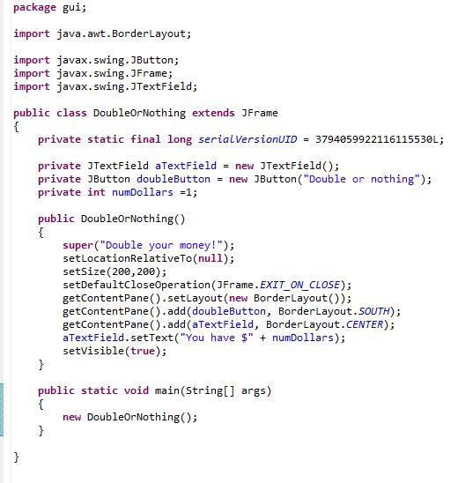
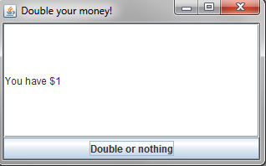

Slide 19
The first thing that we define is a “LayoutManager”.
Tells Java how we want the Components in our Frame
to be laid out in space..
There are many different LayoutManagers (and, of course,
you can make your own).
The two I use the most (and will talk about) are GridLayout
and BorderLayout

Slide 20
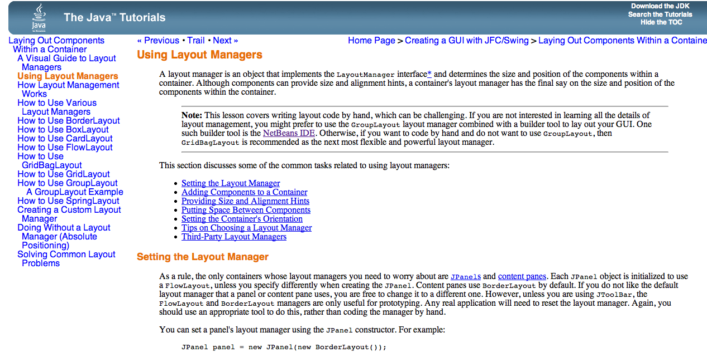
Here is the Sun tutorial…
http://java.sun.com/docs/books/tutorial/uiswing/layout/using.html

Slide 21
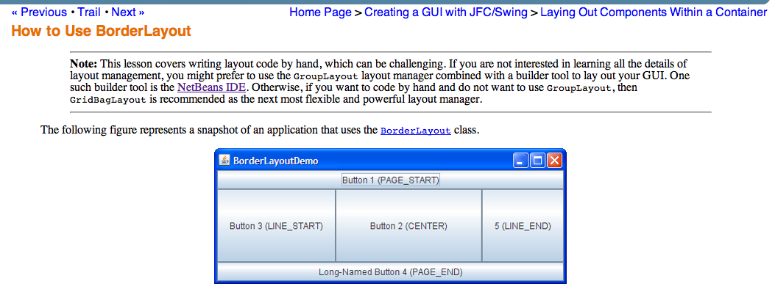
The BorderLayout class has 5 zones, which are EAST, WEST, NORTH, SOUTH and CENTER

Slide 22
We use SOUTH and CENTER in our application

Slide 23
We have a JButton that the user can click (it doesn’t yet do anything!)

Slide 24
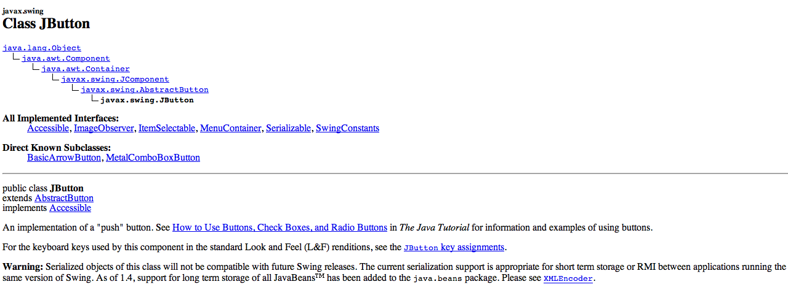
So what’s a JButton?
A JButton is an AbstractButton is a JComponent
is a Container is a Component (is an Object)
Remember that A JFrame is a Frame is a Window
is a Container is a Component (is an Object)

Slide 25
We also have a JTextField to display the results of our doubling

Slide 26
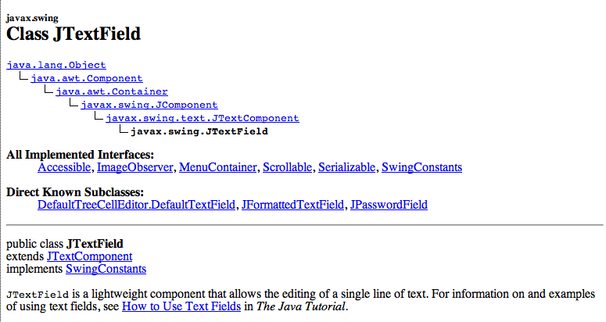
A JTextField is a JTextComonent is a JComponent
is a Container is a Component (is an Object)
A JButton is an AbstractButton is a JComponent
is a Container is a Component (is an Object)

Slide 27
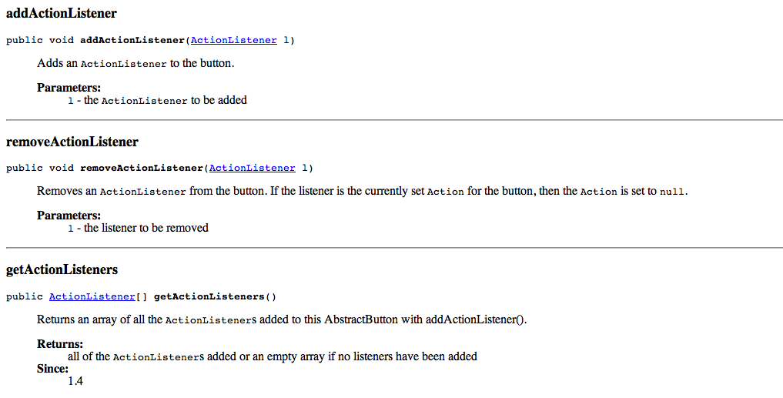
So the question in all of your minds is how do we make the
button DO something?
Answer: We add an ActionListener!
AbstractButton defines a method called addActionListener.
We pass in a class that will be notified when the button is pressed.

Slide 28

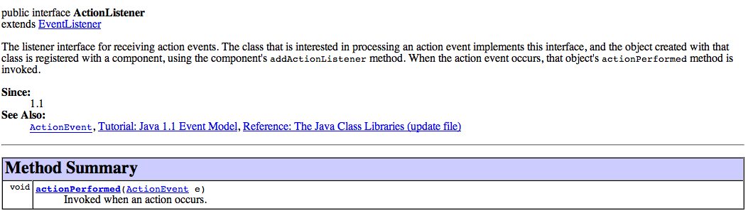
ActionListener is just an interface with a single method

Slide 29
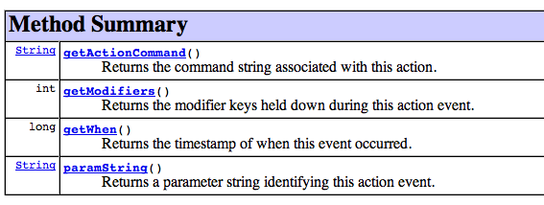
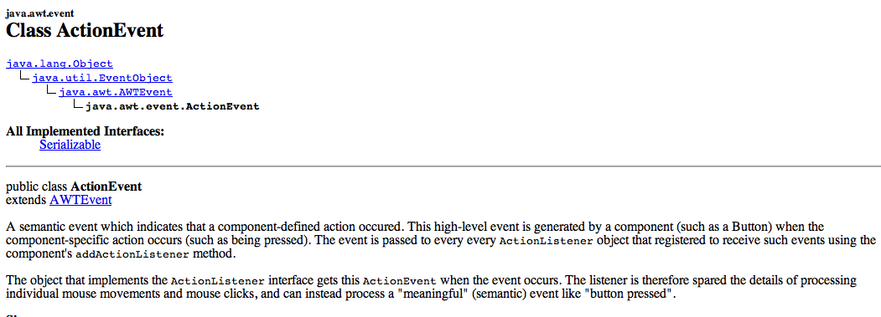
You can use the ActionEvent that Java will pass you
to find out such conditions as a modifier key (alt,shift,cntrl, etc)
being held-down.

Slide 30
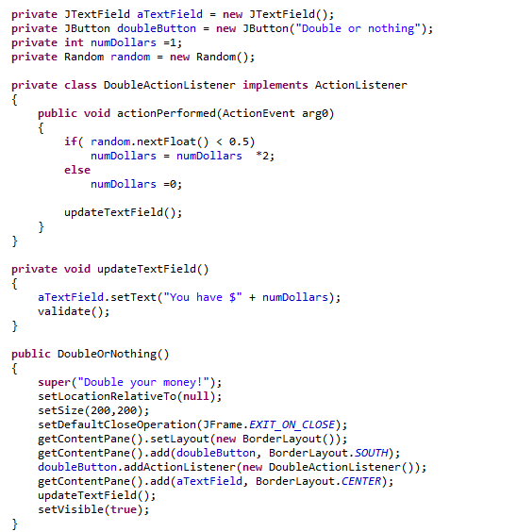
Our ActionerListner is an inner class
A helper method to update
the display
Connects the button
to its function

Slide 31
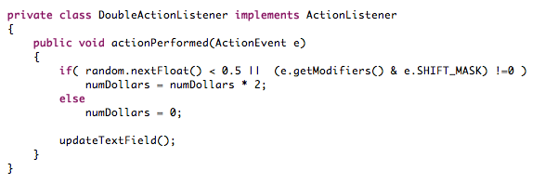
Let’s make a “cheat” mode. If you hold down the shift key,
you always win!!
A small change…
The bitwise and operator tells us if the rightmost bit
in e.getModifiers() is down, which corresponds to shift
being pressed.

Slide 32
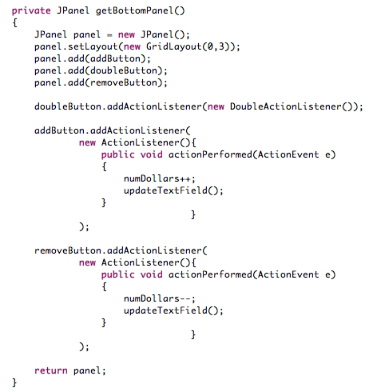
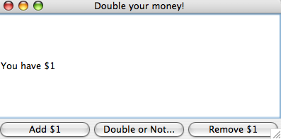
Let’s make things a little bit more complicated.
This method creates the buttom panel
GridLayout
Anonymous ActionListeners!
Add some graphics, you have a video slot machine!

Slide 33
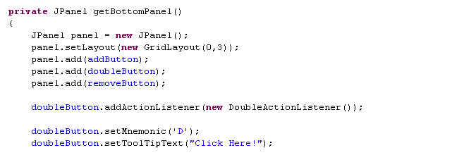
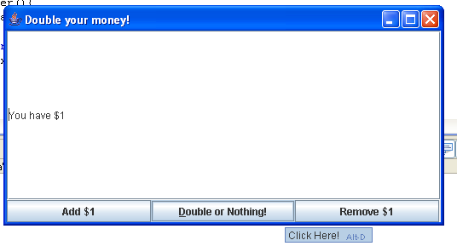
Java lets you do a lot of useful stuff “for free”
Keyboard shortcut
Hover text

Slide 34
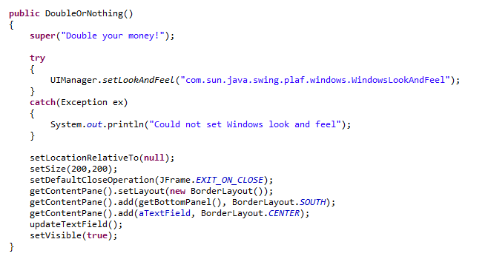
You can change the “Look and Feel” from the default metal
Set look and feel

Slide 35
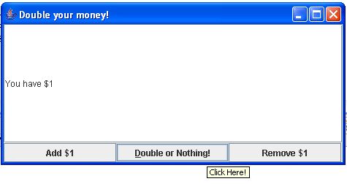
Metal (default)
Windows
Because of IP issues, you can only get the Windows look and
feel on Windows.

Slide 36
Coming up: Our first threads…

