Slide 1
If and switch, = and ==
Precedence
Loops

Slide 2
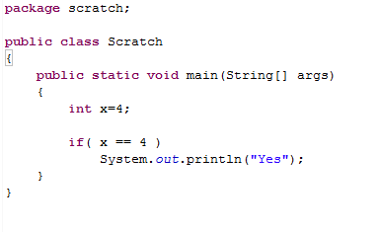
We will start with some basic syntax.
Everything just runs in a method called main…
Optional package
Everything in Java is a class (more on that later)
The “main” method
We declare a variable (more on that later)
What is in the () evaluates as true or false
These brackets define our class

Slide 3
The = assigns
The == compares
(and returns a Boolean)

Slide 4
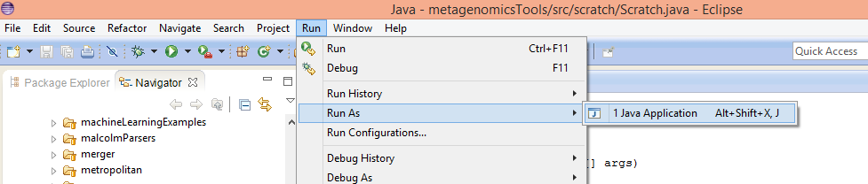
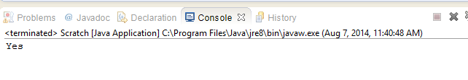
From Eclipse … Run -> Run As >-JavaApplication

Slide 5

Or from the command line….
package.Class

Slide 6
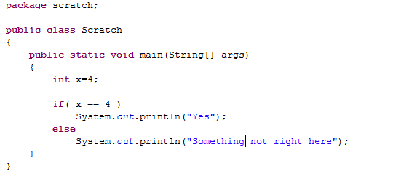
We can add an else to our if statement

Slide 7
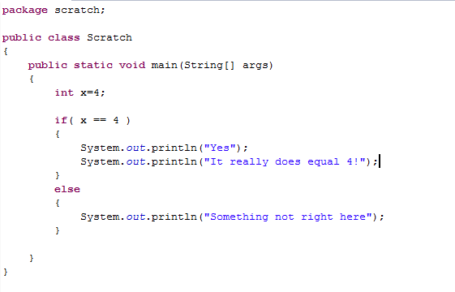
Adding brackets allows more than one line of code to execute.
Python does this with whitespace; Java pays attention to the
curly braces..

Slide 8
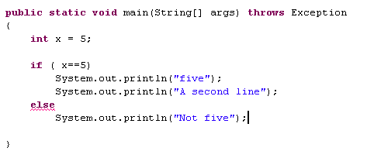
This doesn’t compile (and is confusing)
Unlike Python, Java ignores the whitespace

Slide 9
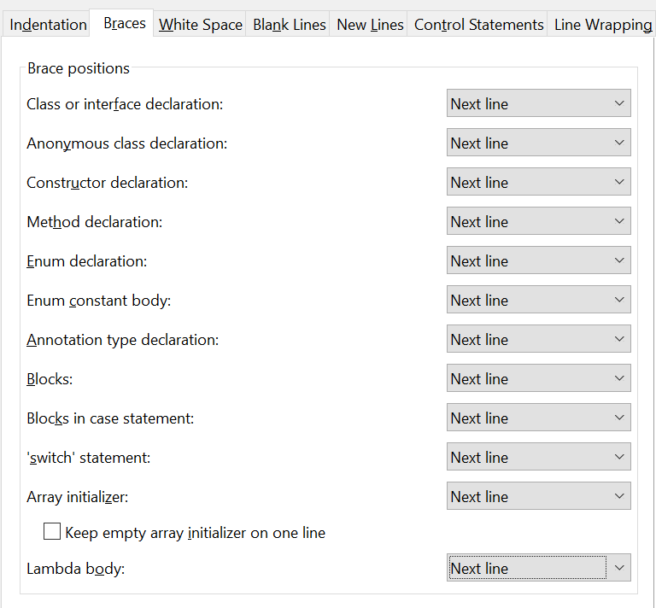
You can set up Eclipse to do the braces in a more “Python like” way…
Project -> Java Code Style -> Formatter ->
Configure Workspace Settings ->
(type in a new name for your new workspace )->
Braces
Switch all these to Next line

Slide 10
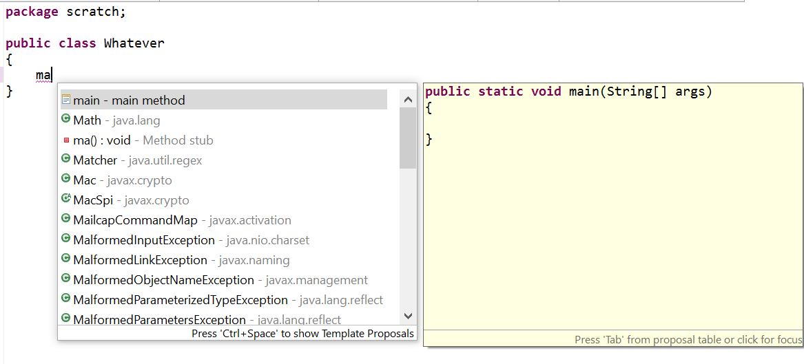
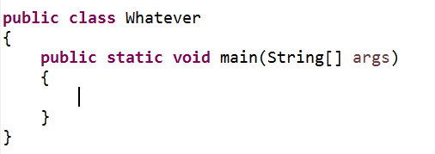
Now to make a main method in Eclipse
Type “ma” > ctrl-space
Hit “enter” - With ~5 characters, Eclipse will format the method

Slide 11
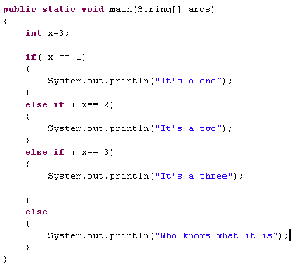
We can add more else statements…
A big advantage of OO is that it largely eliminates
the need for long if-else-if chains.
We’ll take about that later.

Slide 12
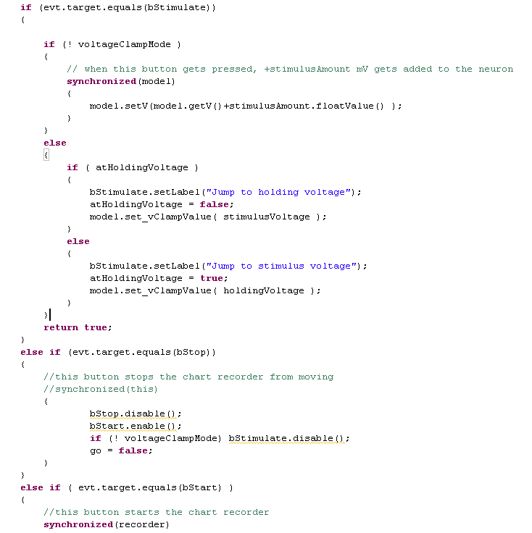
long if-else-if
chains are hard to read.
We’ll learn how to use
OO so we don’t have
to do this.
You never want to have
a method be more than
a screen.
….

Slide 13
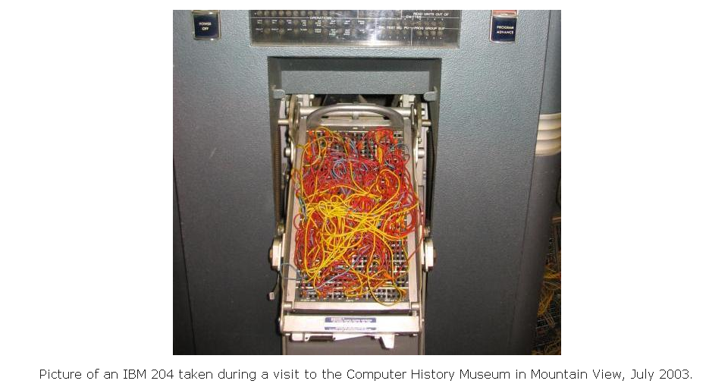
Spaghetti code…

Slide 14
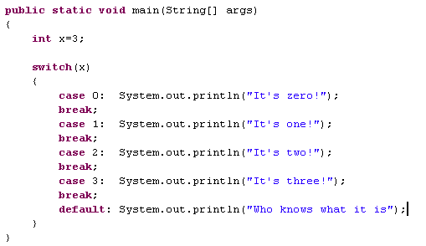
Switch statements are an alternative. I usually avoid them.

Slide 15
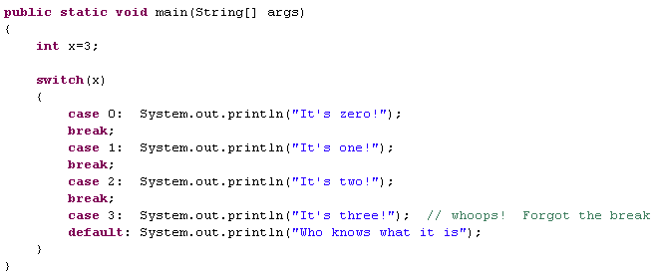

Too easy to make a mistake.

Slide 16
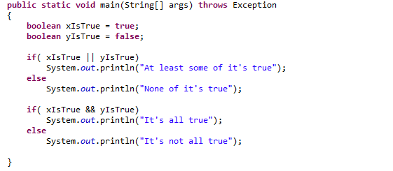

Or is expressed with the || operator
And is expressed with the && operator

Slide 17

Java && and || operators short-circuit
s.length() will not be called if s == null,
So you won’t get a null pointer exception.
Very useful.

Slide 18
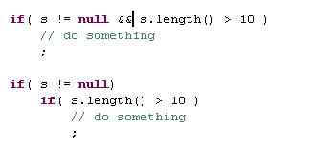
Sometimes, I find the bottom syntax more readable.
They are equivalent.

Slide 19
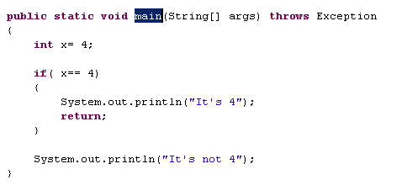
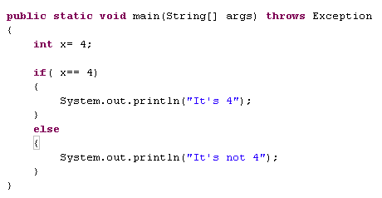
Sometimes, I find the top sytax more readable.
A lot of people prefer the bottom syntax.

Slide 20
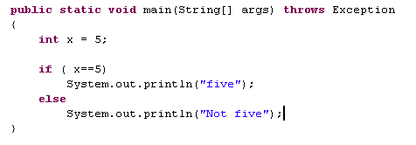
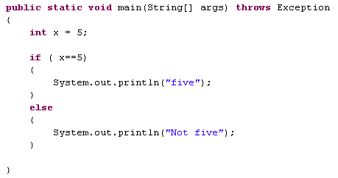
These are equivalent.
A lot of people prefer the bottom

Slide 21
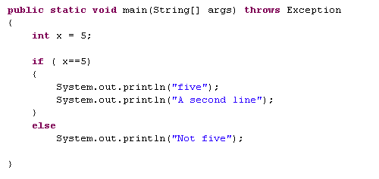
I find this ugly (either use the braces or don’t in a given statement)

Slide 22
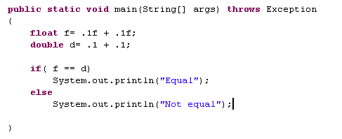
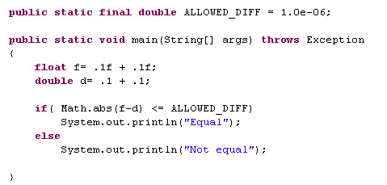
The == operator means every bit is equal
float and double are
different data types
(more on this later..)
You can allow for some round off error in your == assignment

Slide 23
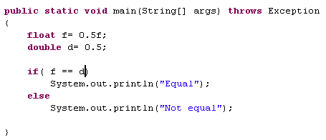
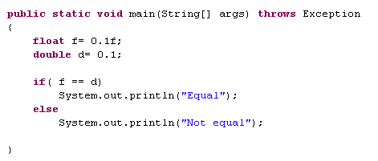
0.5, it turns out, can be exactly represented by floats and doubles…
But 0.1 cannot be exactly represented…
(more on datatypes later…)

Slide 24
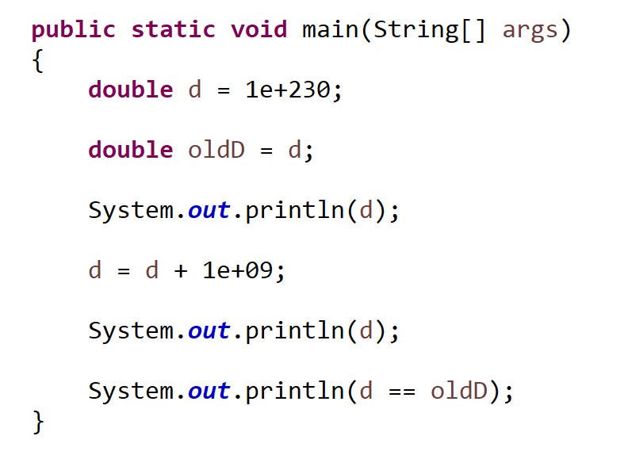
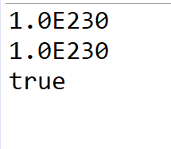
If you are rich enough, a billion dollars is round off error

Slide 25
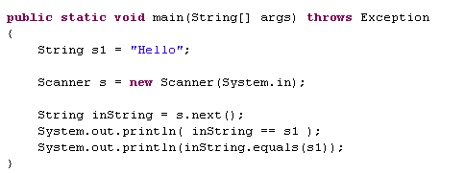

Beware == on Strings
Strings are objects, not basic types.
== on objects means have the same location in memory
.equals is defined for every object. More on this later

Slide 26
If and switch, = and ==
Precedence
Loops
Arrays

Slide 27
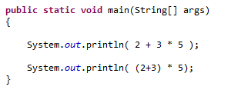

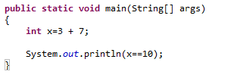

Expressions are evaluated in a certain order.
You probably already have good intuitions about this…
Parentheses can change the order of evaluation
* before +
+ before =
+ before >

Slide 28
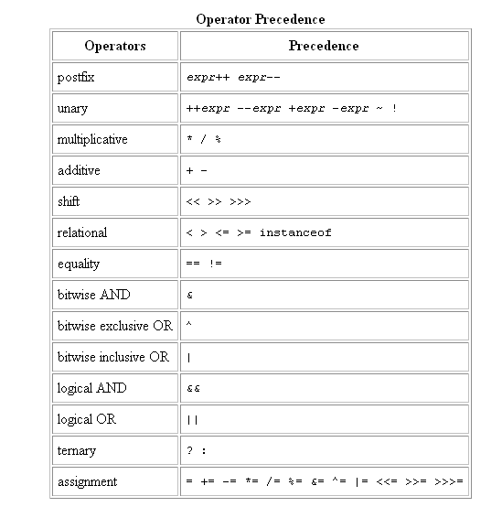
http://java.sun.com/docs/books/tutorial/java/nutsandbolts/operators.html
I almost never have to look at this.
You probably have pretty good intuitions.

Slide 29


Unlike some other languages, Java complains if you
are trying to force something that doesn’t make sense…
(Some languages where 3 > 9 would evaluate as 0 and
So 7 + (3 >9) would be 7 ).
Probably not what you meant to do…

Slide 30
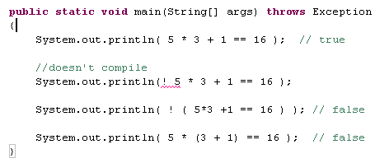
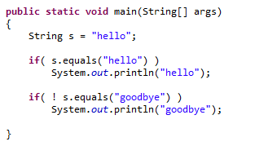
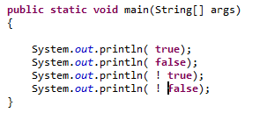


Test your intuitions as to what will happen…
The ! operator flips a boolean value

Slide 31
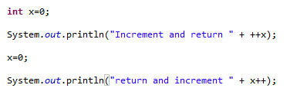

The ++ operator increments by 1 but ++x and x++ are different!

Slide 32
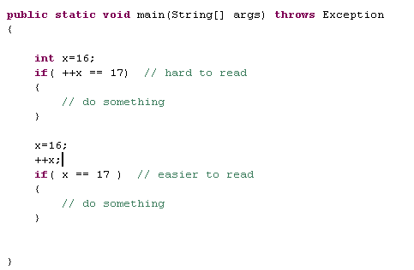
I tend to avoid putting “side-effects” into if statements.
I like the “if logic” to be separate from variables changing.

Slide 33
If and switch, = and ==
Precedence
Loops
Arrays

Slide 34
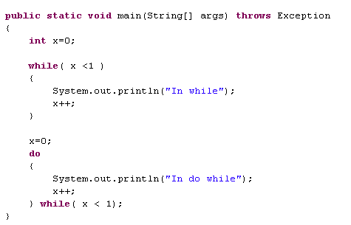

while vs. do…while
I find while more readable
Note the ; (always seems wrong)
do…while is guaranteed to execute at least once

Slide 35


for loops combine the initialization and the boolean check
You will need to memorize this syntax…
initialization (runs once)
Check (runs before first execution
and then after each execution)
Update (runs after
each execution)

Slide 36
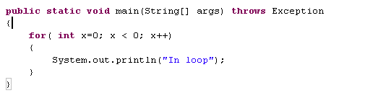
The for loop is not guaranteed to execute
Code never reached

Slide 37
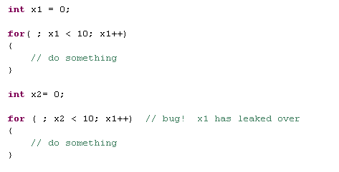
The great thing about for loops is that the scope stays in the loop.
A common error; mis-match of update and assignment variable

Slide 38
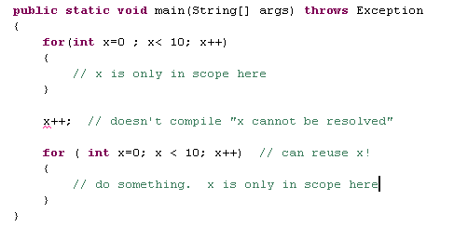
Bloch: Item #29. Minimize the scope of local variables.
x here can’t “leak out” and mess up some other code.
local scope simplifies the logic

Slide 39
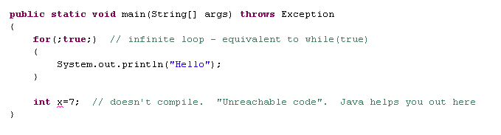
You don’t need all the pieces of a for loop

Slide 40
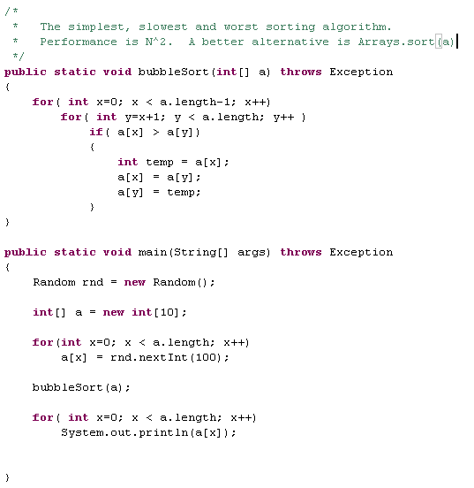

You can (and will) have nested for loops

Slide 41
You are not responsible for break and continue.
I never use them…

Slide 42
Coming up:
data types, methods, towards OO code…
You should be reading the beginning chapters in your
chosen Java text book (e.g. Thinking in Java)

