Slide 1
Comments and Documentation
Java Style
Java’s basic types
Casting
Arrays
Methods

Slide 2
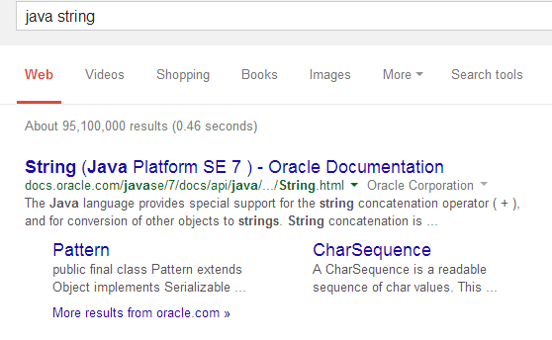
How do you find more about a given class?
Type Java String into Google. Take the first hit.
This is a special kind of documentation called Javadocs.

Slide 3
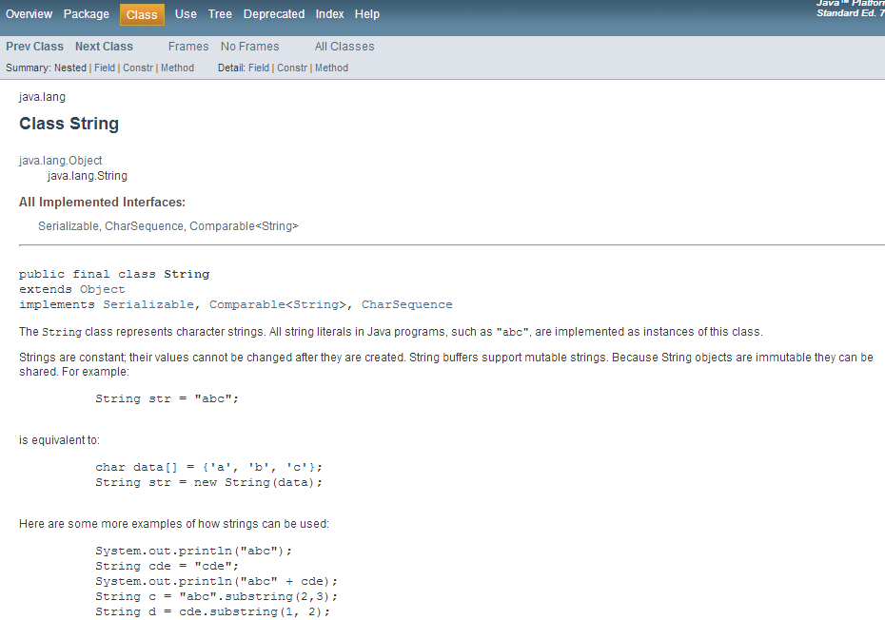

Slide 4
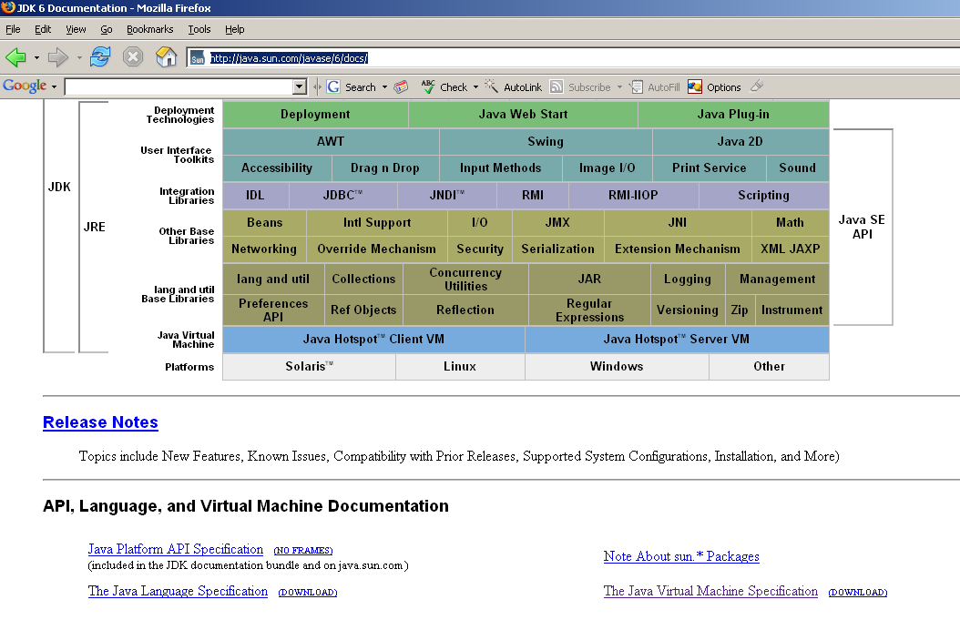
You can also just download all of the javadocs for offline reading…
http://java.sun.com/javase/6/docs/
Download all
the javadocs.
(For online, use Google! The javadoc is almost always the first
hit typing in the name of the class)

Slide 5
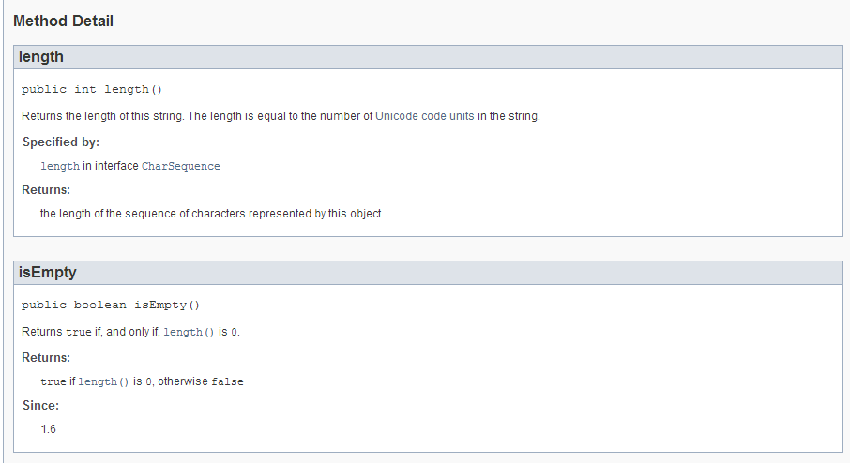
The documentation of the core libraries is (usually) good …

Slide 6
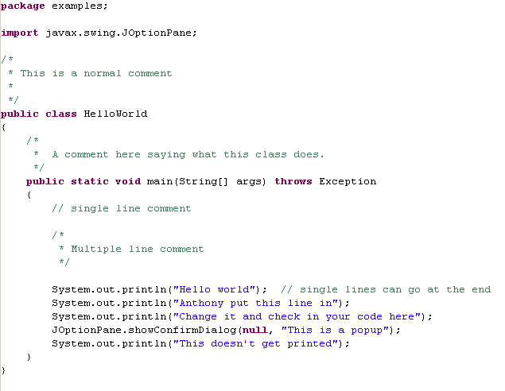
Documentation is built into the language
A “normal”
comment

Slide 7
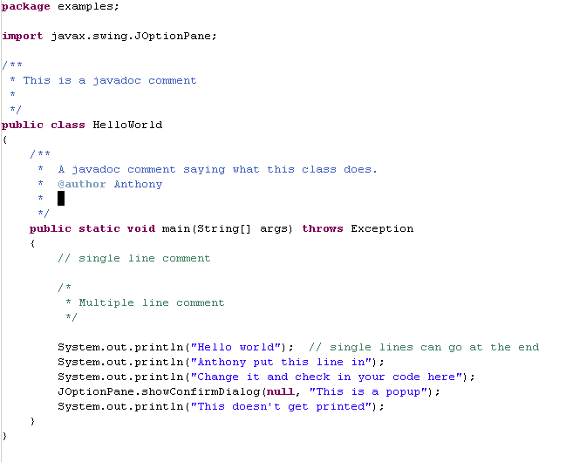
A “javadoc”
comment

Slide 8
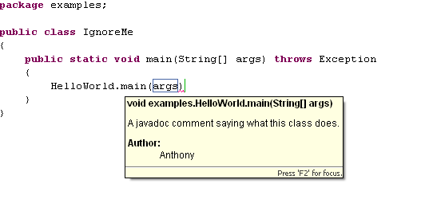
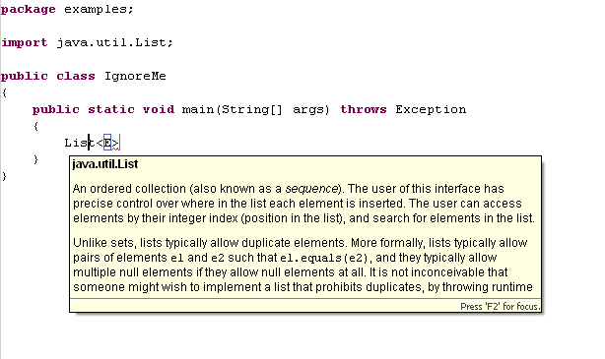
Eclipse is Javadoc aware; mousing over can bring help…

Slide 9
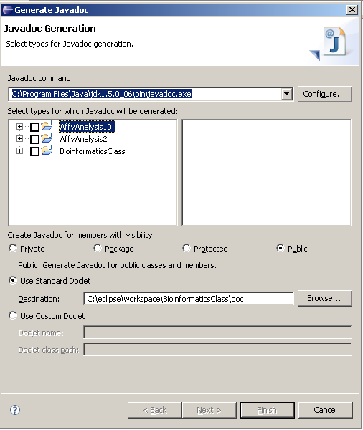
If you do “Project->Generate javadoc from Eclipse
This will make a web page of javadocs describing your code.

Slide 10
Item #28 in Bloch is all about Javadocs.
Know what you are trying to do.
Writing docs takes a long time.
Will other people use your code?

Slide 11
Comments and Documentation
Java Style
Java’s basic types
Casting
Arrays
Methods

Slide 12
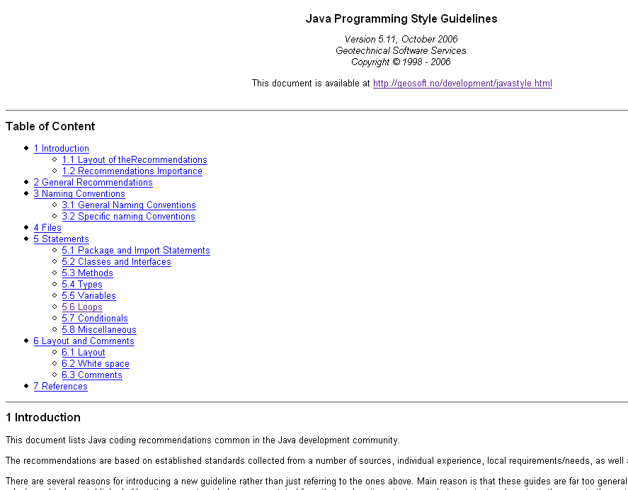
Java style
http://geosoft.no/development/javastyle.html

Slide 13
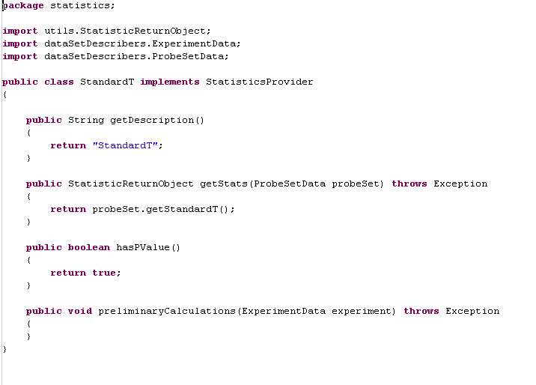
Packages start with lowercase

Slide 14
Classes start with uppercase

Slide 15
Methods start with lowercase

Slide 16
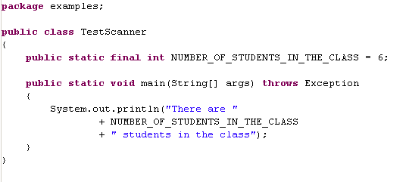
Constants are ALL_UPPERCASE

Slide 17
Comments and Documentation
Java Style
Java’s basic types
Casting
Arrays
Methods

Slide 18
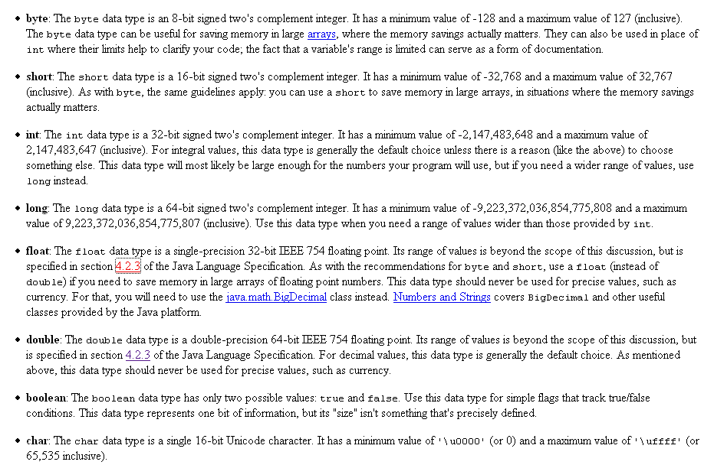
http://java.sun.com/docs/books/tutorial/java/nutsandbolts/datatypes.html

Slide 19
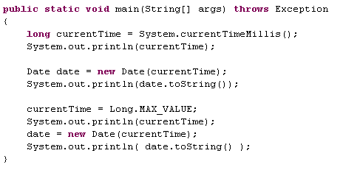

You can get the ranges from Java.
(Note the correct capitilization of MAX_VALUE)
The year “292,278,994” problem

Slide 20


You can look the values up in your book or Google or….

Slide 21


You can get into a lot of trouble quickly by choosing the
wrong data type:
Bloch: Item 31 – Avoid float and double if exact answers
are required
“You have a dollar in your pocket, and you buy nine
Washers priced at ten cents each. How much change do you get?”
double
double
int
Oops.

Slide 22

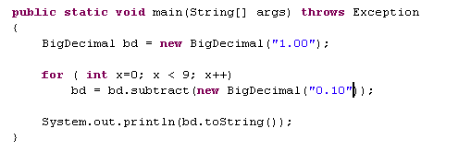
Solutions:
Work with integers
A nice alternative “BigDecimal”

Slide 23
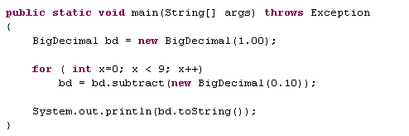
Why does this fail in comparison to the previous example?

Slide 24
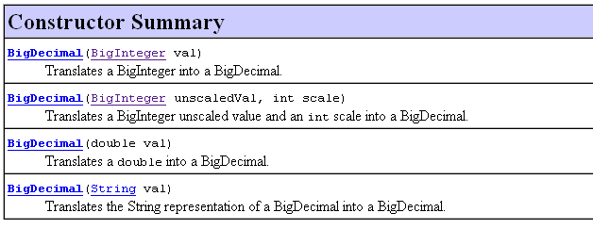
How can you initiate a BigDecimal?
The only way is with a BigInteger or a double or a String.
So any number you pass in will be cast to a double.
Prefer Strings for exact answers.

Slide 25
Comments and Documentation
Java Style
Java’s basic types
Casting
Arrays
Methods

Slide 26
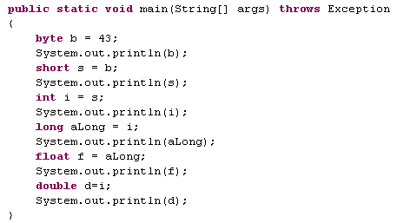

Java will automatically cast from less information to more
More information
Larger range
byte
short
char
int
long
float
double
Possibility for loss of information (in this case there is no
lost information)
(the biggest long can’t be captured exactly by float)

Slide 27
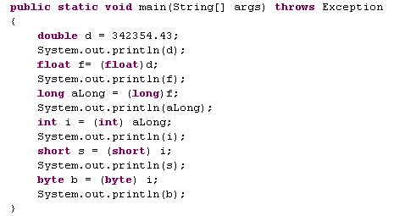
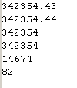
More information
Larger range
byte
short
char
int
long
float
double
Going right to left, you have to cast
By casting, you acknowledge
the possibility of complete
loss of information
big loss of information
garbage
garbage

Slide 28




Java stops you from doing something stupid
but you can insist…

Slide 29


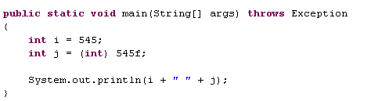
Even when a cast is safe, you still need to explicitly tell
Java that is is ok

Slide 30
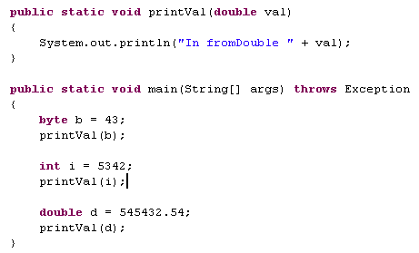

byte
short
char
int
long
float
double
Going from left to right, Java will cast for you.
This has consequences for method calls
Java casts from a byte to a double
Java casts from a int to a double
No cast required
Java automatically casts to find the right method (more on this later)

Slide 31

Java will (probably not that helpfully) cast char to int
byte
short
char
int
long
float
double

Slide 32
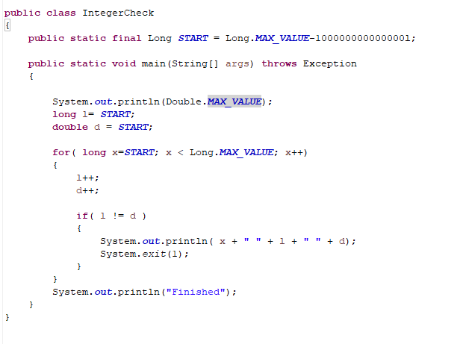

Using the increment operator will eventually fail on floating types
Start at some big #
Check for loss of
precision
https://github.com/afodor/metagenomicsTools/blob/master/src/classExamples/incrementOnFloatingPoint/DoubleToLong.java

Slide 33
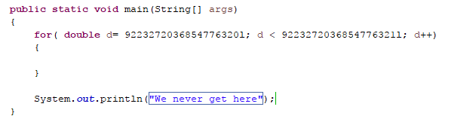
Ends with a “l” (cast to long)
This never terminates!
The “+1” gets rounded down to zero…
https://github.com/afodor/metagenomicsTools/blob/master/src/classExamples/incrementOnFloatingPoint/DoubleNeverTerminates.java

Slide 34
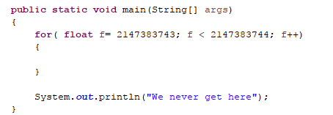
This happens for floats at a modest number of ~2 billion!
So use float++ with due caution!
https://github.com/afodor/metagenomicsTools/blob/master/src/classExamples/incrementOnFloatingPoint/FloatNeverTerminates.java

Slide 35
Comments and Documentation
Java Style
Java’s primitive types
Casting
Arrays
Methods

Slide 36
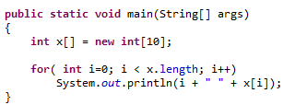

Arrays in Java are declared with the [] operator.
Arrays are zero based.
Numeric arrays are zero-initialized..
reference to the array
A new array of length 10
The array indices are 0 to 9
(alternatively, you can use int[] x= new int[10])

Slide 37
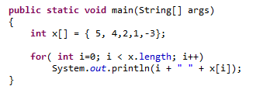

Alternatively, you can use the {} operators to initialize an array

Slide 38
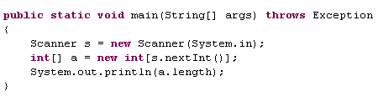

Arrays size can be determined at run-time
But you have to have the memory to initialize the array
The size of an array cannot be changed
We’ll see the List family of objects later (that can be changed)

Slide 39
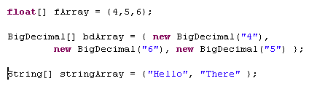
Array can be of primitive types or objects

Slide 40
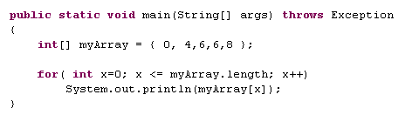
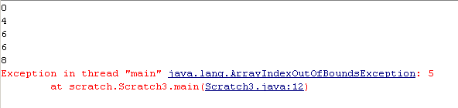
Java gives beautiful errors for arrays out of bounds
bug
Performance hit for that compared to C/C++, but still
a great feature of the language

Slide 41
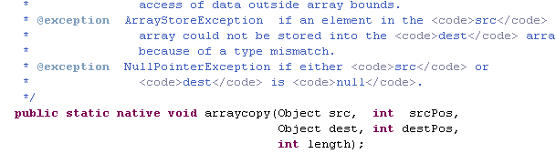
You can use native code to copy arrays
You can use native code to copy arrays
But native code isn’t always significantly (or at all) faster…..

Slide 42
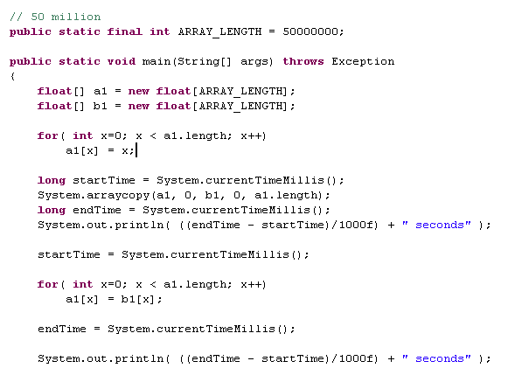

You can use native code to copy arrays
Predicting what will be faster is hard.
Bloch item #37 Optimize judiciously

Slide 43
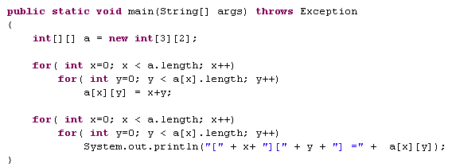
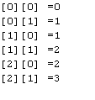
Multi-dimensional arrays are arrays of arrays

Slide 44
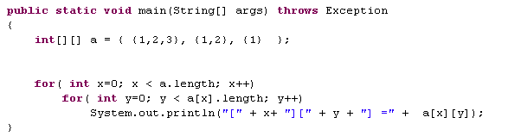
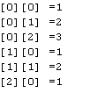
Multi-dimensional arrays can be jagged

Slide 45
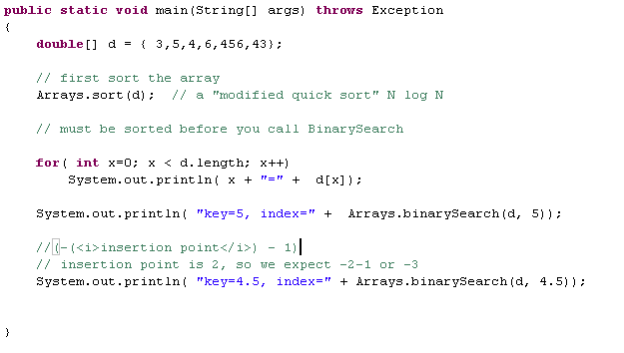
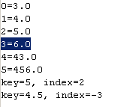
Java implements Sort and Search for us.
Use their implementations!
Bloch item #30: Know and use the libraries

Slide 46
Comments and Documentation
Java Style
Java’s primitive types
Casting
Arrays
Methods

Slide 47
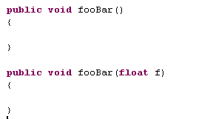
The signature of a method is its name plus parameters list
Access modifier (more on this later)
return type
Method name
Parameter list (optional)
So these are different methods. This complies

Slide 48
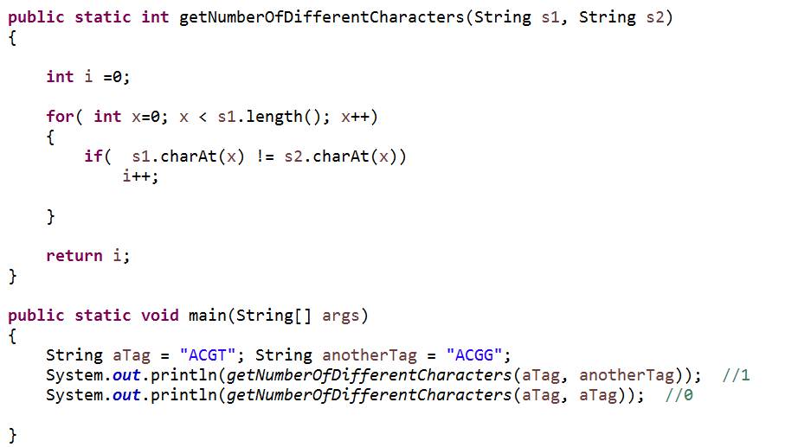
Methods avoid duplicate code….
They are the first abstraction from which we build programs

Slide 49
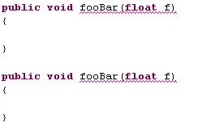

Same method. This does not compile.

Slide 50
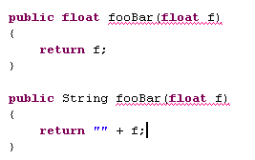

This still does not compile.
You cannot distinguish methods by their return type.
The return type is not part of the signature.

Slide 51
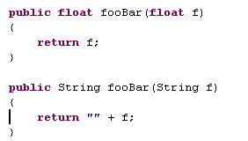
This compiles fine. The overloaded methods do
not have to share a return type.

Slide 52
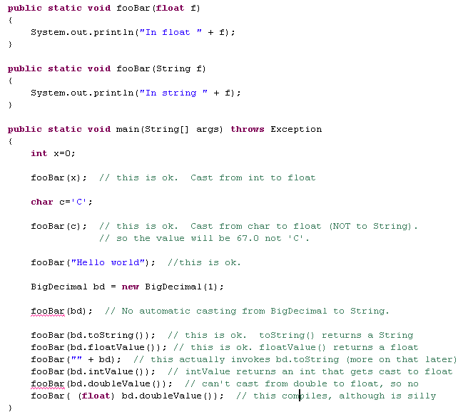
A method must exist for you to call it!

Slide 53
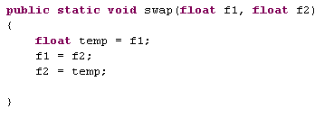
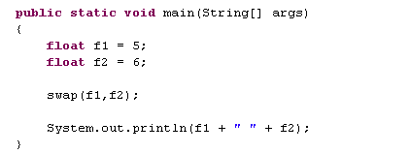
Java is only pass by value ( a new copy is created).
Here is an interview question.
What does this code do?
Answer: nothing

Slide 54
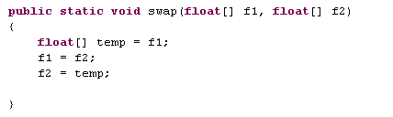
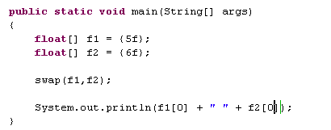
How about this code?
Answer: Nothing
A copy of the reference to the arrays is passed…

Slide 55
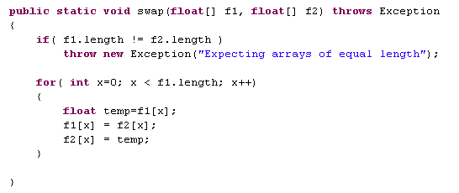


This will swap the contents of equally sized arrays!
The reference to the array is passed by value (copied)
Changes to the contents of the array are kept since
the array itself is not copied, only the reference to it

Slide 56
Bloch Item #23: Check parameters for validity
In Bioinformatics, the worst thing you can do is corrupt your data.

Slide 57

A safer, infinitesimally slower, version of our tag checking method
Bloch Item #23: Check parameters for validity
In Bioinformatics, the worst thing you can do is corrupt your data.

Slide 58


We get a nice error message if we make a mistake invoking the function….

Slide 59

Java won’t automatically cast from an double to an int

Slide 60


I can force a cast, but with potential for garbage
garbage

Slide 61


Java will choose the method with the smallest left-to-right cast
byte
short
int
long
float
double
Java casts from a byte to an int
no cast required
Java casts from a long to a double
No cast required

Slide 62


Method overloading
Bloch thinks it’s confusing
(Item #26)
We’ll come back to it later, but he recommends this…

Slide 63

The nice thing about Bloch’s way of doing this, is that it forces
you to acknowledge the implicit casts and choose which one you want

Slide 64


The change in type is much
clearer hear then when the
method was called printVal(double)
A subtle point, which we will come back to..

Slide 65
Coming up…
Our first classes and objects.
Be sure to be reading your introductory Java book!

