Slide 1
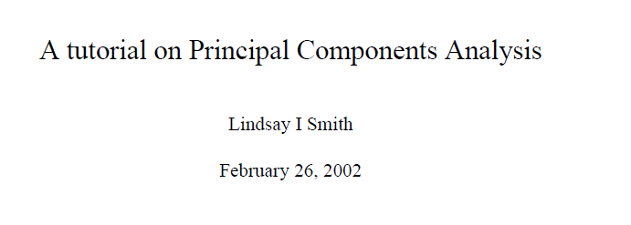
You are NOT responsible for the matrix algebra in this section on the final…
A nice concise summary is here…
http://www.cs.otago.ac.nz/cosc453/student_tutorials/principal_components.pdf
Knowing how to do this means that we can implement PCA in any language
and not be dependent on R.
Plus it is just sort of interesting…

Slide 2
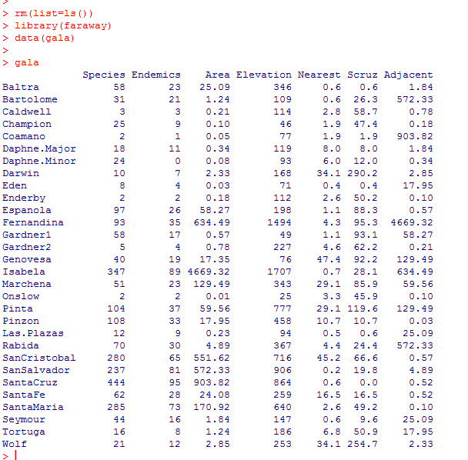
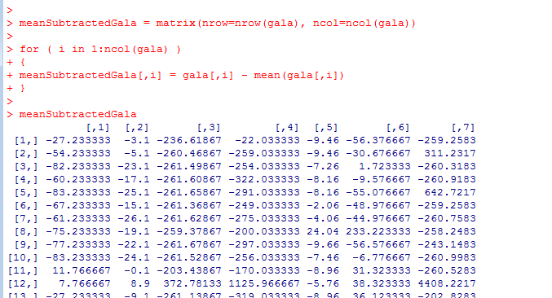
Steps to find the principle components…
Start with your data matrix…
Mean subtract the columns

Slide 3
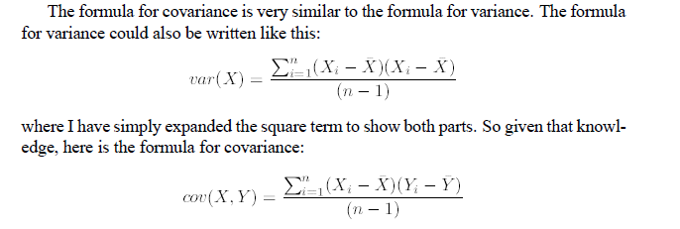
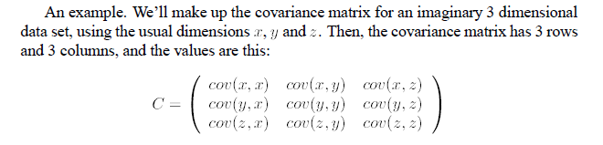
Form a covariance matrix…
For our (6,3) data matrix, the covariance matrix will be (3,3)
Next, generate the Eigenvectors of the covariance matrix.
When we multiply these eigenvectors times the original data, we are transforming the
old coordinates to a new co-ordinate system based on the principle components.
The eigenvectors from the basis of our new coordinate space.

Slide 4
Covariance Matrix
Representing covariance among dimensions as a matrix, e.g., for 3 dimensions:
Properties:
Diagonal: variances of the variables
cov(X,Y)=cov(Y,X), hence matrix is symmetrical about the diagonal (upper triangular)
n-dimensional data will result in nxn covariance matrix

Slide 5
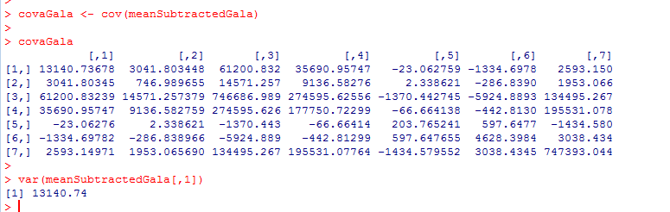

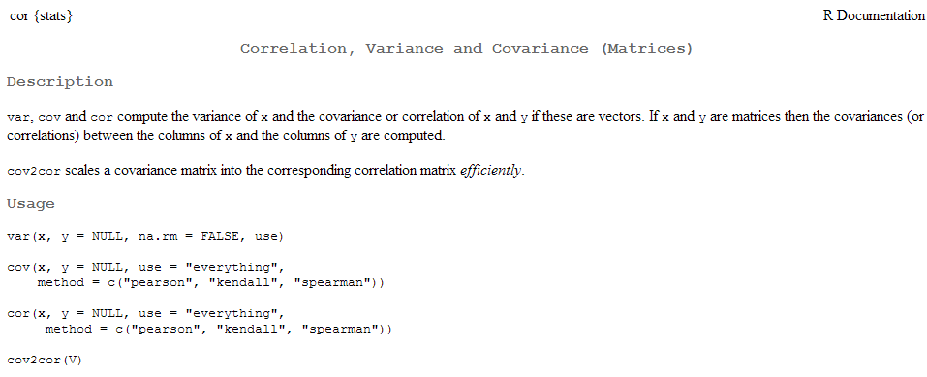
Form a covariance matrix…

Slide 6
Eigenvectors & Eigenvalues
Calculate the eigenvector and eigenvalues of the covariance matrix
Eigenvector: given a nxn matrix (A) there exists a nonzero vector x such that Ax = λx
Eigenvalue: λ is an eigenvalue of A if there is a nontrivial solution of Ax = λx
Example:
Ax =
1 6
5 2
6
-5
-24
20
6
-5
-4x
=
=
-4
=
“Operator”
Eigenvector
Eigenvalue
Eigenvector

Slide 7
Properties of Eigenvectors and Eigenvalues
Eigenvectors can only be found for square matrices and not every square matrix has eigenvectors.
Given an n x n matrix (with eigenvectors), we can find n eigenvectors.
All eigenvectors of a symmetric* matrix are perpendicular to each other, no matter how many dimensions we have.
All eigenvalues of a symmetric matrix are real.
(symmetric matrices are examples of Hermitian matrices)
*Note: covariance matrices are symmetric!

Slide 8
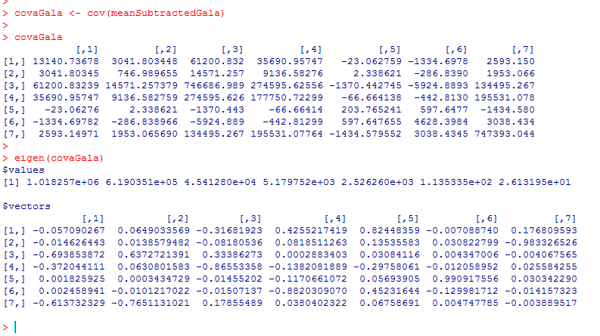
Generate the Eigenvectors of the covariance matrix.
Each of these EignenVectors are orthogonal to each other in some 7 dimensional space…
They form an orthogonal basis..

Slide 9
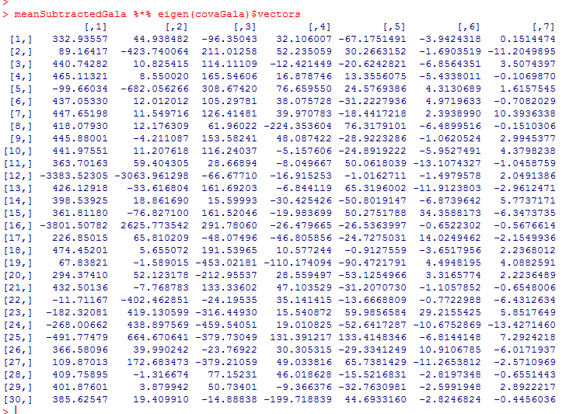
To get the new principle components, multiply the meanSubtractedMatrix times the eigenvectors.
Conceptually, we are “rotating” the data into a new dimensional space with
“orthogonal” vectors generated by the EigenValue decomposition.
We now have our data projected into component space..
These are the principal components of our data..

Slide 10
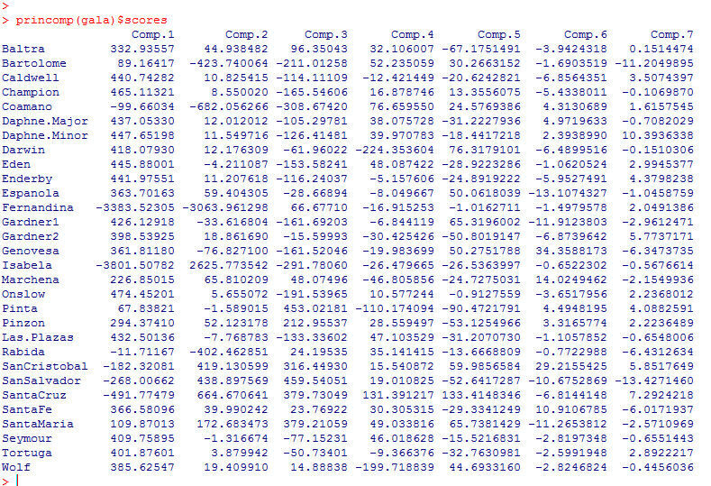
Alternatively (with much less typing)

Slide 11
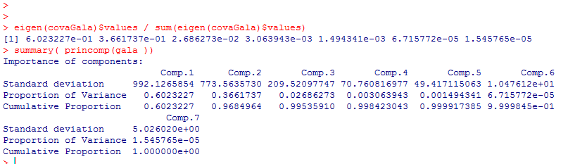
Calculating the percent variance
When the λ_{i}’s (eigenvalues) are sorted in descending order, the proportion of variance explained by the p principal components is:

Slide 12
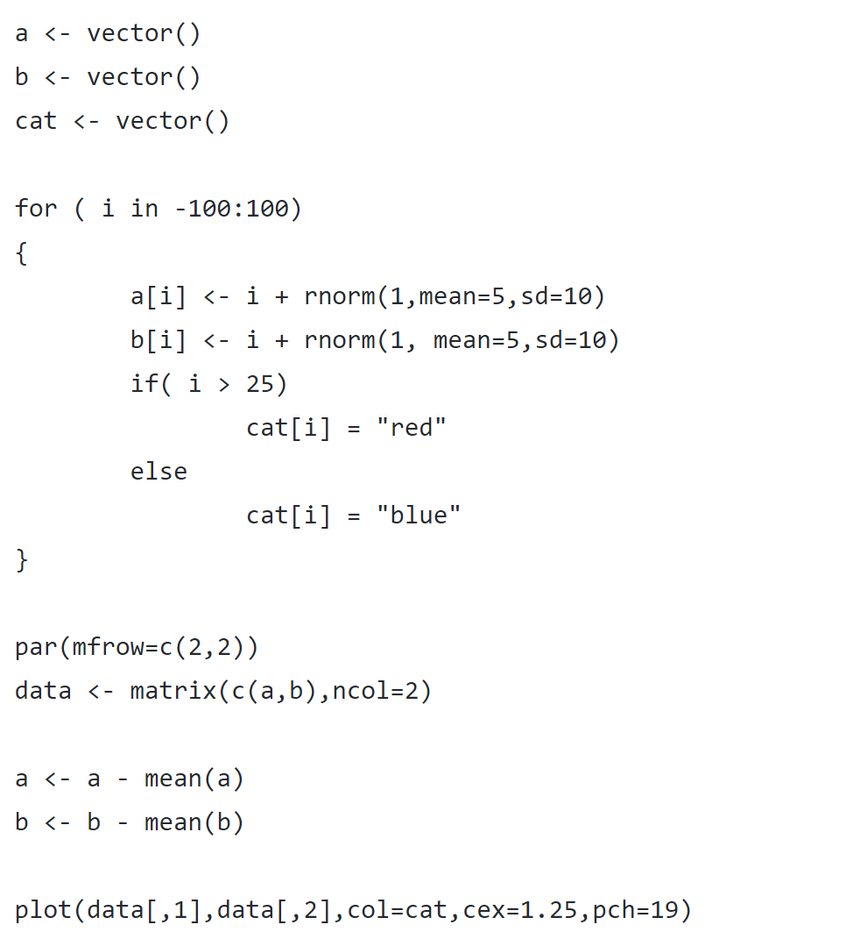
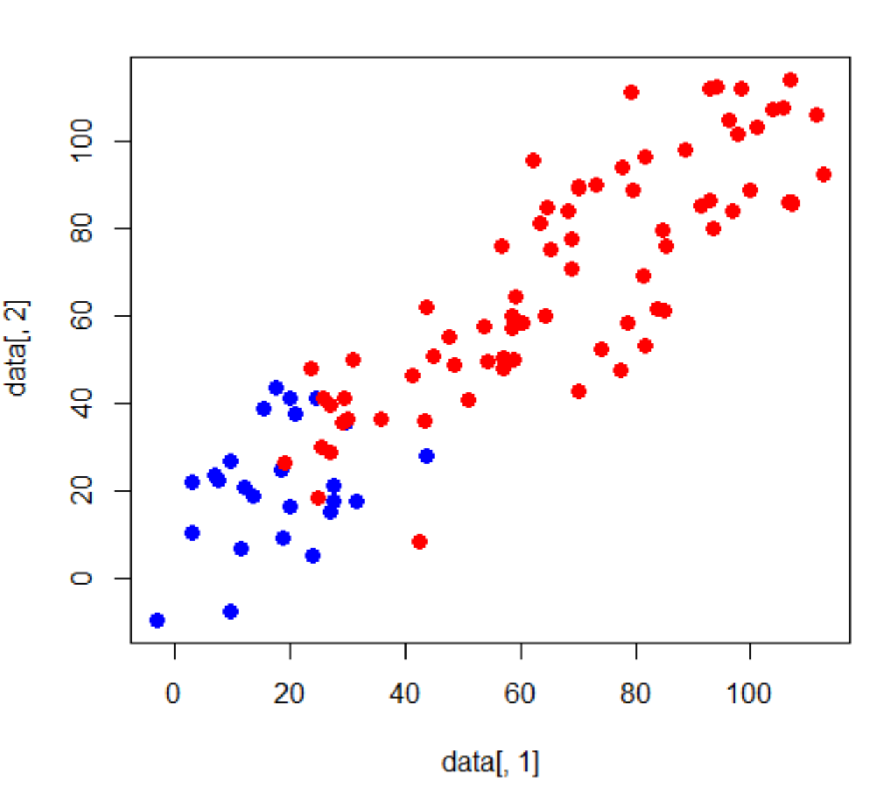
Consider a simulated 2D dataset
https://github.com/afodor/metagenomicsTools/blob/master/src/classExamples/pcaSim.txt

Slide 13
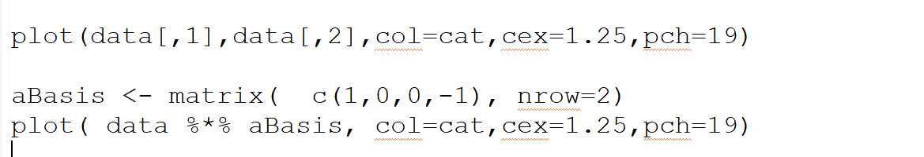
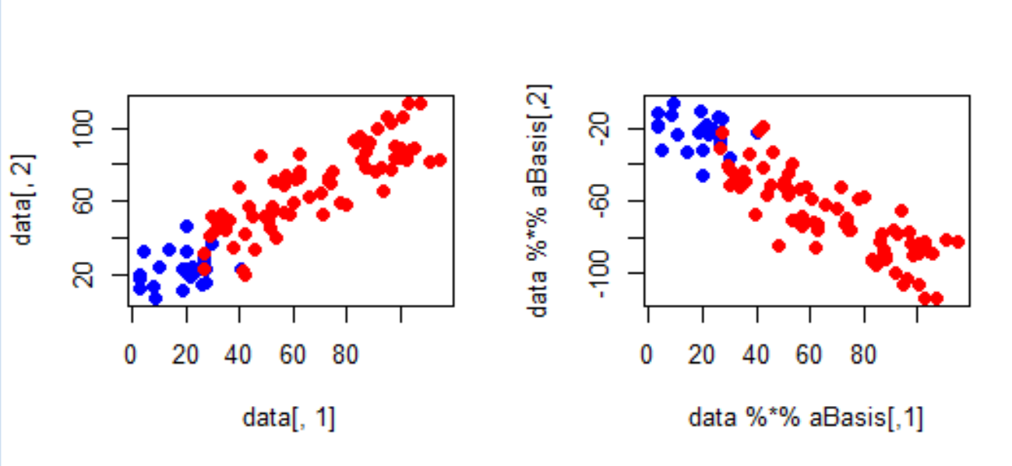
We can rotate these data any way we want to (by any orthornomral basis)
Before rotation
After rotation

Slide 14
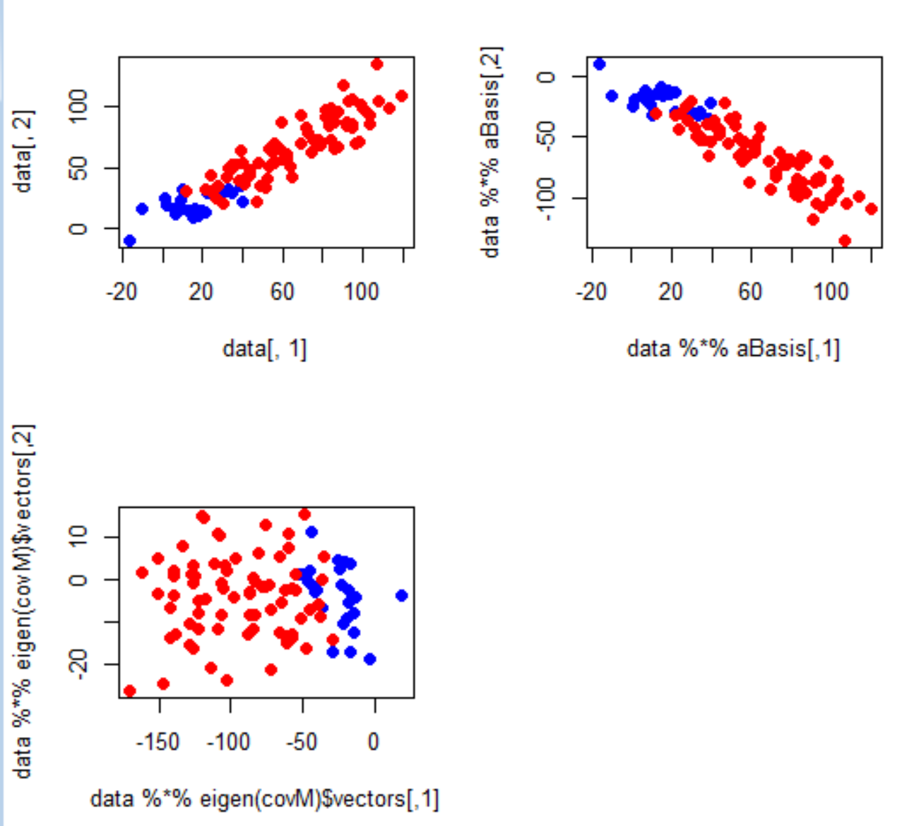
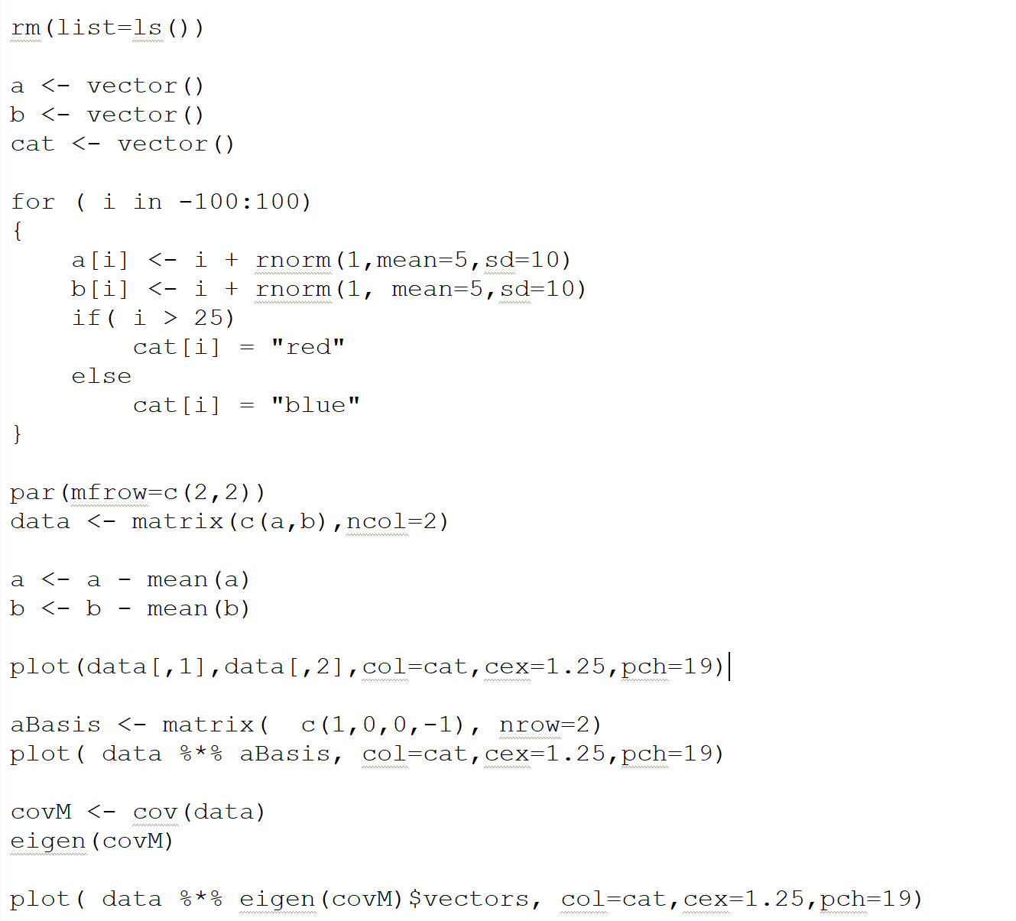
The PCA rotation is the rotation that guarantees that PCA1 will capture the most possible variance of the data in one dimension
We have the option of doing inference (comparing for example red. vs. blue)
in one-dimension (with, for example, a simple t-test) even though we started with
two correlated variables)

Slide 15
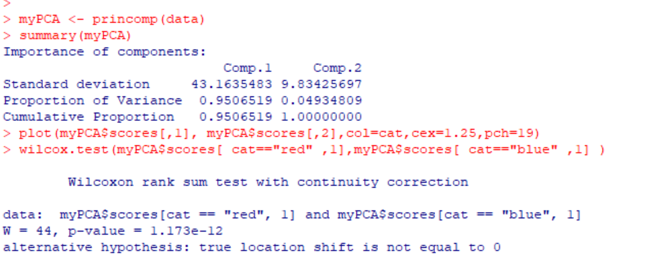
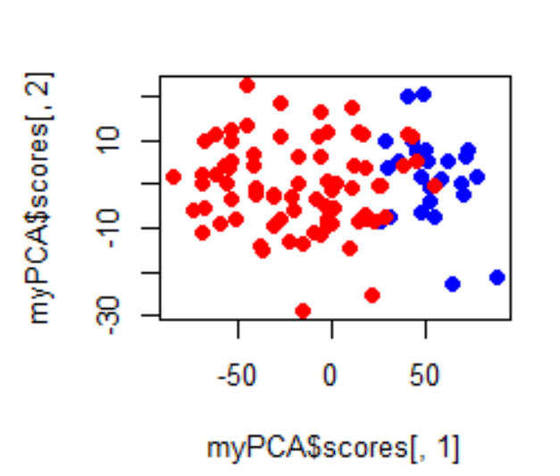
We have the option of doing inference (comparing for example red. vs. blue)
in one-dimension (with, for example, a simple t-test) even though we started with
two correlated variables)

Slide 16

If you want to get into the details of the linear algebra behind eigenvectors,
the first chapter of this book is excellent…
Obviously, not something you will be tested on for the final…

Slide 17
Correlated variables in linear models
PCA in concepts
PCA in equations
PCA in Java (for your reference; not covered in class or in final)

Slide 18
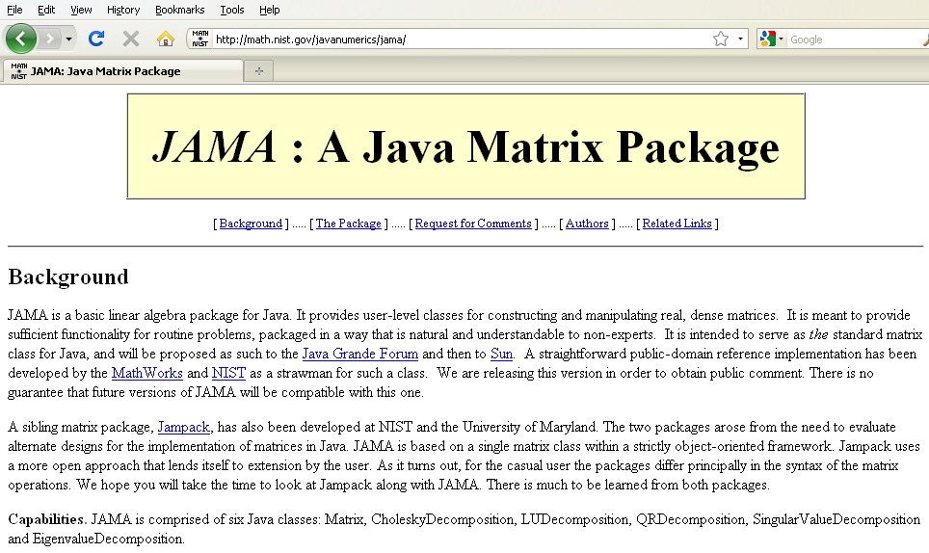
If you have a linear algebra library, PCA is easy to implement
The National Institute of Standards and Technology has been kind enough to provide
us with one…

Slide 19
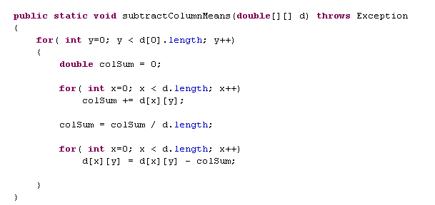
1. Subtract column means…

Slide 20
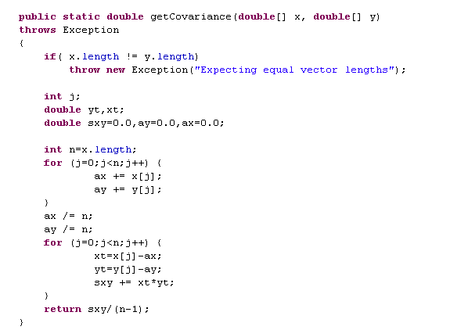
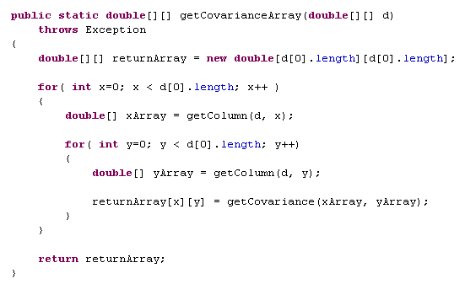
2. Find the covariance matrix

Slide 21
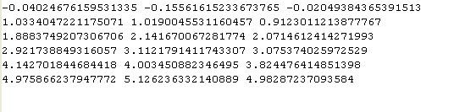
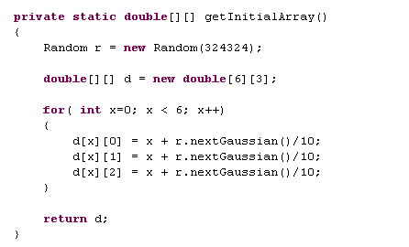
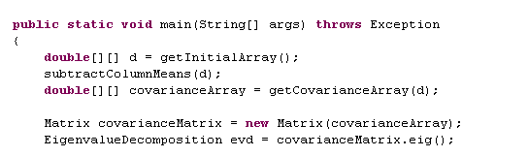

Slide 22
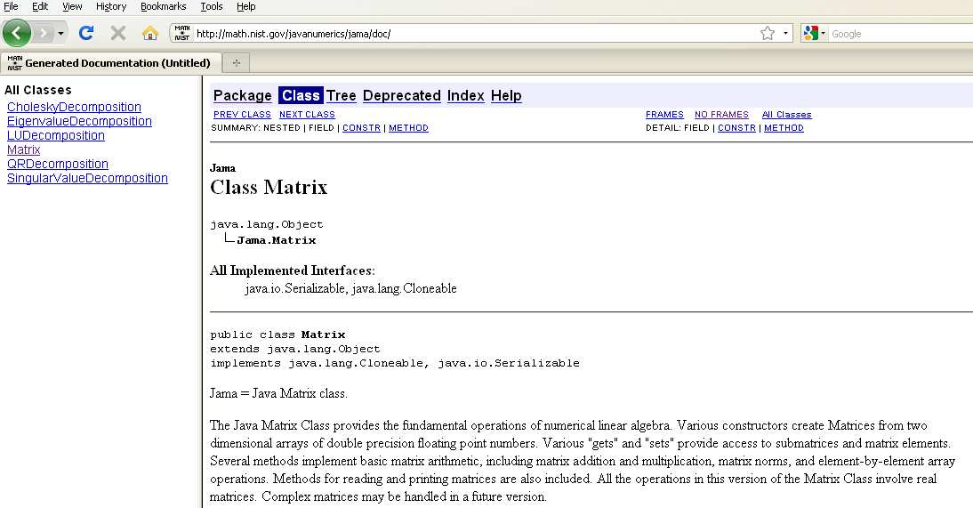

Slide 23
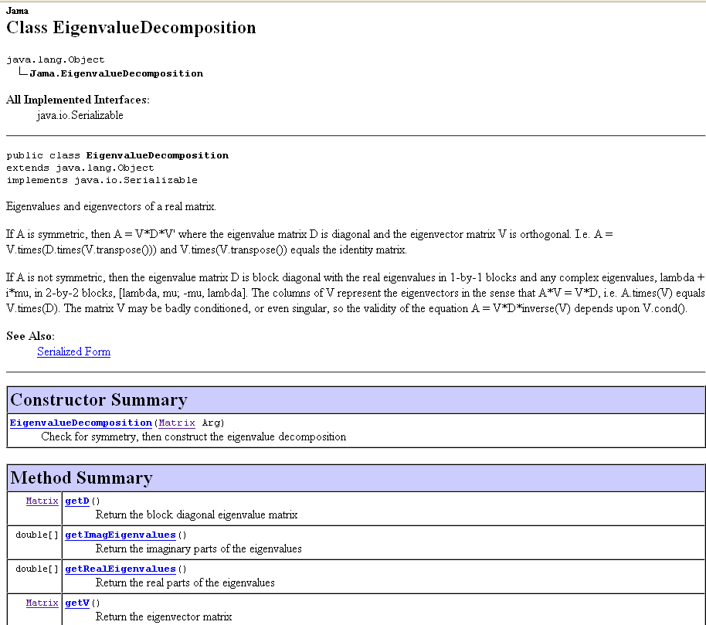

Slide 24
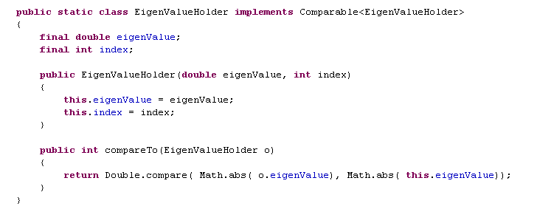
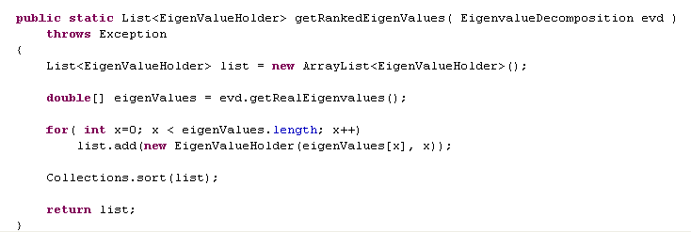
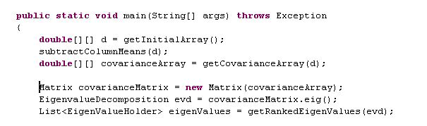

Slide 25
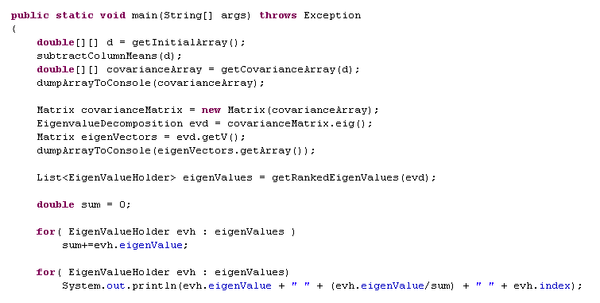



Initial matrix:
Covariance matrix:
Eigen vectors:
,0
,1
,2
Eigen values:
% variance explained
Index in
EigenVector Matrix

Slide 26
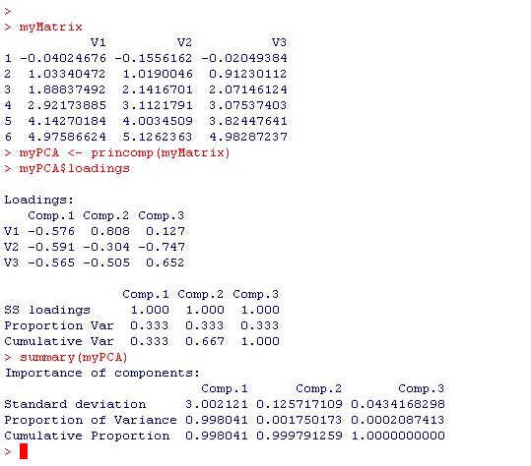
R
JAVA
Initial Matrix
Eigen Values
(r has them sorted)
% variance explained
Index in
EigenVector Matrix

Slide 27
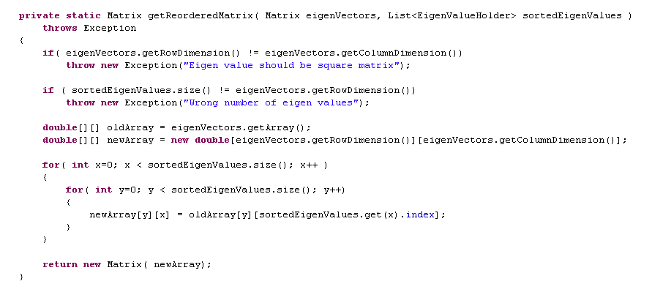

One more trivial helper method to reorder the eigenvalues…
Unsorted Eigen Vectors
Sorted Eigen Values
In:
Eigen value
Index
Out:
Sorted EigenVectors

Slide 28
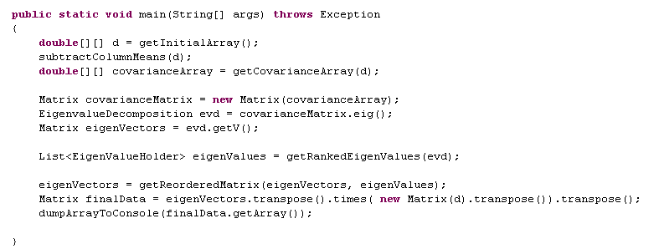
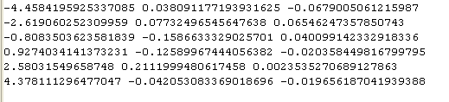
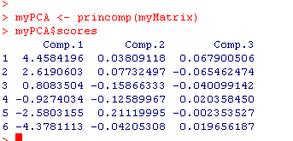
Once we have our Eigenvectors, we are ready to calculate the components….
(or just d.times(eigenVectors))

